Slide 1

Project Cost Redistribution (PCR) Training
Florida Department of
TRANSPORTATION
Office of Comptroller
Last Update 03/20/2018

Slide 2

Introduction - 1
The project cost initiative improves of project cost reporting by capturing detailed project information for the purpose of:
  providing better data for decisions
  managing FDOT’s resources, and
  improved forecasting at the project and program levels
Florida Department of Transportation

Slide 3
Introduction - 2
Job costing has two components:
  Programming specific project numbers to encumber to tasks
  Using PCR to redistribute expenditures from the general project number to the specific project number that the consultant worked on
Florida Department of Transportation

Slide 4
PCR - Why?
Effective July 1, 2008, the Department has implemented a Project Costing Initiative, to identify and track costs associated with District-wide and General Consultant contracts.
PCR allows contract funds to be committed to a general financial project number and reallocated after the work on the component projects is done where the expenditures occurred.
Florida Department of Transportation

Slide 5
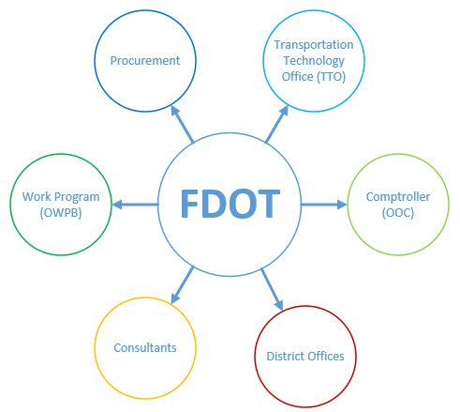
PCR – Who?
Florida Department of Transportation

Slide 6
District Offices
Project Manager
  Contract method of compensation (Exhibit B) will explicitly state if the contract will require a cost redistribution file to be submitted with invoice.
  Note: Project cost redistribution will be restricted only to designated District-wide and General consultant contracts executed after July 1, 2008.
  Provides valid (From and To) financial project numbers to the consultants in order for them to submit Project Cost Redistribution files.
  Note: Contact the District Work Program office with any financial project questions.
  PCR files should be sent along with the Contractor’s invoice and are late if they are not received within 30 days after a paid invoice
  Will receive the email with the current Missing or Failed PCR report monthly
  Based on the newest report, inform the consultant about their outstanding PCR files and that future invoices may or may not be held back until they are received
Florida Department of Transportation

Slide 7
District Offices
PCR Coordinator
  PCR point of contact for the Consultant and the District
  Will receive the email with the current Missing or Failed PCR report monthly
  Will be copied on all of the PCR (both Error and Success) related emails from your District PCR contracts
  Use the PCR resources at FDOT's PCR Internet Site to resolve any of the Consultant’s PCR questions
  Contact your District Work Program Office if you have any financial project questions
  If you have used all the PCR resources and are not able to respond to a Consultant’s question, email FDOT_PRCORD0 for further assistance
Florida Department of Transportation

Slide 8
Central Office
Office of Work Program
  Responsible for all the functional financial project issues for Project Cost Redistribution
  For any questions related to Financial work program numbers or ‘From project ‘ or ‘To project’ numbers contact this office.
Transportation Technology Office
  Mainframe PCR validation process
  Account correlation process
  FLAIR accounting system
Office of Comptroller
  Ownership of Project Cost Redistribution process and functional issues
  This office is responsible for the file processing to FLAIR.
Florida Department of Transportation

Slide 9
Consultants - 1
  Use the FDOT’s PCR Internet site to access:
    PCR Spreadsheet
    PCR Coordinators List
    Additional PCR Information
      PCR FAQ File
      PCR Training PowerPoint (This file)
  Note: Consultants are not required to use the PCR spreadsheet to create PCR data. Please refer to the PCR CBT for correct data formatting.
  Send all PCR files to the PCRLOAD@dot.state.fl.us email address
Florida Department of Transportation

Slide 10
Consultants - 2
  Use the PCR FAQ to correct any error messages that are returned after a PCR file is submitted
  Contact your Project Manager for assistance with financial project errors
  Contact your District PCR Coordinator for all other PCR errors
Florida Department of Transportation

Slide 11
PCR Resources
  PCR Internet Site http://www.fdot.gov/comptroller/pcr.htm
    PCR FAQ file
    PCR Training PowerPoint
    PCR CBTs
      PCR Program for FDOT Staff
      PCR Spreadsheet CBT for Consultants
Florida Department of Transportation

