Slide 1
Determining Quantities for Engineer Approved Changes
For use within the quality control roadway report (qcrr)

Slide 2
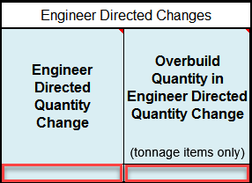
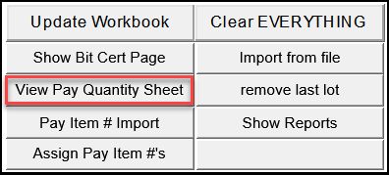
Engineer Approved Quantity
Areas or Tonnages, approved by the engineer to add to the plan quantity, should be entered as positive values
Areas or Tonnages, approved to be removed from the plan quantity, should be entered as negative values
Enter the Areas or Tonnages on
the Pay Quantity Updates Tab here:
On the QCRR Main Tab,
click View Pay Quantity Sheet:

Slide 3
Engineer Approved Quantity
For each pay item
  Enter the appropriate value in the QCRR
  QCRR will add Engineer Approved Changes to the Original Plan Quantity
    This total tonnage will be adjusted by the QCRR based on the G_{mm}’s & tons used for each mix design in order to determine the adjusted plan quantity for the pay item
  Contractor will be paid for asphalt placed up to 105% of the adjusted plan quantity

Slide 4
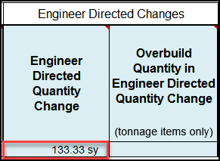
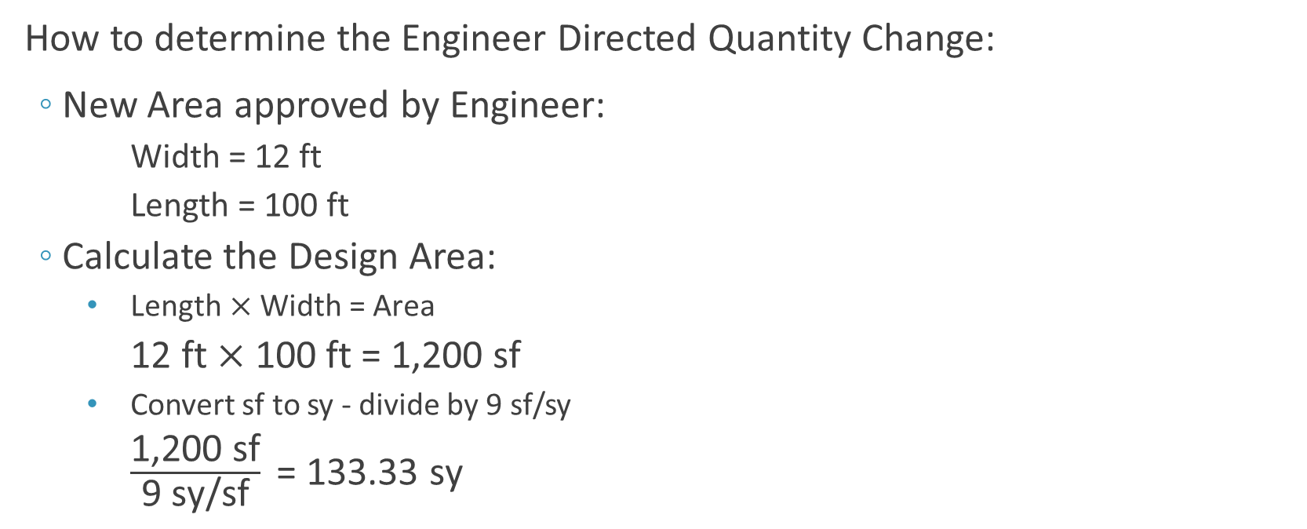
Square Yard Pay Item Changes
How to determine the Engineer Directed Quantity Change:
  New Area approved by Engineer:
    Width = 12 ft
    Length = 100 ft
  Calculate the Design Area:
  $\text{Length} \text{×} \text{Width}\text{ = }\text{Area}$
    $\text{12 }\text{ft} \text{×}\text{ 100 }\text{ft}\text{ = }\text{1,200 }\text{sf}$
    Convert sf to sy - divide by 9 sf/sy
      $\frac{\text{1,200 }\text{sf}}{\text{9 }\text{sy}\text{/}\text{sf}} \text{= 133.33 }\text{sy}$
QCRR Entry:

Slide 5
Tonnage Pay Item Changes
How to determine the Engineer Directed Quantity Change:
  Determine the area using the method shown on the Square Yard Pay Item Changes slide
  Then calculate the corresponding Design Tonnage as follows:
    Determine the Spread Rate using formula in Specifications Section 334-1.4 using the design thickness and Design G_{mm} = 2.540
        Spread rate (lbs/yd²) = t x G_{mm} x 43.3
              Where t = thickness (in.)(plan thickness or individual layer thickness)
              G_{mm} = max. specific gravity from verified mix design
        For FC-5, use the formula in Specifications Section 337-8.2 using the design thickness and Design G_{sb} = 2.635

Slide 6
Tonnage Pay Item Changes
How to determine the Engineer Directed Quantity Change:
    Multiply the Spread Rate by the Area to determine the Pounds of asphalt required
    Convert the Pounds to Tonnage by dividing the Pounds by 2,000 lb/tn

Slide 7
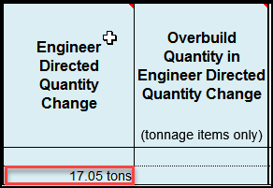
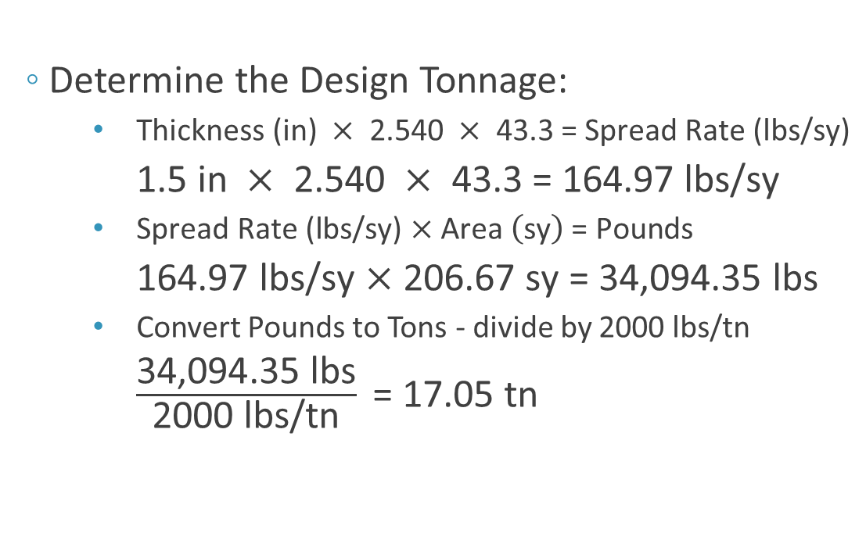
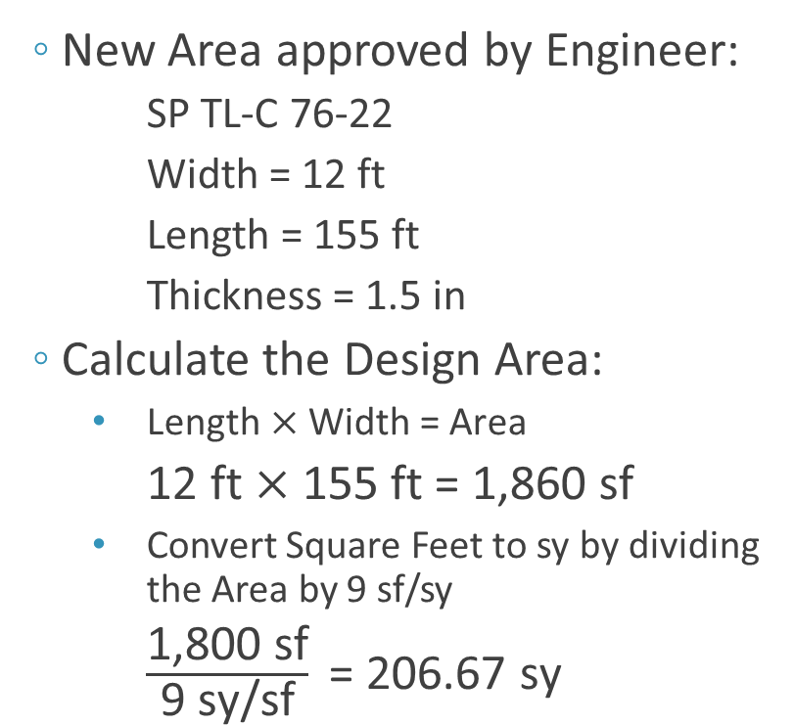
Example: Tonnage Pay Item Change
  Determine the Design Tonnage:
    $\text{Thickness}\text{ (}\text{in}\text{) }×\text{ 2.540 }×\text{ 43.3 }\text{= }\text{Spread} \text{Rate}\text{ (}\text{lbs}\text{/}\text{sy}\text{)}$
    $\text{1.5 }\text{in} ×\text{ 2.540 }×\text{ 43.3 }\text{= 164.97 }\text{lbs}\text{/}\text{sy}$
    $\text{Spread} \text{Rate}\text{ (}\text{lbs}\text{/}\text{sy}\text{) }\text{×} \text{Area} \left(\text{sy}\right) \text{= }\text{Pounds}$
    $\text{164.97 }\text{lbs}\text{/}\text{sy} \text{×}\text{ 206.67 }\text{sy}\text{ = 34,094.35 }\text{lbs}$
    Convert Pounds to Tons - divide by 2000 lbs/tn
    $\frac{\text{34,094.35} \text{lbs}}{\text{2000 }\text{lbs}\text{/}\text{tn}} \text{= 1}\text{7.05} \text{tn}$
  New Area approved by Engineer:
      SP TL-C 76-22
      Width = 12 ft
      Length = 155 ft
      Thickness = 1.5 in
  Calculate the Design Area:
    $\text{Length} \text{×} \text{Width}\text{ = }\text{Area}$
    $\text{12 }\text{ft} \text{×}\text{ 155 }\text{ft}\text{ = 1,860 }\text{sf}$
    Convert Square Feet to sy by dividing the Area by 9 sf/sy
      $\frac{\text{1,}\text{8}\text{00 }\text{sf}}{\text{9 }\text{sy}\text{/}\text{sf}} \text{= }\text{206.67} \text{sy}$
QCRR Entry:

