Slide 1

Straightedge Deficiencies:
Testing Exceptions vs. Waiving Deficiencies
Full Pay vs. No Pay vs. Remove & Replace
Florida Department of
TRANSPORTATION
Richard Hewitt, PE
State Construction Pavement Engineer
FDOT State Construction Office

Slide 2
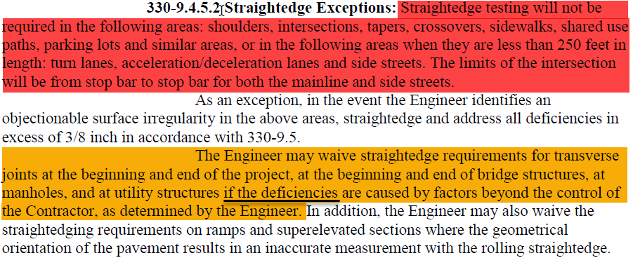

Testing Exceptions vs. Waiving Deficiencies
1st paragraph
  Straightedge Testing Exceptions - Testing not required
2nd paragraph
  Testing the testing exception areas, address anything exceeding 3/8”
3rd Paragraph
  Deficiencies may be waived, if caused by factors beyond contractor’s control
Florida Department of Transportation

Slide 3
Leave in Place vs. Remove & Replace
Remove & Replace
  District Decision
Leave in Place at No Pay
  District Decision
  Per CPAM 11.5
    Requires PA + RE + DPME + DCE approval
Leave in Place at Full Pay
  SCO Decision
  Per CPAM 11.5
    Requires PA + RE + DPME + DCE + SCE approval
Florida Department of Transportation

Slide 4
Leave in Place: Full Pay vs. No Pay
Full Pay
  Factor beyond Contractor’s Control
No Pay
  No Factor beyond Contactor’s Control
Florida Department of Transportation

Slide 5
Full Pay Justification – Photo & Write-up
Goal
  Show/Explain factor beyond contractor’s control
    Prime Contractor’s control, not the paving sub
What’s Needed?
  Typically:
    One Photo
      Correct photo that shows factor beyond contractor’s control
      Usually NOT a photo of straightedge testing
    Short Write-up
      Provides brief description of factor beyond contractor’s control
      Most times it’s one short sentence
Florida Department of Transportation

Slide 6
Typical “Full Pay” Cases
Following Slides are Typical Cases where “Full Pay” is requested & illustrate:
  When “Full Pay” is Justified
  When “No Pay” is Justified
  When factor beyond contractor’s control
    Is shown in a photo
    Is NOT shown in a photo
      Doesn’t necessarily mean “full pay” isn’t warranted, just that existing photo doesn’t support “full pay”
Florida Department of Transportation

Slide 7
Typical “Full Pay” Cases
End of Project Joint
Bridge Joint
Manhole/Structure in Lane
Drainage/Curb Issue Adjacent to Lane
Other??
Florida Department of Transportation

Slide 8
End of Project Joint
Full Pay
  At joint, off-project pavement is rutted or not in same plane across the lane
No Pay
  At joint, off-project pavement isn’t rutted, it’s in the same plane across the lane
    Contractor should’ve been able to pave a smooth, deficiency-free joint
Florida Department of Transportation

Slide 9
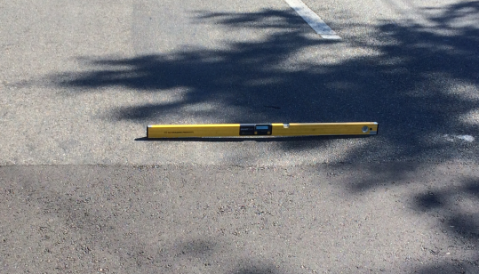
End of Project Joint
“Full Pay” Key photo - Place level/straightedge:
  Across the lane
  At the joint,
  On off-project pavement
  Shows rutting or other issue beyond contractors control
Write-up:
“Rutted, off-project pavement at end of project joint made it beyond contractor’s control to pave joint deficiency free.”
Level/straightedge across lane on off-project pavement shows rutting
Florida Department of Transportation

Slide 10
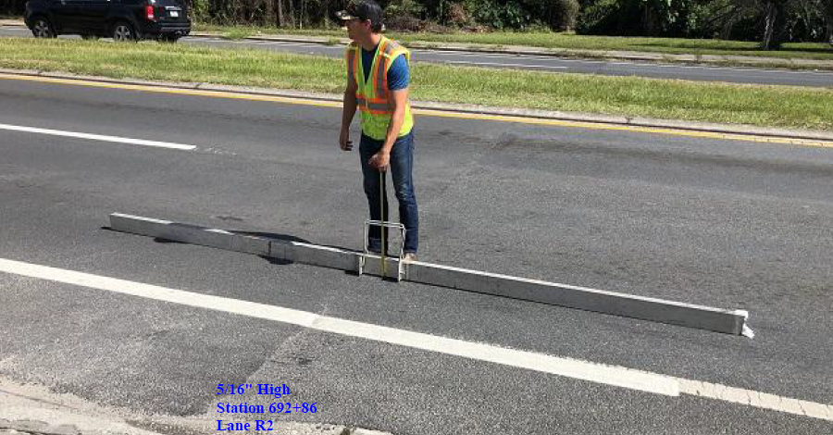
End of Project Joint
Photo doesn’t show factor beyond contractor’s control
Florida Department of Transportation

Slide 11
Bridge Joint
Full Pay
  Situation is beyond contractor’s control if:
    Approach slab is not in same plane AND bridge approach slab construction was not part of the contract
No Pay
  Not beyond contractor’s control if:
    Approach slab concrete is in same plane
    Approach slab concrete not in same plane, but approach slab construction was part of contract
    In both “No Pay” cases, no factor beyond contractor’s control
Florida Department of Transportation

Slide 12
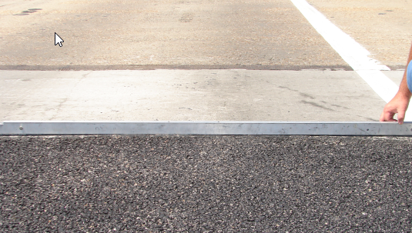
Bridge Joint
Key photo - Place level/straightedge:
  Across the lane
  On approach slab
  At the joint
  Shows approach slab not in same plane across the lane
“Full Pay” Write-up:
“Approach slab not in same plane across the lane”
“Approach slab not part of contract.”
Level/straightedge across lane on approach slab, at joint
Florida Department of Transportation

Slide 13
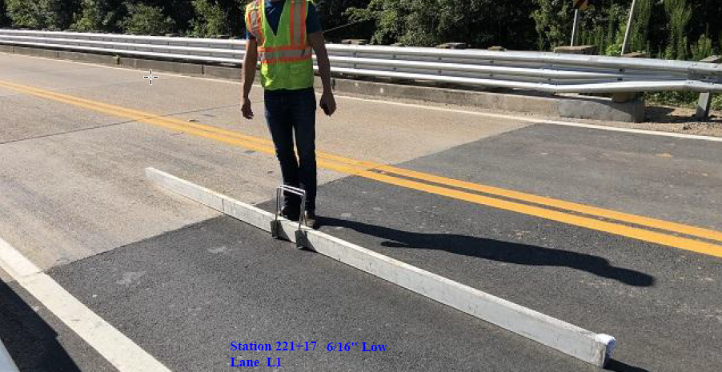
Bridge Joint
Photo doesn’t show factor beyond contractor’s control
Florida Department of Transportation

Slide 14
Manhole/Structure in Lane
Full Pay
  Key here is manhole/structure adjustment wasn’t part of the contract
  Exception is an area with numerous manholes in small area. Then it’s a challenge to pave well with all the manholes in the area, even if they were adjusted per contract
No Pay
  If manhole/structure adjustment was part of contract, then manhole adjustment & paving were within the contractor’s control (prime, not the subs)
  See exception above
Florida Department of Transportation

Slide 15
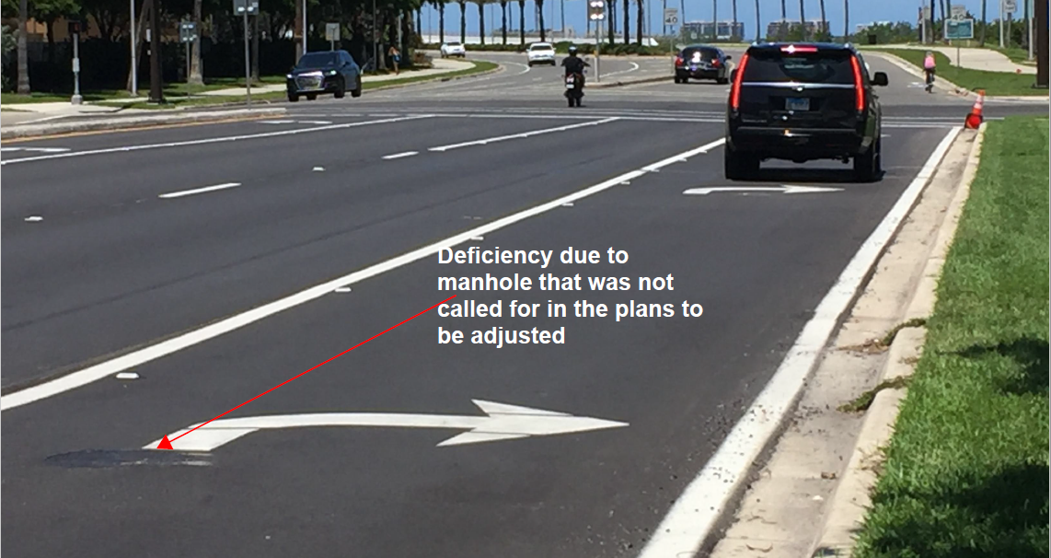
Manhole/Structure in Lane
Key Photo:
  If manhole adjustment was not part of contract, statement is enough, but photo helps.
  If cluster of manholes prevented smooth paving, provide photo of the area.
“Full Pay” Write-up:
“Manhole adjustment not part of contract”
“Number of manholes in small area prevented smooth paving”
District “Write-up” provided in photo
Florida Department of Transportation

Slide 16
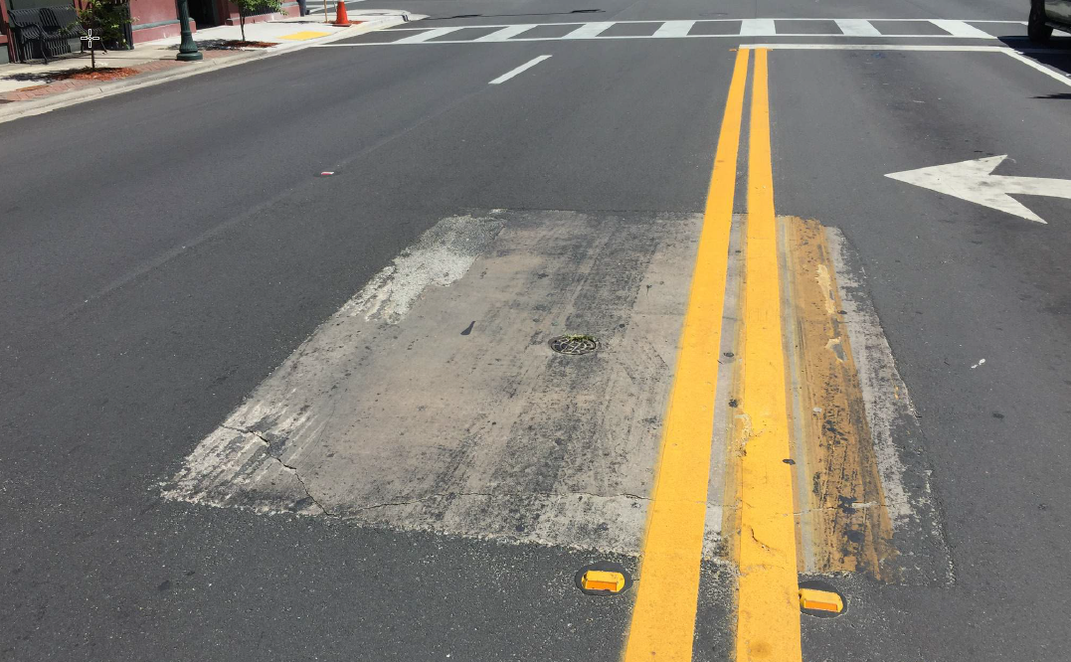
Manhole/Structure in Lane
Another example:
“Full Pay” Write-up:
“Uneven, concrete slab in roadway prevented smooth paving.”
Florida Department of Transportation

Slide 17
Manhole/Structure in Lane
Tough to get a bad photo for this situation
Most photos will work
Florida Department of Transportation

Slide 18
Drainage/Curb Issue Adjacent to Lane
Full Pay
  Beyond Contractor’s Control, if:
    Existing drainage structure/curb & gutter dips down significantly
    Plans didn’t call for raising new structures/curb & gutter
No Pay
  Not beyond contractor’s control if:
    Existing structures/curb & gutter don’t dip down
      i.e. paving to curb didn’t create the deficiency
    New structures/curb & gutter were reconstructed, but placed at incorrect elevation
Florida Department of Transportation

Slide 19
Drainage/Curb Issue Adjacent to Lane
Key Photo(s)
  Photo from across the street which shows the longitudinal dip
    facing the inlet with road running from one side of photo to other
  Second photo (on right) shows contractor attempted to mitigate the issue
“Full Pay” Write-up:
“Deficiency caused by drop in elevation around inlet.”
“Drainage structure construction was not part of contract.”
Florida Department of Transportation

Slide 20
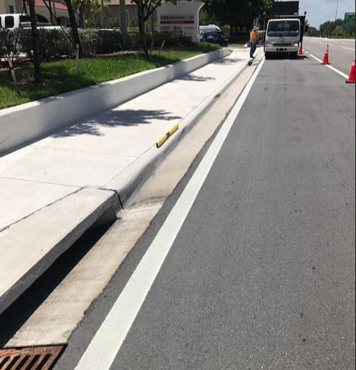
Drainage/Curb Issue Adjacent to Lane
Photo doesn’t show factor beyond contractor’s control
Florida Department of Transportation

Slide 21
Other?
Other situations with factors beyond the contractor’s control may occur
Need to obtain photo that shows factor beyond contractor’s control
If not sure about photo:
  Call me & Explain situation
  I’ll let you know what photo might show it is beyond contractor’s control.
Florida Department of Transportation

Slide 22
Contact Info
For questions & comments contact:
Richard Hewitt, P.E.
  State Construction Pavement Engineer
  Office: (386) 943-5305
  email: richard.hewitt@dot.state.fl.us
Florida Department of Transportation

