Slide 1
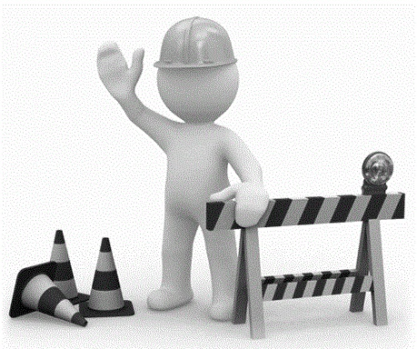

Contractor Past Performance Rating (CPPR)
Presented by Wayne Jackson 2018 Construction Academy
July 31, 2018

Slide 2
Why CPPR System?
More objective process
Communicate performance issues proactively
Tied to outcomes that are important to Customers
“Raise the bar” on Contractor’s performance
Factor in past performance as part of Low-Bid system

Slide 3
Impacts of Past Performance Grades
Derived: Rule 14-22 Florida Administrative Code
Impacts to pre-qualification and bidding capacity.
The higher the average score, the higher the bidding capacity.

Slide 4
Impacts of Past Performance Grades
Contractor past performance score is used to determine bidding capacity.
  Typically, previous year’s scores are averaged but under certain circumstances, up to the last five years of scores can be averaged. Year starts from the date of the Contractor’s pre-qualification (typically April).
TAKE IT SERIOUSLY! WE NEED TO BE FAIR, BUT STILL, A “GOOD” IS A “GOOD” AND A “BAD” IS A “BAD

Slide 5
Bidding Capacity Impacts
MCR = AF x CRF x ANW
Where,
MCR = Maximum Capacity Rating
AF = Ability Factor (ranges from 1 to 15)
CRF = Current Ratio Factor (ratio of adjusted current assets and adjusted current liabilities)
ANW = Adjusted Net Worth
(as described in FAC)

Slide 6
Ability Factor
(revised as part of the new grading system)
Ability Score (avg. of the grades) | Ability Factor
64 or less | 1
65 – 69 | 2
70 – 73 | 3
74 – 76 | 4
77 – 79 | 5
80 – 84 | 8
85 – 89 | 10
90 – 93 | 12
94 – 97 | 14
98 – 100 | 15

Slide 7
Ability Factor
If a Contractor receives an ability score of 76 or less on two or more past performance reports for projects completed during the 12-month period, the AF will be limited to a maximum of 4 and the use of Surety Letter prohibited, unless
  the applicant’s average ability score (inclusive of all score received during the period) is 87 or greater.

Slide 8
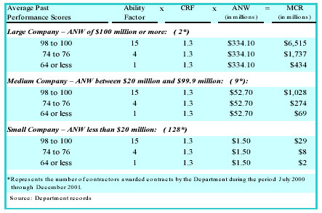
Effect of Past Performance on Maximum Contract Rating

Slide 9
Communication is the Key
(from CEI Standpoint)
Be Reasonable and Fair … we are not expecting perfection, nevertheless we should not rationalize mediocrity.
“No-surprises” but that does not mean there are 100 warnings before action!
Clear Documentation
  Daily diaries
  Weekly/Monthly progress meetings
  Weather letter
Deal with the issues … proactively .. Don’t hide

Slide 10
Communication is the Key
At the Pre-Con, establish who with the Contractor needs to be notified w/project performance issues.
Contractor’s upper management needs to keep tabs on what is being said and written.
Deal with the issues … proactively .. Don’t hide

Slide 11
Outcomes
Scores that truly depict Performance
Clearer divisions between Contractors based on performance rather than perception.

Slide 12
Questions/Refresher
  A Key Element for CPPR to work effectively is ______________.
  Communication
  2. When issues arise, they must be dealt with
  .
  Proactively
  3. Clear is necessary to effectively support CPPR process.
  Documentation
  fair
  4. Be reasonable and _____.

Slide 13
The Nine Categories (weighted)
Pursuit of the work (12)
Proper MOT and minimize impacts to traveling public (12)
Timely and complete submittal of documents (8)
Timely completion of project (14/20)
Cooperation/ Coordination (10)
Mitigate cost and time overruns (12)
Environmental compliance (10/12)
Conformance w/contract documents (20)
DBE Utilization (4)

Slide 14
The Ground Rules
Standard rules of rounding apply
Documentation = Daily Report of Construction, Stop Work Orders, other such notes or communication in the project files or to the contractor from the CEI
Contractor = Prime, Subs, Suppliers
Bonus points (Cat # 4, 7 and 9)
Deficiency Letter (Cat #2, 3, 5, 6, 7)
Warning DL / Verbal Warnings

Slide 15
The Ground Rules
Deficiency Letter Factor (DLF) is influenced by contract duration
Appeals Process
Contractor’s responsibilities
    Do the right thing- Proactive and React
    Keep up with performance
    Keep up with the Subs, Suppliers, etc.
    Progress meetings

Slide 16
The Appeals Process
Procedure provides for appeal
  Contractor can appeal a Deficiency Letter to DCE … Timely notice required
  Contractor can appeal the Final Score to DCE.
  Contractor has Administrative Hearing rights if all else fails.

Slide 17
The Appeals Process
Deficiency letters issued by Operations Center Engineer/Resident Engineer can be rescinded with concurrence from DCE
Appeal should be based on facts
Verbal Warning and DWL cannot be appealed.
DRBs are not authorized to review CPPR issues. It is an Administrative issue not a Contract issue.

Slide 18
Category 1: Pursuit of the Work
Based on the Contractor diligently and systematically pursuing the work each day *Critical Path
Based on how contract time was established
Pursuit is based on work days. Work days will always be less than Present Contract Time.
Cannot be greater than 100 %
No Deficiency Letter used
Daily Report of Construction tracks this.

Slide 19
Category 1: Pursuit of the Work
Pursuit of Work cannot be greater than 100 %.
  Percent is based on allowable contract time (minus weather days) on a five-day work week unless otherwise stated in the Contract.
  On some contracts, the contract time is based on a six-day or a seven-day (rare) workweek.

Slide 20
Category 1: Pursuit of the Work - Examples
Pursuit of Work cannot be greater than 100 %.
  If the Contract Time is based on a five-day workweek but the Contractor has been working six or seven days, Pursuit of Work will based on the five-day workweek and whether Contractor pursued work on that many number or days. Make a notation in the remarks section.
  This will prevent from “banking” the extra days so as to prevent potential abandoning the projects later on and not have negative grade implications.

Slide 21
Category 1: Pursuit of the Work - Examples
Contract Time was based on a six-day work week
For the total month, Contractor worked 20 days of 24 days (20 days divided by 24 days = 83%).

Slide 22
Category 1: Pursuit of the Work - Examples
Contractors need to show non-work period in their schedule if the intent is to not start work once time starts. Signs do not need to be placed.
The intent is not to penalize the Contractor for not starting work when contract time begins (provided schedule shows that) but once the Contractor starts work, it is intended to “count against” the Contractor if he abandons the project, regardless of the schedule.

Slide 23
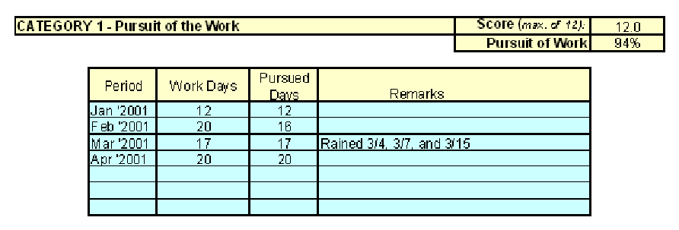
Category 1: Pursuit of the Work - Examples
A Contractor has been working five days a week regularly but during a particular week, it rains one of the days.
  Count this as 100 % pursued (make notation in the system)

Slide 24
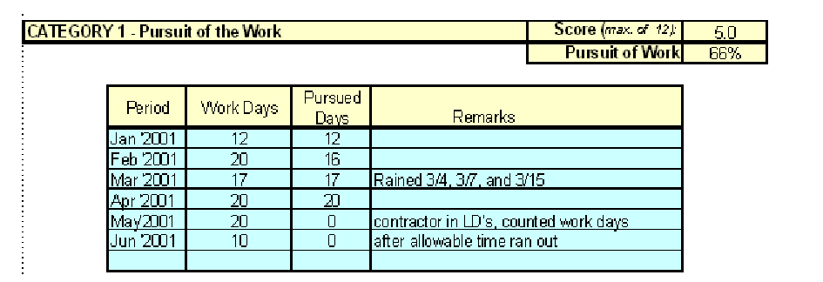
Category 1: Pursuit of the Work - Examples
LDs for Category 1
  Refer to “Additional CPPR Guidelines”

Slide 25

Questions?

Slide 26
Category 2: MOT & Public Impacts
Based on Contractor’s initiative to identify and correct MOT problems in a timely manner
Includes proper MOT, business access, pedestrian issues, and traffic flow
Deficiency Letter process used

Slide 27
Category 2: MOT & Public Impacts - Examples
Does the Contractor have to be reminded that barricades are lying on ground?
Does the Contractor have to be reminded of lane closure restrictions?
Blatant violations, such as violating lane closures restrictions, warrant a DL unless it is an unforeseen situation and the Engineer has been advised and has given concurrence.

Slide 28
Category 2: MOT & Public Impacts - Examples
It is not the intent to remind the Contractor on every requirement of the Contract prior to issuance of a DWL.
We need to recognize that “things” happens and give the Contractor the benefit of doubt, BUT at the same time, we should not tolerate the Contractor’s inability to mitigate the “things” from happening.

Slide 29
Category 2: MOT & Public Impacts – UPDATE 2018
DCE Memorandum 16-18 (FHWA Approved 6/22/18)
TEMPORARY CRASH CUSHIONS AND TEMPORARY BARRIERS
Issue: Improperly installed and maintained Temporary Crash Cushions and Temporary Barriers
CPAM Chapter 9.1 addresses work zone inspections and the role that the Department representatives are to fulfill.

Slide 30
Category 2: MOT & Public Impacts – UPDATE 2018
DCE Memorandum 16-18 (FHWA Approved 6/22/18)
TEMPORARY CRASH CUSHIONS AND TEMPORARY BARRIERS
When improperly installed or maintained devices are found, the contractor will be given a verbal warning and required to make corrections to critical safety issues immediately and to minor issues within 24 hours.

Slide 31
Category 2: MOT & Public Impacts – UPDATE 2018
DCE Memorandum 16-18 (FHWA Approved 6/22/18)
TEMPORARY CRASH CUSHIONS AND TEMPORARY BARRIERS
If the corrections are not made within this timeframe, a deficiency letter will be issued.
If subsequent reviews of MOT items on the project continue to expose improperly installed or maintained devices, a deficiency letter will be issued for each review and a non-conformance day in category 8 of the Contractor’s Past Performance Rating will be charged daily until the MOT corrected.

Slide 32
Category 2: MOT & Public Impacts – UPDATE 2018
DCE Memorandum 16-18 (FHWA Approved 6/22/18)
TEMPORARY CRASH CUSHIONS AND TEMPORARY BARRIERS
ADDITIONAL INFORMATION (SIDE NOTE)
Failure on the part of the Consultants assigned to FDOT projects to identify these temporary crash cushion and barrier installation and maintenance issues, as well as other MOT issues, will result in the performance evaluations, category E. Effective Administration of the Construction Contract, being scored lower accordingly.

Slide 33
Questions/Refresher
  Nine
  1. There are _______ categories in the Contractors Past Performance Report.
  2. T or F A DRB can review CPPR issues.
  cannot
  3. The pursuit of work be greater than 100%.
  Yes
  4. Are DLs used for Category 2 (MOT)?

Slide 34
Category 3: Submittal of Documents
Timely submittal
Complete submittals
FDOT does not have to hold the Contractor’s hand
Can impact Category 8
(Conformance w/Contract Documents)
Deficiency Letter process used

Slide 35
Category 3: Submittal of Documents - Examples
Monthly Certification-had to remind the Contractor of the monthly certification.
Weekly MOT reports.
Quality Control plans.
Environmental Reports
Initial Schedule not submitted.
Schedule updates not submitted.
Engineering Analysis Reports not submitted.

Slide 36
Category 3: Submittal of Documents - Examples
EEO/DBE, trainee, certified payroll issues come into play only when monthly estimate is withheld
Notice Letter advising of missing documentation requesting remittance
Letter notifying possible withholding of monthly estimate – automatic DWL
Letter notifying withholding of monthly estimate – automatic DL

Slide 37
Category 3: Submittal of Documents - Examples
If we had to issue letters, month after month, notifying possible withholding of monthly estimate – issue DWL in Category 3 and DL in Category 5, and give a Non-Conformance day in Category 8.
Issue DL in Category 3 only if the monthly estimate was withheld.

Slide 38
Category 3: Submittal of Documents - Examples
Required Documentation (Shop Drawings, etc)
If Contractor fails to deliver required documentation, issue DWL (or DL) in Category 3, DL in Category 5, and give a Non-Conformance day in Category 8.

Slide 39
Category 3: Submittal of Documents - Examples
Engineering Analysis Reports (EAR)
  Once it is determined that an EAR is needed, mutually agree on a timetable of when this submittal is made.
    If the Contractor fails to acknowledge, then establish a reasonable timeframe ( ie,10 working days) to submit
    If no submittal is made, then issue a DWL and provide for another 5 working days.
    If still no submittal, then issue a DL

Slide 40
Questions?

Slide 41
Category 4: Project Completion
14 points for finishing within Allowable Contract Time.
Bonus points for early completion or within Original Contract Time.
Significant scoring reduction for finishing late
No Deficiency Letters used

Slide 42
Questions?

Slide 43
Category 5: Cooperation/Coordination
Includes CEI personnel as well as property owners, utilities, and third parties
Based on Contractor’s initiative
Deficiency Letter process used
Blatant violations are when CEI tells the Contractor not to do something but the Contractor proceeds anyway. Contractors need to escalate disagreements or misinterpretations prior to proceeding with the work.

Slide 44
Category 5: Cooperation/Coordination - Examples
Contractor was advised to stop work and did not.
Contractor was advised to stop paving and get out of the road due to lane closure time requirement in the Contract. This could result in multiple negative implications (DL in this category, non conformance day in Category 8)
Lack of good coordination, everything seems to be last minute. PLANNING IS KEY.

Slide 45
Questions?

Slide 46
Category 6: Mitigate Cost and Time Overruns
Contractor’s initiative to avoid or minimize cost and time increases
Deficiency Letter process used

Slide 47
Category 6: Mitigate Cost and Time Overruns - Examples
Contractor worked diligently to supply all information on the cost and time increases on claims submitted by them.
The requests for additional money and time are well documented, fair and submitted timely.
Contractor showed good-faith by relocating resources in order to mitigate cost and time increases.

Slide 48
Category 7: Environmental Compliance
Based on Contractor’s initiative to identify and correct problems
FDOT does not have to hold Contractor’s hand
Bonus points for jobs over 300 original days
Deficiency Letter process used

Slide 49
Category 7: Environmental Compliance - Examples
Contractor complied with all the environmental regulation requirements for Federal, State and local.
Contractor complied with the contract erosion control plan, permits, and specifications and corrected deficiencies as necessary.
Proactive in maintenance of erosion control features.
Had foresight on extended weather forecast and put necessary features in place.

Slide 50
Category 7: Environmental Compliance - Examples
Washout into streams, rivers, and waterways result in automatic DL.
Completed the SWPPP inspection reports as required by permit in a timely, meaningful manner with full compliance in all areas of the project.

Slide 51
Questions/Refresher
  1. You can only issue a DL for a Monthly Estimate related issue in Category 3 when the estimate is __________.
  Withheld
  2. Bonus points are issued within Category 4 (Project Completion) for early completion or within _________ contract time.
  Original
  3. Cat 6: The contractor’s request for additional time and/or money should be well documented, , and submitted timely.
  Fair
  4. Cat 5: Cooperation includes ____, utilities, property owners and other third parties.
  CEI

Slide 52
Questions?

Slide 53
Category 8: Conformance with Contract Documents
Contractor’s efforts are such that the Department’s CEI efforts are not essential to ensure quality.
Includes Prime, Subs, Suppliers, etc.
Includes all products and services (temporary and final).

Slide 54
Category 8: Conformance with Contract Documents (cont’d)
Relies on documentation in Daily Reports/other project records
No Deficiency Letters used
Based on chargeable work days. It should always total to Contract Time used.

Slide 55
Category 8: Conformance with Contract Documents
Contractors are concerned about “continuous gigs” in this category
  CEI needs to escalate the concerns through VW, DWL and DL (normal methods)
  Be reasonable!
Refer to “Additional CPPR Guidelines”

Slide 56
Category 8: Conformance with Contract Documents - Examples
Contractor did not lay pipe true to the lines and grades. Non-conformance day just for the day it happens provided the Contractor acknowledges the deficiency and has a plan of corrective action. (If the Contractor is non-responsive to the issue, it could result in multiple non-conformance days)
Contractor has closed a lane of traffic without the lane closure signs. This could result in multiple negative implications (Conformance to Contract Documents, DL in Category #2)

Slide 57
Category 8: Conformance with Contract Documents - Examples
Contractor did not deliver Documentation as required.
Non Conformance day for missing deadline. If Contractor provides a firm commitment to furnish documents on a specified date (and we agree), only count the initial day and do not count subsequent days. If the Contractor fails to meet the specified date, non conformance days will resume until the documents are delivered.
Any day a DWL or DL is issued will be a non-conformance day. However, a VW will not be considered a non-conformance day.

Slide 58
Questions?

Slide 59
Category 9: DBE Utilization
4 bonus points
Based on (1) achieving availability percentage or (2) eight percent, depending upon language of Bid Proposal
No Deficiency Letter used

Slide 60
FAQs
Can a Contractor’s rating be affected in more than one category for the same infraction?
  Is it a non-conformance day if a Contractor constructs an item, recognizes the error and corrects the error without having to have been directed by the CEI?
Yes
NO …. This Contractor is GOOD!

Slide 61
FAQs
What happens when there is an issue pending with the DRB after Final Acceptance?
  The Project Administrator issues a Final Grade within 45 calendar days of Final Acceptance.
  If the DRB ruling affects the score, the Project Administrator adjusts the score and re-issues the final score. **Note: (If DRB ruling occurs after final grade issued, PA will need to contact Zach Wiginton (850-414-4186) to have CPPR opened so updates can be made.

Slide 62
FAQs
Pushbutton Contracts: Don't do CPPR.
Fast Response Contracts: Don't do CPPR for fast response contracts - we typically invite the contractors to bid this work. If don't perform, don't invite next time.
Emergency Contracts: Don't do CPPR.

Slide 63
FAQs
How to show Non Quality days in Category 8 when a project is in Liquidated Damages (LDs)?
Show Zero (0) in Allowable Days and negative (-) days in Quality Days only for non compliant days. Add Remarks to spreadsheet describing non compliant days.
(See Example in Spreadsheet page 12)

Slide 64
FAQs
Are there any perfect construction jobs out there?
  NO.
Does that mean you cannot get a 100?
  NO. You can have less than a perfect job and still get a perfect score.

Slide 65
FAQs
What does the State Construction Office look for when they see a grade?
  The score (obviously)
  Pursuit of work
  Conformance with Contract Document days – if it is 100%, there is something fishy.
  No VW, DWL and DL depending on the complexity of the project and general “street-talk” on how the project is going.
  A lot of VW but no DWL or DL.
  Known facts communicated through formal channels but no VW, DWL, or DL.

Slide 66
Contractor Past Performance Report
Provide copy of the CPPR criteria at Pre-Construction Conference and explain this is the criteria used for rating the Contractor’s performance.
Interim Performance Ratings shall be originated and signed by the Project Administrator. These may be completed at the discretion of the PA at anytime. (CPAM 13.1.6 (A) Revised June 14, 2012)
Interim grades are based on certain assumptions, such as Contractor finished within the allowable contract time and did not achieve or exceed DBE utilization

Slide 67
Visit the State Construction Office Website http://www.fdot.gov/construction/cppr/CPPRGuidelinesMain.shtm
Additional Guidance

Slide 68
If PA is incorrect in Site Manager, then it will be incorrect in CIM. Correct in Site Manager.
FAQ
Periods entered in category 1 & 8 must be completed on a monthly timeframe.
Partial months can be entered to reflect accurate start/end dates. Entering periods that span several months will not be permitted.

Slide 69
CPPR for Defaulted Contractor: For a Contractor that has been defaulted on a Contract, provide a final CPPR for the defaulted Contractor; provide date in the notes for Category # 1, Pursuit of Work, that the Contractor was defaulted. Do not enter the score in Site-Manager. Provide the State Construction Office with the current CPPR information from CIM. The State Construction Office will ensure that the defaulted contract will not show up on the District CPPR overdue lists.
Note: When a Contractor has been defaulted by the
Department, the Surety Company for that Contractor takes over the Contract to complete the Contract. We can not do a final CPPR on the Surety Company due to the Surety will hire a completion Contractor to complete the remaining contract work. Therefore, the completion Contractor becomes a subcontractor to the Surety Company.
FAQ

Slide 70
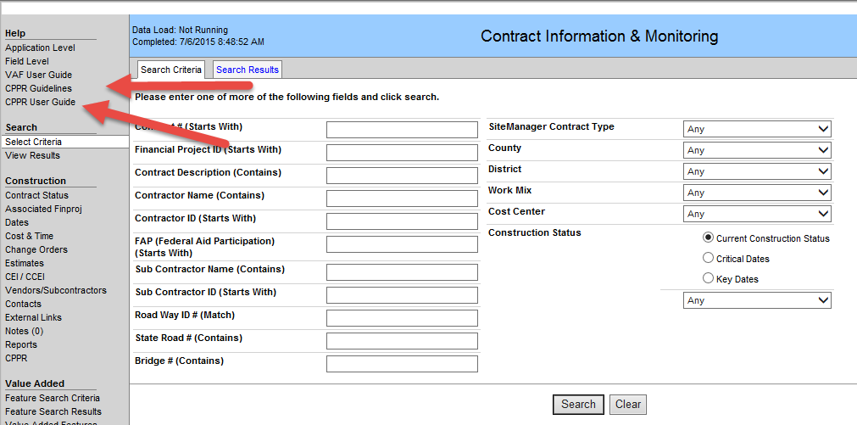
Entry Into CIM
Refer to files “CIM_CPPR_User_Guide” and “CIM_CPPR_Guidelines”
These files are also located

Slide 71
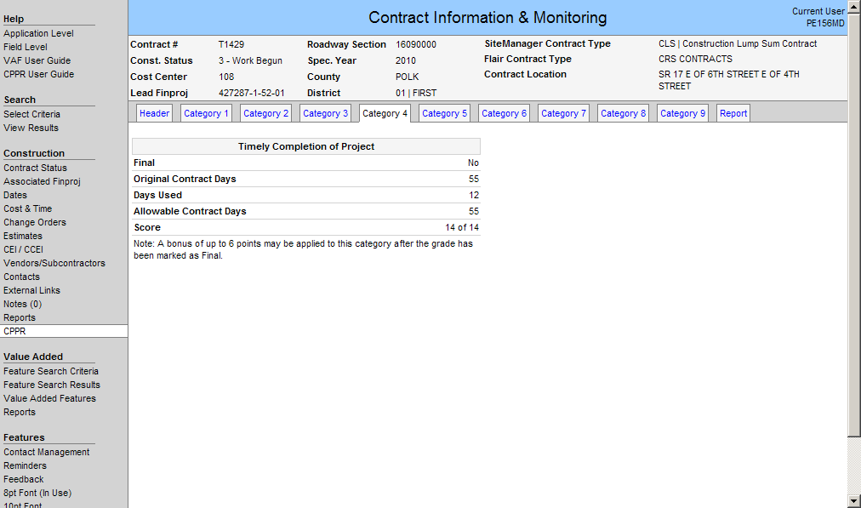
Category 4 is automatically calculated:
Note: The system does not calculate both bonuses and reductions (based on liquidated damages) until the Contract is marked final.

Slide 72
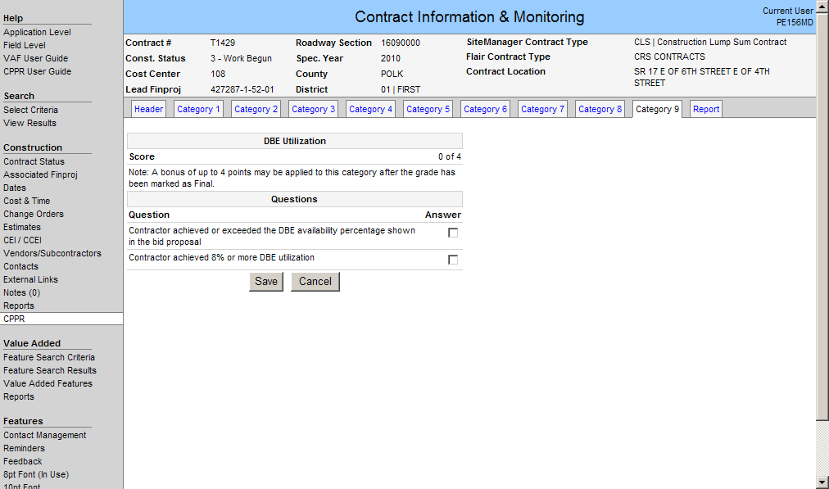

Slide 73

Questions?

