Slide 1
Inertial Profiler Certification Track
Smoothness Rodeo Results
Smoothness Committee Meeting Noah Borelli
May 17, 2018 Noah.Borelli@dot.state.fl.us
(352) 955-1846

Slide 2
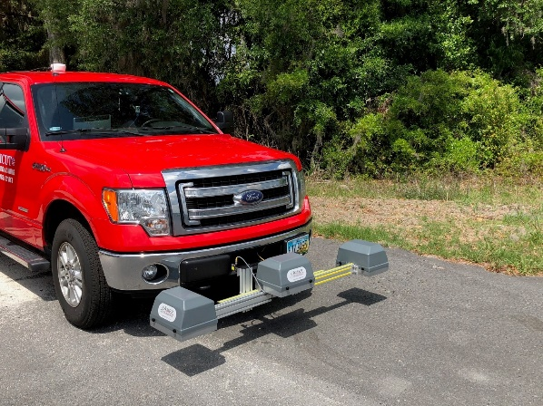
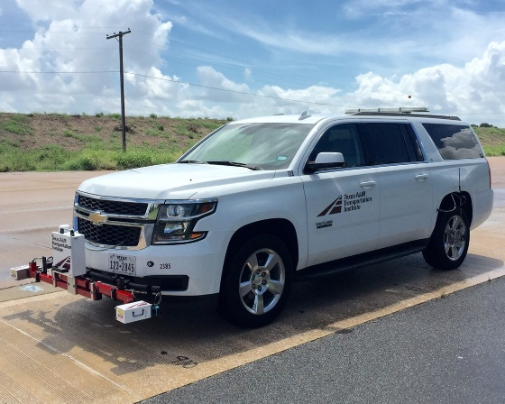
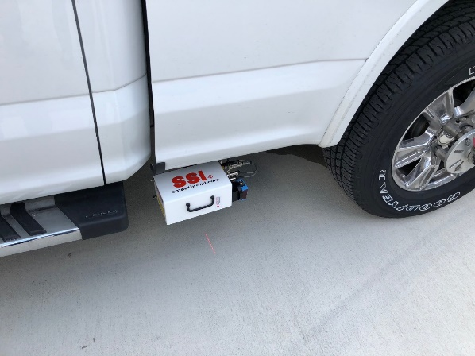
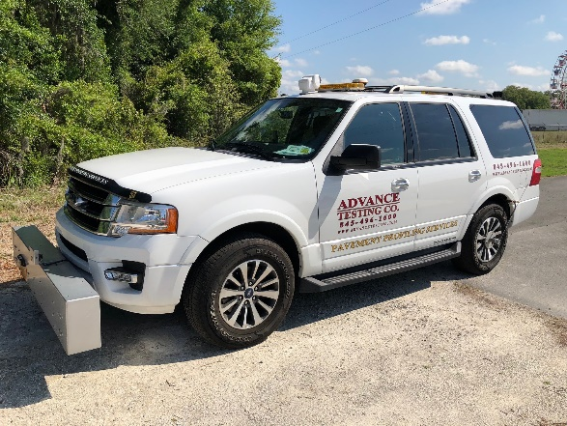
2018 Smoothness Equipment Rodeo
10 different profiler systems representing 4 different manufacturers participated.
- Advance Testing (ICC device)
- Americut (Ames Engineering device)
- Dynatest
- International Cybernetics Corporation (ICC)
High speed and lightweight profilers
- National Center for Asphalt Technology (NCAT) (Dynatest device)
- MacAdam Profiling (Ames Engineering device)
- Surface Systems and Instruments (SSI)
Mid-mount and transverse laser scan profilers
- Texas Transportation Institute (TTI) (SSI device)

Slide 3
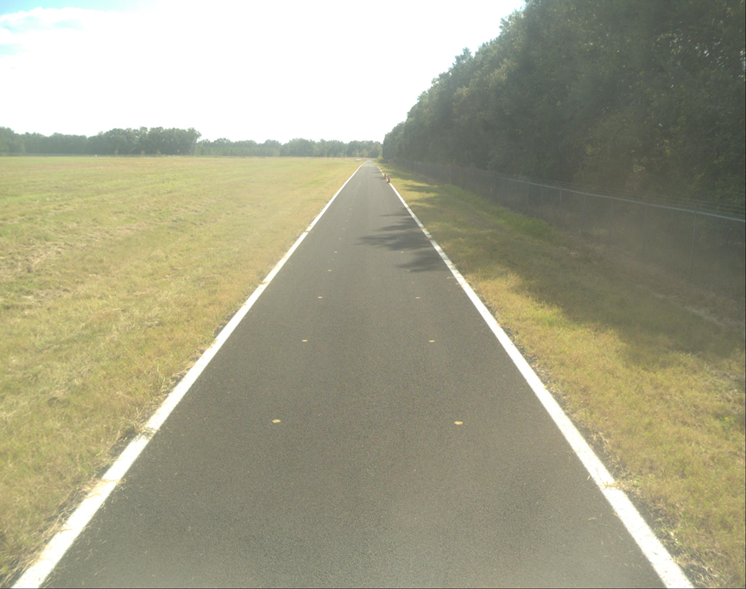
FDOT Profiler Certification Track
3700’ total length single lane located within the Williston Municipal Airport.
Open graded (FC-5) and dense graded (FC-12.5) friction courses each containing a 528’ smooth and 528’ medium-smooth test section.
IRI ranges from 34 in/mi to 105 in/mi.
FDOT Dev330SM
IRI Range (in/mi) Result
30 – 42 Incentive
43 – 55 Full pay
56 – 95 Disincentive
> 95 Remove & replace

Slide 4
Profiler Certification
Smoothness equipment rodeo was held to asses the performance of current profilers on the FDOT profiler certification track and aid in development of the upcoming FDOT profiler certification program.
AASHTO R 56 – Standard Practice for Certification of Inertial Profiling Systems outlines a procedure for certifying inertial profilers.
Goal of certification is a standardized process to verify profilers are reliable and accurate.

Slide 5
AASHTO R 56
AASHTO R 56 uses IRI-filter cross correlation to compare profiles. A cross correlation score of 1.00 means two profiles match exactly.
AASHTO R 56 requires the average repeatability cross correlation for 10 profiler runs to be 0.92 or higher.
AASHTO 56 requires the average accuracy cross correlation for 10 profiler runs to be 0.90 or higher. The accuracy comparison is made to a reference device, such as an ICC SurPro.

Slide 6
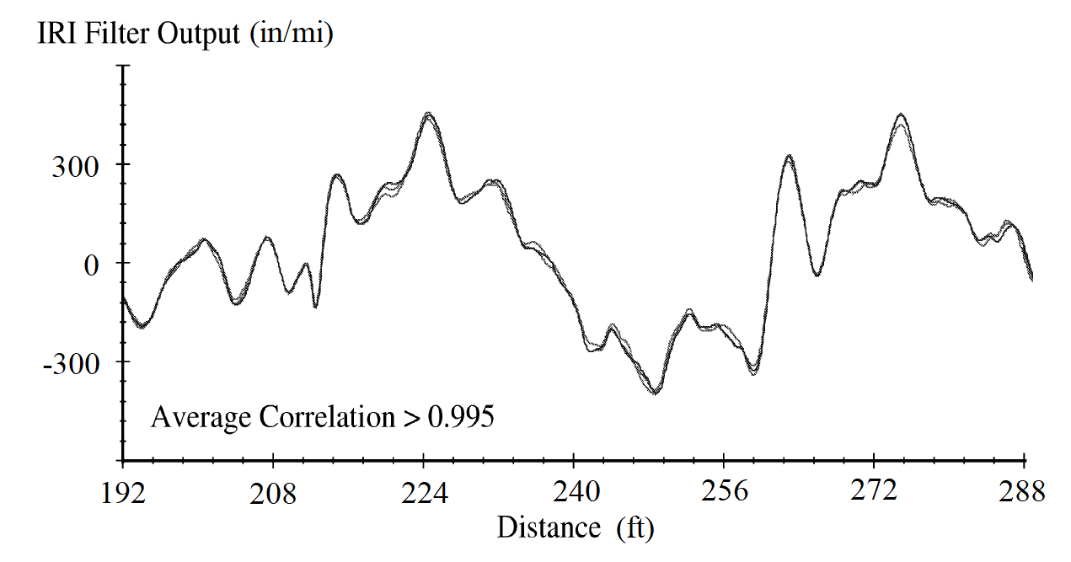
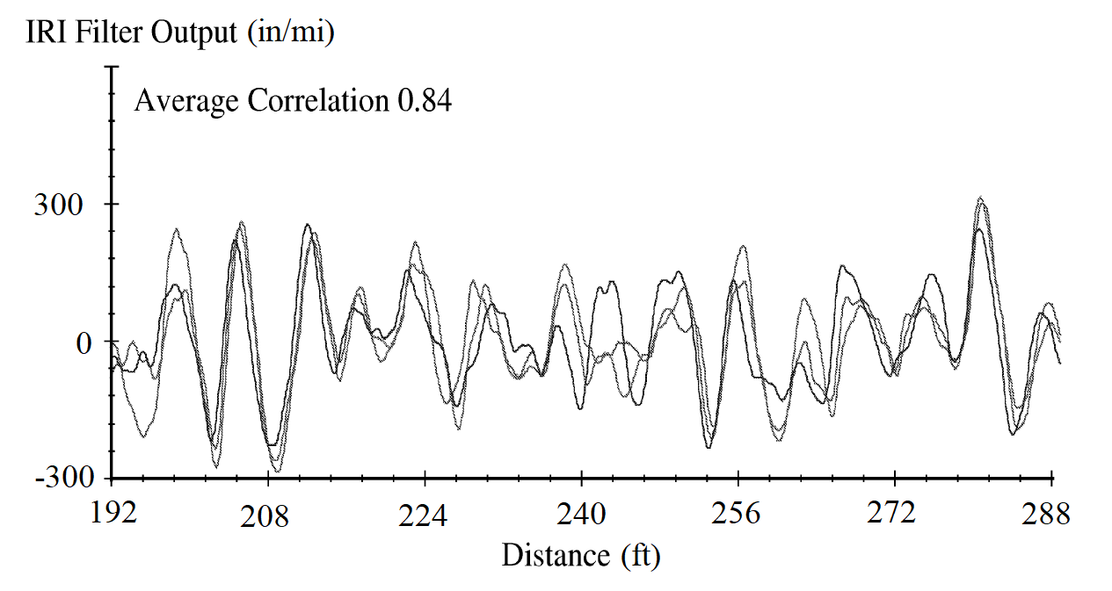
Cross Correlation
Three highly correlated (>0.995) and moderately correlated (0.84) profile measurements. Adapted from Development of Cross Correlation for Objective Comparison of Profiles by S. Karamihas, UMTRI, 2006.

Slide 7
Rodeo Repeatability Results

Slide 8
Rodeo Accuracy Results

Slide 9
Challenges
Cross correlation may not be the best metric for profiler performance on smooth open graded pavements.
Smoothness rodeo results are consistent with FDOT profilers.
Study for Establishing Regional Certification Centers for Inertial Profilers describes the profiler certification procedures of twelve other states. Of these, only two use an open graded pavement for certification. Neither of these states use cross correlation on the open graded portion of the certification.
  TxDOT profiler certification is done at TTI – use an elevation-based accuracy and IRI comparison to SurPro data.
  ALDOT profiler certification is done at NCAT – use a IRI comparison to SurPro data.

Slide 10
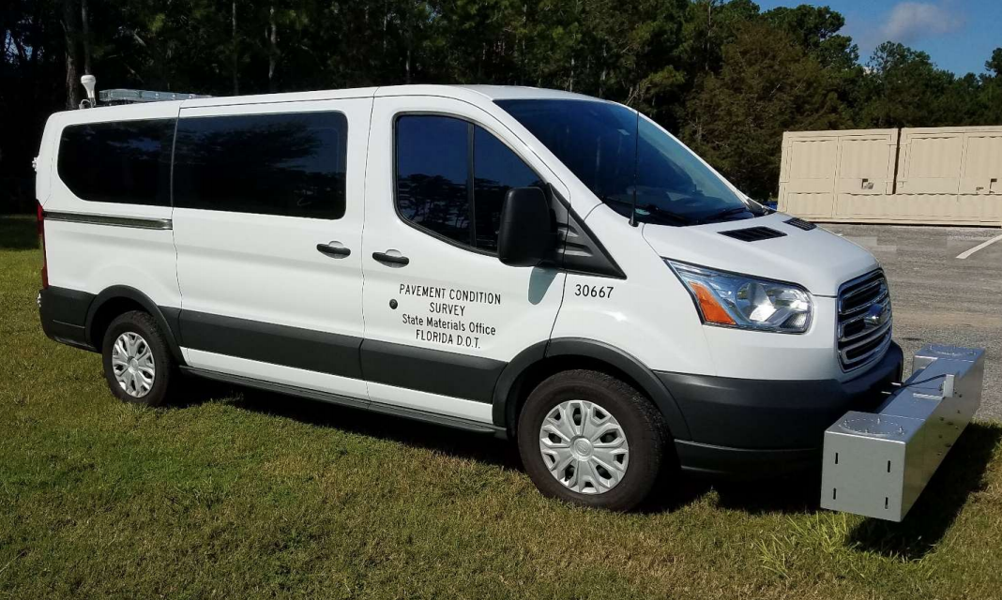
Going Forward
Develop initial certification criteria – June 2018
Test and refine certification criteria on FDOT fleet – Summer 2018
Working certification criteria – Winter 2018

