Slide 1
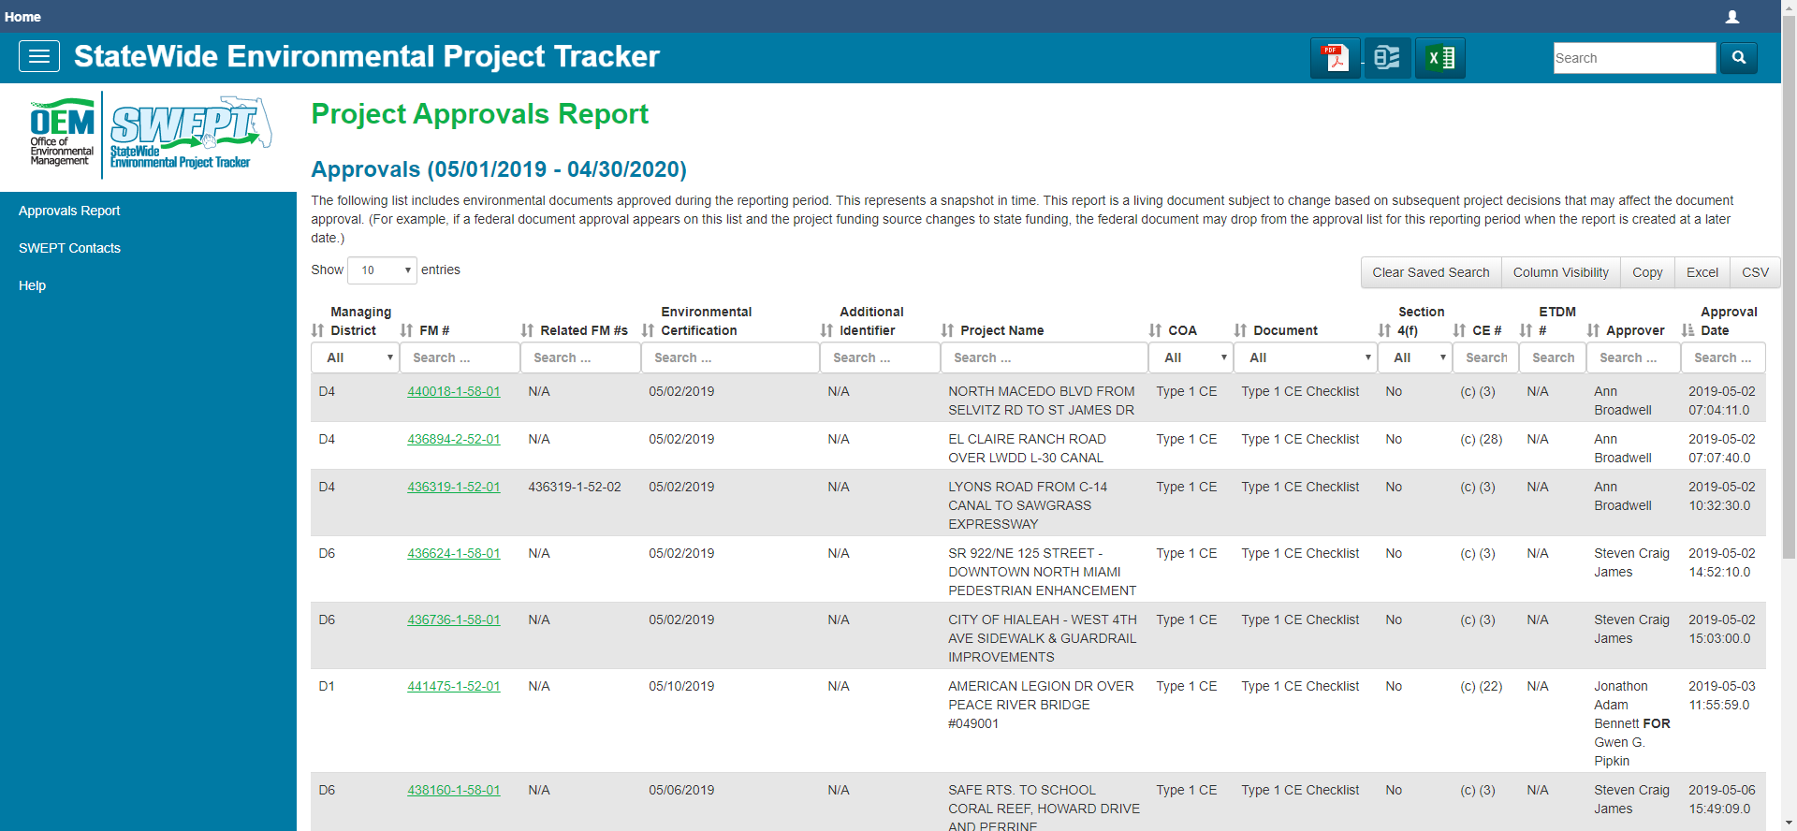
FDOT NEPA Assignment Training for FHWA Auditors –
Audit # 4
Trainers: Jason Watts
Peter McGilvray
Ruth Roaza

Slide 2
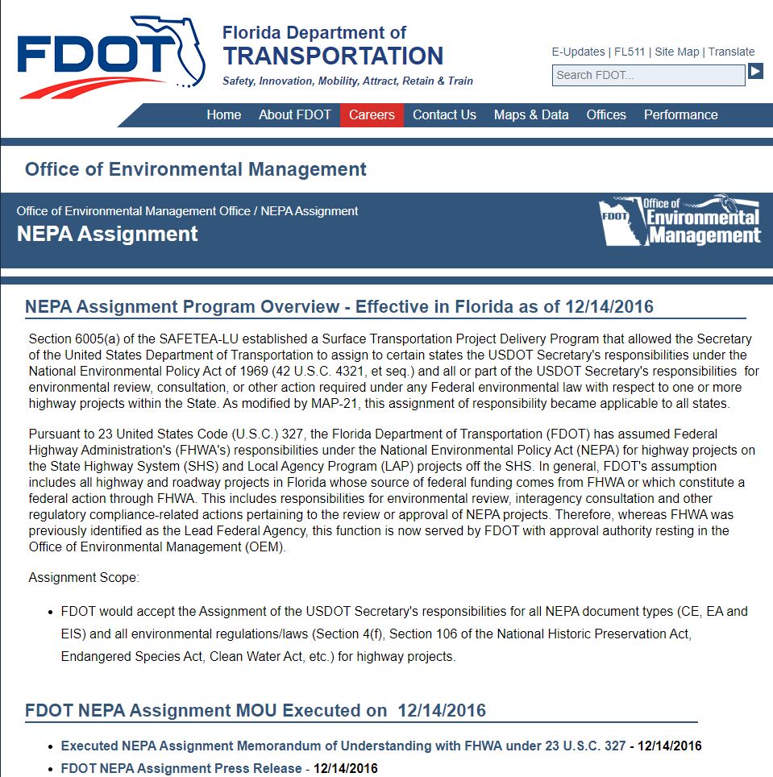
Logistics
GoTo Meeting
  Please mute when not speaking
Recording
  This training will be recorded and provided on our OEM NEPA Assignment Website
http://www.fdot.gov/environment/NEPAAssignment.shtm

Slide 3
OEM Representatives
Jason Watts,
      Director, Office of Environmental Management
      Jason.Watts@dot.state.fl.us
      (850) 414-4316
Peter McGilvray,
State Environmental Quality and Performance Administrator
Office of Environmental Management
Peter.McGilvray@dot.state.fl.us
(850) 414-5330
Ruth Roaza,
Environmental Process Analyst
Office of Environmental Management
Ruth.Roaza@dot.state.fl.us
(850) 414-4620
Notes:
Presenters today are Jason Watts, OEM Director, Pete McGilvray, State Environmental Quality and Performance Administrator, and Eric Whitehead, QA/QC Coordinator. Pete and I will be planning and coordinating the self-assessment process. Here is our contact information.

Slide 5
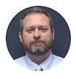
Director’s Opening Remarks
Notes:
The objectives for this presentation include an Overview of Federal Highway Administration (FHWA) requirements, 2019 assessment outcomes, the NEPA Self-Assessment Scope, Self-Assessment Focus Topics, the NEPA Self-Assessment Process, and Important Dates to remember.

Slide 6
Topics
Changes since 2019
StateWide Environmental Project Tracker (SWEPT) Overview
Environmental Review Process in SWEPT
Using SWEPT to Support FHWA Audits
Notes:
Today, Xavier will go over the FDOT Environmental processes for you. Then Pete will provide an overview of the StateWide Environmental Project Tracker (SWEPT) and demonstrate the SWEPT features that FHWA will use to help support the audit.

Slide 7
Changes in FDOT processes & SWEPT since 2019

Slide 8
PD&E Enhancement Highlights (reflected in 2019 version of Manual)
Enhanced emergency declarations guidance in Part 1, Chapter 4
Added CE Guidance from FHWA 2018 memo and Incorporation FHWA 2017 CE Memo
Included changes due to the Final Rule "Environmental Impacts and Related Procedures" FR 54480- 10/29/18 in applicable chapters.
Plans Preparation Manual updated to Design Manual throughout entire manual
Updated Part 1, Chapter 5 to include preparation of CE 2 within SWEPT and establish process
Added guidance on Federal Register Notices from FHWA throughout
Added context classification discussion where appropriate
Added clarifications to Section 4(f) resources chapter
106 Chapter updated with clarifications and added procedure of ACHP’s e106 process
Air Quality Chapter, added guidance from October 2016 Memo
Contamination – clarified expectations of level 1 and level 2 investigations
Commitments – updated to include use of Project Suite Enterprise Edition for tracking commitments

Slide 9
Coming Soon – 2020 PD&E Manual (to be released Spring 2020)
Two New Chapters
  US Coast Guard Chapter Projects and Navigation
  Acquisition and Restoration Council Coordination

Slide 10
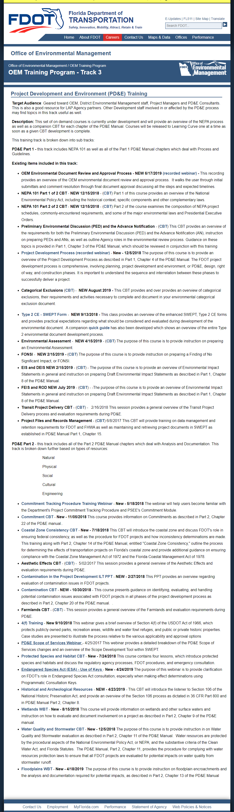
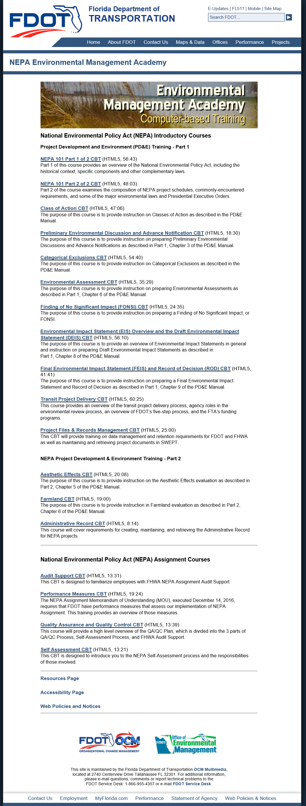
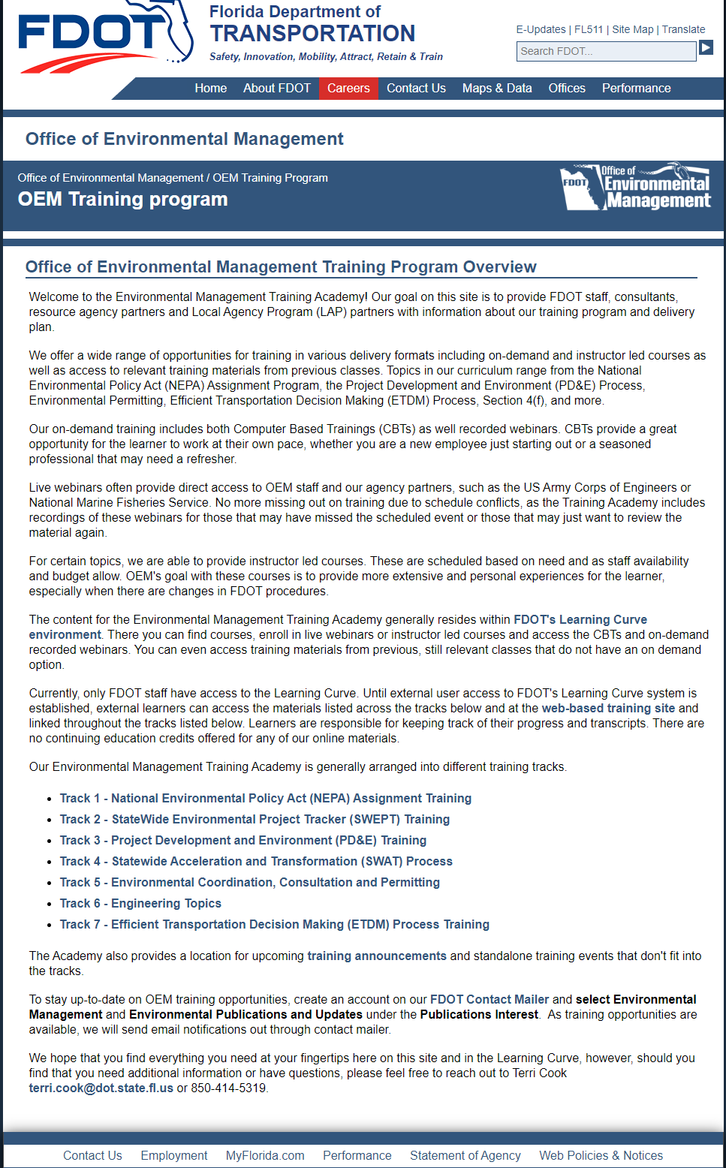
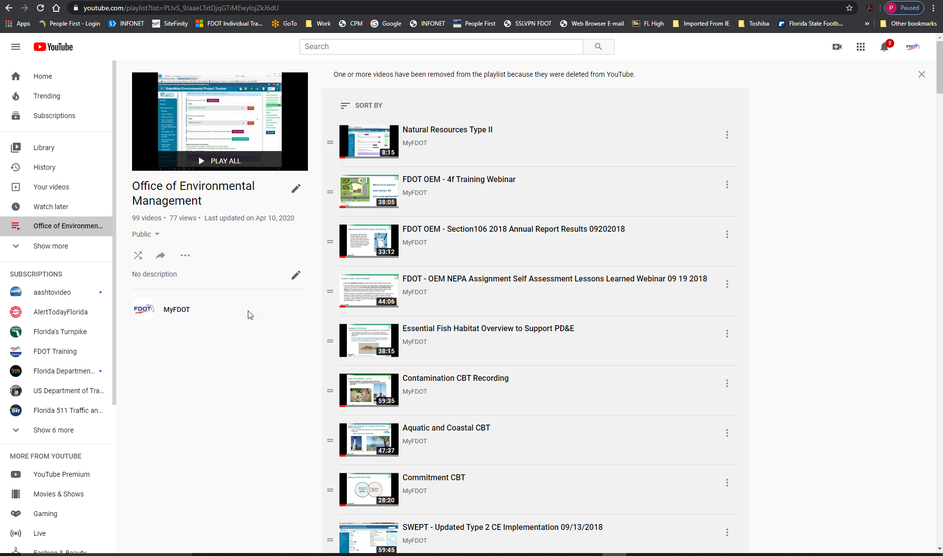
Enhanced Training Resources
Updated PD&E Trainings: https://www.fdot.gov/environment/sched/track3.shtm
OEM Environmental Management Academy: http://wbt.dot.state.fl.us/ois/NEPA/index.html
OEM YouTube Channel: https://www.youtube.com/playlist?list=PLIvS_9JaaeLTxtDjqGTiMEwylojZkJ6dU
OEM Training Program Website: https://www.fdot.gov/environment/sched/train1.shtm
SWEPT Specific Trainings: https://www.fdot.gov/environment/sched/track2.shtm

Slide 11
SWEPT Enhancements to Standard Forms
Enhancement | Implementation Date
Improved formatting and text styles in PDFs created from e-forms | 9/26/2019
Split up the TIP/STIP fields on e-forms | 3/25/2020
T2CE - Display the "Public Hearing not needed" statement in the PDF, when applicable | 7/2/2019
T2CE - Reflect updated standard statement language for Section 4(f) and 106 Resources | 12/10/2019
T2CE - Include a job aid of the standard statements under the SWEPT Help section | 12/11/2019

Slide 12
SWEPT Enhancements to Standard Forms (continued)
Enhancement | Implementation Date
Re-eval - Allow comments when Right-of-Way question is answered "Yes" | 5/23/2019
Re-eval - Display the Signature Timestamp for the OEM Director on the PDF | 8/7/2019
Re-eval - Require an attachment for the Re-evaluation consultation | 8/23/2019
Re-eval - Import Type 2 Data into Re-evaluation Form, when applicable | 5/13/2019

Slide 13
SWEPT Enhancements (Miscellaneous)
Enhancement | Implementation Date
FDEP Grants Program added to SWEPT | 7/24/2019
Improved usability of Forgot Password function | 12/11/2019
Approvals Report - Additional information about Environmental Certifications | 12/20/2019
Approvals Report - Added Related FM#s | 12/20/2019
Provide Excel listing of all files included in the Project File | 9/12/2019

Slide 14
SWEPT Enhancements to Project Page
Enhancement | Implementation Date
Add Cooperating/Participating Agencies | 4/23/2020
Make Project Description expandable | 4/23/2020
Display FM numbers for prior re-evaluations and segments being advanced | 4/23/2020
List Cooperating/Participating Agencies | 4/13/2020
Include segment number(s) being evaluated for Re-evaluations in the Project Approval History | 4/28/2020

Slide 15
Future SWEPT Enhancements
Enhancement | Implementation Date
Electronic Implementation of 4(f) forms and approvals | Summer 2020
Electronic Implementation of the State Environmental Impact Statement | Summer 2020
Electronic Implementation of the Environmental Assessment | ~ Winter 2020
Consolidation / Reorganization of SWEPT project file | Winter 2020
Closer Integration of SWEPT and the EST | Spring 2021

Slide 16
Any Questions?
Notes:
Do you have any questions?

Slide 17

Overview
Notes:
Now Pete will give an overview of the StateWide Environmental Project Tracker (SWEPT).

Slide 18


Key Features
SWEPT provides tools to help:
Track environmental project schedules
Integrate PD&E Scopes of Service
Assign and document environmental document reviews
Provide for consistent and reliable file management and retention
Support Self-Assessment and FHWA audits of environmental documents
Report quality and performance management results
Username
Password
Sign In
Forgot Your Password?
Contact Us
Notes:
SWEPT supports activities in FDOT’s environmental process, such as::
Track environmental project schedules
Build consistent PD&E Scopes of Service
Assign and document environmental document reviews
Provide for consistent and reliable file management and retention
Support FHWA audits of environmental documents
Report quality and performance management results
SWEPT pulls project information from various FDOT databases such as the Work Program, Environmental Screening Tool, and PSM. It provides tools to upload and organize environmental files. It also provides an interface to FDOT’s Electronic Document Management System (EDMS), automatically transferring files to EDMS at certain milestones, such as when the Environmental Document is approved. SWEPT supports FDOT’s NEPA Assignment Program by helping to process environmental documents through OEM reviews and approvals. It also includes a robust Quality and Performance module to monitor performance measures and support the audits and self-assessments required by the program.

Slide 19

SWEPT User Community
District Environmental Administrators and Managers
District PD&E Managers, Project Managers, & Team Members
OEM Project Delivery Coordinators & Managers
OEM Quality Assurance and Quality Control Staff
OGC Environmental Document Reviewing Attorneys
FHWA Auditors
Notes:
People use SWEPT to support the environmental process in a variety of ways, depending on their roles and responsibilities:
District Environmental Administrators review, edit, and approve Type 1 CE’s and environmental certifications. They also use SWEPT to submit other environmental documents to OEM for approval. They may delegate the SWEPT approval authority to other FDOT personnel.
District PD&E Project Managers and their teams use SWEPT to set up projects, manage the project file, and recommend environmental documents for approval. Team members may include consultants.
OEM staff use the site to review and approve environmental documents, and to support NEPA Assignment audits and self assessments
OGC attorneys also have access to the project files through SWEPT to review and approve documents and administrative records.

Slide 20

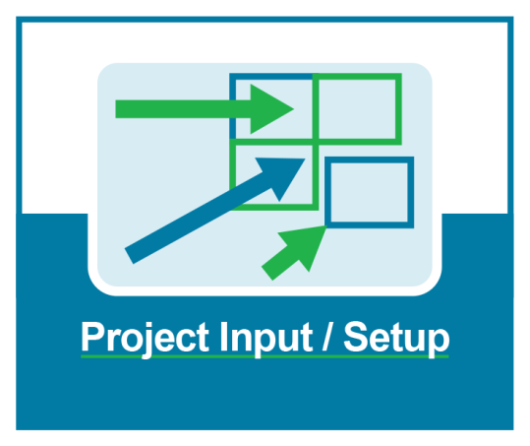
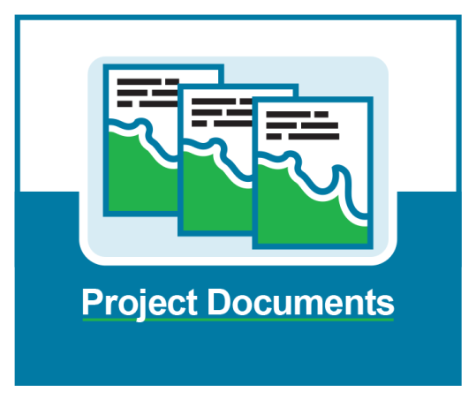


SWEPT Components
Notes:
The SWEPT tools are organized into 5 main sections.
Project Dashboards
PD&E Project Input/Setup
Project Environmental Documents
Team Management
Quality & Performance Management
Access to the modules depends on the user roles.

Slide 21
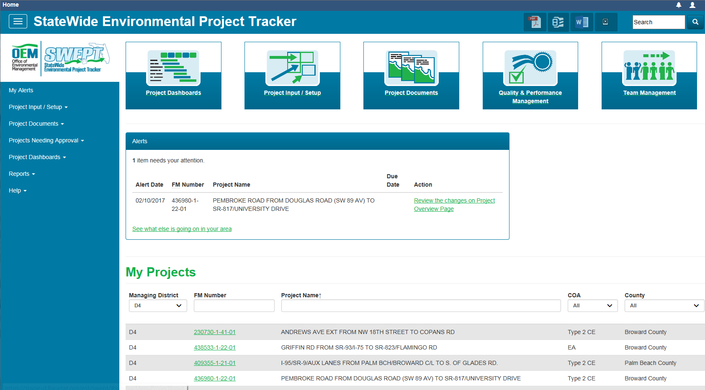
SWEPT Home Page
Click box to go to module
Menus expand to list more pages
Notes:
Users get to these modules from the SWEPT Home Page. They can click on the box at the top for the module they want to use, or use the menu at the left to go to specific pages in the module.

Slide 22
SWEPT Demonstration
General navigation
User settings
Search function
Project page
Help
Notes:
Now we’ll log onto the site and show you how to use it.

Slide 23
SWEPT Support for the Environmental Document Review Process
Notes:
SWEPT supports the environmental document review process by
Enforcing legal sufficiency and prior concurrence requirements with legal staff
Documenting and processing the review and approvals of environmental documents
Your handouts include a quick reference to help guide you through the process. Let’s go through it in more detail.

Slide 24
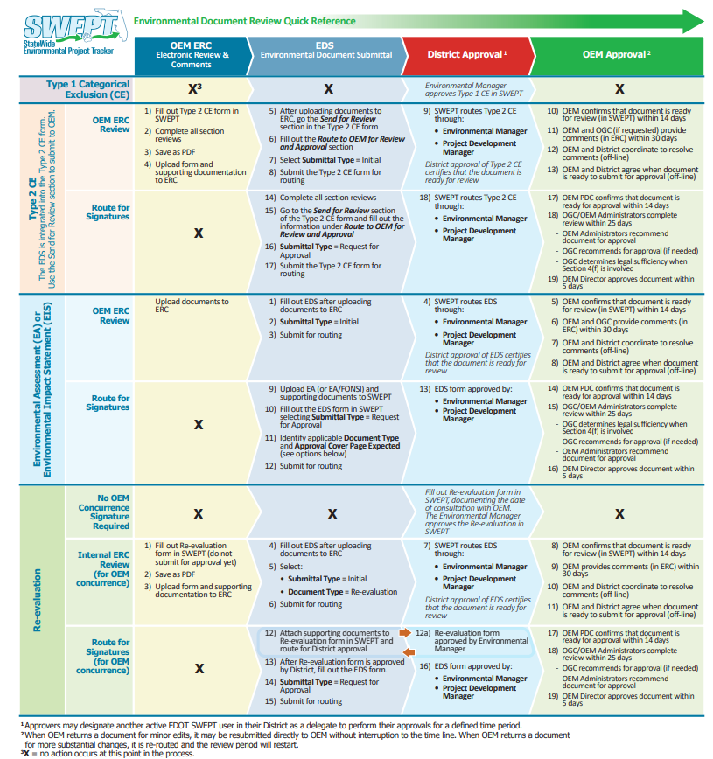

Environmental Document Review
Quick Reference

Slide 25
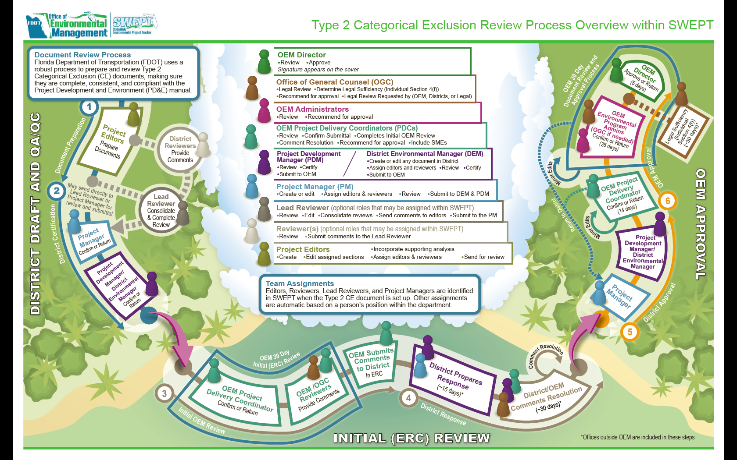
Example: Type 2 CE Process within SWEPT

Slide 26
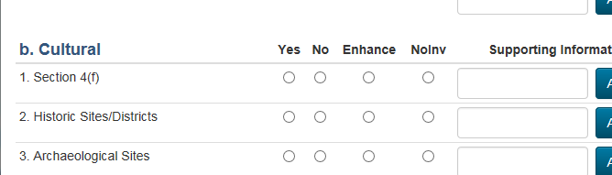
OGC Review and Legal Sufficiency Determination
EIS Significant Impacts to Section 4(f)?
YES - Legal Sufficiency Determination required
PDC
OGC and OEM Env. Administrators
OEM Director
No or Enhancement
  Legal Sufficiency Determination not required
  OGC review only required if determined by OEM or OGC
PDC
OGC and OEM Env. Administrators
OEM Director
No Involvement – No OGC review or Legal Sufficiency Determination
PDC
OEM Env. Administrators
OEM Director
PDC
OGC
OEM Env. Administrators
OEM Director
Notes:
Depending on the impact to Section 4(f) resources, the Office of General Council may need to review Type 2 CE’s and/or provide Legal Sufficiency Determinations during the Request for Approval process:
When Yes is checked for Section 4(f) resources, indicating that they are significantly impacted, Legal Sufficiency Determination is required and OGC is added to the Review Team. The Legal Sufficiency Review would flow as: PDC -> OGC -> EPAs -> OEM Director
When significant impacts to Section 4(f) = NO or Enhancement
OGC Added to Team and Legal Review required
EDS should flow to Kat, XP, MK at same time and all three should sign off
When there is no involvement with Section 4(f) resources, OGC will not review the Type 2 CE and Legal Sufficiency Determination is not required.

Slide 27
SWEPT Demonstration as FHWA Audit Team
Project approvals
Navigation
User settings
Search function
Project page
Help
Notes:
Now we’ll log onto the site and show you how to use it.

Slide 28
Any Questions?
Notes:
Do you have any questions?

Slide 29
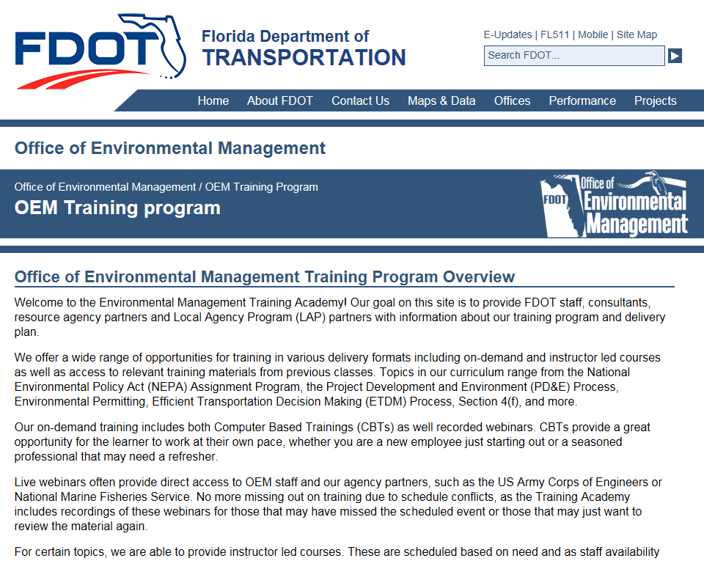
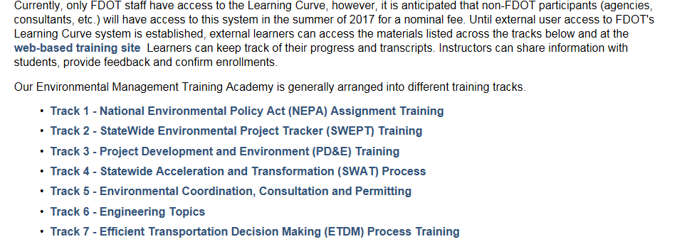

SWEPT Videos
http://www.fdot.gov/environment/sched/train1.shtm
Notes:
SWEPT Videos are available on the OEM Website.

Slide 30
SWEPT Contacts
Office of Environmental Management
Pete McGilvray
Peter.McGilvray@dot.state.fl.us
(850) 414-5330
Ruth Roaza
Ruth.Roaza@dot.state.fl.us
(850) 414-5620
SWEPT Help Desk
swept@fla-etat.org
(850) 414-5334

