Slide 1
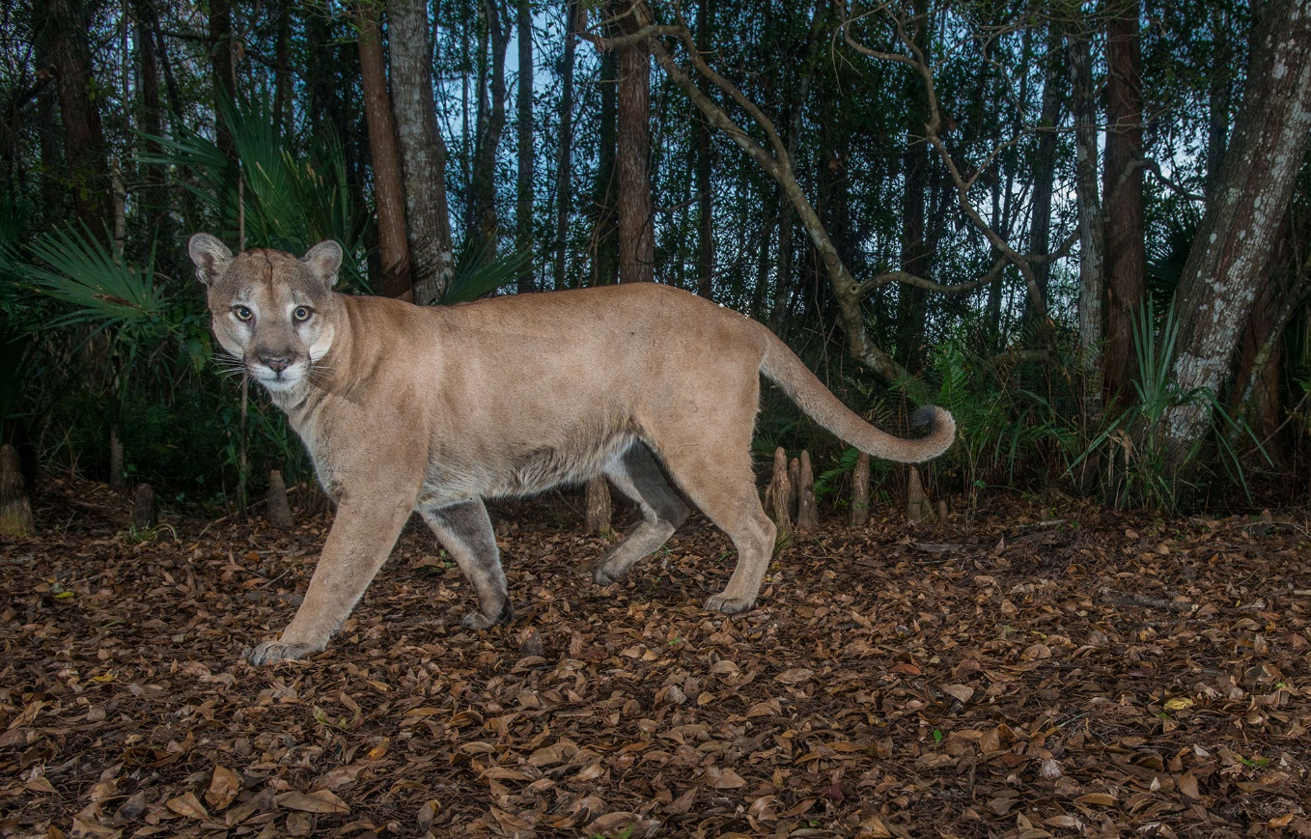


Florida Panthers
A Better Understanding
Photo: Carlton Ward Jr.
Ashlee O’Connor
Panther Outreach Specialist
Florida Fish & Wildlife Conservation Commission
Ashlee.Oconnor@myfwc.com
Notes:
Hello Everyone!
Welcome to “Florida Panthers: A Better Understanding”.
My name is Ashlee O’Connor and I am the Panther Outreach Specialist for the Florida Fish & Wildlife Conservation Commission.
I am going to guide you through a brief presentation about Florida panthers. If you have unanswered questions or need further assistance please feel free to contact me via the email address listed on this slide.
Also, Please know that within the allotted time we have, I am unable to completely cover all aspects of the Florida panther.

Slide 2

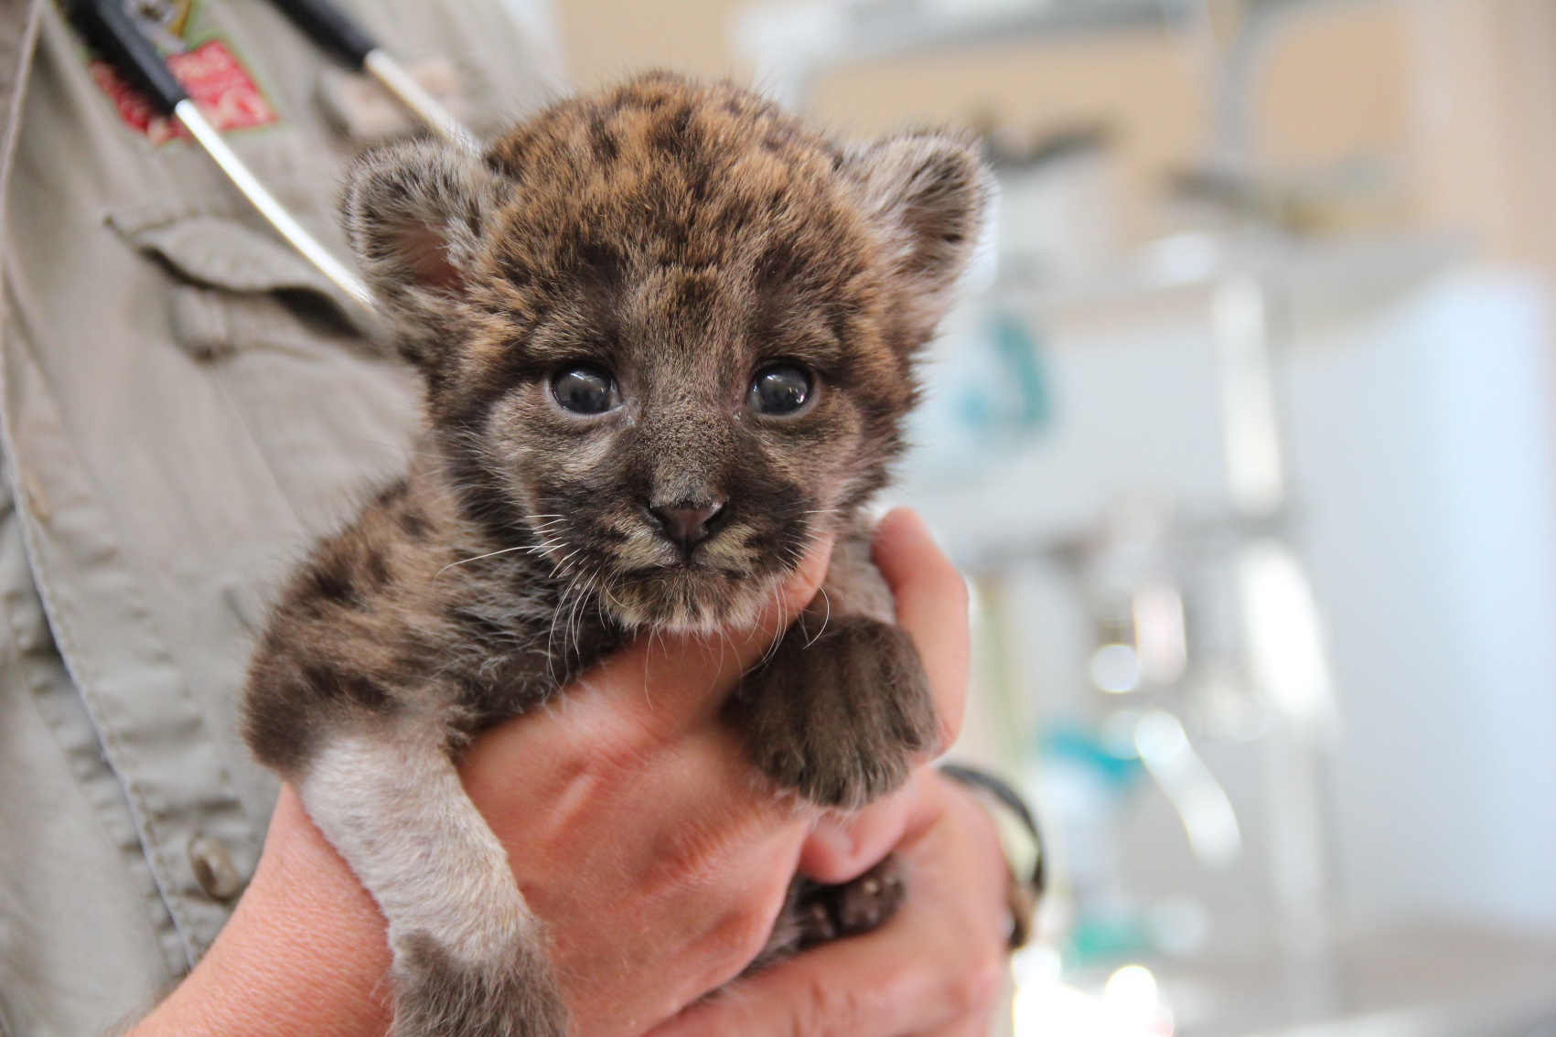
Outline
Biology & Ecology
Former & Current Range
Impacts to the Population
Panthers & Roadways
Learning Panther Sign
How to Avoid an Interaction
What to do if you Encounter a Panther
Notes:
Here we have an outline of the topics I will discuss today.

Slide 3
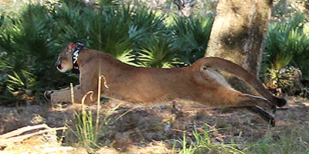
What is a Florida Panther?
Currently,
Puma concolor coryi
Large Feline
Hypercarnivore eats more than 70 % meat
Cougar, Mountain lion, Puma, Catamount, Painter, Ghost Cat…
Notes:
The panther in the Family Felidae. It is Currently classified as a subspecies of Puma concolor; that is Puma concolor coryi.
Previously the Genus was Felis instead of Puma. science is evolving as technologies increase and influence our understanding of the natural world.
Pumas are relatively large cats, documented at 60-160 lbs in Florida. These cats are not technically one of the “Big 4”, which include Lions, Tigers, Jaguars and Leopards. These 4 cats can roar, but pumas cannot.
Pumas go by many names; here is FL we call it panther. Oregon says Cougar, California Mountain Lion, Pennsylvania Nitny Lion and so on
Pumas are like the reclusive neighbor; often discussed, but seldom seen.

Slide 4
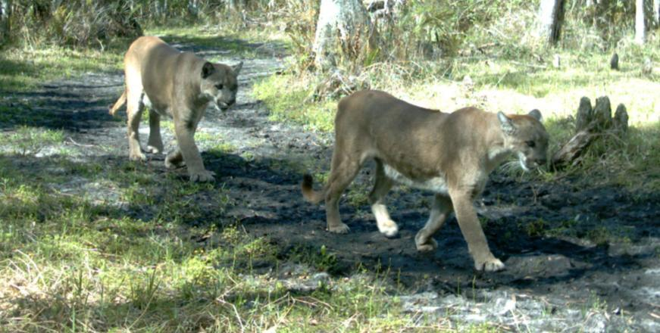
Biology
Can breed all year
Estrous is 7 days
Frequent copulation
Separate after 7 days
Male will have no further part in the raising of young.
Notes:
Panthers can breed any month of the year and therefore produce offspring in any month.
The male and female have found each other through the scent of hormones in the female’s urine. This signals she is in estrous. This is her receptive time when she can get pregnant.
During the next 7-10 days, the pair will copulate frequently before going their separate ways. The male will have no further role in the raising of the offspring.

Slide 5
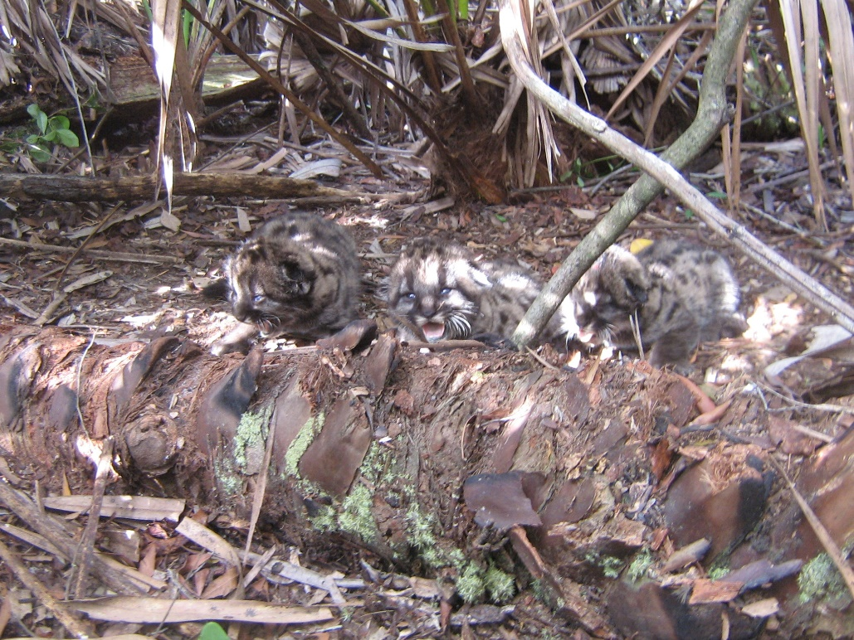
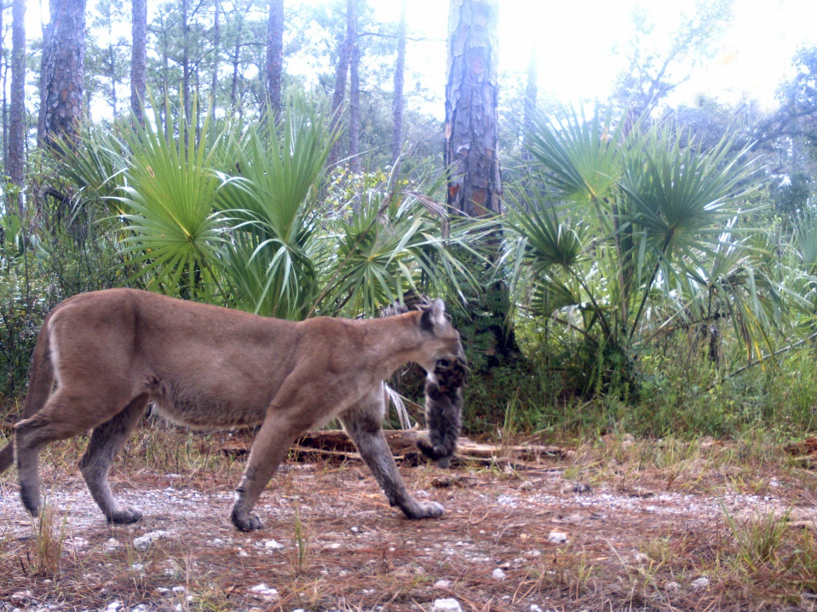
Biology
Gestation last ~ 3 months
Kittens birthed in a den
1-4 kittens born, typically 2-3
Born eye closed & ears folded down
Notes:
The female will now gestate for approximately 3 months. When it is time to deliver the cubs/kittens she will bed down in a saw palmetto thicket or other densely vegetated location.
She will usually give birth to 2 or 3 kittens. These kitten weight about 1 pound at birth and have their eyes closed and ears folded down.

Slide 6
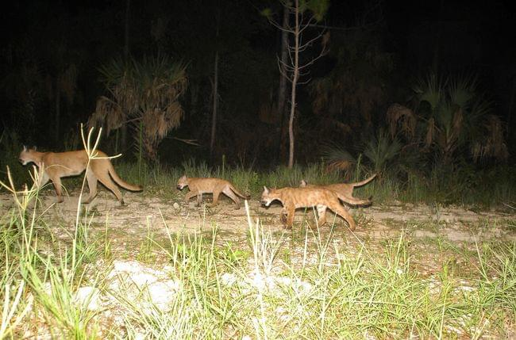
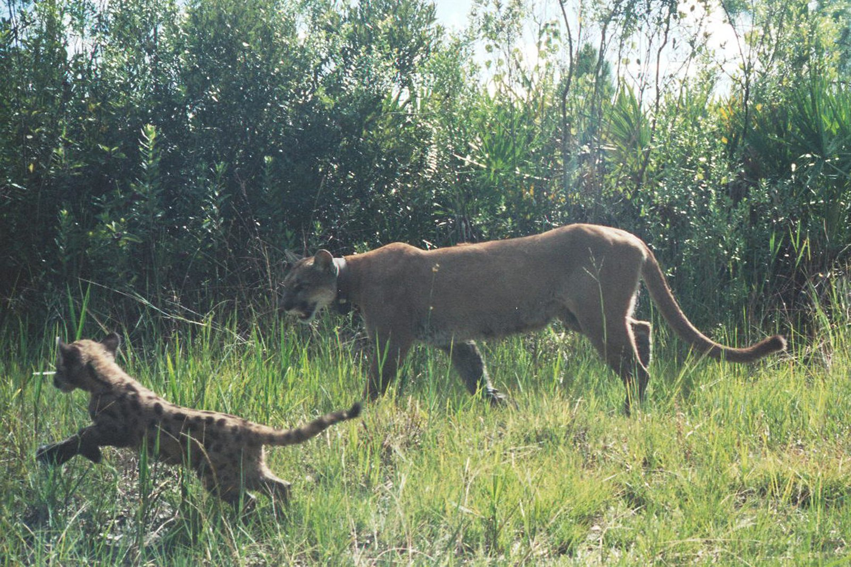
Biology
Long upbringing
Diet: Milk, then meat
Offspring disperse
Female can reproduce again
Notes:
The mother will spend the next 9-18 months raising her offspring. The kittens will have only their mother’s milk for the first couple months, they will then be transitioned to small scrapes of meat. Playing with the carcass that mom brings them to after she makes a kill.
The kittens gradually learn to hunt small prey, then moving on to larger prey like deer and hogs.
At around a year, give or take, the offspring will disperse from their mother, entering a life of general solitude.
The exodus of her offspring allows the female panther to return to a reproductive state, starting the cycle once again.

Slide 7
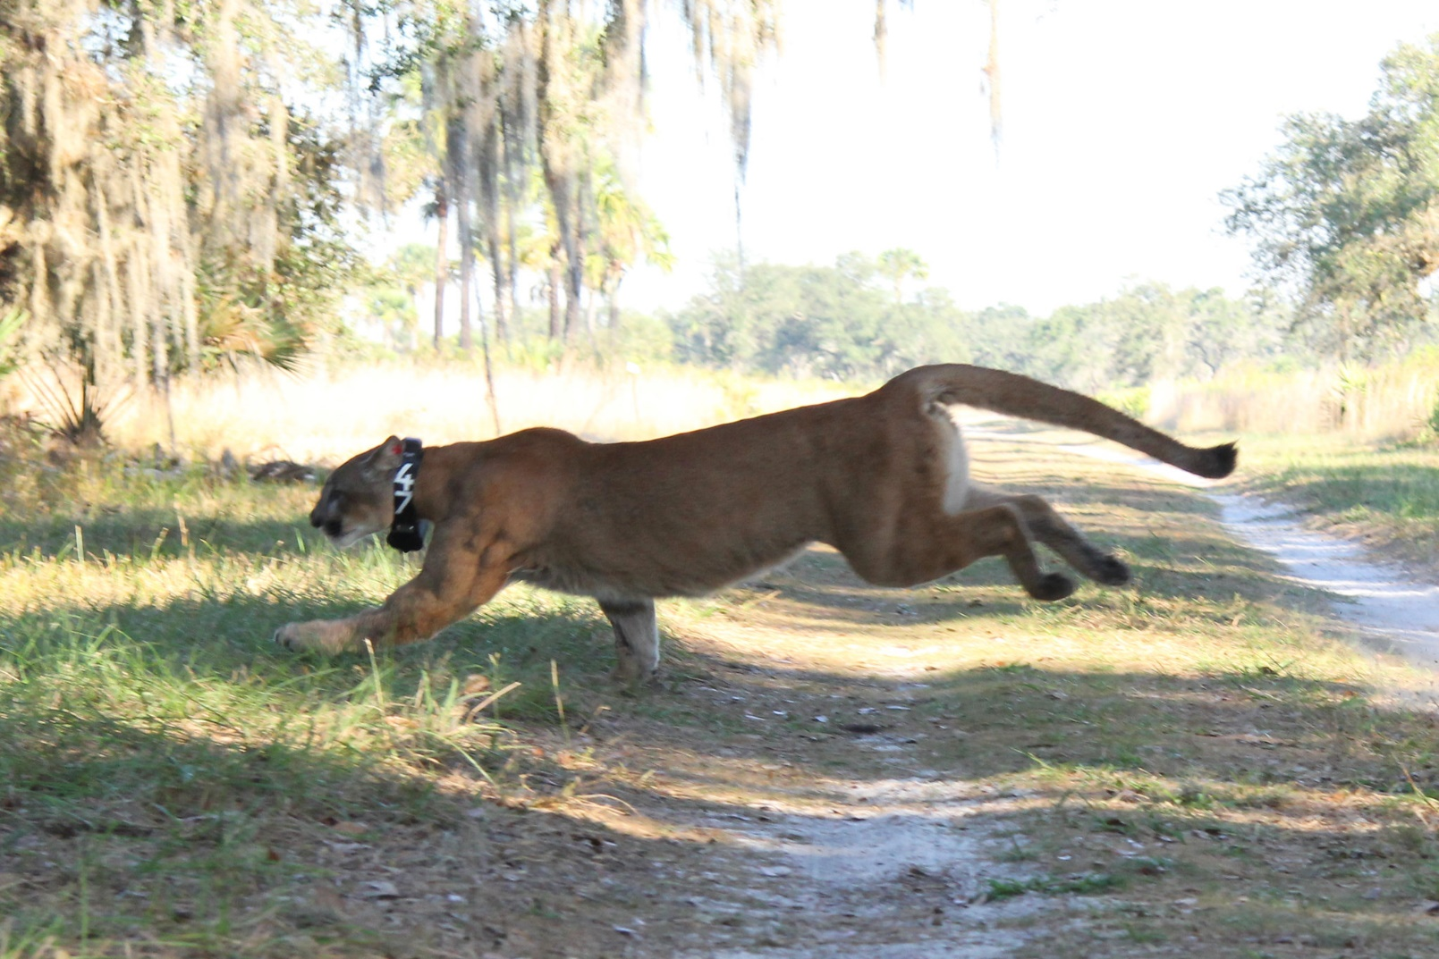
Natural Life Expectancy
Males ~10 years Females ~ 15 years
Notes:
Panthers can live 20 years or more in the wild. However the average lifespan for a male is 10 years and a female 15.
The oldest documented panther in the wild was a 19 year old female!
Reasons they may not make it that long include: being hit by a vehicle, panther on panther fighting (intraspecific aggression), kitten mortality (nutrition, disease, survival is ~30%, Lack of data here ), and a variety of other diseases and illnesses.
When the population was at its lowest in the 70s, 80s and 90s the animals experienced inbreeding depression which shortened their lifespan, amongst other issues.

Slide 8
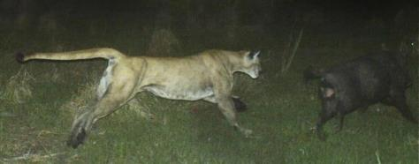
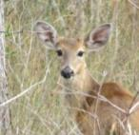
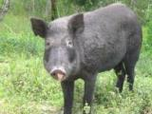

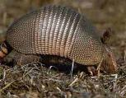
Food
Panthers are carnivores
Deer and hogs make up the majority of their diet
Panthers have also been documented eating a variety of domestic animals:
Will feast on armadillos, raccoons and other small mammals.
Goats
Sheep
Pigs
Donkeys
Calves
Foals
Chickens
Turkeys
Emus
Swans
Dogs
Cats
Alpaca
And even wallabies!
Notes:
Panthers are carnivores, which means they are hunting other animals for food.
Deer and hogs are at the top of the menu, but they will also consume a variety of other small mammals.
Unfortunately, animals we bring into our lives like pets and livestock have found themselves on the menu as well.
I have highlighted donkeys and alpacas. These livestock animals have been used as livestock guardians, but being on this list means they are not effective guardians against pumas.

Slide 9
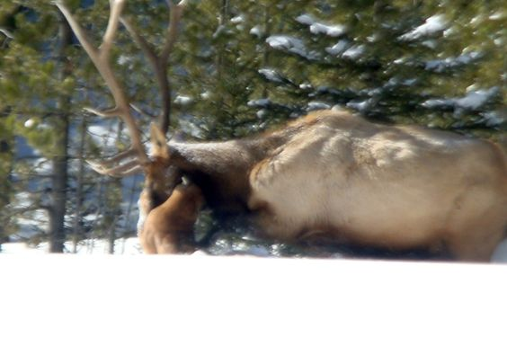
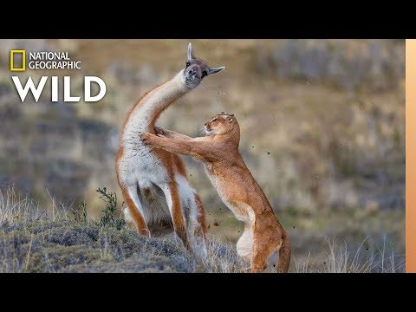
Notes:
As you can see in these images, pumas can take down large animals they can even kill bull elk.
Their main food source in parts of South America is the Guanaco, which is related to the llama & alpaca.
FWC has also documented panthers killing donkeys, so these animals aren't sufficient guardians of livestock, they can even be prey.

Slide 10
Physique
Adults: 60-160 lbs.
2 ft
7-8 ft
Notes:
Panthers in Florida have been documented at 60-160 lbs. Males are larger than females, with Males averaging 130 lbs and females averaging 80 lbs.
The animal is approximately 7-8 feet in length from the tip of the nose to the tip of the tail.
Tale of the panther can touch the ground! This is an important identifier.

Slide 11
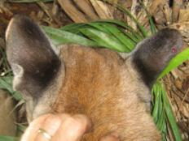
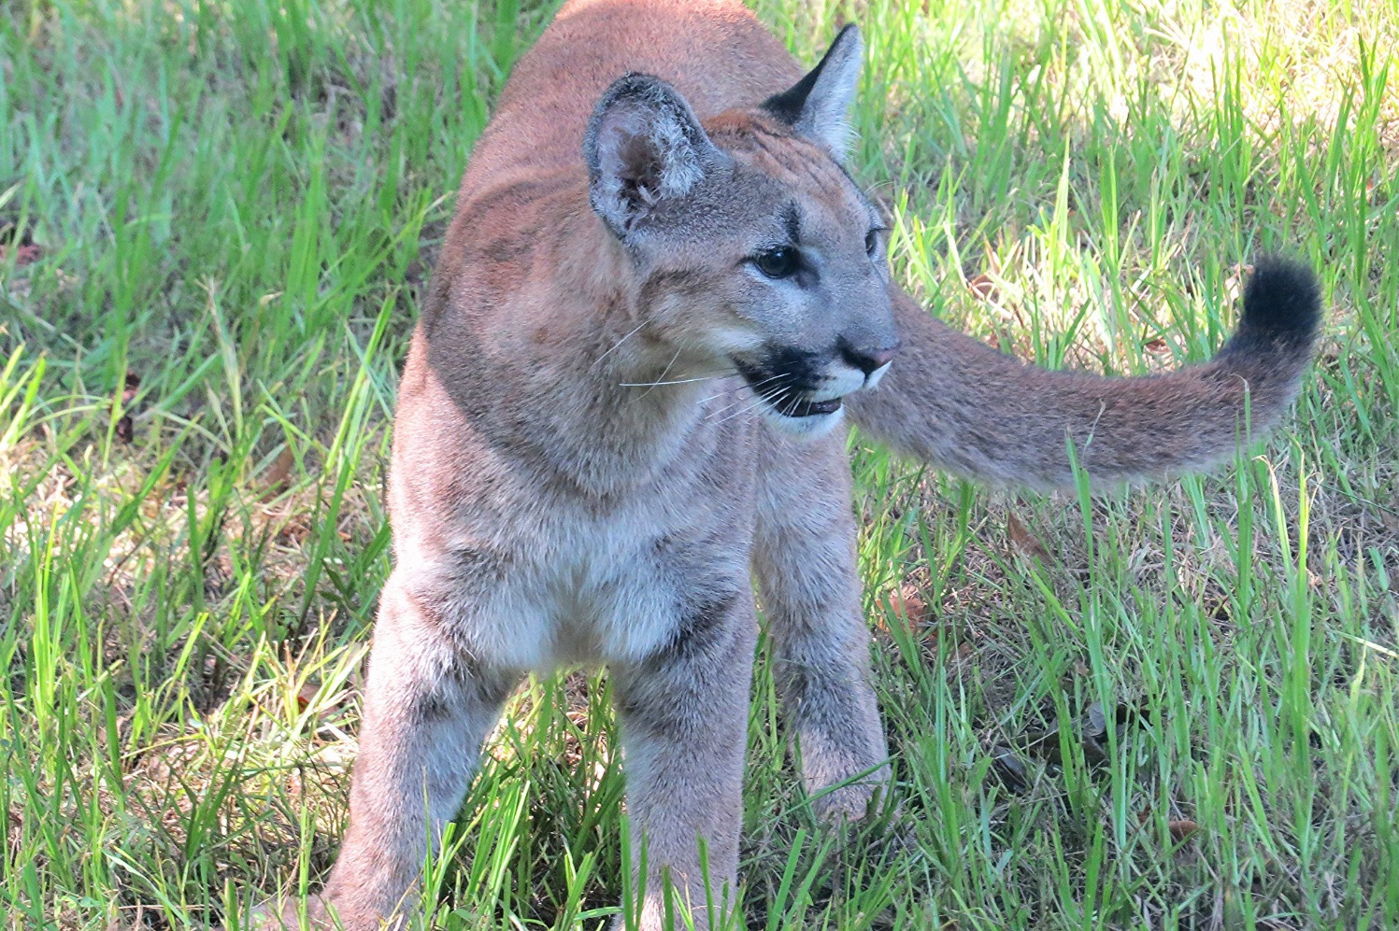

Coloration
Tan fur (reddish to golden)
Black: back of ears, tip of the tail, face
Back of ears
Notes:
This animal is tan, always.
Though it is tan, you can find a bit of black around the back of the ears, mouth and the tip of the tail.
The underbelly is white in coloration.
You have already seen 11 slides with panther pictures, but I doubt these small areas of black were noticeable in the photos.

Slide 12

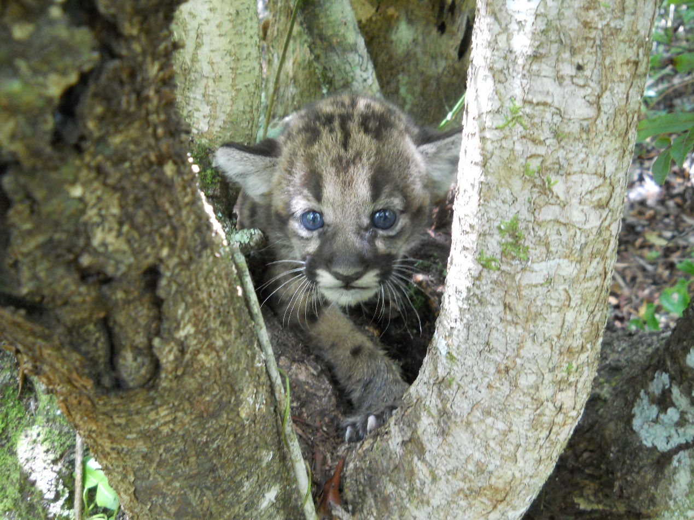
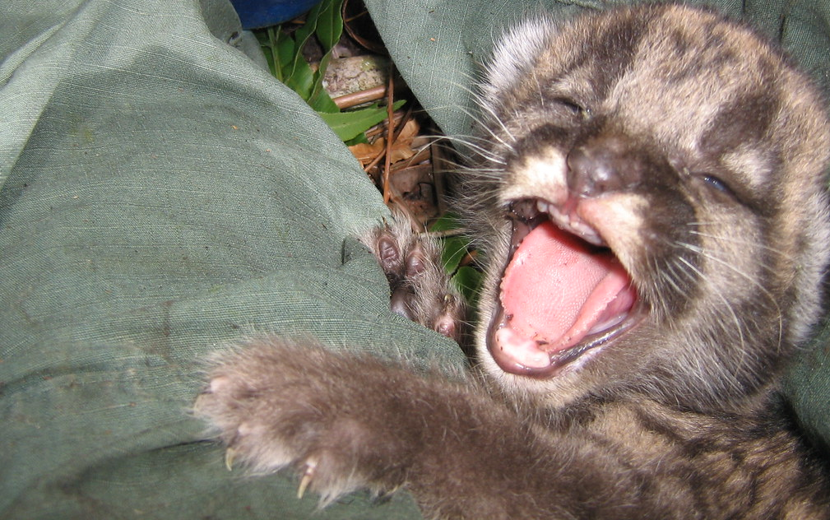
Coloration Continued
Kittens: spotted with blue eyes
Notes:
As infants, panthers are tan with dark spots.
The coloration of the kittens helps to camouflage them on the forest floor.
The spots and blue eyes fade as they grow.

Slide 13
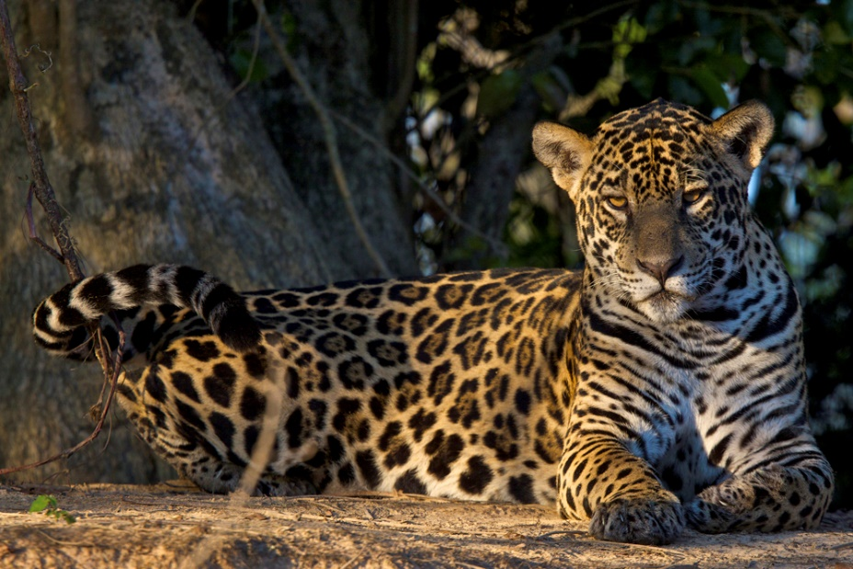
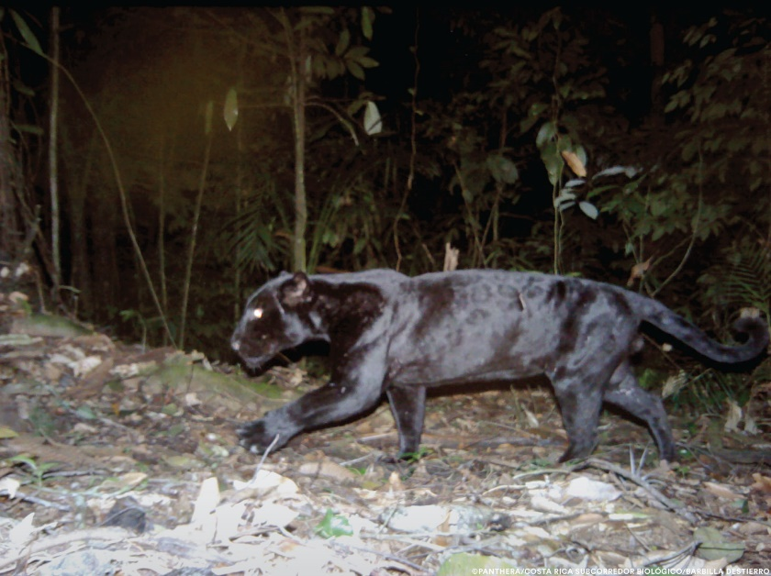
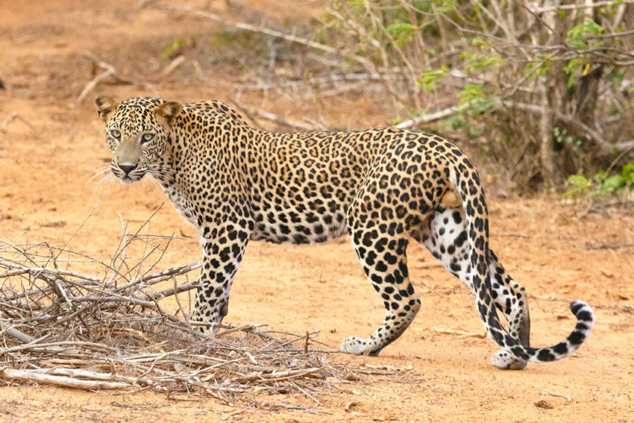
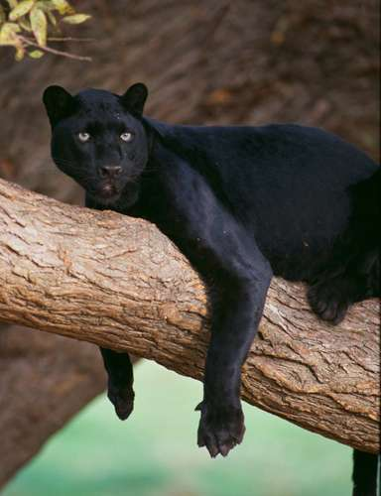
Mistaken Identities
Jaguar & Melanistic Jaguar
Leopard & Melanistic Leopard
Notes:
Like we have discussed, the coloration of Pumas is tan or tawny.
There has never been a documented Puma in the entire range, from Canada to southern Argentina, that had a black or melanistic coat.
The term “panther” does not describe any one cat. It is a word used around the world to describe different cats.
If you were in the Americas the term “black panther” would be referring to a black or melanistic jaguar. Seen at the top right…..and it its more common coat coloration at the top left.
If you were in Asia or Africa then the term “black panther” would be referring to a black or melanistic leopard, seen on the bottom right…and with its common coat coloration on the bottom left.

Slide 14

Mistaken Identity
(not a Florida panther)
Notes:
Not to be confused! King T’challa was a melanistic African leopard.

Slide 15
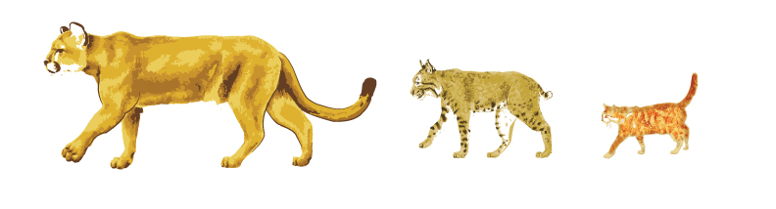
Notes:
This is a helpful image comparing native and domestic cats in Florida.
At the left we have a panther, in the middle a bobcat and on the right a domestic cat.
Note how the cats carry their tails, domestic cats often have their tail up which is not something panthers do.

Slide 16
Notes:
Here we have a great comparison of our native wild cats.
Note the yellow and orange silhouettes comparing the size of the two cats.
Also note the length of the tail. The bobcat’s tail may seem “long” but it will never touch the ground. The panther tail can touch the ground.

Slide 17
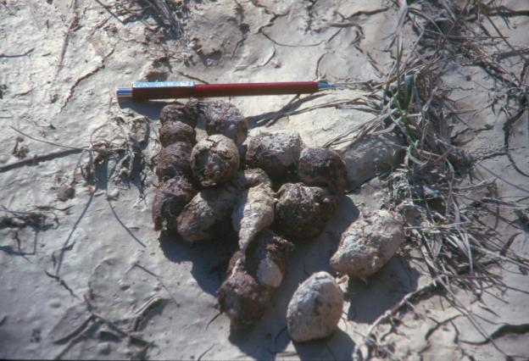
Panther Sign: Scat
1 ½ to 1 ¾ inches in diameter
Segmented
6-9 inches long
Large bone fragments
Notes:
Here we have panther scat: large, segmented and with bone fragments about the size of your thumb nails.

Slide 18
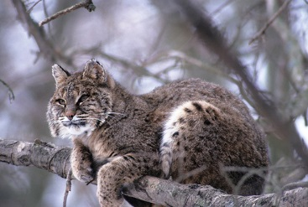
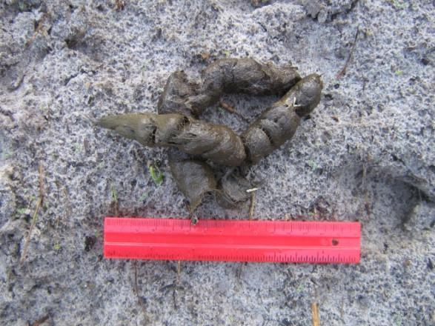
Most commonly confused with…..
Bobcat
1 inch diameter
Segmented
5-6 inches long
Small bone fragments
Notes:
It is most commonly confused with bobcat scat.
It is smaller in comparison, segmented and with bones about the size of your pinky nail.
It is important to take a photo next to a reference items; like a ruler, pocketknife, glasses….

Slide 19
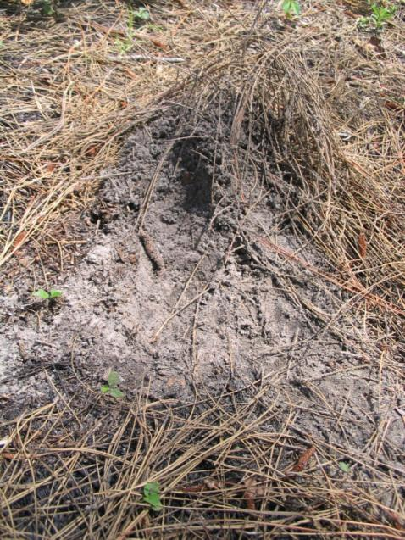
Panther Sign: Scrapes
Heaping leaf litter with back feet
Marks with
  Urine
  Scat
Why?
  Mating
  Territory
Notes:
Another sign left by panthers is a scrape.
So this is where a cat pushes up A heap of litter and debris by the back paws.
Th cat then urinates on top of the pile and will sometimes defecate on it.
Panthers do not cover their excrement. The scrape is left as a signal and covering it would defeat the purpose.
It is used to mark territory and to signal estrous.

Slide 20
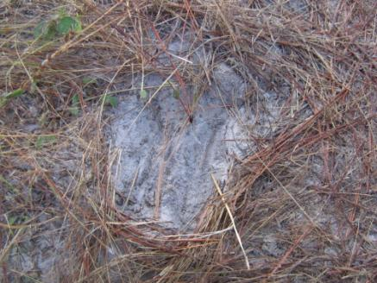
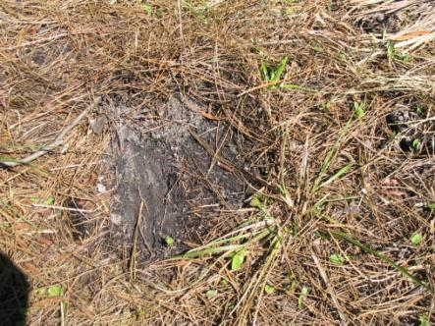
Bobcats & Panthers scrape
Smaller feet and toes = narrower scrape
Bobcat
Panther
Notes:
Bobcats and panthers both make scrapes.
You can see from these two photos that without a size reference it is almost impossible to know with a high level of certainty the animal that made the mark.

Slide 21
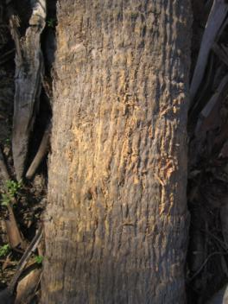
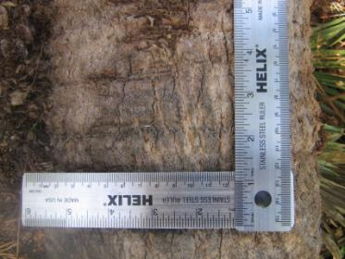
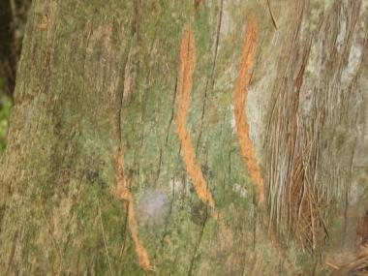
Panther Sign: Scratches
Panther
Sharpen claws
Prefer fallen cabbage palms
What other animals might claw trees?
Bobcat
Bear
Notes:
When you are out in the woods you’ll run scratch marks. Several animals leave scratch marks behind.
Bears have blunt claws and therefore leave behind larger, wider markings.
Panther and bobcats both scratch, but again the size difference will be the determining factor.

Slide 22
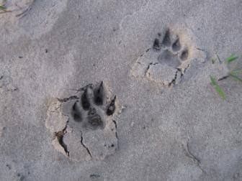
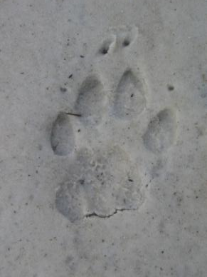
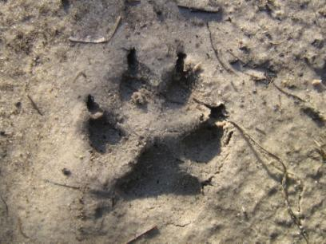
Panther Sign: Tracks
Panther
Panther
Dog
Notes:
Generally speaking; panther tracks do not show claw marks but that is not an absolute rule. As you can see with the photos above. Sometimes claw marks are noticeable in soft, deep substrate or if panther is running.
Panther claws are thin and sharp. Dog claws are blunt and wide.
Because panther paws are shaped differently than dog paws it’s still possible to differentiate between the two, even if there are claw marks present.

Slide 23
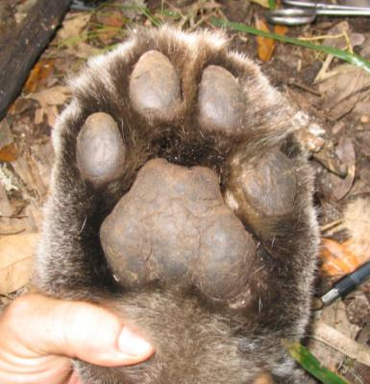
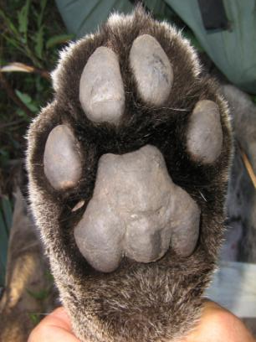
Panther Sign: Tracks
Front Foot
Wide pad
Round
Back Foot
Narrow pad
Oval
Notes:
The front and rear paws of the panther have different shapes to them.
The front being wide and circular, while the rear is narrower and oval.

Slide 24
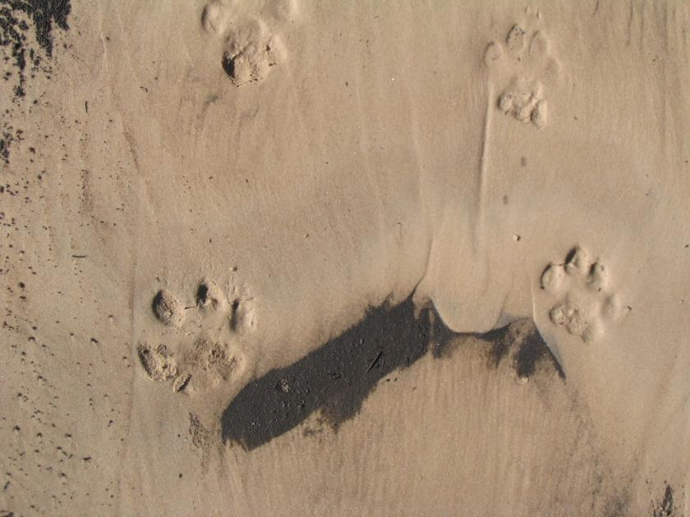
Identify the Sex
Male > 2”
Female < 2”
1 ¾”
2”
♀
♂
Notes:
You can determine the sex of the animal by measuring the width of the foot pad. It is less than 2” it is a female, if it is more than 2” it is a male.

Slide 25
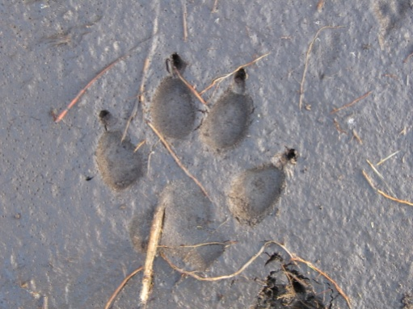
Other Sign: Dog
Pad more triangular (not 3-lobed)
Toes splayed outward from pad parallel with each other
Blunt claws present
X factor
Notes:
Identifying other common tracks will help you accurately identify animals in the area.
Panther tracks are most confused with domestic dog tracks.

Slide 26
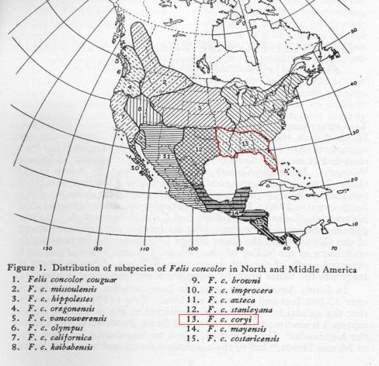
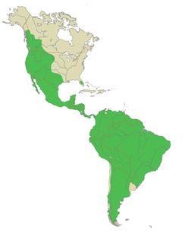
Pumas are an American cat
Historic Distribution N & C America
Current Puma distribution range wide
____EXTINCT____
Notes:
Now we are going to switch gears and discuss some history and management.
Historically, pumas ranged from Canada all the way to the southern tip of South America.
You can see the subspecies designations on the left, the panther highlighted in yellow.
On the right is the current range of pumas. Note the tiny green dot representing our panthers in Florida.
The massive separation between pumas in the west and pumas in FL is an important factor in their management and recovery.

Slide 27
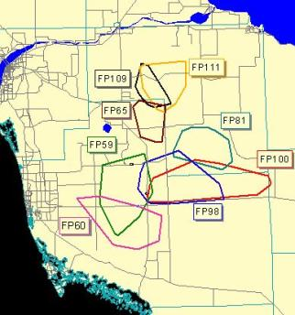
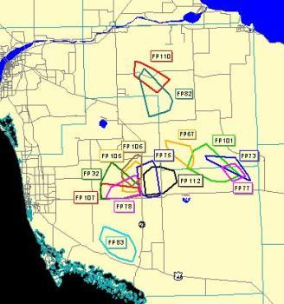
Home Range
Males: 200 sq mi
Females: 80 sq mi
♂
♀
Notes:
Panthers require a massive home range to fulfill their needs.
Males need around 200 sq miles and females around 80 sq miles.
The male home ranges can and do overlap, as you can see on the map on the left.
It is much more common for the female ranges to overlap, that can often be multigenerational overlap.
You can see GPS data from radio-collard cats on this slide.

Slide 28
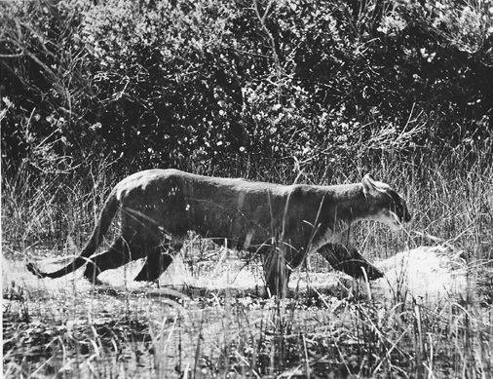
ENDANGERED
1950: Declared a game species
1958: Listed as endangered by FL
1967: Listed as endangered by U.S.
1973: Protection under ESA
Notes:
Panthers had no protection, whatsoever, until 1950. That year a small step towards conservation was made by declaring them as a game species. This meant setting a limit and a season.
The protections continued to increase until the Endagered Species Act passed in 1973.

Slide 29
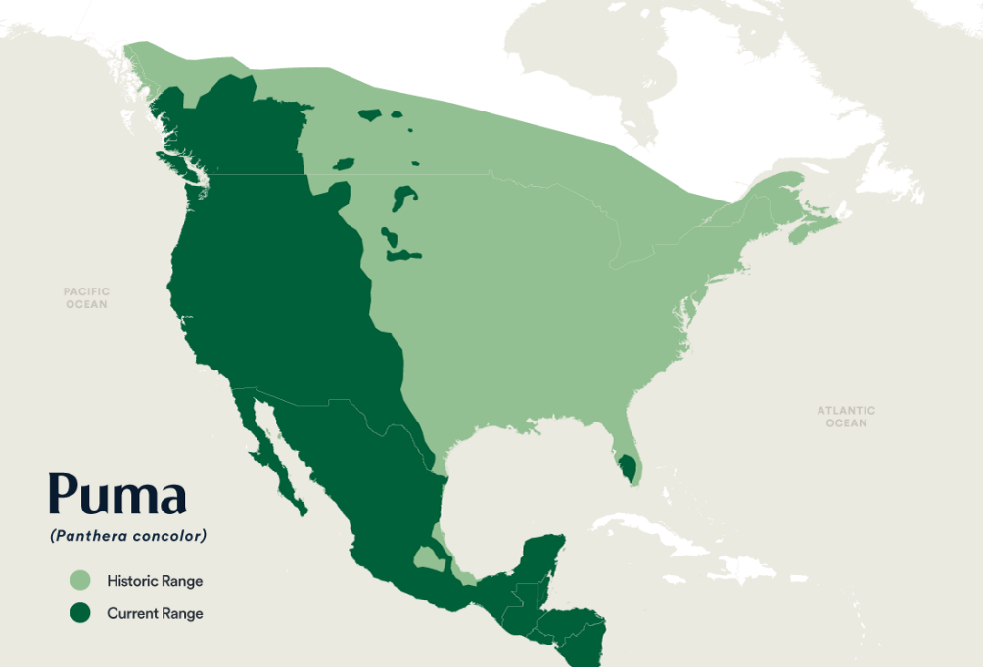
Current Status
Status: Federally endangered
Geographically isolated
Current Population in Florida: 120-230 adults and sub-adults, as of the 2015 population assessment.
Panthera
Notes:
These cats are currently federally endangered in Florida.
They are geographically isolated as you can see in the maps here.
As of 2015, the population estimation was 120-230 adults and sub-adults.

Slide 30
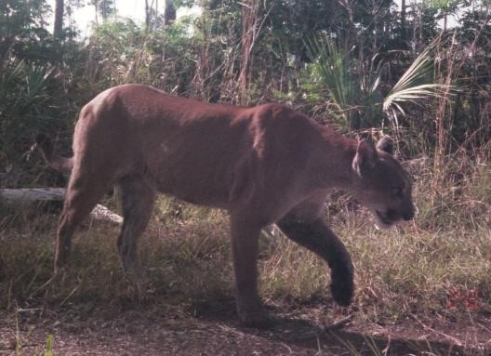
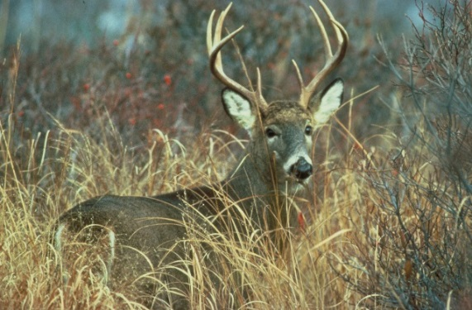
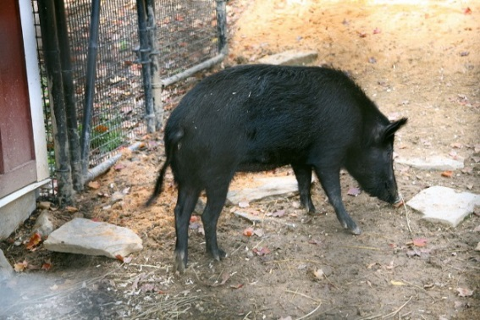
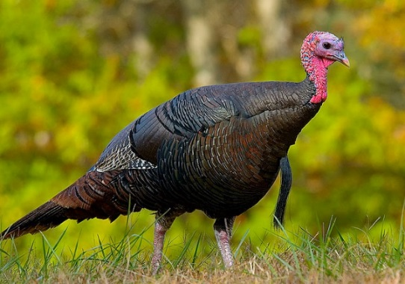




Ecology
Apex Predator
Keystone
Species
Notes:
What role does the panther play in the ecosystem?
They are an apex predator. As Adults, they are at the top of the food chain.
They are also considered a Keystone Species. This means they play a crucial role the ecosystem and if they were to be removed the ecosystem would degrade and suffer.

Slide 31







Umbrella Species
Notes:
Panthers are also an umbrella species.
When you protect Florida panthers, you protect all the other plants and animals in the ecosystem.
You are also protecting land for future generations.
Protecting large tracts of contiguous land also help humans by cleaning the air and recharging the aquifer.

Slide 32




What’s impacting the panther?
Habitat loss
Illegal killing
Inbreeding
Vehicles
Introduced diseases (FeLV)
FLM
  (Feline leucomylopathy)
Notes:
The number one impact that panthers are affected by is habitat loss and fragmentation.
They also experience many other challenges in addition to living the life of a wild predator.
Illegal Killing, Inbreeding (because of their geographic isolation), vehicle strikes, introduced diseases from pets and a new disease, FLM, that we are still trying to gain an understanding of.

Slide 33

Habitat Loss & Fragmentation
Notes:
Habitat Loss & Fragmentation is the #1 issue that threatens the present and future of panthers and other wildlife.
You can see from this photo by Carlton Ward during for the FL Wildlife Corridor that humans continue to encroach on once wild places.
This thin green corridor is all that is left and on top of that it is bisected by a major road.
How do you think we help wildlife in a situation like this?

Slide 34


Roadways
Notes:
Roadways are a major concern for panther recovery.
As development continues and the population in florida grows, more cars are on the road.
Continued development = habitat loss & fragmentation
Large home ranges = more road crossing
Female with Kittens = more loss
Roadways are a huge challenge for all wildlife.

Slide 35



Recovery Efforts
Genetic restoration
Habitat preservation
  Mitigation during development
  Conservation Easements
  Publicly held lands
Underpasses with fencing
Notes:
How do you think we help wildlife in a situation like this?
The Florida Fish & Wildlife Conservation Commission along with many other organizations have taken a variety steps towards helping this population of wild cats.
In 1995 FWC released 8 female panthers from Texas to reinvigorate the genetics of our isolated population. This is what has brought these cats out of a downward spiral.
Many different habitat preservation projects and events contribute to the protection of wild spaces for panthers and other wildlife.
A major impact to protecting the population has been the installation of wildlife crossing & underpasses.

Slide 36

Wildlife Crossings
Notes:
Wildlife crossings decrease road mortality for animals that are dispersing or traversing their home ranges.
The first wildlife crossings in FL were installed in Collier County when Alligator Ally became Interstate 75.
Wildlife crossing are mostly underpasses in FL and are most effective when coupled with fencing. The fencing funnels the animals to the underpass for a safe crossing.
24 wildlife crossings as well as 12 other bridges modified for panther use were installed in the 1990s on a 40-mile stretch of I-75.

Slide 37

Wildlife Crossings Contd.
Notes:
Many crossing on Interstate 75 are quite large (8 ft tall by 120 ft wide) like the photo on the left.
It was originally assumed that panthers would be weary of entering a small tunnel-like structure.
We are learning, mostly through remote camera sensing, that panthers will use much smaller underpasses that were not specifically designed with them, like the photo on the right ( a structure that is 5 ft tall by 10 ft wide)

Slide 38



Wildlife Crossings Contd.
FGCU Panther Posse
Notes:
The female with two kittens in this photo is heading towards an underpass on Immokalee Road in Naples. The underpass is quite small when compared to the ones along I-75, but serves the purpose.

Slide 39




Florida Panther Response Plan
An interagency plan for dealing with human-panther interactions and conflicts to promote public safety while assuring the conservation of the panther.
Notes:
The FWC and other partner agencies have come together to create a plan for how to respond to human-panther interactions.

Slide 40


Florida Panther Response Plan
Human-Panther Interactions
  Sightings
  Encounter
  Incident
  Threat
  Attack
Depredations
Outreach
Notes:
The Response Plan has 3 parts: Human-Panther Interactions, Depredations & Outreach.
The first section defines the 5 ways a human can interact with a panther.
The second section dives into depredations: where a panther kills a pet or livestock animal.
And the last one details the vital aspects of community outreach.

Slide 41








Is it always a panther?
Dog / coyote
Bear
Bobcat
Raccoon
Opossum
Hawks
Owls
Don’t forget that we have several other predators with an influx of nonnative predators arriving often.
Notes:
With regards to depredations, is it always a panther? NO
There are so many predators living on this landscape that kill pets and livestock.
Luckily, they all kill in their own way and that allows our biologists to determine the culprit.

Slide 42



Ways to Minimize Interactions
1. Be alert from dusk ’til dawn
2. Keep panther prey away
3. Keep pets and domestic livestock secure
4. Landscape for safety
5. Consider other deterrents
6. Hike or bike with a friend
Notes:
This slide and the next are very important, so pay attention!!
This is a short list of ways we, as humans, can exist in a world with animals that can pose a threat to us.

Slide 43


What if you encounter a panther?
Keep children and pets within sight and close to you
Do Not Turn Your Back to the animal
Give them space
DO NOT RUN
Avoid crouching or bending
Appear larger
Fight back if attacked

Slide 44



Safety for People and Panthers
Observe posted limits
Spend an extra minute
Be aware when driving

Slide 45

MyFWC.com/panther
Submit photos of Panther Tracks and Panthers:
MyFWC.com/PantherSightings
Report Wildlife Incidents to:
(888) 404-FWCC (3922) or Tip@MyFWC.com
Support panther conservation?
Purchase the panther plate or donate to the
Florida Panther Research and Management Trust Fund through the Fish and Wildlife Foundation of Florida

Slide 46
FWC Panther Contact Information
FWC Naples Field Office (Location of all Panther Staff)
  298 Sabal Palm Road
  Naples, FL 34114
  Mark Lotz, Panther Biologist
    (239) 417-6352
    Mark.Lotz@myfwc.com

Slide 47

Thank You

