Slide 1
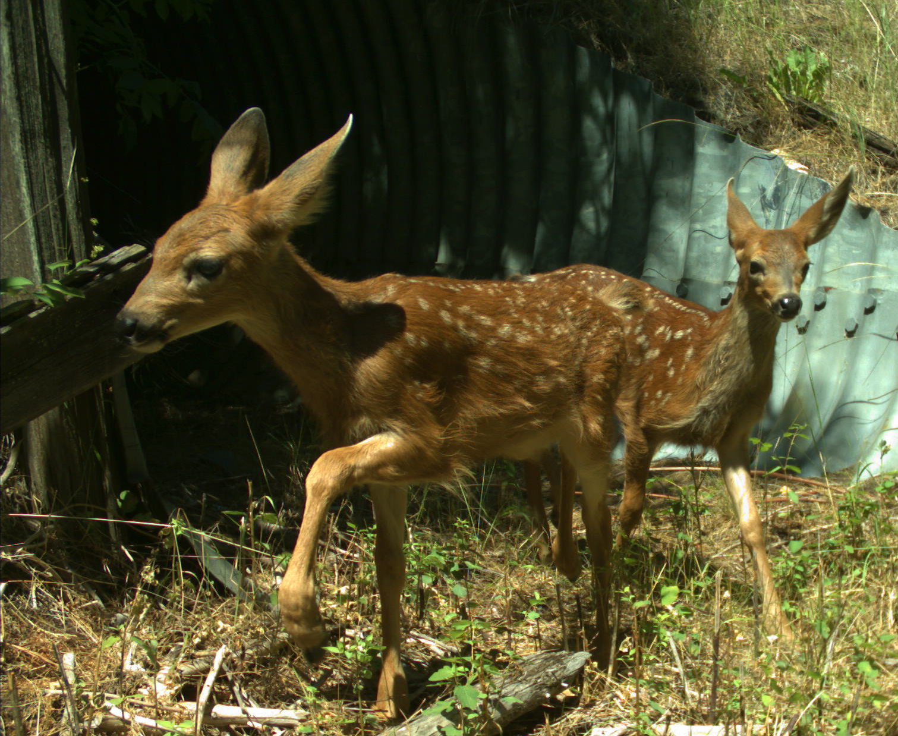
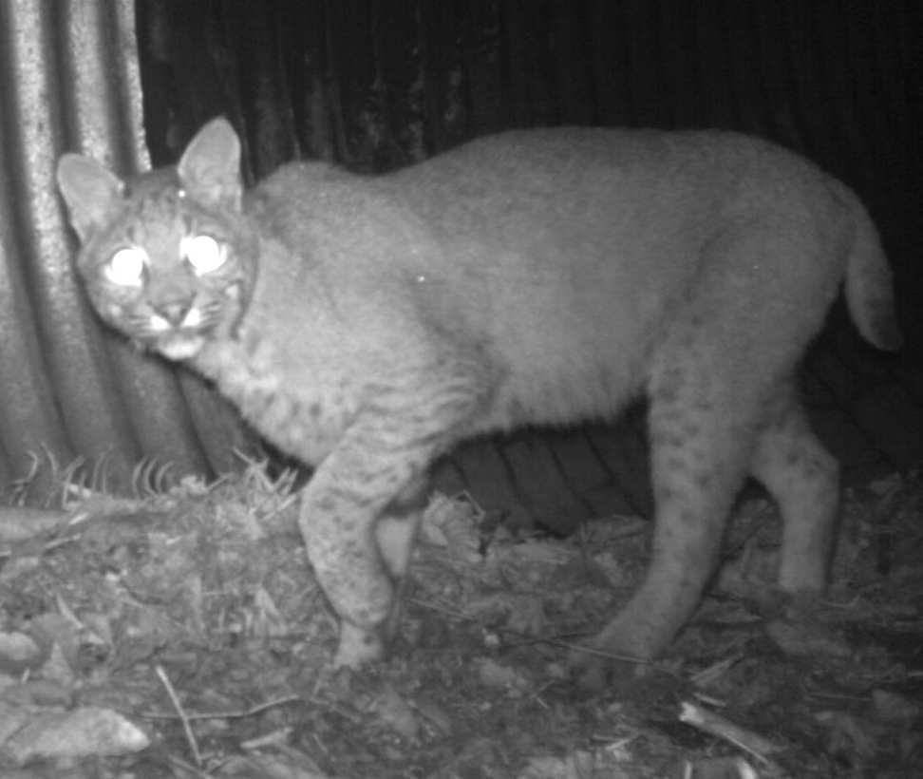


Wildlife Crossings and Passage Structures
February 2020
Sean Greene, Land Use Planning Program
Office of Conservation Planning Services

Slide 2
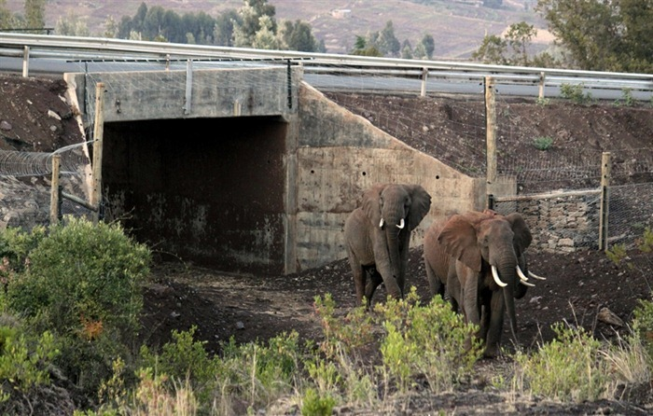
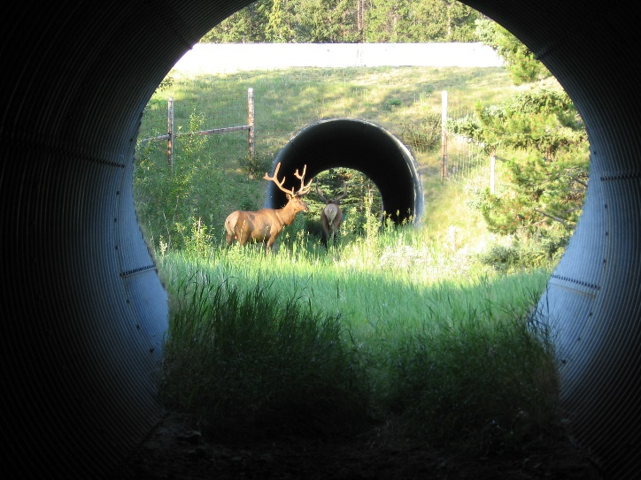
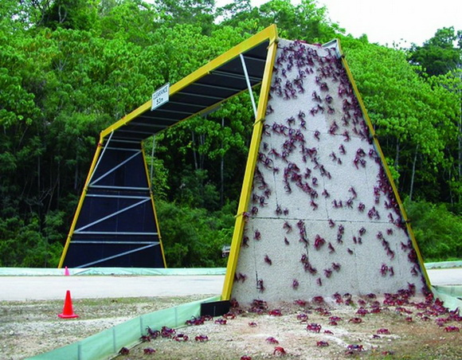
Wildlife Passage Structures
Three primary types:
  Bridge underpasses
  Culverts
  Bridge overpasses
Many originally designed to pass water beneath road infrastructure
Fencing must be used to direct wildlife to passage structures
Tend to focus on large mammalian species
amusingplanet.com
humansandnature.org
arc-solutions.org

Slide 3
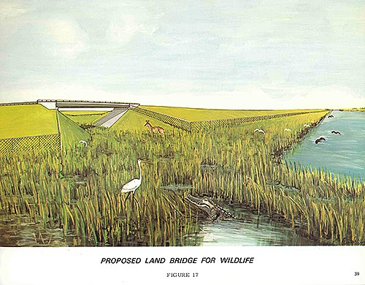
Wildlife Crossings in Florida
Range in size from 12 inch culvert pipes to the bridge underpasses on I-75 that measure 8 feet high and 120 feet wide
First wildlife crossings were included during the planning for the conversion of Alligator Alley to I-75 in 1972
Hundreds of wildlife crossings in Florida today
FDOT, FWC, and USFWS consider the need for wildlife crossings in all new road construction and expansion

Slide 4
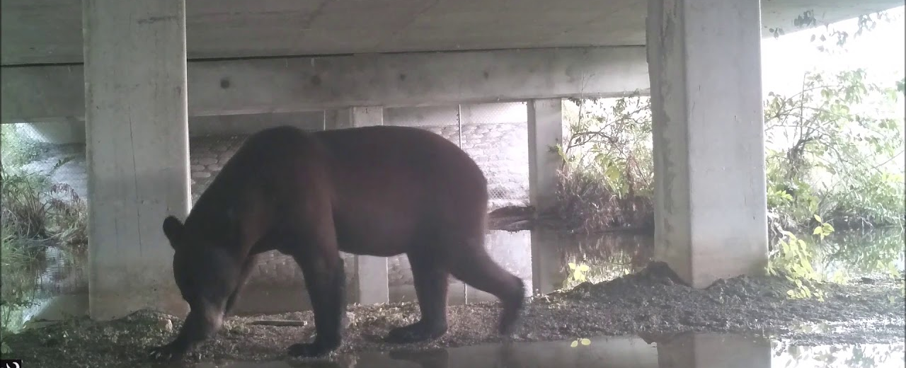
FDOT Wildlife Crossing Guidelines
Guidelines “evaluate the appropriateness of including wildlife crossings…for proposed projects”
Consultation during the ETDM and PD&E
Define situations when a crossing may be
needed and identify the goals and
limitations of crossings
Regularly updated and have been valuable in codifying the cooperation between FDOT, FWC/USFWS, and local stakeholders
Naples Daily News

Slide 5
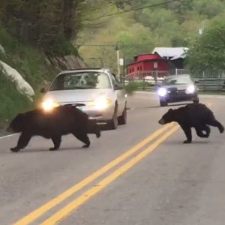
Wildlife Vehicle Collisions (WVCs)
Reduce Wildlife Vehicle Collisions (WVCs)
  2.6 million WVCs per year in US
  59,000 human injuries
  440 human deaths
  $21.8 billion in damages
  4-10% increase per year
Florida Black Bears
  WVCs account for over 90% of bear deaths in FL
  WVCs with bears have increased steadily since 1981
    Over 50% increase in last 10 years
K. Gunson, G. Mountrakis, L. Quackenbush (2011)
Florida black bears can weigh up to 760 pounds.

Slide 6
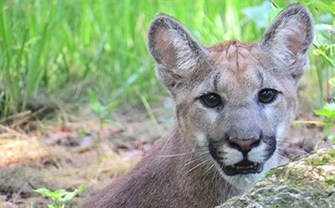
Florida Panther
1981-1999: 1.5 mortalities per year
2000-2017: 15+ mortalities per year
59% of panther deaths are due to WVC
66% less than 3 years old
Early measures:
  Lower speed limits at night
  Widening road shoulders
  Reflectors
  Rumble strips
  Public information
Most effective (and most expensive) measure remains wildlife crossings
Early measures reduce WVCs, wildlife crossings can eliminate them

Slide 7
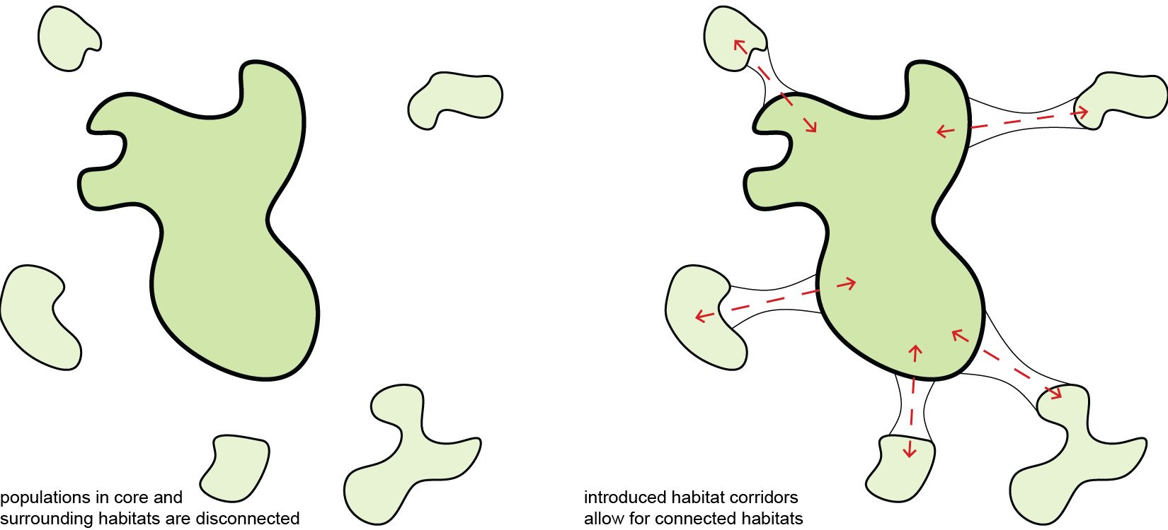
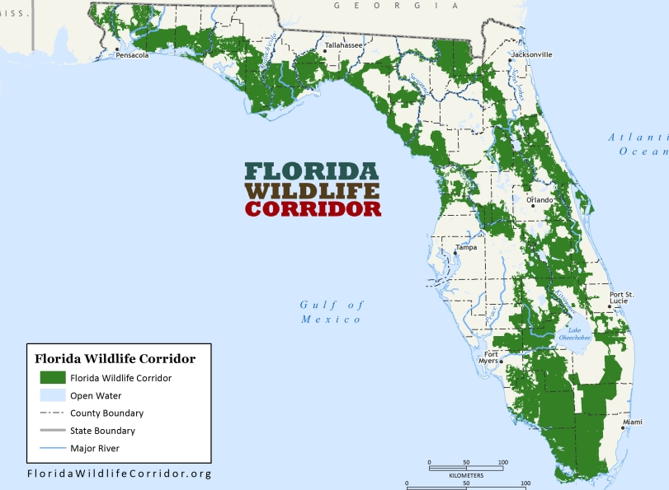
Wildlife Populations
Habitat Connectivity
  Deer – 7 square miles
  Black Bear – 60 square miles
  Coyote – 60 square miles
  Panther – 200 square miles
Genetic Isolation
  “Island Populations”
  Increased inbreeding and disease risk
  Approximately 20 black bears isolated at Chassahowitzka

Slide 8
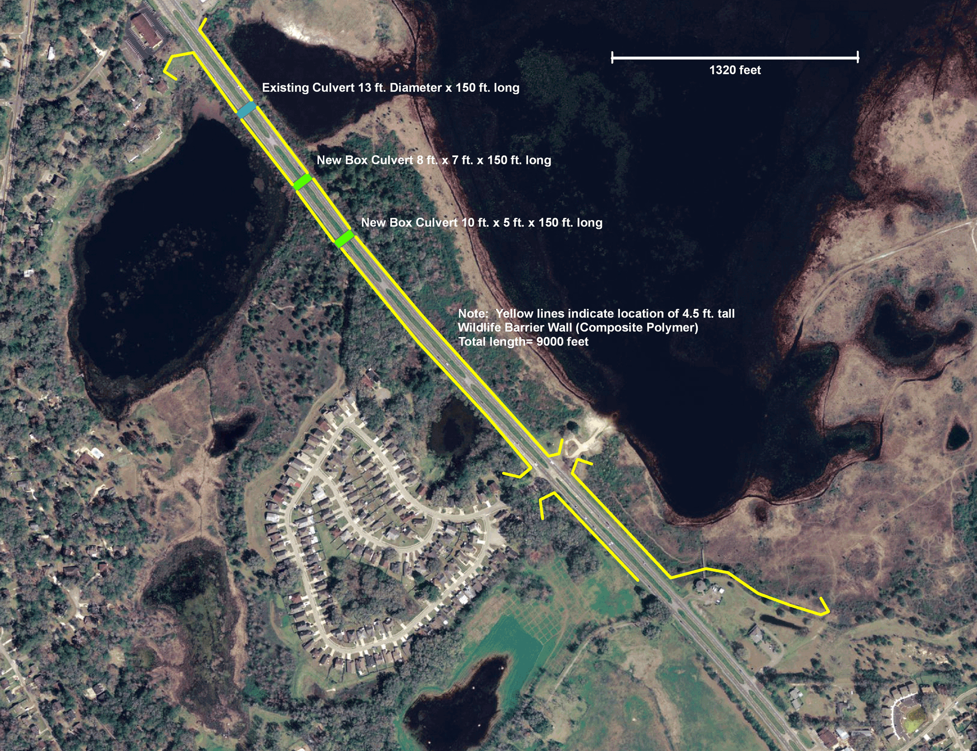
Case Study: Lake Jackson Ecopassage
4000 acre sinkhole lake bisected by US 27
Turtles regularly cross in search of water
  2,710 crossing attempts per year per mile
11,000+ WVCs over 5 year period
  98% mortality rate for crossings
FDOT, Capital Regional Transportation, Leon County, and NGOs work to address issue
Construction of solid wall and multiple culverts in 2010
  $3.4 million in federal stimulus money
  0 recorded mortalities since
Lake Jackson Turtle Rescue

Slide 9
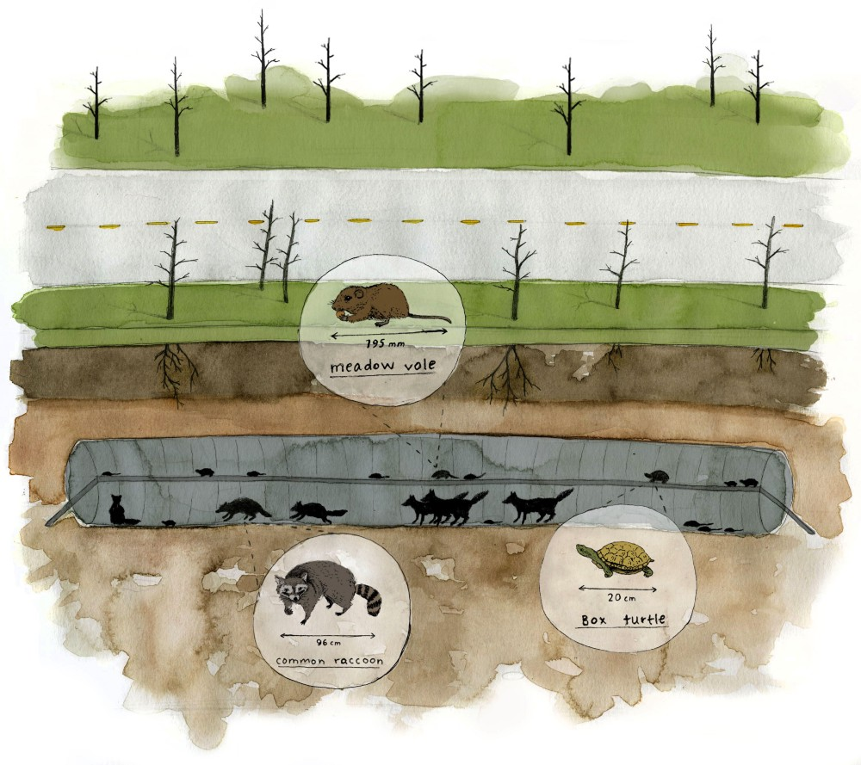
Small Animal Design
Entrance coverage
  Especially for prey species
  Montana Study
    42.9% increase in passage rate when
    coverage added
Shelving throughout crossing
  Especially when water present
  Montana Study
    0 small animal species use of wet culvert without shelving
    14 species once shelving added
Illustration by Summer Ortiz

Slide 10
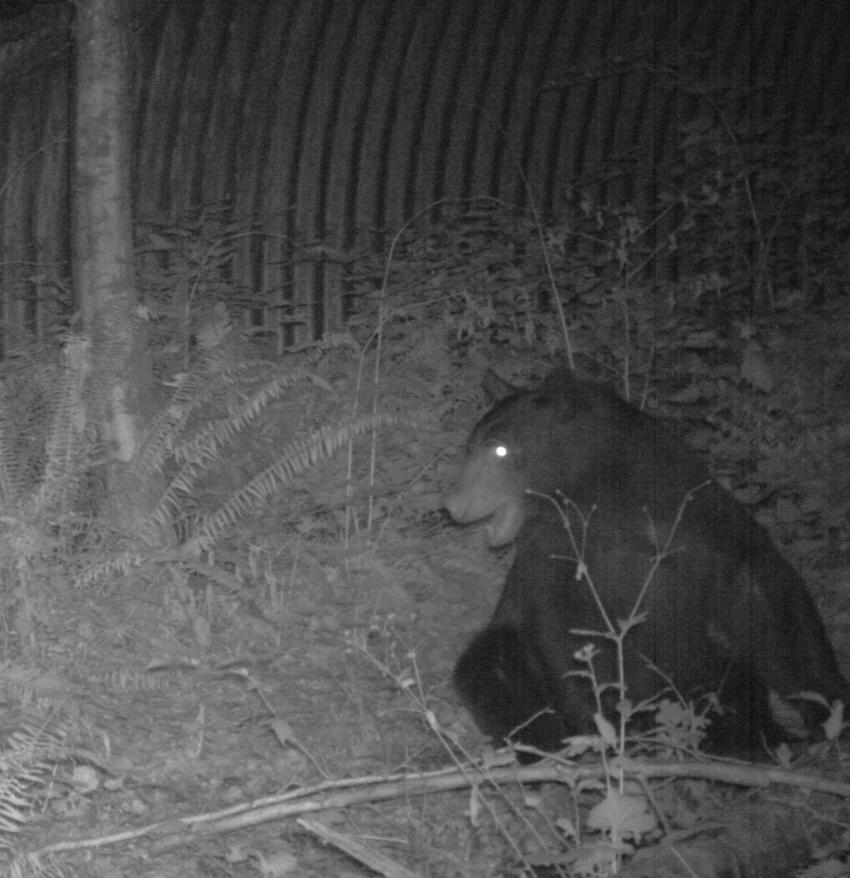
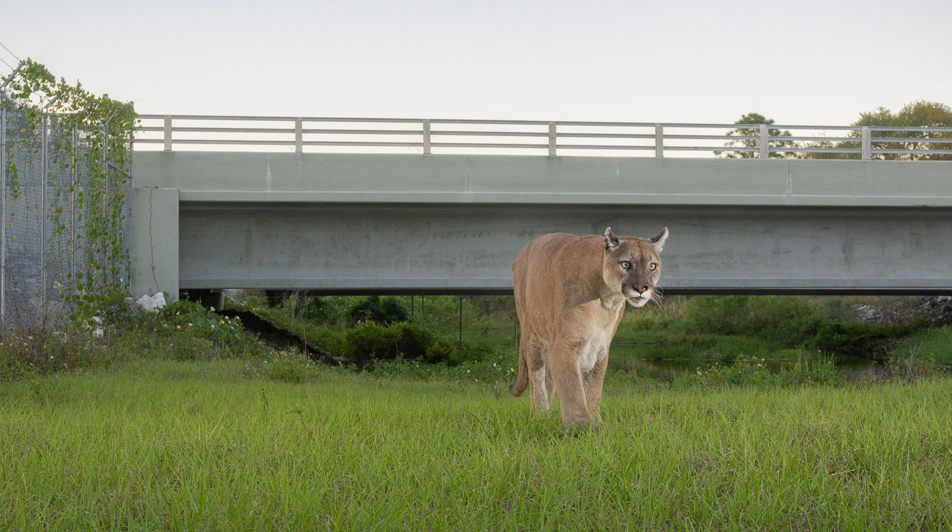
Large Animal Design
Require a large cross-sectional space (passage height x width)
  Limited to large (7+ foot diameter) culverts or bridge underpasses
  Clear lines of sight are highly preferred
More sensitive to influence of human co-use
  Large mammals will develop strategies to minimize human interactions
  Temporal divergence (humans at day, wildlife at night)
  Physical divergence (humans cross on north path, wildlife on south)
In Washington study, one paired bridge underpass had a cement trail frequented by humans during the day
  Over 90% of wildlife crossings occurred through
  the opposite underpass
Photo by Carlton Ward Jr.

Slide 11
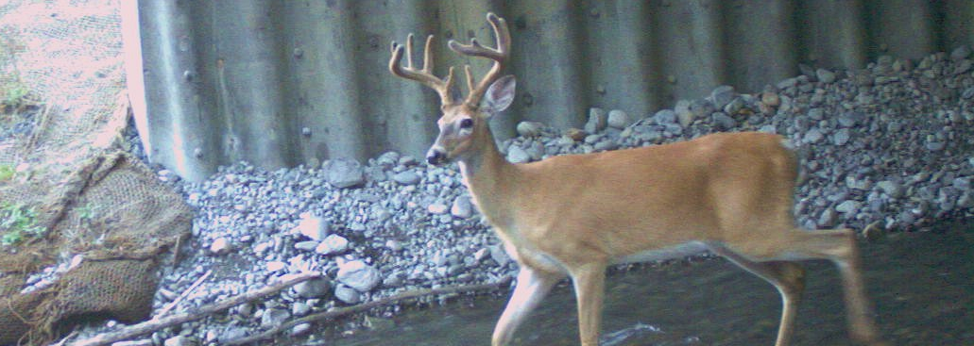
Conclusions
Bridge underpasses and culverts play a valuable role in maintaining habitat connectivity and reducing wildlife vehicle collisions
Wildlife crossings are the only method proven to fully eliminate wildlife vehicle collisions on targeted sections of roadway
A wide variety of species will make use of wildlife crossings
Specific design elements can increase the utility of wildlife passage structures for specific types of species

Slide 12
Jason Hight, Program Administrator
  Land Use Planning Program Administrator
  (850) 413-6966
Sean Greene, Land Use Planning Biologist
  14495 Harllee Road
  Palmetto, FL 34221
  (386) 406-0814
  Sean.Greene@MyFWC.com

Slide 13
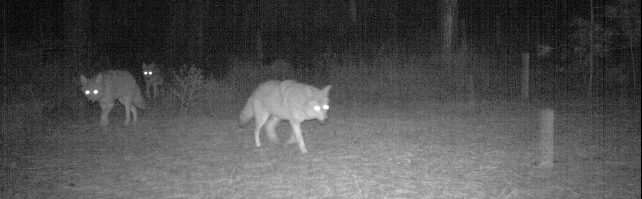
Questions?

