Slide 1
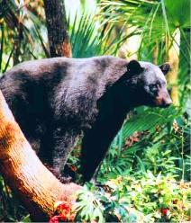
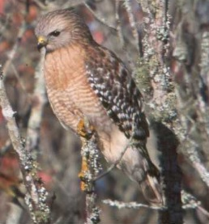
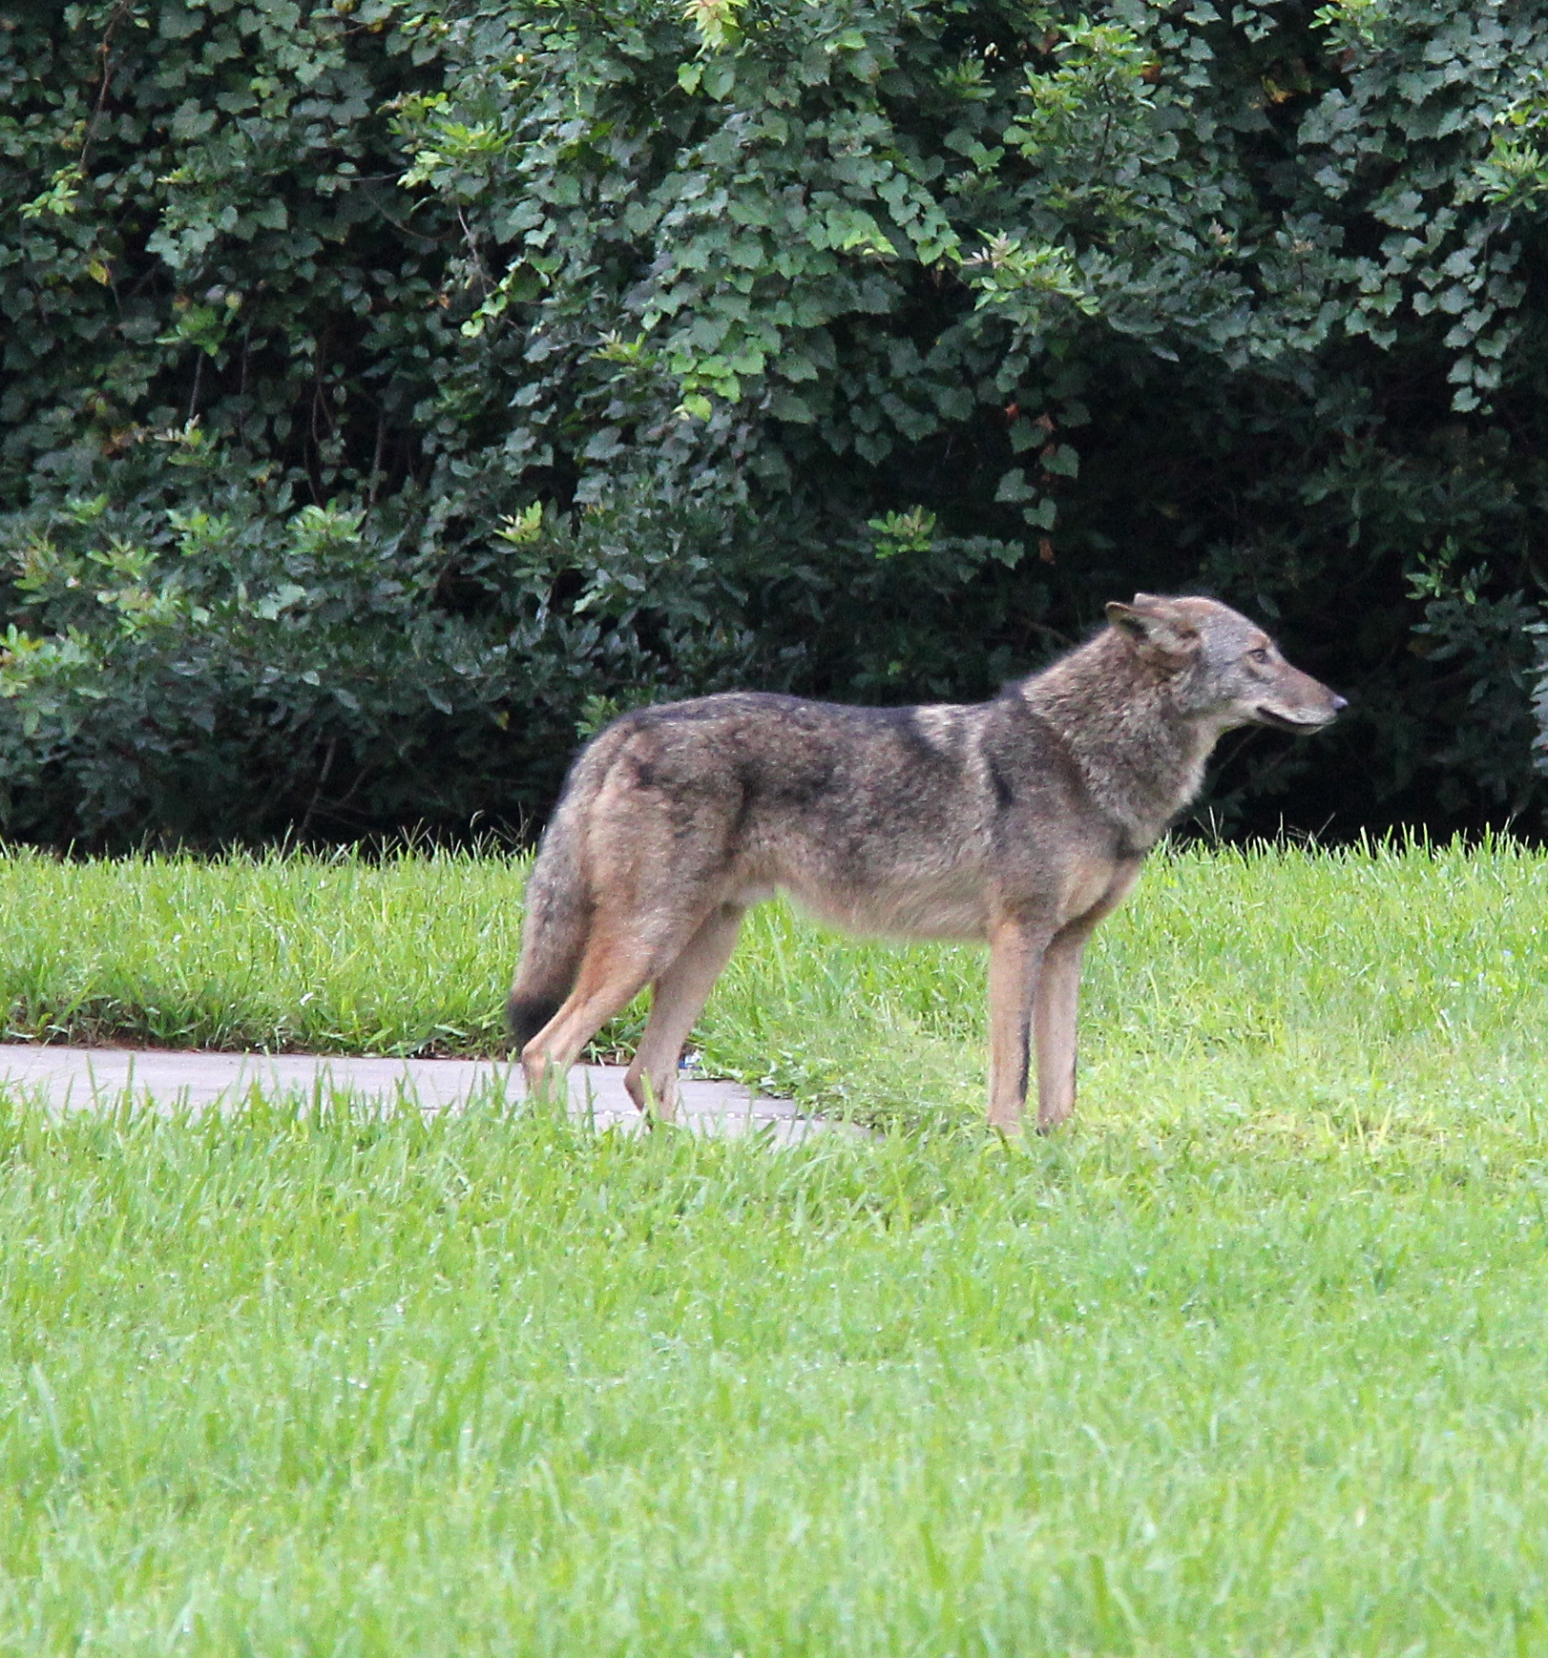
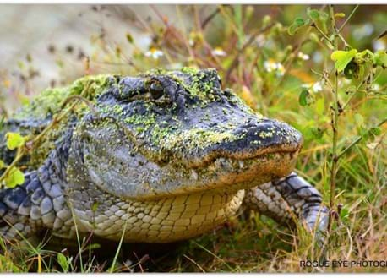
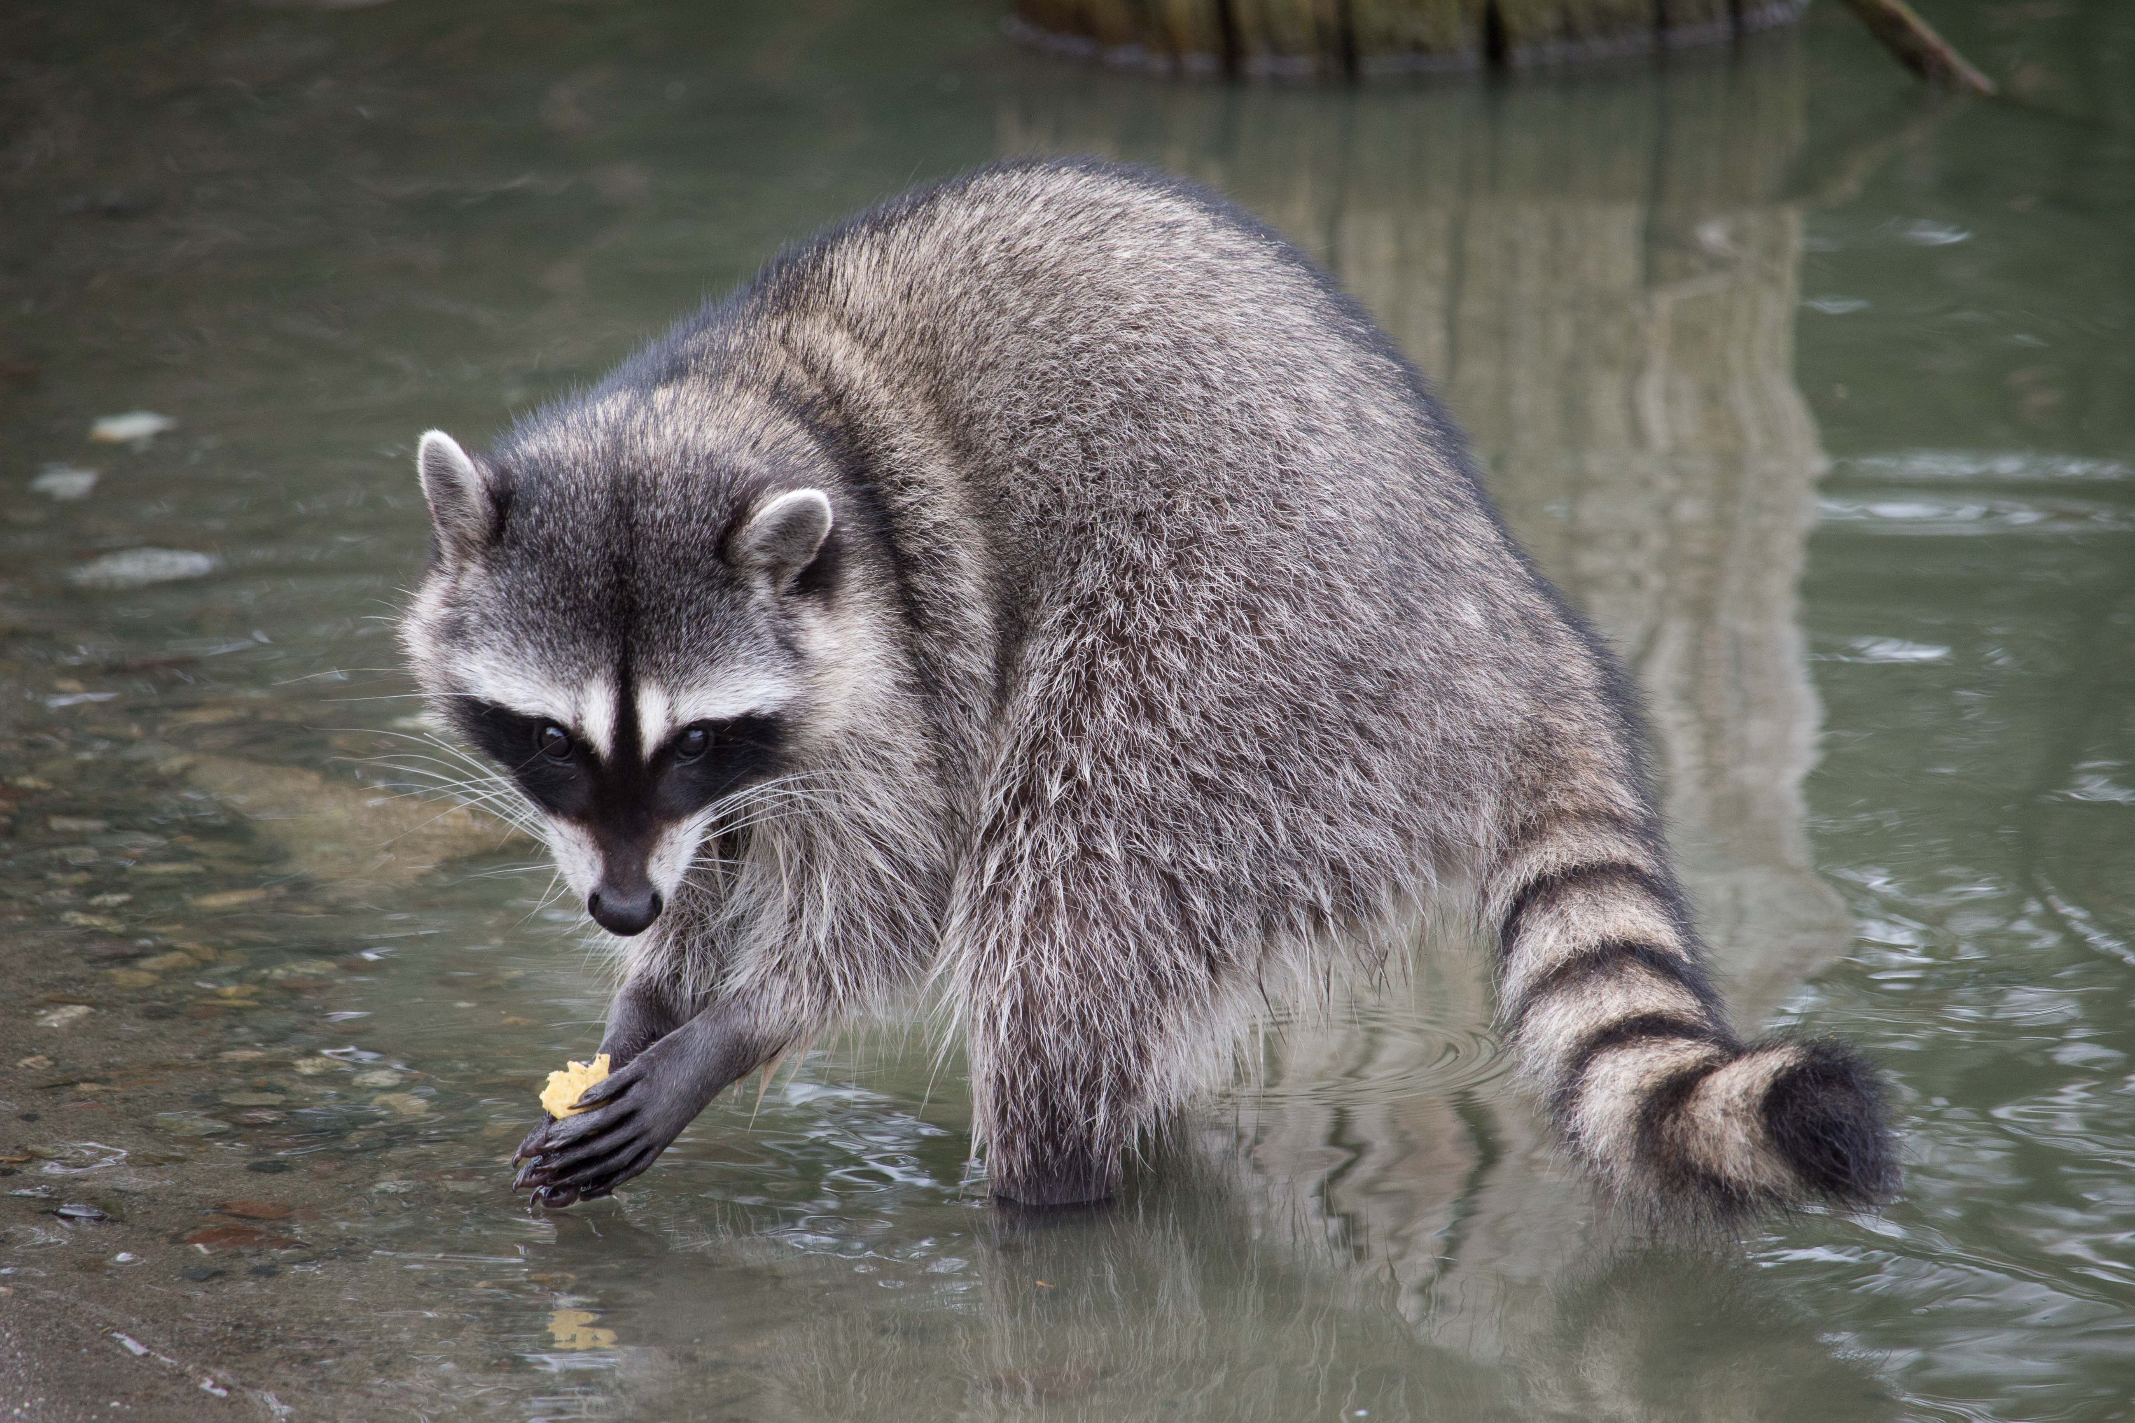

Wildlife Safety in the Field
Bryce Pierce
Wildlife Assistance Biologist
Florida Fish and Wildlife Conservation Commission
All Photos by FWC Unless Specified

Slide 2
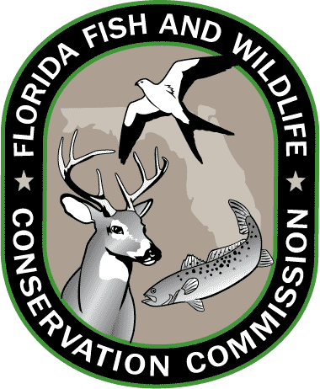
Overview of FWC
State agency – managing fish and wildlife resources for their long-term well-being and the benefit of the people
Headquarters Tallahassee, 5 regional offices, 76 field offices and facilities
  Freshwater & Marine Fisheries Mgmts.
  Fish and Wildlife Research Institute
  Hunting and Game Mgmt.
  Law enforcement: Protect, patrol, and preserve
  Habitat & Species Conservation
    Wildlife Impact Management
      Wildlife Assistance Program – assisting the public with nuisance wildlife and conflict issues thru education and outreach
      Non-native Wildlife Program

Slide 3
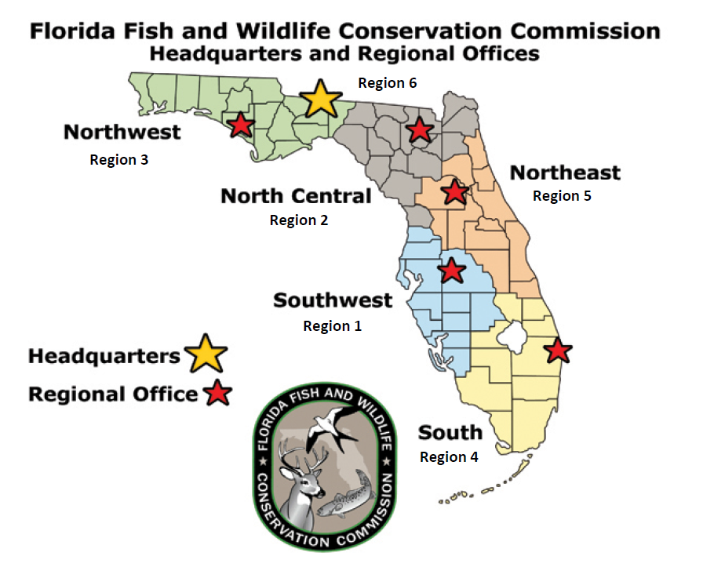
Wildlife Assistance Program
…Addressing Conflict, Fostering Coexistence
Six regional staff & 2 senior staff providing technical assistance to foster coexistence
  Primarily over the phone
  Site visits
Partnerships and coordination with other agencies and NGOs
Pro-active engagement of communities and neighborhoods

Slide 4
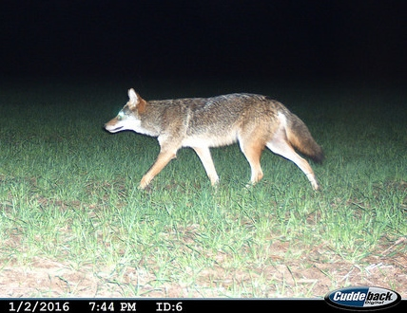
Some thoughts on wildlife…
Wildlife is not inherently dangerous to people
Most people injured by wildlife are doing something they shouldn’t
  Trying to capture the animal
  Trying to kill the animal
  Trying to feed the animal
  Getting between the animal and it’s food or offspring
Prevent encounters with wildlife by paying attention to your surroundings, securing attractants, and using common sense
Know the species in your geographic area
  Knowing how to identify wildlife and a little about their biology can help reduce encounters and conflicts.

Slide 5
Distinguishing Behaviors of Wildlife
Avoidance
Curiosity
Indifference
Most common behavior by far
Running or flying away
Hiding
Climbing trees
Stay still and hope not to be noticed
Stays in place or cautiously approaches
May stand upright to get a better view or smell (bears, raccoons)
Ears, nose, eyes, alert and directed toward the person
Animal is trying to assess its situation
Not reacting to human presence at all
May come close to humans without seemingly acknowledging them
May continue to engage in its activities

Slide 6
Distinguishing Behaviors of Wildlife
Defensive
Aggressive
Animal feels threatened
May produce noises such as growls, yelps, other calls
Circling the threat but not coming closer
Bared teeth, hair or feathers puffed up trying to look threatening or larger, snake in s-shape, rattling tail (not just rattlesnakes)
Produces musky odors (skunk, snake)
Unprovoked physical contact
Factors influencing this behavior include disease (rabies), breeding conditions, previous feeding issues
May not produce noise – sneaking up on prey
Charging or dive bombing at a person can be confused for aggressive but is defensive if the animal feels threatened

Slide 7
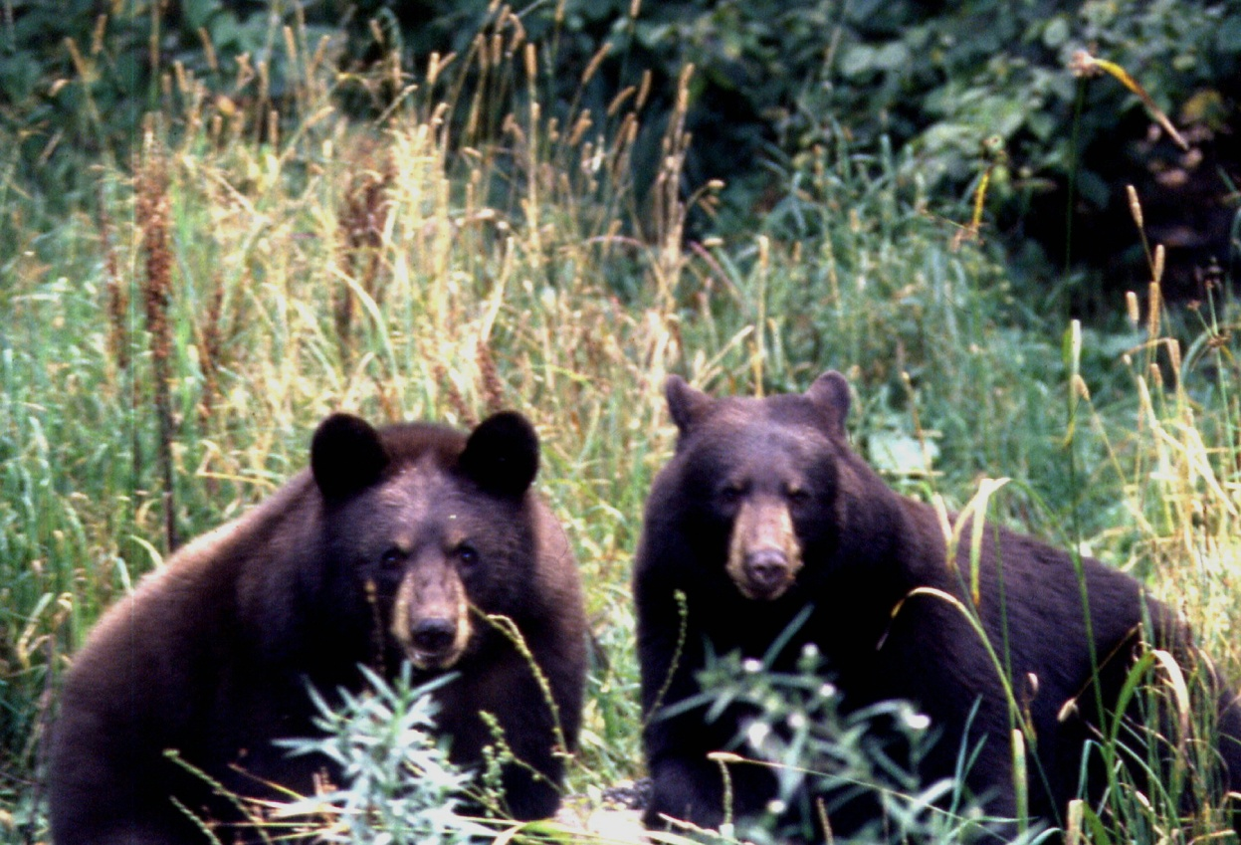
Florida Black Bear
Weight: Males avg. 250-450lbs (max 760), females 125-250lbs (max 400)
Diet primarily consists of plants and insects
Commonly attracted to neighborhoods by unsecured household garbage, bird feeders, grills, and pet food
Bears in Florida do become less active in winter, but sightings occur year round

Slide 8
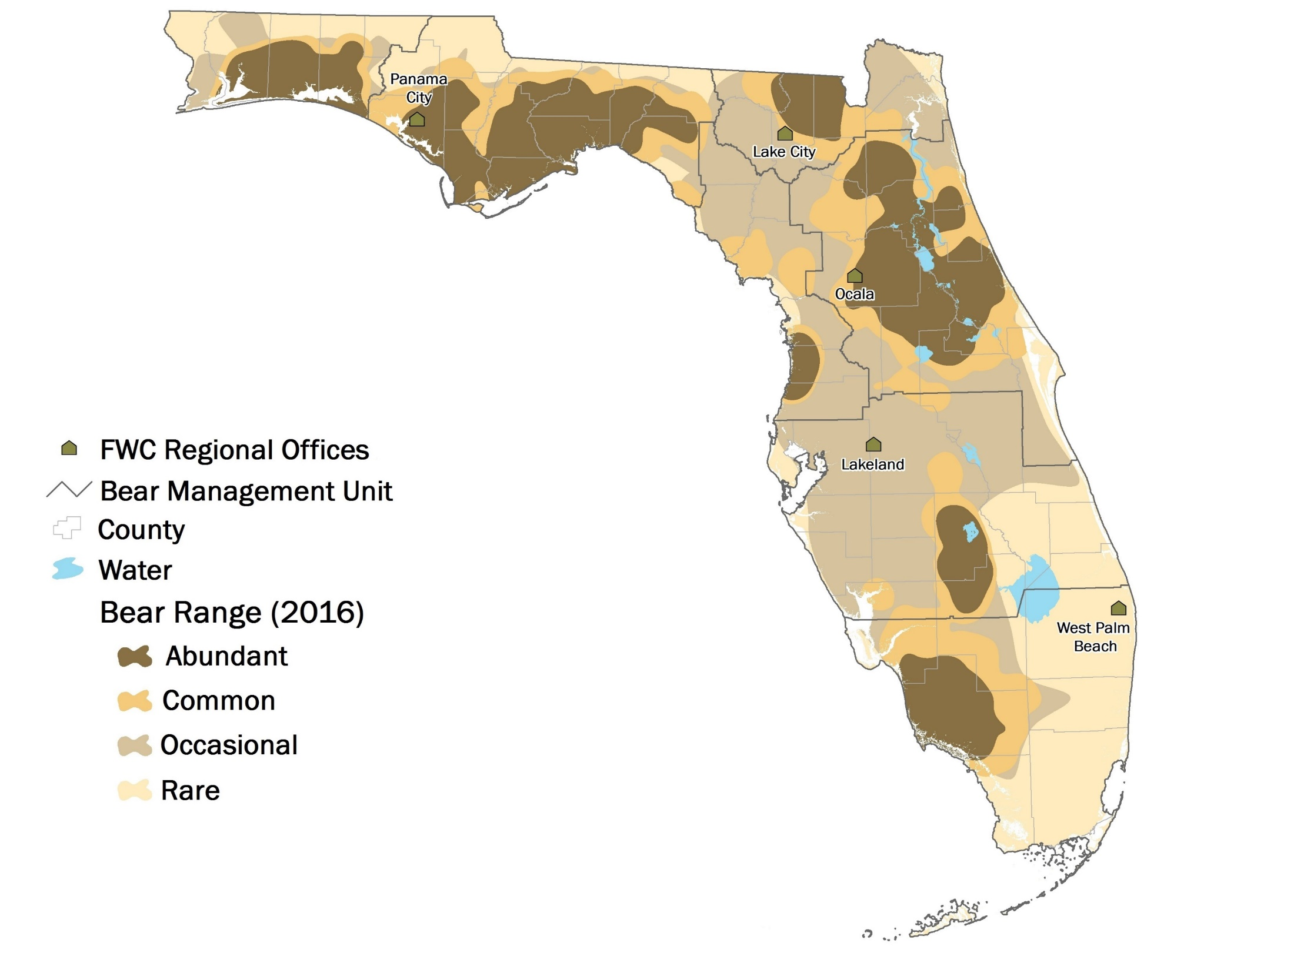
North 500
West Panhandle
120
Central
1,200
Males range wider than females
(The species as a whole has a large range from Alaska and northern Canada to Mexico)
East Panhandle
1,060
South Central
100
Big Bend 30
South
1,040
4,050 Statewide
Centered on Public Lands

Slide 9
Coyotes
25-40lbs, ~3-4ft long, ~2ft shou lder height, fur color varies greatly
Abundant: Found from Alaska to Panama, every US state
Naturalized in Florida, found in all counties
  Major range expansion –wolf removal, forest clearance and urban food sources
Highly adaptable diet and behavior

Slide 10
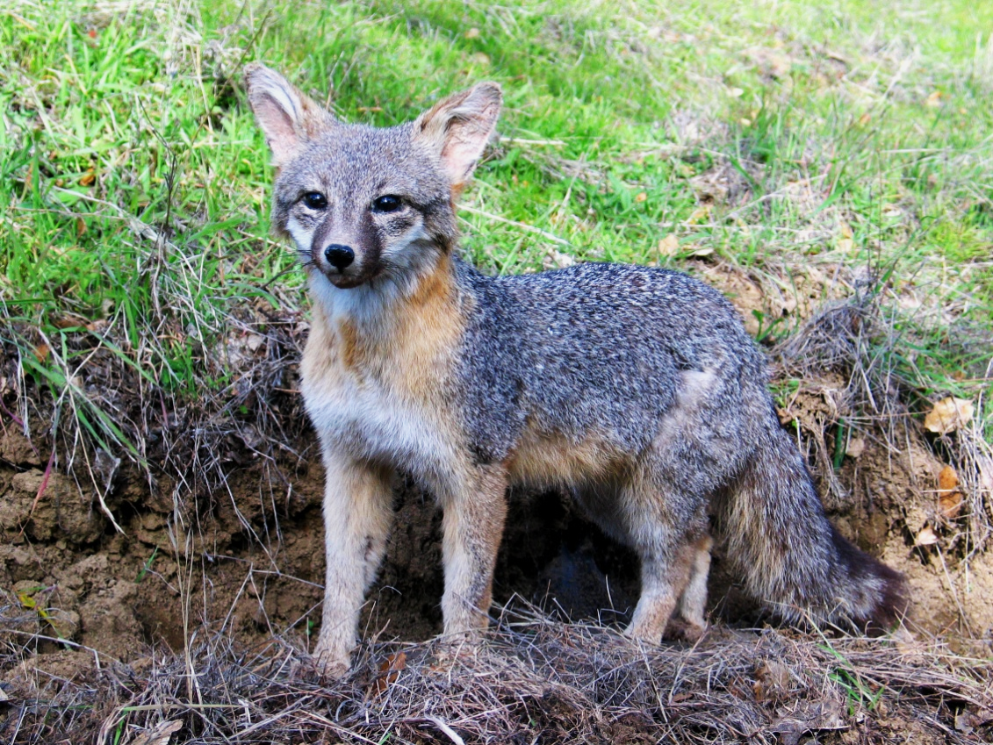
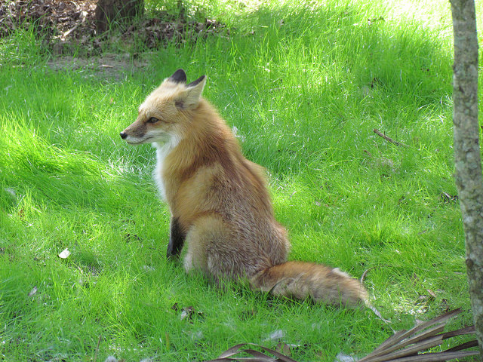
Grey Foxes
Red Foxes
~8 to 15lbs, ~30-45in total body length, ~12-15in shoulder height, grizzled fur on back and sides
Found throughout much of USA and Cen. Am. to N. S Am.
~5 to 24 lbs, ~18-35in body length, ~12-22in tail length, ~14-20in shoulder height
Many subspecies around the northern hemisphere
Also naturalized like coyotes

Slide 11
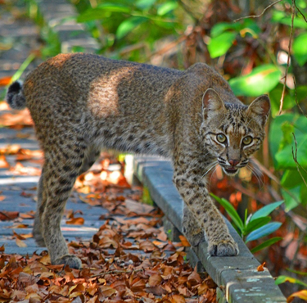
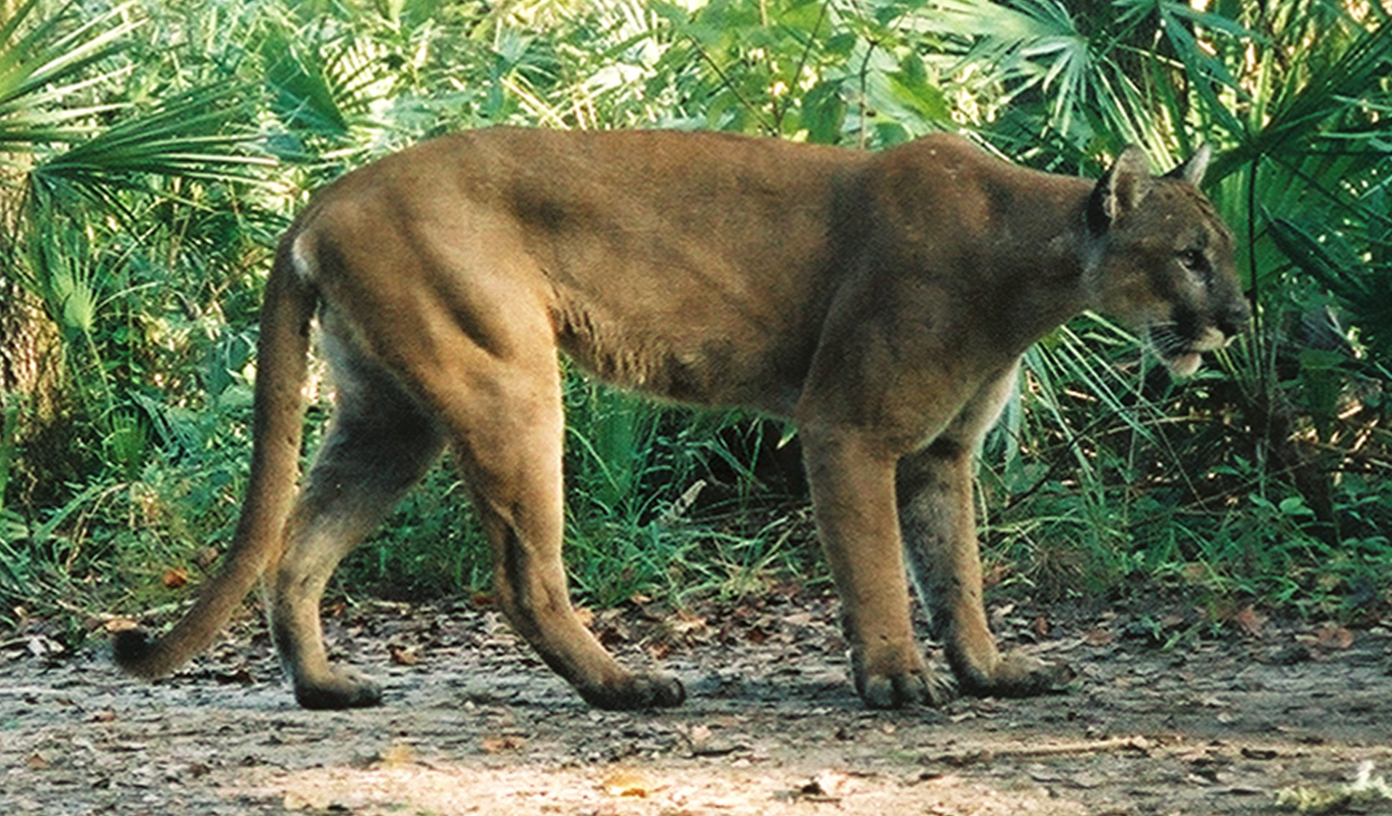
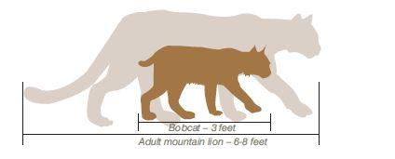
Bobcats
Florida Panthers
Found from S. Canada to Cen. Mexico
Fur mostly a spotted tan, pointed ears, short tail
Weight: 8-40 lbs
Often confused for a panther
Endangered Subpopulation found only in SW FL
  Species is found from from SW Canada to Tierra del Fuego
Fur mostly solid tan, young can be spotted like a bobcat, long, thick tail
Weight: 55-176 lbs
PLEASE REPORT DEAD PANTHERS IF SEEN

Slide 12
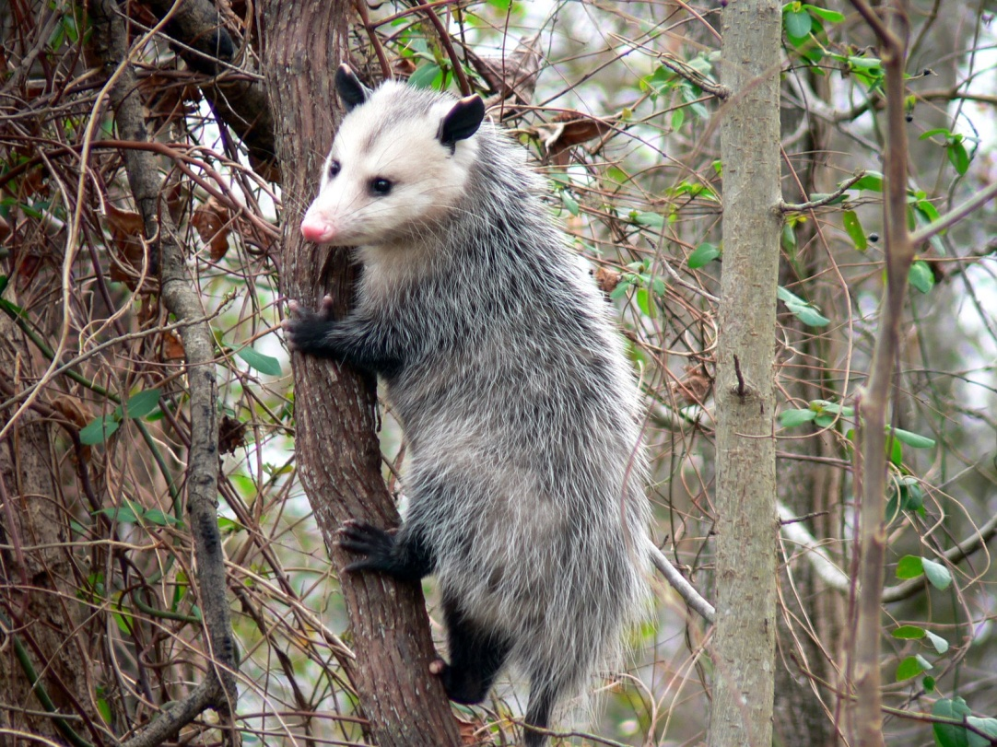
Raccoons
Opossums
River Otters
Only native marsupial of USA
Found across most of E US and US W Coast, and in Cen. Am.
Weight: 1.7 to 14 lbs
Can “play possum” – playing dead
Found throughout much of N and Cen. Am.
Weight: 10 – 30 lbs
Commonly attracted to human dwellings and farms
Found throughout Canada, Alaska, NW US, and E US
Weight: 11-30 lbs
Found in a variety of aquatic habitats

Slide 13
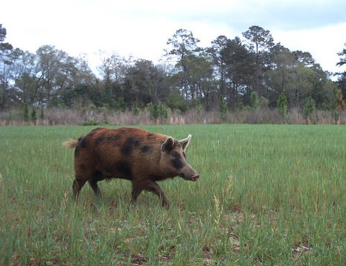
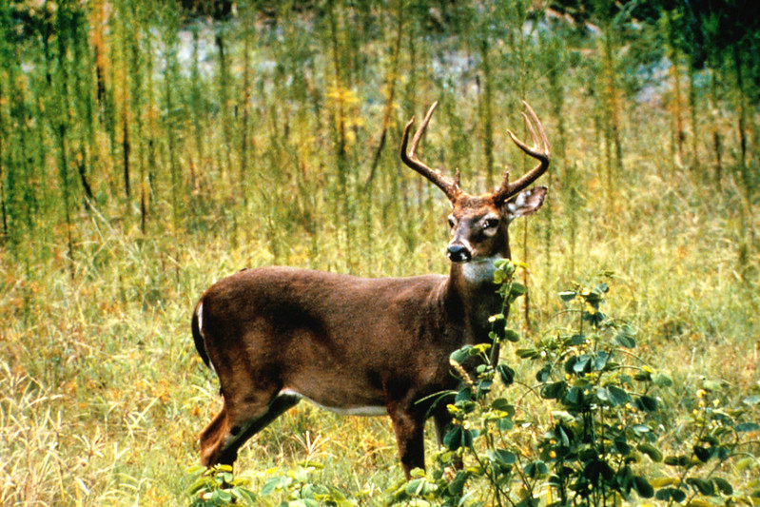
Wild Hogs
White-tailed Deer
Invasive/non-native species
Weight: 200 lbs or more
Found throughout SE USA
Travel alone or in small groups
Most common in areas with dense vegetation
Florida’s only native deer
Up to 125 lbs on the males
Wide range in North America, every county in FL
Endangered population in the lower FL Keys
Sometimes attracted to roadsides to feed on grasses and weeds

Slide 14
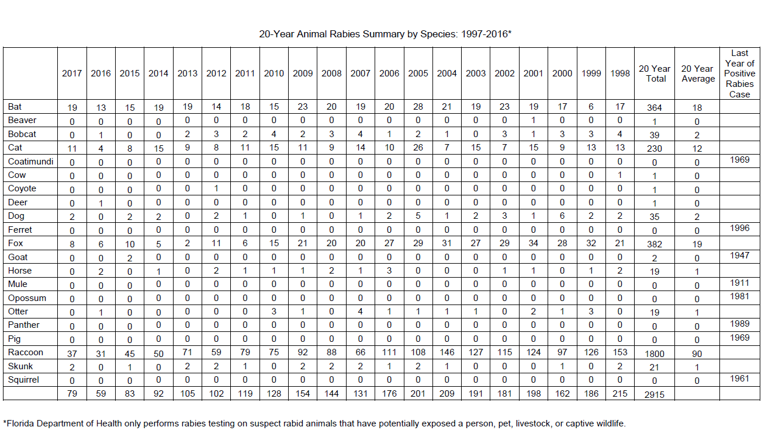
Rabies
Seek medical attention if ever bitten by a mammal species
Courtesy of the Florida Department of Health
Notes:
Rabies is present in the wild population. It’s transmissible to mammals, and is fatal if not treated. The Florida Department of Health tracks positive rabies cases statewide.
Coyotes are mammals, so they are at risk of rabies. However, from 1998- 2017, only one coyote tested positive for rabies in the entire state. Other mammals are at higher risk of rabies, including bats, raccoons and domestic cats.

Slide 15
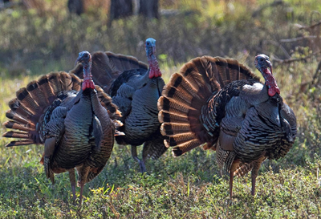
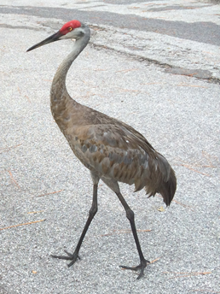
Wild Turkeys
Sandhill Cranes
Protected species in Florida
Will approach people if being fed, turkey toms can have breeding aggression
May peck at reflective surfaces
Can be scared away with loud noises, etc. (cannot be done around nests)

Slide 16
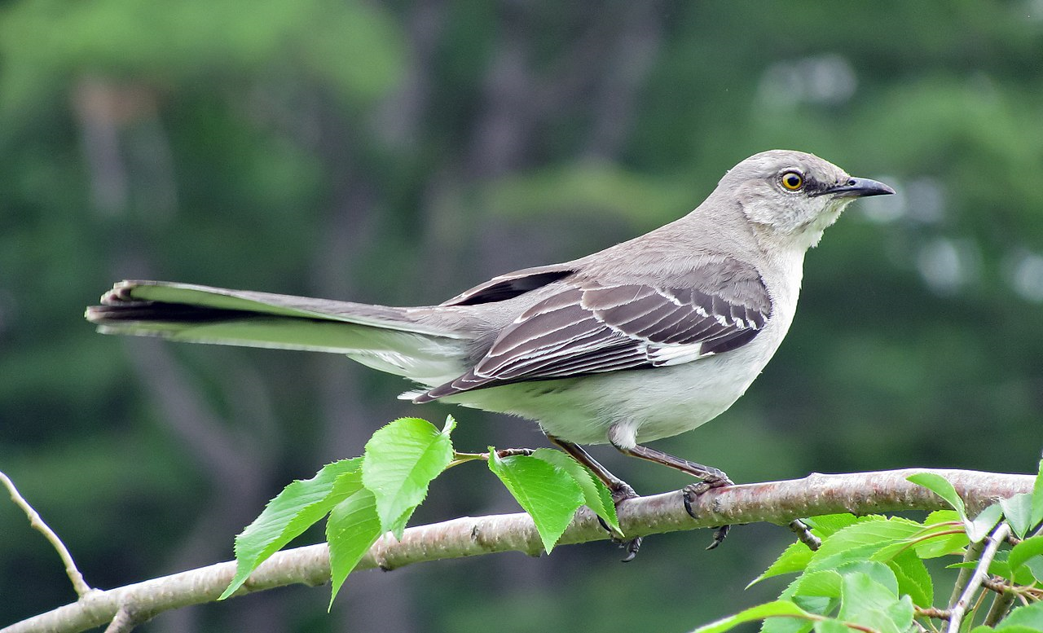

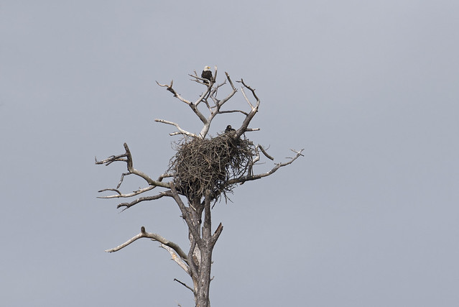
Bird Nests, Hawks and Songbirds
Birds nest in trees, shrubs, in or on a structure, or on the ground or in a wetland depending on species
Defensive of their nests, especially between Feb-May – may swoop at a person’s head
Keep distance from nest as much as possible
Use umbrella, hats, or hazing techniques to keep aggressive bird away from contacting you
Birds, eggs, and active nests are protected by federal and state law – do not cause nest abandonment
  Active nest = a nest with live chicks or young being tended by the parent(s)
N. Mockingbird By Captain-tucker - Own work, CC BY-SA 3.0, https://commons.wikimedia.org/w/index.php?curid=6930319

Slide 17
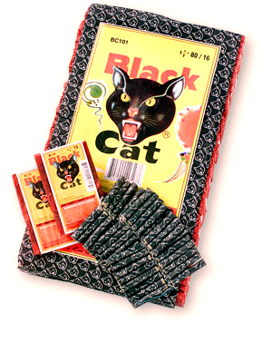
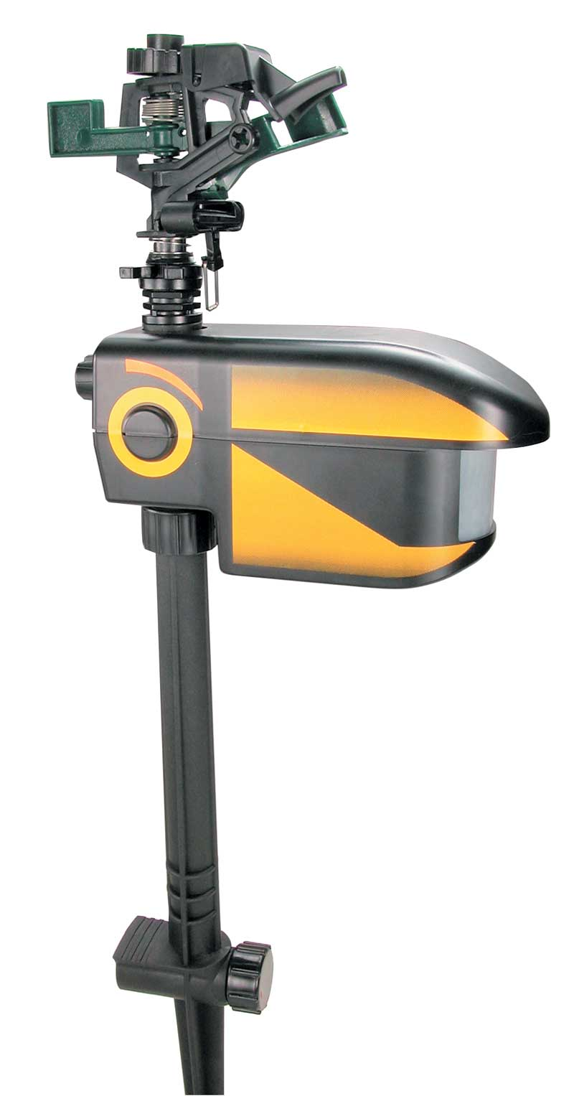
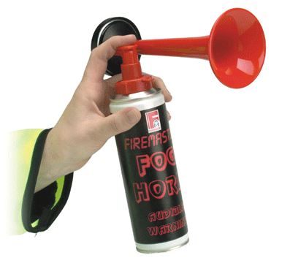
Prevent Problems with Mammals and Birds: Hazing
Establish Human Dominance
Rocks & sticks
Whistles
Pots & Pans
Car & air horns
“Coyote shaker”
Motion-activated sprinklers
Water pistols
Motion lights
Firecrackers
Bear spray

Slide 18
Bear Spray
For mammals only
Have easily accessible
Aim just below face
2-3 second bursts
15-25 feet
More effective than a gun
Account for wind direction
Have a container to store can in

Slide 19
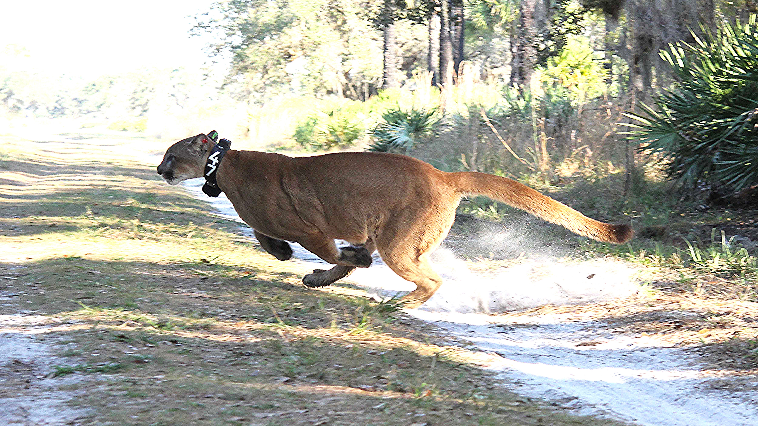
Notes about Hazing
Do not haze birds when you are very close to the nest
  This could cause nests to fail from the disturbance
Make sure the animal has a safe place to escape to
Be mindful of where the wildlife will retreat to. Wildlife may try to escape towards a busy road, endangering the animal and people on the road, or into a building

Slide 20
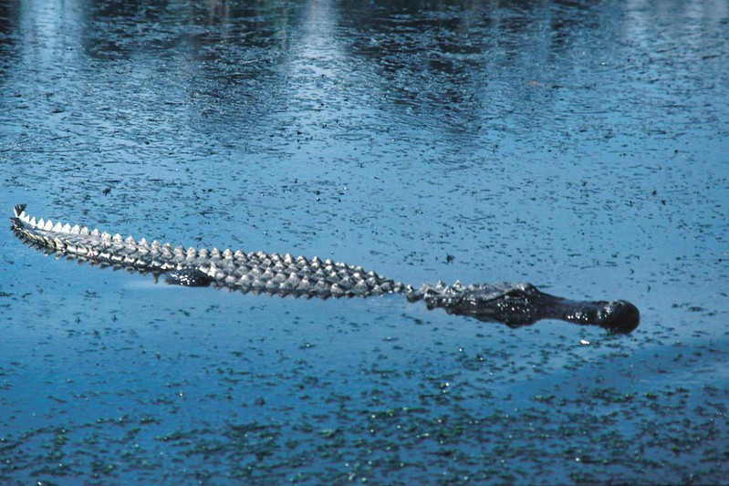
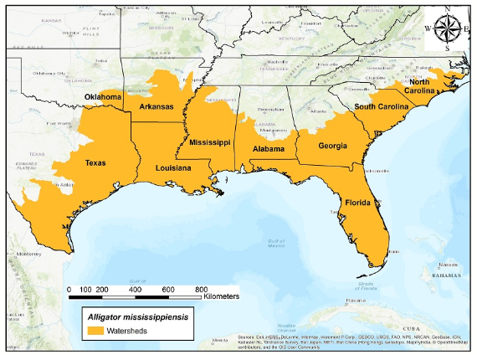
American Alligator
Conservation success in Florida
Included on original Federal Endangered Species List in 1967
Today, population estimated at 1.3 million alligators of every size in FL alone
Population stable for many years
American alligator U.S. range

Slide 21
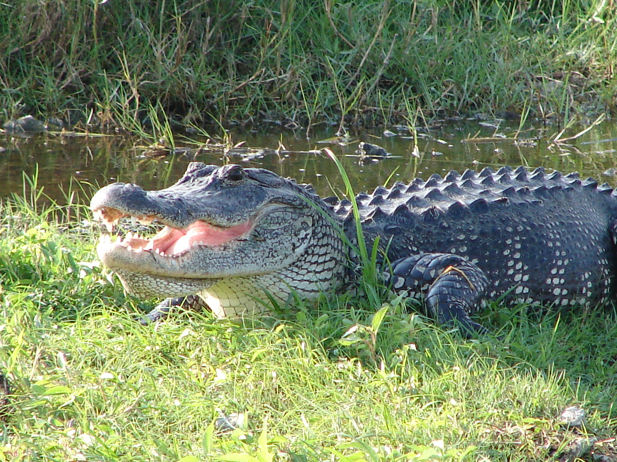
American Alligator Biology and Ecology
Can’t tell males and females apart by outward appearances
  Males can grow to 14 feet in length
  Females smaller than males. Can grow to 8-9 feet in length
More visible and active when temperatures rise
  Bask in sun to regulate body temperature
Courtship begins in the spring, with mating occurring in late May or June
  Nests constructed after courtship
  Eggs hatch from August to September
  Mother alligators defend their nest

Slide 22
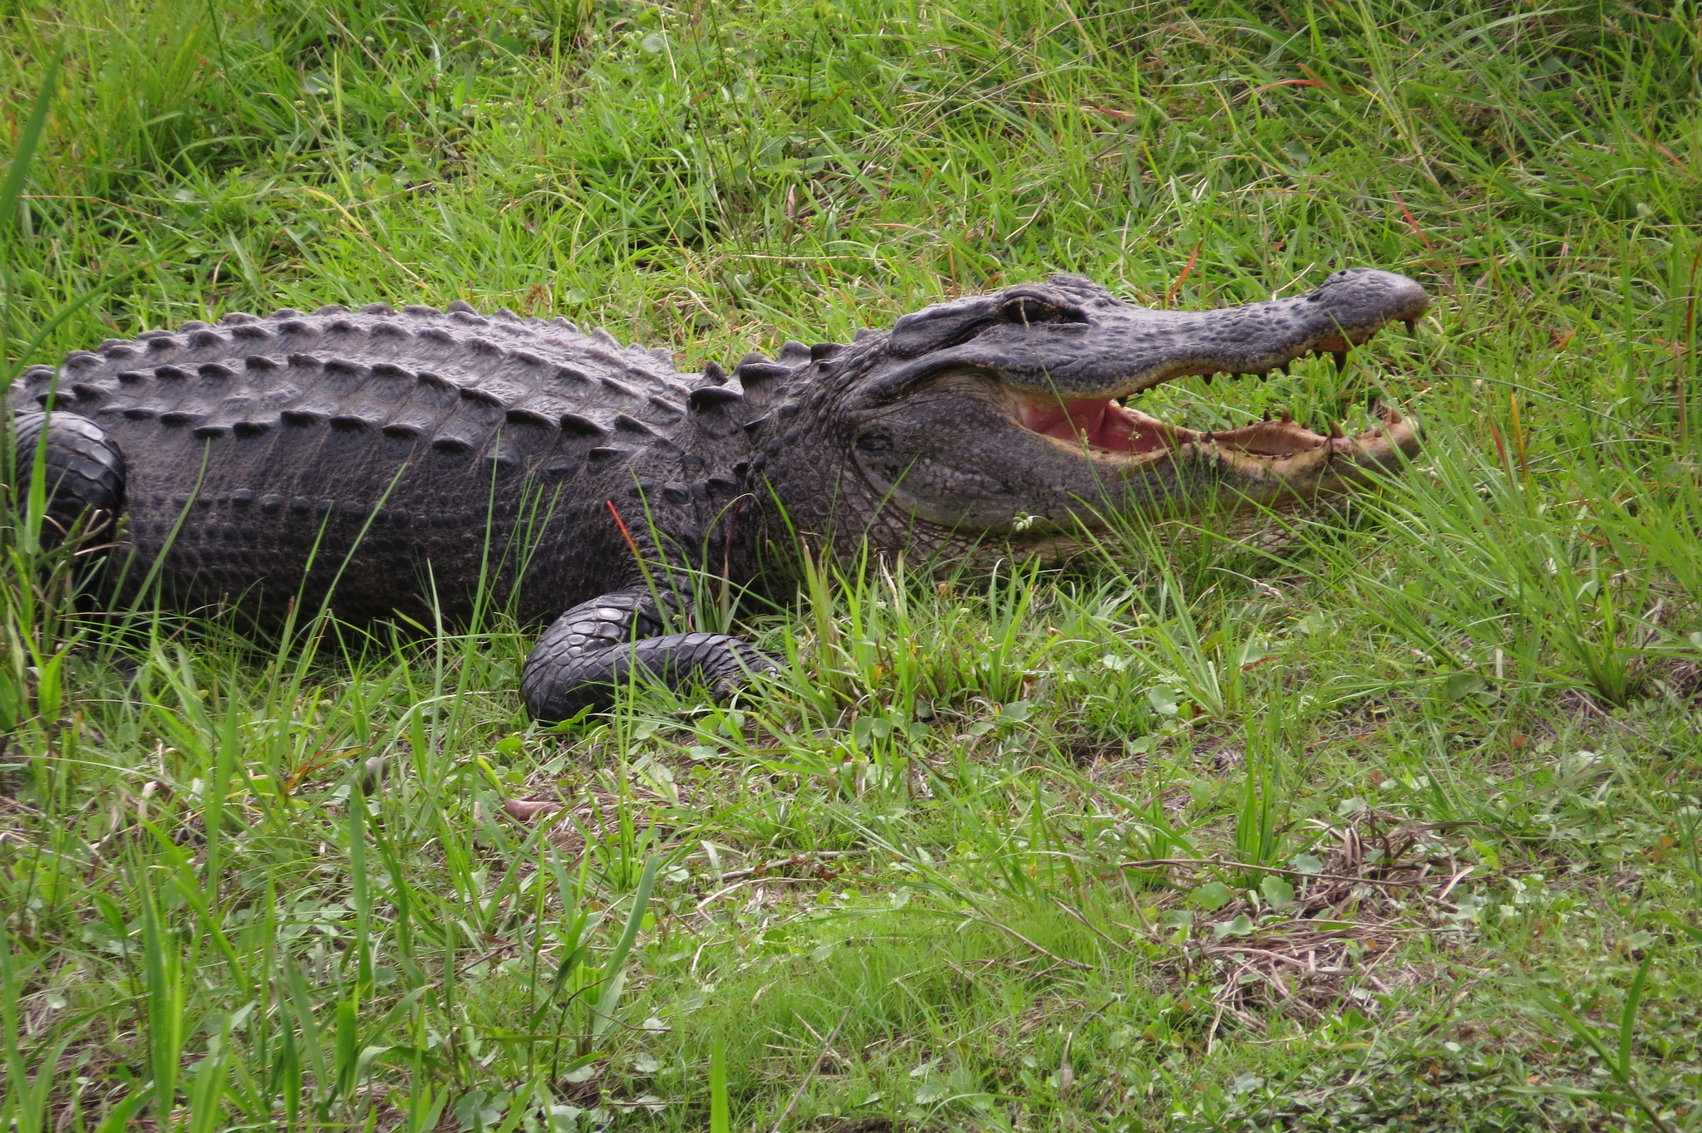
Avoiding Conflicts with American Alligators
Any fresh or brackish water could have alligators - crocodiles in far southern Florida
Be on the lookout for alligators when working in water or near water's edge
Alligators are most active at dawn and dusk
Seek medical attention if bitten, serious infections can occur

Slide 23
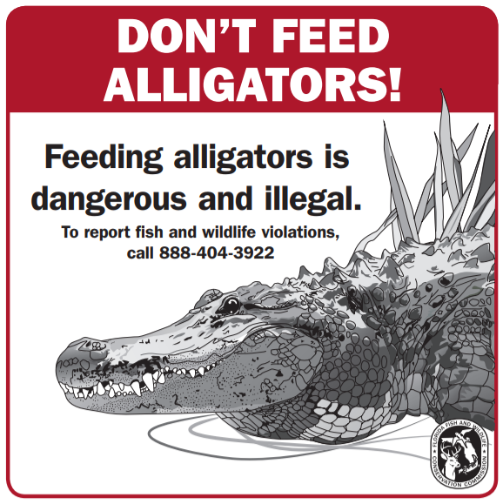
Avoiding Conflicts with American Alligators
Never feed an alligator
When fed, alligators can overcome their natural wariness and learn to associate people with food
Also prohibited: harassing, killing, or possessing alligators w/o permit
If you see or have knowledge of an alligator being fed or other issues, report it to Wildlife Alert Rewards Program
Also illegal to feed bears, coyotes, foxes, raccoons, sandhill cranes, and pelicans

Slide 24
FWC Statewide Nuisance Alligator Program (SNAP)
If you encounter an alligator that you believe poses a threat to people, pets or property, call:
FWC’s Nuisance Alligator Hotline at:
866-FWC-GATOR (866-392-4286)
Please be aware, nuisance alligators are killed, not relocated.
SNAP uses contracted nuisance alligator trappers throughout the state.
If a complaint meets the criteria, SNAP will issue a permit to a contracted nuisance alligator trapper authorizing the removal of the animal.
Complainant must be able to grant legal access to the property on which the alligator is located. SNAP does not permit the removal of nuisance alligators from private or publicly managed property without first obtaining permission from the property owner or management authority.

Slide 25
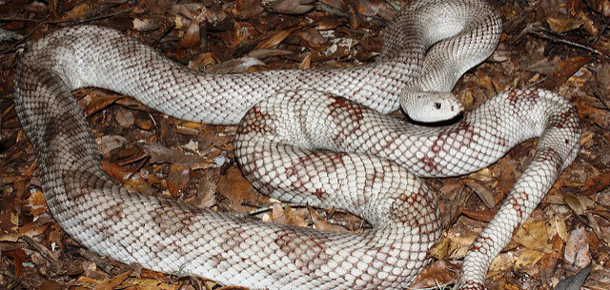
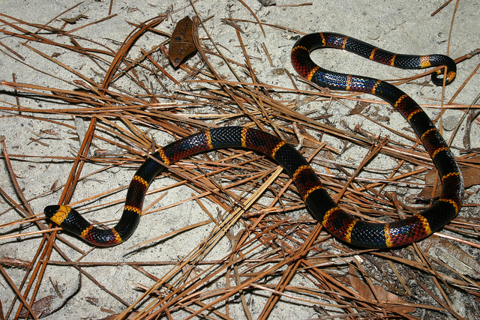
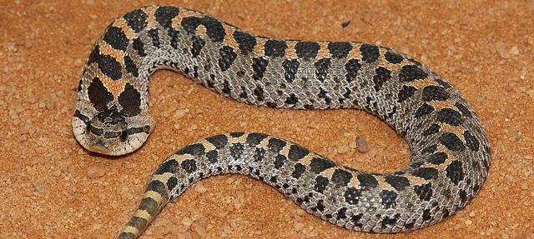
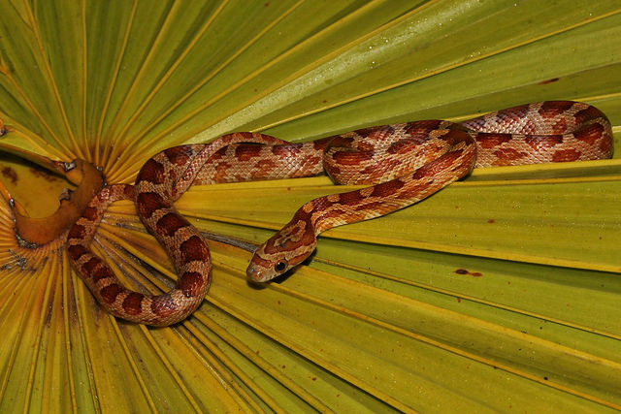
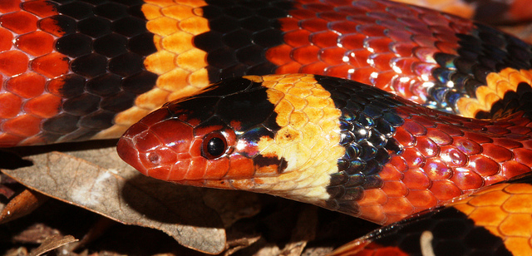
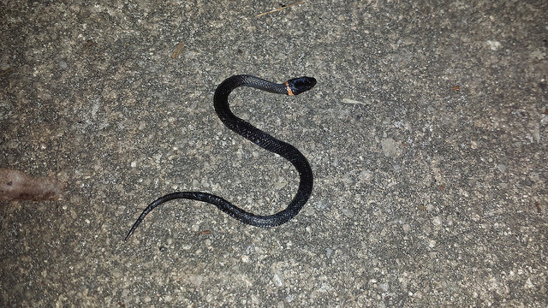
Florida’s Snakes

Slide 26
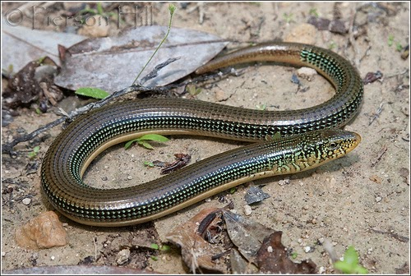
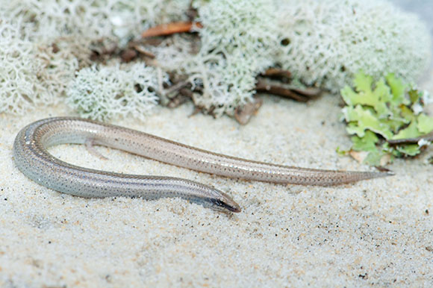
Introduction to Florida’s Snakes
About Snakes
Snake Lookalikes
45 species native to the state - 6 venomous
Cold-blooded, smooth- or keel-scaled, no eyelids
All are carnivorous
Lay eggs or live birth
Young do not require parental care
Legless lizards (e.g. skink)
Glass lizards
Florida worm lizard
Eastern Glass Lizard
Sand Skink (Federally threatened)

Slide 27
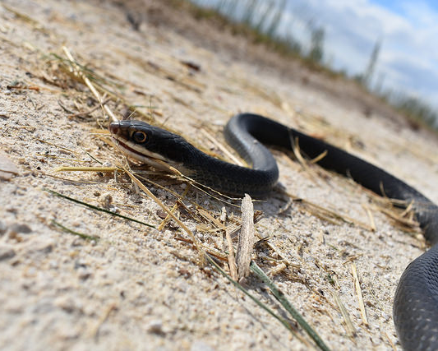
Southern Black Racer
Red Rat Snake
Common Species
Know Your South Florida Snakes
Southern Ring-necked Snake

Slide 28
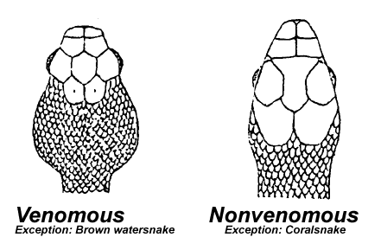
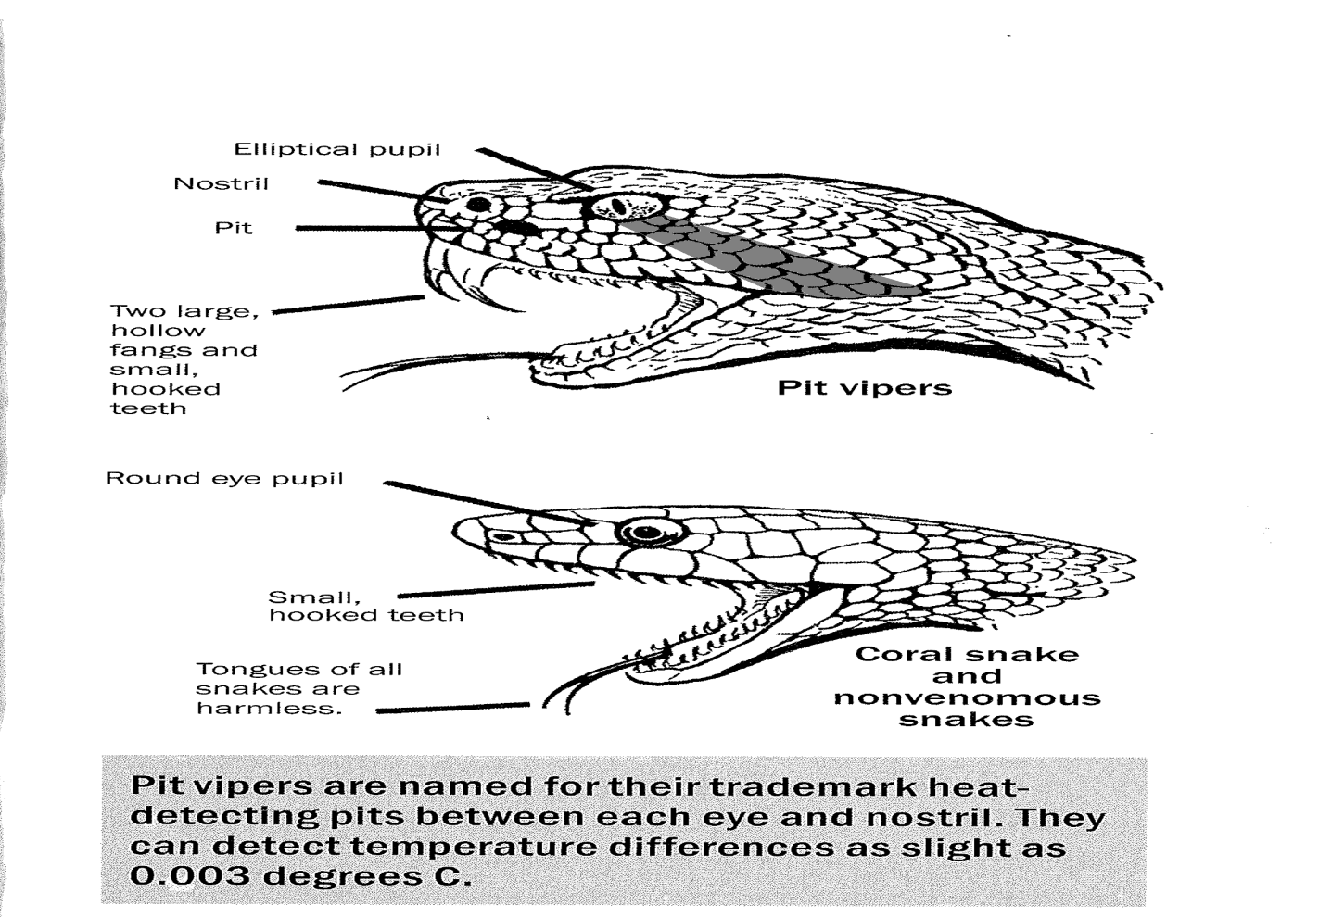
Identifying Venomous Snakes

Slide 29
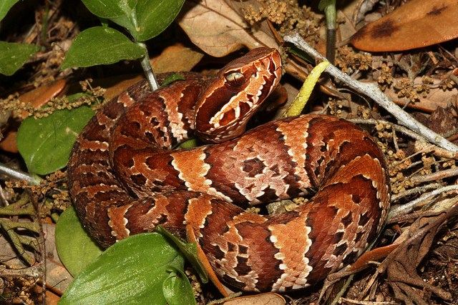
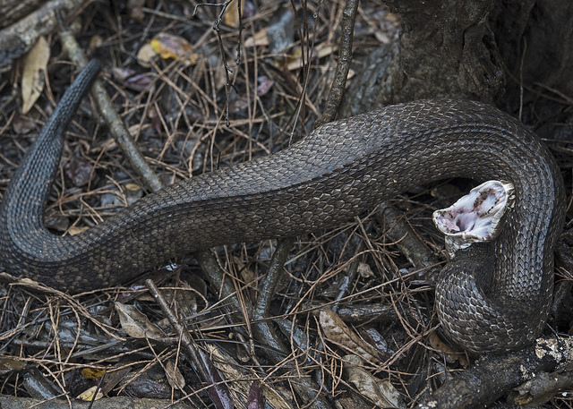
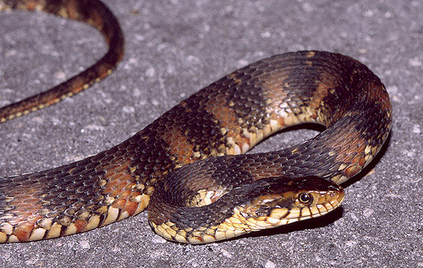
Cottonmouth/Water Moccasin
Broad, angular head & thick body, up to 4ft
Usually found in wet habitats, eats primarily aquatic animals
When threatened will open jaws and reveal white inside mouth
Look alikes: Water snakes, genus Nerodia – notice round pupils
Juvenile Cottonmouth
Banded Water Snake (nonvenonmous)
Adult Cottonmouth

Slide 30
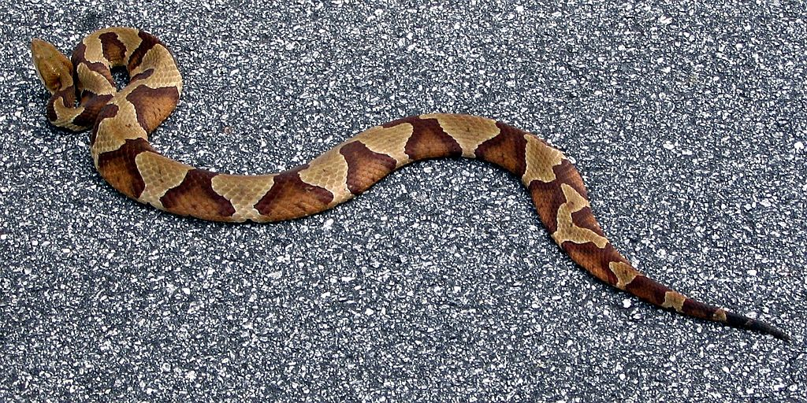
Copperhead
Close relative of cottonmouth
Up to 3 ft long, distinguished by copper-colored head and the design on the back – like a saddle or hourglass (this design can vary)
Young are grey with yellow tails and become more red as they age.
Woodland snake only found in a few counties in the Panhandle
Rattles its tail against the ground as a warning to stay away.
Copperhead
By Steve Karg - Own work, CC BY 2.5, https://commons.wikimedia.org/w/index.php?curid=1212158

Slide 31
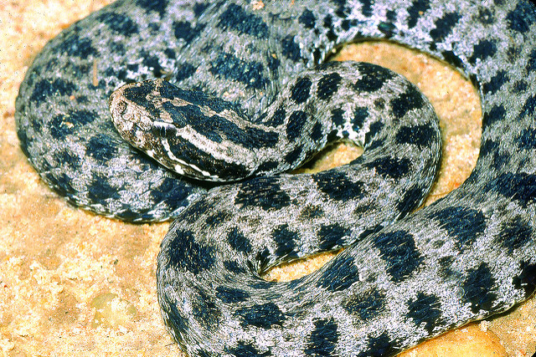
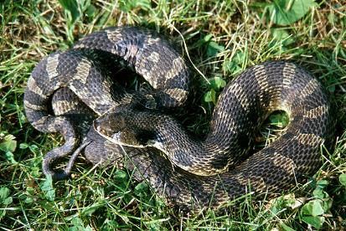
Pygmy Rattlesnake
Up to 2 ft long
Has rows of black patches on a lighter body, with variable amounts of red or other colors. Rattle very small if present
Found in areas of dense forests or shrubs
Similar Species: Hog nosed snakes
  Non-venomous
  2 species in Florida: both possess prominent up-turned nose used for burrowing
  Defensive strategies: puff up their necks like a cobra, play dead
Pygmy Rattlesnake
Eastern Hog-nosed Snake

Slide 32
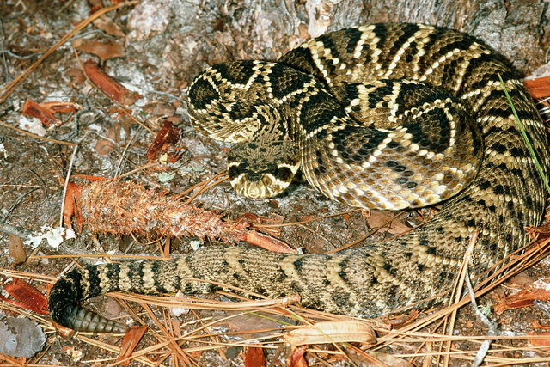
Eastern Diamondback Rattlesnake
Length up to 6ft
Diamond-shaped designs on keeled scales, sometimes possesses distinct rattle on tip of tail
Can be found in a variety of habitats, prefers gopher tortoise burrows
Will warn a threat by shaking its tail, may form an s-shape with its body
  May possess rattle but it can be broken off
NOTE: Many species of snake rattle their tail to scare off a threat

Slide 33

Timber/Canebrake Rattlesnake
Grows up to 5 feet long
Possesses a distinct rattle – behaves similarly to an eastern diamondback when threatened
Light brown or pinkish w/ stripes down the body or broken bands, terminating in a dark-colored tail, sometimes very dark overall
Mostly found in northern Florida, as far south as Alachua county -Prefers dense forests, but also found in old fields
All Florida pit vipers produce hemotoxin, which affects the bloodstream
By Jonathunder - Own work, GFDL 1.2, https://commons.wikimedia.org/w/index.php?curid=64755005

Slide 34

Eastern Coral Snake
Black nose, red with yellow on either side (red on yellow – kill a fellow), avg. length to 30in
Rear-fanged elapid (cobra family) - will only bite if handled or severely harassed
  Produces neurotoxin
Spends much time hidden underground, in debris, or in rotting logs
Similar Species: Scarlet snake and scarlet kingsnake
  Non-venomous
  Very similar to each other
  Red-tipped nose, red bands surrounded by black bands (red on black – friend of jack / venom lack)
Eastern Coral Snake
Scarlet Kingsnake

Slide 35

Preventing Encounters
Stack materials neatly on a platform above ground
Check behind objects
Avoid thick vegetation or tread lightly through it
Leave the snake alone so it doesn’t become defensive
Toss objects towards it to scare it away
Check for potential entry points in vehicles or buildings
  -ex. Doors, pipes, windows

Slide 36
Venomous Snakebite Do’s
Most people bitten are capturing them or killing them
If struck, move away from the snake.
Seek medical treatment immediately.
Keep victim warm and as comfortable as possible.
Note any symptoms and allergies of victim.
Remove bracelets, rings and constrictive clothing.
Keep the bite area lower than victim’s heart.
Wash the bite wound with soap and water.

Slide 37
Venomous Snakebite Don’ts
Do not wait for symptoms to develop!
Do not apply “traditional” remedies.
Do not apply ice, heat, or a tourniquet.
Do not draw an “X” incision and suck out the venom.
DO NOT ATTEMPT TO CATCH OR KILL THE SNAKE!
  Obtain a photo if you feel necessary
  There are only 2 types of anti-venom needed for any venomous snake in North America

Slide 38

High Priority Non-Native Species
Please Report Sightings to 888-IVE-GOT1
Always use caution
Park a short distance away
Take photos while approaching
Keep a distance of 15 ft
If bitten, wash wound with soap and water
  Seeking medical attention recommended
Man holding a monitor lizard being bit

Slide 39


Burmese python
Boa Constrictor
Burmese pythons/Photo credit Edward Mercer

Slide 40


Tegus
(Argentine Black-and-White)
Monitor Lizards (Nile)

Slide 41

Things to Remember...
Be aware of your surroundings
Know the attractants
Stop and stay calm
Haze the animal if needed
Defend yourself
Seek medical attention
Respect wildlife
Report nonnative species

Slide 42

FWC Contact Information
Regional Offices
Wildlife Alert Hotline / Rewards Program:
  (888) 404-3922
  Text/email Tip@myfwc.com
Exotic Species Hotline:
  (888) 483-4861
AskFWC for online inquiries

Slide 43
THANK YOU!

