Slide 1
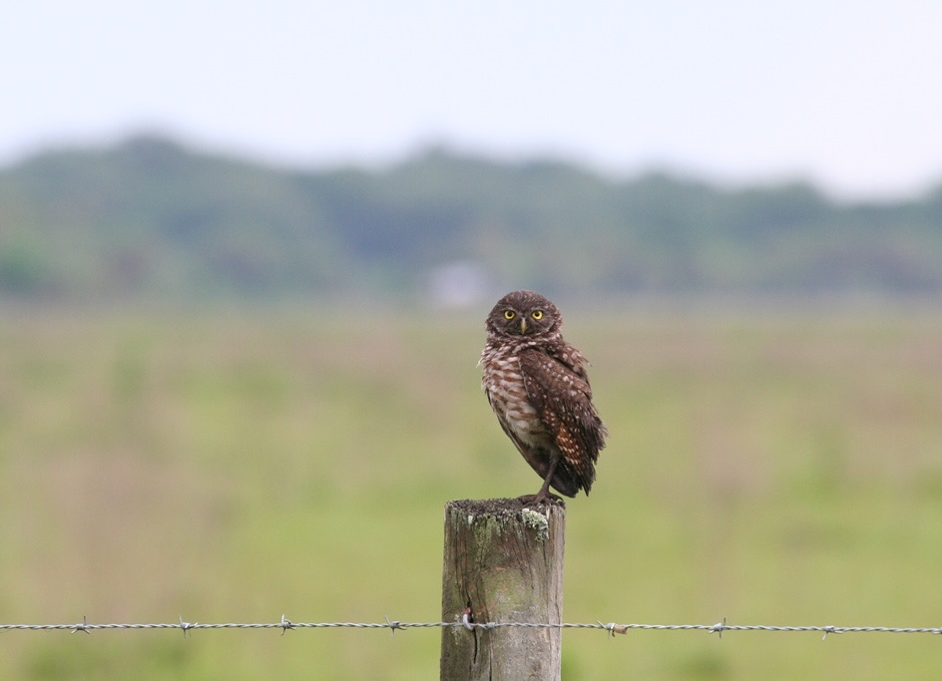

Species Conservation Measures and Permitting Guidelines
for the Florida burrowing owl
Adrienne Fitzwilliam
Florida Fish and Wildlife Conservation Commission
2020

Slide 2
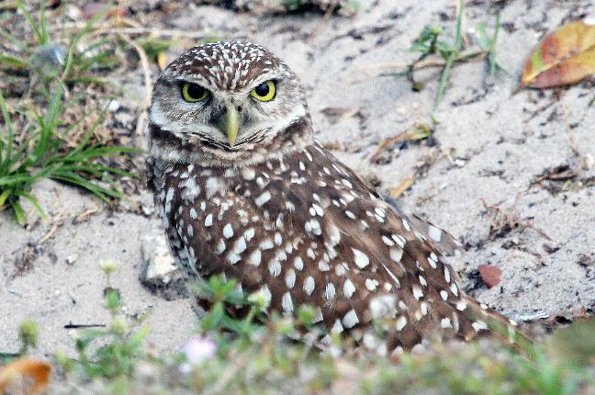
Outline
Biological Background
Status & protections
Permitting
  How to avoid take
  How to determine if a permit is needed
Contacts & resources

Slide 3
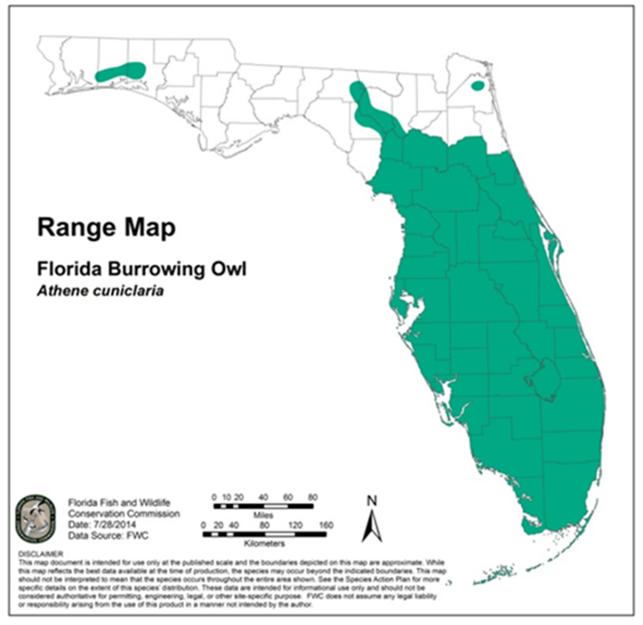
Florida Burrowing Owl
    Found in open areas with short groundcover
    Rely on burrows year-round for breeding and sheltering
    A single pair may use several burrows
    Burrows typically 5-10 feet long

Slide 4
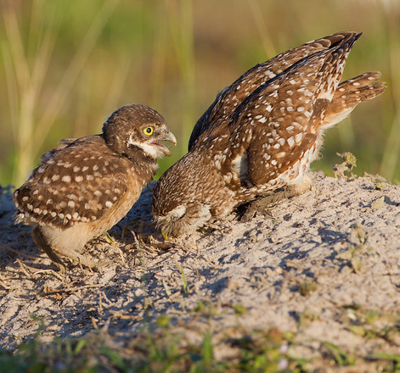
Florida Burrowing Owl
Small, ground-dwelling owl lacking ear tufts
Active during the day, especially during the breeding season (February 15 – July 10)
Young emerge from burrow at ~ 2 weeks after hatching, and fly well at 6 weeks
Photo by Ron Bielefed
Notes:
- Young continue to use burrows for 30-60 days after they start flying

Slide 5
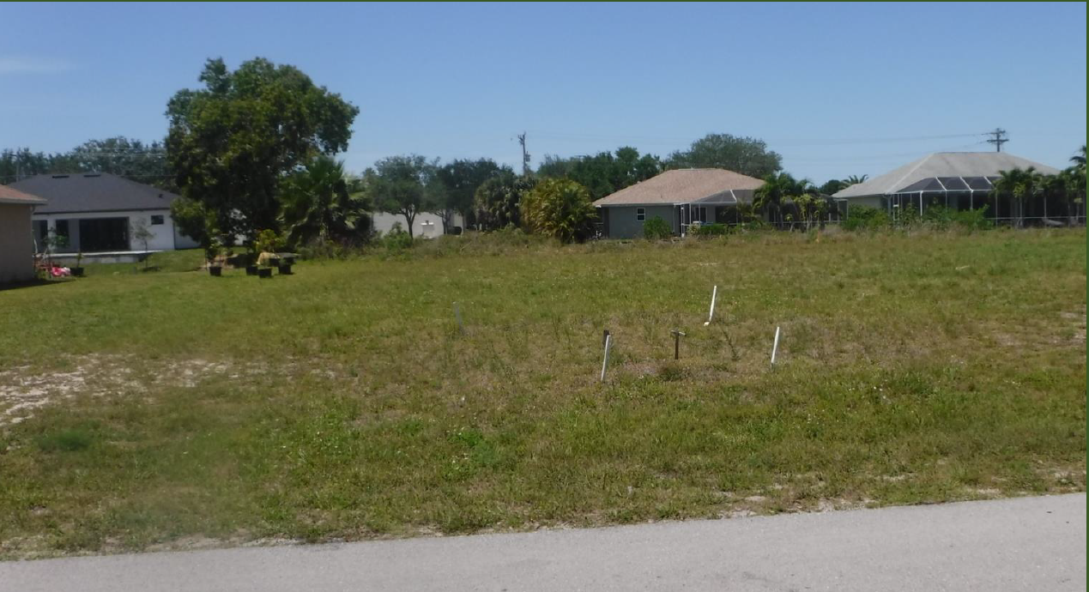
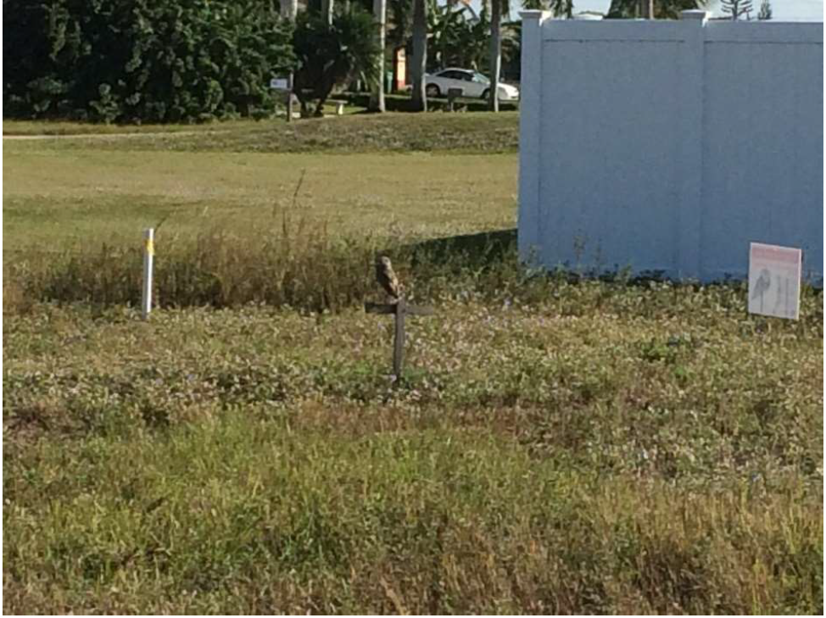
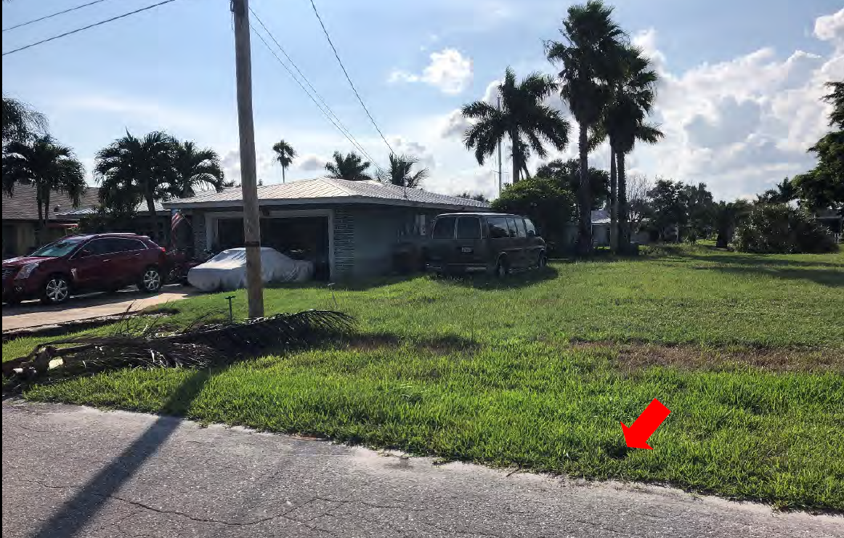
Habitat
Photos from FWC Permit Applications

Slide 6
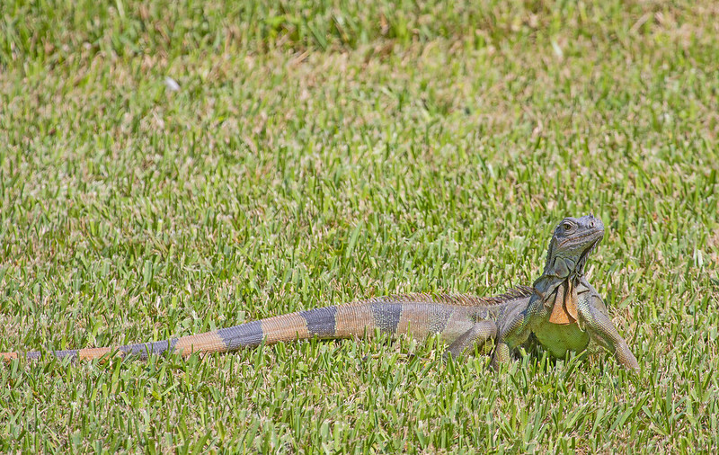
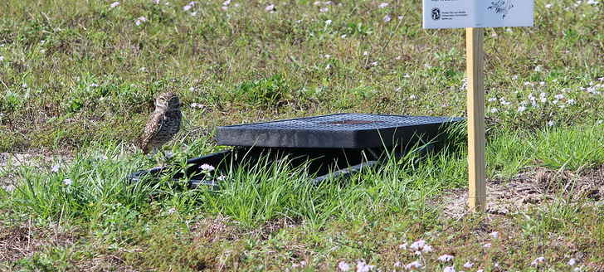
Threats
Loss of native habitat and land conversion
Destruction of burrows by human activities
Domestic animals
Collisions with automobiles
Pesticides, especially rodenticides
Invasive species such as green iguanas
FWC Photo by Andy Wraithmell
FWC Photo by Carol Rizkalla

Slide 7
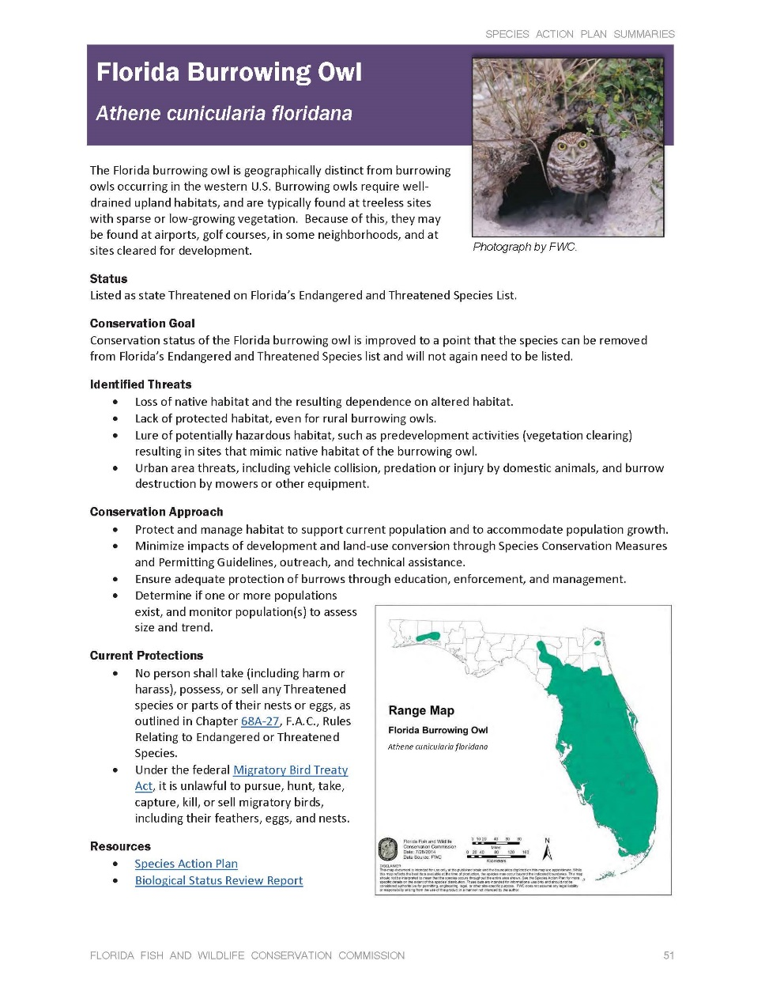
Listing Status
    Included in Imperiled Species Management Plan
    Species Action Plan
    In January 2017 listing status changed from Species of Special Concern to state Threatened
Notes:
Burrowing Owls are included in the Imperiled Species Management Plan that was approved in November of 2016. Their status change took place in January of 2017 and the Guidelines were approved in February of 2018.
Goal
Conservation status of the Florida burrowing owl is improved to a point that the species can be removed from the Florida Endangered and Threatened Species list and will not again need to be listed.
We know that in order to maintain the population, and conserve burrowing owl habitat statewide, we cannot rely on regulatory approaches alone. FWC is open to larger scale conservation efforts and hopes to partner with landowners in both urban and rural areas that have owls. Mitigation funding that we receive will be used to implement the Species Action Plan and further the long-term conservation of owls state wide. Add rule citation - Florida Statute XVIII Chapter 259.105
How is CCFW using the mitigation contributions? How are they tracking the use of their funds?

Slide 8
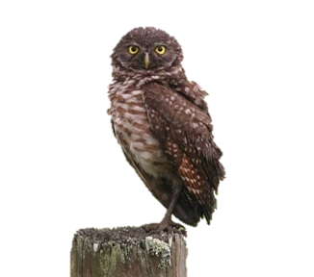
Rules and Regulations
68A-27.003(a), F.A.C. No person shall take, possess, or sell any of the endangered or threatened species included in this subsection, or parts thereof or their nests or eggs except as allowed by specific federal or state permit or authorization.
Notes:
The prohibitions in rule 68A-27 include “take,” which is further defined to include…
Some key terms in the definition of tare are “harm” and “harass.”
The term “harm” in the definition of take means an act which actually kills or injures fish or wildlife. Such act may include significant habitat modification or degradation where it actually kills or injures wildlife by significantly impairing essential behavioral patterns, including breeding, feeding or sheltering.
The term “harass” in the definition of take means an intentional or negligent act or omission which creates the likelihood of injury to wildlife by annoying it to such an extent as to significantly disrupt normal behavioral patterns which include, but are not limited to, breeding, feeding or sheltering.

Slide 9
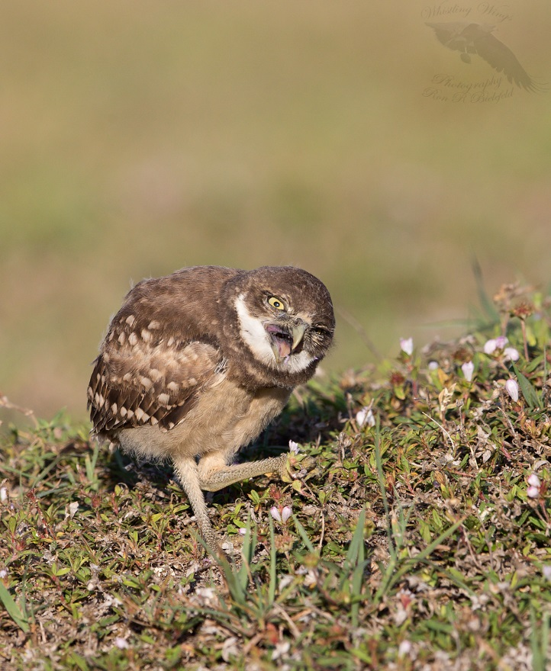
What is
“take?”
Ron Bielefeld, Whistling Wings Photography

Slide 10
What is “take?”
68A-27.001(4): “Take – to harass, harm, pursue, hunt, shoot, wound, kill, trap, capture, or collect, or to attempt to engage in such conduct.”
Notes:
State-designated Threatened species are protected by a different definition of “take” compared to Species of Special Concern. The definition of take for state Threatened species includes the terms “harm” and “harass.”
To “take” a burrowing owl means to harass, harm, pursue, hunt, shoot, wound, kill, trap, capture, or collect a burrowing owl, or its eggs (or to attempt to do any of the above). “Harm” means an act which actually kills or injures a burrowing owl. This can include significant habitat modification that kills or injures burrowing owls by significantly impairing essential behavioral patterns, including breeding, feeding or sheltering. “Harass” means an intentional or negligent act or omission which creates the likelihood of injury to a burrowing owl by annoying it to such an extent as to significantly disrupt normal behavioral patterns which include, but are not limited to, breeding, feeding or sheltering (Rule 68A-27 F.A.C.). For example, burrowing owls use burrows for sheltering year-round, and collapse of burrows is expected to result in take, even when the burrow is not being used for raising young. Pages 3 and 4 in the Florida Burrowing Owl Species Conservation Measures and Permitting Guidelines provide information on what constitutes take for burrowing owls.
Definition of take:
Injury or death
Collapsing or blocking burrows
Disturbances within 10 feet year-round * except for activities that are not likely to cause take
Disturbances within 33 feet during breeding season * except for activities that are not likely to cause take
Intentionally flushing owls (harassment)
Capturing handling owls or eggs
Using a burrow scope
Sig Habitat modification

Slide 11
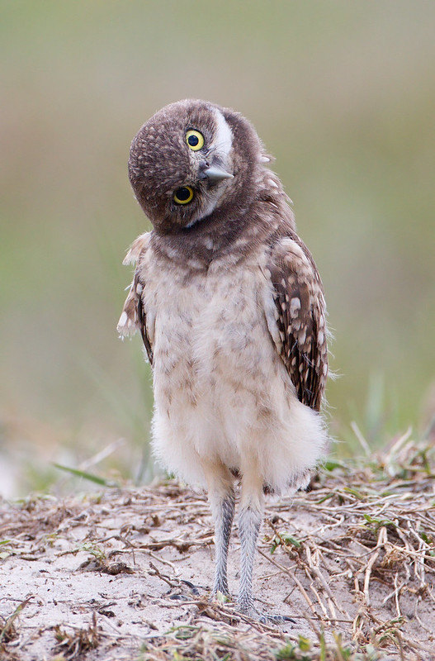
What does it mean to “harm?”
68A-27.001: “The term ‘harm’…means an act which actually kills or injures fish or wildlife. Such act may include significant habitat modification or degradation where it actually kills or injures wildlife by significantly impairing essential behavioral patterns, including breeding, feeding or sheltering.”
Photo by Ron Bielefed
Notes:
An example of harm is when an activity collapses a burrow with flightless young inside

Slide 12
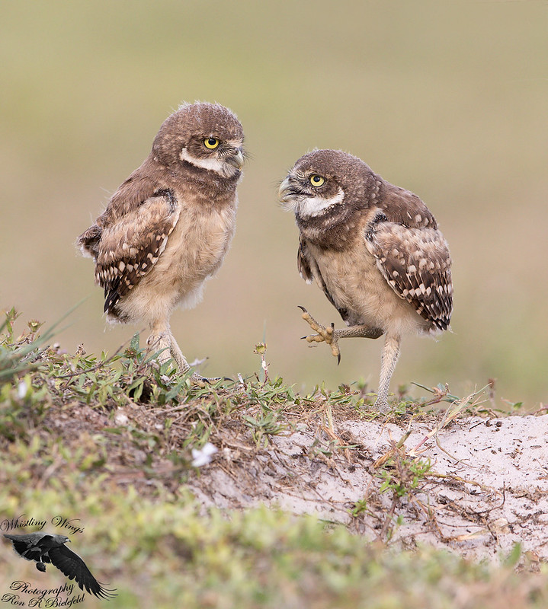
What does it mean to “harass?”
68A-27.001: “The term ‘harass’…means an intentional or negligent act or omission which creates the likelihood of injury to wildlife by annoying it to such an extent as to significantly disrupt normal behavioral patterns which include, but are not limited to, breeding, feeding or sheltering.”
Photo by Ron Bielefed
Notes:
An example of harass is a project

Slide 13
Guidelines: What does take mean?
    68A-27.001 – Definition of take
    Injury or death of owls, young or eggs
    Collapsing or blocking burrows
    Disturbances within 10 feet year-round expected to cause take
    Disturbances within 33 feet during the breeding season expected to cause take
    Intentionally forcing owls to fly
    Using a burrow scope
Notes:
To “take” a burrowing owl means to harass, harm, pursue, hunt, shoot, wound, kill, trap, capture, or collect a burrowing owl, or its eggs (or to attempt to do any of the above). “Harm” means an act which actually kills or injures a burrowing owl. This can include significant habitat modification that kills or injures burrowing owls by significantly impairing essential behavioral patterns, including breeding, feeding or sheltering. “Harass” means an intentional or negligent act or omission which creates the likelihood of injury to a burrowing owl by annoying it to such an extent as to significantly disrupt normal behavioral patterns which include, but are not limited to, breeding, feeding or sheltering (Rule 68A-27 F.A.C.). For example, burrowing owls use burrows for sheltering year-round, and collapse of burrows is expected to result in take, even when the burrow is not being used for raising young. Pages 3 and 4 in the Florida Burrowing Owl Species Conservation Measures and Permitting Guidelines provide information on what constitutes take for burrowing owls.
Definition of take:
Injury or death
Collapsing or blocking burrows
Disturbances within 10 feet year-round * except for activities that are not likely to cause take
Disturbances within 33 feet during breeding season * except for activities that are not likely to cause take
Intentionally flushing owls (harassment)
Capturing handling owls or eggs
Using a burrow scope
Sig Habitat modification

Slide 14
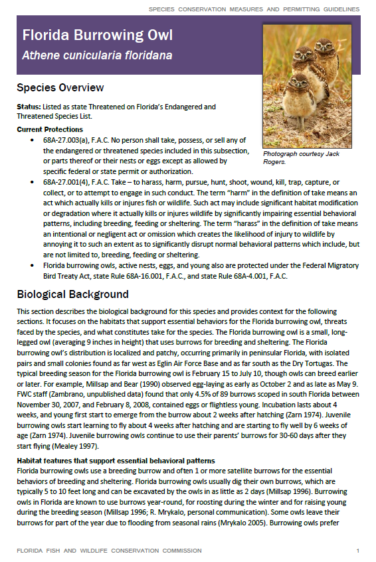
Species Conservation Measures and Permitting Guidelines
    Guidelines approved in February 2018
    A single source for technical assistance and permitting
    Incorporated into rule
Notes:
A single source for technical assistance & permitting, including:
Biological background.
Distribution & survey methodology.
Recommended conservation practices.
Ways to avoid needing a permit.
FWC permitting, including minimization & mitigation

Slide 15
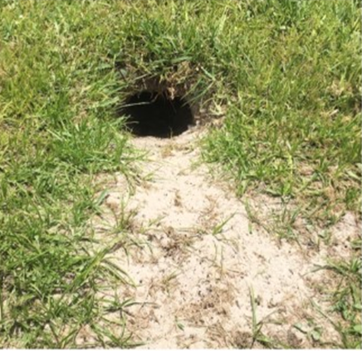
Burrow Definitions
    Potentially Occupied burrow -
  Active Burrow - contains eggs or is used by flightless young.
  Inactive Burrow – does not contain eggs or flightless young.
Abandoned Burrow – burrow entrance or significant portion of the burrow tunnel has filled in, collapsed, or is blocked to an extent that owls cannot access the burrow.

Slide 16
Burrows
FWC photos

Slide 17
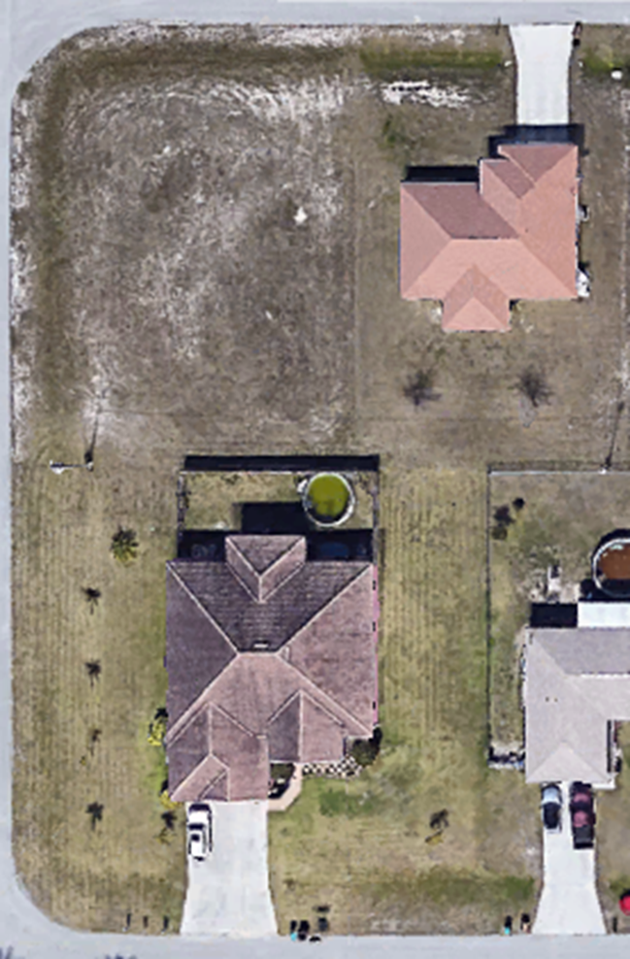

How to avoid the need for a permit
    Avoid acts that can kill or injure burrowing owls or eggs (e.g., collapsing or blocking burrows)
    Buffers around the entrance of the burrows :
      A 10-foot buffer year-round and
      At least a 33-foot buffer during the breeding season (Feb 15 – July 10)
    Page 10 of the Guidelines describes other circumstances under which take is authorized without a permit
Notes:
If you cannot avoid take, come to FWC for a permit
How can people avoid take? How can they avoid the need for a permit? - Pages 7 through 9 in the Florida Burrowing Owl Species Conservation Measures and Permitting Guidelines provide information on how to avoid take, including:
a. Avoiding acts that can kill or injure burrowing owls or eggs, and
b. Maintaining at least a 10-foot buffer during the non-breeding season (July 11-February 14) and at least a 33-foot buffer during the breeding season (February 15-July 10) around the entrance of burrowing owl burrows (Please note: for projects started during the non-breeding season that unexpectedly extend into the breeding season, contact the FWC regarding permitting options), and
c. Ensuring that the project does not cause significant habitat modification through the loss of greater than 50% of the total foraging habitat within a 1,970-foot radius circle around a burrowing owl burrow. Activities that may cause significant habitat modification include, but are not limited to, clearing, grading, paving, bulldozing, digging, building construction, and site preparation for development. Foraging habitat includes a variety of open habitats with low vegetation (e.g., prairies, pastures, fields, depression marshes, vacant lots, etc.).
Page 10 of the Guidelines describes other circumstances under which take is authorized without a permit. Please be aware that take can occur even if the burrow is on an adjacent property.

Slide 18
Activities not expected to cause take
    Maintenance of lawns that does not result in harm to burrowing owls and do not collapse or flood burrows
    Use of pesticides and herbicides according to the label instructions and not immediately around the burrow entrance
    Re-sodding of a lawn (outside of the breeding season)
    Other activities listed on page 8-9 of the Guidelines
Notes:
If you cannot avoid take, come to FWC for a permit

Slide 19

More on take…
    Take can occur even if burrows are on an adjacent property
    Projects started during the non-breeding season that unexpectedly extend into the breeding season
Photo by Ron Bielefeld
Notes:
If you cannot avoid take, come to FWC for a permit

Slide 20
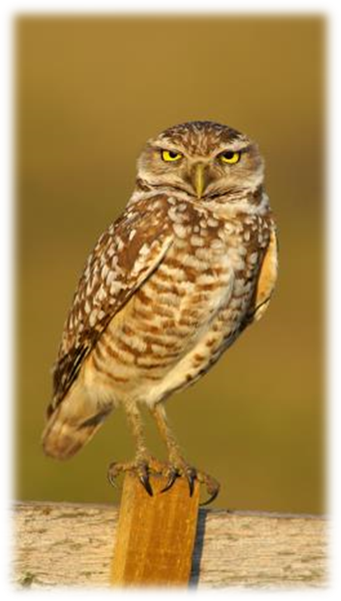
Types of permits
Incidental Take
Intentional Take
FWC

Slide 21
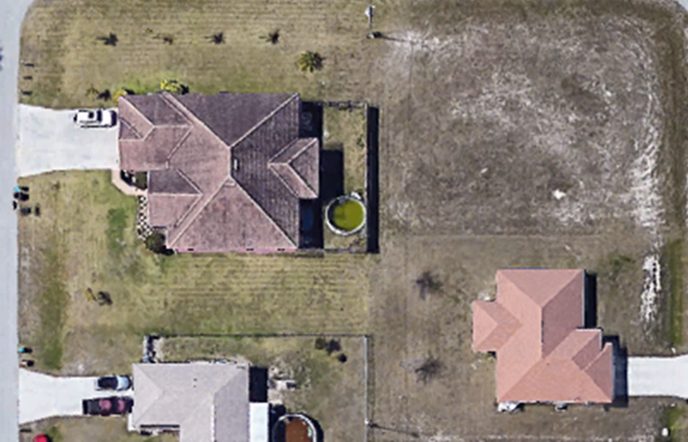
Incidental Take Permits
Incidental Take refers to take that is incidental to, and not the purpose of, carrying out an otherwise lawful activity
“Migratory Bird Nest Removal” in online permit system

Slide 22
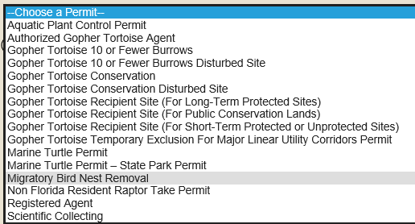
Incidental Take Permit

Slide 23
What can be done with a permit?
    In some cases, permit conditions will allow permittees or their designees to:
      Scope burrows;
      Excavate and fill burrows that are inactive;
      Harass burrowing owls within 33 feet of a burrow;
      Activities within 10 feet of a burrow.
Notes:
If mitigation is being provided, permits are not complete until mitigation has been received by the Foundation.
Category 1: for collapse of burrows without change in surrounding habitat there are 3 options. Installation of a starter or artificial burrow on site; installation of starter/artificial burrow offsite; contribution of $1900 to the conservation fund.
Category 2: for collapse of burrows with some changes in surrounding habitat there are 3 options. Installation of 2 artificial burrows and $600 contribution per burrow cluster; installation of 2 starter burrows and $850 contribution per burrow cluster; contribution of $1900 per burrow cluster.
Category 3: for significant habitat modification where greater than 50% of available foraging area within a 1,970 foot radius of a burrow cluster will be removed the options will be evaluated on a case by case basis and include scientific benefit by filling data gaps, habitat restoration, protection, or maintenance, and financial contributions.

Slide 24
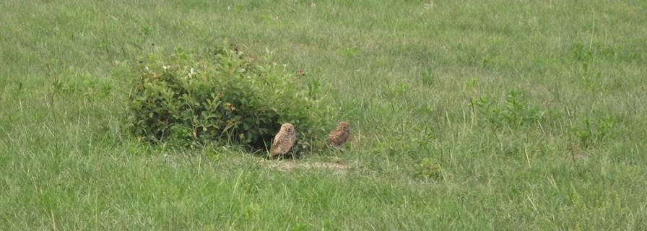
Mitigation
Applying for a permit is free
But there may be mitigation associated with the permit

Slide 25
Mitigation
Category 1: Mitigation for projects that do not involve changes to foraging habitat (per burrow)
Onsite starter or artificial burrows | $0
Financial contribution with offsite starter or artificial burrow | $600
Financial contribution alone | $1,900
*Starter or artificial burrows maintained for 3 years
Notes:
According to our state rules, the FWC Incidental take permits are issued when there is a scientific or conservation benefit to the species. can demonstrate scientific or conservation benefit by showing a combination of measures that minimize impacts to burrowing owls and their burrows and measures that mitigate for unavoidable take that may occur.
The guidelines provide mitigation options for commonly encountered scenarios. There is no cost to apply for a permit.
I’ll describe the two most commonly encountered scenarios. First, Category 1 includes projects that do not involve changes to foraging habitat. Examples include when burrows obstruct lawful activities in cemeteries, athletic fields, school fields, utility line easements, golf courses, etc. In these cases, burrows may need to be destroyed, but the foraging habitat remains intact. Mitigation for these scenarios is on a per burrow basis.

Slide 26
Mitigation
Category 2: Mitigation for projects with changes to foraging habitat but no significant habitat modification (per burrow cluster)
Financial contribution with artificial burrows* | $600
Financial contribution with starter burrows* | $850
Financial contribution alone | $1,900
*Starter or artificial burrows maintained for 3 years
Notes:
Category 2 includes most residential and commercial developments, where there are changes to foraging habitat, but the changes aren’t large-scale enough to rise to the level of “significant habitat modification.” Mitigation for category 2 is on a per burrow cluster basis.
*A burrow cluster is 1 or more burrows within 150 feet of each other. For the purposes of calculating mitigation, the burrow cluster is meant to represent the burrows potentially used by a single breeding pair of owls. 150 feet represents approximately 1/4 of the mean nearest-neighbor distance in Cape Coral (Millsap and Bear 1997) and the approximate distance from nest burrows that burrowing owls typically roost and loaf (Haug and Oliphant 1990). Mealey (1997) observed several pairs with satellite burrows over 100 feet away from the nest burrow.

Slide 27
Minimization
Conducting project activities outside of the breeding season (Feb 15 – July 10)
Maintain appropriate buffers around at least some Potentially Occupied burrows
Maintaining vegetation height around Potentially Occupied burrows
More minimization found in the Guidelines on pages 13-14

Slide 28
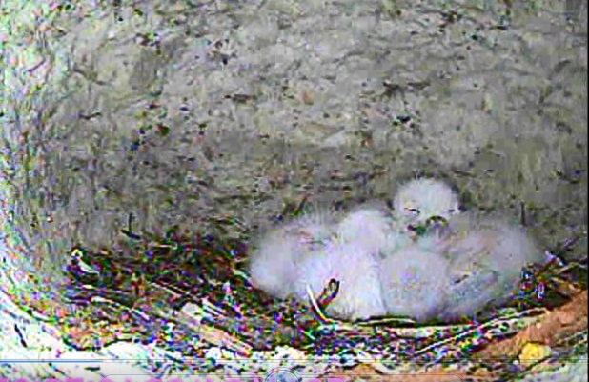
Excavating and filling burrows
    Require minimum qualifications to excavate and fill a burrow or scope a burrow
    Qualified individual scopes burrow prior to confirm burrow is inactive
Courtesy of Alli Smith UF/IFAS

Slide 29
Excavating and filling burrows
    Permit must be posted on site
    Excavation/filling must occur within 48 hours before project
    Permits issued only when activity is scheduled
    FWC typically does not issue permits for active burrows (i.e., eggs or young present)
Notes:
The third bullet refers to: we don’t issue permits so someone can make the lot more attractive for selling it.

Slide 30
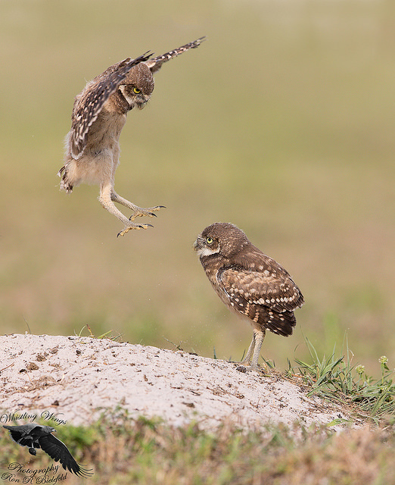
Intentional Take Permit
When take is the purpose of the action
Prohibited without…
  Scientific Collecting Permit
  Or other authorization
Photo by Ron Bielefeld

Slide 31
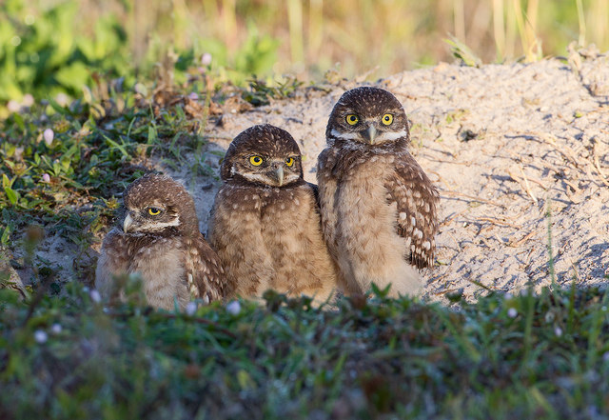
Permit Process
Same general process for all permits
Online permitting system
90 days to approve or deny complete application
Request for Additional Information if not complete
Photo by Ron Bielefeld

Slide 32
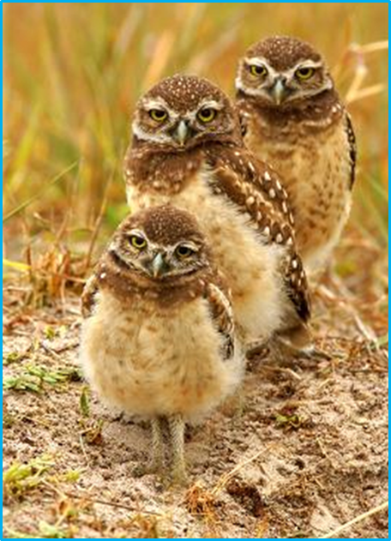
When do you need a permit?
    If you are unable to avoid by 10 feet or 33 feet
    If you are conducting an activity not listed on page 8 and 9 of the guidelines (e.g. lawn maintenance, resodding, construction indoors, etc.)
    If not included in authorized list of activities found on page 10 of the guidelines (e.g. airports, emergency power restoration, land management consistent with a management plan, etc.)

Slide 33
What if I’m not sure if
I need a permit?
Ron Bielefeld, Whistling Wings Photography

Slide 34
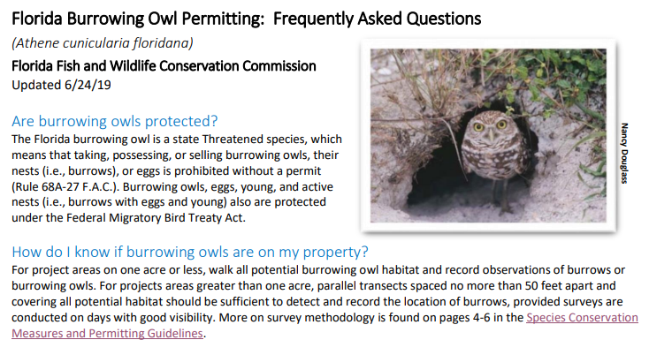
Resources
Guidelines:
  https://myfwc.com/wildlifehabitats/wildlife/species-guidelines/
Florida Burrowing Owl Permit information and FAQs:
  https://myfwc.com/license/wildlife/protected-wildlife-permits/burrowing-owl/
Notes:
Programmatic permits increase efficiency for permittees by allowing them to cover a suite of similar activities under a single, multi-year permit, as opposed to permitting each activity individually.
For example, a county may want a single permit for burrowing owls for all county maintained recreational areas. This would give the county assurance that they could respond quickly to owls in ball fields, following the conditions included in their programmatic permit.

Slide 35
How do I apply for a permit
or look up a permit?
Ron Bielefeld, Whistling Wings Photography

Slide 36
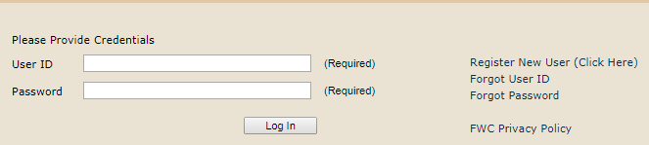
Online Permitting System
http://www.myfwc.com/license/wildlife/protected-wildlife/

Slide 37
Questions
Adrienne Fitzwilliam
Avian Conservation Biologist
Adrienne.Fitzwilliam@MyFWC.com
(352) 620-7732
Craig Faulhaber
Avian Conservation Coordinator
Craig.Faulhaber@MyFWC.com
(352) 620-7346

