Slide 1
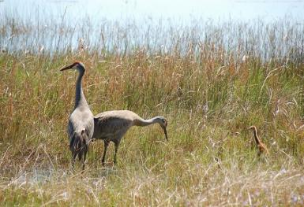

Species Conservation Measures and Permitting Guidelines​ for the Florida Sandhill Crane
Craig Faulhaber
Florida Fish and Wildlife Conservation Commission
Notes:
The goal of this presentation is to introduce you to the Species Conservation Measures and Permitting Guidelines for the Florida sandhill crane.

Slide 2
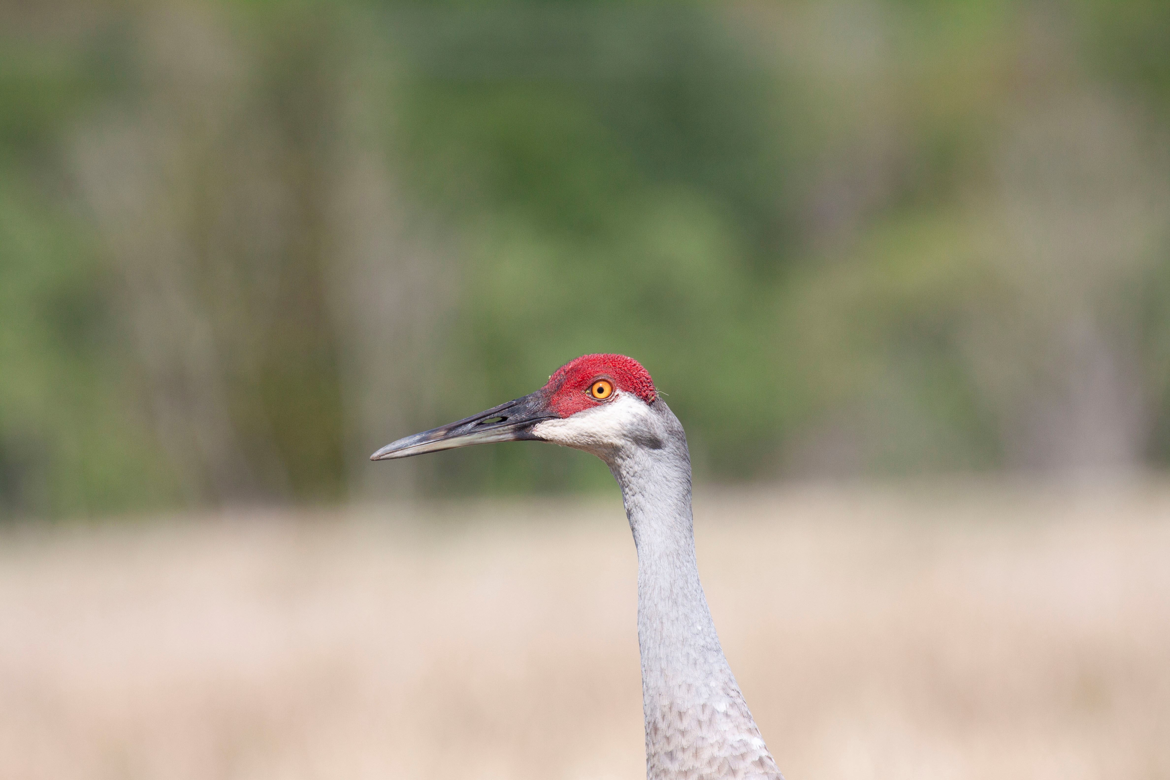
Outline
Biological background
Status & protections
Permitting
  Are cranes using the site?
  Is take avoidable?
  Types of permits
  Permitting process
Conservation design considerations
Contacts & resources
Photo by Craig Faulhaber
Notes:
I’ll start by telling you a bit about the Florida sandhill crane, then I’ll discuss the species’ status and protections. Next, I’ll provide an overview of FWC’s permitting process, including survey methods, how to know when a permit is needed, the types of permits available, and the permitting process. We’ll finish up with some design considerations when constructing roadways and some helpful contacts and resources for you.

Slide 3
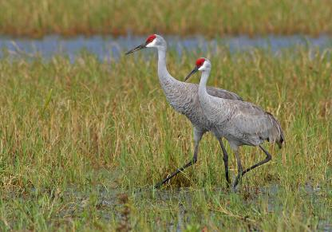
Biological background
    Long-legged, long-necked gray bird
    Can reach height of 47 inches
    Bare patch of red skin on crown of head
    Flies with outstretched neck, unlike herons
    Can live as long as 21 yrs (average 7)
Photo by FWC
Notes:
The Florida sandhill crane is a long-necked, long-legged gray bird that can stand as tall as 47 inches in height. Sandhill cranes can be distinguished from superficially similar herons and egrets by a bare patch of red skin on the crown of the head and by their flight – unlike herons, cranes fly with an outstretched neck. Sandhill cranes are long-lived birds that can live up to 21 years, though the average age of those that survive to independence is 7 years.

Slide 4
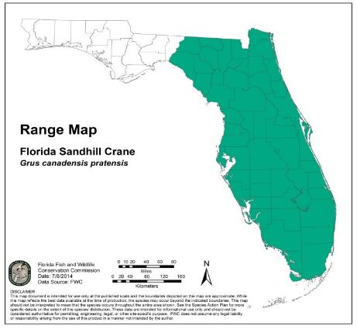
Biological background
    Non-migratory subspecies
    Note: non-listed, migratory winters in Florida (Oct-Mar) but breeds elsewhere
    Subspecies difficult to tell apart
Notes:
The Florida sandhill crane is a non-migratory subspecies of sandhill crane that resides in southern Georgia and throughout Peninsular Florida. Florida sandhill cranes are joined in the winter by large numbers of the migratory subspecies of sandhill crane, which is present in Florida from October through March but breeds in the northern US and Canada. The two subspecies are very difficult to tell apart, but those observed in the peninsula from April to September can be assumed to be the resident Florida subspecies.

Slide 5
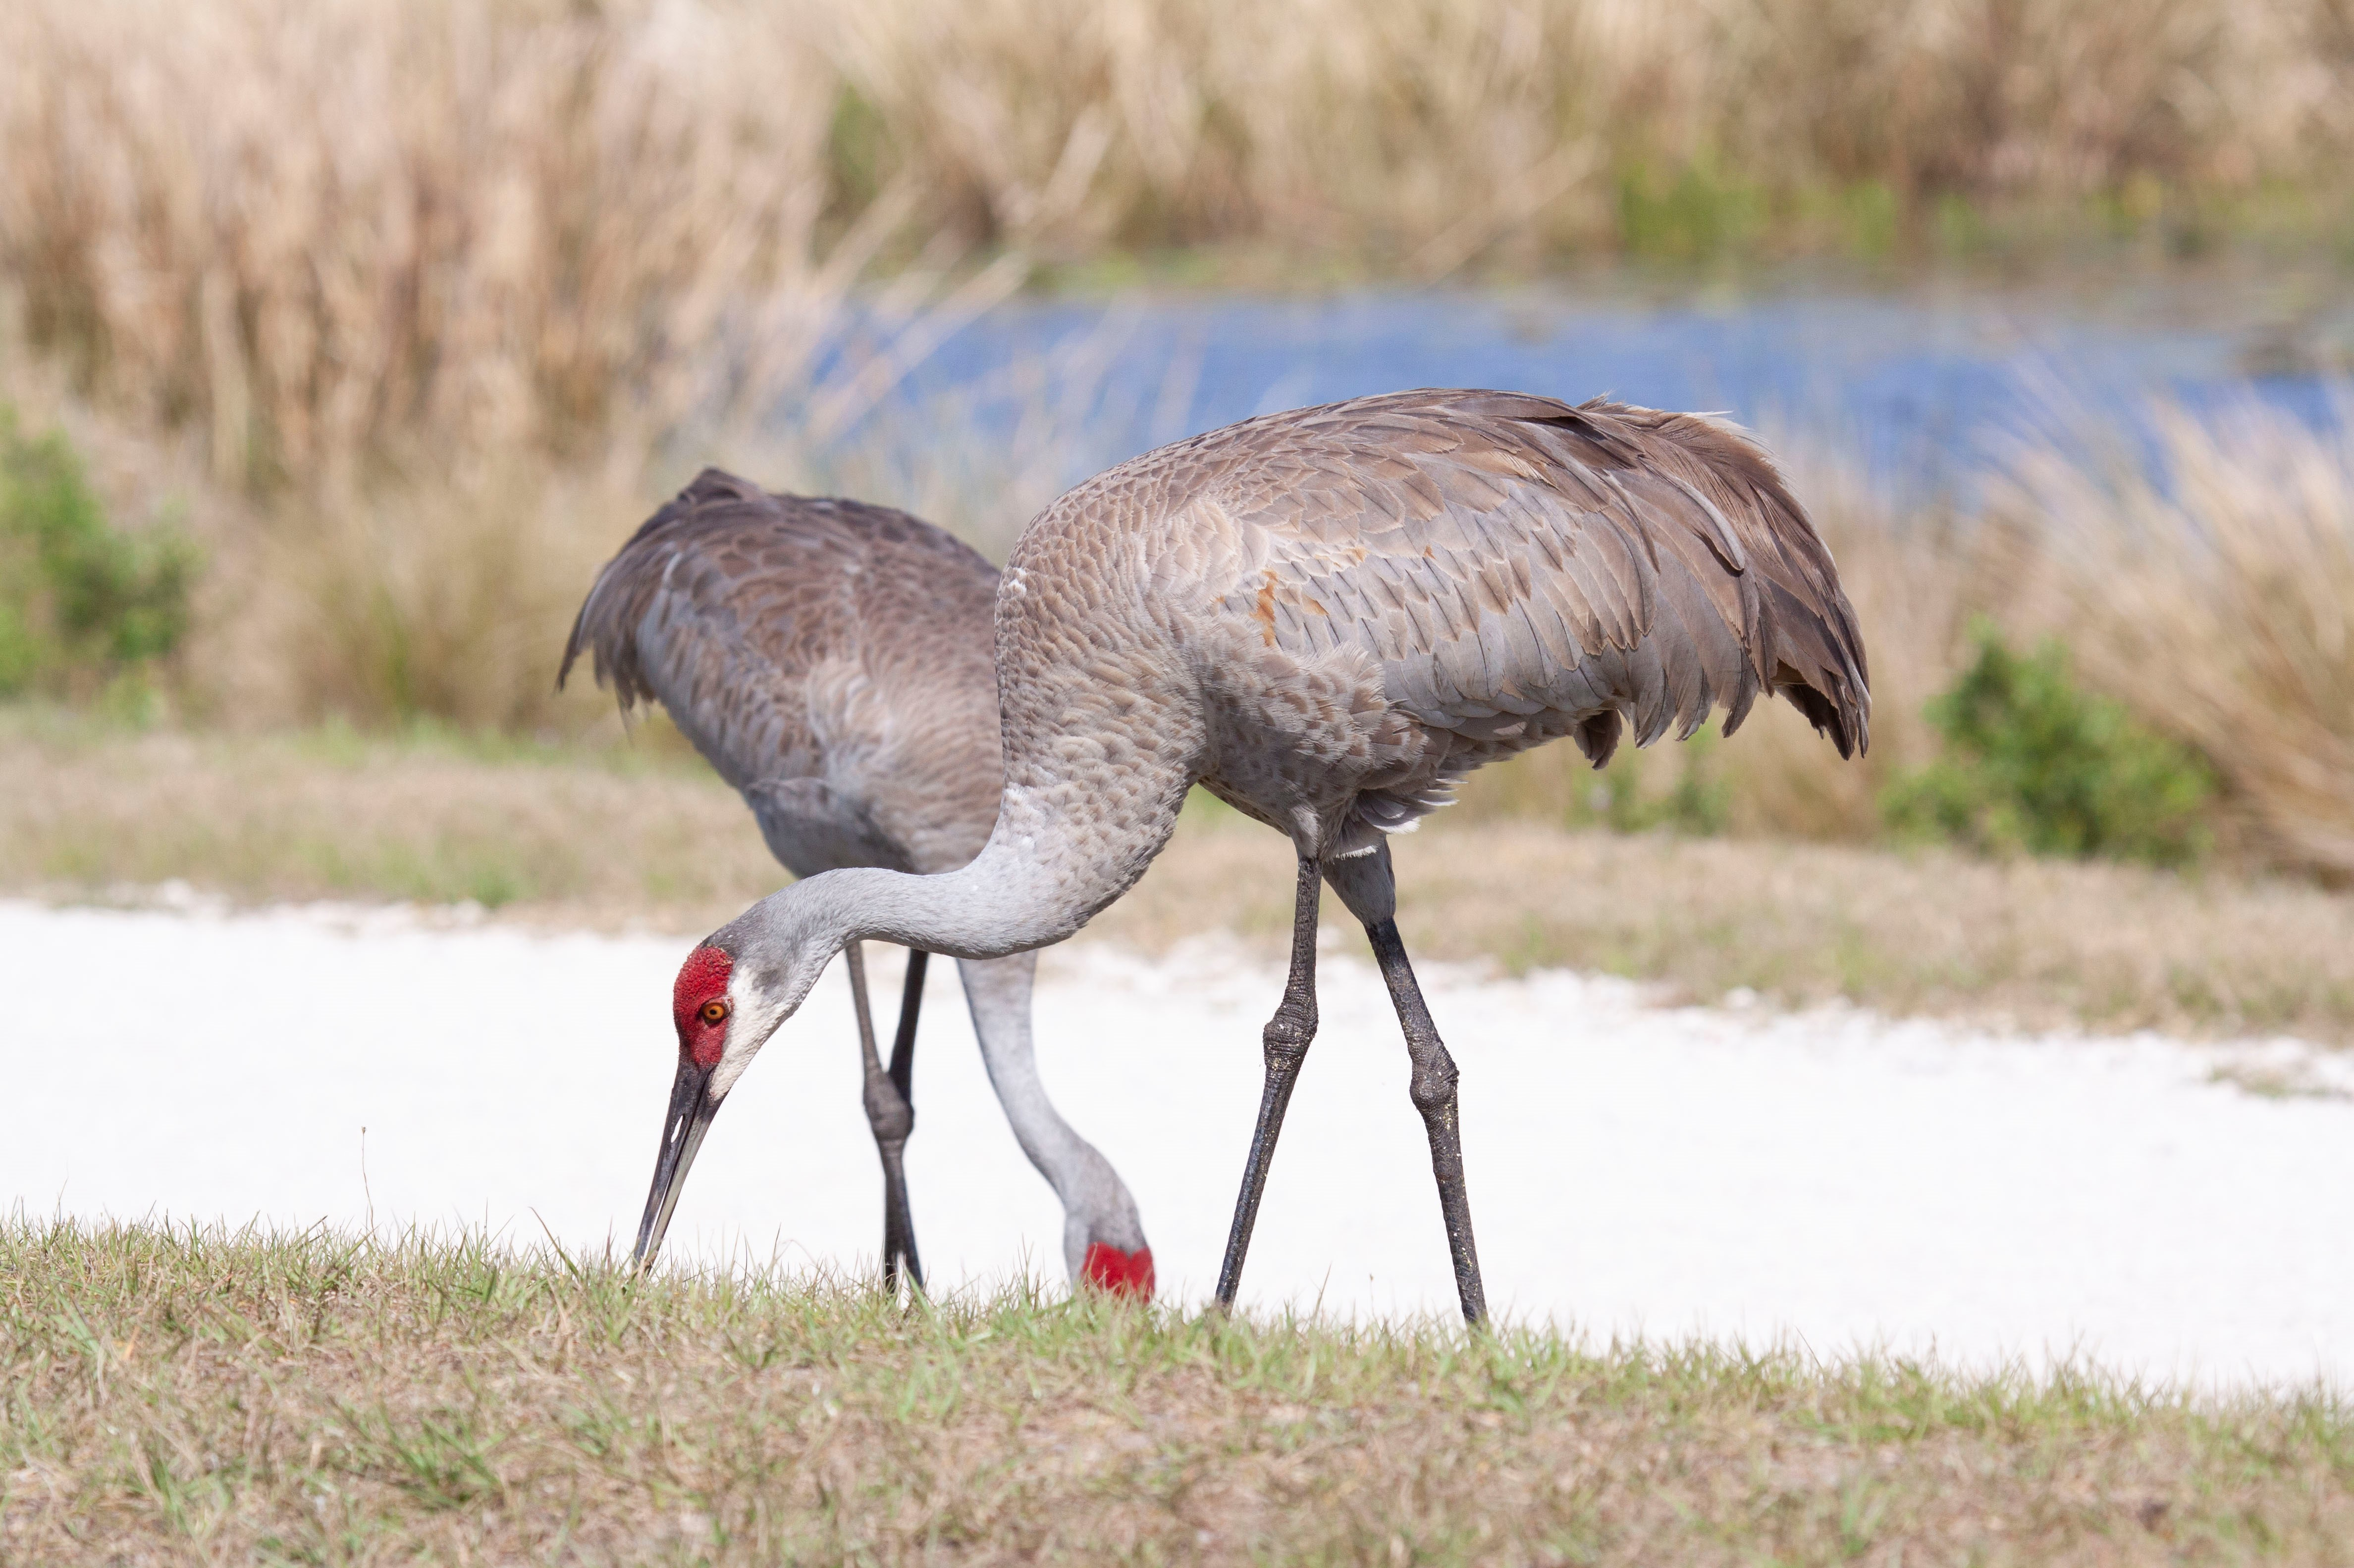
Biological background
    Open, shallow freshwater marshes critical for nesting/roosting
    Forage in a variety of open wetlands and uplands
      Omnivorous
        Seeds, roots, invertebrates, small vertebrates, etc.
Photo by Craig Faulhaber
Notes:
Open, shallow, freshwater marshes are critical for both nesting and roosting. Florida sandhill cranes forage in a variety of open habitats, including shallow herbaceous wetlands, improved pastures, prairies, open pine forests, croplands, golf courses, airports, and sod farms. Cranes generally avoid areas with tall vegetation or thick forest canopies. Sandhill cranes are omnivores that eat a wide variety of plant material, insects and other invertebrates, and small vertebrates like snakes and frogs.

Slide 6
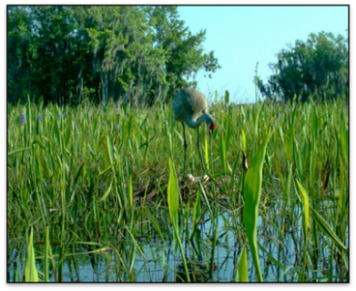
Biological background
    Breeding season typically Feb-Apr
      As early as Dec, as late as Aug
      Nests built of plant stems in shallow marshes
      Nesting locations vary from year to year with water conditions
      Clutch size 1-3 eggs, typically 2
Photo by FWC
Notes:
Florida sandhill cranes typically breed from February through April, but the breeding season can extend as early as December and as late as August. Sandhill cranes build their nests from plant material in shallow freshwater marshes. The location of a nest within a crane’s territory varies from year to year depending on water conditions. Sandhill cranes can lay 1-3 eggs, but the most common number is two.

Slide 7
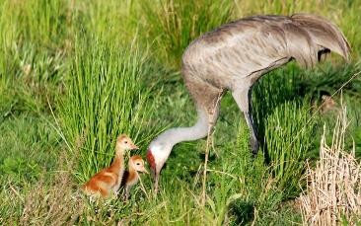
Biological background
      Uplands adjacent to nest marsh critical for foraging until chicks can fly (~70 days)
      Young stay with adults for 10 months
Photo by FWC
Notes:
Uplands directly adjacent to nesting marshes are important for young sandhill cranes for the first several months until they are capable of flying. Flightless chicks forage in the uplands and then return to the safety of the wetland to roost at night. It typically takes 65-70 days before young sandhill cranes can fly. Young birds, which have a grayish crown for much of their first year, stay with their parents for the first 10 months of their life before departing to find their own territory.

Slide 8
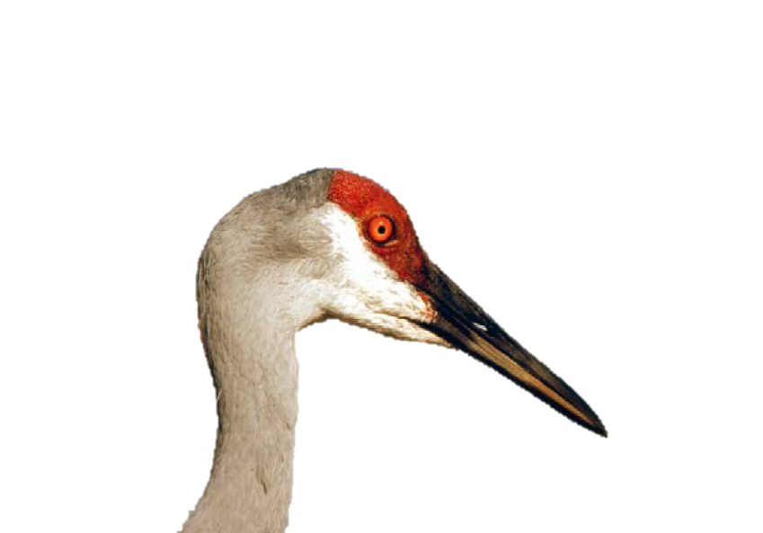
Protections
    State designated Threatened (Chapter 68A-27, F.A.C.)
    Federal Migratory Bird Protection Act and associated state rule
Notes:
The Florida sandhill crane was listed as a state designated Threatened species in 1974. As such, the Florida sandhill crane receives the protections in Chapter 68A-27 of the Florida Administrative Code. Florida sandhill cranes, active nests, eggs, and young also are protected under the Federal Migratory Bird Treaty Act and associated state rule.

Slide 9
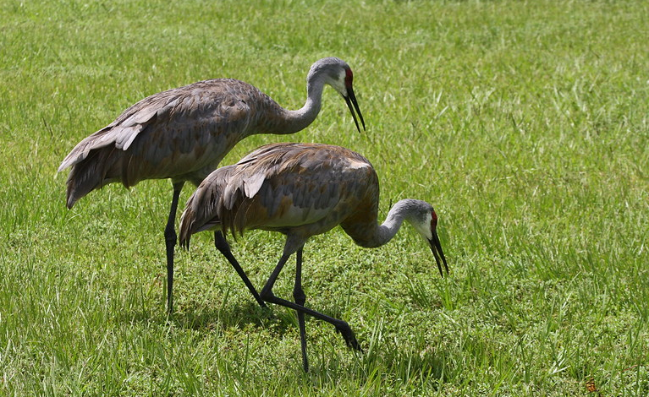
Rules and Regulations
68A-27.003(a), F.A.C. No person shall take, possess, or sell any of the endangered or threatened species included in this subsection, or parts thereof or their nests or eggs except as allowed by specific federal or state permit or authorization.
Notes:
The prohibitions in rule 68A-27 include “take,” which is further defined to include…
Some key terms in the definition of tare are “harm” and “harass.”
The term “harm” in the definition of take means an act which actually kills or injures fish or wildlife. Such act may include significant habitat modification or degradation where it actually kills or injures wildlife by significantly impairing essential behavioral patterns, including breeding, feeding or sheltering.
The term “harass” in the definition of take means an intentional or negligent act or omission which creates the likelihood of injury to wildlife by annoying it to such an extent as to significantly disrupt normal behavioral patterns which include, but are not limited to, breeding, feeding or sheltering.

Slide 10
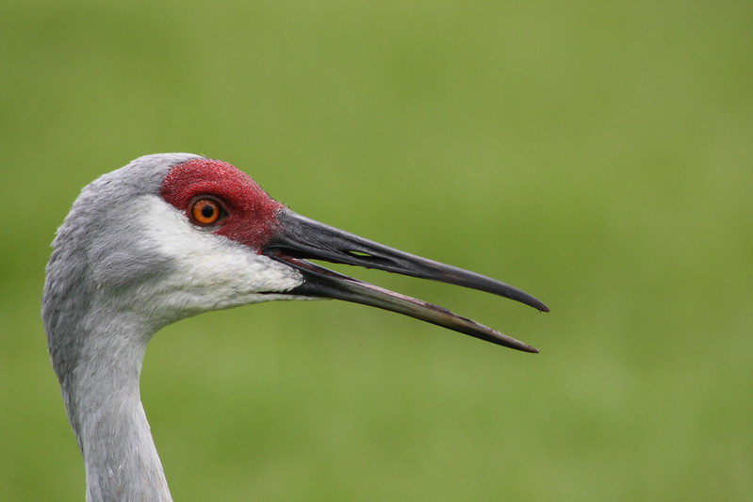
What is “take?”
68A-27.001: “Take – to harass, harm, pursue, hunt, shoot, wound, kill, trap, capture, or collect, or to attempt to engage in such conduct.”
Photo by FWC
Notes:
Some key terms in the definition of take are “harm” and “harass.”

Slide 11
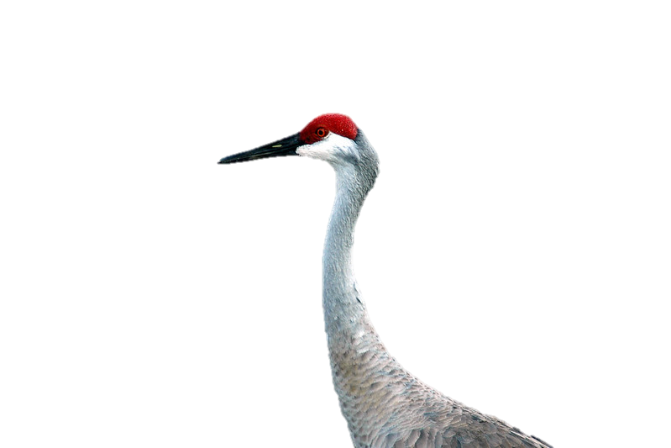
What does it mean to “harm?”
68A-27.001: “The term ‘harm’…means an act which actually kills or injures fish or wildlife. Such act may include significant habitat modification or degradation where it actually kills or injures wildlife by significantly impairing essential behavioral patterns, including breeding, feeding or sheltering.”
An example: A vehicle runs over a chick.
Notes:
The term “harm” in the definition of take means an act which actually kills or injures fish or wildlife. Such act may include significant habitat modification or degradation where it actually kills or injures wildlife by significantly impairing essential behavioral patterns, including breeding, feeding or sheltering.
An example of harm is a construction vehicle running over a chick.

Slide 12
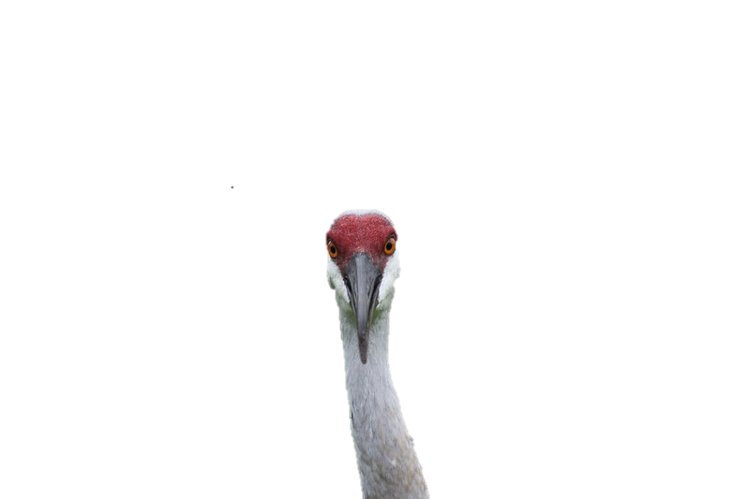
What does it mean to “harass?”
68A-27.001: “The term ‘harass’…means an intentional or negligent act or omission which creates the likelihood of injury to wildlife by annoying it to such an extent as to significantly disrupt normal behavioral patterns which include, but are not limited to, breeding, feeding or sheltering.”
An example: Construction activities flush an adult off a nest, which creates the likelihood of injury to the eggs.
Notes:
The term “harass” in the definition of take means an intentional or negligent act or omission which creates the likelihood of injury to wildlife by annoying it to such an extent as to significantly disrupt normal behavioral patterns which include, but are not limited to, breeding, feeding or sheltering.
An example of harassment is when construction activities flush an adult off of a nest, which creates the likelihood of injury by exposing the egg to the elements and to predators. Such disturbance can even lead to abandonment of the nest.

Slide 13
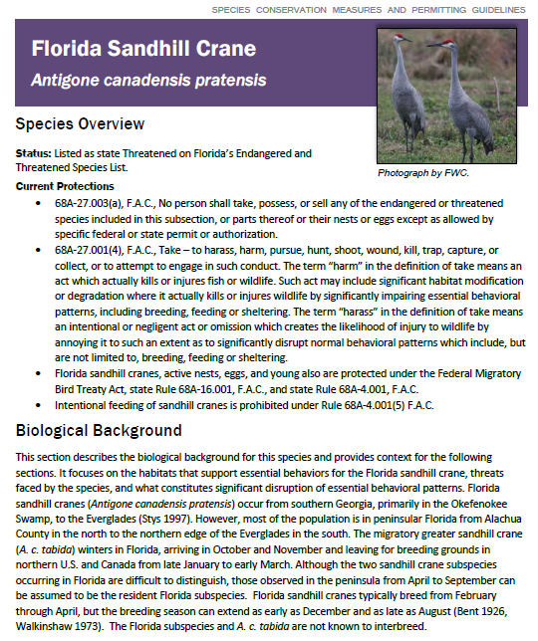
Species Conservation Measures & Permitting Guidelines
Meant to streamline technical assistance & permitting
  Expounds on definition of take
  Includes avoidance measures
  FWC permitting, including minimization & mitigation when take unavoidable
Incorporated in rule
Notes:
To streamline technical assistance and information on permitting, the FWC created Species Conservation Measures and Permitting Guidelines. We hope the Guidelines will help a wide range of stakeholders understand the FWC’s permitting process when planning and implementing projects.
Guidelines expound on the definition of take for a particular species and provide measures for how to avoid take. The Guidelines also provide information on FWC’s permitting process, including minimization and mitigation measures when take is unavoidable. Although we call them “guidelines,” the document is incorporated by reference in state rule.

Slide 14
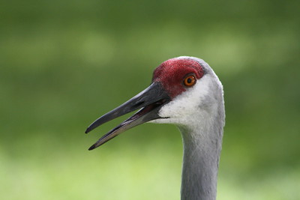
Guidelines: What does take mean?
    Injury or death of adults, young or eggs
    Flushing cranes from nests
    Significant habitat modification
      E.g., cutting off access of flightless young to adjacent upland foraging habitat
Photo by FWC
Notes:
As I mentioned, the Guidelines help to expound on what constitutes take for a species. For Florida sandhill cranes, the most obvious form of take is injury or death of adults, young, or eggs. Flushing cranes from nests also is expected to cause take, and take also includes modification of habitat that significantly impairs breeding, feeding, or sheltering. For example, cutting off access of flightless young to adjacent upland foraging habitat can result in the death of the chick.

Slide 15
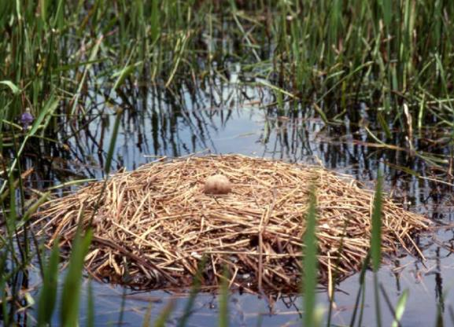
Step 1: Are cranes using the site?
    Project Planning surveys
      In early stages of project planning
      To aid in development of avoidance or minimization/mitigation
      3 surveys, at least 3 weeks apart
        During breeding season (ideally early Mar, early Apr, early May)
Photo by Marty Folk/FWC
Notes:
So, when planning a project, how does one know if sandhill cranes are using the project site? The Guidelines strongly recommend two types of surveys: Project Planning Surveys and Pre-activity Surveys.
Project Planning Surveys take place during the early stages of a project (e.g., as part of the Environmental Resource Permit [ERP] process) to identify areas used for nesting in order to aid in development of appropriate avoidance, minimization, and mitigation. Guidelines recommend 3 surveys, speced at least 3 weeks apart during the breeding season. Ideally, surveys would take place in early March, early April, and early May.

Slide 16
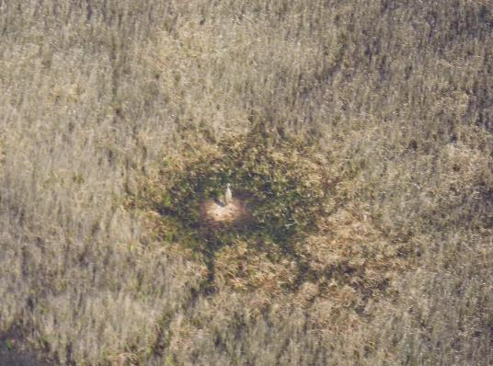
Step 1: Are cranes using the site?
    Pre-activity surveys
      Immediately prior to project activities in breeding season
      To identify active nests or flightless young
      Within 30 days of initiation of activities
      1 aerial survey or 2 ground surveys
        See Guidelines for methods
Nest observed during aerial survey
Notes:
Pre-activity surveys, also referred to as pre-clearing or pre-construction surveys, occur immediately prior to project activities that will take place during the breeding season. These surveys, which take place within 30 days of initiating project activities, identify active nests or flightless young within the project area.
Pre-activity surveys should include either 1 aerial survey or 2 ground surveys. Nests are more easily observed from the air and are more difficult to locate from the ground. The Guidelines provide more details about how to conduct aerial and ground surveys.

Slide 17
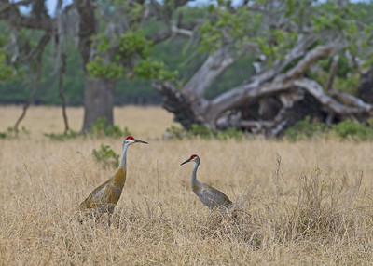
Step 2: Is take avoidable?
    Avoid acts that can kill or injure adults, eggs, or young
    Avoid activities within 400 feet of active nests
    Avoid impacts to suitable natural wetlands
Notes:
If sandhill cranes are identified during either Project Planning or Pre-activity Surveys, the next question to ask is: “can take, and therefore the need for a permit, be avoided?”
To avoid take, projects must avoid acts that can kill or injure adults, eggs, or young. Projects also must avoid activities with 400 feet of active nests to keep from flushing birds from nests., and projects must avoid impacts to suitable natural wetlands used for foraging or nesting. When flightless young are still using a wetland for roosting at night, projects must avoid land use conversion in suitable uplands within 1,500 feet of the nest site until after young are capable of sustained flight (~70 days). The objective of avoiding development of adjacent uplands is to ensure that flightless young are able to forage in adjacent uplands and return to the wetland to safely roost at night. Therefore, projects must avoid creating a “donut effect” that keeps young birds from being able to find food or return to roost.

Slide 18
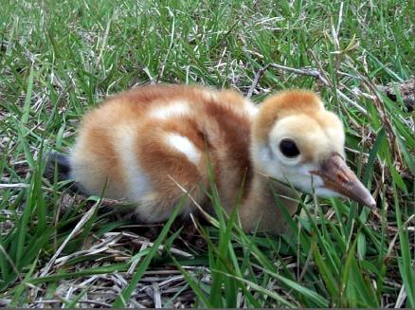
Step 2: Is take avoidable?
    When flightless young are still using a wetland for roosting at night, avoid land use conversion in suitable uplands within 1500 feet until after young can fly (~70 days).
      Ensures that flightless young have access to adjacent uplands for foraging
Photo by Marty Folk/FWC
Notes:
The objective of avoiding development of adjacent uplands is to ensure that flightless young are able to forage in adjacent uplands and return to the wetland to safely roost at night. Therefore, projects must avoid creating a “donut effect” that keeps young birds from being able to find food or return to roost.

Slide 19
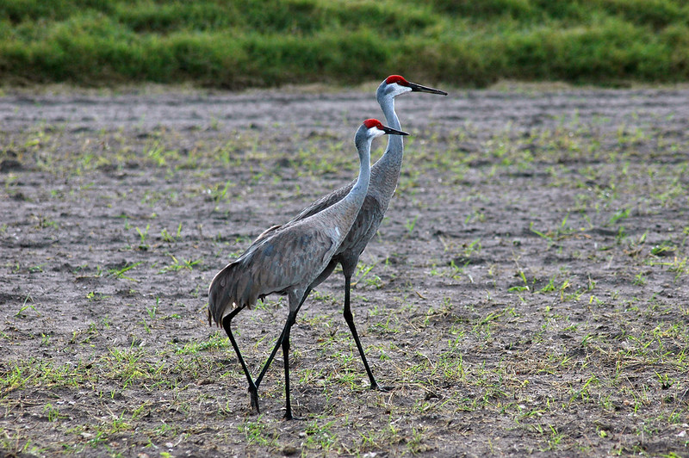
Activities not expected to cause take
    Removal of inactive nests
      No eggs, and flightless young no longer using at night
    Aerial transect surveys > 250 feet above nests
    Highway right-of-way vegetation maintenance outside of the breeding season
Photo by FWC
Notes:
Guidelines also point out activities that are not expected to cause take. For example, removing an inactive nest (one that has no eggs and that flightless young are no longer using at night) is authorized without a permit, because cranes do not re-use nests. Aerial surveys conducted at altitudes greater than 250 feet are not expected to cause take. The same is true for highway right-of-way vegetation maintenance that occurs outside of the breeding season.

Slide 20
Step 3: What type of permit do I need?
Incidental Take
  Incidental to an otherwise lawful activity
  E.g., construction
Intentional Take
  Take is the purpose of the activity
  E.g., scientific research, harassment for human safety
Notes:
If take is unavoidable, you’ll need to contact the FWC for a permit. There are two types of permits: Incidental Take Permits and Intentional Take Permits. Incidental Take Permits authorize take that is incidental to an otherwise lawful activity, like construction projects. Intentional Take Permits authorize are for situations where take is the purpose of the activity. Examples include capturing birds for scientific research or harassing birds to protect human health and safety.

Slide 21
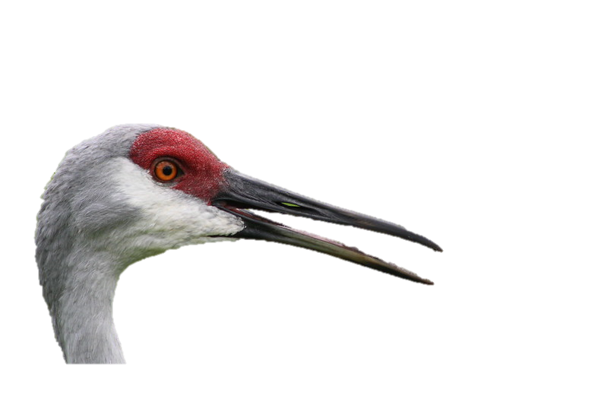
Step 4: What is the process for getting a permit?
Same general process for all permits, except intentional harassment
Apply via online permitting system
90 days to approve or deny complete application
Request for Additional Information if not complete
Notes:
The same general application process applies for both incidental and intentional take permits, with the exception of incidental take for harassment. Permit applicants can apply through our online permitting system. By statute, our Protected Species Permitting Office has 90 days to approve or deny a complete application. The key word is complete – if the Protected Species Permitting Office has to issue a Request for Additional Information, the statutory clock resets. This is why submitting a complete application is key to timely permit issuance.

Slide 22
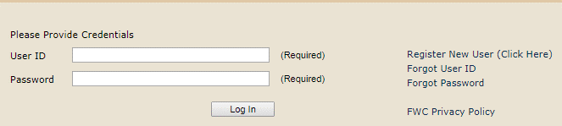
Online Permitting System
http://www.myfwc.com/license/wildlife/protected-wildlife/
Notes:
Permit applicants can use the online permit system to look up older permits and to apply for new ones.

Slide 23
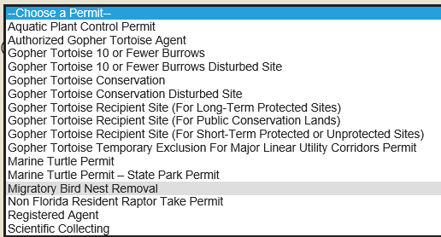
Incidental Take Permit
Notes:
When choosing a permit type in the online system, please choose “Migratory Bird Nest Removal” when applying for an Incidental Take Permit. This is a quirk in our online system that we are trying to resolve, so I wanted to make you aware of it.

Slide 24
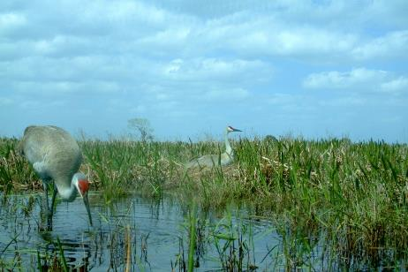
Incidental Take Permit
A complete application will contain:
  Project description
  Why take is unavoidable
  Extent and type (e.g., harm, harass) of anticipated take
  Minimization and mitigation measures
Photo by FWC
Notes:
As I mentioned before, a complete application is key to timely permit issuance. When filling out the online application, please also upload a document that includes the following elements: a description of the project activities; a justification for why take is unavoidable; the extent of anticipated take (e.g., the number of sandhill cranes); the type of anticipated take being requested (e.g., harassment of nesting cranes); and the minimization and mitigation measures that you intend to use to reduce the extent of take, to counterbalance the take that will occur, and to provide an additional benefit. I’ll describe minimization and mitigation in more detail in the next slide. Including these elements will help avoid a Request for Additional Information.

Slide 25
Minimization and Mitigation
Applying for a permit is free
But permits must achieve conservation or scientific benefit (per Rule 68A-27.007, F.A.C.)
Benefit typically achieved through combination of:
  Minimization measures to reduce take
  Mitigation measures to counterbalance take and achieve benefit
ERP mitigation typically sufficient for take via significant modification of wetland foraging or nesting habitat
Notes:
Applying for a permit is free, but there may be mitigation costs associated with the permit. The FWC can issue Incidental Take Permits when there is a scientific or conservation benefit to the species, per Rule 68A-27.007, F.A.C. Conservation benefit typically is achieved through a combination of minimization measures, which reduce the amount of take, and mitigation measures, which counterbalance the take that occurs and provides an additional benefit. When take is solely through significant habitat modification of wetland foraging or nesting habitat (i.e., there is no other harm or harassment to sandhill cranes, eggs, or young), ERP mitigation typically is sufficient to provide conservation benefit.

Slide 26
Intentional Take Permit for research
Notes:
When applying for an Intentional Take Permit for research or educational purposes, select Scientific Collecting in the online permitting system.

Slide 27
Aversive conditioning
To address issues of human health, safety, destruction of property by sandhill cranes
First, coordinate with a Wildlife Assistance Biologist in one of our Regional Offices for passive deterrent methods.
Aversive conditioning methods listed in Guidelines are approved without a permit, if passive methods are unsuccessful.
Methods not listed in Guidelines require an Intentional Take Permit
  For an Intentional Take Permit application for harassment, contact WildlifePermits@myfwc.com
Notes:
However, please note that a different process applies when harassment of sandhill cranes is necessary to address a human health and safety issue or to address destruction of property by sandhill cranes. In these instances, we recommend coordinating first with a Wildlife Assistance Biologist in one of our Regional Offices to resolve the conflict using passive techniques. If these techniques are unsuccessful, Guidelines include approved Aversive Conditioning Methods that can be employed without a permit. If Aversive Conditioning Methods are unsuccessful or not feasible, landowners can apply for an Intentional Take Permit by contacting WildlifePermits@myfwc.com.

Slide 28
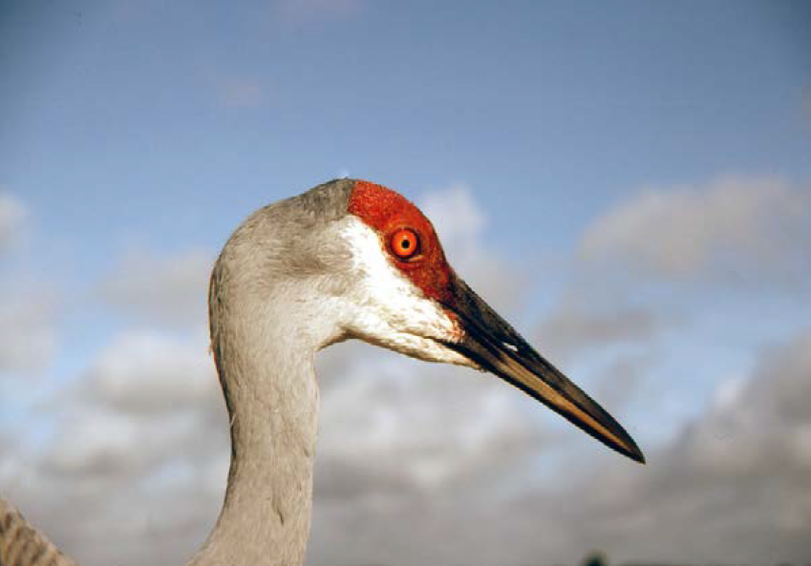
What if I’m not sure if
I need a permit?
Marty Folk/FWC

Slide 29
Resources
    Guidelines:
      http://myfwc.com/wildlifehabitats/imperiled/species-guidelines/
Regional Conservation Biologists:
https://myfwc.com/license/wildlife/protected-wildlife-permits/contacts/
Notes:
After reading the Guidelines, if you are unsure whether you need a permit, you can seek technical assistance from one of our Regional Species Conservation Biologists.

Slide 30
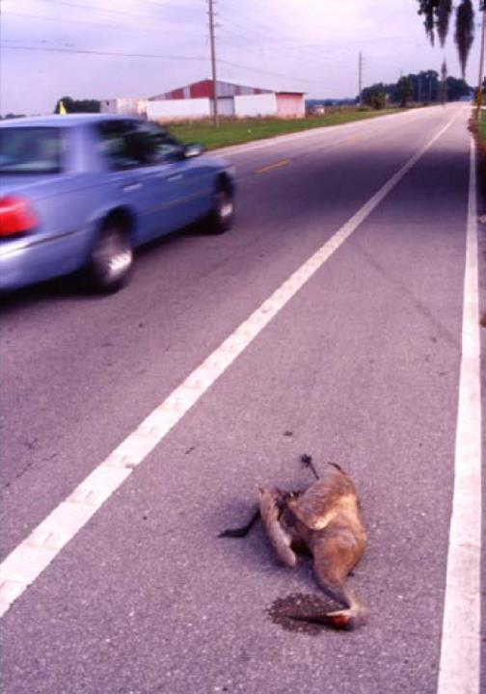
Conservation Design considerations
Designing roads away from suitable wetlands
  Reduces vehicle mortality
  Reduces flooding of nests due to runoff from impervious surfaces
  Maintaining or restoring natural hydrology
  Signage, speed limits, or other methods to reduce vehicle mortality
Photo by Marty Folk/FWC
Notes:
Finally, when designing roadways, there are some design considerations that could help conserve Florida sandhill cranes. First, designing roadways away from shallow herbaceous wetlands helps sandhill cranes by (1) reducing vehicle mortality and (2) reducing flooding of nests from runoff from impervious surfaces during storms. Using water control structures to maintain or restore natural hydrology also helps maintain nesting and foraging habitat for sandhill cranes. Third, vehicle mortality is a serious threat for sandhill cranes. Strategic use of signage, speed limits, or other methods can help sandhill cranes stay safe near roadways.

Slide 31
Questions
http://myfwc.com/wildlifehabitats/imperiled/
Craig.Faulhaber@MyFWC.com
Adrienne.Fitzwilliam@MyFWC.com

