Slide 1
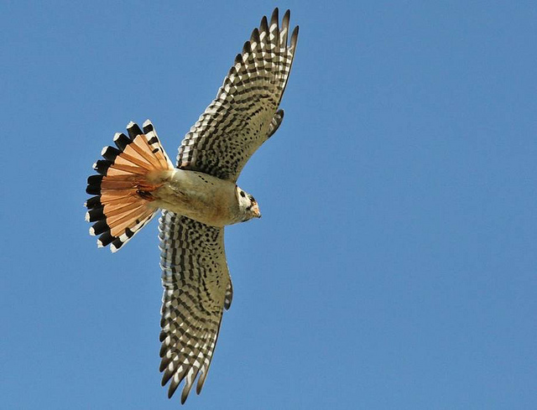

Southeastern American Kestrel Species Conservation Measures and Permitting Guidelines: FDOT Presentation
Adrienne Fitzwilliam
Avian Conservation Biologist
2021
FWC Photo

Slide 2
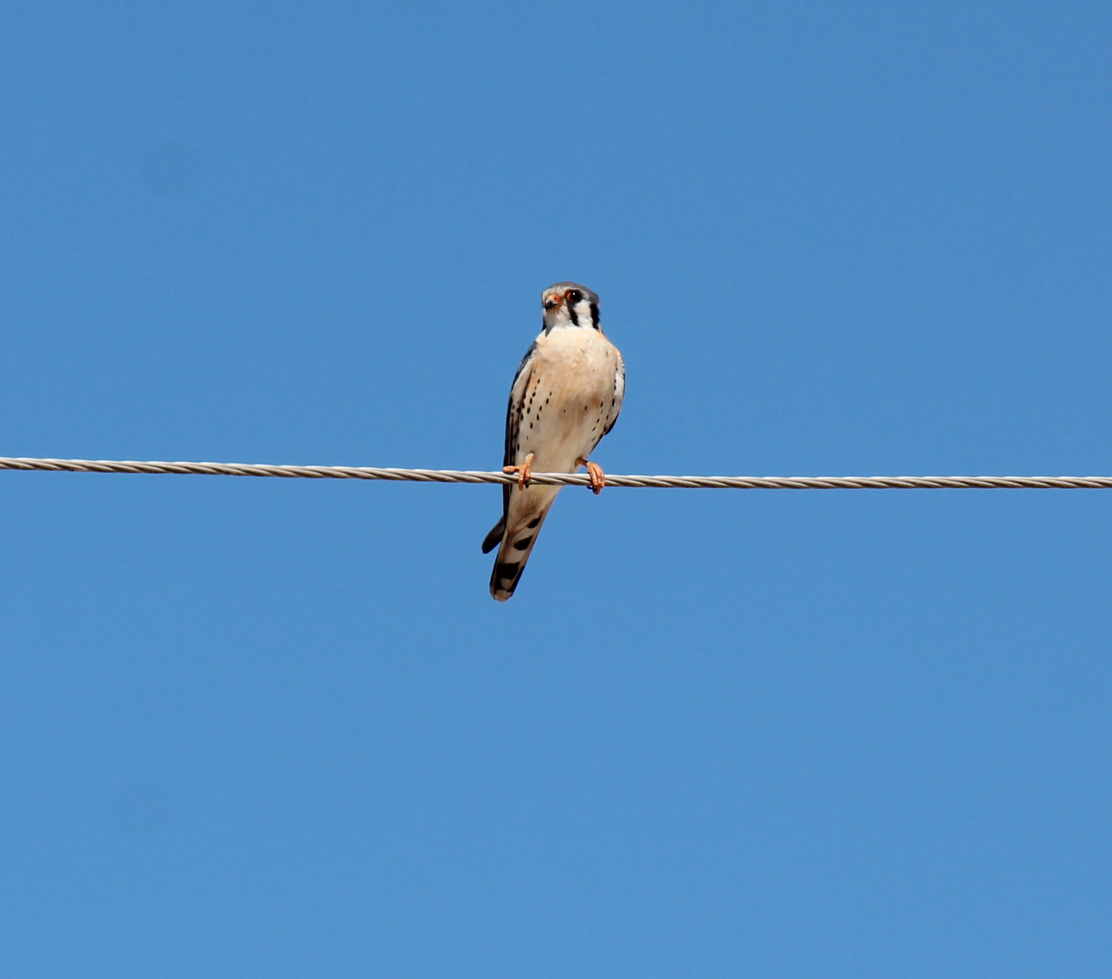
Outline
Background, status and protections
Permitting
  How to avoid take
  How to determine if a permit is needed
Contacts and Resources
FWC Photo by Adrienne Fitzwilliam

Slide 3
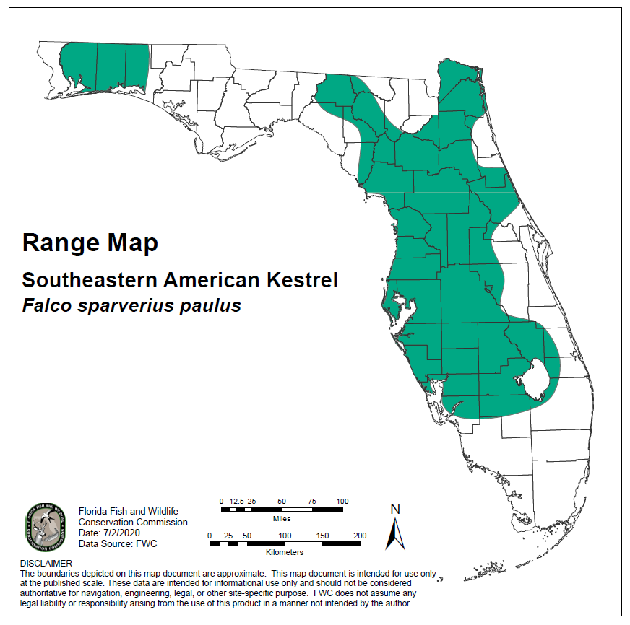
Background
State Threatened
Open habitat (ideally canopy cover 25% or less) with low vegetation
Obligate secondary cavity nester (i.e., dependent on cavities created by other species)
Notes:
[ADRIENNE]
Biological Background
- Kestrels require open and low vegetation to visually hunt from perches, so they need to be able to see their foraging habitat. Their main food source in Florida is invertebrates and anoles (occasionally small mammals). They historically occupied well burned sandhill and old growth pine but have shifted to open grassland as that habitat disappeared. The isolated area of kestrels in the panhandle consists of well managed sandhill on well-managed land – Eglin Airforce Base, Blackwater River WMA.
Kestrels cannot excavate a cavity, so they depend on other species, such as woodpeckers, to create cavities for them. They do not bring nesting material into cavities, and they reuse them for nesting and sheltering outside of the breeding season.

Slide 4
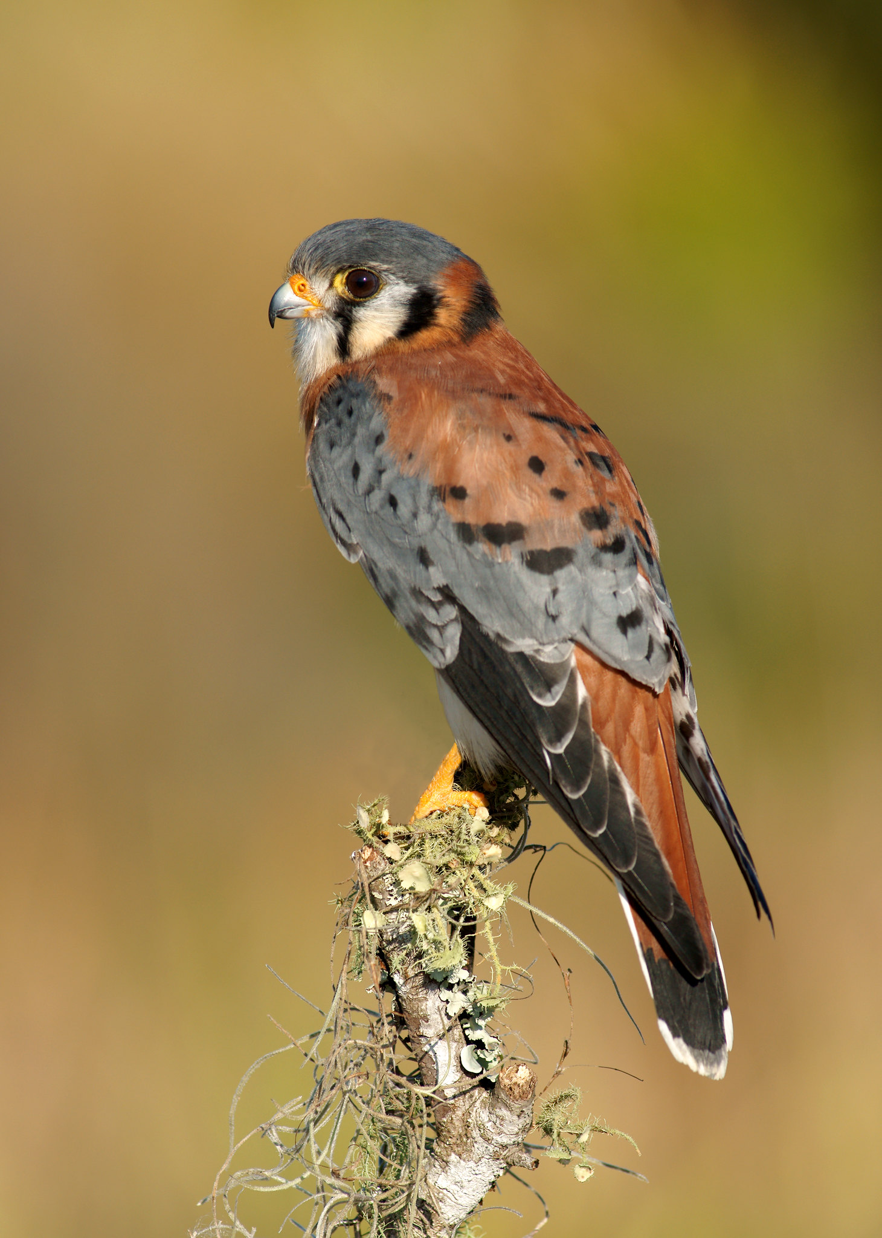
Background
Subspecies of American kestrel
  Southeastern American kestrel is non-migratory, remain on territories year-round
  Cannot visually tell the difference
  Migratory population leaves Florida from April - August
  Southeastern American kestrels breed from March – July
FWC Photo by Jack Rogers
Notes:
The migratory subspecies American kestrel is difficult to distinguish from the southeastern American kestrel visually, but the migratory population leaves Florida from April – August. During this time you can reliably identify kestrels seen as southeastern AMKE. Southeastern American kestrels are non-migratory and remain on their territories year-round. We’ll refer to the state-threatened species as just kestrel for this presentation.

Slide 5
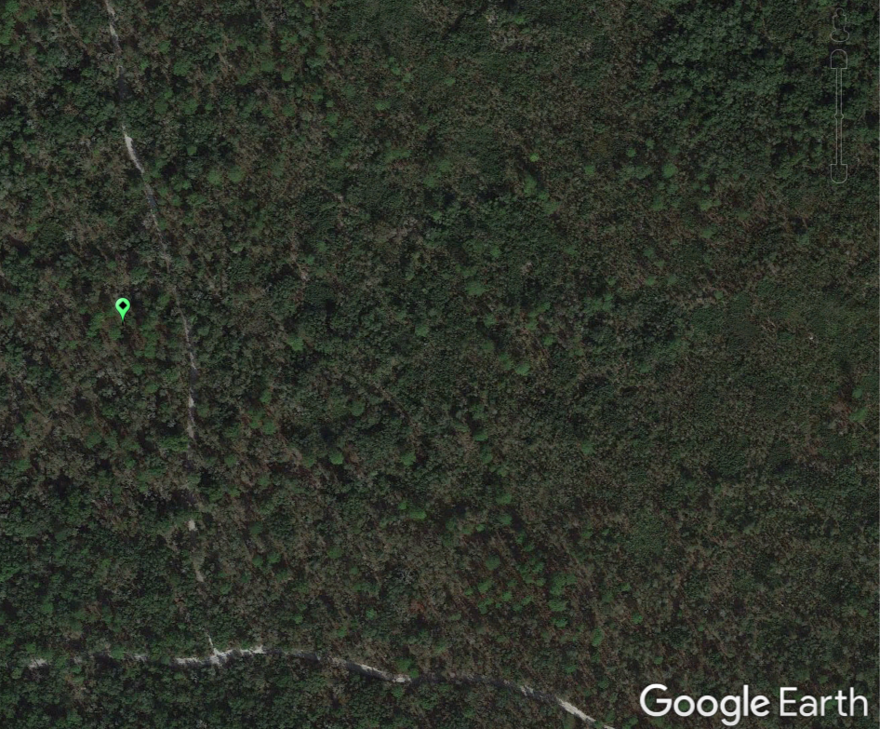
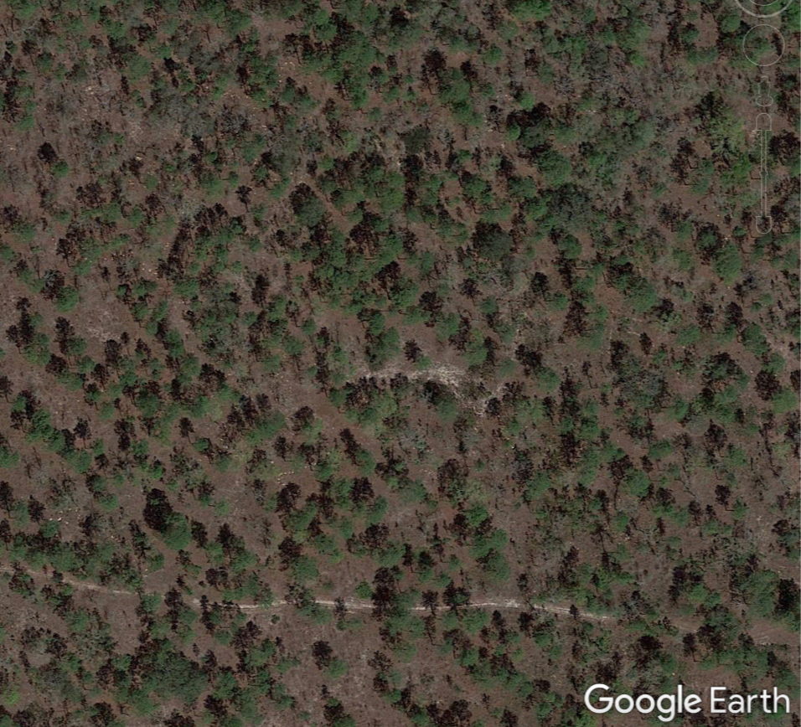
Example Habitat
UNSUITABLE
SUITABLE
Ross Prairie State Park
Withlacoochee State Forest
Notes:
Right – Ross Prairie Left – Citrus Tract

Slide 6
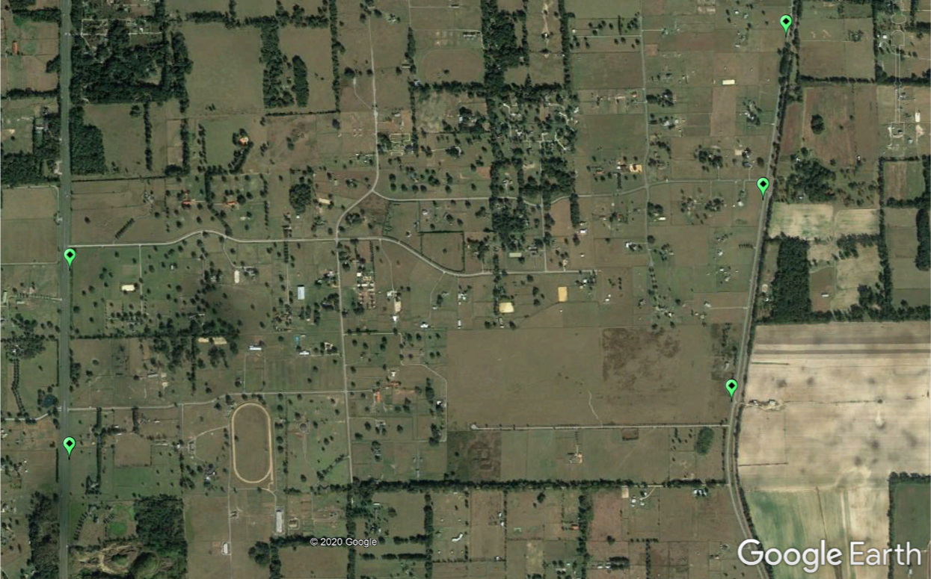
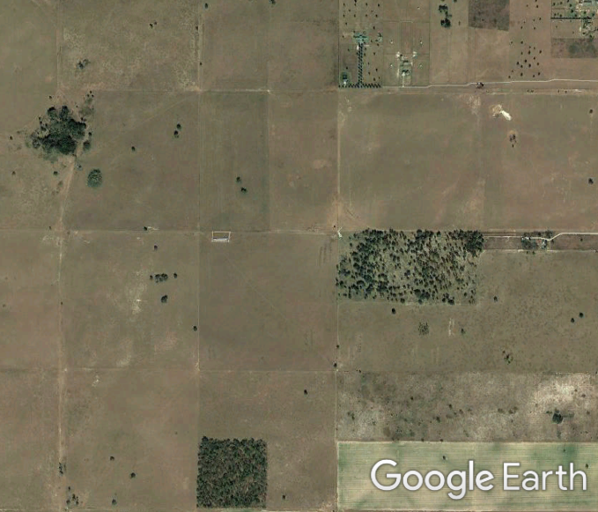
SUITABLE
SUITABLE

Slide 7
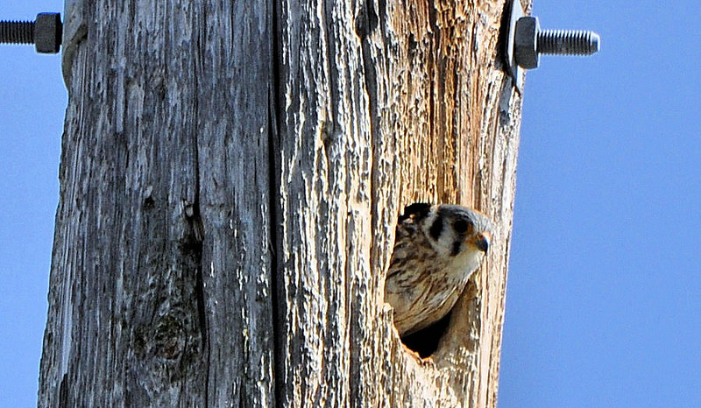
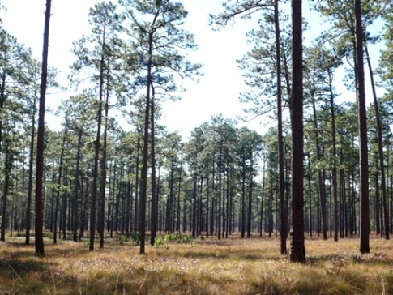
Threats
Habitat loss
A pair of kestrels requires large areas of suitable foraging habitat (124 acres) to feed and raise young
Landscape connectivity is important, young do not disperse far
Lack of cavities for nesting
Vehicle collisions, rodenticides and pesticides
FWC Photo
FWC Photo
Notes:
[ADRIENNE]
Threats Facing SE AMKE:
The main threat to this subspecies is loss of habitat
Although these birds are small, they require a large area of suitable foraging habitat to successfully feed and raise their young, thus they are vulnerable to habitat loss, fragmentation, and degradation
Young do not disperse far (mean 6 miles), which makes landscape connectivity important. You can see how the subpopulation in the panhandle is isolated.
Cavity limited and reuse cavities for breeding and sheltering
SE AMKE are also vulnerable to vehicle collisions and mortality from rodenticides and pesticides. Rodenticides affect them when they consumed poisoned small mammals and feel the effects of the poisoning, where as pesticides wipe out a large prey base.

Slide 8
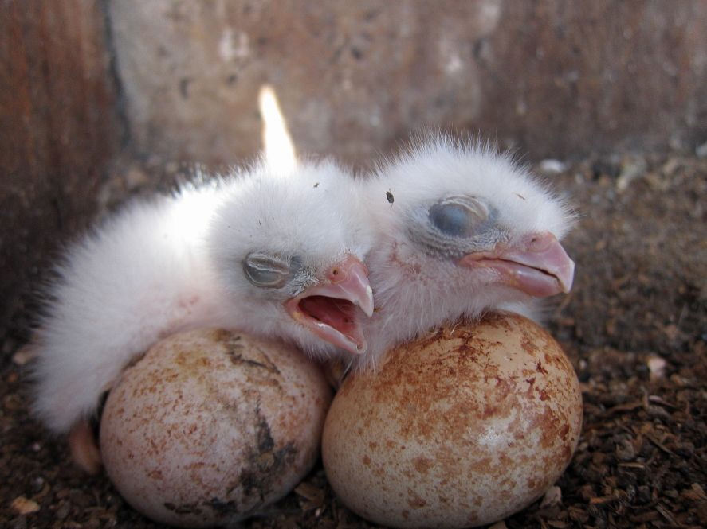
Protections for state Threatened species
68A-27.003(a), F.A.C. No person shall take, possess, or sell any of the endangered or threatened species included in this subsection, or parts thereof or their nests or eggs except as allowed by specific federal or state permit or authorization.
FWC Photo
Notes:
[ADRIENNE]
Protections for the kestrel are defined in rule as a state Threatened species

Slide 9
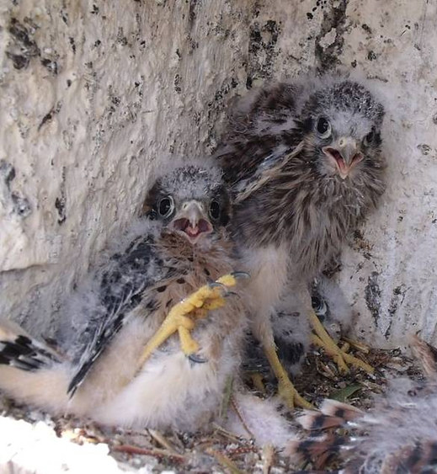
What is “take?”
68A-27.001: “Take – to harass, harm, pursue, hunt, shoot, wound, kill, trap, capture, or collect...”
FWC Photo
Notes:
[ADRIENNE]

Slide 10
What does it mean to “harm?”
68A-27.001: “The term ‘harm’…means an act which actually kills or injures fish or wildlife. Such act may include significant habitat modification or degradation where it actually kills or injures wildlife by significantly impairing essential behavioral patterns, including breeding, feeding or sheltering.”
Example: Removing a snag that has an Active Nest Cavity
FWC Photo
Notes:
[ADRIENNE]

Slide 11
What does it mean to “harass?”
68A-27.001: “The term ‘harass’…means an intentional or negligent act or omission which creates the likelihood of injury to wildlife by annoying it to such an extent as to significantly disrupt normal behavioral patterns which include, but are not limited to, breeding, feeding or sheltering.”
Example: Construction activity takes place near an Active Nest Cavity, which disrupts the adult’s regular feeding of young inside the cavity.
FWC Photo
Notes:
[ADRIENNE]

Slide 12
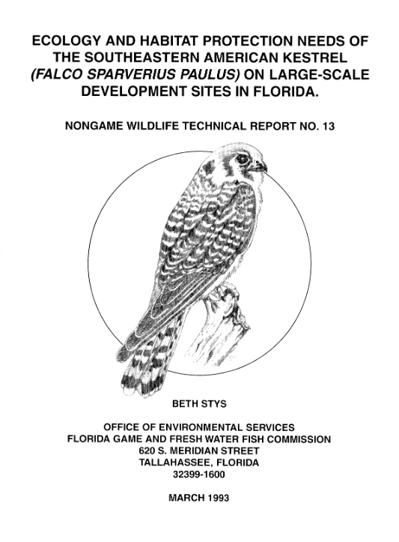
Guidelines and 1993 Technical Report
1993 Technical Report No. 13​ provided recommendations
Guidelines are incorporated into rule
  Regulatory assurance
2020 Guidelines and 1993 Technical Report align:​
  Buffer distance around active nest (490 feet) ​
  Minimum foraging acreage (124 acres)
Notes:
[ADRIENNE]
Guidelines are incorporated into rule
Regulatory assurance
Specifically defines take, significant habitat modification, and outlines minimization measures and permitting options
1993 Technical Report was not incorporated into rule, although consultants and developers have used it to evaluate take.
Point out slight rounding difference – 490 instead of 492

Slide 13
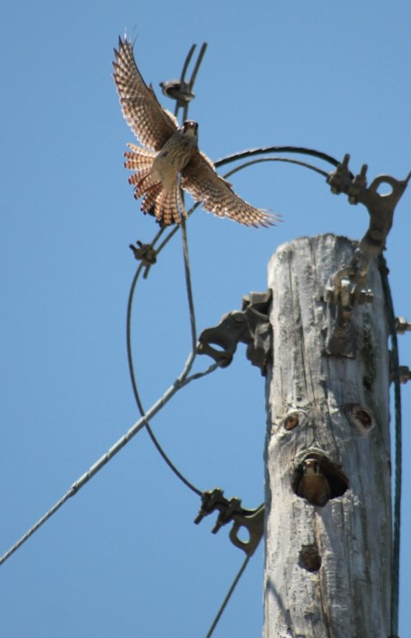
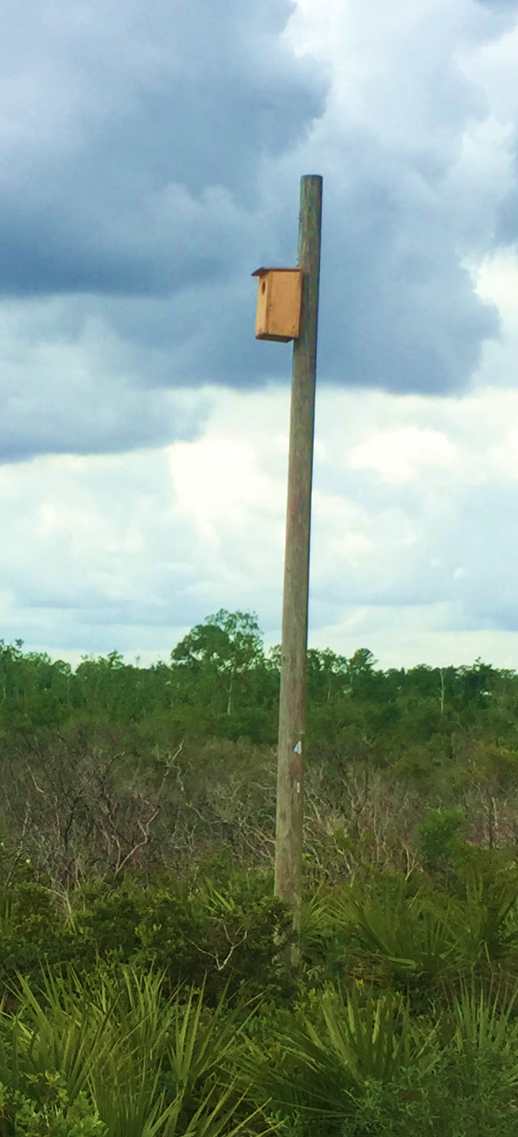
Man-made structure policy
For actions proposed where state-listed species have recently been using a man-made structure for essential behaviors, removal or modification of the structure is authorized without a permit (nest must be inactive)
  Need to contact regional conservation biologist 14 days prior
  Or have an approved wildlife habitat management plan
FWC Photo by Jonny Baker
FWC Photo
Notes:
[ADRIENNE]
Certain conditions for the man-made structure policy:
The nest is inactive (no flightless young or eggs, outside of the breeding season) AND
An approved wildlife/HMP is in place for the area in which the activity will occur OR at least 14 days prior notification to the FWC’s Wildlife Diversity Conservation Regional Biologist
Man-made structure policy has been in place since 2016 when the ISMP was approved. Man-made structures include utility poles, nest boxes, buildings, and any structure put up by humans, even if the cavity was excavated naturally by a woodpecker.
Exception – if nest box was put up as mitigation and permit is still active

Slide 14
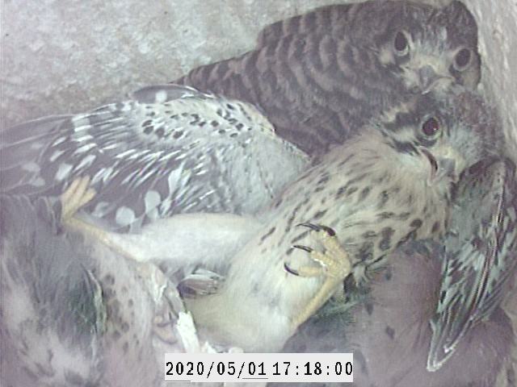
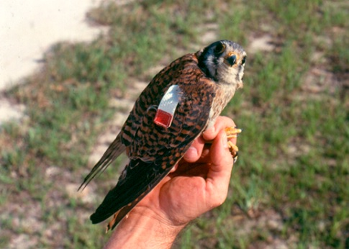
Activities cause take if they result in…
Injury or death of adults, eggs, young
Activity within 490-foot (150-meter) buffer around an Active Nest Cavity
Removal of cavities that have supported past breeding (Inactive Nest Cavities)
Significant habitat modification
Capturing, handling, collecting, etc.
FWC Photo
Notes:
The Guidelines define activities that cause take specific to kestrels
Avoid these activities to avoid needing a permit.
Capturing, handling, collecting refers to activities that are connected to scientific collecting, not incidental take.
Significant habitat modification defined on slide 19

Slide 15
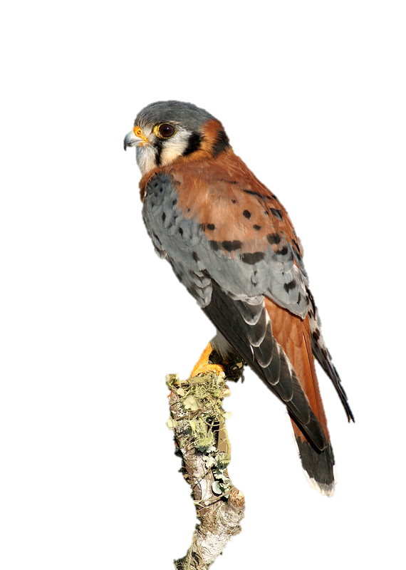
Kestrel Guidelines: Survey Recommendations
Survey Season: April – August
Breeding Season: March 1 – July 31
For areas with suitable habitat in the range of southeastern American kestrels, surveys are always recommended within the survey season, April – August. If this is not possible, surveys should be completed outside of the survey season and consider any kestrel recorded to be a southeastern American kestrel.
Surveys are good until the start of the next breeding season
FWC photo by Jack Rodgers
Notes:
The survey season is determined by the time when the migratory American Kestrel is out of Florida, but it does not line up with the southeastern’s breeding season. To allow projects that cannot survey within the narrow survey window, surveys can take place outside of the survey window and any kestrel on-site will be considered southeastern American kestrel.
Kestrels stay on their territory year-round. Surveys are good until the start of the next breeding season (March 1st). So surveys done in April are good for almost a year, while surveys done in December are good for a few months.

Slide 16
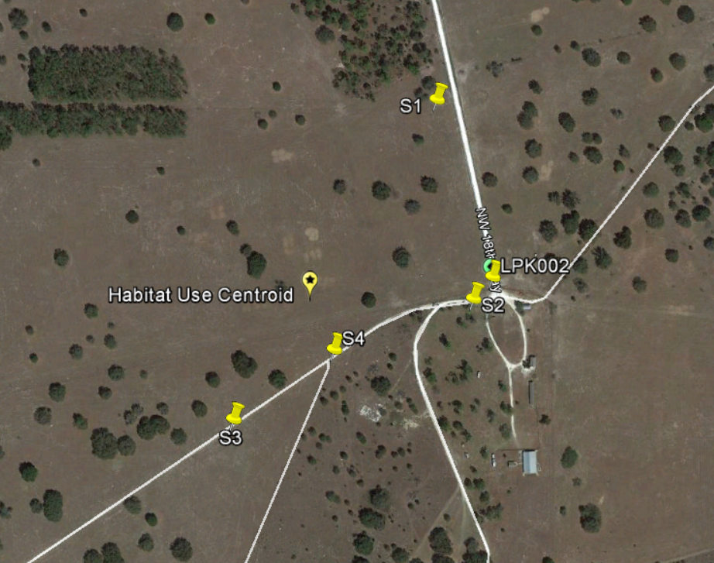
Habitat Use Centroid
Based on GPS points of kestrel sightings over a minimum of three surveys
Take average of latitudes and average of longitudes
Notes:
[ADRIENNE]
S1 – S4 are sightings recorded during all surveys, LPK002 is the nest site. All are averaged together to determine the Habitat Use Centroid, which approximates the center of the kestrel territory. These sightings are recorded locations of kestrels hovering over a spot while hunting, perched, or cavities they are going in and out of. Flyovers do not count as a point but should be noted in surveys.

Slide 17
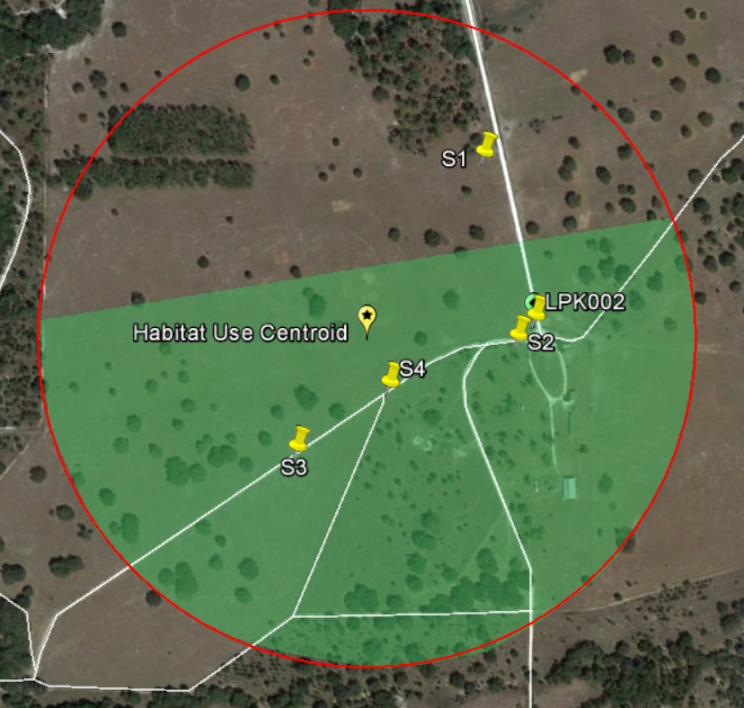
Significant Habitat Modification
An activity that results in reduction of suitable foraging habitat to less than 124 acres within a 0.31-mile radius (0.5-km) around the Habitat Use Centroid may result in significant habitat modification by impairing the essential behaviors of breeding and foraging.
Notes:
[ADRIENNE]
Reduction of suitable foraging habitat can occur via clearing, grading, paving, bulldozing, digging, building construction and site preparation for development. If 124 acres of suitable foraging habitat is not available prior to development, then take via significant habitat modification will not occur.

Slide 18
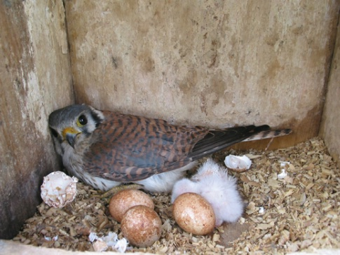
Avoidance and authorizations
Guidelines include:
  Avoidance measures (e.g., 490-ft buffer)
  Examples of activities not expected to cause take (e.g., standard vehicular traffic on roads near kestrel nests)
  Other authorizations for take (e.g., actions for human health and safety)
    Participation in Florida Forestry Wildlife BMPs and Florida Agricultural Wildlife BMPs does not require a permit authorizing incidental take
    BMPs do not authorize take when there are land use changes
FWC Photo
Notes:
[ADRIENNE]
Avoidance and other authorizations are also included in the guidelines. Avoidance measures are things like working outside of a 500-foot buffer during the breeding season when a cavity is active. The guidelines also include examples of activities expected to cause take and those not expected to cause take, as well as other authorizations for take.

Slide 19
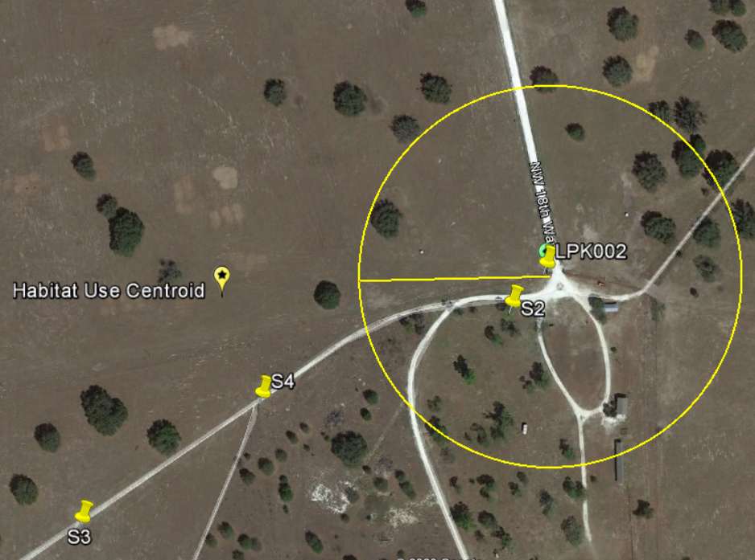
How to avoid a permit
Avoid working within 490 feet (150 meters) of the nest cavity during the breeding season (March 1 – July 31)
Notes:
[ADRIENNE]
Let’s walk through ways to avoid needing a permit. First, you can avoid working within 500 feet of an active nest cavity. This applies to both natural and man-made structures. You can build prior to the breeding season (March 1) to avoid construction disturbance around the nest cavity or wait until the end of the breeding season, when the nest has fledged.

Slide 20
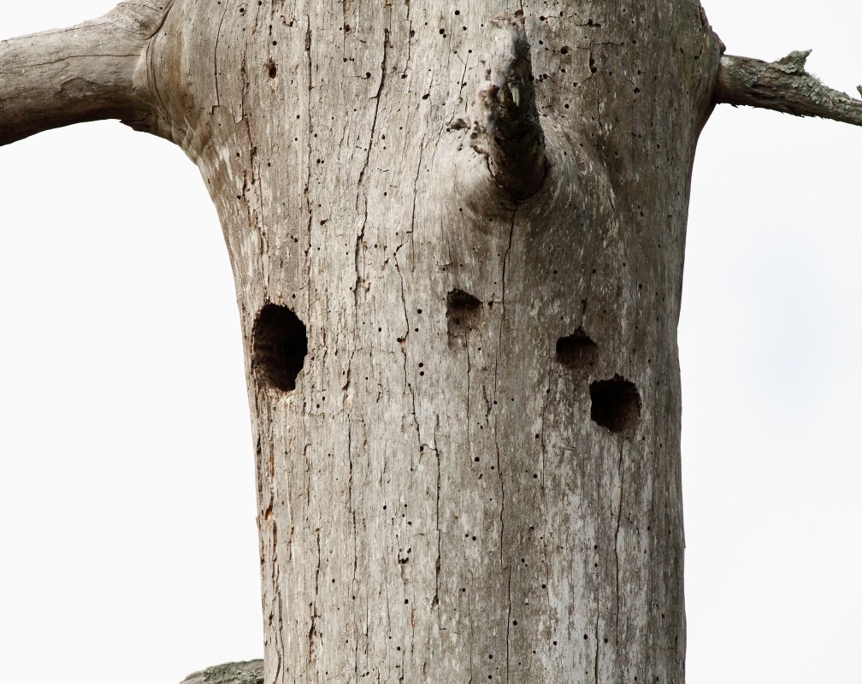
How to avoid a permit
Retain nest cavities for continued kestrel use in future breeding seasons
Notes:
[ADRIENNE]
Retain the natural nest cavity previously used by kestrels when foraging habitat is still available on-site post construction. Note that if the nest cavity is in a man-made structure, then it can be removed without a permit outside of the nesting season.

Slide 21
How to avoid a permit
Leave at least 124 acres surrounding the Habitat Use Centroid as suitable foraging habitat
  Habitat off-site but within the 0.31-mile radius is included
  If prior to development 124 acres of suitable foraging habitat was not available, a permit is not needed
Notes:
[ADRIENNE]
For large projects, leave some habitat available so that the total amount in the kestrel territory remains 124-acres. Remember, habitat off-site is included if it’s within the 0.31-mile radius.

Slide 22
Activities not expected to cause take
Routine vegetation maintenance activities within existing utility rights-of-way within 490 feet of an Active Nest Cavity, provided the activity is short in duration (1 hour or less)
Routine maintenance of roads, such as mowing, culvert and sign maintenance, line painting, and other short duration (1 hour or less) activities within 490 feet of an Active Nest Cavity.
  This does not include road expansion (i.e., creating new lanes, road widening), grading/resurfacing existing roads, or paving an unpaved road.
See page 9 and 10 in the Guidelines for a complete list

Slide 23
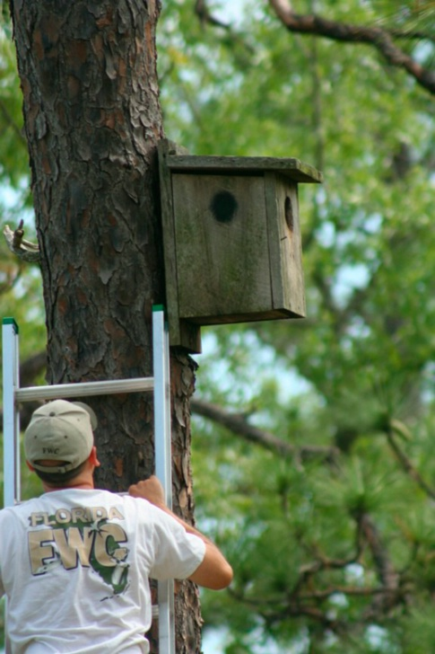
Nest boxes and significant habitat modification
Significant habitat modification within 0.31 miles of a kestrel nest box is authorized if one of the following conditions are met:
  The kestrel nest box was installed by FWC or partners that coordinate and report the box to FWC (e.g., State Parks, City Parks, Audubon), or
  The kestrel nest box is installed on a Utility Company structure within a utility easement.
FWC Photo
Notes:
[ADRIENNE]
This exception for significant habitat modification is to encourage utility companies to install nest boxes when replacing wooden poles with cavities and to ensure Audubon and other partners can continue installing nest boxes adjacent to private landowners without creating regulatory burden. Nest boxes are important conservation tools for kestrels, and we do not want to discourage their installment or keeping them on the landscape.
Nest boxes installed by FWC or partners will be available for viewing on an online mapping tool (in development) and boxes put up by utility companies within rights-of-ways for mitigation will also be available on the mapping tool. Mitigation boxes are NOT included in this exemption from significant habitat modification.

Slide 24
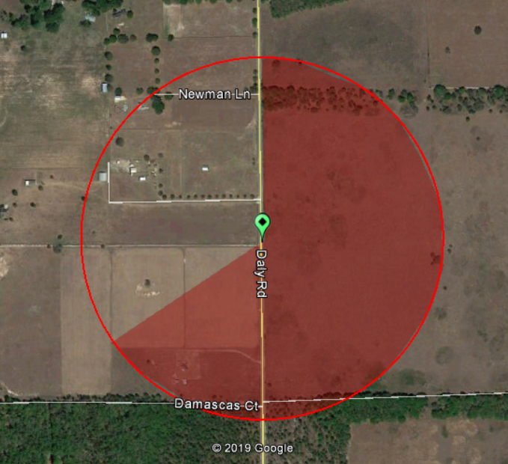
Example
Productive box in Hernando County
Near Perry Oldenburg WMA
Monitored and maintained by FWC volunteers
DRAFT
Notes:
[ADRIENNE]
Here’s a good example of the exemption. We have a productive kestrel nest box that FWC installed and monitors land owned by private landowners. If landowners want to develop and leave less than 124 acres of foraging habitat, then they would not need to get a permit for significant habitat modification.

Slide 25
Example
If landowners adjacent to the nest box developed, would not need a permit for significant habitat modification
Does not authorize take via harassment (activity within 490-foot buffer)
Does not authorize take of active nest
DRAFT
Notes:
[ADRIENNE]
Note that they would still need a permit for activities within 500 feet of the active nest site or removal of the nest box while the nest is active.

Slide 26
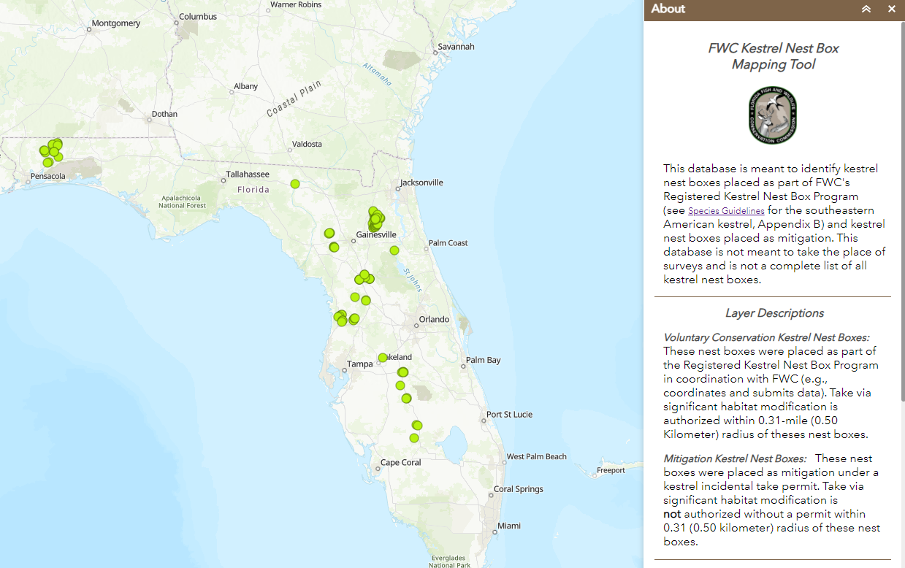
Kestrel Mapping Tool
Found at https://geodata.myfwc.com/pages/upland

Slide 27
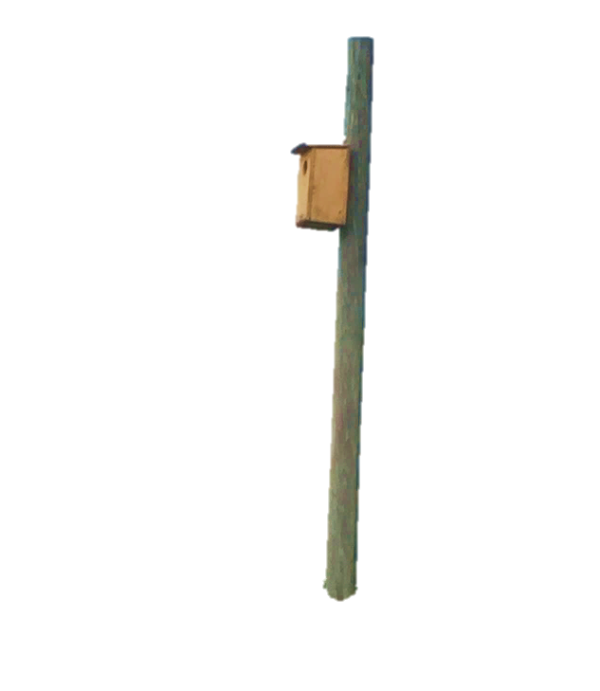
Kestrel Box Mapping Tool
Intended to provide technical assistance to stakeholders when they are determining if significant habitat modification will occur
Not a tool to determine if kestrels are on or nearby a project
Limited number of boxes included
  They were put up by FWC or partners that communicated locations and monitoring
  Does not include boxes on utility poles
  Will include permitted boxes down the line (as Significant Habitat Modification could occur within 0.5-km)

Slide 28
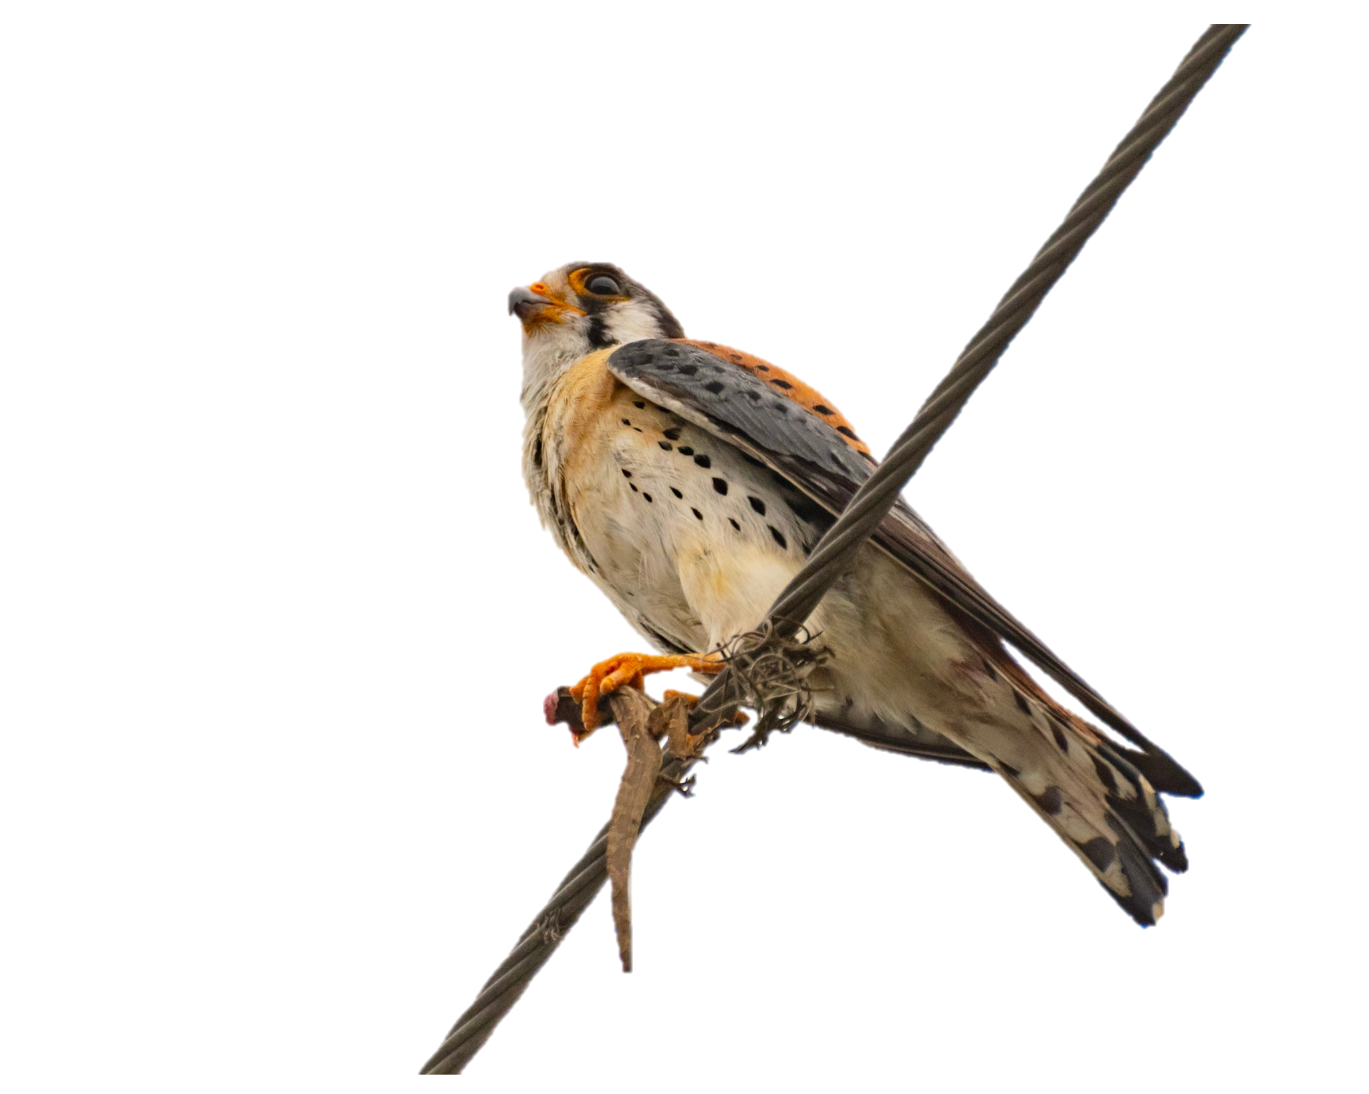
FWC Permitting
If take is unavoidable, FWC can issue an Incidental Take Permit
  Issued when there is conservation or scientific benefit to the species
  Benefit typically through minimization and mitigation
  Minimization reduces take
  Mitigation counterbalances take and provides a benefit
Photo by Kelly O’Connor
Notes:
[ADRIENNE]

Slide 29
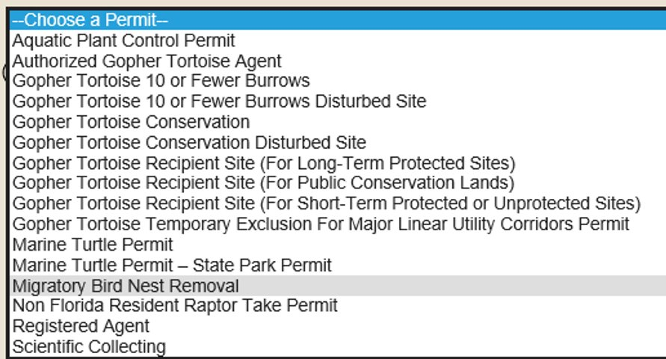
Incidental Take Permits
Incidental Take refers to take that is incidental to, and not the purpose of, carrying out an otherwise lawful activity ​
“Migratory Bird Nest Removal” in online permit system

Slide 30
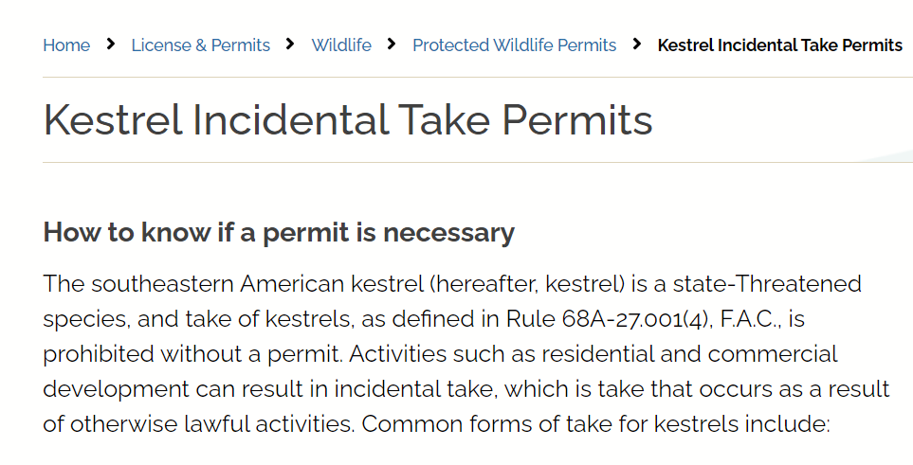
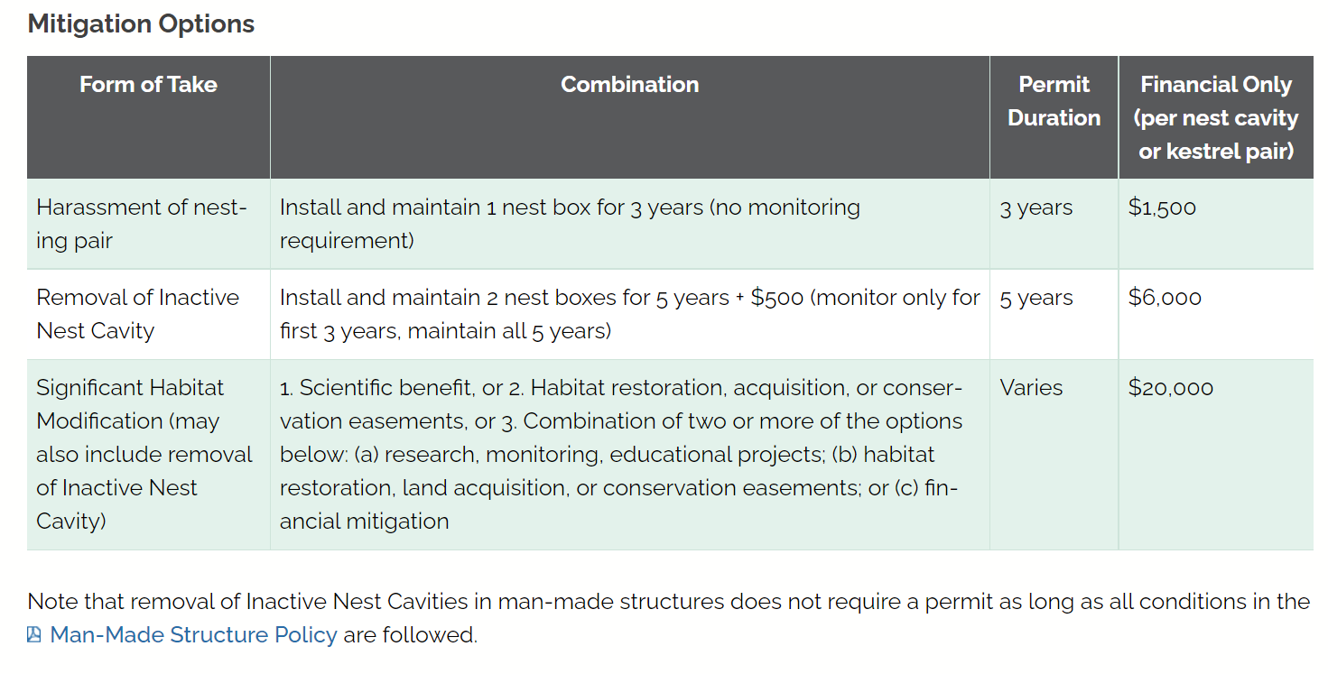
FWC Permitting
See the webpage to help stakeholders submit a complete application
  Includes a Kestrel Supplemental Application Form
  Reporting form for boxes
https://myfwc.com/license/wildlife/protected-wildlife-permits/kestrel/
Notes:
[ADRIENNE]
Should be live by February, highly encourage applicants to use the supplemental application form instead of filling in boxes with “see nest report”

Slide 31
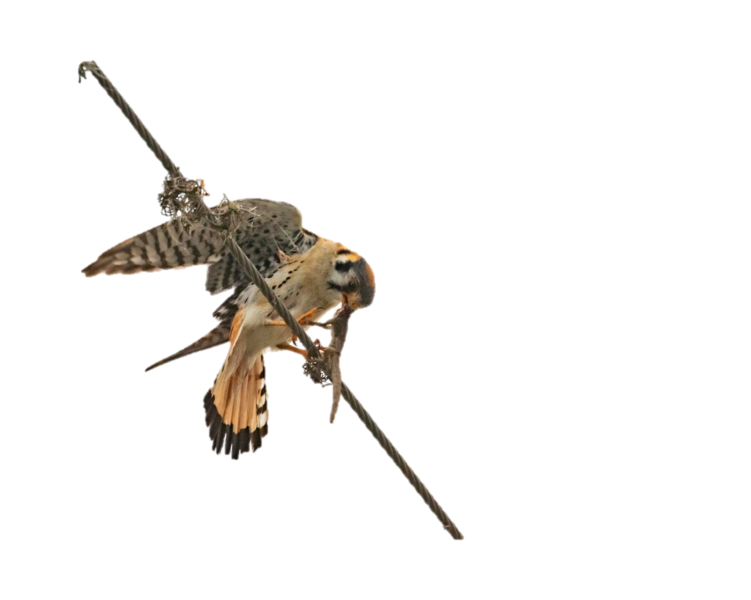
Examples of minimization options
Conduct activities outside of the breeding season
Minimize noise and duration of activities within 490 feet of active nests
Educate project personnel about the active nest onsite
Retain and manage suitable foraging habitat on the project site
Photo by Kelly O’Connor
Notes:
[ADRIENNE]

Slide 32
Form of Take​ | Mitigation Options​ |  | ​ Financial only ​ (per nest cavity / kestrel pair) ​
 | Combination​ | Permit duration ​
Harassment of nesting pair (activities within 490-foot buffer of an active nest)​ | Install and maintain 1 nest box for 3 years ​ (no monitoring requirement)​ | 3 years ​ | $1,500 ​
Removal of inactive nest cavity* ​ (foraging habitat remains)​ | Install and maintain 2 nest boxes for 5 years + $500 (monitor only for first 3 years, but maintain all 5 years)​ | 5 years ​ | $6,000 ​
Notes:
[ADRIENNE]
*does not include man-made structures
For harassment and inactive nest box removal – Finical cost calculated by taking the average amount it costs to hire an environmental consultant to purchase nest boxes, install them, annual maintenance, and monitoring where required. Monitoring occurs three times a year, and maintenance occurs annually. All financial contributions will go to the Fish and Wildlife Foundation of Florida and will only be spent on kestrel conservation measures.

Slide 33
Form of Take​ | Mitigation Options​ |  | ​ Financial only ​ (per nest cavity / kestrel pair) ​
 | Combination​ | Permit duration ​
Significant habitat modification ​ (may also include removal of nest cavity)​ | 1. Scientific benefit​ 2. Habitat restoration, acquisition, or conservation easements​ 3. Combination of above with some financial mitigation ​ | Varies ​ | $20,000 ​
Notes:
[ADRIENNE]
For significant habitat modification, financial contribution will meet a suite of conservation measures and benefit (such as, land acquisition and easements, sandhill restoration, research, and nest box program monitoring). Other mitigation options include scientific benefit, habitat restoration, acquisition, or conservation easements, or some combination of these options, or some combination of these options plus financial mitigation.

Slide 34
Resources
Guidelines:
  https://myfwc.com/wildlifehabitats/wildlife/species-guidelines/
Kestrel Permit Information and Supplemental Application:
  https://myfwc.com/license/wildlife/protected-wildlife-permits/kestrel/

Slide 35
Contact for more information
Adrienne Fitzwilliam​
Avian Conservation Biologist​
Adrienne.Fitzwilliam@MyFWC.com​
(352) 620-7732
Craig Faulhaber​
Avian Conservation Coordinator​
Craig.Faulhaber@MyFWC.com​
(352) 620-7346

