Slide 1
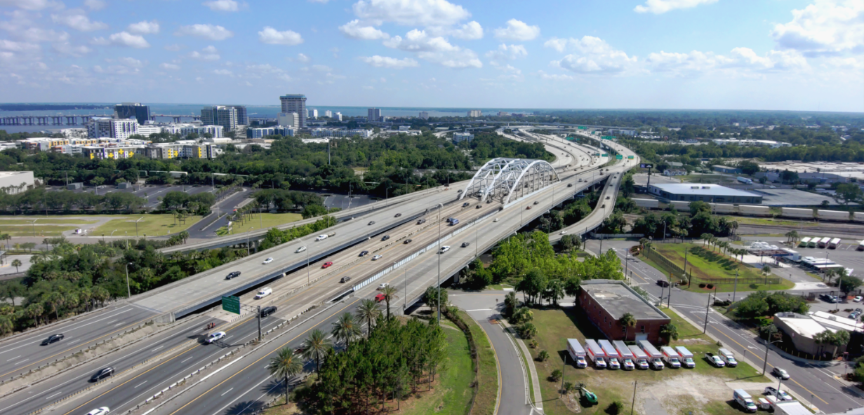


Opening Slide
Training on Purpose and Need Statements
October 2023
Notes:
Welcome to the FDOT Office of Environmental Management’s Purpose and Need Statements training.
Before we get started, we wanted to make note that any non-FDOT attendees who wants credit for the class will need to provide name, e-mail and PE Number (as applicable) to the Chat box. We will use this information to send out Certifications.

Slide 2
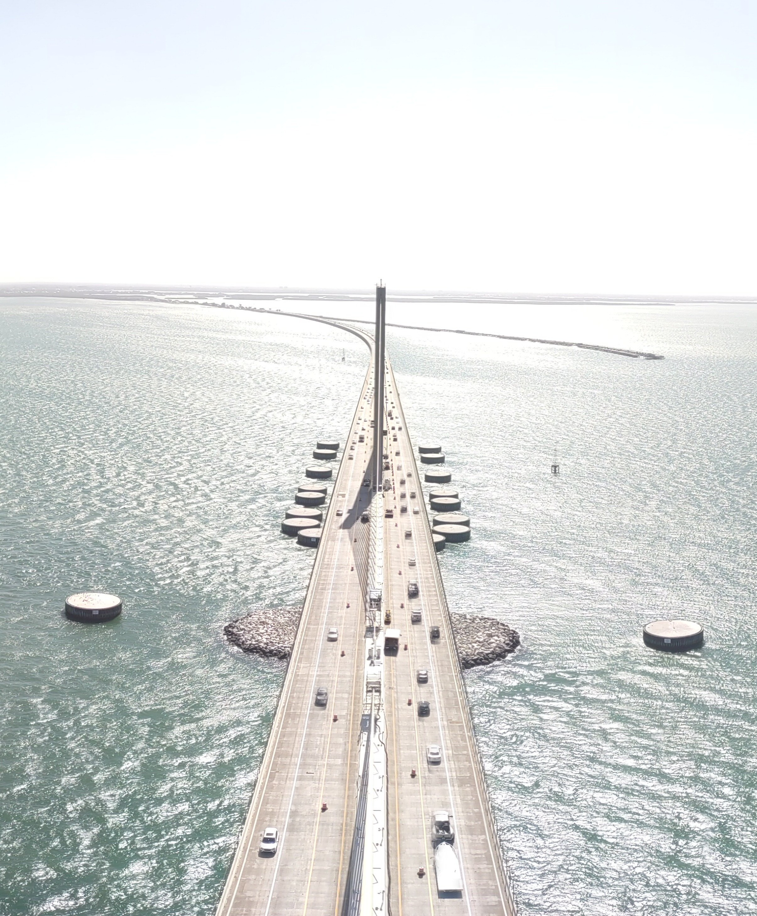
Training Topics
What is a Purpose and Need Statement?
How Do We Develop a Purpose and Need Statement?
How Do We Use a Purpose and Need Statement?
A Purpose and Need Statement can be the most difficult section to write in a NEPA document.
2
Notes:
For some people the Purpose and Need Statement can be the most difficult section to write in a NEPA document and at the same time it is one of the most important sections of the document.
If you do not have an approved Purpose and Need Statement your project will not advance.
This training is to support the FDOT and practitioners in explaining:
What is a Purpose and Need Statement,
How do we develop a Purpose and Need Statement, and
How do we use a Purpose and Need Statement.
Each of these items will be covered in today’s training …

Slide 3

Why Is a Purpose and Need Statement Required?
The CEQ issued Regulations for Implementing the Procedural Provisions of the National Environmental Policy Act (NEPA) (40 CFR Section 1500-1508)
To address CEQ requirements, FHWA issued regulations: Environmental Impact and Related Procedures (23 CFR Section 771)
Purpose and Need Legal Requirements
NEPA Regulations: “The statement shall briefly specify the underlying purpose and need to which the agency is responding in proposing the alternatives including the proposed action”. (40 CFR 1502.13)
23 CFR Appendix A to Part 450 (Linking the Transportation Planning and NEPA Processes) states “The transportation planning process also provides a potential forum to define a project’s purpose and need by framing the scope of the problem to be addressed by a proposed project”.
menti.com
Notes:
….and will be identified at the bottom of the slide with a tab like the one shown here that’s says, “What is a Purpose and Need Statement?”. Also, throughout this training we will have interactive quiz questions through Mentimeter so have your phone or computers ready for when we get to those questions after each section at menti.com.
It is always important to know why we do things in our profession and understand the legal requirements of those actions. This slide identifies just a few of the regulations pertaining to Purpose and Need. The first one is shown on the left.
Legal guidance originates from the NEPA CEQ Regulation 40 CFR Section 1500-1508 and in 1502.13 says “The statement shall briefly specify the underlying purpose and need to which the agency is responding in proposing the alternatives including the proposed action.”
Then FHWA followed the CEQ with regulations they established under 23 CFR 771.
The third regulation is 23 CFR Appendix A to Part 450 (Linking the Transportation Planning and NEPA Processes) which states “The transportation planning process also provides a potential forum to define a project’s purpose and need by framing the scope of the problem to be addressed by a proposed project.”

Slide 4

Why Is a Purpose and Need Statement Required?
Purpose and Need Statements Will:
    Explain why impacts are acceptable based on the project’s importance.
    Establish why FDOT is proposing to spend large amounts of taxpayers’ money.
    Justify to the public and decisionmakers that the expenditure of funds is necessary.
Notes:
Furthermore, a well-written and well-justified Purpose and Need Statement will accomplish the following:
Explain why impacts are acceptable based on the project’s importance,
Establish why FDOT is proposing to spend large amounts of taxpayers’ money, and
Justify to the public and decisionmakers that the expenditure of funds is necessary.

Slide 5

Avoid Legal Challenges
Legal challenges to NEPA compliance are made under the Administrative Procedure Act (APA) (5 U.S.C. Section 551 et seq.)
The APA is a federal act that governs the procedures of administrative law such as NEPA.
In NEPA, plaintiff’s common claims challenge a federal agency’s actions as being:
    Arbitrary and capricious.
    An abuse of discretion because of agencies failure to meet NEPA’s requirements.
    Insufficient documentation of environmental review.
A well written Purpose and Need Statement supports the decision-making process when it is:
Written with simple and clear text.
Understandable to lay readers (including a judge).
Shows the reader the FDOT has a credible rational for proposing actions in the project area.
Notes:
The US Department of Agricultural wrote that when challenged in court, agencies have won every case where the need statement was narrowly stated and lost every case where the need statement was broadly stated or absent.
Legal challenges to NEPA compliance are made under the Administrative Procedure Act which is a federal act that governs the procedures of an administrative law such as NEPA.
In NEPA, Plaintiffs’ common claims challenge a federal agency’s actions as being:
Arbitrary (not supported by fair or substantial cause or reason) and capricious (inconsistent or erratic),
An abuse of discretion because of an agency’s failure to meet NEPA’s requirements, and/or
Insufficient documentation of environmental review.
A Purpose and Need Statement supports the decision making process when it is written with simple and clear text where lay readers (including a judge) should be able to review the listed needs and conclude that the agency has a credible rationale for proposing actions in the project area.

Slide 6
What is a Purpose and Need Statement?
A Purpose and Need Statement provides justification of why the proposed improvement should be implemented.
FHWA Guidance
It drives the process for development and evaluation of reasonable, prudent, and practicable alternatives consideration, and ultimately the selection of a Preferred Alternative.
It is comprehensive, as specific as possible, and is reexamined and updated as appropriate throughout the project development process.
Notes:
Moving from the “Why” we are now going to dive into the “What”
A Purpose and Need Statement provides justification of why the proposed improvement should be implemented.
It drives the process for development and evaluation of reasonable, prudent, and practicable alternatives consideration, and ultimately the selection of a Preferred Alternative.
It is comprehensive, as specific as possible, and is reexamined and updated as appropriate throughout the project development process. Which I will discuss more towards the end of the training.

Slide 7
A Purpose and Need Statement is…
The Purpose is the “what” of the proposed action (i.e., what FDOT is trying to accomplish).
The Need is the “ why” the proposed action is needed. It identifies the problem(s) the proposed project will address.
Purpose and Need Statement
The Purpose should be stated as the positive outcome that is expected (e.g., “the purpose is to reduce traffic congestion in the corridor”).
The Need should establish the evidence that the deficiency or problem exists or will exist if projected population and planned land use growth are realized.
Notes:
So, in plain language….
The Purpose is the “what” of the proposed action. What FDOT is trying to accomplish. It should be stated as the positive outcome that is expected. For example, “the purpose is to reduce traffic congestion in the corridor”.
The Need is the “why” the proposed action is needed. It identifies the problem(s) the proposed project will address. It should establish the evidence that the deficiency or problem exists or will exist if projected population and planned land use growth are realized. I would like to bring your attention to the word evidence. I will be explaining that in more detail later in this training.
The common perception of the Purpose and Need Statement is that it is difficult to write, but if you keep to these simple definitions above writing it can be a straight forward task.

Slide 8


A Purpose and Need Statement is the Project Foundation
Development of a Purpose and Need Statement is the critical first step that begins in Planning and evolves through PD&E as more information is known about the project.
It is the foundation the project is built on.
Which foundation will your project be built on?
This Photo by Unknown Author is licensed under CC BY-ND
Notes:
The development of a Purpose and Need Statement is the critical first step that begins in Planning and evolves through the PD&E phase as more information is known about the project. It is the foundation the project is built upon. Think of it as a foundation a house is built on or the first tier of a multi-layered cake. It is important that this foundation is firm and can fully support the project.

Slide 9
A Purpose and Need Statement is NOT…
  Too vague to be useful.
  Written in complicated, unclear text.
  Obviously biased in the project justifications.
  Inadequate to support each subsequent step in NEPA analysis and in the final FDOT decision document.
  A discussion of alternatives or a particular action.
Solution Statement
Notes:
We just went through what a Purpose and Need Statement “is”, but we also need to identify what it “is not”.
Most importantly it is not a solution statement. We are not solving the problem with a Purpose and Need Statement, just stating what the project is and why it is needed.
The Purpose and Need Statement should be narrowly stated but it should not be too vague to not be useful or written in complicated or unclear text. It should not show obvious bias in the project justifications nor be inadequate to support each subsequent step in the NEPA analysis and in the final decision document. Also, it should not be a discussion of alternatives or of a particular action. The project description and other parts of the NEPA document will cover this information.

Slide 10

Not for Sale
Do NOT sell the project with the Purpose and Need Statement.
Notes:
Lastly, do not sell the project with the Purpose and Need Statement.

Slide 11
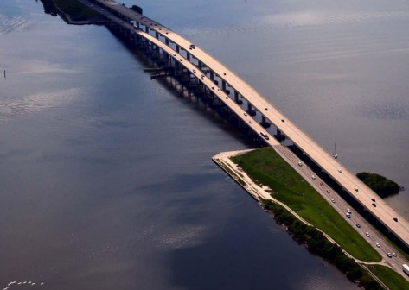
Quiz – Question 1
Which of the following are not common legal challenges to NEPA documents?
Insufficient documentation of environmental review.
A failure to meet the schedule that the federal agency committed to during scoping.
Arbitrary and capricious decisions made by federal agency(ies).
A federal agency’s abuse of discretion because their failure to meet NEPA’s requirements.
Notes:
Before we move into our next training section, we have a few quiz questions to make sure we understand what is a Purpose and Need statement. Please select what you feel to be the correct answer.

Slide 12
Quiz – Question 1
Answer
Which of the following are not common legal challenges to NEPA documents?
b. A failure to meet the schedule that the federal agency committed to during scoping.
The schedule is created at the beginning of the project, and it is usually modified throughout the PD&E study. It is typically not used as a basis for a legal challenge.
Notes:
The correct answer is b. A failure to meet the schedule that the federal agency committed to during scoping. The schedule is created at the beginning of the project, and it is usually modified throughout the PD&E study. It is typically not used as a basis for a legal challenge.

Slide 13
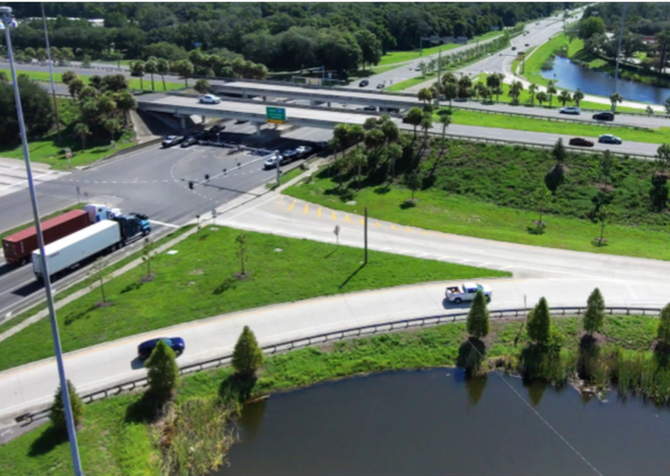
Quiz – Question 2
True or False?
The Purpose and Need Statement drives the process for development and evaluation of reasonable, prudent, and practicable alternatives.
Notes:
Our final quiz question for this section of the training is a True or False question.…

Slide 14
Quiz – Question 2
Answer
True or False?
The Purpose and Need Statement drives the process for development and evaluation of reasonable, prudent, and practicable alternatives.
True
The Purpose and Need Statement explains to the reader why an agency action is necessary and serves as the basis for identifying reasonable alternatives which meet the Purpose and Need.
Notes:
You are right if you answered True. The Purpose and Need Statement explains to the reader why an agency action is necessary and serves as the basis for identifying reasonable alternatives which meet the Purpose and Need.

Slide 15


Define the Purpose…the “What” of the Proposed Action
  Write a problem statement.
  State the reason why FDOT is proposing a certain project.
  Articulate in one or two sentences the project's primary objective.
  Do not be overly broad such that it invites the consideration of an infinite number of alternatives.
Good “Purpose”
Sentence
The purpose of the project is to reduce congestion and improve mobility on SR 76 between Elm Street and Oak Avenue.
The purpose of the project is to widen SR 76 between Elm Street and Oak Avenue from a two-lane road to four lanes to relieve congestion.
Bad “Purpose”
Sentence
This Purpose Sentence gives a solution, discusses a particular action, and does not fully state the problem.
Notes:
We are now moving to the “How Do We Develop the Purpose and Need Statement” segment of the training. This is the meat of the training where we will dig deeper into what a purpose and need should look like, the elements of need, and you will see both good and bad examples of a Purpose and Need Statement. The examples used for the training are based on real projects but have been changed with fictitious details and have been simplified for training purposes.
We will start with how to Define the Purpose and then move into the Need.
Earlier we discussed that the Purpose is the “what” of the proposed action. What FDOT is trying to accomplish. So, we will want to write a problem statement. When doing this, state the reason why the FDOT is proposing a certain project. The Purpose should articulate in one or two sentences the project's primary objective. We do not want to be overly broad such that it invites the consideration of an infinite number of alternatives.
Shown here is an example of a good Purpose. “The purpose of the project is to reduce congestion and improve mobility on S.R.76 between Elm Street and Oak Avenue.”
A bad Purpose might say “The purpose of the project is to widen S.R.76 between Elm Street and Oak Avenue from a two-lane road to four lanes to relieve congestion.” Here the purpose sentence states a solution, discusses a particular action, and does not fully state the problem. These are things that should NOT be in a purpose statement.

Slide 16

Should Primary and Secondary Purposes Be Included?
  There can be primary and secondary Purposes, but it is not required to have both.
  Data must be provided to support both primary and secondary Purposes.
Primary
Secondary
vs.
  Is the “driver” of the project.
  Reflects the fundamental reason why the project is being proposed.
  Used to develop and screen alternatives.
  Is an additional purpose that is desirable (non-critical), but not the core purpose of the project.
  Not used to screen alternatives, however they may be able to support selection of the preferred alternative.
The Purpose of this project is to improve roadway deficiencies (primary purpose) along Florida Road between Riverview Drive and College Avenue. In addition, a goal of this project is to improve safety conditions (secondary purpose) for vehicle and pedestrian traffic.
Example
Notes:
OEM often is asked “should primary and secondary purposes be included”? The answer is there can be primary and secondary Purposes, but it is not required to have both. If you decide to have both, data must be provided to support both. Note you can have multiple primary and secondary purposes.
Sometimes it can be confusing to distinguish between the two. A Primary purpose is a “driver” of the project. It reflects the fundamental reason why the project is being proposed and it is used to develop and screen alternatives. Whereas a secondary purpose is an additional purpose. It is desirable (non-critical), but not the core purpose of the project. A secondary purpose is not used to screen alternatives; however, they may be able to support selection of the preferred alternative.
An example of a purpose that has both primary and secondary is: “The Purpose of this project is to improve roadway deficiencies along Florida Road between Riverview Drive and College Avenue (primary purpose). In addition, a goal of this project is to improve safety conditions for vehicle and pedestrian traffic.” (secondary purpose)

Slide 17

Define the Need …the “Why” the Proposed Action is Needed
  Provide data to support the problem statement (purpose).
  Describe the key problem(s) and the cause of those problems that are being addressed by the proposed project/action.
  Provide verifiable data in tables and graphs to document a demonstrated need.
  Do not include non-transportation-related issues or outcomes and goals that are desirable, but not essential. For example, do not include “minimization of environmental impacts.”
  Be consistent with the Purpose sentence.
The project is needed because SR 76 between the intersections with Elm Street and Maple Street is:
(a) inadequate to meet current and future traffic volumes, resulting in congestion, reduced mobility, and a Level of Service of ‘F’ on this stretch of highway; and
(b) does not meet current design standards as the travel lanes are too narrow and there are no shoulders.
Need
TIP: Limit the Need Statement to problems or unsatisfactory conditions for which a solution is truly needed – the more concise and focused the Need Statement, the easier it will be to later compare and evaluate alternatives.
Notes:
Now I want to Define the Need. As a recap, the Need is the “ why” the proposed action is needed. It identifies the problem(s) the proposed project will address, but remember we are not solving the problem.
When writing the need, we must provide data to support the purpose which is the problem statement.
In doing this we describe the key problem(s) and the cause of those problems that are being addressed by the proposed project/action.
Keep in mind these next three bullets as well. First, provide verifiable data in tables and graphs to document a demonstrated need. I will show you examples of this later in the training.
Next, do not include non-transportation-related issues or outcomes and goals that are desirable, but not essential. For example, do not include “minimization of environmental impacts.”
Lastly, we should be consistent with the Purpose sentence.
An example of a good Need sentence is “The project is needed because S.R.76 between the intersections with Elm Street and Maple Street is:
(a) inadequate to meet current and future traffic volumes, resulting in congestion, reduced mobility, and a Level of Service of ‘F’ on this stretch of highway; and
(b) does not meet current design standards as the travel lanes are too narrow and there are no shoulders for this classification of roadway.”
This sentence would then be followed-up with verifiable data using table to quantify the LOS data.
One tip I would like to leave you with here is to limit the Need Statement to problems or unsatisfactory conditions for which a solution is truly needed – the more concise and focused the Need Statement, the easier it will be to later compare and evaluate alternatives.

Slide 18




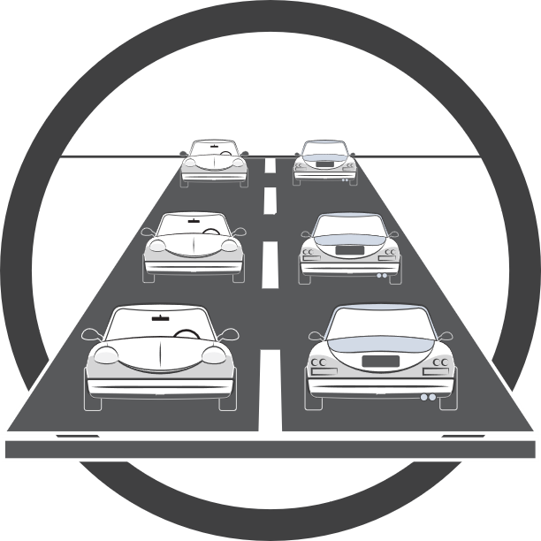





9 Elements of Need
Legislation
Project Status
Purpose and Need Statements must include Project Status and any other Need elements that are applicable.
Roadway
Deficiencies
Capacity
NEED
Modal
Interrelationships
Safety
Social Demands or
Economic Development
Transportation
Demand
System Linkage
Notes:
FHWA guidance and the PD&E Manual outline nine elements of Need shown here, but there can be other needs not on this list. Also, the project need statement must include Project Status and any other Need elements that are applicable. If numerous elements apply you may want to consider having primary and secondary purpose and needs.
We are going to discuss each of these Needs elements in detail. Each of these slides is packed with information and examples. This was intentional so that you can come back to this presentation at a later date and utilize this information to guide you through developing a Purpose and Need Statement.

Slide 19
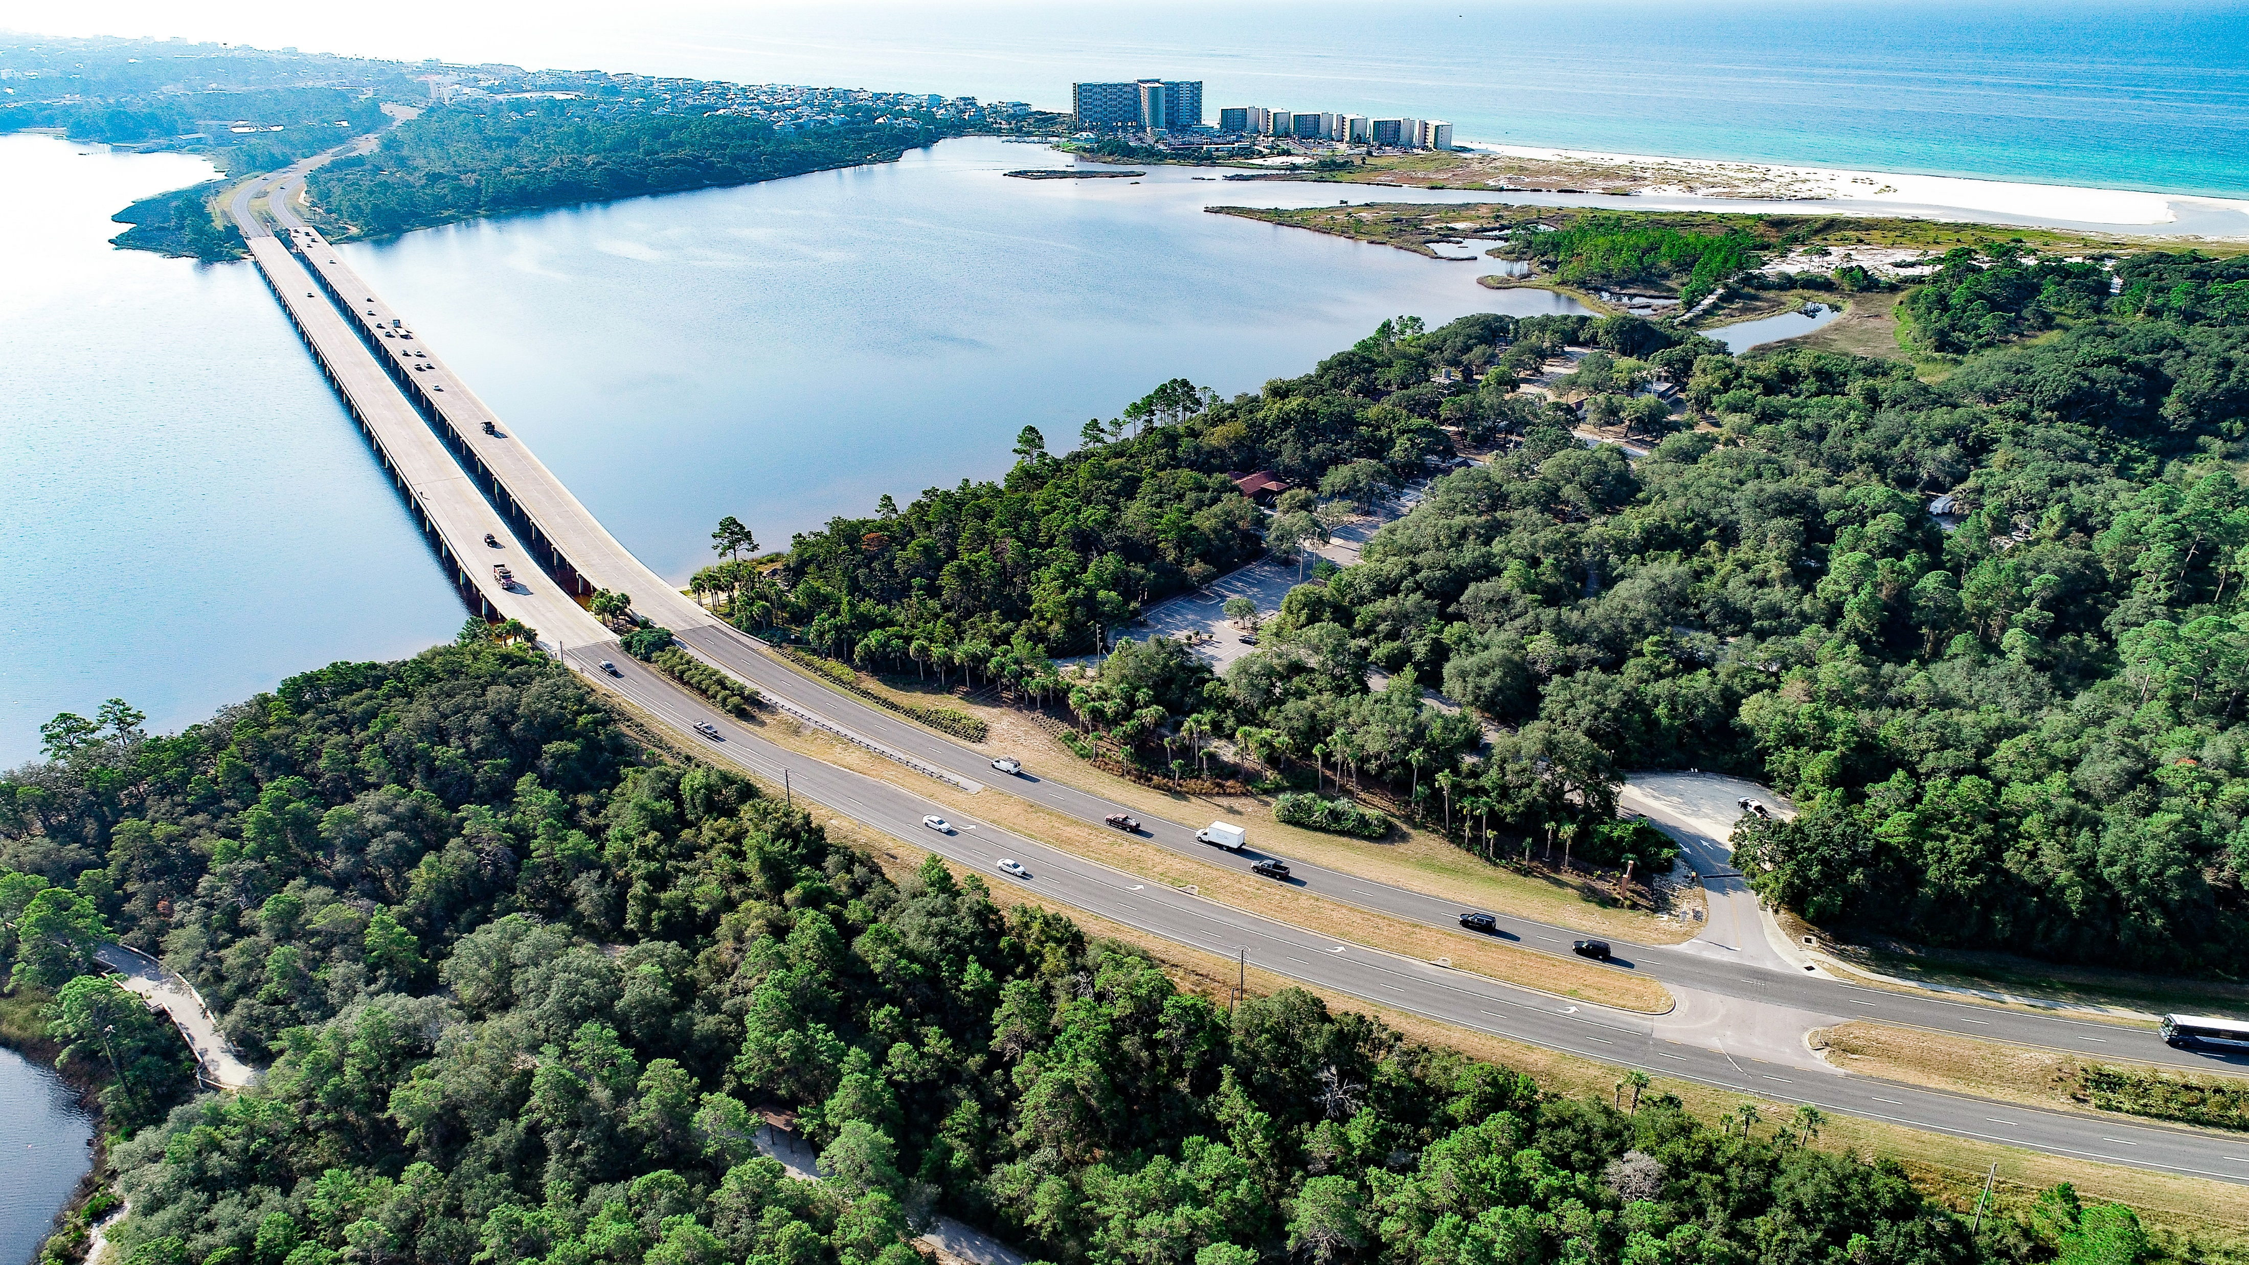
Need Element - Project Status
  Project Status is required for all projects.
  Planning Consistency is a component of Project Status.
  Provide a narrative referencing the FDOT STIP and, if applicable, the MPO’s Cost Feasible LRTP and TIP that describes all project phases. Attach pages from these documents as appropriate.
  Confirm the project description text, including limits, match what is shown in LRTP.
  Describe the project’s history including measures taken to date, other agencies and governmental units involved, action spending, schedules, etc.
Data Sources
Local Plans
Regional Long Range Transportation Plans
TIP
STIP
Feasibility Studies
Bicycle & Pedestrian Master Plans
Comprehensive Plans
Notes:
As I mentioned, the first Need element is the only one required for all projects, Project Status.
Planning Consistency is a component of Project Status therefore, we should provide a narrative referencing what is currently in the FDOT State Transportation Improvement Program or STIP and, if applicable, the MPO’s Cost Feasible Long Range Transportation Plan (LRTP) and Transportation Improvement Program, or TIP, that describes all project phases. Depending on the phase the project is in these planning consistency documents must be attached in the Efficient Transportation Decision Making, or ETDM, Environmental Screening Tool or as an attachment to the environmental document during the PD&E study. Also, confirm that the project description text and limits match what is shown in the LRTP. It is important to do this early in the life of the project because the limits need to match in order to receive planning consistency. Updating limits in the LRTP can take several months since the changes have to be approved by the City or County entity.
Planning consistency is required for all projects. A project cannot receive Location and Design Concept Acceptance, or LDCA, if planning consistency is not obtained. OEM has planning consistency training available on their website.
Lastly, within the Project Status section describe the project’s history including measures taken to date, other agencies and governmental units involved, action spending, and schedules.
I would like to direct your attention to the Data Sources box. Most of these Needs elements slides have this box to provide examples of where you can find data to write about for that particular element and provide the data or evidence that the deficiency or problem exists.

Slide 20
Need Element - Project Status
A Feasibility Study was completed for this project in 2023. A Build Alternative was recommended for further review during the PD&E study that will provide 4-lane divided roadway with multi-modal improvements on Sunset Boulevard from 4th Street to the Bay Bridge. The preliminary results also indicate that the left, center, and right alignment options are similar when compared to natural and human environment impacts. With this knowledge, the PD&E study will have the opportunity to further reduce adjacent impacts by considering potential combinations of all the mentioned alternative alignments in order to determine an optimal solution.
Sunset Boulevard from 4th Street to the Bay Bridge is listed in the Cost Feasible Plan (project 33) of the Pinellas County MPO 2050 Long Range Transportation Plan (LRTP) for preliminary engineering to provide multi-modal improvements.
Funding for PD&E and Design for Sunset Boulevard is listed in the Forward Pinellas 2023/24-2028/29 Transportation Improvement Program (TIP). The project is included in the current FDOT 2023-2027 State Transportation Improvement Program (STIP) and the FDOT 2023-2027 Five-Year Work Program with $1,700,000 programmed for the PD&E phase in Fiscal Year (FY) 2025.
Project Example
Notes:
Our example for Project Status starts out with the project’s history beginning with the Feasibility Study and its results. “A Feasibility Study was completed for this project in 2023. A Build Alternative was recommended for further review during the PD&E study that will provide a 4-lane divided roadway with multi-modal improvements on Sunset Boulevard from 4th Street to the Bay Bridge. The preliminary results also indicate that the left, center, and right alignment options are similar when compared to natural and human environment impacts. With this knowledge, the PD&E study will have the opportunity to further reduce adjacent impacts by considering potential combinations of all the mentioned alternative alignments in order to determine an optimal solution”.
“Sunset Boulevard from 4th Street to the Bay Bridge is listed in the Cost Feasible Plan (project 33) of the Pinellas County MPO 2050 LRTP for preliminary engineering to provide multi-modal improvements.” This paragraph notes priority of the project and what the funding is designated for.
“Funding for PD&E and Design for Sunset Boulevard is listed in the Forward Pinellas 2023/24-2028/29 TIP. The project is included in the current FDOT 2023-2027 STIP and the FDOT 2023-2027 Five-Year Work Program with $1,700,000 programmed for the PD&E phase in Fiscal Year (FY) 2025.” This paragraph fulfils the planning consistency requirement of the project status.
It is important to note that we should not rely exclusively on planning or programming documents, like the STIP, to justify the project. It’s not sufficient to just say, “this project is called-for by the STIP,” as this does not convey the true, underlying purpose and need of the project.

Slide 21
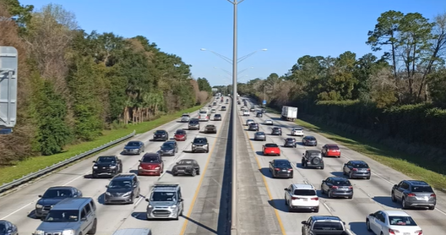
Need Element - Capacity
Questions to Consider
How to Answer
  Is the capacity of the existing facility inadequate to serve traffic?
  What is the projected transportation demand?
  What capacity is needed?
  What is the Level of Service (LOS) for existing and proposed facilities?
  Discuss the capacity of the present facility and its ability to meet present and projected traffic demands.
  Discuss the capacity of the existing facility, its existing and anticipated LOS, and any operational deficiencies.
  State the target LOS.
Data Sources
Traffic Counts
Level of Service
Notes:
When developing information concerning Capacity, our next needs element, we need to consider the following questions.
Is the capacity of the existing facility inadequate to serve traffic?
What is the projected transportation demand?
What capacity is needed?
What is the Level of Service (LOS) for existing and proposed facilities?
Ways to answer to these can be to discuss the capacity of the present facility and its ability to meet present and projected traffic demands.
Also, discuss the capacity of the existing facility, its existing and anticipated LOS, and any operational deficiencies, but make sure to state the target LOS. The Target is policy identified LOS which is considered the acceptable capacity of that facility based on its context classification. A portion of the policy states “It is the Department’s intent to plan, design and operate the State Highway System at an acceptable level of service for the traveling public. The automobile mode level of service targets for the State Highway System during peak travel hours are “D” in urbanized areas and “C” outside urbanized areas.”

Slide 22
Need Element - Capacity - Example
Currently there are capacity issues on US 15 from Dragger Street to SR 401, in the Town of Goodwin. Given the existing land uses that includes a Walmart Distribution Center with heavy truck traffic, this problem is expected to increase. The Town wants to make capacity improvements to US 15 to address existing and future congestion.
Project Example
The Purpose of this project is to provide additional capacity on US 15 from Dragger Street to SR 401 in order to accommodate existing capacity and future traffic demand for vehicular and truck traffic along the corridor.
Purpose
The Need is to reduce traffic congestion on US 15 from Dragger Street to SR 401 since the corridor is currently operating at a failing LOS F, but the Target Level of Service is LOS C. This project is needed to accommodate future traffic demand since traffic, including truck volumes, is projected to increase. US 15 is an important east-west connection between the Towns of McKinney and Goodwin and serves as an important regional trucking route.
Need
(Insert data to support Need after this statement)
Notes:
For each of the remaining Need elements I am going to provide an example of a Purpose and Need Statement. This does not include the supporting data that is required after the Need statement. Here is an example of a Purpose and Need where capacity issues are the problem and the land use and distribution centers, including a Walmart Distribution Center are adding to the increase in traffic and future demand.
The Purpose of this project is to provide additional capacity on US 15 from Dragger Street to S.R.401 in order to accommodate existing capacity and future traffic demand for vehicular and truck traffic along the corridor.
The Need is to reduce traffic congestion on US 15 from Dragger Street to SR 401 since the corridor is currently operating at a failing LOS F, but the Target Level of Service is LOS C. This project is needed to accommodate future traffic demand since traffic, including truck volumes, is projected to increase. US 15 is an important east-west connection between the Towns of McKinney and Goodwin and serves as an important regional trucking route.
Types of supporting data that should be included after this Need statement would include, but is not limited to, existing and anticipated LOS and the target LOS.

Slide 23
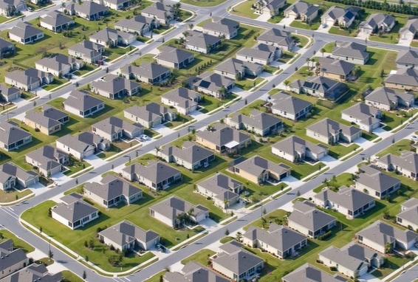
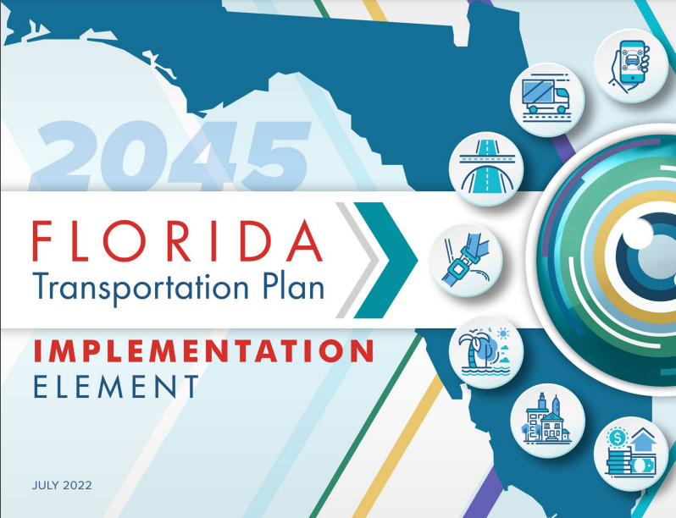
Need Element - Transportation Demand
Questions to Consider
How to Answer
  Will the project accommodate the forecasted transportation demand as shown in the adopted state and local transportation plans?
  Will the project meet future transportation demands based on the projected population, employment growth, and increase in freight movement, or other demands on the transportation system?
  Discuss the project’s relationship to any statewide transportation plan or adopted urban transportation plan.
  Explain any related traffic forecasts that are different from previous estimates.
Data Sources
Transportation Model
Florida Transportation Plan
Adopted Urban Transportation Plans
Freight Plans
Corridor Traffic Forecasting Studies
Project-Level Traffic Forecasting Studies
Notes:
Transportation Demand can be a difficult need element to wrap our heads around and it is not often used. It is often confused with Capacity, but is different and should not be written in conjunction with Capacity. Questions we would need to consider are:
Will the project accommodate the forecasted transportation demand as shown in the adopted state and local transportation plans?
Will the project meet future transportation demands based on the projected population, employment growth, and increase in freight movement, or other demands on the transportation system?
If data supports this need, then we would discuss the project’s relationship to any statewide transportation plan or adopted urban transportation plan. We would also explain any related traffic forecasts that are different from previous estimates. Data Sources can include Transportation Plans and Forecasting Studies.

Slide 24
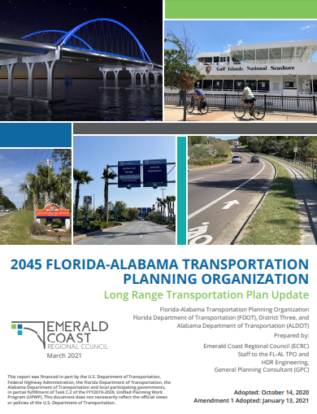
Need Element - Transportation Demand - Example
US 15 in Andorra has 23 signalized intersections along the corridor. The projected 2050 future traffic results in unacceptable signalized intersection Level of Service (LOS) at all intersections. Therefore, the corridor does not meet the future transportation demand based on projected population and employment growth. As such, additional capacity is needed on US 15 in order to meet the future transportation demands as outlined in the Florida-Alabama TPO LRTP.
Project Example
The Purpose of this project is to provide intersection improvements along US 15 in order to meet the future traffic demand along the corridor. In 2050, the Florida-Alabama TPO LRTP states that all 23 signalized intersections along the corridor need to operate at a Level of Service (LOS) C or above.
Purpose
Need
(Insert data to support Need after this statement)
The Need of this project is to improve intersection configurations in order to meet the future transportation demand based on projected population and employment growth and desired LOS as outlined in the Florida-Alabama TPO LRTP.
Notes:
In this example US 15 has 23 signalized intersections along the study corridor. The projected 2050 future traffic results in unacceptable signalized intersection Level of Service (LOS) at all intersections. Therefore, the corridor does not meet the future transportation demand based on projected population and employment growth. As such, additional capacity is needed on US 15 in order to meet the future transportation demands as outlined in the Florida-Alabama TPO LRTP.
The Purpose of this project is to provide intersection improvements along US 15 in order to meet the future traffic demand along the corridor. In 2050, the Florida-Alabama TPO LRTP states that all 23 signalized intersections along the corridor need to operate at a LOS C or above.
The Need of this project is to improve intersection configurations in order to meet the future transportation demand based on projected population and employment growth and desired LOS as outlined in the Florida-Alabama TPO LRTP.
Types of supporting data that should be included after this statement would include, but is not limited to, traffic demand forecast information, population and employment growth in charts or tables, and information from Forecasting Studies, if applicable.

Slide 25
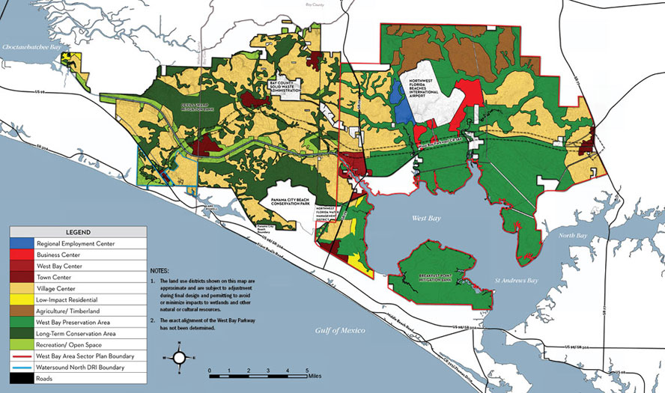
Need Element - Social Demands or Economic Development
Question to Consider
How to Answer
  What projected economic development/land use changes indicate the need to modify the transportation facility, network or system?
  Describe how the action will foster new employment, benefit schools, land use plans, recreation facilities, etc.
  Discuss types of social and economic traffic generators, both existing and planned, which exert travel demands on the facility.
  It is important that the Purpose and Need be grounded in transportation and as such a description of the projected economic development/land use changes that indicate the need to improve the highway.
Data Sources
Zoning and Development Master Plans
Regional Planning Studies
Origin/Destination Studies
Local Economic Plans/Visioning Documents
Access Management Studies
Corridor Freight Studies
Sustainability Studies
Economic Impact and Forecasting Analysis
TIP: This Needs Element is uncommon and must be well documented.
Notes:
Rarely used, but a viable element is Social Demands and Economic Development. One question to consider is, what projected economic development/land use changes indicate the need to modify the transportation facility, network or system?
To answer this, we can do the following:
Describe how the action will foster new employment, benefit schools, land use plans, recreation facilities, and/or
Discuss types of social and economic traffic generators, both existing and planned, which exert travel demands on the facility.
It is important that the Purpose and Need be grounded in transportation and as such a description of the projected economic development/land use changes that indicate the need to improve the highway.
In order for Economic Development to be considered a primary need, there must be demonstrated progress in implementing the master or comprehensive plan, such as zoning changes, investment/funding for proposed developments, or active development. Furthermore, the Purpose and Need must provide quantified data that illustrates existing and future conditions related to transportation needs will impact planned development when built. This focus will help avoid defining a broad purpose that may require a vast range of transportation and/or non-transportation alternatives for promoting economic development.
There are numerous data sources shown here, but if we use this Need element, it must be well documented and may require an economic analysis be completed.

Slide 26
Need Element - Social Demands or Economic
Development - Example
Over the past few years, the Town of Kerry has experienced a tremendous increase in traffic in the vicinity of the I-99 and US 83 interchange as a result of a lack of long-range transportation planning. New, significant businesses, including big box stores and an existing adjacent casino are causing increased transportation demands along the existing network. In addition, a planned expansion of the casino through adjacent available lands located in the southeast quadrant of the interchange has been proposed. It has been shown that the proposed development can generate increases in annual sales tax revenue for the Town of Kerry. An economic analysis was completed for this project.
Project Example
The Purpose of this project is to facilitate economic development by improving access and traffic operations to both developed and undeveloped lands located near the interchange.
Purpose
The Need for this project is to reduce the existing and future congestion at the interchange. Based on a report by the FDOT, the existing road network would not support the casino expansion which would then limit an increase in jobs and continue to constrain traffic to other local businesses.
Need
(Insert data to support Need after this statement)
Notes:
Our example here is for the Town of Kerry who has experienced a tremendous increase in traffic in the vicinity of the I-99 and US 83 interchange. New, significant businesses, including big box stores and an existing adjacent casino are causing increased transportation demands along the existing network. There is also a planned expansion of the casino through adjacent available lands at the interchange. It should be noted that it has been shown that the proposed development can generate increases in annual sales tax revenue for the Town of Kerry.
The Purpose of this project is to facilitate economic development by improving access and traffic operations to both developed and undeveloped lands located near the interchange.
The Need for this project is to reduce the existing and future congestion at the interchange. Based on a report by the FDOT, the existing road network could not support the casino expansion which would then limit an increase in jobs and continue to constrain traffic to other local businesses.
Attachments and data that can support the Need for this project may include a map of the interchange area and where the box stores and casino are located in relation to the interchange, a map of the casino expansion, data showing the anticipated increase in jobs and if there is anything documenting the proposed increase in annual sales tax revenue. Since an economic analysis was completed for this project, it should be referenced.

Slide 27
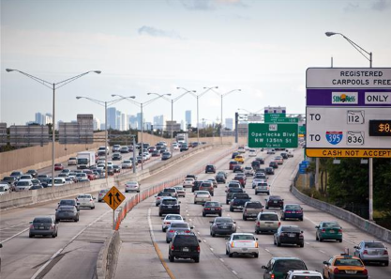
Need Element - Safety
Questions to Consider
How to Answer
  Is the proposed project necessary to correct an existing or potential safety hazard?
  Is the existing crash rate higher that the statewide average for similar facilities?
  How will the proposed project improve it?
  Discuss crashes which have occurred in the study area that may indicate a need for improvements. The discussion may include crash types, frequency, crash pattern, crash contributing causes, and the rate of crashes when compared with the statewide average for similar facilities.
  Identify existing high-hazard sections of the facility and how the project will address the safety problem.
  If applicable, discuss how the project will support emergency evacuation of designated evacuation routes.
Data Sources
Crash data
Hurricane Evacuation Designated Route Map
Notes:
Safety is another Need Element that is often used that must have supporting data. Questions to consider include:
Is the proposed project necessary to correct an existing or potential safety hazard? This is not limited to only vehicle safety, but also to bicycle and pedestrian safety.
Is the existing crash rate higher that the statewide average for similar facilities?
How will the proposed project improve it?
The Safety section is a good place to address emergency or hurricane evacuation as well if it is a primary need with supporting data.
When writing about safety discuss crashes which have occurred in the study area that may indicate a need for improvements. The discussion may include crash types, frequency, crash pattern, crash contributing causes, and the rate of crashes when compared with the statewide average for similar facilities. This information is often best presented in a table and summarized in the text.
Also, identify existing high-hazard sections of the facility and how the project will address the safety problem. Considering attaching heat maps if available.
If applicable, discuss how the project will support emergency evacuation of designated evacuation routes.
Many transportation projects produce safety benefits, in the sense that completing the project will tend to reduce crash rates and/or the overall number of crashes. Yet, the potential for a safety benefit does not necessarily mean that safety is one of the need elements of the project. In general, safety should be included as a project purpose and need only where there is an identified safety need, supported by facts. For example, a crash rate that exceeds the statewide average for similar roadways.

Slide 28
Need Element - Safety
S.R. 234 from Campmor Road to Haskle Drive is a two-lane undivided rural roadway with a 55-mph speed limit. Although the roadway has adequate signage and road stripping, it does not have lighting, has several areas with sharp turns, and the roadway does not have passing lanes. These road conditions have led to a recent increase in head-on collisions and fatalities.
Project Example
The Purpose of this project is to address safety issues on S.R. 234 from Campmor Road to Haskle Drive.
Purpose
The Need is to address safety concerns on S.R. 234 from Campmor Road to Haskle Drive resulting from the high crash rates, which are significantly higher with and average crash rate of 4.35 than the statewide average of 1.72 for similar facilities. The two-lane undivided highway is experiencing a recent increase in the number of head on collisions resulting in eight fatalities between 2020 and 2022. These collisions are due to the roadway having sharp turns and vehicles passing each other. There are currently no passing lanes along this segment of the corridor.
Need
(Insert data to support Need after this statement)
Notes:
This safety example shows a project that is a two-lane undivided rural roadway with a 55-mph speed limit. The roadway does not have lighting and has several areas with sharp turns and no passing lanes which has led to a recent increase in head-on collisions and fatalities.
The Purpose of this project is to address safety issues on S.R. 234 from Campmor Road to Haskle Drive.
The Need is to address safety concerns on S.R. 234 from Campmor Road to Haskle Drive resulting from the high crash rates, which are significantly higher with an average crash rate of 4.35 than the statewide average of 1.72 for similar facilities. The two-lane undivided highway is experiencing a recent increase in the number of head on collisions resulting in eight fatalities between 2020 and 2022. These collisions are due to the roadway having sharp turns and vehicles passing each other. There are currently no passing lanes along this segment of the corridor.
Types of supporting data that should be included after this statement would include, but is not limited to, comparison of crash rates to the statewide average by year, types of crashes, number of injuries and fatalities.

Slide 29
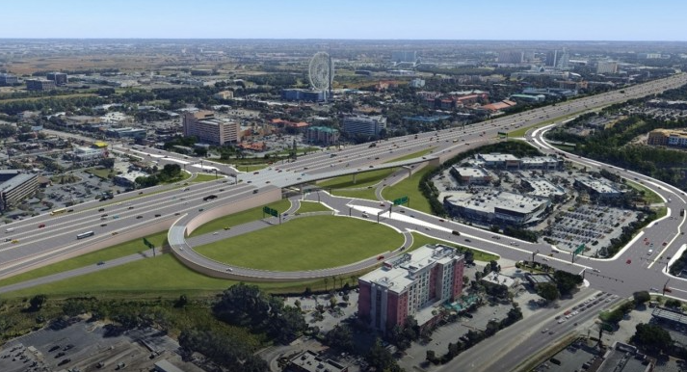
Need Element - System Linkage
Questions to Consider
How to Answer
  Is the proposed project a local, regional, or interregional “connecting link”? (Links include connection of existing transportation facilities, modal facilities, geographic areas, etc.)
  How does it fit in the transportation system?
  Discuss how the proposed project fits into the existing and future local, regional and state transportation system (network) and contributes to the movement of people, goods, and services.
  Discuss how the proposed project contributes to the
  multi-modal transportation network.
Data Sources
Local or Regional Long Range Transportation Plans
Development Plans
Origin/Destination Studies
Access Management Studies
Existing Land Use
Feasibility Studies
Notes:
Our next Need element is System Linkage. Questions we would consider here are:
Is the proposed project a local, regional, or interregional “connecting link”? (Links include connection of existing transportation facilities, modal facilities, geographic areas)
How does it fit in the transportation system?
To answer these, we can discuss how the proposed project fits into the existing and future local, regional and state transportation system (network) and contributes to the movement of people, goods, and services. Also, discuss how the proposed project contributes to the multi-modal transportation network. This is a great opportunity to include maps to show the existing and needed linkages.

Slide 30
Need Element - System Linkage - Example
Currently the City of Bayfield along with surrounding regional destinations, including the Stateside Air Force Base (AFB), access to I-70 via SR 65 through downtown Bayfield. SR 65 is currently overcapacity because every road uses SR 65 to access the Interstate. The City is planning a bypass around Bayfield to connect Stateside AFB directly to I-70, which would reduce traffic on SR 65 and improve regional mobility and connectivity.
Project Example
The Purpose of this project is to increase access to I-70, to reduce travel demand on SR 65, and improve regional mobility and connectivity for Stateside AFB.
Purpose
The Need for the project is to better facilitate regional travel by providing an alternative route to the highway and provide relief to the congested SR 65 corridor. Running between Sunny Beach to the south and Kannerville to the north, SR 65 carries the majority of the regional traffic and provides primary access to and from Stateside AFB and the surrounding beach communities.
Need
(Insert data to support Need after this statement)
Notes:
Currently the City of Bayfield along with surrounding regional destinations, including the Stateside Air Force Base (AFB), access to I-70 via SR 65 through downtown Bayfield. SR 65 is currently overcapacity because every road uses SR 65 to access the Interstate. The City is planning a bypass around Bayfield to connect Stateside AFB directly to I-70, which would reduce traffic on SR 65 and improve regional mobility and connectivity.
The Purpose of this project is to increase access to I-70, to reduce travel demand on SR 65, and improve regional mobility and connectivity for Stateside AFB.
The Need for the project is to better facilitate regional travel by providing an alternative route to the highway and provide relief to the congested SR 65 corridor. Running between Sunny Beach to the south and Kannerville to the north, SR 65 carries the majority of the regional traffic and provides primary access to and from Stateside AFB and the surrounding beach communities.
This is the perfect example where supporting data included after the Need Statement can add clarity. In this case, including a map showing the linkage of I-70, Bayfield, Stateside AFB and the regional facilities helps the reader understand the road network for context.

Slide 31
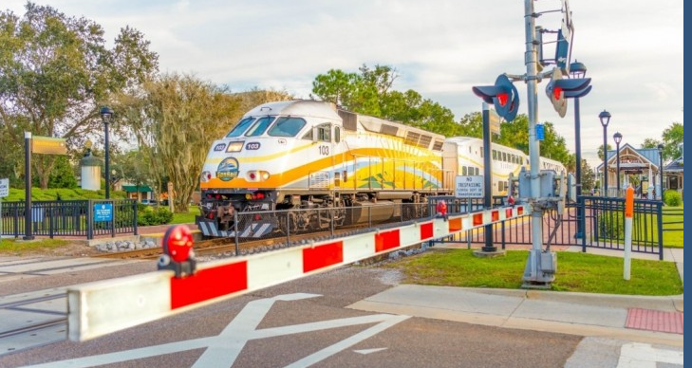
Need Element - Modal Interrelationships
Question to Consider
How to Answer
  How will the proposed project interface with and serve to complement other modes of transportation such as airports, freight facilities, rail and port facilities, bicycle and pedestrian facilities, and passenger transit services?
  Identify the needs to address other modes of transportation (e.g., airports, rail and port facilities, passenger transit services, bicycle/pedestrian accommodations, ridesharing, special use lanes) associated with the project.
  Discuss how the proposed action will compliment other modes of transportation.
Data Sources
Freight Plans
Bicycle and Pedestrian Master Plans
Local or Regional Long Range Transportation Plans
Development Plans
Comprehensive Plans
Notes:
When other modes of transportation are involved, Modal Interrelationships is sometimes an applicable Need element.
The question to consider here is how will the proposed project interface with and serve to complement other modes of transportation such as airports, freight facilities, rail and port facilities, bicycle and pedestrian facilities, and passenger transit services?
We can answer this if we identify the needs to address other modes of transportation associated with the project. We can also discuss how the proposed action will compliment other modes of transportation.
Data sources that can be used for this Need element include freight plans, master plans, LRTPs, and other plans.

Slide 32
Need Element - Modal Interrelationships - Example
The Port of Riverdale is expanding its facility to receive and distribute more goods. Hwy 10 is the major distribution route that connects the port to I-99. Hwy 10, a two-lane road, is currently at capacity for vehicles and port freight and will not be able to accommodate the additional future freight traffic from an expanded port facility.
Project Example
The Purpose of this project is to improve intermodal connectivity by creating a corridor with increased capacity along Hwy 10 between the port and I-99 to accommodate future freight.
Purpose
Need
(Insert data to support Need after this statement)
The Need for this project is to improve projected Level of Service F on Hwy 10, expected to occur within the next two years, and to eliminate significant delays of freight between the port and I-99.
Notes:
A project example for Modal Interrelationships involves the Port of Riverdale which is expanding its facility to receive and distribute more goods. Hwy 10 is the major distribution route that connects the port to I-99. Hwy 10, a two-lane road, is currently at capacity for vehicles and port freight and will not be able to accommodate the additional future freight traffic from an expanded port facility.
The Purpose of this project is to improve intermodal connectivity by creating a corridor with increased capacity along Hwy 10 between the port and I-99 to accommodate future freight.
The Need for this project is to eliminate significant delays of freight between the port and I-99.

Slide 33
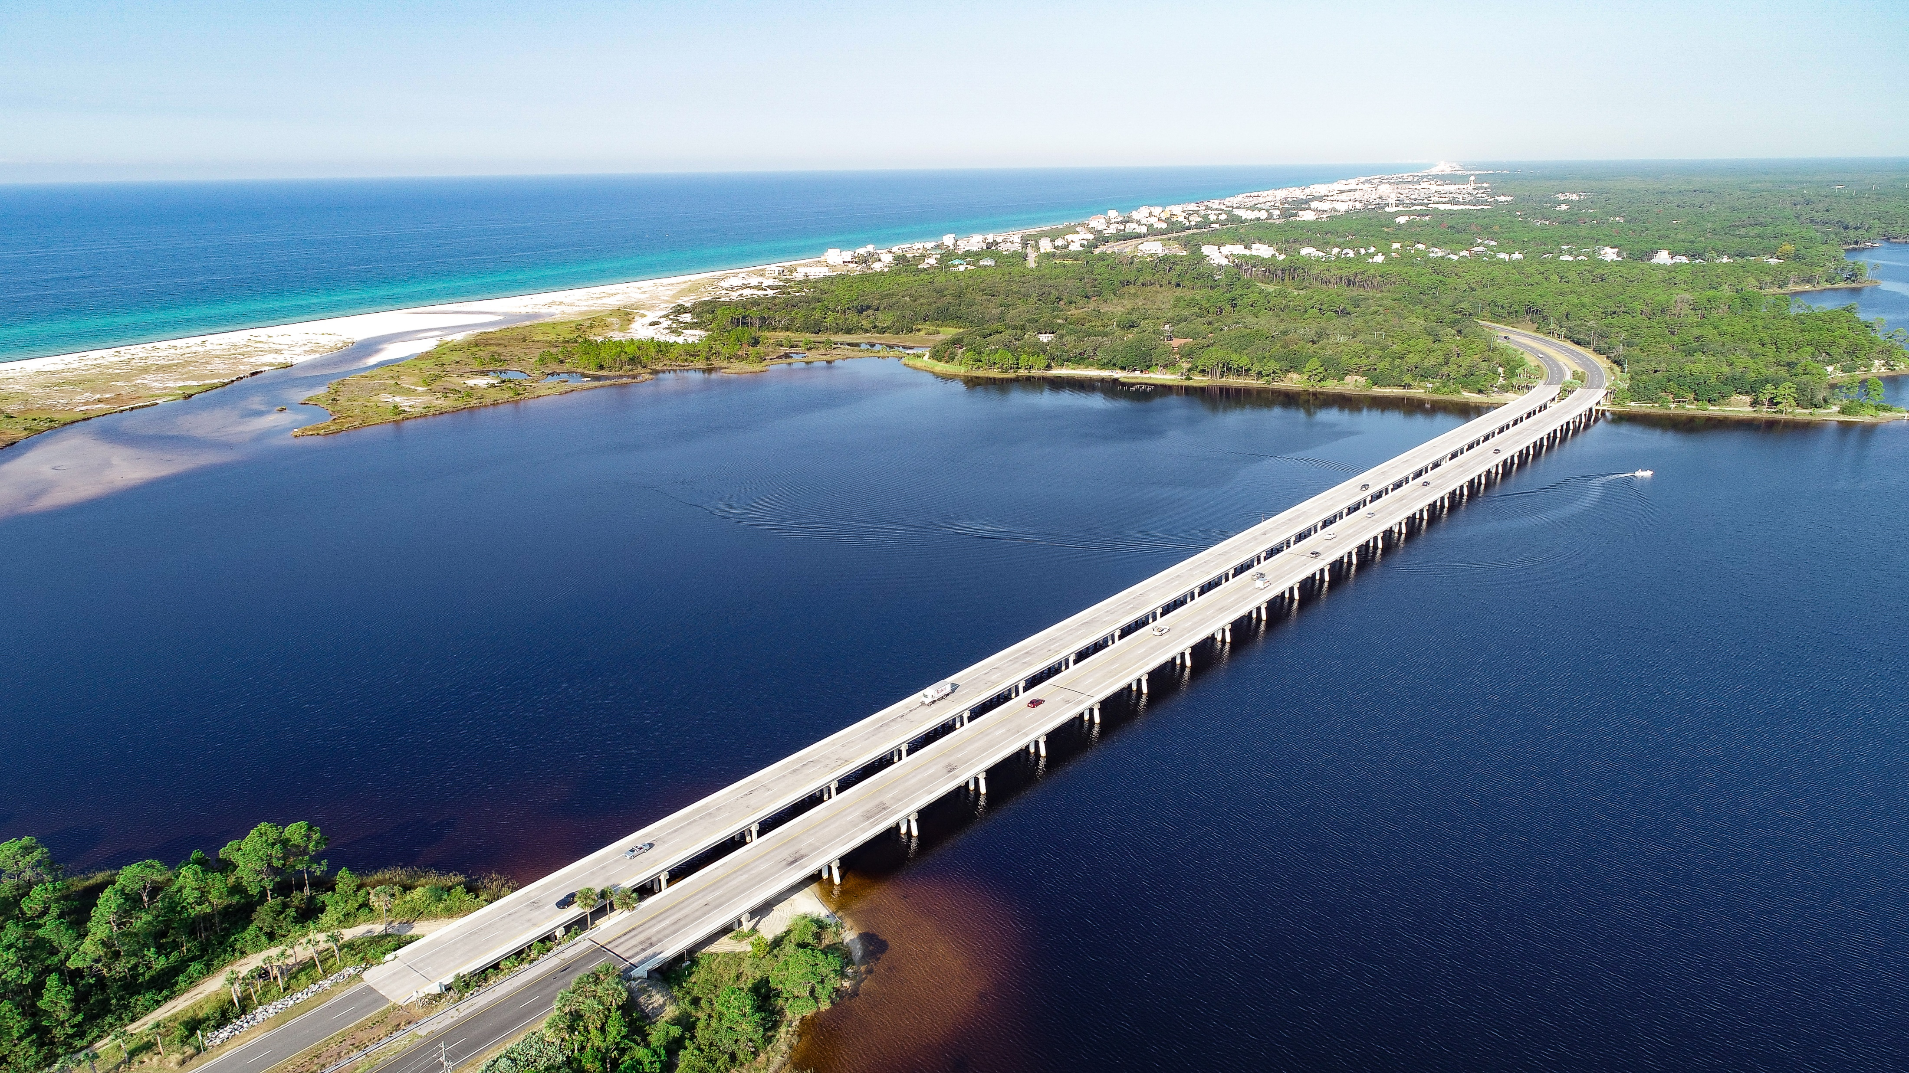
Need Element - Roadway Deficiencies
Questions to Consider
How to Answer
  Is the proposed project necessary to correct existing roadway deficiencies?
  How will the proposed project address the deficiencies?
  Is there a deficient or substandard bridge?
  Does the current facility meet Design Standards?
  The need and rationale behind reconstructing or replacing a roadway or existing bridge must be provided.
  Provide a detailed description of the existing structure(s) and their deficiencies. Deficiencies may include substandard geometrics, load limits on structures, inadequate SIS roadway design standards and/or high maintenance costs.
  For bridges, the deficiencies identified may be the result of structural and functional ratings, horizontal and vertical clearances, state of repair, weight restrictions or limitations.
Data Sources
Bridge Inspection Reports
Pavement Condition Ratings
Florida Design Manual
USCG Guide Clearance Lists and Navigational Maps
Notes:
Another common Need element is Roadway Deficiencies. Questions to Consider here are:
Is the proposed project necessary to correct existing roadway deficiencies?
How will the proposed project address the deficiencies?
Is there a deficient or substandard bridge?
Does the current facility meet Design Standards?
To answer these questions, we must provide two things:
The need and rationale behind reconstructing or replacing a roadway or existing bridge and
A detailed description of the existing structure(s) and their deficiencies. Deficiencies may include substandard geometrics, lack of turn lanes, load limits on structures, inadequate SIS roadway design standards and/or high maintenance costs.
For bridges, the deficiencies identified may be the result of structural and functional ratings, horizontal and vertical clearances, state of repair, weight restrictions or limitations. This information can be obtained from Bridge Inspection Reports. We would need to use the most recent reports which can be obtained through the District Structures Office and may require an application and personal identification for the information. Information from these reports can be summarized in the Need but should not be attached.

Slide 34
Need Element - Roadway Deficiencies - Example
The Seaside Beach Causeway consists of two bridges (north and south) that connect the communities of Westport and Seaside Beach. The north bridge does not meet minimum USCG clearances and is starting to deteriorate from the saltwater conditions. The current bridge structures, constructed in 1960, are nearing the end of their useful service lives and are considered structurally deficient and functionally obsolete by the FDOT. The next closest bridge crossing to the mainland from the beach communities is 20 miles south in Loveland Beach.
Project Example
The Purpose of this project is to address structural issues related to the existing Seaside Beach Causeway bridges.
Purpose
The Need for this project is to address the deficiencies of the existing Seaside Beach Causeway Bridges which are considered structurally deficient and functionally obsolete by FDOT, and the current navigational and vertical clearance of the north bridge do not meet the minimum requirements by the USCG for bridge height over the Gulf Intracoastal Waterway.
Need
(Insert data to support Need after this statement)
Notes:
A good example of this is for the Seaside Beach Causeway which consists of two bridges. The north bridge does not meet minimum USCG clearances and is starting to deteriorate from the saltwater conditions. Both bridges were constructed in 1960 and are nearing the end of their useful service lives and are considered structurally deficient and functionally obsolete by the FDOT. The next closest bridge crossing to the mainland from the beach communities is 20 miles south in Loveland Beach.
The Purpose of this project is to address structural issues related to the existing Seaside Beach Causeway bridges.
The Need for this project is to address the deficiencies of the existing Seaside Beach Causeway Bridges which are considered structurally deficient and functionally obsolete by FDOT, and the current navigational and vertical clearance of the north bridge do not meet the minimum requirements by the USCG for bridge height over the Gulf Intracoastal Waterway.
Data to support this need from the bridge inspection report should be summarized within the Roadway Deficiencies section.

Slide 35
Need Element - Legislation
Question to Consider
How to Answer
  Is there a federal, state, or local government mandate for the action?
  Document the need to respond to federal, state, or local government requirements.
  When using a federal, state or local government mandate to support the purpose and need for a proposed project/action it is important to check the wording of the legislation for specific references to the project with respect to design, location, mode, etc.
Notes:
Our final Need element is Legislation. This is another element that is not often used because there has to be legislation passed in order to use it. The Question to consider here would be:
Is there a federal, state, or local government mandate for the action?
To answer this, we would document the need to respond to federal, state, or local government requirements. When using a federal, state or local government mandate to support the purpose and need for a proposed project/action it is important to check the wording of the legislation for specific references to the project with respect to design, location, mode, etc.

Slide 36
Need Element - Legislation - Example
The US 99 corridor between the Metro Parkway and I-90 in Newtown currently consists of a 4-lane rural arterial roadway that is part of the FDOT Strategic Intermodal System (SIS). Due to continued population growth throughout the state and increasing pressure on Florida’s interstate system, Florida Statute 339.66 has mandated the FDOT to consider improvements along US 99 in order to maintain and preserve free-flow conditions into the future. The US 99 PD&E study will evaluate non-toll based solutions for improving the operations and capacity along this corridor in order to achieve this purpose.
Project Example
Consistent with 339.66 of the Florida Statutes, the Purpose of the proposed action is to upgrade existing facilities to controlled and/or limited access arterial roadways to achieve free-flow conditions between the Metro Parkway and I-90.
Purpose
Need
(Insert data to support Need after this statement)
The Need of this project is to improve the operational deficiencies along US 99 to meet the requirements of 339.66 of the Florida Statutes.
Notes:
An example of a Legislation need is for this US 99 corridor project on the Strategic Intermodal System (SIS). Due to continued population growth throughout the state and increasing pressure on Florida’s interstate system, Florida Statute 339.66 has mandated the FDOT to consider improvements along US 99 in order to maintain and preserve free-flow conditions into the future. The US 99 PD&E study will evaluate non-toll based solutions for improving the operations and capacity along this corridor in order to achieve this purpose.
You will notice that there is a Florida Statute mandate in play here. This must be directly referenced in the Purpose and Need.
So, we would write “Consistent with 339.66 of the Florida Statutes, the Purpose of the proposed action is to upgrade existing facilities to controlled and/or limited access arterial roadways to achieve free-flow conditions between the Metro Parkway and I-90”
The Need for this project is to improve the operational deficiencies along US 99 to meet the requirements of 339.66 of the Florida Statutes.”

Slide 37
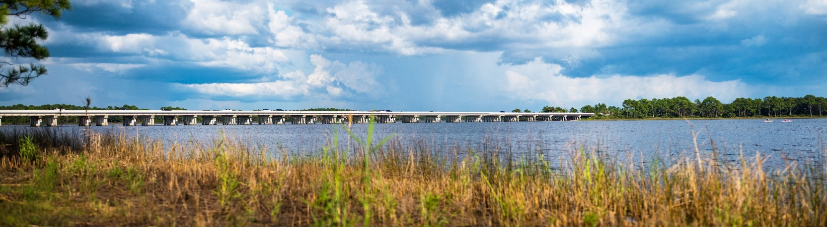
Purpose and Need Considerations
    Careful consideration should be given when describing purposes for proposed actions.
    Items should not be included in the Purpose and Need Statement for the sake of increasing substance.
    Although environmental protection and community enhancement are important goals, these issues should not be a part of the Purpose and Need Statement.
For example, “the Purpose of this project is to increase capacity, improve safety and modal interrelationships.” If data is only available to support the need to increase capacity and safety, then modal interrelationships should not be included in the Purpose and Need statement. Only needs that have supporting data and factual information should be included.
Notes:
Before we move into our final training segment, I want to point out some considerations for the Purpose and Need.
First, careful consideration should be given when describing purposes for proposed actions. Items should not be included in the Purpose and Need Statement for the sake of increasing substance.
For example, “the Purpose of this project is to increase capacity, improve safety and modal interrelationships.” If data is only available to support the need to increase capacity and safety, then modal interrelationships should not be included in the Purpose and Need statement. Only needs that have supporting data and factual information should be included.
Lastly, although environmental protection and community enhancement are important goals, these issues should not be a part of the Purpose and Need Statement.

Slide 38
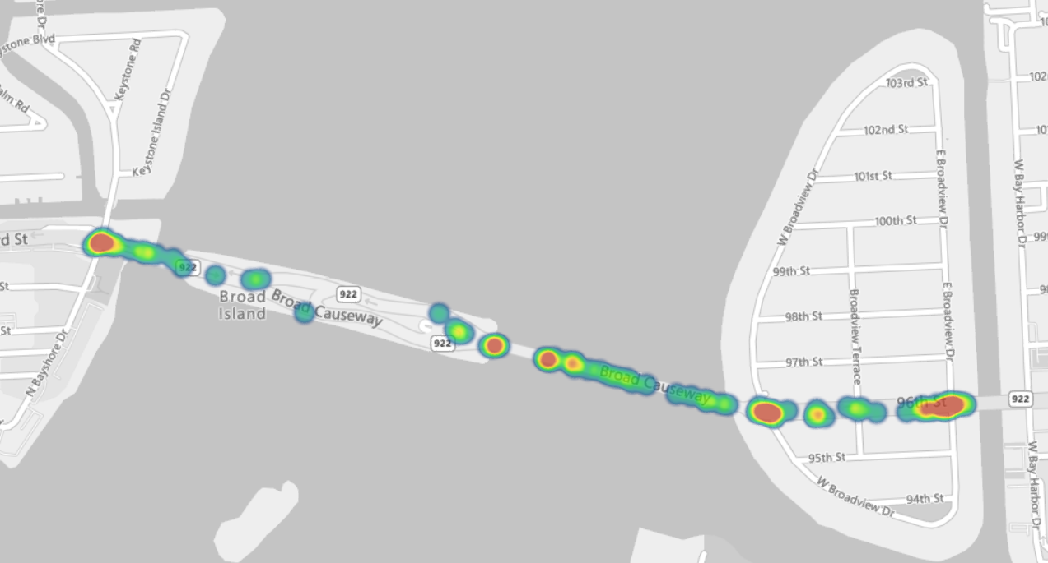
Purpose and Need Considerations
Project Area Crash Heat Map (January 2018 – January 2023)
    Use plain language.
    Use action verbs: to provide, to obtain, to repair, etc.
    Use bullets or numbering to itemize purpose and needs.
    Provide specific supporting data for each need.
    The supporting data should be current, accurate, and above all relevant to the issues being considered.
    If any exists, describe agency and public involvement in developing the purpose and need.
    Use graphics, charts, tables, maps to illustrate needs.
Safety Supporting Data Visuals
US 84 LOS Evaluation for Year 2021 and Year 2050
Segment: | No. of Lanes | 2021 AADT | 2021 LOS | 2050 AADT | 2050 LOS | Target LOS
East of the Harbor Bridge to Gulf Drive | 4 | 50,500 | F | 75,700 | F | D
Gulf Drive to West Pass Bridge | 4 | 43,000 | F | 85,000 | F | D
US 84 Crash Rates for 2017-2021
Segment | 2017 | 2018 | 2019 | 2020 | 2021 | 2017-2021 Average | Statewide Average
East of the Harbor Bridge to the West Pass Bridge | 2.02 | 1.89 | 1.94 | 1.95 | 1.89 | 1.94 | 1.711
US 84 Top Five Crash Types for 2017-2021
Segment | Rear End | Side swipe | Off Road | Other | Left Turn | Total Fatalities
East of the Harbor Bridge to the West Pass Bridge | 398 | 91 | 60 | 58 | 54 | 15
Notes:
When writing a Purpose and Need Statement use plain language and action verbs such as to provide, to obtain, to repair. Use bullets or numbering to itemize purpose and needs.
Earlier I talked about how the Need should establish the evidence that the deficiency or problem exists or will exist if projected population and planned land use growth are realized. This evidence is in the data. Provide specific supporting data for each need. The supporting data should be current, accurate, and above all relevant to the issues being considered.
If any agency and public involvement in developing the purpose and need exists, describe it.
Use graphics, charts, tables, and maps to illustrate needs. Shown here is a heat map that can identify high-hazard sections of the facility. These tables show the existing and projected traffic without improvement along with the target LOS. Other tables shown here identify average crash rates by year in comparison to the Statewide average and also the type of crashes in the project area.

Slide 39
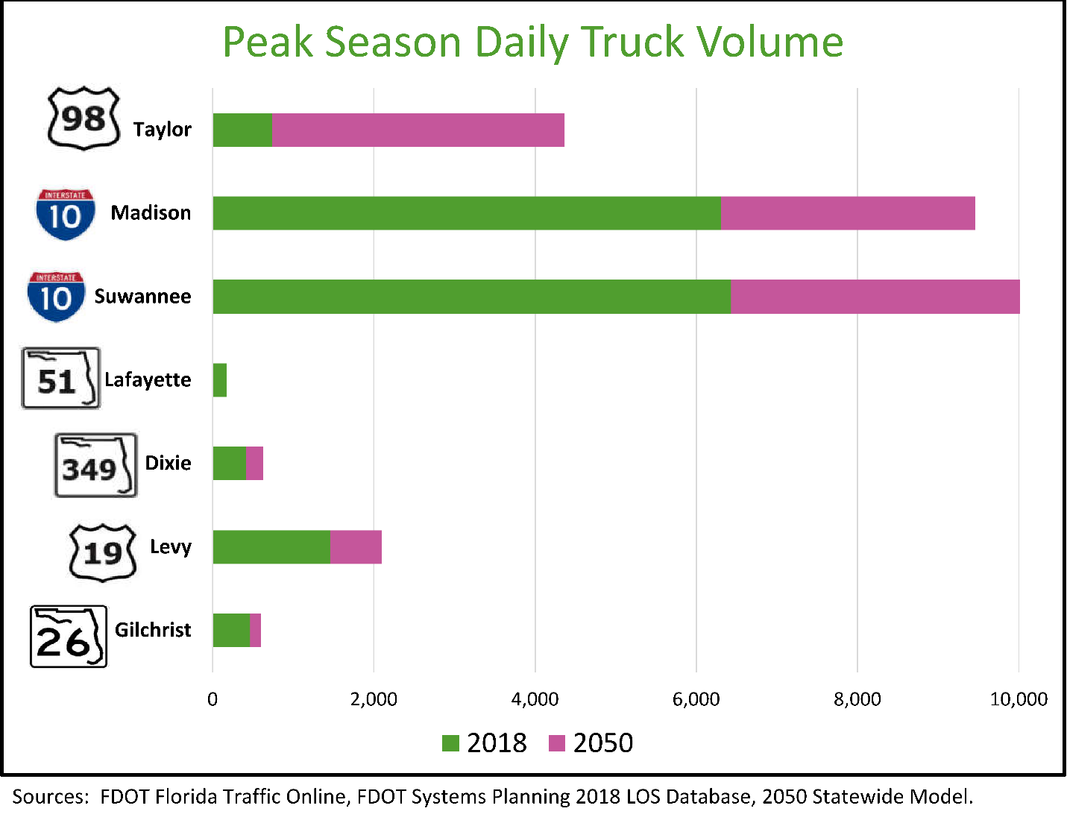
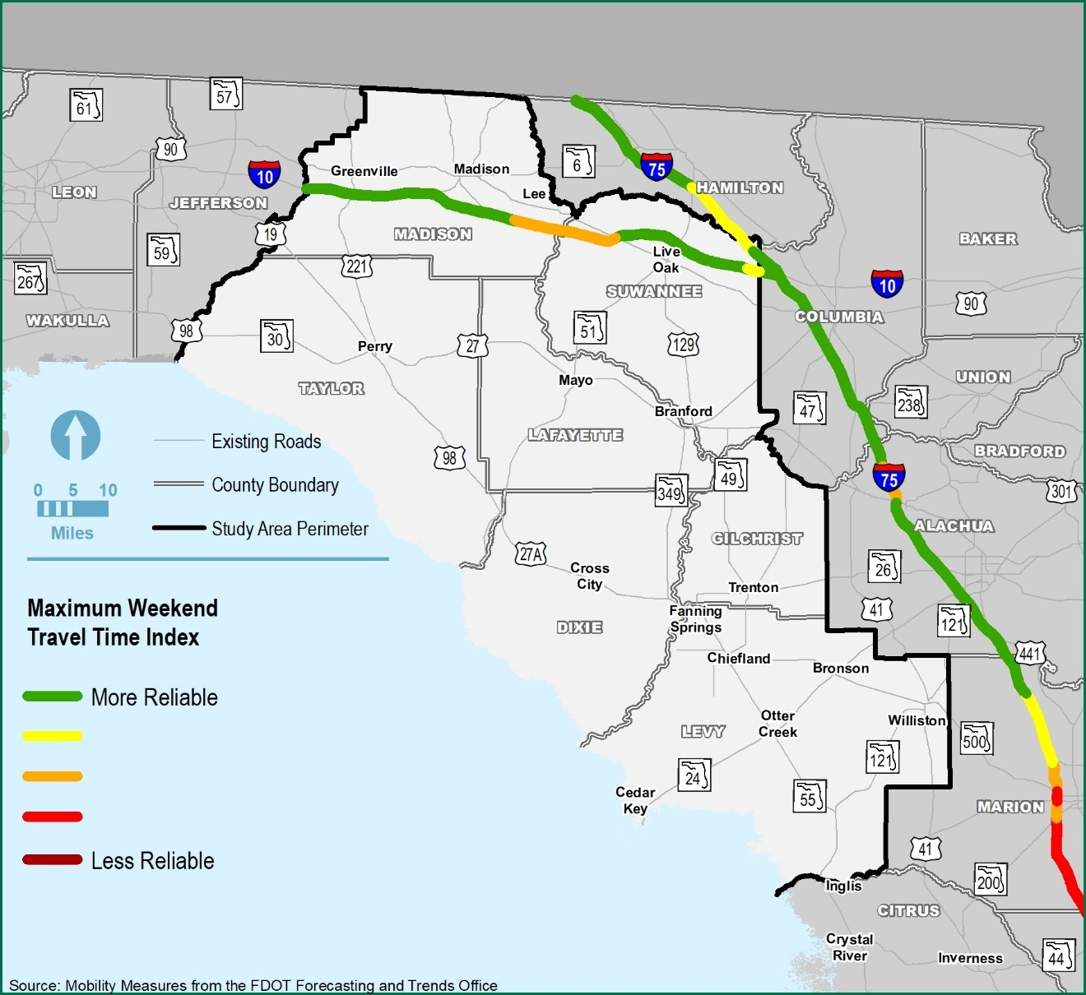
Purpose and Need Considerations
2018 Travel Time Reliability
Supporting Data Visuals
Origin-Destination (O-D) Daily Trip Summary
Trip Category | Type of Trips | All Vehicles |  | Trucks
 |  | # of Trips | % of Total Trips | # of Trips | % of Total Trips
Category 1 | Trips that both start and end completely within each study area county. | 509,894 | 71% | 5,284 | 20%
Category 1 | Trips that both start and end completely within the study area while traveling between the study area counties. | 26,177 | 4% | 1,180 | 5%
Category 2 | Trips that start within the study area, then end outside the study area and trips that start outside the study area, then end inside the study area. | 153,739 | 22% | 17,547 | 66%
Category 3 | Trips that both start and end completely outside the SCC study area, but pass-through the study area | 22,644 | 3% | 2,482 | 9%
Total |  | 712,454 | 100% | 26,493 | 100%
Notes:
Here are a few more examples of supporting visual data including a travel time reliability map that can be used to support Transportation Demand, peak season daily truck volume graph that can support Capacity or Modal Interrelationships, and details of an origin-destination study that can be used to support System Linkage or Social Demands and Economic Development.

Slide 40
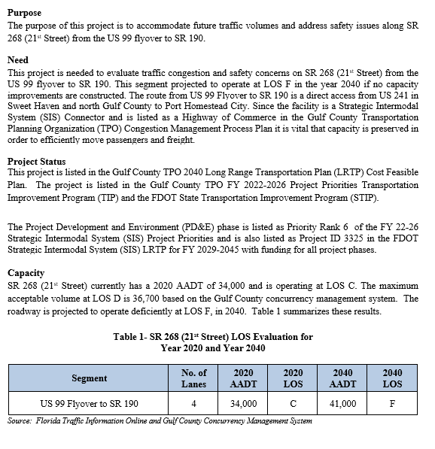
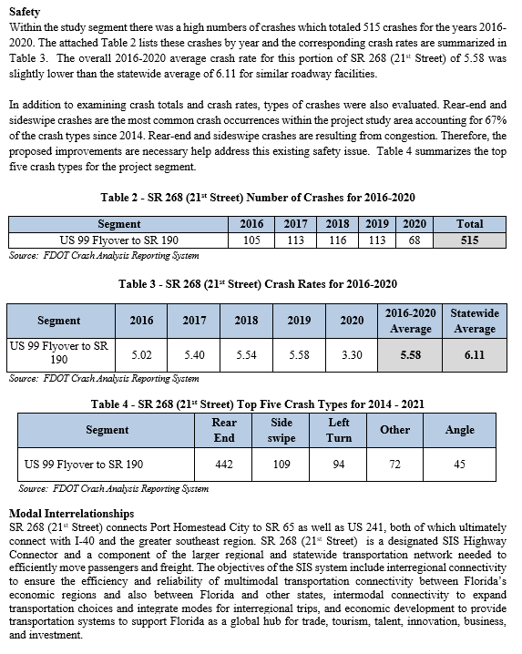
Purpose and Need Example
Three parts to a Purpose and Need Statement:
    Purpose
    Need
    Supporting Facts/Data
Notes:
Lastly, here is an example of a complete Purpose and Need Statement. You can see shown here that there are three parts of a Purpose and Need Statement; the Purpose, Need, and Supporting facts and/or data. For this example, it has the required project status, and three more needs elements, Capacity, Safety, and Modal Interrelationships with supporting visual data.

Slide 41
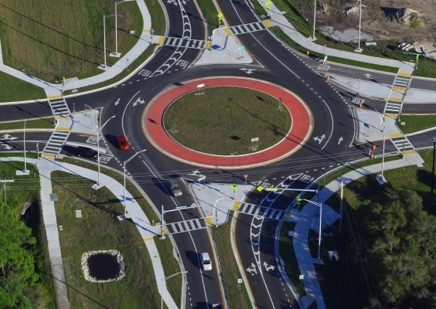
Quiz – Question 3
Which of the following tips is not recommended for developing a Purpose and Need Statement?
Use plain language.
Use graphics, charts, tables and maps to illustrate needs.
Provide a list of preliminary alternatives under consideration.
Provide specific supporting data for each need.
Notes:
We have finished this section of the training so we have our next group of quiz questions.

Slide 42
Quiz – Question 3
Answer
Which of the following tips is not recommended for developing a Purpose and Need Statement?
c. Provide a list of preliminary alternatives under consideration.
The Purpose and Need Statement is not a discussion of potential solutions to the problem(s).
Notes:
C. is the correct answer. Provide a list of preliminary alternatives under consideration.
The Purpose and Need Statement is not a discussion of potential solutions to the problem(s).

Slide 43
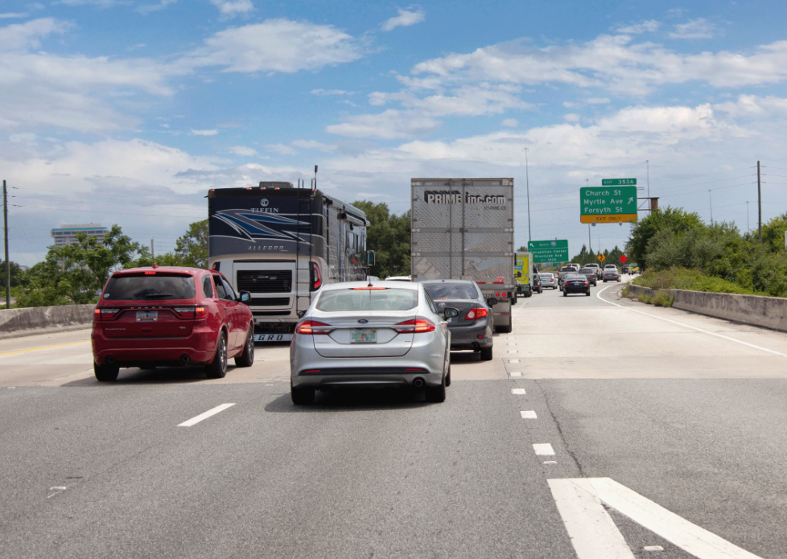
Quiz – Question 4
True or False?
A Project Status description is only required in the Need when the project has a long history with other agencies and governmental units.
Notes:
Here is another true or false question.

Slide 44
Quiz – Question 4
Answer
True or False?
A Project Status description is only required in the Need when the project has a long history with other agencies and governmental units.
False
The Project Status is an element of the Need and is required for every project.
Notes:
For those that choose False that is correct. The Project Status is an element of the Need and is required for every project.

Slide 45
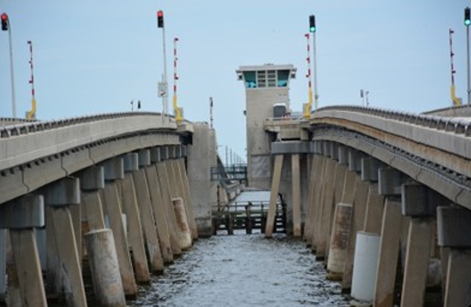
Quiz – Question 5
Which of the following data sources are not recommended for understanding capacity needs?
Future land use maps
Traffic counts
Population and employment growth projections
Sustainability studies
45
Notes:
On Mentimeter you will now have to select “Join another presentation” and enter this code. Our next questions is….

Slide 46
Quiz – Question 5
Answer
Which of the following data sources are not recommended for understanding capacity needs?
d. Sustainability studies
Sustainability studies do not typically provide evidence of capacity needs.
Notes:
D. is the correct answer here, sustainability studies do not typically provide evidence of capacity needs.

Slide 47
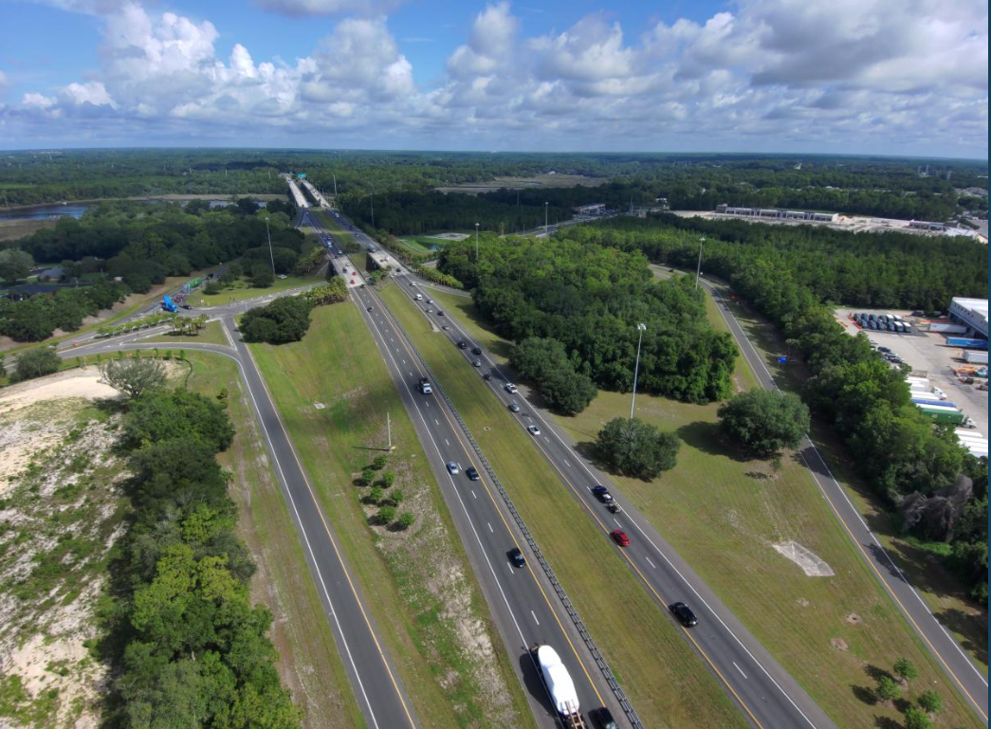
Quiz – Question 6
Which one of the following topics is included in a Purpose and Need Statement?
Benefits of the project
Preliminary cost estimates
A justification of why FDOT is completing the project
Environmental impacts summary
Notes:
Here is our last question for this section.

Slide 48
Quiz – Question 6
Answer
Which one of the following topics is included in a Purpose and Need Statement?
c. A justification of why FDOT is completing the project
    The justification of why the project is being completed is included to satisfy the Need of the project.
Notes:
The correct answer is C. The justification of why the project is being completed is included to satisfy the Need of the project.

Slide 49
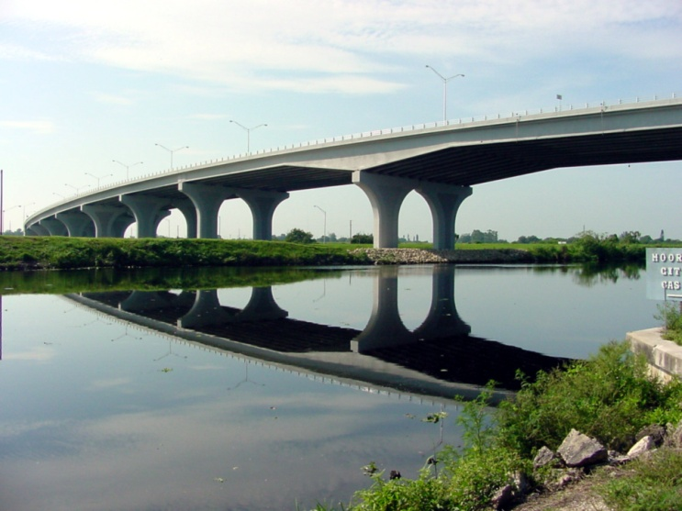
How is a Purpose and Need Statement Used?
Is used as a key factor in determining the range of alternatives.
Is used as a vital component to meeting the requirements of:
    Section 4(f) (49 USC 303) (23 CFR774)
    Executive Order on Wetlands (E.O. 11990)
    Executive Order on Floodplains (E.O. 11988)
    Clean Water Act Section 404(b)(1) Guidelines
    Is used in FDOT decision documents to explain why the FDOT is choosing a single alternative.
    Record of Decision (ROD)
    Finding of No Significant Impact (FONSI)
Notes:
We have learned what a purpose and need statement is and why we are required to complete one along with how to develop a Purpose and Need statement. Our last training section is “How Do We Use a Purpose and Need Statement”.
The Purpose and Need Statement is used as a key factor in determining the range of alternatives.
A well-defined Purpose and Need is especially important for projects that may be subject to other laws shown here.
It is a vital factor when explaining why the FDOT is choosing a single alternative in decision documents such as the Record of Decision or the Finding of No Significant Impact.

Slide 50
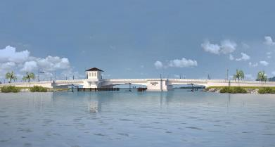
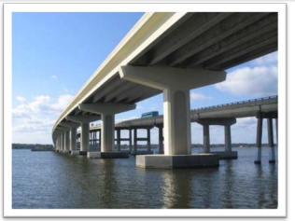
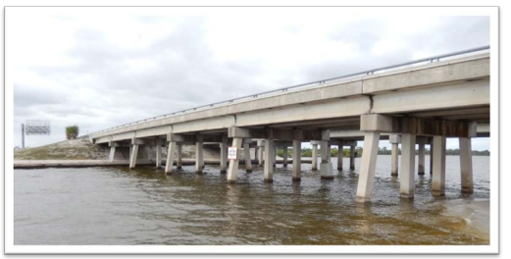
Develop, Evaluate, and Eliminate Alternatives
Purpose and Need is the heart of NEPA analysis.
A well-defined Purpose and Need Statement will determine which alternatives are reasonable, prudent and practicable.
Alternatives that fail to meet the Purpose and Need can be eliminated without detailed study.
Secondary Purpose and Needs are not used to evaluate and eliminate or advance project alternatives.
Notes:
A well-defined Purpose and Need Statement is the baseline in the development, evaluation and elimination or advancement of alternatives, including selection of the preferred alternative. It will determine which alternatives are reasonable, prudent and practicable. Alternatives that fail to meet the Purpose and Need can be eliminated without detailed study. Also, the Purpose and Need is instrumental in illustrating that a No Build alternative will not solve an existing transportation problem. It should be noted that the Secondary Purpose and Needs are not used to evaluate and eliminate or advance project alternatives.

Slide 51
Develop, Evaluate, and Eliminate Alternatives - Example
The project is to repair or replace the aging Lincoln Causeway Bascule Bridge. This project has three needs:
Meets USCG requirement for navigation.
Reduces bridge openings.
Provides safe access for multi-modal transportation.
Potential Alternatives | Meets USCG Requirements for Navigation | Reduces Bridge Openings | Provides Safe Access for Multi-modal Transportation | Meets Purpose and Need
No-Build/ Repair | Yes | No | No | No – Remains a viable option throughout the PD&E study.
Low-level Moveable Bridge (21 ft MHW) Replace In-kind | Yes | No | Yes | No – Eliminate from detailed evaluation.
Mid-level Moveable Bridge (45 ft MHW) | Yes | Yes | Yes | Yes – Advance to detailed evaluation.
High-level Fixed Bridge (55 ft MHW) | No | Yes | Yes | No – USCG requires new fixed bridge at this location to be 65 ft or higher. Eliminate from detailed evaluation.
High-level Fixed Bridge (65 ft MHW) | Yes | Yes | Yes | Yes – Advance to detail evaluation.
Notes:
Here is an example of how a Purpose and Need can be used to develop, evaluate and eliminate alternatives.
The project is to repair or replace the aging Lincoln Causeway Bascule Bridge with a new structure.
Many of you are familiar with an alternatives evaluation matrix and the Purpose and Need is a component of that matrix. Based on the Purpose and Need Statement three criteria were identified that need to be met to advance the alternative forward.
Meets USCG requirement for navigation.
Reduces bridge openings.
Provides safe access for multi-modal transportation.
There are four alternatives and a No-Build/Repair Alternative which is a viable alternative throughout the PD&E study. The low-level moveable bridge does not reduce bridge openings; therefore, it does not meet the Purpose and Need and has been eliminated. The 55 foot high-level fixed bridge was also eliminated because the USCG requires the new fixed bridge in that location to be 65 feet or higher.

Slide 52
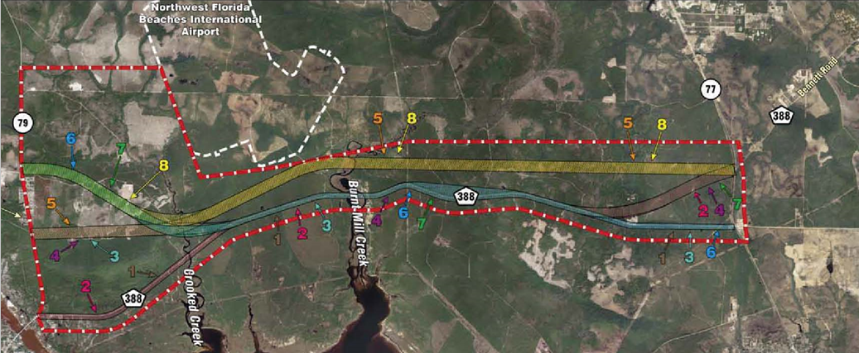



Develop, Evaluate, and Eliminate Alternatives
Notes:
Our second example is a new corridor project with a No-Build and eight Build alternatives as shown here.

Slide 53
Develop, Evaluate, and Eliminate Alternatives
CR 368 from SR 35 and SR 76 PD&E Study – Purpose and Need Matrix
Purpose and Need | No Build | Alt. 1 | Alt. 2 | Alt. 3 | Alt. 4 | Alt. 5 New Alignment | Alt. 6 | Alt. 7 | Alt. 8 New Alignment
Correct geometric and operational deficiencies of the existing highway. | No | Yes | Yes | Yes | Yes | No | Yes | Yes | No
Improve access to the intermodal and freight activity centers in the Homer City area and new international airport. | No | Yes | Yes | Yes | Yes | Yes | Yes | Yes | Yes
Provide capacity to meet future traffic demands. | No | Yes | Yes | Yes | Yes | Yes | Yes | Yes | Yes
Improve emergency evacuation network and reduce evacuation times. | No | Yes | Yes | Yes | Yes | Yes | Yes | Yes | Yes
Meets Purpose and Need | No – Remains a viable option throughout the PD&E study. | Yes – Advance to detailed evaluation. | Yes – Advance to detailed evaluation. | Yes – Advance to detailed evaluation. | Yes – Advance to detailed evaluation. | No – Eliminate from detailed evaluation. | Yes – Advance to detailed evaluation. | Yes – Advance to detailed evaluation. | No – Eliminate from detailed evaluation.
Notes:
The Purpose and Need identified four criteria. The alternatives needs to:
Correct geometric and operational deficiencies of the existing highway.
Improve access to the intermodal and freight activity centers in the Homer City area and new international airport.
Provide capacity to meet future traffic demands.
Improve emergency evacuation network and reduce evacuation times.
As a result, two alternatives were eliminated because they did not correct geometric and operational deficiencies of the existing highway.

Slide 54
What Projects Require a Purpose and Need Statement?
FEDERAL FUNDING
STATE FUNDING
Class I
Class III
Class II
SEIR
NMSA
Minor Projects
PEIR
EIS
EA
Type 2 CE
Type 1 CE
Minor Projects
23 CFR § 771.117(c)
23 CFR § 771.117(d)
Notes:
As shown here all major federal and state-funded projects require a Purpose and Need Statement. Minor projects such as Type 1 Categorical Exclusions or CE and Non-Major State Actions do not require one.
For the major projects the level of detail for the Purpose and Need Statement can vary and is dependent on project type and complexity. A Type 2 CE will have less complicated and detailed needs than those projects classified as Environmental Assessments and Environmental Impact Statements.

Slide 55

Purpose and Need Statement Timeline
0
Planning/
ETDM Planning Screen
ETDM Programming
Screen
PD&E Study
I. PLANNING
First identified in transportation plans.
May be the first opportunity agencies and other interested parties have to provide input.
II. PROGRAMMING
Updated/current information should be provided.
If not previously screened, develop new Purpose and Need Statement.
Lead Agency (FDOT - OEM) Approves/Not Approves
III. PD&E
Purpose and Need Statement should be consistent from the ETDM screenings through the PD&E study (same need components, but updated information).
Purpose and Need Statement for the Environmental Document and Preliminary Engineering Report need to be exactly the same.
Review current transportation plans.
Verify whether supporting information is still valid and refine if necessary.
Gather new data to fill any information gaps.
Notes:
It’s now time to learn about the “When” do we complete a Purpose and Need Statement. This timeline helps us visualize it. The Purpose and Need is first developed during the Planning phase and the Efficient Transportation Decision Making, referred to as ETDM, Planning Screen. It is identified in transportation plans and this may be the first opportunity agencies have to provide input.
The next time we see the Purpose and Need Statement is the ETDM Programming Screen. If a Planning screen was completed, then the information in the Purpose and Need Statement should be updated. If not previously screened, we would develop a new Purpose and Need Statement. During the Programming Screen the Lead Agency (typically the FDOT Office of Environmental Management [OEM]) Approves/Not Approves the Purpose and Need Statement.
As we move forward in the life of the project into the PD&E study the Purpose and Need Statement should be consistent from the ETDM screenings through the PD&E study (same need components, but updated information).
The Purpose and Need Statement for the Environmental Document and Preliminary Engineering Report need to be exactly the same.
It is important to review current transportation plans and confirm the project has planning consistency.
During the PD&E study we should verify whether supporting information is still valid and refine, if necessary, along with gather new data to fill any information gaps, ...

Slide 56

Caution…Refine vs. Change During the PD&E Study
  As the PD&E scope becomes more refined the Purpose and Need evolves and is not final until the Environmental Document is approved.
  No changes or refinement can occur in the Design phase.
Refine
Change
vs.
  Data used to establish the Need can become outdated as the PD&E study moves forward.
  Refine with current data or more detail.
  Purpose and Need Statement does not have to be re-approved by Office of Environmental Management (OEM).
  Purpose and Need Statement is altered to add, change, or eliminate previously approved Purpose and Need.
  If changes are made, it may be necessary to revisit prior alternatives screening decisions and potentially re-initiate the public and participating agency involvement pursuant to 23 USC 139.
  Required to coordinate and have Purpose and Need Statement approved again by OEM.
Notes:
…but I want to caution you on knowing what the difference between refinements and changes.
This is an important slide because it is often forgotten or not fully understood and can delay a project from being approved.
As the PD&E scope becomes more refined the Purpose and Need evolves and is not final until the Environmental Document is approved. No changes or refinement can occur in the Design phase.
If the data used to establish the Need becomes outdated as the PD&E study moves forward, we can refine the Need with current data or more detail. If only this is done then the Purpose and Need Statement does not have to be re-approved by OEM.
BUT if you change the Purpose and Need Statement where it is altered to add, change, or eliminate previously approved Purpose and Need statements and elements then we are required to coordinate and have the Purpose and Need Statement approved again by OEM.
Also keep in mind that if changes are made, it may be necessary to revisit prior alternatives screening decisions and potentially re-initiate the public and participating agency involvement pursuant to 23 USC 139.

Slide 57
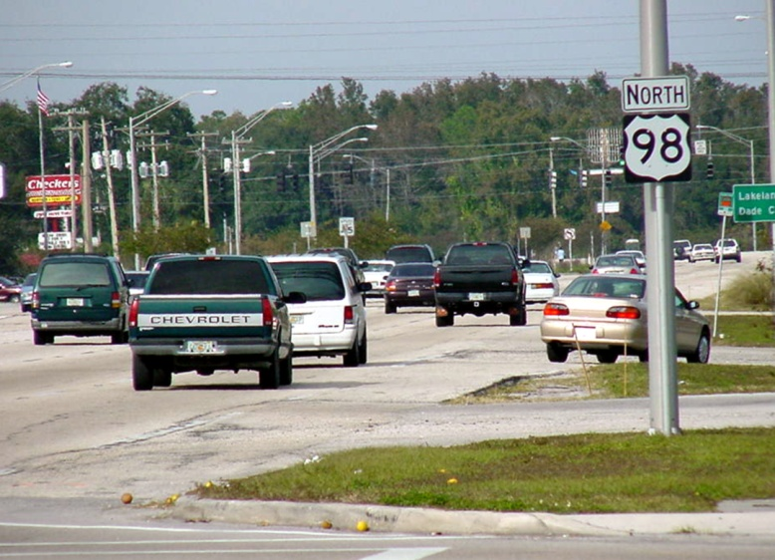
Quiz – Question 7
True or False?
The PD&E Purpose and Need Statement must be consistent with what is in the ETDM Programming Screen.
Notes:
We have come to our last quiz question.

Slide 58
Quiz – Question 7
Answer
True or False?
The PD&E Purpose and Need Statement must be consistent with what is in the ETDM Programming Screen.
True
The PD&E Purpose and Need Statement must be consistent with what is in the ETDM Programming Screen. Refinements can be made to reflect current data and more detail, but any changes will require coordination with and approval from OEM.
Notes:
True is the correct answer. The PD&E Purpose and Need Statement must be consistent with what is in the ETDM Programming Screen. Refinements can be made to reflect current data and more detail, but any changes will require coordination with and approval from OEM.

Slide 59
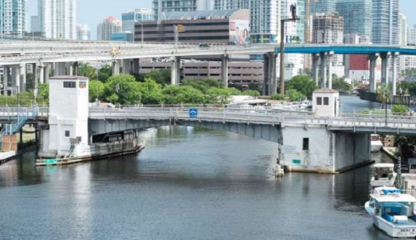
Takeaways
The Purpose is the “what” of the proposed action. It is not a solution statement.
The Need identifies the problem(s) the proposed project will address.
The Purpose and Need is the foundation the project is built on.
A well-defined Purpose and Need can help determine which alternatives are reasonable, prudent and practicable.
Alternatives that fail to meet the Purpose and Need can be eliminated without detailed study.
Purpose and Need can be refined in the PD&E study, but if it is changed it must go back to OEM for coordination and re-approval.
59
59
Notes:
This concludes the training. We hope this training has been informative and will support you in building a solid foundation when writing your Purpose and Need Statements. These are a few key takeaways that we hope will remain forefront in your mind.
The Purpose is the “what” of the proposed action. It is not a solution statement,
The Need identifies the problem(s) the proposed project will address,
The Purpose and Need is the foundation the project is built on,
A well-defined Purpose and Need can help determine which alternatives are reasonable, prudent and practicable,
Alternatives that fail to meet the Purpose and Need can be eliminated without detailed study, and
The Purpose and Need Statement can be refined in the PD&E study, but if it is changed it must go back to OEM for coordination and re-approval.

Slide 60
Resources
Federal Agency | Title | Source | Resource Type
CEQ | Regulations for Implementing the Procedural Provisions of the National Environmental Policy Act (NEPA | 40 CFR Section 1500 - 1508 | Federal Statutes
FHWA, FRA, FTA, and US DOT | Part 771 - Environmental Impact and Related Procedures | 23 CFR Section 771 | Federal Regulations
FHWA, FTA | Linking the Transportation Planning and NEPA Processes | 23 CFR Appendix A to Part 450 | Federal Regulations
FDOT with NEPA Assignment | Project Development and Environment Manual (PD&E) July 2020 Part 2, Chapter 1 Project Description and Purpose and Need | https://www.fdot.gov/environment/pubs/pdeman/pdeman-current | Guidance
FHWA | Environmental Review Toolkit | http://www.environment.fhwa.dot.gov/index.asp | Guidance
FHWA | FHWA Technical Advisory T 6640.8A | Environmental Review Toolkit (dot.gov) | Guidance
FTA | Standard Operating Procedures (SOP) Number 4, “Purpose and Need” | Environmental Standard Operating Procedures | FTA (dot.gov) | Guidance
AASHTO Practitioner’s Handbook | Defining the Purpose and Need and Determining the Range of Alternatives for Transportation Projects - Aug 2016 | https://environment.transportation.org/resources/practitioners-handbooks/ | Guidance
60
Notes:
These are the resources that were used to develop this training. This training has been recorded and can be found on the OEM website.

Slide 61

Opening Slide
Questions?
FDOT OEM Contact:
Engy M. Samaan, PE
Project Development Engineer
Phone: (850) 414-4804
engy.samaan@dot.state.fl.us
Notes:
Thank you for attending. If you have any questions, please enter them in your chat box and we will try to address as many as we can with the remaining time. Any questions we are not able to address we will respond to you via e-mail.
You can also direct questions to Engy Samaan at the contact information listed here.
Again, any non-FDOT attendees who wants credit for the class will need to provide their name, e-mail, and PE Number (as applicable) to the Chat box. We will use this information to send out Certifications.

