Slide 1

NEPA Assignment:
OEM NEPA Review Process for OEM Reviewers
2016
The environmental review, consultation, and other actions required by applicable federal environmental laws described in this training are carried out by FDOT pursuant to 23 U.S.C. §327 and a Memorandum of Understanding dated [INSERT DATE], executed by FHWA and FDOT.

Slide 2
Outline and Overview
Under the NEPA Assignment Program, FDOT assumes all of FHWA’s responsibilities for environmental review, resource agency consultation and other environmental regulatory compliance-related actions pertaining to the review or approval of projects.
Lesson 1 Foundation for Review Process
Lesson 2 Pre-PD&E / Pre-NEPA: Planning and Environmental Linkages
Lesson 3 Overview of NEPA Assignment Program
Lesson 4 Environmental Document Review Process
Lesson 5 NEPA Document Review for Type 1 CEs
Lesson 6 NEPA Document Review for Type 2 CEs, EAs and EISs
Lesson 7 Collaboration (EAs and EISs)
Lesson 8 Quality Assurance and Quality Control
Lesson 9 Tracking the Review Process

Slide 3
Lesson 1:
Foundation for Review Process

Slide 4
The Basics…
Districts develop project documents (OEM supports as needed)
NEPA Assignment Program Quality Assurance / Quality Control Plan
Public Involvement and Coordination with local government, agencies and
Indian Tribes
Development decisions are based on FDOT’s Manuals, Standards and Guidelines and Programmatic Agreements
District Quality Control Certification
Follow OEM’s NEPA Review Process
Additional requirements based on Class of Action significance

Slide 5

FDOT Manuals, Standards and Guidance
  Project Development and Environment (PD&E) Manual
  Efficient Transportation Decision Making (ETDM) Manual
  Design Standards
  Plans Preparation Manual (PPM)
  Interchange Access Request User’s Guide
  Public Involvement Resources for the Practitioner
  Public Involvement Handbook
  Construction Project Administration Manual (CPAM)
  Guidance Documents and Training Materials available on FDOT’s website under EMO Resources: http://www.dot.state.fl.us/emo/resources.shtm

Slide 6

Programmatic Agreements (PA)
FORMAL, LEGALLY BINDING DOCUMENTS
PA for Categorical Exclusions (CEs) under 23 CFR § 771.117
On the effective date of the NEPA Assignment Program, the existing PA is suspended as FDOT assumes authority for CE approvals
PA Between FHWA and FDOT Regarding Approval of Specific Types of Changes in Interstate System Access
PA Section II: Processing Requirements for I-System Access Requests
FDOT Procedure No. 525-030-160, New or Modified Interchanges
FDOT Interchange Access Requests User’s Guide
  Section 1.7 Acceptance Authorities
  Section 3.11 Environmental Considerations
  Section 3.12 Review of the Report
  Section 3.13 Quality Control
  PA among FHWA, Advisory Council on Historic Preservation, the Florida Division of Historic Resources and FDOT Regarding Implementation of the Federal-Aid Highway Program in Florida
Specifies procedures for resolving conflicts with external agencies
Under NEPA Assignment, FDOT assumes FHWA’s role in the PA
Section III. Responsibilities and General Requirements of the FDOT
Notes:
A Programmatic Agreement is a formal, legally binding agreement between FDOT and other state and/or Federal agencies that streamline the environmental review and project delivery process
FDOT authorized to make a determination on the engineering and operational acceptability of certain types of interstate system access changes to expedite FHWA approval

Slide 7
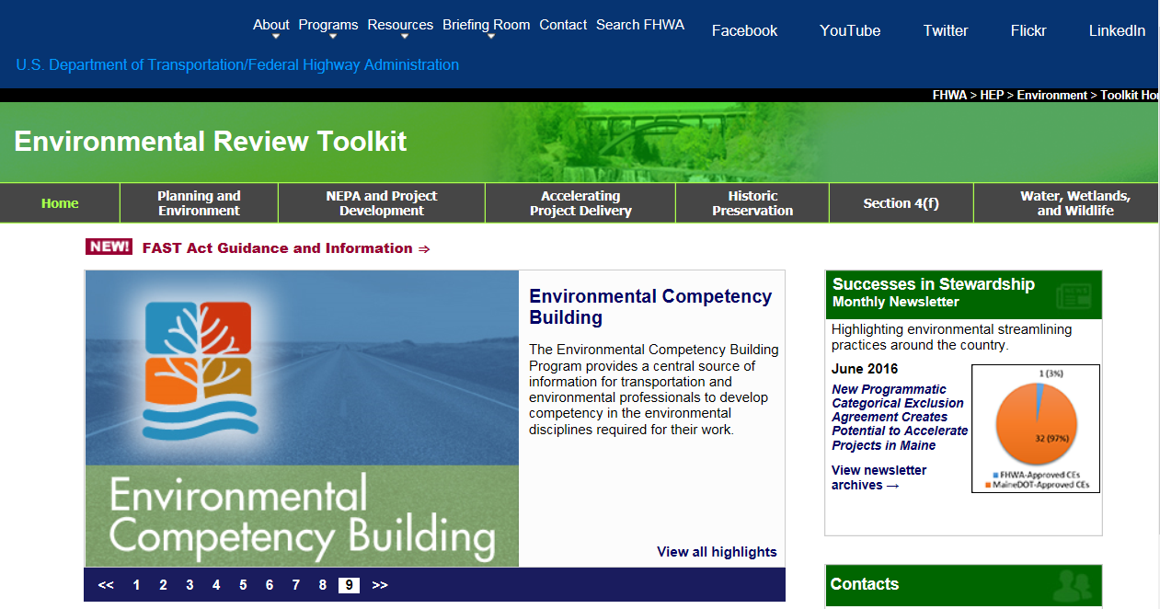
FHWA Guidance
Federal-aid Highway Program Policy and Guidance Center
http://www.fhwa.dot.gov/pgc/
Office of Planning,
Environment Website
http://www.fhwa.dot.gov/environment/
Environmental Review Toolkit
(and FAST Act Guidance)
https://www.environment.fhwa.dot.gov/index.asp
https://www.environment.fhwa.dot.gov/strmlng/environmental_provisions.asp#fast

Slide 8
Lesson 2:
Pre-PD&E / Pre-NEPA:
Planning and Environmental Linkages

Slide 9
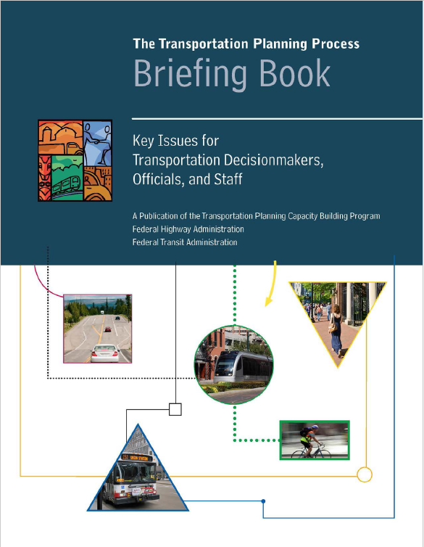
Transportation Planning Process
  Long Range Transportation Plan (LRTP)
  Cost Feasible Plan (CFP)
  Strategic Intermodal System (SIS) Plans
  Corridor Planning Studies
  Planning Studies
  Define or refine project parameters
  Establish Purpose and Need
  Facilitate scope of work for PD&E Study
  Alternatives Development
Notes:
https://www.environment.fhwa.dot.gov/integ/related.asp

Slide 10


Planning and Environmental Linkages (PEL)
Process for incorporating environmental considerations into transportation planning
Uses information, analysis and products developed during planning to inform the environmental review process
Enhances inter-agency participation and coordination reducing the potential for conflict
Identifies fatal flaws and reduces duplication of project development efforts
Streamlines project delivery by promoting efficient and cost-effective planning phase solutions
Notes:
https://www.environment.fhwa.dot.gov/integ/related.asp
Use information from Oregon for script -

Slide 11

Laws and Regulations
  Regulatory Authority
Integration of Planning and Environmental Review; 23 United States Code (U.S.C.) § 168
Transportation Planning Studies and Project Development; 23 Code of Federal Regulations (CFR) §§ 450.212 and 450.318
Linking the Transportation Planning and NEPA Process; Appendix A of 23 CFR 450
Efficient Environmental Reviews for Project Decision Making; 23 U.S.C. § 139
  Fixing America’s Surface Transportation (FAST) Act
Additional direction for using planning decisions in NEPA
Amends the Efficient Environmental Review Process to expedite project delivery; consultation requirements
Transparency in environmental review process
  National Permitting Dashboard
  Public website of project review and permitting status
Notes:
MAP 21 – Section 1310 – https://www.environment.fhwa.dot.gov/integ/related.asp
Adoption of Planning Products for Use in NEPA Proceedings-
'(1) IN GENERAL- Subject to the conditions set forth in subsection (d), the Federal lead agency for a project may adopt and use a planning product in proceedings relating to any class of action in the environmental review process of the project.
'(2) IDENTIFICATION- When the Federal lead agency makes a determination to adopt and use a planning product, the Federal lead agency shall identify those agencies that participated in the development of the planning products.
'(3) PARTIAL ADOPTION OF PLANNING PRODUCTS- The Federal lead agency may adopt a planning product under paragraph (1) in its entirety or may select portions for adoption.
'(4) TIMING- A determination under paragraph (1) with respect to the adoption of a planning product may be made at the time the lead agencies decide the appropriate scope of environmental review for the project but may also occur later in the environmental review process, as appropriate.
PLANNING DECISIONS- Planning decisions that may be adopted pursuant to this section include—
'(A) whether tolling, private financial assistance, or other special financial measures are necessary to implement the project;
'(B) a decision with respect to modal choice, including a decision to implement corridor or subarea study recommendations to advance different modal solutions as separate projects with independent utility;
'(C) a basic description of the environmental setting;
'(D) a decision with respect to methodologies for analysis; and
'(E) an identification of programmatic level mitigation for potential impacts that the Federal lead agency, in consultation with Federal, State, local, and tribal resource agencies, determines are most effectively addressed at a regional or national program level, including—
'(i) system-level measures to avoid, minimize, or mitigate impacts of proposed transportation investments on environmental resources, including regional ecosystem and water resources; and
'(ii) potential mitigation activities, locations, and investments.
PLANNING ANALYSES- Planning analyses that may be adopted pursuant to this section include studies with respect to—
'(A) travel demands;
'(B) regional development and growth;
'(C) local land use, growth management, and development;
'(D) population and employment;
'(E) natural and built environmental conditions;
'(F) environmental resources and environmentally sensitive areas;
'(G) potential environmental effects, including the identification of resources of concern and potential cumulative effects on those resources, identified as a result of a statewide or regional cumulative effects assessment; and
'(H) mitigation needs for a proposed action, or for programmatic level mitigation, for potential effects that the Federal lead agency determines are most effectively addressed at a regional or national program level.
'(d) Conditions- Adoption and use of a planning product under this section is subject to a determination by the Federal lead agency, with the concurrence of other participating agencies with relevant expertise and project sponsors as appropriate, and with an opportunity for public notice and comment and consideration of those comments by the Federal lead agency, that the following conditions have been met:
From Part 1 Chapter 4: Planning and PD&E should be seamlessly integrated in the project development process. The benefits of linking planning decisions and the PD&E Study include performing a study based on decisions and information developed during planning, minimizing duplication of project development efforts, streamlining project delivery by promoting efficient and cost-effective Planning phase solutions, among others.
Linking planning and NEPA does not mean the planning products should be prepared to a level comparable to a NEPA analysis. Pursuant to 23 U.S.C § 134(o), 23 U.S.C. § 135(j) and 49 U.S.C. § 5305(h), transportation plans and programs are exempted from NEPA review. Environmental evaluations that are conducted during Planning phase are not required to address all regulatory requirements that should be addressed by the NEPA analysis.
SAFETEA-LU included a process for conducting “Efficient Environmental Reviews for Project Decision Making” for highway projects under Section 6002 (b) of the bill.
In December 2005, FHWA recognized the ETDM process as satisfying the statutory requirements of SAFETEA-LU Section 6002(b) and being acceptable for use on federal-aid projects.

Slide 12
FAST: Using Planning Decisions to Inform NEPA
  Concurrence of federal Cooperating Agencies on adoption of planning product when planning product will be used for permit
  Lead Federal Agency must provide guidance in planning decisions
  Adopt or incorporate by reference entire planning product or select portions
  Public Notice required on intent to adopt / incorporate
  During planning process
  During environmental review
  Planning-level analysis does not need to rise to the level of detail required in the NEPA process
  FDOT Guidance: PD&E Manual, Part 1 Chapter 4
I don’t think we do public notice now…
Need to add to our
Procedures/manuals?
Notes:
Concurrence of federal Cooperating Agencies on adoption of planning product when planning product will be used for permit
Lead Federal Agency must provide guidance in planning decisions
Adopt or incorporate by reference entire planning product or select portions
Public Notice required during planning process that planning products may be adopted during a subsequent environmental review process
During environmental review process, provide notice of the intention to adopt or incorporate by reference planning products or decisions in NEPA
Planning-level analysis does not need to rise to the level of detail required in the NEPA process
FDOT Guidance: PD&E Manual, Part 1 Chapter 4
MAP 21 – Section 1310 – https://www.environment.fhwa.dot.gov/integ/related.asp
Adoption of Planning Products for Use in NEPA Proceedings-
'(1) IN GENERAL- Subject to the conditions set forth in subsection (d), the Federal lead agency for a project may adopt and use a planning product in proceedings relating to any class of action in the environmental review process of the project.
'(2) IDENTIFICATION- When the Federal lead agency makes a determination to adopt and use a planning product, the Federal lead agency shall identify those agencies that participated in the development of the planning products.
'(3) PARTIAL ADOPTION OF PLANNING PRODUCTS- The Federal lead agency may adopt a planning product under paragraph (1) in its entirety or may select portions for adoption.
'(4) TIMING- A determination under paragraph (1) with respect to the adoption of a planning product may be made at the time the lead agencies decide the appropriate scope of environmental review for the project but may also occur later in the environmental review process, as appropriate.
PLANNING DECISIONS- Planning decisions that may be adopted pursuant to this section include—
'(A) whether tolling, private financial assistance, or other special financial measures are necessary to implement the project;
'(B) a decision with respect to modal choice, including a decision to implement corridor or subarea study recommendations to advance different modal solutions as separate projects with independent utility;
'(C) a basic description of the environmental setting;
'(D) a decision with respect to methodologies for analysis; and
'(E) an identification of programmatic level mitigation for potential impacts that the Federal lead agency, in consultation with Federal, State, local, and tribal resource agencies, determines are most effectively addressed at a regional or national program level, including—
'(i) system-level measures to avoid, minimize, or mitigate impacts of proposed transportation investments on environmental resources, including regional ecosystem and water resources; and
'(ii) potential mitigation activities, locations, and investments.
PLANNING ANALYSES- Planning analyses that may be adopted pursuant to this section include studies with respect to—
'(A) travel demands;
'(B) regional development and growth;
'(C) local land use, growth management, and development;
'(D) population and employment;
'(E) natural and built environmental conditions;
'(F) environmental resources and environmentally sensitive areas;
'(G) potential environmental effects, including the identification of resources of concern and potential cumulative effects on those resources, identified as a result of a statewide or regional cumulative effects assessment; and
'(H) mitigation needs for a proposed action, or for programmatic level mitigation, for potential effects that the Federal lead agency determines are most effectively addressed at a regional or national program level.
'(d) Conditions- Adoption and use of a planning product under this section is subject to a determination by the Federal lead agency, with the concurrence of other participating agencies with relevant expertise and project sponsors as appropriate, and with an opportunity for public notice and comment and consideration of those comments by the Federal lead agency, that the following conditions have been met:
From Part 1 Chapter 4: Planning and PD&E should be seamlessly integrated in the project development process. The benefits of linking planning decisions and the PD&E Study include performing a study based on decisions and information developed during planning, minimizing duplication of project development efforts, streamlining project delivery by promoting efficient and cost-effective Planning phase solutions, among others.
Linking planning and NEPA does not mean the planning products should be prepared to a level comparable to a NEPA analysis. Pursuant to 23 U.S.C § 134(o), 23 U.S.C. § 135(j) and 49 U.S.C. § 5305(h), transportation plans and programs are exempted from NEPA review. Environmental evaluations that are conducted during Planning phase are not required to address all regulatory requirements that should be addressed by the NEPA analysis.
SAFETEA-LU included a process for conducting “Efficient Environmental Reviews for Project Decision Making” for highway projects under Section 6002 (b) of the bill.
In December 2005, FHWA recognized the ETDM process as satisfying the statutory requirements of SAFETEA-LU Section 6002(b) and being acceptable for use on federal-aid projects.
For purposes of transportation planning alone, a planning-level analysis does not need to rise to the level of detail required in the NEPA process. Rather, it needs to be accurate and up-to-date, and should adequately support recommended improvements in the statewide or metropolitan long-range transportation plan. The SAFETEA-LU requires transportation planning processes to focus on setting a context and following acceptable procedures. For example, the SAFETEA-LU requires a “discussion of the types of potential environmental mitigation activities” and potential areas for their implementation, rather than details on specific strategies. The SAFETEA-LU also emphasizes consultation with Federal, State, and Tribal land management, wildlife, and regulatory agencies.

Slide 13
FAST: Efficient Environmental Review Process
  Issue Checklist - Lead Federal Agency in consultation with participating agencies (Type 2 CE, EA and EIS); satisfied by ETDM
  Schedule - Lead Federal Agency with consultation and concurrence from Participating Agencies for EISs
  Schedule changes require concurrence
  Occurs during Environmental Scoping Process for EISs
  Early participation or issue resolution - with applicable federal resource agencies during the NEPA Scoping process; satisfied by ETDM
  Purpose and Need
  Range of Alternatives for EISs
Notes:
MAP 21 – Section 1310 – https://www.environment.fhwa.dot.gov/integ/related.asp
Adoption of Planning Products for Use in NEPA Proceedings-
'(1) IN GENERAL- Subject to the conditions set forth in subsection (d), the Federal lead agency for a project may adopt and use a planning product in proceedings relating to any class of action in the environmental review process of the project.
'(2) IDENTIFICATION- When the Federal lead agency makes a determination to adopt and use a planning product, the Federal lead agency shall identify those agencies that participated in the development of the planning products.
'(3) PARTIAL ADOPTION OF PLANNING PRODUCTS- The Federal lead agency may adopt a planning product under paragraph (1) in its entirety or may select portions for adoption.
'(4) TIMING- A determination under paragraph (1) with respect to the adoption of a planning product may be made at the time the lead agencies decide the appropriate scope of environmental review for the project but may also occur later in the environmental review process, as appropriate.
PLANNING DECISIONS- Planning decisions that may be adopted pursuant to this section include—
'(A) whether tolling, private financial assistance, or other special financial measures are necessary to implement the project;
'(B) a decision with respect to modal choice, including a decision to implement corridor or subarea study recommendations to advance different modal solutions as separate projects with independent utility;
'(C) a basic description of the environmental setting;
'(D) a decision with respect to methodologies for analysis; and
'(E) an identification of programmatic level mitigation for potential impacts that the Federal lead agency, in consultation with Federal, State, local, and tribal resource agencies, determines are most effectively addressed at a regional or national program level, including—
'(i) system-level measures to avoid, minimize, or mitigate impacts of proposed transportation investments on environmental resources, including regional ecosystem and water resources; and
'(ii) potential mitigation activities, locations, and investments.
PLANNING ANALYSES- Planning analyses that may be adopted pursuant to this section include studies with respect to—
'(A) travel demands;
'(B) regional development and growth;
'(C) local land use, growth management, and development;
'(D) population and employment;
'(E) natural and built environmental conditions;
'(F) environmental resources and environmentally sensitive areas;
'(G) potential environmental effects, including the identification of resources of concern and potential cumulative effects on those resources, identified as a result of a statewide or regional cumulative effects assessment; and
'(H) mitigation needs for a proposed action, or for programmatic level mitigation, for potential effects that the Federal lead agency determines are most effectively addressed at a regional or national program level.
'(d) Conditions- Adoption and use of a planning product under this section is subject to a determination by the Federal lead agency, with the concurrence of other participating agencies with relevant expertise and project sponsors as appropriate, and with an opportunity for public notice and comment and consideration of those comments by the Federal lead agency, that the following conditions have been met:
From Part 1 Chapter 4: Planning and PD&E should be seamlessly integrated in the project development process. The benefits of linking planning decisions and the PD&E Study include performing a study based on decisions and information developed during planning, minimizing duplication of project development efforts, streamlining project delivery by promoting efficient and cost-effective Planning phase solutions, among others.
Linking planning and NEPA does not mean the planning products should be prepared to a level comparable to a NEPA analysis. Pursuant to 23 U.S.C § 134(o), 23 U.S.C. § 135(j) and 49 U.S.C. § 5305(h), transportation plans and programs are exempted from NEPA review. Environmental evaluations that are conducted during Planning phase are not required to address all regulatory requirements that should be addressed by the NEPA analysis.
SAFETEA-LU included a process for conducting “Efficient Environmental Reviews for Project Decision Making” for highway projects under Section 6002 (b) of the bill.
In December 2005, FHWA recognized the ETDM process as satisfying the statutory requirements of SAFETEA-LU Section 6002(b) and being acceptable for use on federal-aid projects.

Slide 14
FAST: Efficient Environmental Review Process
  Methodology – Lead Federal Agency in collaboration with Participating Agencies
  Alternative Corridor Evaluation
  Others as part of ETDM Process
  Involvement of public and Participating Agencies in:
  Purpose and Need
  Range of Alternatives
  Limits opportunities for regulatory issues which have been resolved early in the process from being raised again
  Limits Participating Agencies to comment only within their areas of expertise
  Lead Federal Agency has deadlines for initiating project and consulting with Participating Agencies for EAs and EISs
  Continued emphasis on combining Final EIS (FEIS) with Record of Decision (ROD)
Notes:
MAP 21 – Section 1310 – https://www.environment.fhwa.dot.gov/integ/related.asp
Adoption of Planning Products for Use in NEPA Proceedings-
'(1) IN GENERAL- Subject to the conditions set forth in subsection (d), the Federal lead agency for a project may adopt and use a planning product in proceedings relating to any class of action in the environmental review process of the project.
'(2) IDENTIFICATION- When the Federal lead agency makes a determination to adopt and use a planning product, the Federal lead agency shall identify those agencies that participated in the development of the planning products.
'(3) PARTIAL ADOPTION OF PLANNING PRODUCTS- The Federal lead agency may adopt a planning product under paragraph (1) in its entirety or may select portions for adoption.
'(4) TIMING- A determination under paragraph (1) with respect to the adoption of a planning product may be made at the time the lead agencies decide the appropriate scope of environmental review for the project but may also occur later in the environmental review process, as appropriate.
PLANNING DECISIONS- Planning decisions that may be adopted pursuant to this section include—
'(A) whether tolling, private financial assistance, or other special financial measures are necessary to implement the project;
'(B) a decision with respect to modal choice, including a decision to implement corridor or subarea study recommendations to advance different modal solutions as separate projects with independent utility;
'(C) a basic description of the environmental setting;
'(D) a decision with respect to methodologies for analysis; and
'(E) an identification of programmatic level mitigation for potential impacts that the Federal lead agency, in consultation with Federal, State, local, and tribal resource agencies, determines are most effectively addressed at a regional or national program level, including—
'(i) system-level measures to avoid, minimize, or mitigate impacts of proposed transportation investments on environmental resources, including regional ecosystem and water resources; and
'(ii) potential mitigation activities, locations, and investments.
PLANNING ANALYSES- Planning analyses that may be adopted pursuant to this section include studies with respect to—
'(A) travel demands;
'(B) regional development and growth;
'(C) local land use, growth management, and development;
'(D) population and employment;
'(E) natural and built environmental conditions;
'(F) environmental resources and environmentally sensitive areas;
'(G) potential environmental effects, including the identification of resources of concern and potential cumulative effects on those resources, identified as a result of a statewide or regional cumulative effects assessment; and
'(H) mitigation needs for a proposed action, or for programmatic level mitigation, for potential effects that the Federal lead agency determines are most effectively addressed at a regional or national program level.
'(d) Conditions- Adoption and use of a planning product under this section is subject to a determination by the Federal lead agency, with the concurrence of other participating agencies with relevant expertise and project sponsors as appropriate, and with an opportunity for public notice and comment and consideration of those comments by the Federal lead agency, that the following conditions have been met:
From Part 1 Chapter 4: Planning and PD&E should be seamlessly integrated in the project development process. The benefits of linking planning decisions and the PD&E Study include performing a study based on decisions and information developed during planning, minimizing duplication of project development efforts, streamlining project delivery by promoting efficient and cost-effective Planning phase solutions, among others.
Linking planning and NEPA does not mean the planning products should be prepared to a level comparable to a NEPA analysis. Pursuant to 23 U.S.C § 134(o), 23 U.S.C. § 135(j) and 49 U.S.C. § 5305(h), transportation plans and programs are exempted from NEPA review. Environmental evaluations that are conducted during Planning phase are not required to address all regulatory requirements that should be addressed by the NEPA analysis.
SAFETEA-LU included a process for conducting “Efficient Environmental Reviews for Project Decision Making” for highway projects under Section 6002 (b) of the bill.
In December 2005, FHWA recognized the ETDM process as satisfying the statutory requirements of SAFETEA-LU Section 6002(b) and being acceptable for use on federal-aid projects.

Slide 15
Efficient Transportation Decision Making (ETDM)
Satisfies the statutory requirements
  Safe, Accountable, Flexible, Efficient Transportation Equity Act: A Legacy for Users (SAFETEA-LU), Section 6002(b) for Efficient Environmental Reviews for Project Decision Making
  Consistent with the streamlining objectives of the Moving Ahead for Progress in the 21st Century Act (MAP-21) and the FAST Act
Incorporates environmental considerations into transportation planning to inform project delivery
Provides agencies, local governments, tribes and other stakeholders the opportunity for early input and consideration of the environment in planning
  Planning Screening Event
  Programming Screening Event
Notes:
https://www.environment.fhwa.dot.gov/integ/related.asp

Slide 16
OEM’s New Role in
Pre-PD&E / Pre-NEPA
Advance Notification / Programming Screen
Officially invite and approve Cooperating and
Participating Agencies
ETDM Issue Resolution process
Review and adopt planning
products for use during NEPA
Project Purpose and Need
Alternative Corridor Evaluation (ACE) Methodology Memorandum (MM) and Alternative Corridor Evaluation Report (ACER)
Other Methodology documents
Elimination of unreasonable alternatives
Review and approve the Class of Action (COA) for
the federal Environmental Document
Districts propose COA and provide supporting documentation as needed
OEM coordinates with Districts, review and approve
the final COA
Provide comments
and recommendations regarding proposed transportation projects during the Planning and Programming
Screening events

Slide 17

Statewide Acceleration Transformation (SWAT)
  Systematic approach to accelerate pre-construction activities
  Process benefits both state and federally funded projects
  Coordinated with Work Program Development Cycle
  Multi-disciplinary coordination through SWAT Team meetings
  Goals
  Simplify documentation requirements
  Reduce redundant work
  Overlap PD&E and Design Phases
  Identify issues earlier through cross-functional review

Slide 18
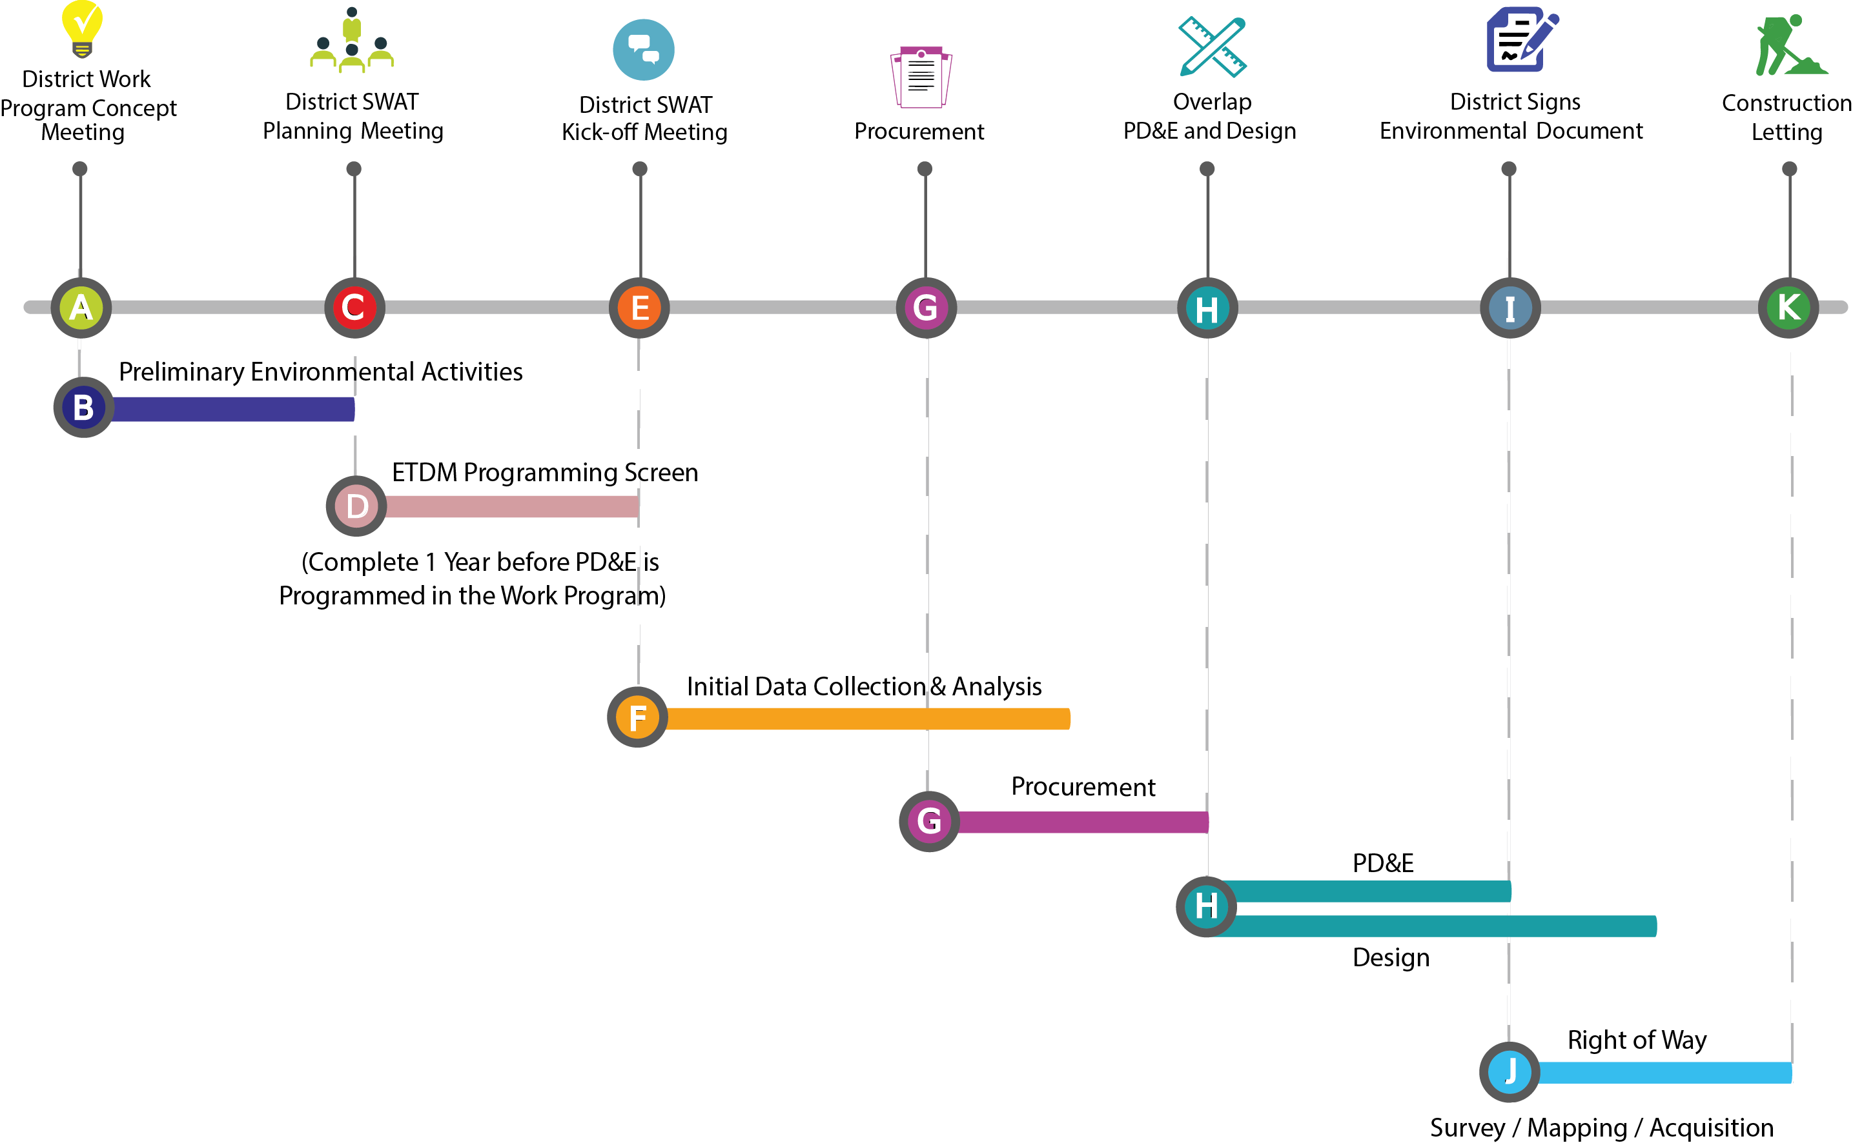
SWAT Process Timeline

Slide 19
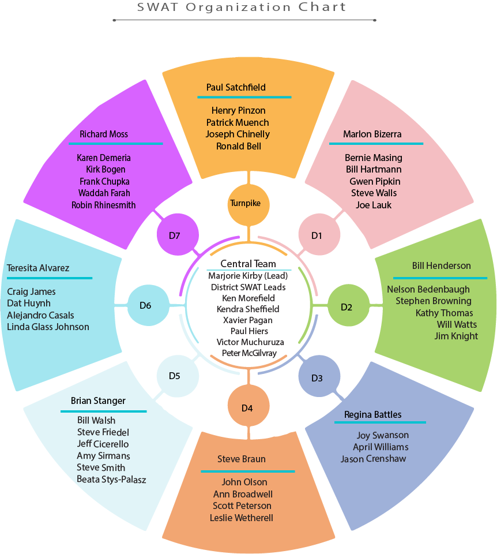
OEM’s Role in SWAT
Central Team meets quarterly
  Track SWAT projects
  Share Lessons Learned
  Refine / Update Guidance
Support District Coordination
  Work Program Concept Meeting
  SWAT Planning Meeting
  SWAT Kick-off Meeting
Provide training
  SWAT Training Workbook
  NEPA 102 SWAT and Project Development Process Training Module

Slide 20
Lesson 3:
Overview of NEPA Assignment Program

Slide 21
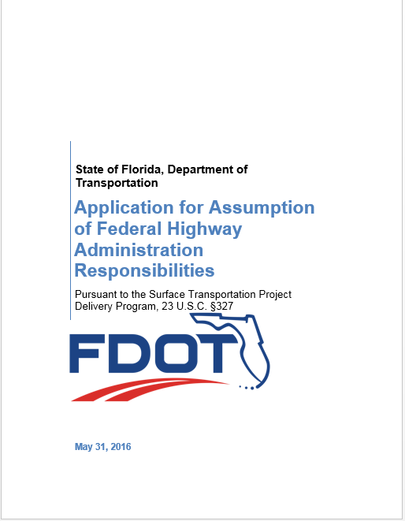
What is NEPA Assignment ?
Formal Assignment of FHWA’s NEPA project decision responsibilities for highway projects to FDOT who would assume:
Responsibilities cited codified in 23 U.S.C. § 327
NEPA, all eligible Federal Environmental Laws and Executive Orders as provided in Appendix A to Part 773
All Classes of highway projects
  Class I: Environmental Impact Statement (EIS) projects
  Class II: Categorically Excluded (CE) projects
  Class III: Environmental Assessments (EA)
Local Agency Program (LAP) Highway Projects

Slide 22

OEM’s New Role under NEPA Assignment
Program Management and Oversight
Documentation and Records Managements
Quality Assurance / Quality Control
Self-Assessment and support of FHWA Audits
Training
Agency and Stakeholder Coordination
Communication with Districts on changes in laws or Executive Orders
Coordination with Office of General Counsel
  Legal Reviews / Legal Sufficiency Reviews
Coordination with State Transportation Development Administrator
  Prior Concurrence
NEPA

Slide 23
How will this change the process?
Resource Agencies will work directly with FDOT
FDOT becomes solely responsible and legally liable for its decisions
FHWA Revised Responsibilities
  Stewardship and Oversight responsibilities
  Provide training
  Program technical assistance and policy interpretation, NO PROJECT ASSISTANCE
  Audit FDOT’s program once a year for first four years
  Engineering decisions
  Project level air quality conformity determinations (Florida is in attainment)
  Government to government Tribal consultations
  USDOT responsibilities for statewide and metropolitan planning
  Projects the cross state lines
  On-going projects excluded from NEPA Assignment
23

Slide 24
Lesson 4:
Environmental Document Review Process

Slide 25
Overview of Environmental Document Review Process
ETDM Screening; Scope of Services Finalized; Advance Notification; Class of Action evaluation
(1)(2)
Project Initiation
Technical Studies
District Review of Technical Studies
Prepare Draft Environmental Document
District Quality Control Certification prior to submittal to OEM
OEM and Legal
Document Review
(3)
District Updates Draft Environmental Document
OEM and Legal
Review and Approval
Public Hearing
District Updates Final Document
OEM and Legal
Review of Final Document
District Certifies Final Document
OEM Approves Final Document; Location and Design Concept Acceptance
Additional Steps for FONSI/ROD (Publication and Limitation of Claims)
NOTES:
Type 1 CEs are not screened in ETDM and will continue to be prepared and approved at the District level.
The MiCE process is used as described in Part 1 Chapter 2 of the PD&E Manual.
Type 2 CEs reviewed prior to public hearing upon request.
Final Legal Sufficiency Completed for EISs and Individual Section 4(f)
Notes:
District Project Core Team
District Project Manager and District Liaisons representing applicable functional areas (e.g., environment, design, drainage, permitting)
Technical Studies are conducted to address specific issues
Technical Reports are prepared and reviewed following the OEM Document Review Process (after District QC)
Coordination and Public Involvement is conducted and documented
District Project Core Team discusses possible ways to avoid or minimize identified potential impacts (with support from OEM as needed)
Environmental Document is prepared and reviewed following same process
Public Hearing held; documents updated
Legal Sufficiency as required
Approval of Environmental Document
Additional Steps for Finding of No Significant Impact or Record of Decision)

Slide 26
Lesson 5:
NEPA Document Review Process for Type 1 CEs

Slide 27

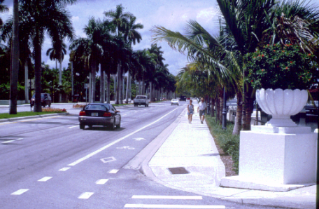

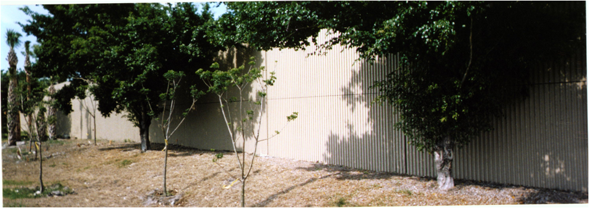
Type 1 Categorical Exclusion Overview
Non-construction activities
Limited construction activities
Qualify as Categorical Exclusions
  23 CFR § 771.117(a)
Actions listed in:
  23 CFR § 771.117(c), or
  23 CFR § 771.117(d)
  Part 1, Chapter 2 – PD&E Manual

Slide 28
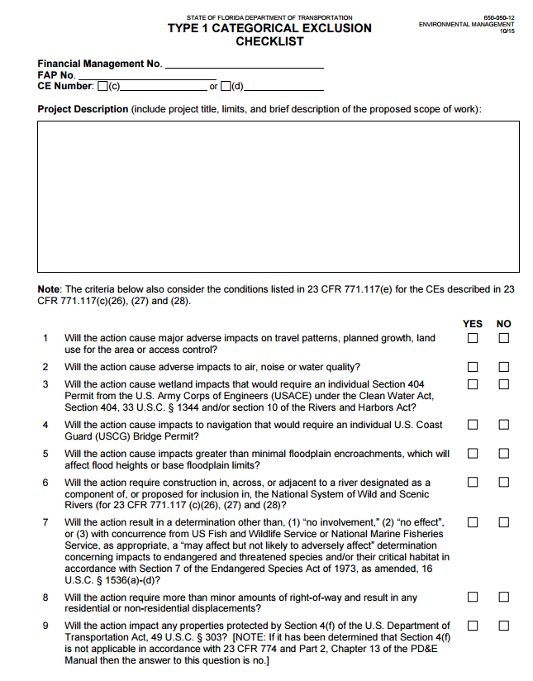
Type 1 Categorical Exclusions - Documentation
Type 1 Categorical Exclusion Checklist
  Part 1, Chapter 2 - PD&E Manual
  Form No. 650-050-12
Checklist is the Environmental Document
Include supporting documentation in File
  Agency Coordination
  Technical Memos

Slide 29
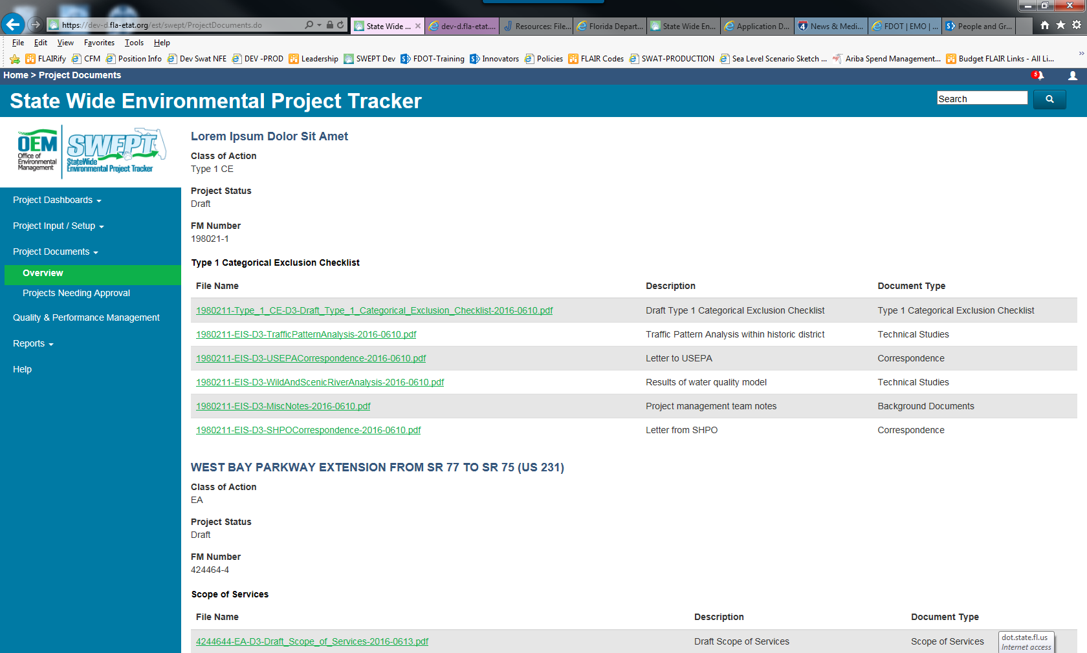
NEPA Document Review for Type 1 CEs
Approvals of Type 1 CEs delegated to Districts
  Districts responsible for internal Quality Assurance / Quality Control
  Review and Approval is NOT REQUIRED from OEM
Document uploaded to the State Wide Environmental Project Tracker (SWEPT) discussed in Lesson 9
Notes:
District certifies action qualifies for a CE under 23 CFR 771.117 (c) and identified in 23 CFR 771.117(d)
District uploads documentation to the Statewide Environmental Project Tracker (SWEPT)

Slide 30
Lesson 6:
NEPA Document Review Process for Type 2 CEs, EAs, and EISs

Slide 31

OEM’s Role in NEPA Document Review Process
Assigns Project Lead Review Team 1 Engineer and 1 Environmental Analyst
Coordinate with Districts to determine project issues
Review and provide approval at project review milestones
Coordinate with Legal to confirm Document is ready for signature
Assigns Subject Matter Experts (SMEs) as necessary
Provide support to district throughout PD&E study
Provide guidance on new federal and state policies

Slide 32
New Roles and Responsibilities of OEM Reviewers
OEM District Liaisons
OEM Project Coordinators
  One Environmental and Engineering Liaison established per District
  Provide District support and guidance (District Go To Person)
  Address general questions (unrelated to reviews); policy, process, technical issues
  Seek input from Subject Matter Expert and together respond to District
Assigned to District projects based on availability and complexity of project
Lead review process and address District review questions
May or may not be same person as the OEM District Liaison

Slide 33
OEM District Liaisons
ENVIRONMENTAL
Katasha Cornwell*
Thu-Huong Clark
Katasha Cornwell*
Thu-Huong Clark
Thu-Huong Clark *
Katasha Cornwell
Erika Thompson*
Shereen Yee-Fong
Erika Thompson*
Shereen Yee Fong
Shereen Yee Fong*
Erika Thompson
Shereen Yee Fong*
Erika Thompson
Use contact for geographic District
D1
D2
D3
D4
D5
D6
D7
FTE
Use contact for geographic District
Jenna Bowman
TBD
Catherine Bradley
Martha Hodgson
Jenna Bowman
Catherine Bradley
Martha Hodgson
ENGINEERING
NOTES: * Primary Contact
Administrator Support to all Districts
Marjorie Kirby
Victor Muchuruza
Xavier Pagan
Office of General Counsel
Kathleen Toolan

Slide 34
NEPA Document Review Process Flowchart
STEP 1
STEP 2
STEP 3
STEP 4
STEP 5
ASSIGN OEM PROJECT LEAD REVIEW TEAM
(AT THE BEGINNING OF PROJECT DEVELOPMENT)
1 Engineer / 1 Environmental Analyst
STATE ENVIRONMENTAL PROCESS ADMINISTRATOR
COORDINATE WITH DISTRICTS TO DETERMINE PROJECT ISSUES
ASSIGN SUBJECT
MATTER EXPERTS (SME) AS NECESSARY
EVALUATE
CLASS OF ACTION
STEP 11
STEP 10
STEP 9
STEP 8
STEP 7
STEP 6
OEM, LEGAL AND COOPERATING AGENCIES
30-DAY REVIEW AND SUBMITTAL OF COMMENTS TO DISTRICT (2)
DISTRICT QUALITY CONTROL CERTIFICATION
PRIOR TO SUBMITTAL TO OEM AND LEGAL
(1)
DISTRICT PROJECT BRIEFING FOR OEM
AND
LEGAL REVIEWERS
OEM LEAD
REVIEW TEAM
confirms
documents are
ready for
review
DISTRICT UPLOADS DRAFT DOCUMENTS INTO ELECTRONIC REVIEW SYSTEM
DISTRICT PREPARES DRAFT DOCUMENTS
STEP 12
STEP 13
STEP 14
STEP 15
STEP 16
DISTRICT ADDRESSES COMMENTS AND DISTRICT ENVIRONMENTAL ADMINISTRATOR RESUBMITS FOR OEM APPROVAL
COMMENT RESOLUTION MEETING WITH DISTRICT (OPTIONAL)
LEGAL
SUFFICIENCY REVIEW
IF REQUIRED
OEM AND LEGAL
CONFIRM DOCUMENT
IS READY FOR
SIGNATURE
DOCUMENT
SIGNED BY
DIRECTOR OF
OEM OR
DELEGATE
NOTES:
This process applies to Type 2 CEs (after public hearing), EAs and EISs.
Legal Review of Type 2 CEs as appropriate.

Slide 35
NEPA Document Review Process Steps
STEP 1
State Environmental Process Administrator
  Receives notification that a new project is coming online
  Assigns OEM Project Coordinator (lead environmental scientist)
State Environmental Development Engineer assigns lead engineer
Review team consists of at least 1 Environmental Scientist / 1 Engineer
OEM Project Coordinator
  Schedules introductory meeting with District
  Assesses need for consultant support in review process
Meeting with District
  Introduce District’s Project Core Team and OEM Review Team
  Communicate mutual expectations about project
  Discuss project schedule, review schedule and document review milestones
  District provides project summary and issue discussion
STATE ENVIRONMENTAL PROCESS ADMINISTRATOR
STEP 2
ASSIGN OEM
PROJECT LEAD
REVIEW TEAM
STEP 3
COORDINATE WITH DISTRICTS TO DETERMINE PROJECT ISSUES

Slide 36
NEPA Document Review Process Steps
STEP 4
Class of Action (COA) Evaluation
District proposes COA and provides supporting documentation
OEM Project Coordinator reviews proposed COA and if disagrees discusses reasons why with Districts until agreement is reached
Districts submit proposed COA in the Environmental Screening Tool
Director of OEM (or designee) reviews and approves COA (during ETDM Programming Screen or after as needed)
EVALUATE
CLASS OF
ACTION
STEP 5
Subject Matter Experts and Office of General Counsel (OGC) Staff
Requested by OEM Project Coordinator based on project issues
Part of Review Team and involved during entire process
ASSIGN SUBJECT
MATTER EXPERTS (SME) AS NECESSARY

Slide 37

NEPA Document Review Process Steps
Know when to involve FDOT Office of General Counsel (OGC)
  Environmental Impact Statements
  Complex Environmental Assessments
  Complex Issues on any project (Type 2 Categorical Exclusions reviewed upon request)
  Potential / Actual Section 4(f) issues
  Potential for controversy
  A credible agency or legal opposition is discovered
  Limitation on Claims posting
Get them involved early and throughout the process

Slide 38

NEPA Document Review Process Steps
STEP 6
District Prepares Draft Document
Address EDTM issues
Address Public, local government, agency and tribal comments
Perform required Technical Studies and reference in the Environmental Document
Include Standard statements as applicable
In accordance with PD&E Manual
DISTRICT PREPARES DRAFT DOCUMENTS

Slide 39
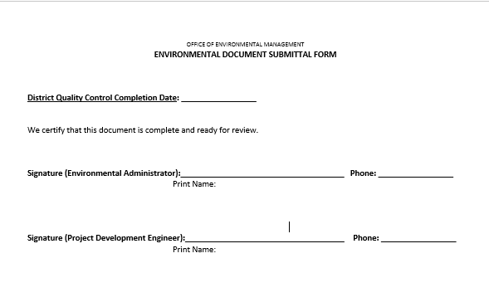
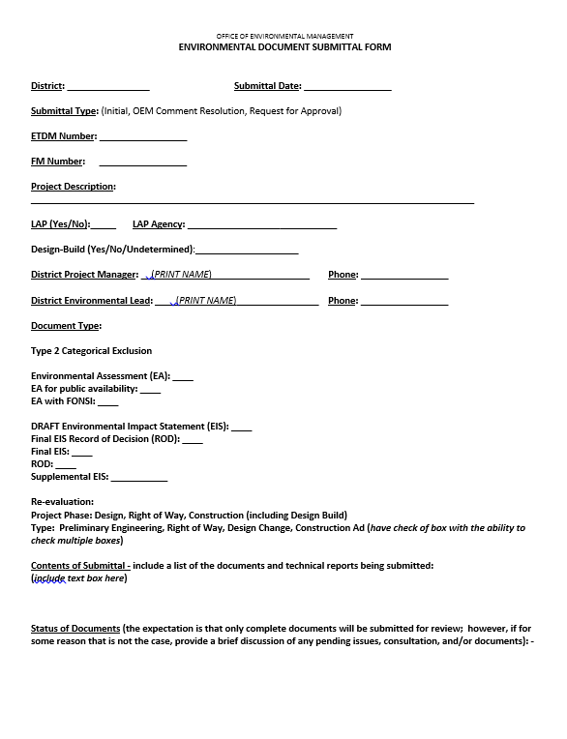
NEPA Document Review Process Steps
STEP 7
District Quality Control Certification
District certifies that they performed their own review
Consultant QC Certification to Districts is recommended
DISTRICT QUALITY CONTROL CERTIFICATION
PRIOR TO SUBMITTAL TO OEM AND LEGAL
Environmental Document Submittal Form
Submittal Type (Initial, Comment Resolution, Approval)
Local Agency Program (LAP)?
Design-Build?
District Leads
Type of Document
Contents of Submittal

Slide 40
NEPA Document Review Process Steps
STEP 8
Electronic Review System
District Project Manager uploads document(s) for review
DISTRICT UPLOADS DRAFT DOCUMENTS INTO ELECTRONIC REVIEW SYSTEM
STEP 9
Readiness Check by Project Coordinator
Is package complete?
Environmental Document Form (QC Certification) completed?
ETDM issues addressed?
Technical Studies performed and appropriately referenced
Public, local government, agency and tribal comments addressed
Possible Outcomes
Document is returned as “Not Ready for Review”
Review Cycle initiated
OEM LEAD
REVIEW TEAM

Slide 41
NEPA Document Review Process Steps
STEP 10
Project Briefing scheduled by District Project Manager
Summarize issues and Coordination held during study
Include Cooperating Agencies
30 Day Review Cycle
Day 1 to Day 21: submittal reviewed by OEM and Legal (as applicable)
Day 21 to Day 30: OEM comments reviewed for accuracy and consolidated; value added comments
Cooperating Agencies transmit comments at end of 30 day cycle
Comment Resolution Meeting (Optional)
Requested by Districts as needed
Discuss major comments and responses that were not understood and
Address additional District’s questions
Include Cooperating Agencies as needed
DISTRICT PROJECT BRIEFING FOR OEM AND LEGAL REVIEWERS
STEP 11
OEM , LEGAL AND COOPERATING AGENCIES
30-DAY REVIEW AND SUBMITTAL OF COMMENTS TO DISTRICT
STEP 12
COMMENT RESOLUTION MEETING WITH DISTRICT (OPTIONAL)

Slide 42
NEPA Document Review Process Steps
  Do we want
  Districts to
  Submit Certification
  With resubmittal?
STEP 13
Resubmittal
Include Environmental Document Submittal Form
Best Practice - use “Tracked Changes” for quicker follow up review
ERC should include reference to where change was made
DISTRICT ADDRESSES COMMENTS AND DISTRICT ENVIRONMENTAL ADMINISTRATOR RESUBMITS FOR OEM APPROVAL
STEP 14
Legal Sufficiency Review
Required for Draft Final EISs and Individual Section 4(f) Evaluations
  Assesses whether the Environmental Document adequately addresses the NEPA procedures, laws and policies concerning the project
  Evaluates potential litigation risk
Refer to Legal Sufficiency Reviews and Certification Training Module
LEGAL
SUFFICIENCY REVIEW
IF REQUIRED

Slide 43

Prior Concurrence pursuant to 23 CFR § 771.125 (c)
  What is it and how was it handled before NEPA Assignment?
FHWA Division Offices or Headquarters (HQ) identified projects with potential to rise to the level of national policy or having significant controversy
“Green light” approval from HQ required prior to proceeding with key approvals under NEPA
  May apply to projects with:
Impacts of unusual magnitude
High levels of controversy
Major unresolved issues
Emerging or national policy issues under development
Issues for which Districts seek policy assistance
Notes:
Starting in 1996, FHWA delegated to the Divisions greater responsibility in the oversight of the National Environmental Policy Act (NEPA)/Project Development process for transportation projects. However, because certain NEPA actions could rise to the level of national policy or significant controversy, certain projects may warrant a "prior concurrence" by FHWA Headquarters (HQ). For these selected, pre-identified projects, prior concurrence is a step in the project development process at which FHWA field offices obtain a "green light," or approval, from HQ before proceeding with key approvals under NEPA.
Prior concurrence is a finding by the Planning and Environment CBU that the document in question is acceptable from a policy/program perspective. Legal sufficiency is a review by the Office of Chief Counsel to ensure that the documentation meets legal minimums and will therefore be defensible in court.

Slide 44
Prior Concurrence under NEPA Assignment
  Districts and OEM Collaborate on decision to seek Prior Concurrence
Determined on a case by case basis
Mostly applies to EIS projects at Final EIS stage but can apply to Draft EIS
Can apply to Record of Decision if issues have not been addressed
  When projects are anticipated to involve a constructive use under Section 4(f)
FDOT will coordinate with FHWA on underlying policy issues before making final determination of a Section 4(f) constructive use
Section 4(f) constructive use evaluations will undergo legal review before they are signed by Director of OEM

Slide 45

Prior Concurrence under NEPA Assignment
  Prior Concurrence Review
EIS reviewed by State Environmental Programs Administrator or State Environmental Process Administrator or designee
  SMEs and OGC provide input, as appropriate
  Prior Concurrence Approval
State Transportation Development Administrator (STDA) or designee, after consulting with OGC if desired, determines whether the project can proceed with key NEPA approvals.
Documented in an email from STDA to the Director of OEM
  Summarize issues in questions have been resolved
  Summarize actions undertaken to address issues

Slide 46
NEPA Document Review Process Steps
STEP 15
OEM Review Team and OGC
Ensure all issues have been addressed
Confirm document is ready for signature
OEM AND LEGAL
CONFIRM DOCUMENT
IS READY FOR
SIGNATURE
STEP 16
Director of OEM or designee signs Environmental Document
Type 2 CE = Location Design Concept Approval
Draft EA and EIS = approval for Public Availability
Additional Steps for EAs and EISs
DOCUMENT
SIGNED BY
DIRECTOR OF
OEM OR
DELEGATE

Slide 47
EA Considerations in NEPA Document Review Process
After Public Hearing
  No significant impacts, prepare a Finding of No Significant Impact (FONSI)
  Follow NEPA Document Review Process for EA with FONSI Step 6 - 16
Director of OEM or designee signs EA with FONSI
  Grants Location Design Concept Acceptance
Limitation of Claims Notice 23 U.S.C § 139 (l)
Refer to Finding of No Significant Impact (FONSI) Training Module
Public Hearing
Prepare FONSI
Prepare DEIS
OR
PD&E Manual Part 1 Chapter 7

Slide 48
EIS Considerations in NEPA Document Review Process
After Public Hearing
  Prepare Final EIS and Record of Decision (combined or separate)
  Follow NEPA Document Review Process for FEIS/ROD Steps 6 - 16
Director of OEM or designee signs FEIS and ROD or combined FEIS/ROD
  Grants Location Design Concept Acceptance
Limitation of Claims Notice 23 U.S.C § 139 (l)
Refer to Final EIS and ROD Training Module
Public Hearing
Prepare Combined FEIS with ROD
Prepare Separate FEIS and ROD
OR
PD&E Manual Part 1 Chapter 9

Slide 49


Re-evaluations
Documents whether or not changes have occurred
since the approval of the original Environmental
Document
Required:
  Prior to requesting federal-aid authorization for subsequent
  project phases (final design, right of way and construction)
  Major design/project changes
  Major design/project changes during a design-build project
  Project changes from the federal process to the state
  process
Refer to Re-evaluations Training Module

Slide 50
Re-evaluations
3
1
    CHANGES REQUIRED
    OEM Project Coordinator and District determine level of analysis and public involvement required to advance project
5
    RE-EVALUATION MEETING
    OEM Project Coordinator and District meet to discuss validity of Environmental Document
    APPROVAL
    Director of OEM signs Re-evaluation. District completes Status of Environmental Certification Form
2
4
    DOCUMENT
    STILL VALID
    District proceeds with project and documents results of coordination in project file
    OEM NEPA
    DOCUMENT REVIEW
    Follow steps 6 – 16, OEM Reviewers confirm analysis and required public involvement was conducted

Slide 51
Best Practices for Conducting Reviews
Does Environmental Document comply with FDOT standards and manuals?
Were major issues identified in ETDM Programming Screen addressed?
Is the Purpose and Need supported and consistent across documents?
Is information appropriately referenced or incorporated?
Do technical reports provide proper analysis and conclusions?
If methodology memoranda was developed, was it followed or reasons for updates to methodology explained?
Does the Alternatives Analysis justify the Recommended Alternative
Are project issues and impacts addressed satisfactorily?
Were public, local government, agency and tribal comments addressed?
Were previous review comments addressed?

Slide 52
Best Practices for Conducting Reviews
Get Organized
  Develop comment spreadsheet (can be through Electronic Review system when used)
  Include the page number and exact location the comment is referencing
  Apply a neutral attitude to the comment and be courteous. No emotions, snarky or inappropriate comments “Kill them with kindness”
  Be clinical - Point out errors, unsupported statements and mistaken or inappropriate conclusions (often necessary as future legal documentation)
  Less is better, No speculation
  Remember, we are all on the same team and trying solve problems
Review comments for accuracy and consolidate
Comment Resolution Meetings provides a forum for reviewer and District to go over how comment was addressed
District Responses should not be “this was addressed” but should explain how and if not addressed, why it wasn’t

Slide 53
Best Practices for Conducting Reviews
Using consultant resources during OEM reviews
  Consultants can support the review process as long as there is no conflict of interest
  Consultants are NOT allowed to make decisions
  Need should be identified early and consultants invited to participate from the beginning of the process
Maintaining the same reviewers throughout the study ensures consistency between reviews, no learning curve
Project Coordinator should review all documents for consistency, often one document is updated and others with similar information are not
Front end submittal optional, can help accelerate review process
  Have an informal review and approval of format and front end text (e.g., cover page, project description, purpose and need, location map)

Slide 54
Lesson 7:
Collaboration (EAs and EISs)

Slide 55
Collaboration (EAs and EISs)
Collaboration between OEM and Districts at key points during environmental process
Ensure studies and documents are appropriately scoped
Ensure the NEPA process is followed and compliance with law and procedures
Prevents delays through early identification and resolution of issues
Presents more opportunities for Quality Assurance and Quality Control
Helps ensure success in NEPA Assignment
Complex or controversial projects benefit from monthly status meetings
Should be discussed and scheduled during OEM/District Introductory Meeting
Review status of engineering, environmental process and public involvement activities
Get ahead of issues and formulate a plan

Slide 56

Collaboration (EAs and EISs)
Additional Collaboration Points
SWAT Kick-off Meeting (discussed previously)
Alternative Corridor Evaluation (ACE) process, range of Alternatives
ETDM Programming Screen / Class of Action evaluation
PD&E Scope of Services Development
At project initiation; once Consultant is on board
At key Public Involvement Milestones
  Public Involvement Plan, Notice of Intent, Scoping
  Briefing OEM before and after major events (response to public, agency and tribal comments)
  Assess need to update Environmental Document after hearing

Slide 57

Collaboration (EAs and EISs)
Development of Alternatives
Alternatives Screening
Identification of Preferred Alternative
Technical Reports
Discuss approach/methodology, assumptions and results
Trouble shooting during analysis or production of Environmental Document as needed
Other Considerations
Project File organization and Administrative Record
Seek advice from OGC as needed
Maintain meeting notes, document decisions made and add to the project file

Slide 58
Lesson 8:
Quality Assurance and Quality Control

Slide 59
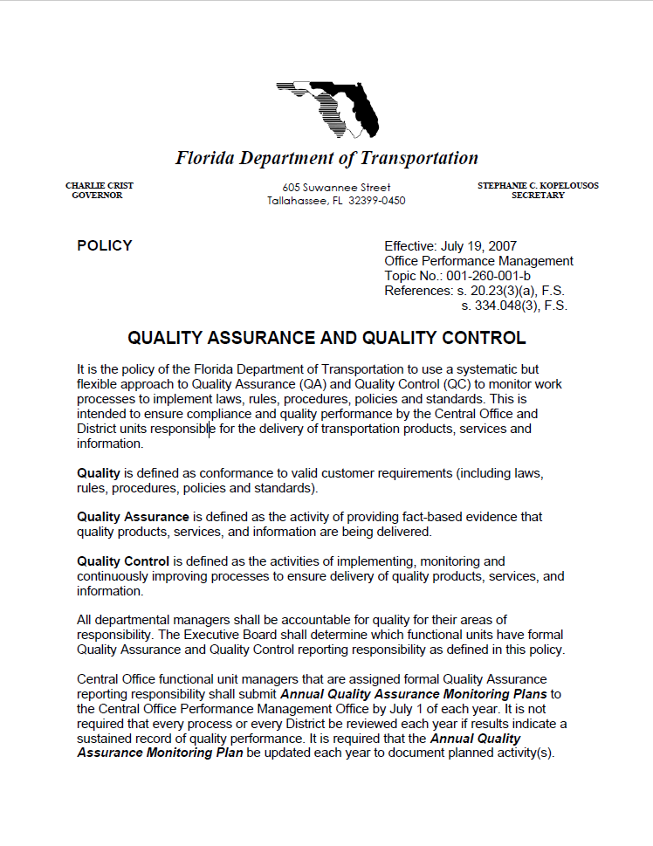

FDOT Quality Assurance / Quality Control Policy
QA/QC Policy, Topic Number 001-260-001
Ensures compliance and quality performance by the Central Office and District staff responsible for the delivery of transportation products, services, and information.

Slide 60
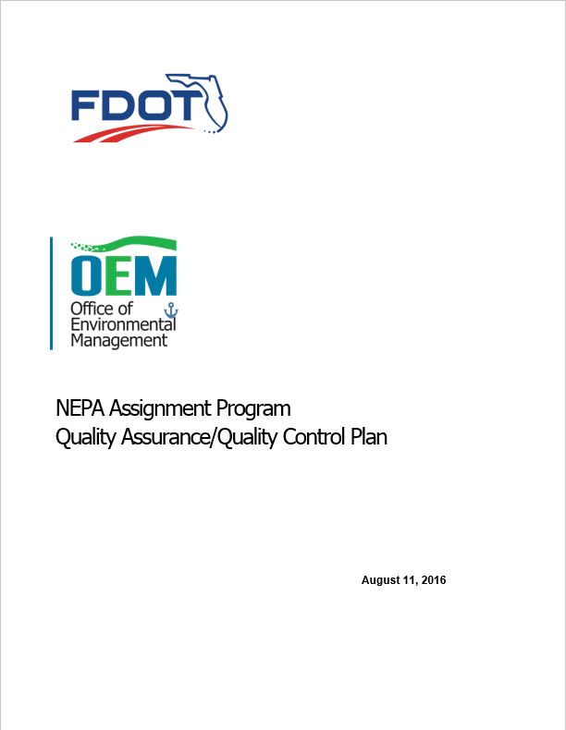
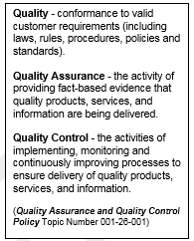
NEPA Assignment Program Quality Assurance/Quality Control Plan
Addresses NEPA Assignment Responsibilities
involved with:
  Linking Planning and NEPA
  NEPA Document Review Process
  Self-Assessment
  MOU Performance Measures
  Audit Support Responsibilities
  Data Management and Record Retention
Identifies program and project level responsibilities
Refer to xxx and xxx Training Modules
Notes:
The OEM NEPA Assignment Program QA/QC plan integrate NEPA Assignment requirements and describe FDOT’s process for complying with negotiated performance measures in the NEPA Assignment Program MOU.
The OEM QA/QC Plan supports quality assurance procedures, self assessments, and the FHWA audits in the following fundamental areas:
Linking Planning and NEPA – describes early environmental review processes which occur prior to initiation of environmental studies
NEPA Compliance – provides an overview of the document review and approval, legal sufficiency, and prior concurrence processes
Project Level Compliance – details review and approval procedures for each class of action
Quality and Performance Monitoring – identifies procedures for assuring program level quality
Recordkeeping and Retention – addresses requirements for maintaining project files and administrative records.

Slide 61
MOU and Performance Measures Introduction
  Compliance with NEPA, FHWA NEPA regulations, and other federal environmental statutes and regulations
Maintain documentation regarding compliance with responsibilities assumed under MOU
  QA/QC for NEPA decisions – Maintain internal QA/QC measures and processes
Record of Legal Sufficiency Reviews
Compliance with FDOT’s environmental document content standards and procedures, including those related to QA/QC
Notes:
FDOT will monitor performance measures to evaluate its NEPA Assignment Program responsibilities:

Slide 62
MOU and Performance Measures Introduction
  Relationship with agencies and the general public
Maintain communication considering timeliness and responsiveness among FDOT, federal and state resource agencies, Indian Tribes and the public
Provide opportunities for public involvement and comment
Use NEPA issue resolution process, as appropriate
  Increase efficiency and timeliness in completion of the NEPA process
Compare time of completion of environmental document (e.g., NEPA documents and technical repots) approvals before and after assumption of responsibilities)

Slide 63
Performance Measures Matrix – QA/QC
  Matrix establishes how Performance Measures will be evaluated
    Target
    Responsible Party
    Critical Process
    Desired Outcome
    Tool/Indicator
MOU Performance Measure | OEM Sub-Measure | Target | Responsible Party | Critical Process | Desired Outcome | Tool/Indicator
QA/QC for NEPA decisions: Maintain internal QA/QC measures and processes, including a record of: Completion of legal sufficiency reviews by FDOT’s Office of General Counsel | Percent of FEISs, FEIS/RODs, and individual section 4(f) determinations reviewed for legal sufficiency prior to environmental document approval. | 100% | Office of General Counsel | Final legal sufficiency review completed | Legal sufficiency reviews performed by FDOT Office of General Counsel for final EISs and Individual Section 4(f) evaluations before final document approval | Tracking method = In SWEPT, the date of legal sufficiency determination occurs before environmental document approval date. (Enforce procedure in SWEPT: these environmental documents cannot be approved until approved by OGC)
Notes:
The following table presents the NEPA Assignment performance measures, monitored process, desired outcomes, tools and indicators, and metrics. Italicized statements are from the FDOT NEPA Assignment Program Application.

Slide 64
Performance Measures Matrix – QA/QC
MOU Performance Measure | OEM Sub-Measure | Target | Responsible Party | Critical Process | Desired Outcome | Tool/Indicator
QA/QC for NEPA decisions: Maintain internal QA/QC measures and processes, including a record of: Compliance with FDOT’s environmental document content standards and procedures, including those related to QA/QC | Percent of draft environmental documents submitted with the District environmental certification form | 95% | District Environmental Project Manager | NEPA decisions made in accordance with ETDM and PD&E Manuals | Environmental documents sufficiently complete to begin formal review Document District completion of Quality Control activities on environmental documents | Tracking method = certification forms recorded in SWEPT
 | Percent of draft environmental documents certified by the District and accepted for document review by OEM at first submittal. | 80% | District Environmental Administrator | NEPA decisions made in accordance with ETDM and PD&E Manuals | Environmental documents sufficiently complete to begin formal review Verification by OEM of District Quality Control activities on environmental documents | Tracking method = SWEPT reports number of times document certification submitted before review starts
 | Percent of environmental documents approved by OEM on first submission of final environmental document | 85% | OEM Management Team | NEPA decisions made in accordance with ETDM and PD&E Manuals | Obtain approval of NEPA document | Tracking method = SWEPT reports number of times submitted before approval
Notes:
The following table presents the NEPA Assignment performance measures, monitored process, desired outcomes, tools and indicators, and metrics. Italicized statements are from the FDOT NEPA Assignment Program Application.

Slide 65
Lesson 9:
Tracking the Review Process

Slide 66
State wide Environmental Project Tracker (SWEPT)
Interactive web-based application:
Project Input/Setup – Create project scopes of work
Project Dashboards – Track project schedules
Quality & Performance Management – Record and report QA/QC results
Team Management – Assign and notify review teams
Project Documents – Maintain and provide access to the environmental project file of record
Communicates with Work Program and Project Schedule Management Codes

Slide 67
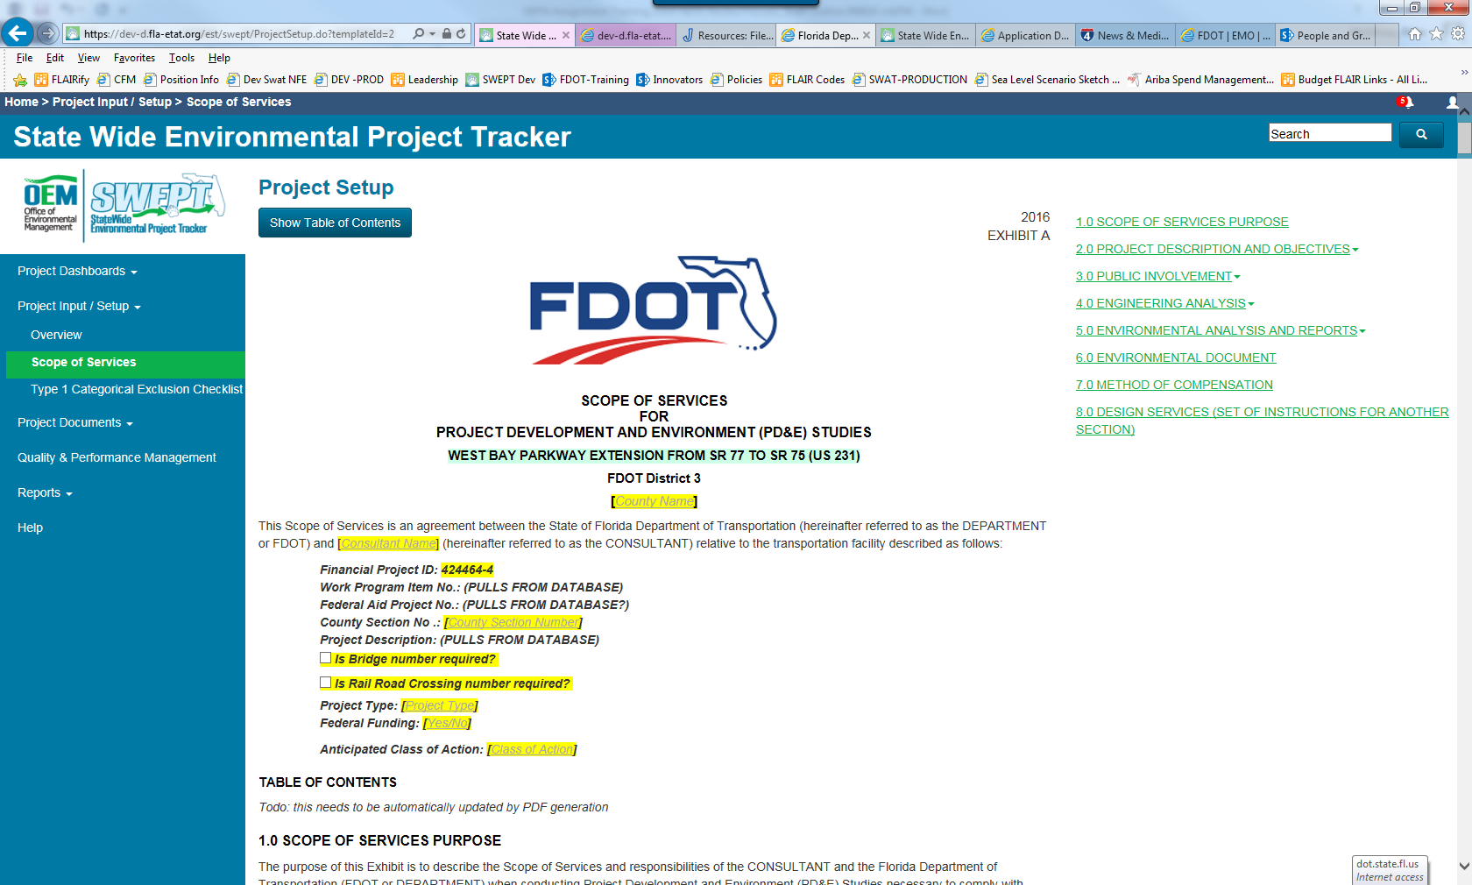
Project Input / Set up: Create Scope of Services

Slide 68
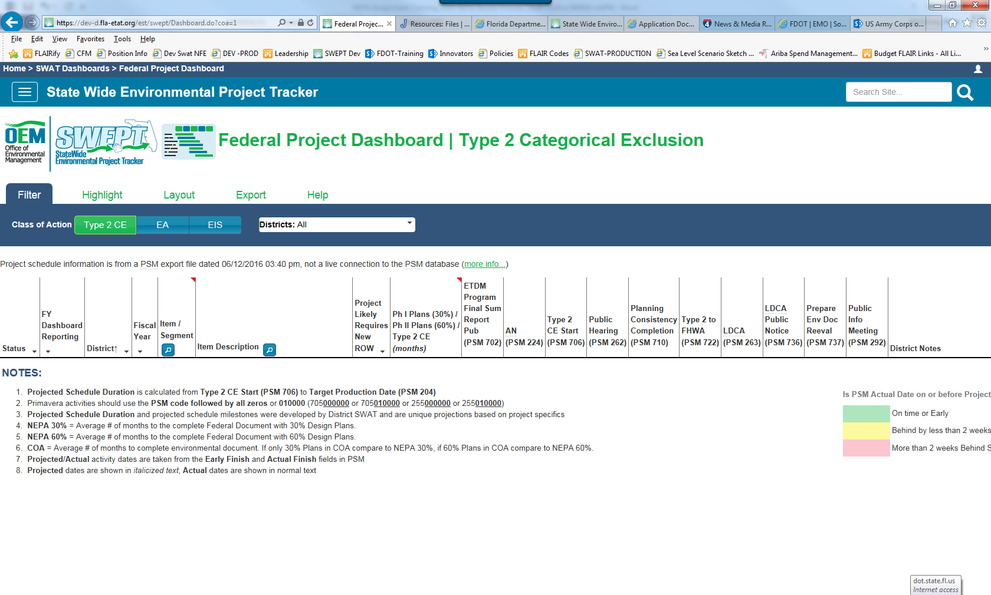
Project Dashboard: Track Project Schedules

Slide 69
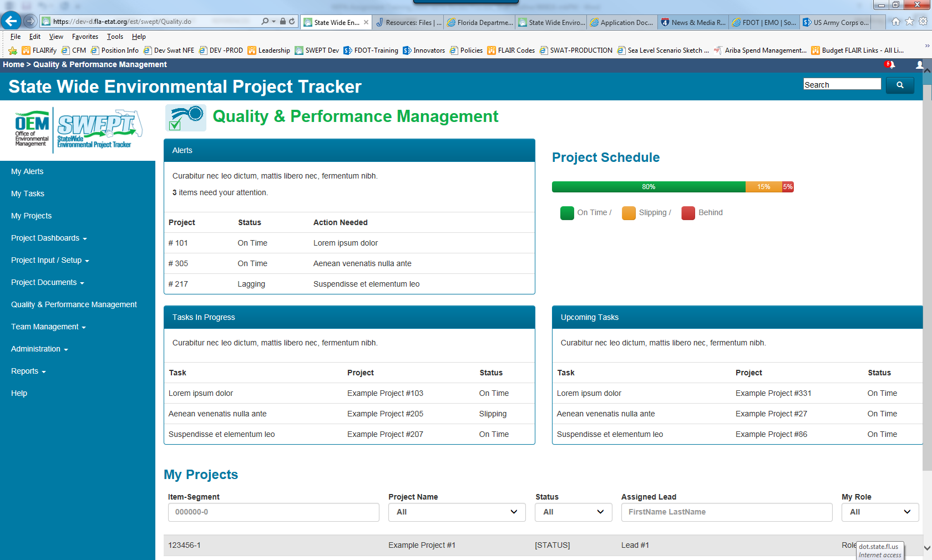
Quality and Performance Management

Slide 70
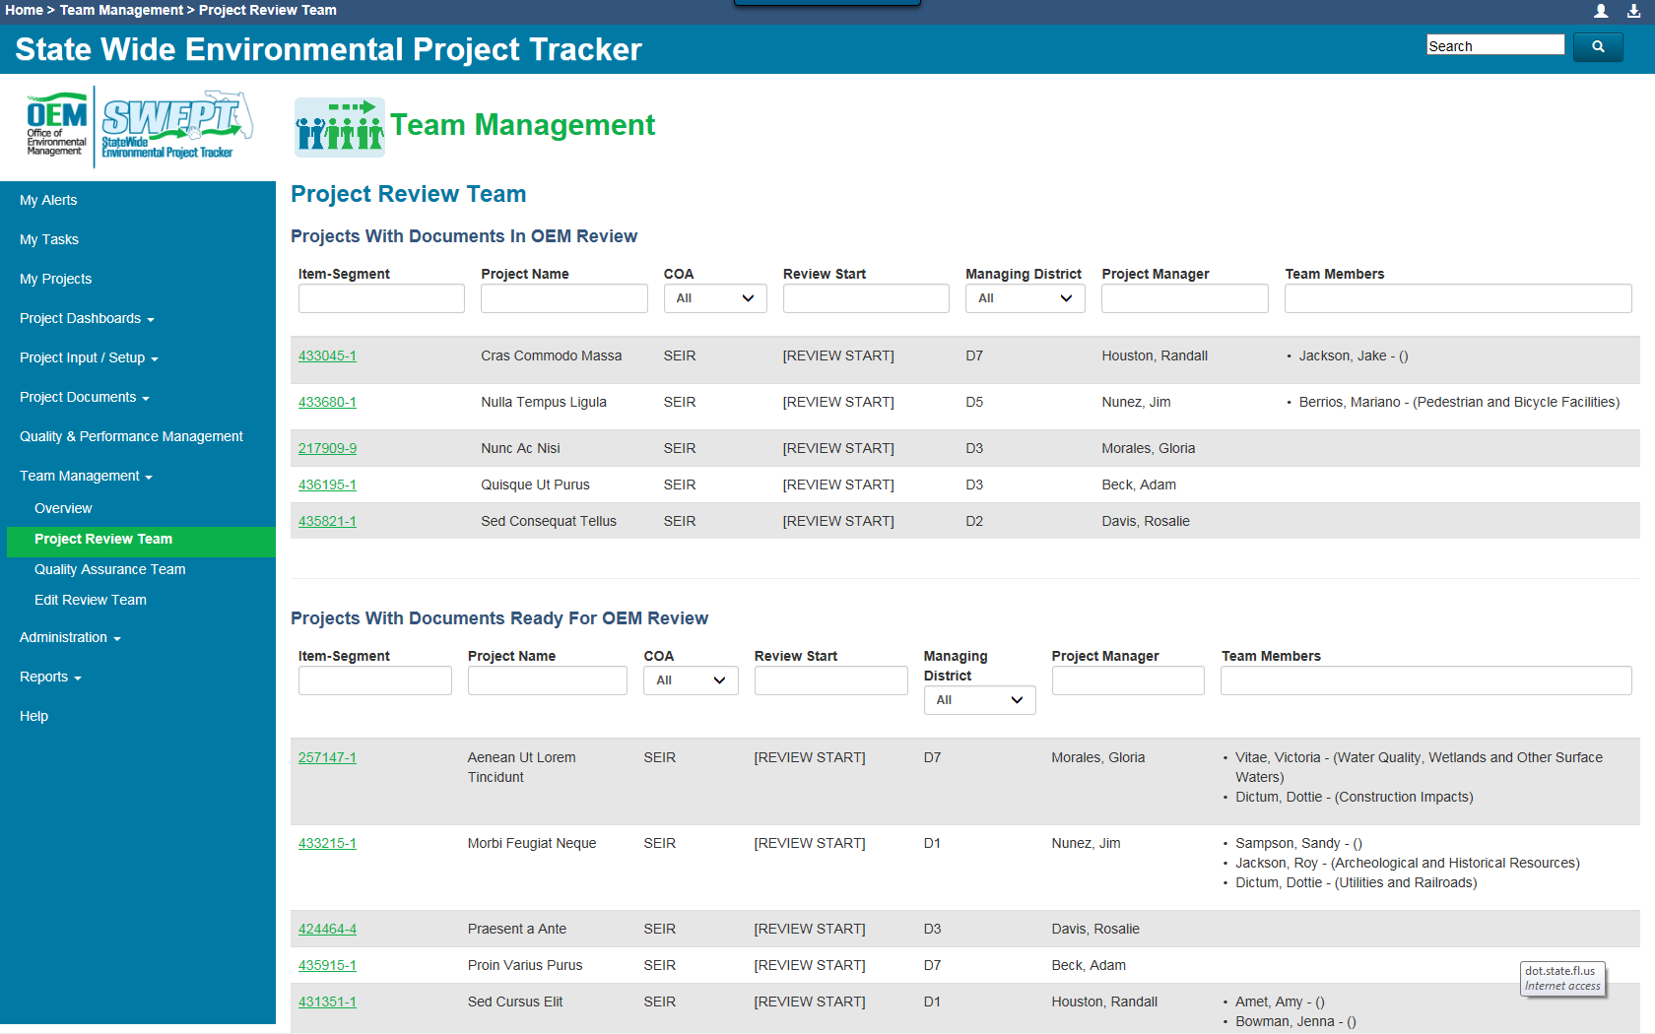
Team Management – Assign and Notify Reviewers

Slide 71
Environmental Project File

