Slide 1
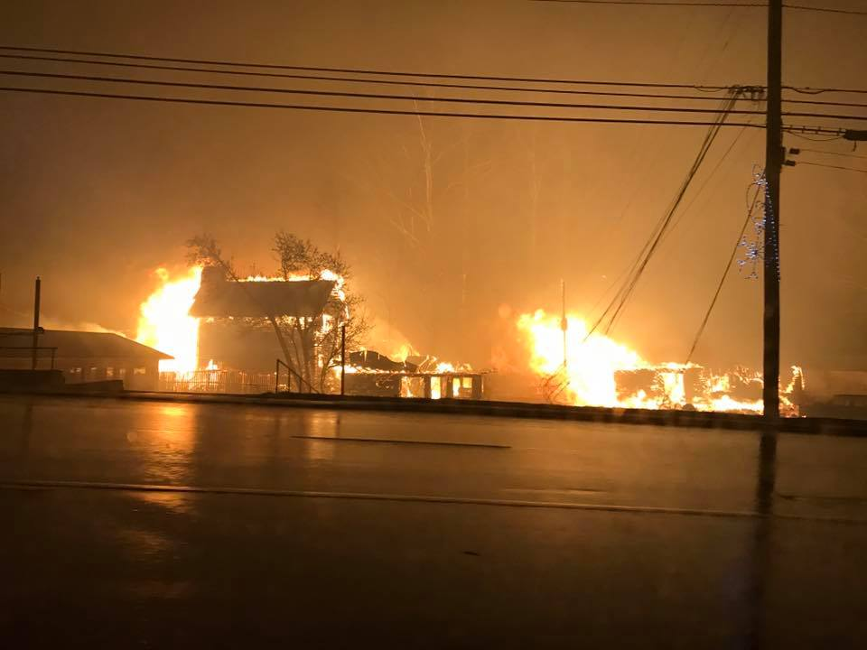
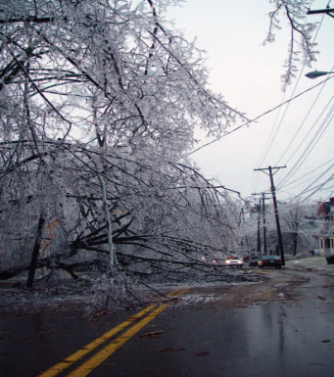
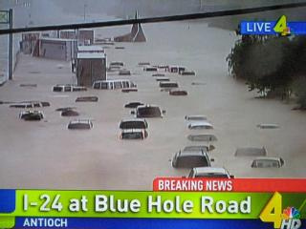
TDOT’s Strike Force - Response to 2016 Gatlinburg Wildfires
Jerry Hatcher, P.E. State Maintenance Engineer
Estel Hagewood, Transportation Manager 2
10/24/2017

Slide 2
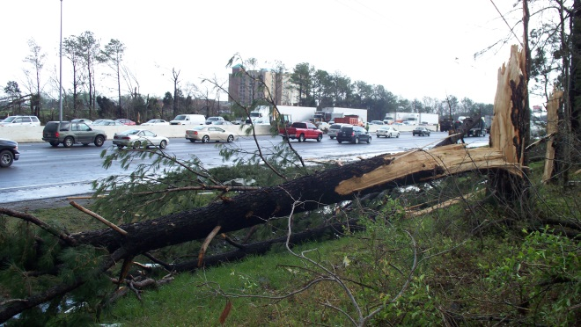
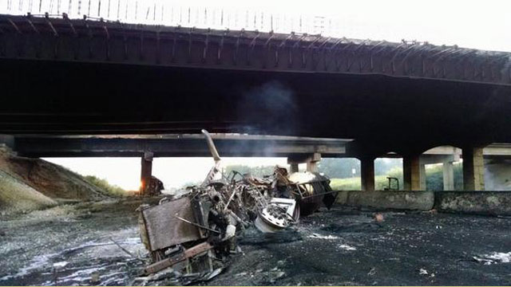
Disaster Recovery
Disasters occur across the state on a relatively routine basis
Natural Disasters
  Heavy Rainfall/flooding
  Snow
  Ice
  High Winds
  Tornados
  Hurricanes
  Rockfall
  Slides
Man Made Disasters
  Traffic Crashes
  Chemical Spills
  Protests
  Terrorism
Whatever Happens, We Are There!

Slide 3
Disaster Recovery
TDOT has a long history of working to get roads back open and cleaning up after disaster events.
Tennessee Emergency Management Agency is the Lead Agency for Disaster Events
TDOT serves a Emergency Service Function (ESF) in State Government

Slide 4
Disaster Recovery
Emergency Support Function | TDOT’s Role | Responsibilities
ESF–1 (Transportation) Transportation | Lead | Provide for the coordination of state transportation support to local governments in Tennessee. Coordinate the movement of essential personnel, equipment and support resources into, out of, around, through and within an impacted area.
ESF-3 (Infrastructure) Route Clearance & Bridge Inspection | Lead | Collect current information from field units (TDOT, THP, TDF, local officials, etc.) regarding blocked or damaged roads and bridges. Request assistance from Military and Civil Air Patrol aerial units for reconnaissance if deemed necessary or if requested by ESF 5 Information and Planning or the Direction and Coordination Group at the State Emergency Operations Center (SEOC). Determine best routes for use by emergency personnel responding to affected areas. Provide primary and alternate route information (to the extent possible) to agencies requesting routing information. Prioritize the restoration of route to usable conditions. Deploy TDOT units to areas in need of debris removal or road restoration operations. Request Military or Forestry units for assistance when necessary. Request assistance from U.S. Army Corps of Engineers and/or federal TDOT officials if needed to perform inspections, debris removal, or other functions.
ESF-3 (Infrastructure) Debris Removal | Lead | Responsible for the physical removal of debris. Provide personnel and equipment to local governments as requested to assist in debris removal operations. Obtain disposal site information from local officials or state environmental officials. Coordinate the removal of debris with federal, state and local environmental and public works officials.

Slide 5
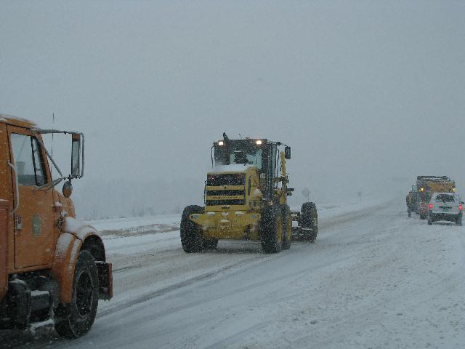
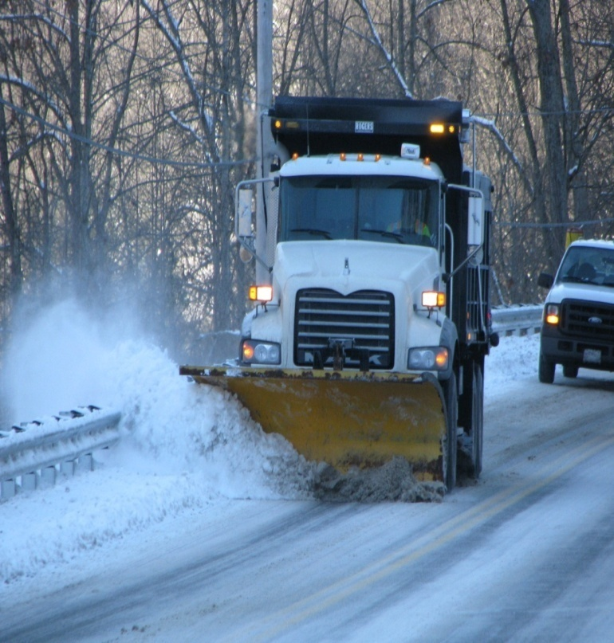
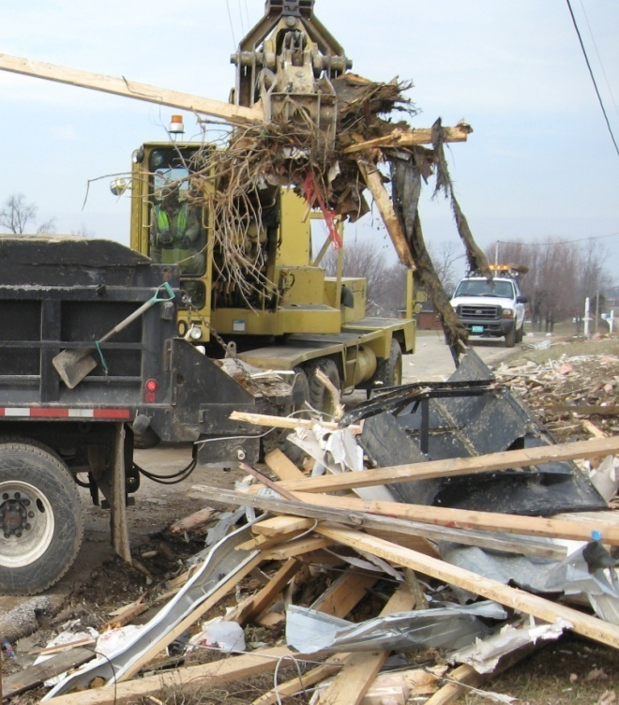

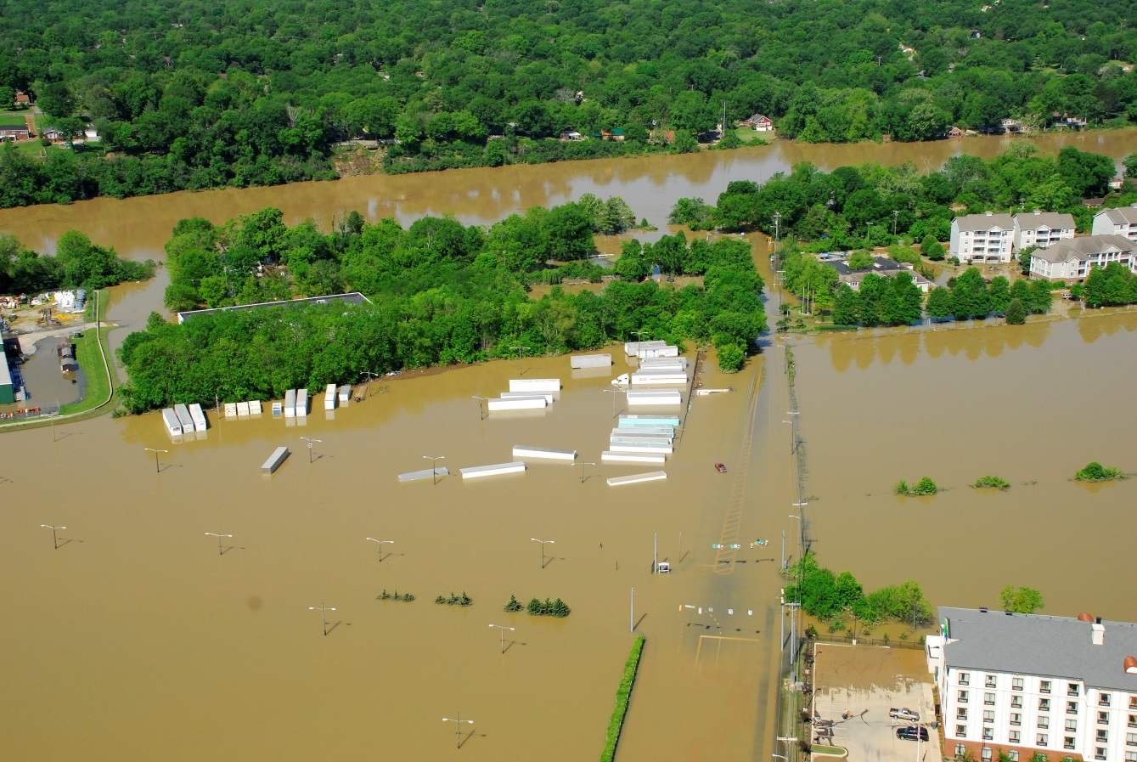
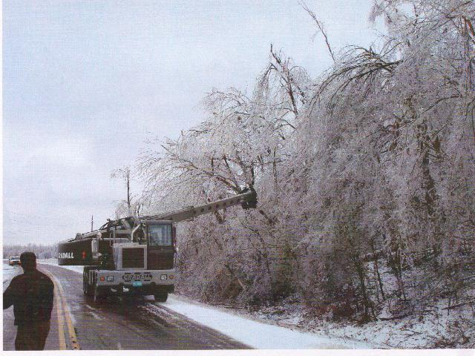
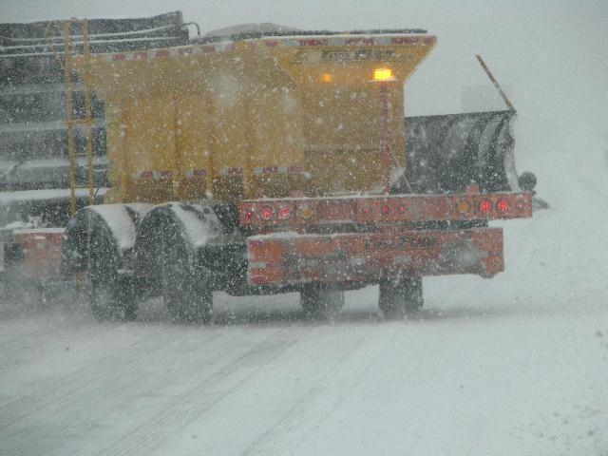
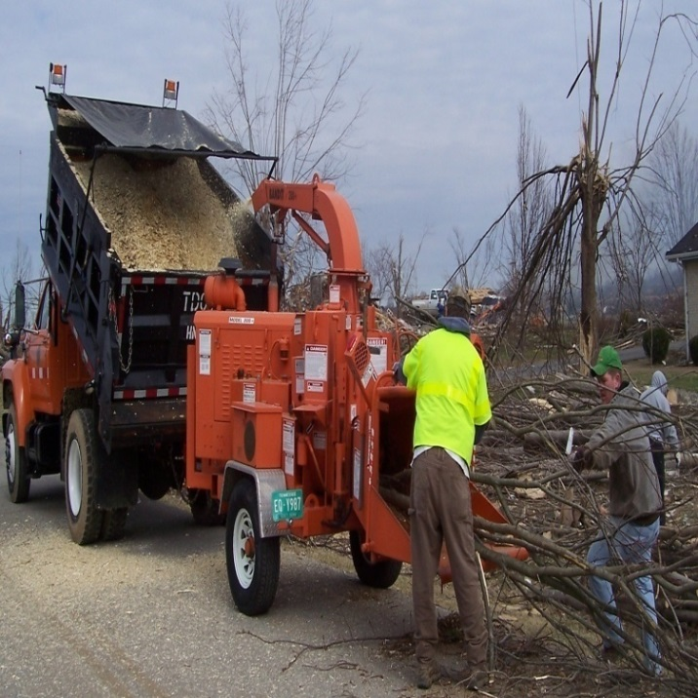

Slide 6
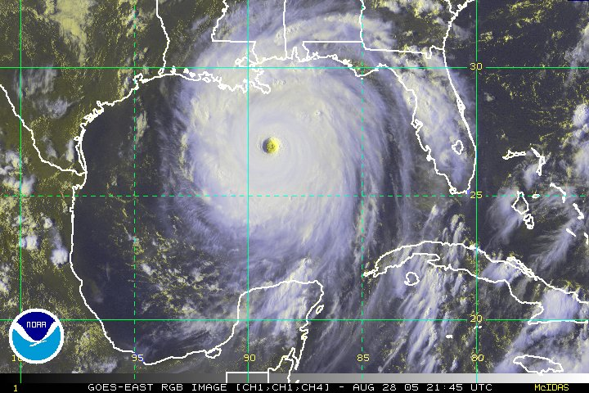
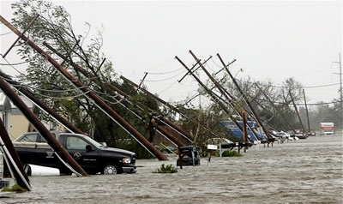
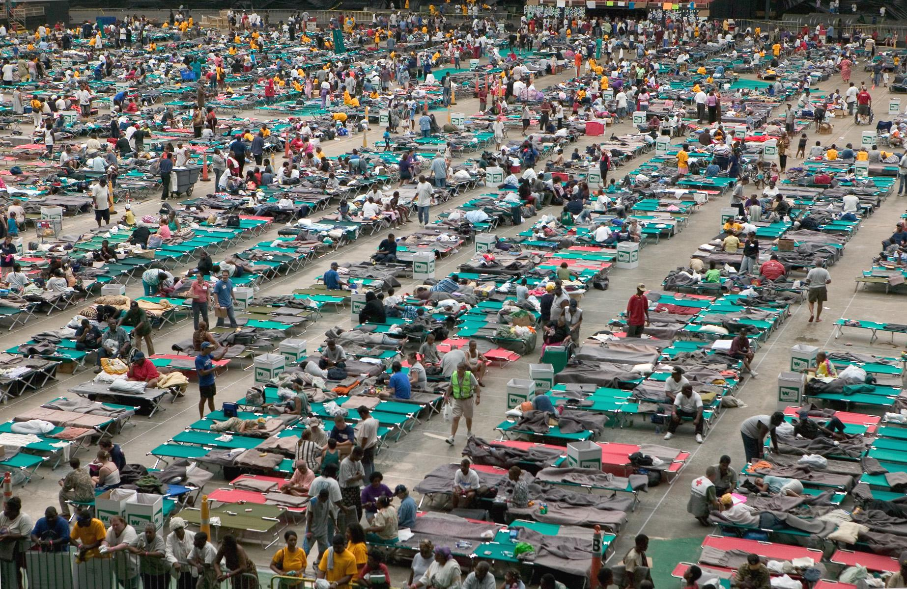
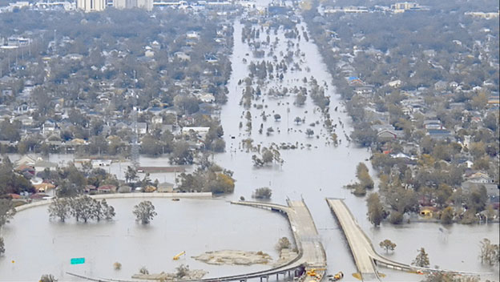
Hurricane Katrina
Louisiana & Mississippi appreciated our offer for assistance…
But they already had enough victims.

Slide 7

Strike Force Team Development
Tennessee STRIKE FORCE
Team

Slide 8

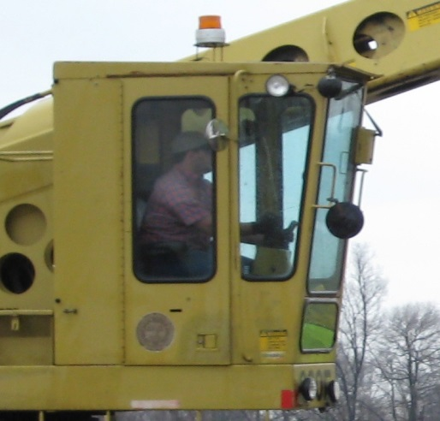
Strike Force - Personnel
25 person teams
Each team consist of:
3-Supervisors
6-Equipment Operators
12-Truck Drivers
2-Tractor Lowboy Drivers
2-Mechanics
List of alternates

Slide 9
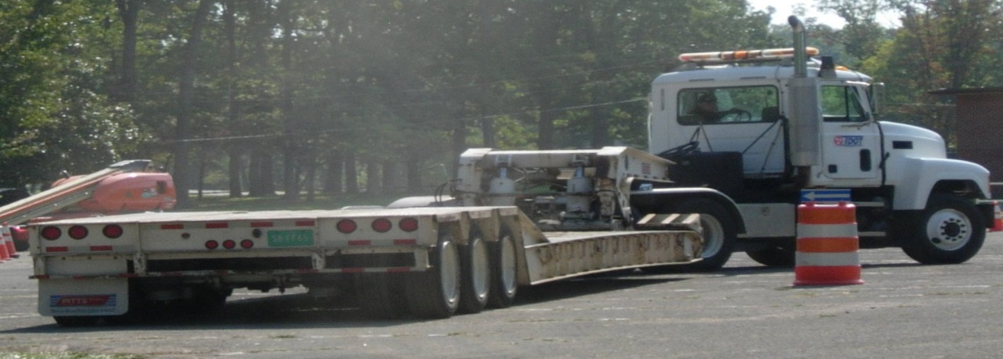
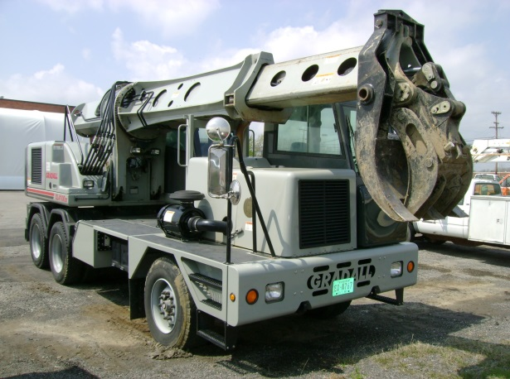
Strike Force - Equipment
Crewcab
Crewcab service body
Large Service Truck
Fuel truck/trailer
Tandem Axle Dumps
Single Axle Dumps
Tri-axle tractor lowboys with drop deck trailers
Large tag-a-long trailers
Enclosed Trailers (28ft long)
Large track-hoe with thumb
Medium track-hoe with thumb
Rubber tired loaders: 4 in 1 bucket
Small dozer
55kw trailer mounted generators
10kw generators
Trailers (bunks, showers, kitchen, rest room)

Slide 10
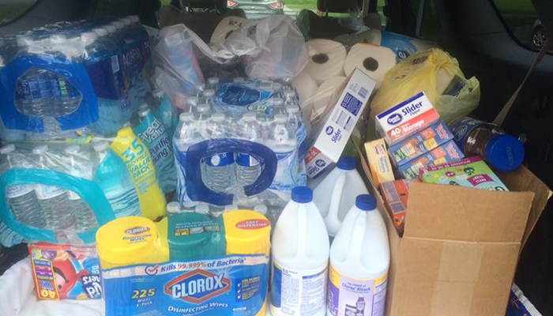
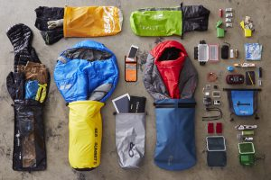
Strike Force - Subsistence
Sleeping Bags
Cots
Tables and Chairs
Water Containers
Ice Chest
Dry Storage chest
Tarpaulins
Towel and wash cloth sets
Garbage can and bags
Paper goods
Eating utensils
Cooking Equipment
Cooking kit
Cast Iron cook ware
Propane cylinders
Refrigerators
Stoves
Toilets

Slide 11
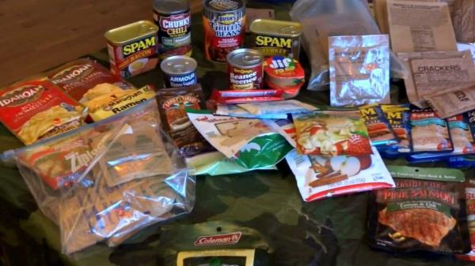
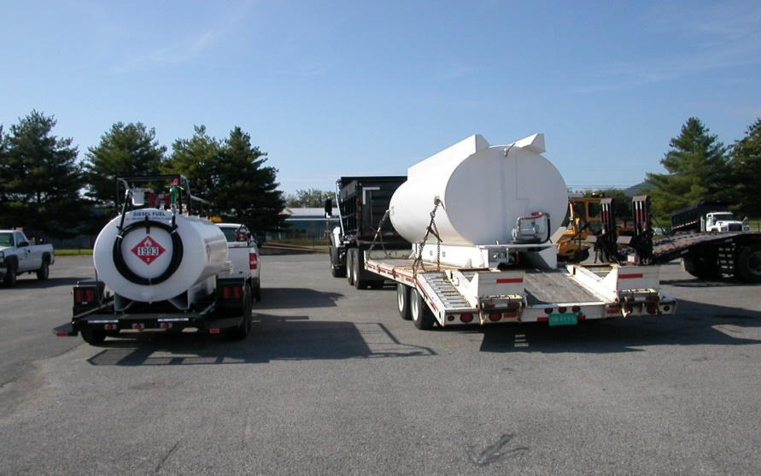
Strike Force - Fuel, Food, & Water
FUEL
Fuel will be delivered to each Region for the mobile fuel tanks by contract supplier
FOOD/WATER
Develop a shopping list for your 25 person strike team
Pre-determine where these supplies can be purchased (24 hour availability)
Food supplies should last 7 days.

Slide 12
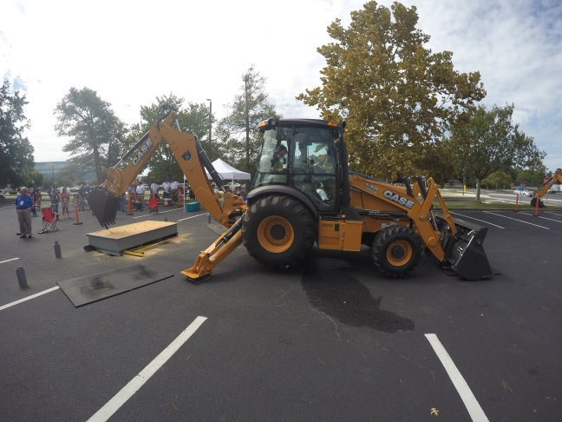
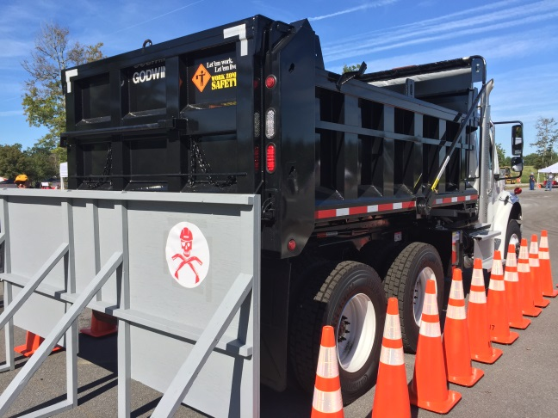
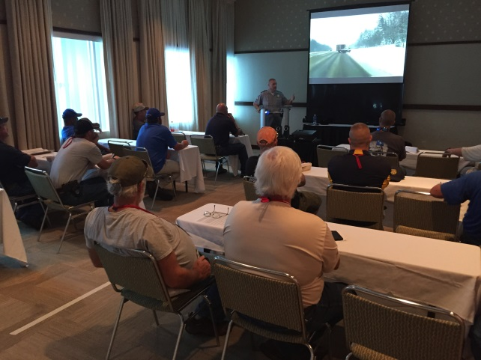
Strike Force Annual Drill
Uniform Equipment Across the State
Annual Training and Education
Annual Strike Force Drill
  Started in 2011

Slide 13
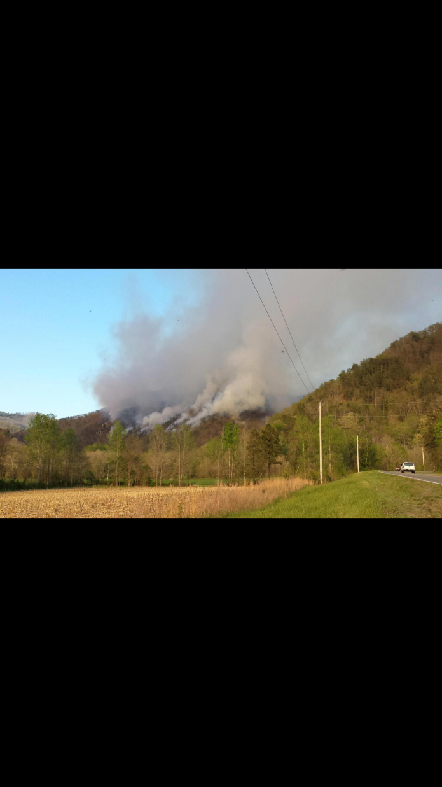
2016 Strike Force Drill

Slide 14
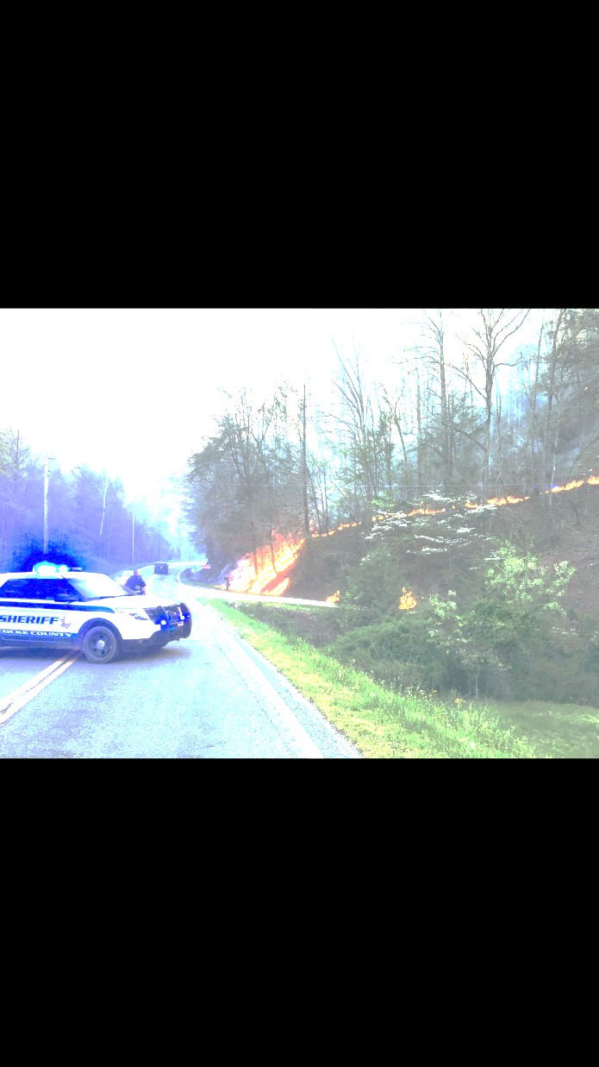
Scenario
Simulation of forest fire activity
  Greene County SR70 / Cocke County SR107 & SR9
  Remove first row of trees hanging over or that could fall on roadway and remove large brush along ditches and back slope.
All regions participating
Base Camp, I-81 Salt Bin
October 25-27, 2016

Slide 15
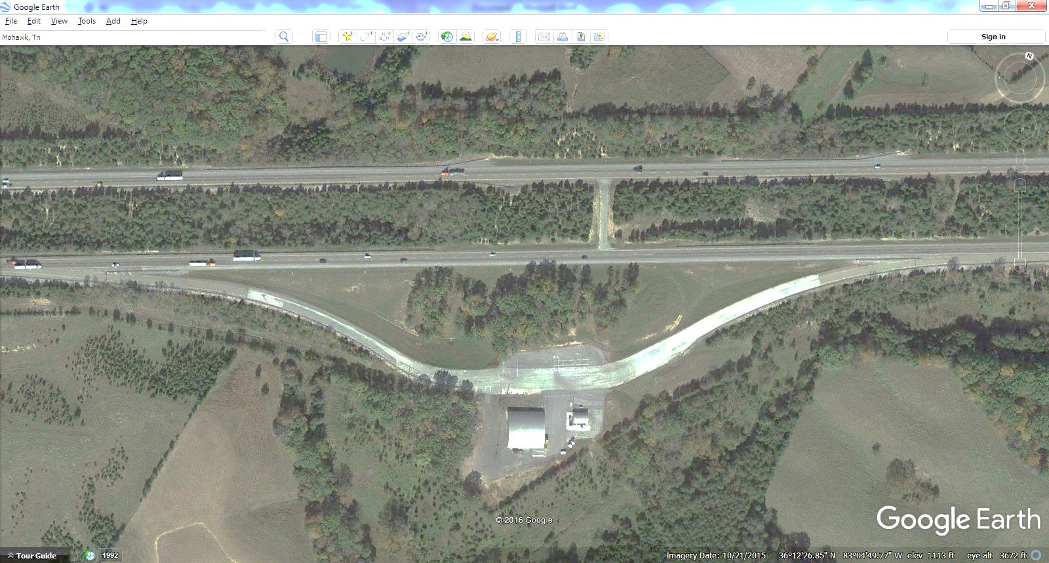
Camp
I-81 Salt Bin
Les Janow/Frank Bailey
Set up October 20-24

Slide 16
Region 1 Personnel
Incident Command
Dexter Justis
Randy Busler
Support
Ben Price
Doug Tarwater
Rodney Dooley
Willis Coffey
Medical
HELP
Work Site Crew Leaders
Roger Carter
Carl Ellison
Ray Frazier
Marcario Reyes
Traffic Control
1702
1802
Administration
James Rosen
17W/18E ASA2s
Work Crew
Dennis Peters
Eric Wolfenbarger
Tim Drummonds
Carter Moulden
CJ Maish
Brian Baker
Treve Helton
Mike Killion
Chris Schaar

Slide 17
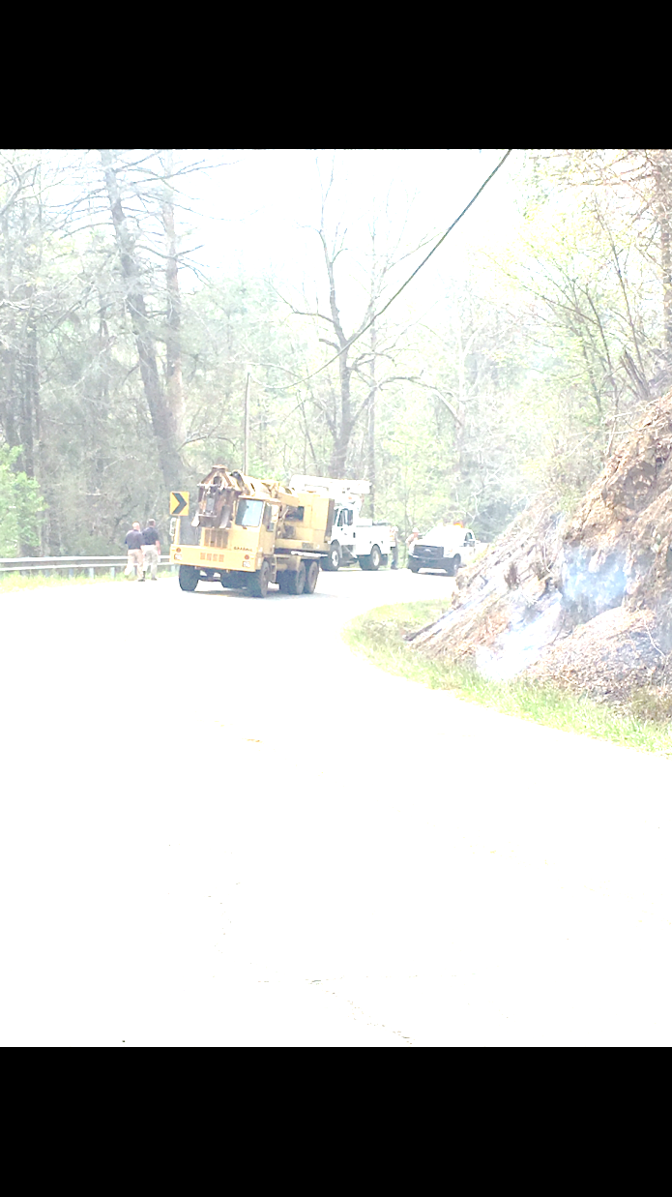
Equipment
Chainsaws – 10 available per crew
Gradall – 1 per crew
Skid Steer – brush grapple & dirt bucket
Dump Trucks – 6 per crew

Slide 18
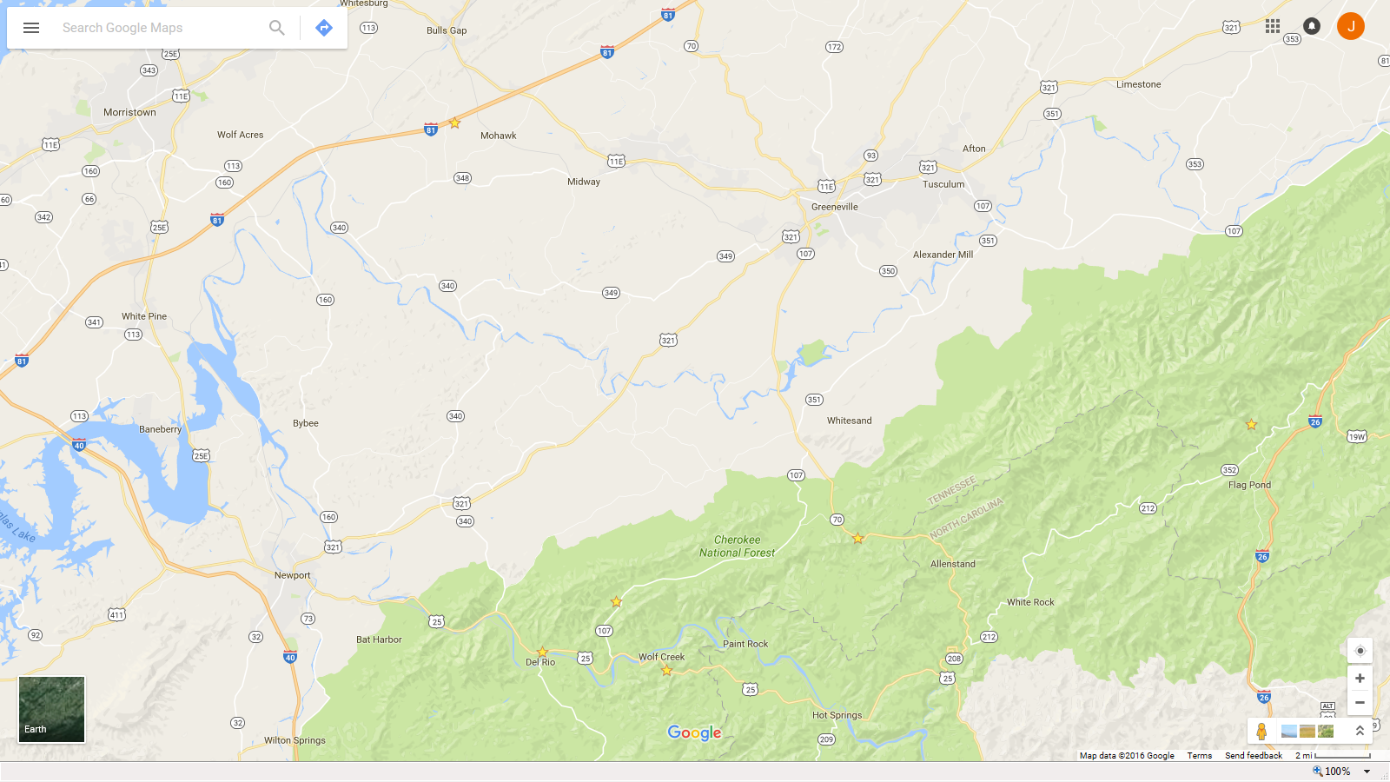
Salt Bin
Site B
Site A
Site D
Site C

Slide 19
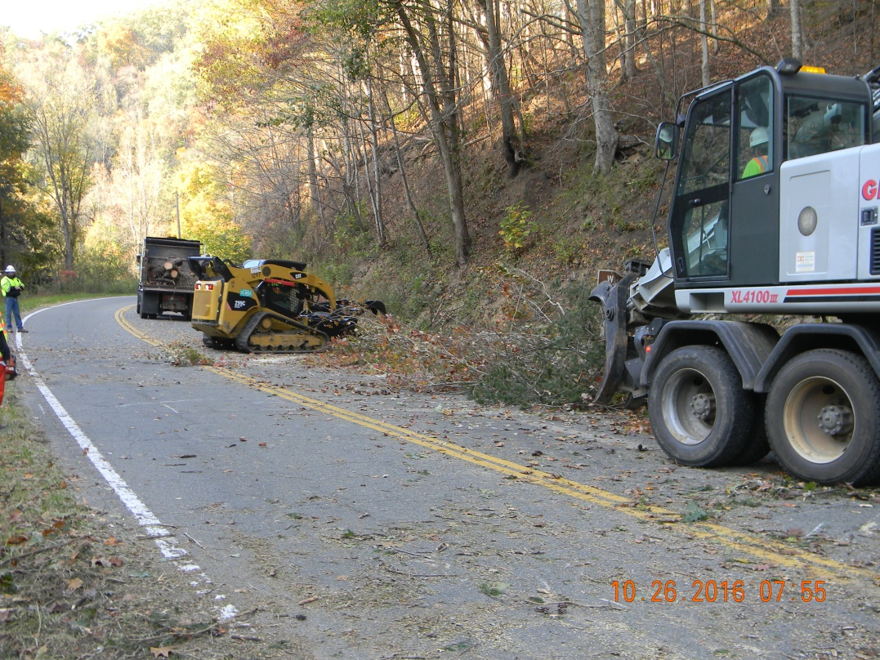
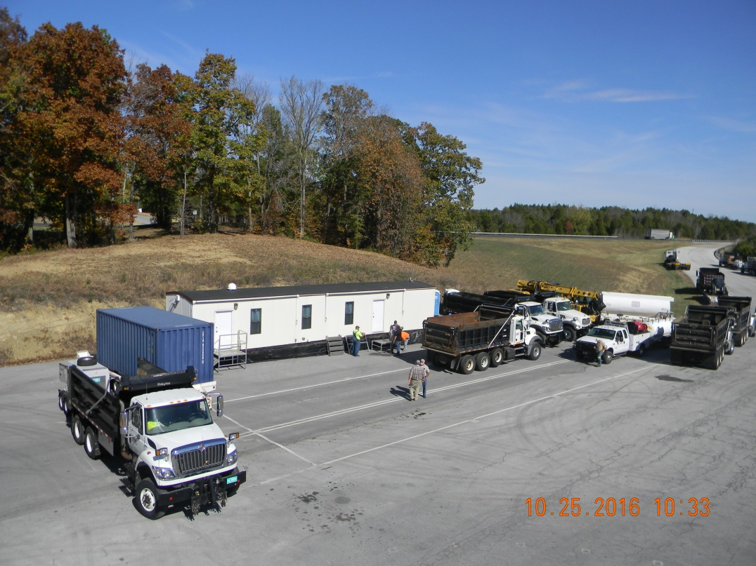
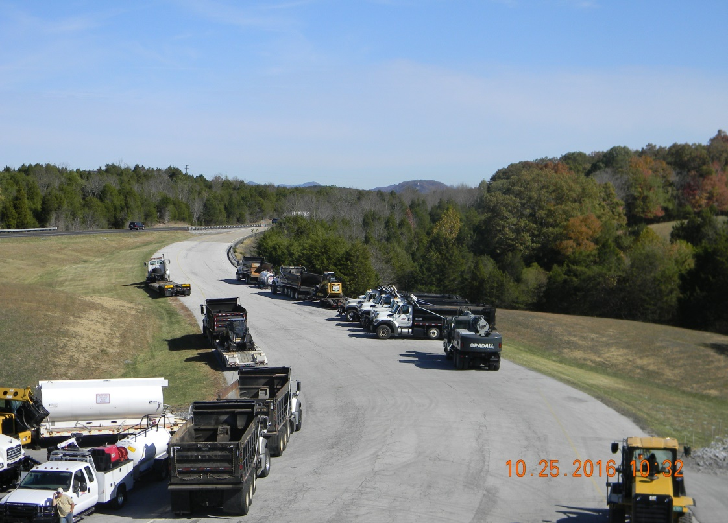
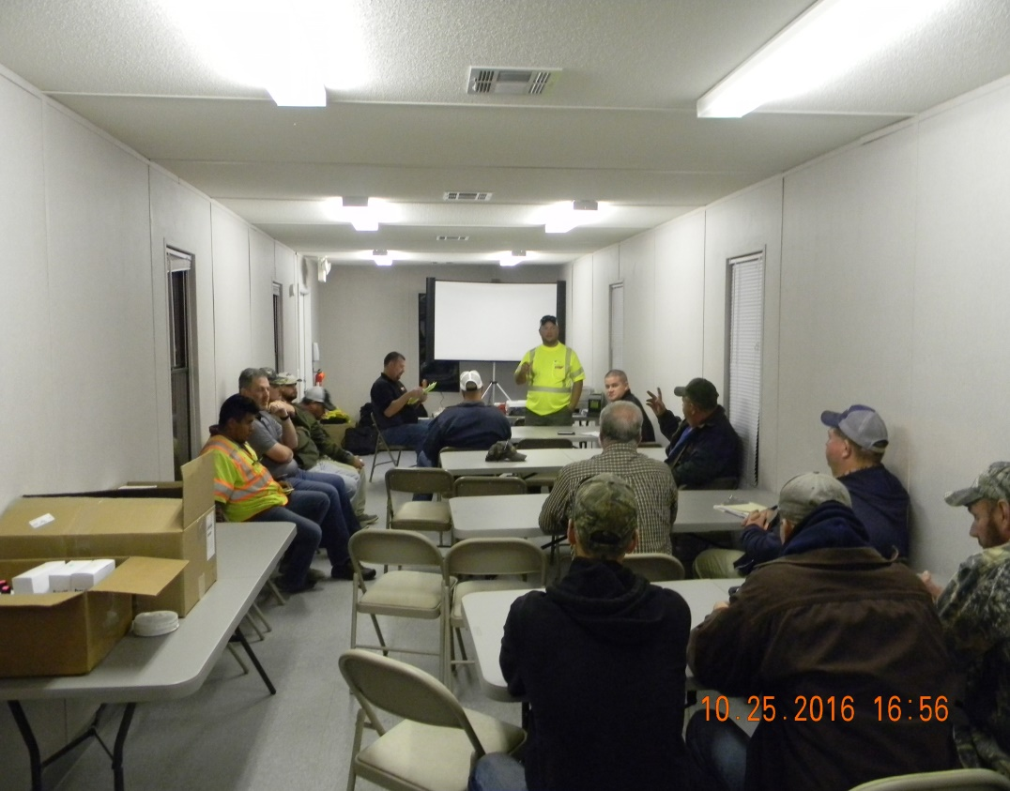
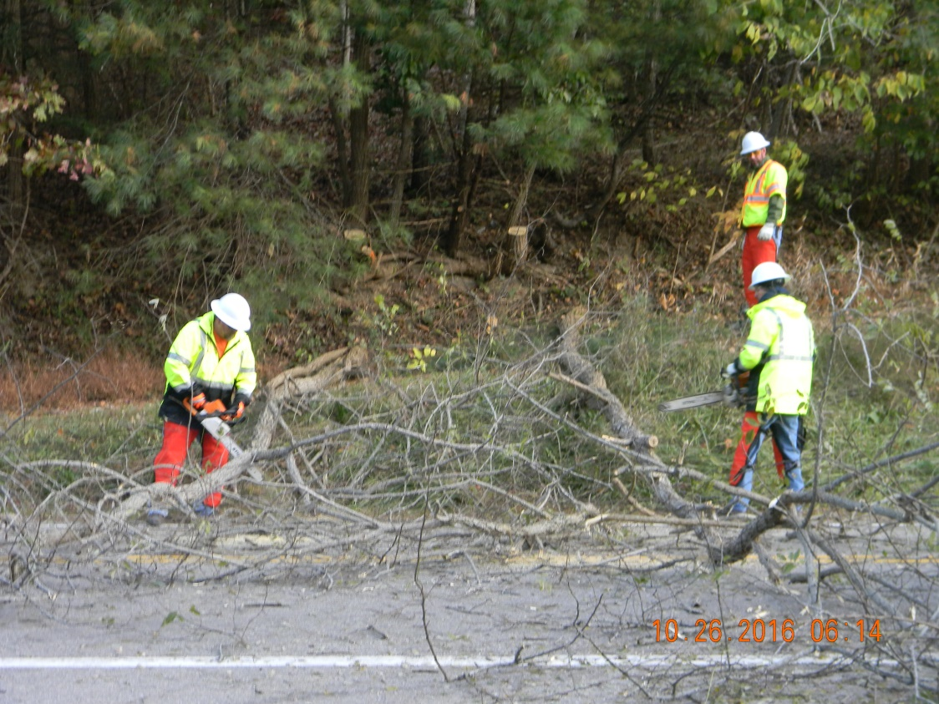
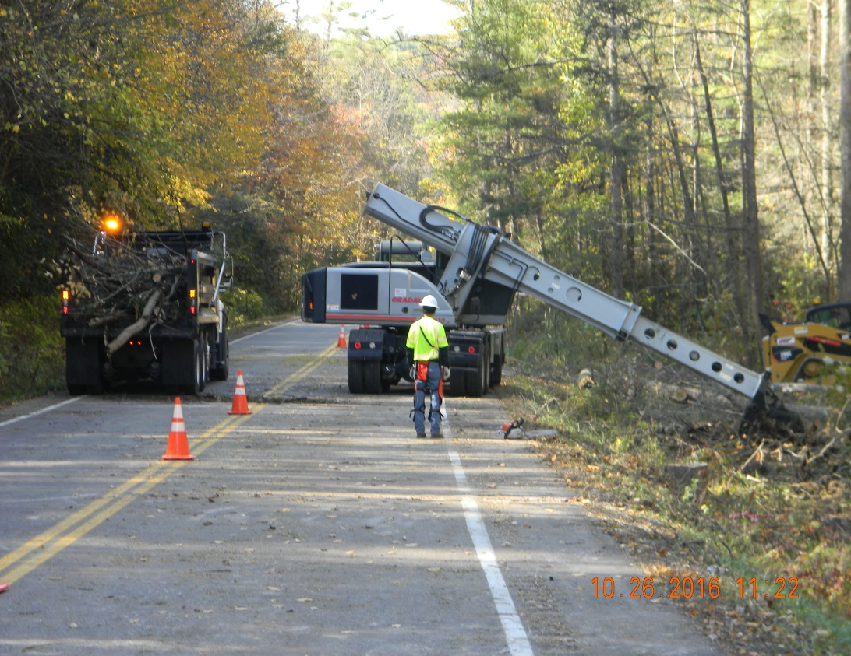

Slide 20

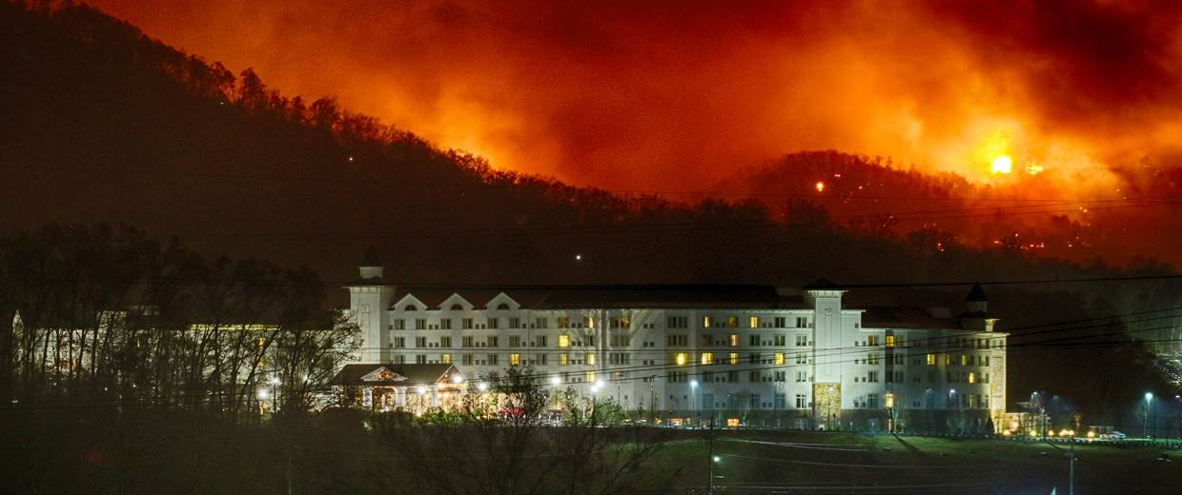
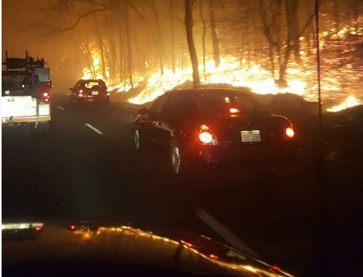
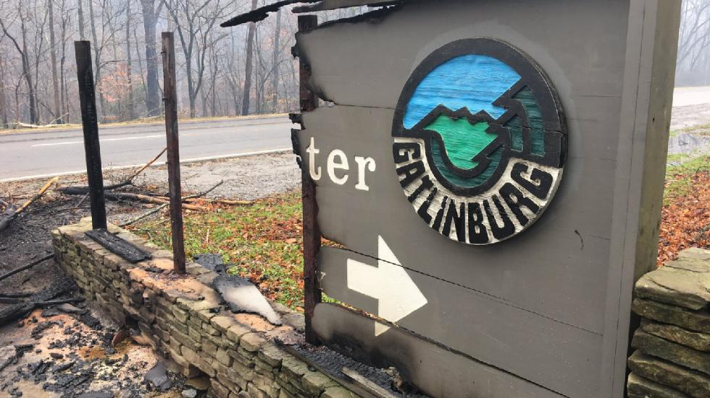
Gatlinburg Wildfire:
TDOT Strike Force Response

Slide 21
Incident Overview
TDOT Response/Assistance:
11/12/16 – 11/21/16 – Crews assisting w/ Neddy Mtn. wildfire
11/28/16 – 12/2/16 – Gatlinburg fire response/assistance

Slide 22
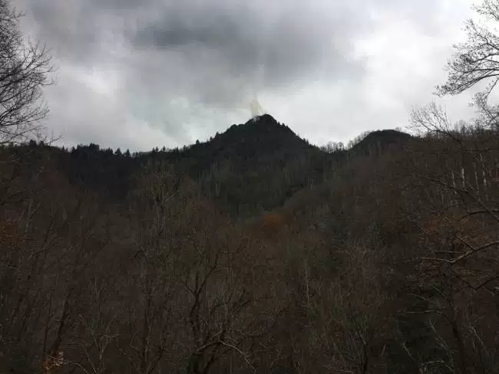
Incident Overview
On Wednesday, 11/23/16 at 5:30 p.m. Great Smoky Mountain National Park officials observe a smoke column at the top of Chimney Tops located about 5.5 miles of Gatlinburg about 1.5 acres.
TDOT Response
Crews | None
Equipment | None

Slide 23
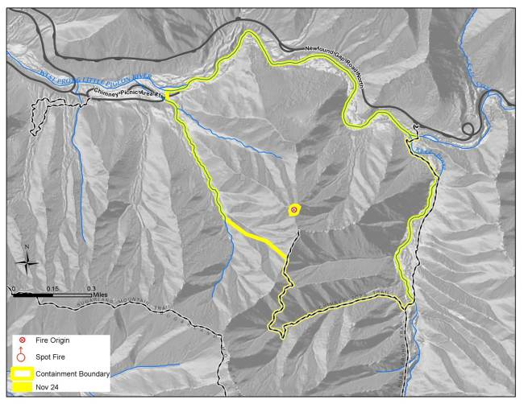
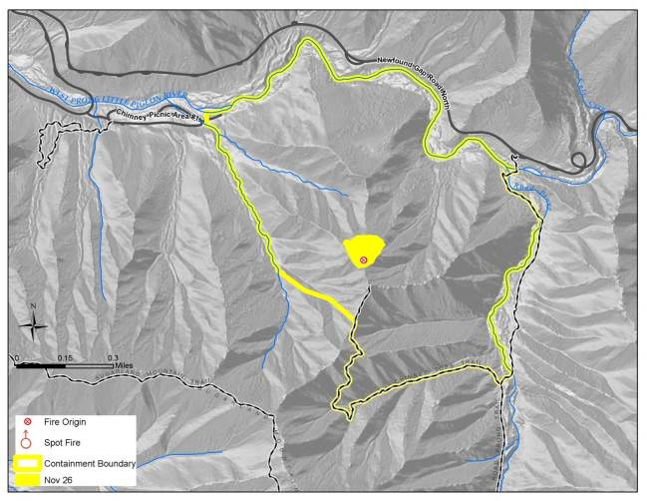
Incident Overview
Thursday 11/24 – Park Firefighters set up
containment area of 410 acres.
Saturday 11/26 – Fire has grown to 6 acres
TDOT Response
Crews | None
Equipment | None

Slide 24
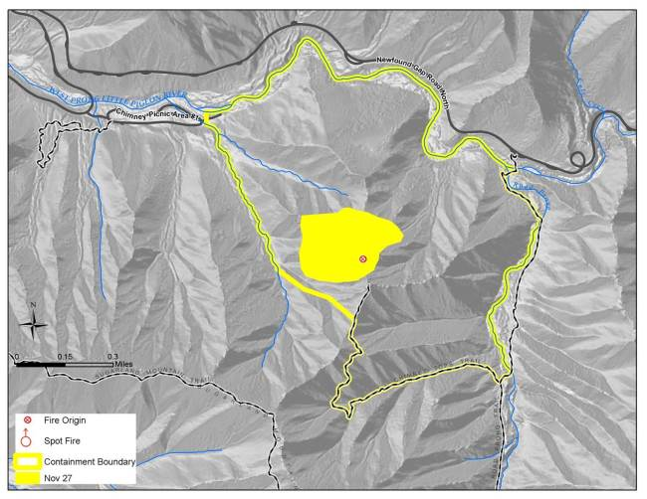
Incident Overview
Sunday 11/27 – 35 acres burning.
-Winds pick up & humidity drops.
-Morning -12 mph winds w/25mph gusts.
-Evening predictions- 40 mph gusts
-Park Service orders 3 helicopters for water
dumps
TDOT Response
Crews | None
Equipment | None

Slide 25
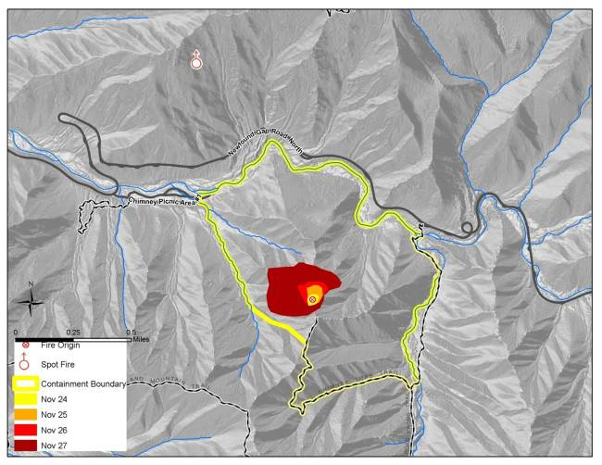
Incident Overview
Monday 11/28 – Weather changes
-Strong winds push fire NE
-Burning embers creating spot fires up
to 1 mile away
-Park officials order additional
firefighting crews & resources
Fire is 4.5 miles away from Gatlinburg
TDOT Response
Crews | None
Equipment | None

Slide 26
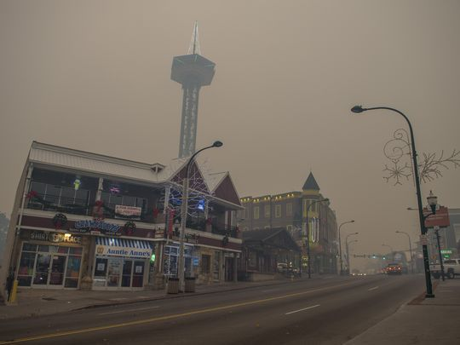
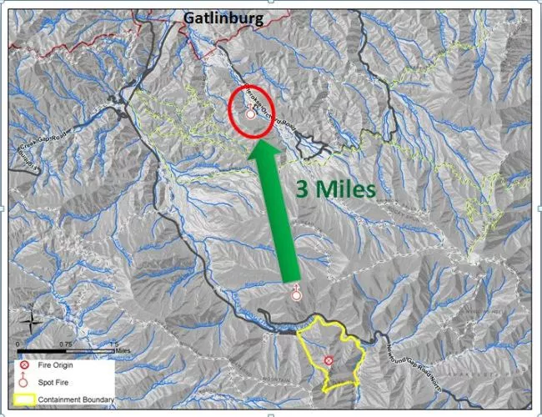
Incident Overview
Monday 11/28 – Surrounding area becoming
covered in heavy smoke.
-Park officials notify Gatlinburg FD to watch
for spot fires “though highly unlikely”
-11:35 a.m. Spot fire discovered Twin Creeks area of Park near Cherokee Orchard Rd.
TDOT was aware of visibility issues in Gatlinburg and Cosby.
Fire had spread 3 miles in 4 ½ hours
TDOT Response
Crews | None
Equipment | None

Slide 27
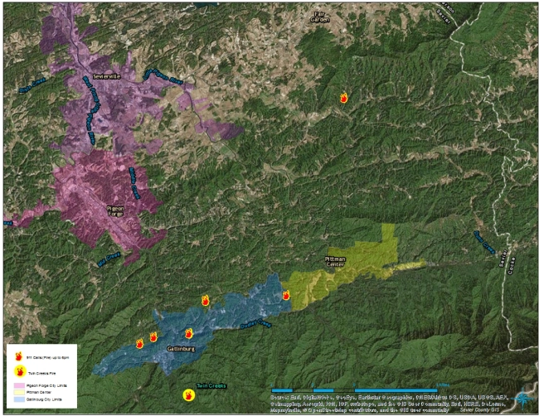
Incident Overview
Monday 11/28 – Gatlinburg FD begins positioning trucks at Park boundary & begin building fire lines w/dozers.
-Started going door to door w/ voluntary evacuations.
-Begins calls for mutual aid.
-200+ FF from multiple agencies respond.
5:45pm -6pm: -Multiple fires in Gatlinburg begin to ignite from wind blown embers.
(87 mph wind gust recorded at Cove Mtn. nearby)
-Sevier Co. Supervisor Brad Oakley put TDOT crews on standby.
TDOT Response
Crews | Sevier Co. on Standby
Equipment | County Fleet on Standby

Slide 28
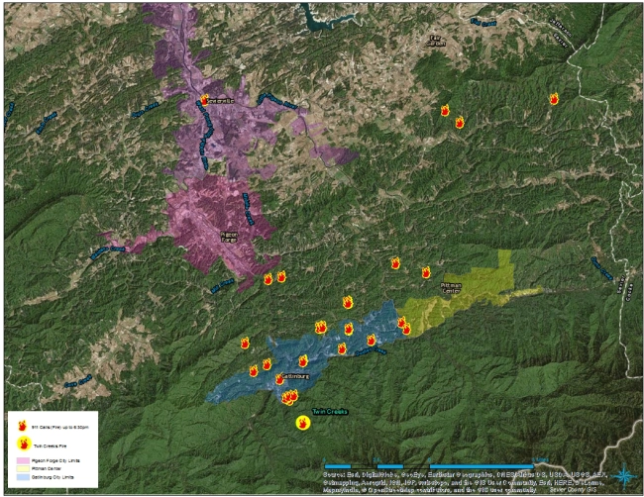
Incident Overview
Monday 11/28 – Fires reported at 6:30 p.m.
- Mandatory evacuations begin in Mynatt Park area & Turkey Nest area.
TDOT Response
Crews | Sevier Co. Crews in Route
Equipment | County Fleet in Route

Slide 29
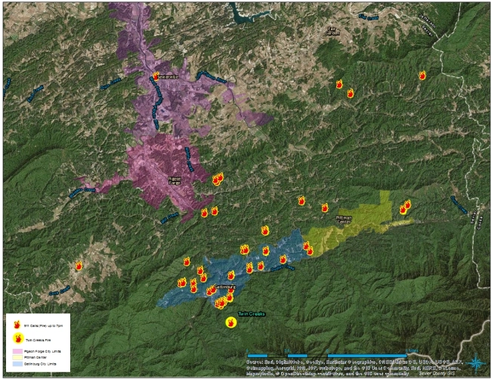
Incident Overview
Monday 11/28 – Fires reported by 7 p.m. - Mandatory evacuation of threatened areas
TDOT Response
Crews | Sevier Co. Crews on Scene - 12
Equipment | County Fleet on Scene – 7 Dump Trucks, 1 Gradall

Slide 30

Incident Overview
Monday 11/28 – By 8 p.m. -
8:15 p.m. – Widespread loss of power in Gatlinburg.
Fire resources depleted
Mandatory evacuation of
Gatlinburg area was ordered
8:30 p.m. – TDOT joined command post for Emergency Services
TDOT Response
Crews | Sevier Co. Crews on Scene – 12 Cocke & Jefferson Co. Crews on Scene – 12 additional (24 Total)
Equipment | County Fleet on Scene – 18 Dump Trucks, 1 Gradall

Slide 31
Incident Overview
Monday 11/28 – 8:30 p.m. -SCEMA calls TEMA to send public alert message to evacuate area.
8:45 p.m. – 2 cell phone towers go down
TEMA tries to call SCEMA to approve wording of warning message but unable to get through due to towers down
Message does not go out
Message Goes out @ 9:03pm by NWS
TDOT Response
Crews | Sevier Co. Crews on Scene – 12 Cocke & Jefferson Co. Crews on Scene – 12 additional (24 Total)
Equipment | County Fleet on Scene – 18 Dump Trucks, 1 Gradall

Slide 32


Incident Overview
Monday 11/28 – Fires by 10 p.m.
-Fires burning through the Spur
-Fires in Pigeon Forge
-At this time TDOT has been fully engaged in road clearing activities on SR-73, SR-416, SR-454, and keeping SR-71 open for emergency purposes.
-TDOT had helped free trapped fire truck at Beech Branch.
TDOT Response
Crews | Sevier, Cocke, Jefferson, & Grainger Co. Crews on Scene – 29 Total
Equipment | County Fleet on Scene – 5 Pickups, 23 Dump Trucks, 1 Gradall

Slide 33
Incident Overview
Tuesday 11/29 – Midnight – 8 AM
Overnight the Following Activities were performed by TDOT crews:
-Kept Beech Branch, Wiley Oakley, Campbell Lead, Topside, Gatlinburg Bypass as well as state routes in the immediate vicinity open for emergency crews and evacuations.
-Additional Equipment
1 Gradall, 2 loaders, 2 skidsteers, 1,000 gal mobile fuel tank, 3,000 gal mobile fuel tank, 2 service trucks, 1 tire trailer
-Continued to staff the command center and provided (shuttled) fuel to fire trucks that were actively engaged in fire fighting activities.
TDOT Response
Crews | Crews from Across the Region on Scene – 53 Total
Equipment | Regional Fleet on Scene – 39 Total, 25 Chainsaws

Slide 34

Incident Overview
Tuesday 11/29 – 8 AM – 8 PM
-First priority included reopening state maintained routes, including SR-73, SR-416, SR-454.
-State maintained routes were opened by 10:30 AM
-After the above routes were cleared, efforts were focused on SR-71 (the Spur/US-441).
-The clearing efforts resulted in over 1,000 C.Y. of material or over 83 loads of material being removed from these routes.
-Established a transition plan to staff the Incident Command Center through the weekend (December 2) and maintain a work crew to assist with various duties through Friday afternoon.
TDOT Response
Crews | Crews from Across the Region on Scene – 10 average
Equipment | Regional Fleet on Scene – Various

Slide 35
Daily Cost Analysis

Slide 36
Incident Overview
TDOT Response/Assistance:
Total Cost $215,550
Combined Response/Assistance Resources-
3,066+ person-hours
pickup trucks; dump trucks; loaders; Gradalls; trackhoes; Roller; forklift; air compressor; service trucks; fuel tanks; message boards; light plants; chainsaws
Services- Traffic control; debris removal, cutting/clearing trees; Emergency vehicle maintenance; victim search/rescue teams
Cocke/Grainger/Hamblen/Jefferson/Sevier

Slide 37
Incident Overview
November 28, 2016 Gatlinburg Wildfires
14 Deaths
130+ Reported injuries
2,400+ Structures damaged or destroyed
14,000 Residents & Visitors forced to evacuate
Over $1 Billion Damages

Slide 38


Gatlinburg Strike Force Response
Here is the long form Gatlinburg Fires documentary
https://www.youtube.com/watch?v=WZr3CPCe8BI&t=71s
Here is the shortened version of the Gatlinburg Fires documentary
https://www.youtube.com/watch?v=aiN6YYFS3lM

Slide 39
Questions???
Jerry Hatcher
jerry.hatcher@tn.gov
615-741-2027
Estel Hagewood
estel.hagewood@tn.gov
615-741-2027

