Slide 1

TRACTOR RENTAL CONTRACT

Slide 2



Disney World -- 2010

Slide 3


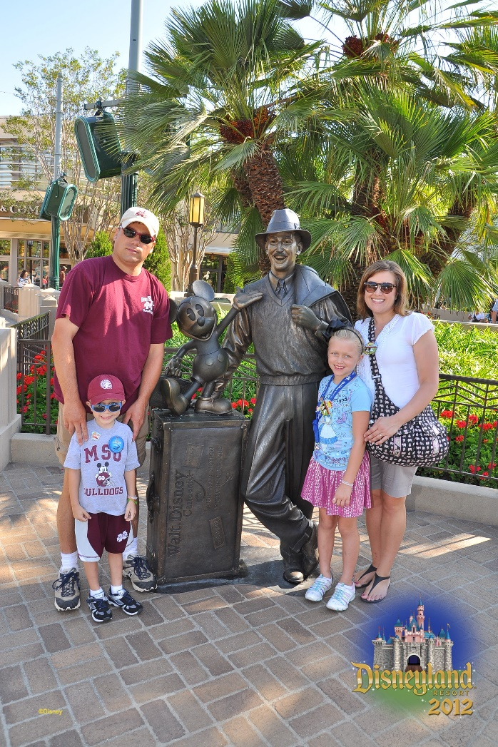
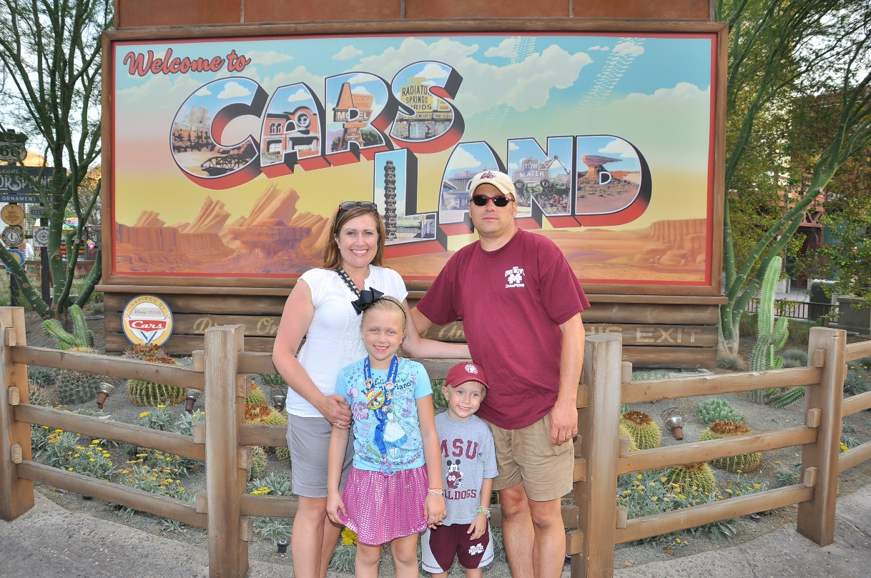
Disneyland -- 2012

Slide 4


Disney World -- 2014

Slide 5
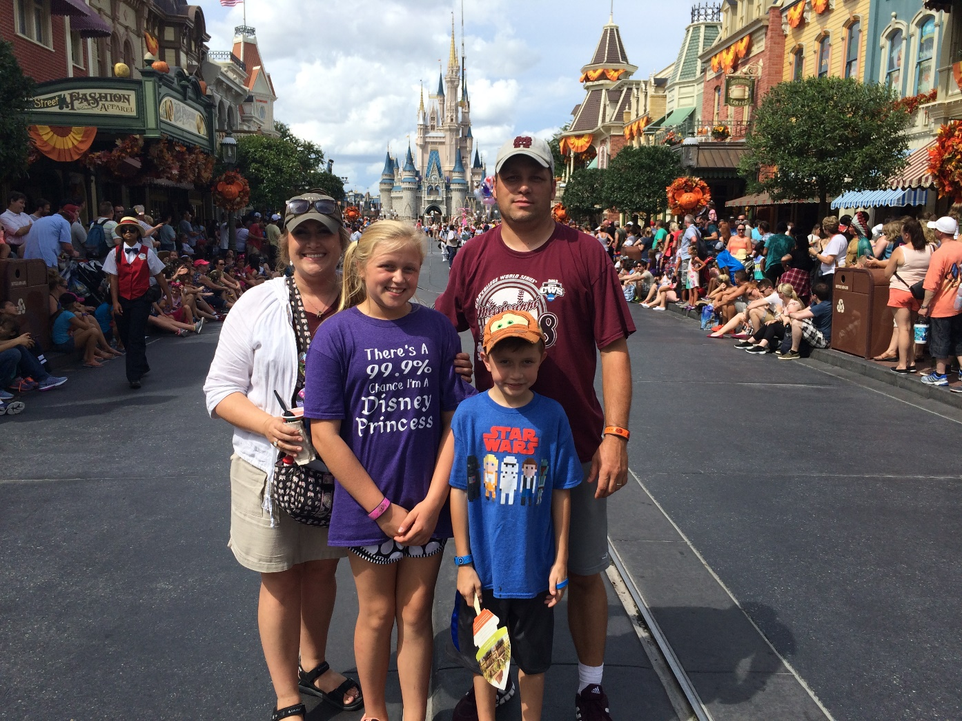
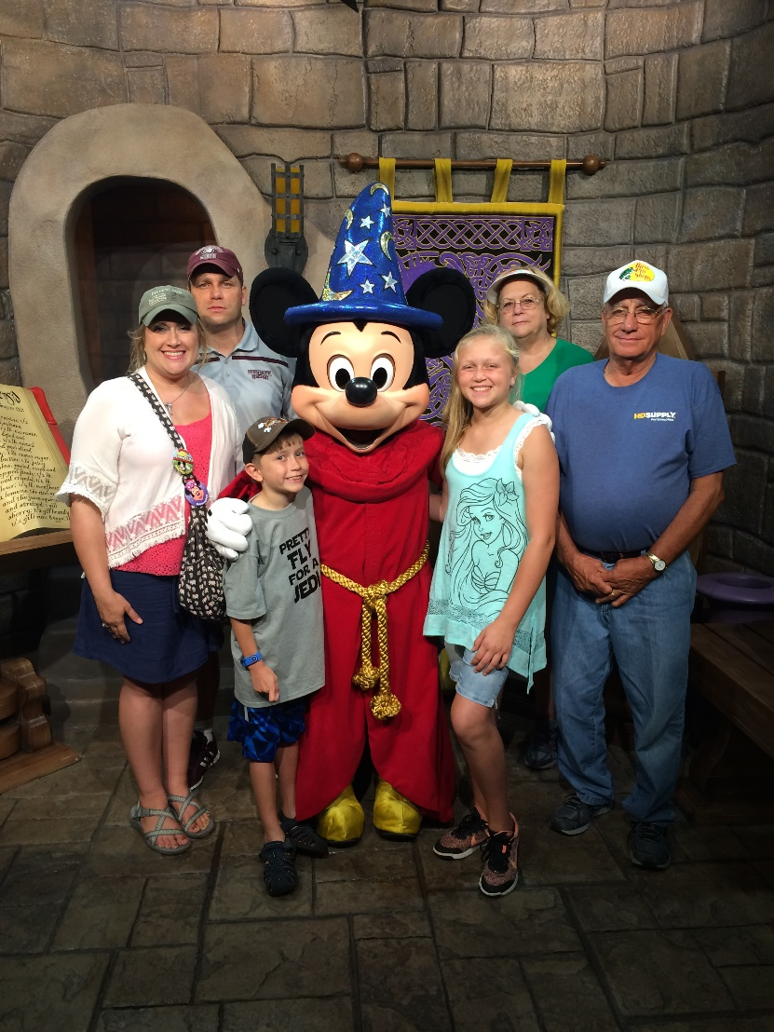
Disney World -- 2016

Slide 6

Disney World -- 2017

Slide 7

General Contract Requirements
Contractor shall provide twenty-five (25) tractors
Tractors shall be new and current model
Contract Period – Date of award until November 30, 2016
  Four (4) one-year extension periods at the option of MDOT and written acceptance by the contractor until November 30, 2020

Slide 8
Escalation Clause
Consumer Price Index (CPI): Contract prices for equipment and/or service will remain firm through November 30, 2016
If necessary, contractors must request price adjustments, in writing, 30 days prior to the extension date.
Price adjustments will be made in accordance with the percentage change in the U.S. Department of Labor CPI for Jackson, MS area.
The rate will be determined by the percentage difference between the six month average CPI for the base year (January through June 2015) and each six month average thereafter.

Slide 9
Rental Period
8 month rental period beginning April 15th and ending December 15th of each year.
Units will be delivered by the vendor to the department on or before April 15th, but not before April 1st of each year.
    If not delivered by April 15th, a penalty of $100 for every day the tractors is past due will be charged to the vendor
Units will be picked up by the vendor on or after December 15th , and before December 31st of each year.

Slide 10
Equipment Usage
All units delivered must be completely covered by the manufacturer’s warranty for the entire length of the rental period, including parts, labor, and transportation.
Equipment must be new current models with less than two hundred (200) hours when the department receives the unit.
The department guarantees a use of 350 hours with a maximum use not to exceed 400 hours for an eight-month period. Usage beyond this amount will be paid at 1.5 times the 8 month hourly rate at the end of the rent period.

Slide 11
Equipment Damage
MDOT will be responsible for abuse or damage to the unit beyond normal expected wear for highway mowing operations.
Repairs for abuse or damage shall be made by MDOT or its designee or the vendor and will be mutually agreed upon by MDOT and the vendor.
MDOT will be responsible for this expense, but will be the determining factor whether or not the damage exceeds normal wear and tear.
The vendor will be responsible for any tire failure due to mechanical or manufacturer defect. The department shall replace any inoperable tire with the same make and model tire originally supplied with the tractor. All tires must be brands, models and sizes readily available from multiple dealers in the domestic market. The vendor may install used tires on tractor rims but must have at least 2/3 tread remaining on tires. No fluid filled tires will be accepted. MDOT will pay and perform all tire repairs during the rental period according to professional standards. Upon return, if the tires will hold air without a boot, MDOT will not pay for the replacement of the tire.

Slide 12
Tractor Maintenance
Service and Repair
All routine service will be performed on site within seven (7) business days of the department’s call. If the time frame cannot be met, arrangements must be made by the vendor to accommodate the department’s need.
The vendor shall furnish all necessary replacement parts and repair. The vendor is responsible for all warranty repairs at no cost to the department.
If equipment is not repairable on site, vendor shall make an attempt to transport equipment that day, no later than 48 hours from time of department’s call.

Slide 13
Tractor Maintenance
Downtime
If the unit is unavailable for use at any time due to OEM equipment failure, the vendor must substitute a loaned unit of mutually agreed upon type within four (4) business days of notification from the department that the tractor is inoperable.
If the unit or substitute is unavailable for more than ten (10) business days during the rent period, a penalty of $100 per calendar day will be charged to the vendor.

Slide 14
Tractor Specifications
Engine: Minimum – 105 Engine HP
Maximum – 150 Engine HP
Transmission: Either hydrostat, CVT, or min. 8 synchronized forward gears with wet clutches and power reverse. A hydraulic shuttle shift for going from forward to reverse without clutching.
PTO: Independent 540/1000 RPM

Slide 15
Tractor Specifications
Seat: Super deluxe heavy duty industrial with foam padded upholstered seat cushion and backrest. Complete vertical and horizontal adjustment with coil spring or equal type shock absorber suspension and tension adjustment. Can be either Mechanical or Air.
Brakes: Wet disk brakes with foot pedals operated individually or latched together and operated simultaneously.
Three Point Hitch: Category II hitch (minimum) with adjustable stabilizers.

Slide 16
Tractor Specifications
Cab Rollover Protective Structure and Seat belt: ROPS certified cab tractor to include; AC/Heat, front and rear windshield wipers with fluid applicator, seatbelt mounted and securely anchored to provide operator protection. Unit to have slow moving plaque mounted on rear.
Steering: Power Assist
Front Axle: Four (4) Wheel Assist shall be standard for all tractors.

Slide 17
Tractor Specifications
Rear Tires and Wheels: The rear wheels and tires are to be set as wide as possible to provide better stability.
Hydraulics: The unit shall have live hydraulics with three (3) double acting auxiliary valves, (2) with float positions and detents.
Lights: Unit shall have an SAE Class 1 amber LED beacon installed on ROPS or Cab. Beacon must be visible at 360 degrees.

Slide 18
Tractor Specifications
Front Weights: Standard front weight bracket must be installed on the front of the tractor.
Color: Manufacturers' standard color.

Slide 19
Training
The vendor/manufacturer shall provide a minimum of one (1) day of in service training at a location selected by MDOT. The training shall be provided by factory personnel. The training shall be setup as a morning and afternoon class. The classes shall be hands on maintenance and operational training on the units being covered by the contract.

Slide 20

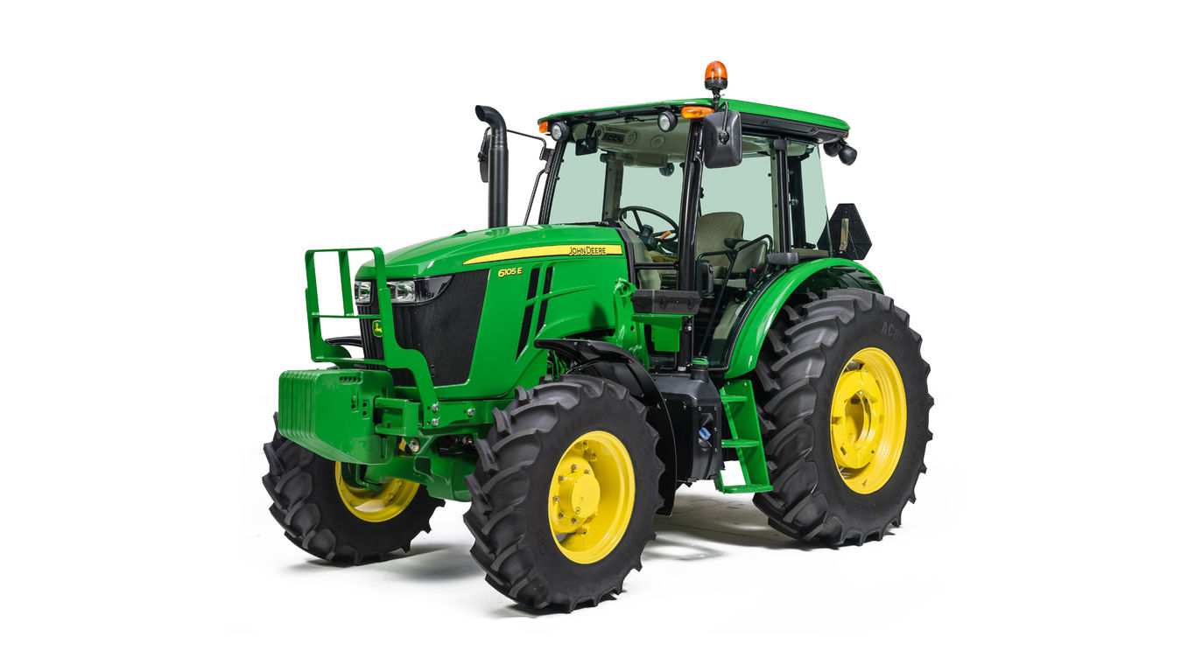
John Deere 6105E

Slide 21
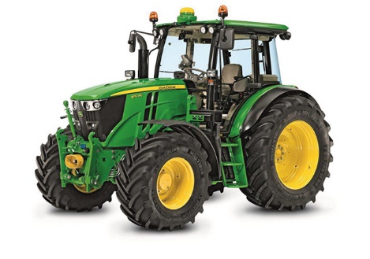
John Deere 6110M

Slide 22
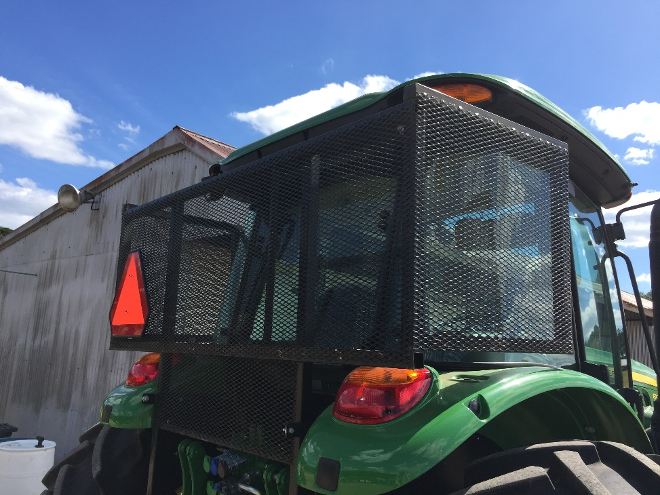
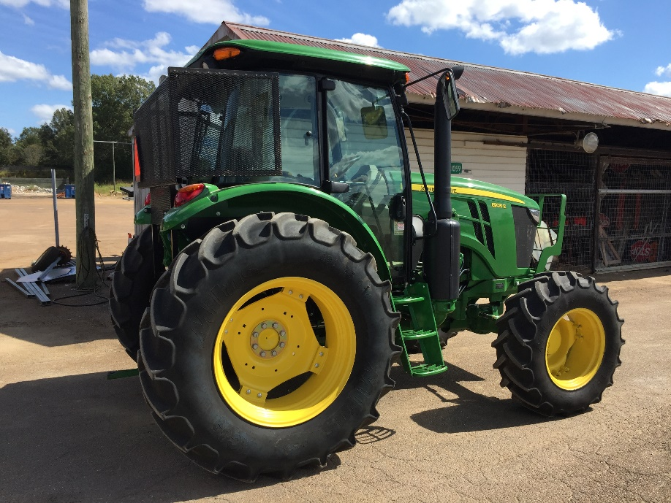
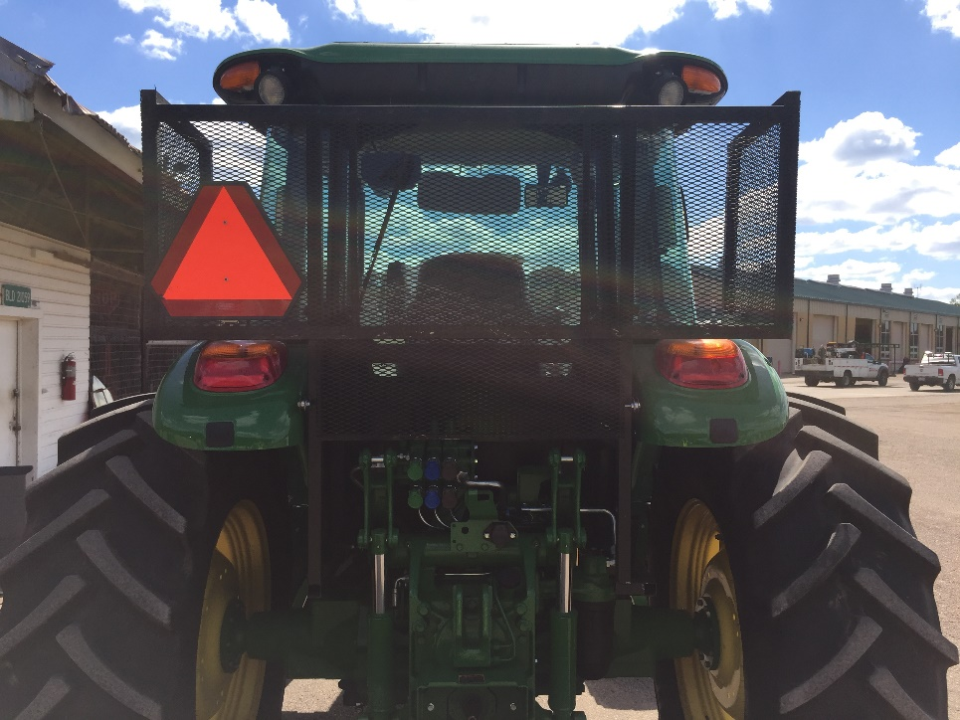
Modifications

Slide 23
Rental Cost for 2016
$18.10 per hour per unit (minimum 350 hours of use for 8 months)
$18.10 x 350 hours = $6,335.00

Slide 24
New Tractor Cost
John Deere 6105 E
$56,263.50 in April 2016

Slide 25
Initial Cost Difference
$18.10 x 350 hours = $6,335.00 per tractor for 2016
$56,253.50 / $6,335.00 = approximately 9 years
Our average life expectancy for tractors is around 10 – 12 years

Slide 26
Warranty Work Cost
This is for 7 different tractors
$5,923.56 / 7 = $846.22 per tractor

Slide 27
Warranty
Warranty on our new tractors is usually 1 year, so that would leave roughly 8 years out of warranty
$846.22 x 8 years = $6,769.76 per tractor

Slide 28
Routine Maintenance
  100 hour service @ $555.00
    Change Transmission / Hydraulic Oil Filter
    Change Engine Oil and Filter
    Change Axle and Wheel Hub Oil
250 hour service @ $110.00
  Inspect engine air intake filters
  Check oil level in axle and wheel hubs
  Inspect alternator/fan belt
  Lubricate 3-hitch
  Inspect and clean fuel tank vent
  Drain water from fuel tank
  Check neutral start system
  Check and adjust brake pedal free travel
  Inspect ROPS/Cab mounting hardware
  Clean Cab Air Filters

Slide 29
Routine Maintenance
$555.00 + $110.00 = $665.00 per tractor per year
$665.00 x 9 years = $5,985.00

Slide 30
In The End
We’re getting new tractors every year, instead of every 10 – 12 years
1. Cuts down on the maintenance, and service costs
2. Cuts down the down time for maintenance, and service
◦ New tractors every year
◦ Dealer has to provide replacement within 4 days
3. Employees’ Moral
◦ Who wouldn’t want to be on the newest & greatest rather than the old & wore out?

Slide 31
QUESTIONS?

