Slide 1

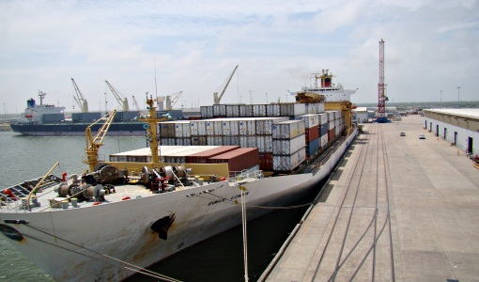

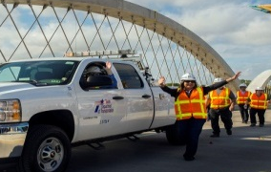


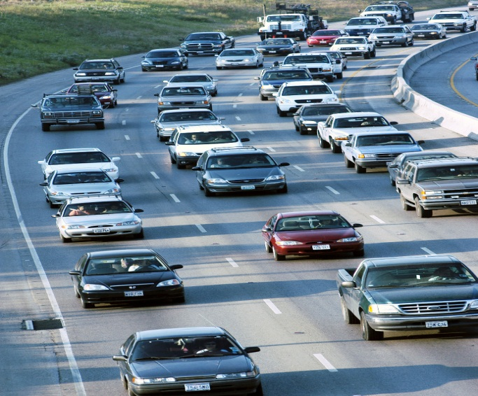
2017 SASHTO
Southeast Regional
Maintenance Conference
Orlando, Florida
10/25/2017

Slide 2
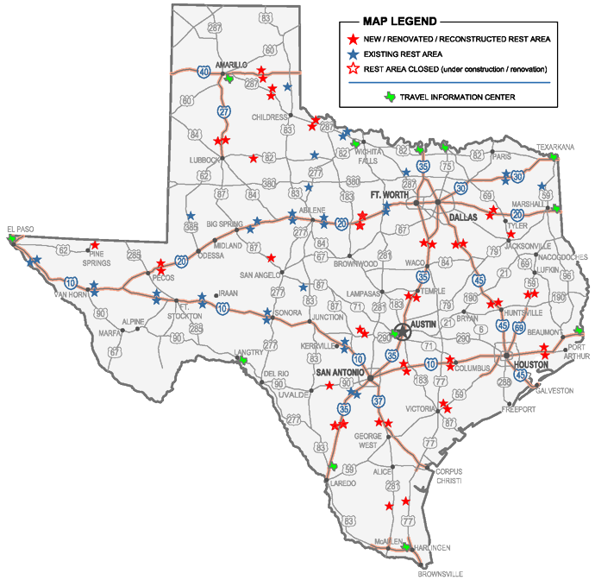
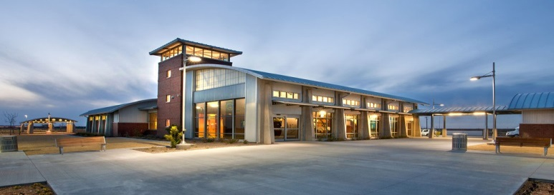
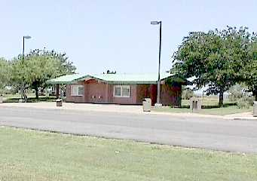
TxDOT’s Safety Rest Area System
80 Facilities
46 New Style
34 Old Style (Pre Interstate)

Slide 3
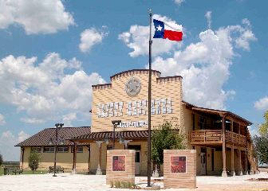
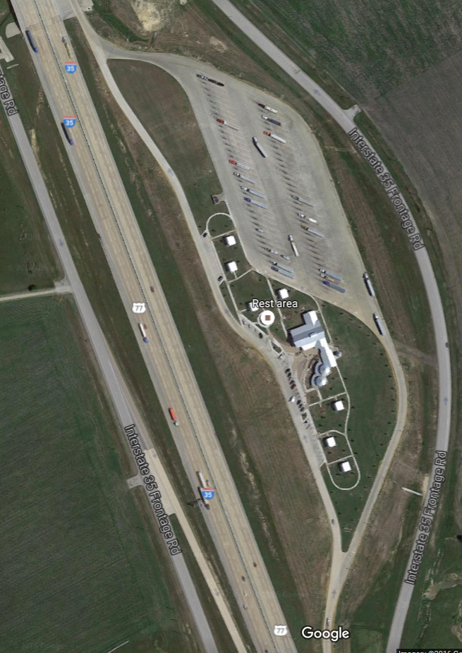
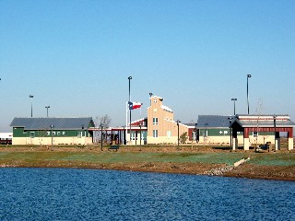
SAFETY REST AREA PROJECTS
YEAR | COUNTY | # | $
1998 | Brooks* | 1 | 132,000
2000 | Colorado* | 2 | 237,010
2001 | Gillespie | 2 | 1,169,000
2001 | Kenedy | 1 | 2,308,000
2001 | Live Oak* | 2 | 1,750,000
2002 | Hardeman | 2 | 9,269,000
2002 | Donley/Gray | 2 | 16,848,488
2002 | Victoria* | 2 | 3,229,000
2003 | Coke | 1 | 1,895,000
2003 | Donley US 287 | 2 | 10,499,000
2004 | Hale | 2 | 5,494,000
2004 | Medina US 90c | 1 | 4,890,000
2004 | Cherokee | 1 | 1,279,239
2005 | Culberson | 1 | 2,260,293
2006 | Guadalupe | 2 | 10,567,256
2007 | Walker | 2 | 17,852,000
2007 | Polk | 2 | 7,774,900
2008 | Bell | 2 | 16,408,000
2009 | Navarro | 2 | 15,501,394
2009 | Chambers | 2 | 15,500,000
2012 | Ward | 2 | 14,473,729
2013 | La Salle | 2 | 14,508,653
2013 | Hill | 2 | 15,253,154
2014 | Eastland | 2 | 16,358,387
2015 | Pecos (W) | 2 | 23,135,092
2016 | Hopkins | 2 | 23,690,540
 |  | 46 | $252,283,135
Future Projects
Minimum 5000 vehicles per day
Long distance travel corridor
Prioritize with fatigue related accident data
One hour drive spacing (or from metropolitan areas)
* Renovation

Slide 4
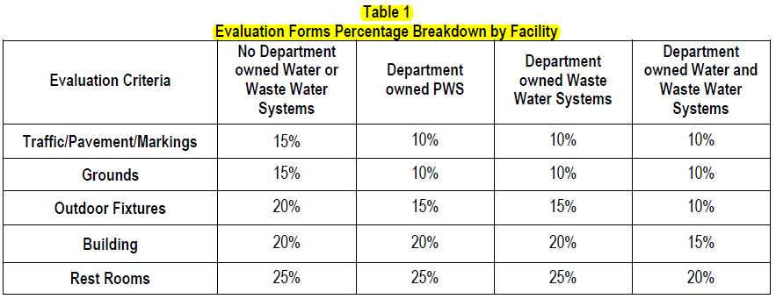
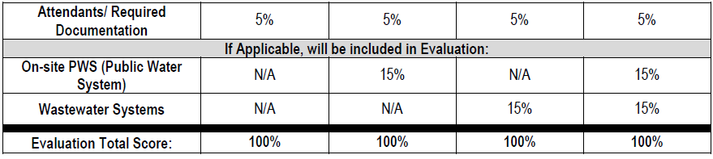
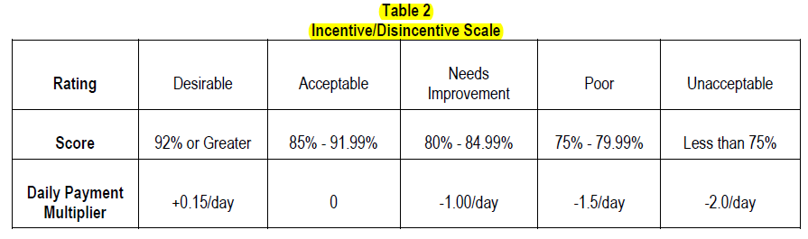
Safety Rest Area Maintenance
Performance Based Maintain, Repair & Operate Contracts
28 locations – work 12 hours per day
50 locations – work 24 hours per day
Total monthly maintenance cost is $1.2M (varies with incentive/disincentive evaluations)
~$18.5M budget for FY 18
Six Contracts
3 – contracts are through State Use (sheltered workshops)
3 – contracts are low bid

Slide 5
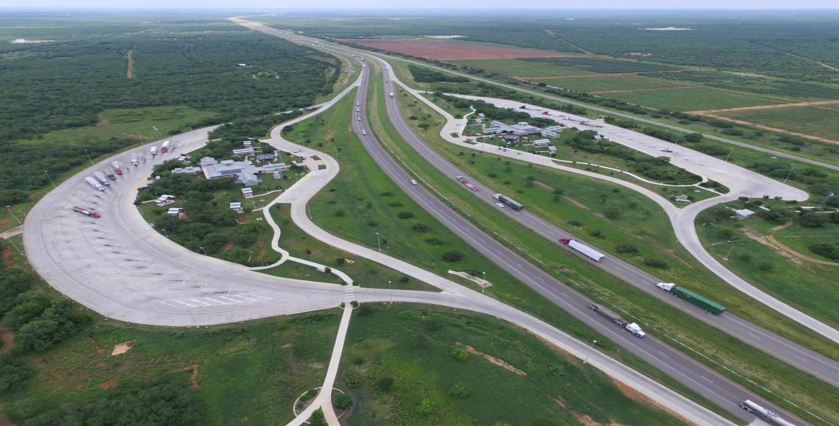
La Salle Co. SRA on IH 35

Slide 6
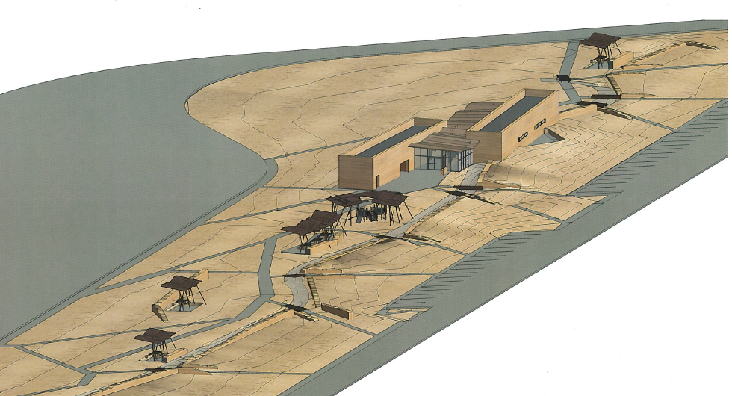
West Pecos Co. SRA on IH 10

Slide 7
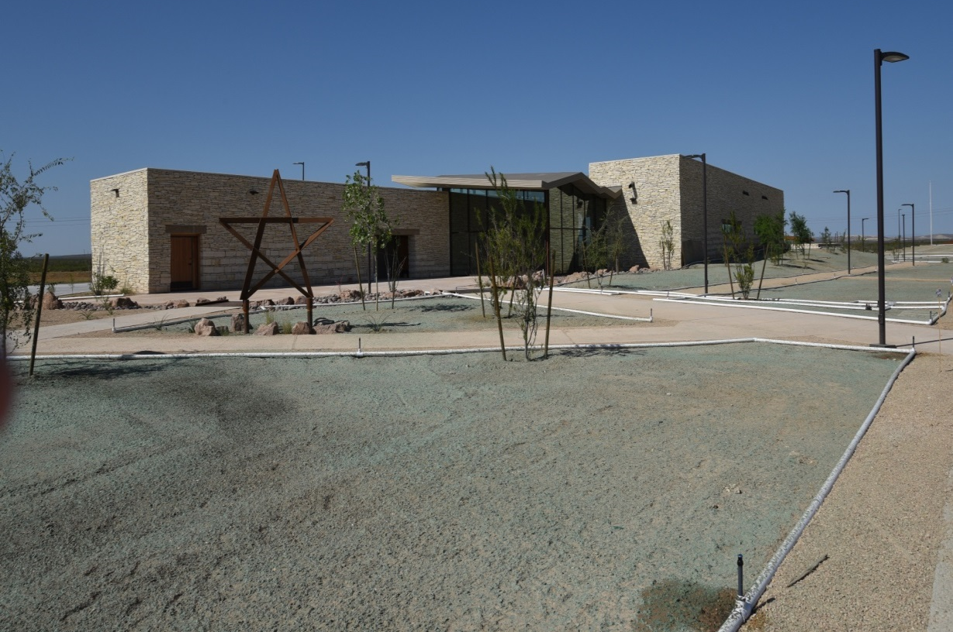
West Pecos Co. SRA on IH 10
COST of 2 FACILITIES
BUILDING- $ 7,500,000
ROADWAY- $15,635.000

Slide 8
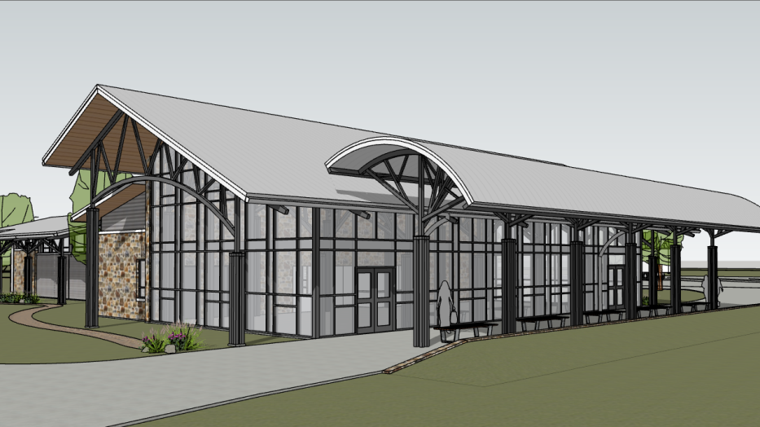
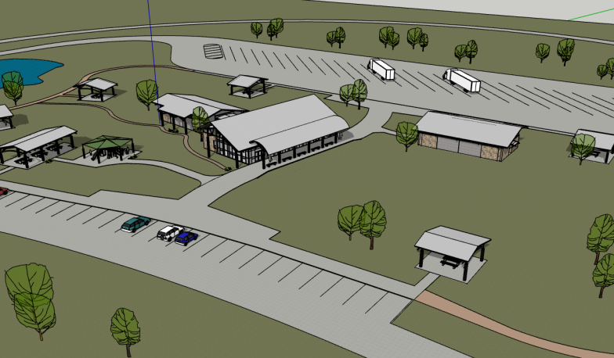
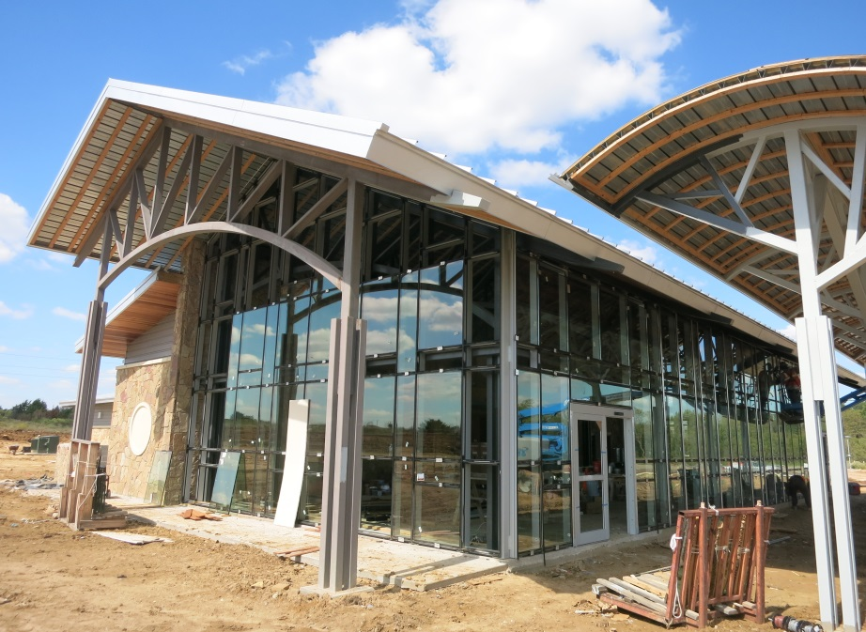
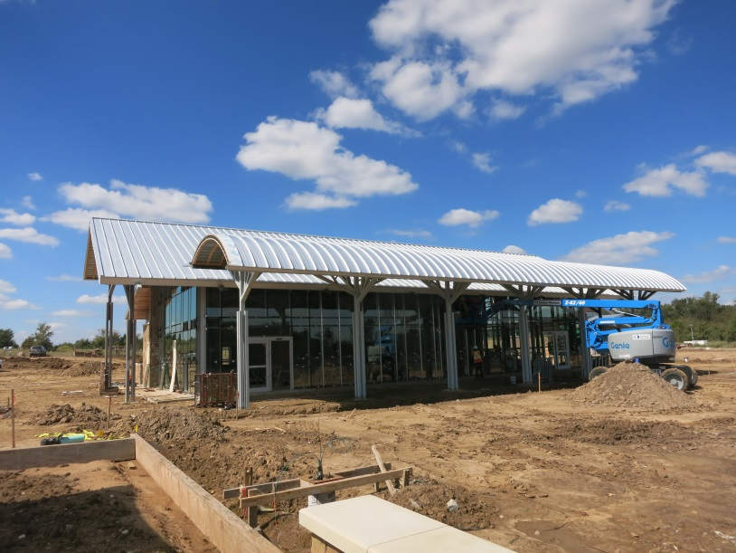
Hopkins Co. SRA on IH 30
COST of 2 FACILITIES
BUILDING- $ 10,100,000
ROADWAY- $ 13,591,000*

Slide 9
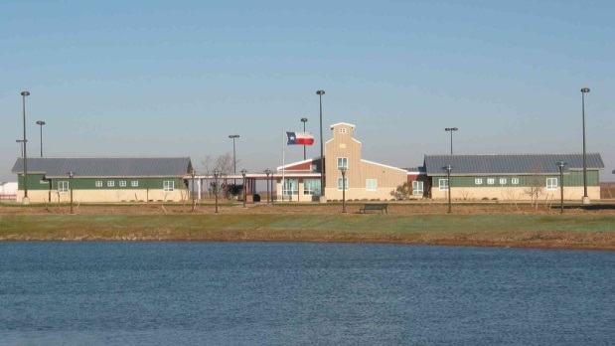
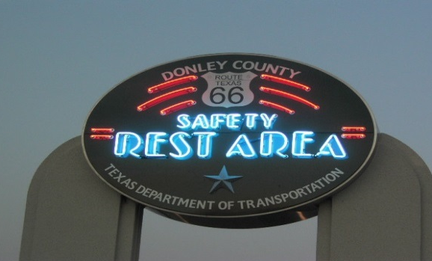
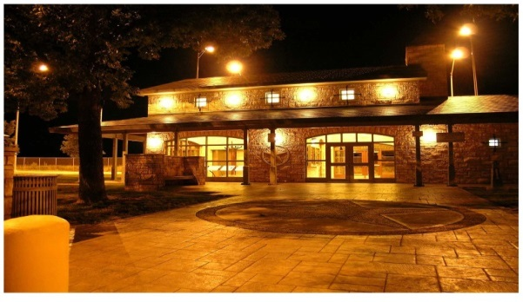
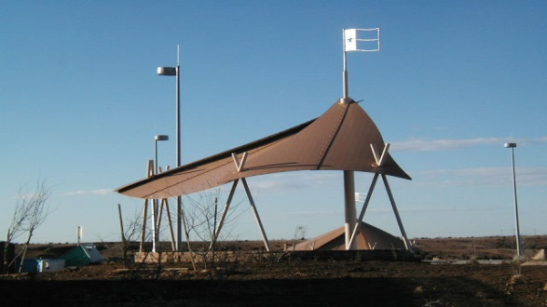
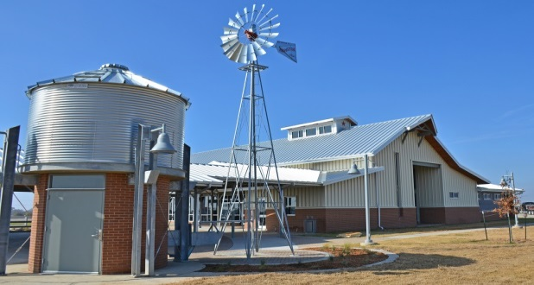
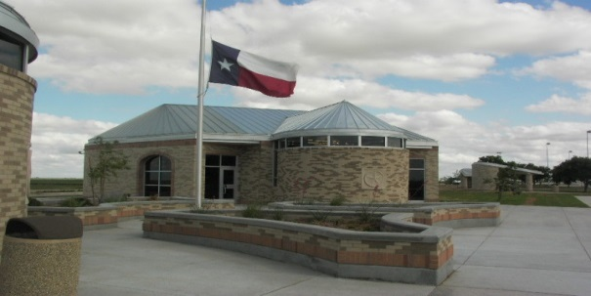
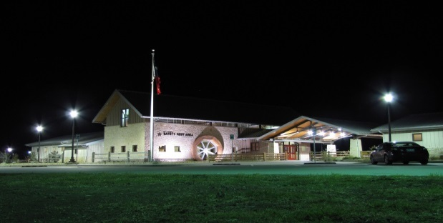
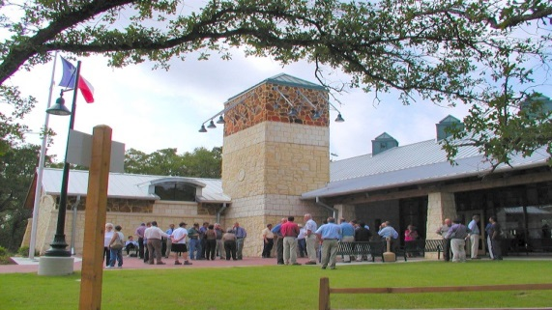

Slide 10
TxDOT
Automated
Data Collection
TxDOT Experience

Slide 11
Texas Department of Transportation
25 Districts
254 Counties
Approximately 195,700 lane miles
Approximately 63,000 NHS Lane Miles

Slide 12
TxDOT Pavement Data Collection
FY 17
  Multiple Award
    Fugro Roadware $3.2M Contract ($70 Per lane mile)
    Pathway Services $3.0M Contract ($65 Per lane mile)
FY 18
  Single Award
    Pathway Services $5.7M Contract ($59 Per lane mile)

Slide 13
What Pavement Condition Data is Collected
Ride (IRI)
Surface Distress
  ACP (Cracking, rutting, patches, failures, raveling, flushing)
  CRCP (Punchouts, spalls, patches)
  JCP (Cracking, failed joints & cracks, faulting, patching, shattered slabs)

Slide 14
How Pavement Data is Collected & Processed?
100% of Every Roadbed Annually
  ~90,000 lane miles
Automated Data Collection
Automated Post Processing of images for distresses like rutting, cracking, raveling, flushing, spalls, faulting, etc.
Semi-Automated Data Collection
  Manual Post processing of images for distresses like Patches & failures, etc.

Slide 15
Impact of Automated Data Collection
% Lane Miles Good or Better | FY 16 | FY 17 | Change
Statewide | 87.32% | 84.65% | -2.67%
More Cracking
More Rutting
  (Transitioned from 5 point acoustic sensors to full transverse profile)

Slide 16
Contact Information
Magdy Mikhail, P.E.
Maintenance Division
Director of Pavement Asset Management Section
Magdy.Mikhail@txdot.gov
Phone: (512) 416-3288

Slide 17
TxDOT Pavement Management System – Pavement Analyst
  Pavement Analyst:
    Web-accessed
    Easy Access to all Pavement Condition and Inventory Data
    Ability to query and extract all Pavement data
    Ability to Export Data to Excel, Shape file
    Work History & Surface Age (Routine MNT, PM & Rehab)
    Summary Reports
    Analytical capability
      Predict future Pavement Condition (based on available funds & planned projects)
      Evaluate Impact of Funding Levels on Pavement Performance
      Determine Funding needs to achieve a Pavement Condition Target

Slide 18
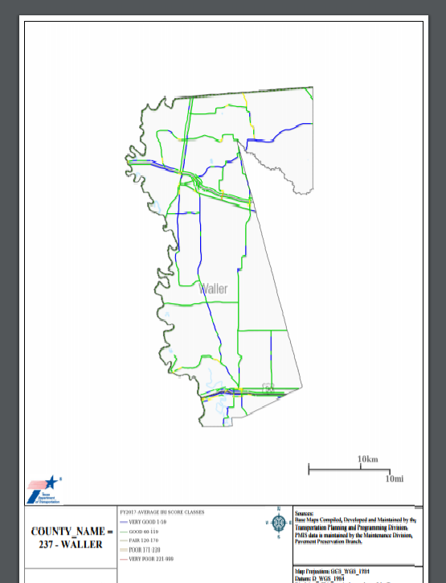
Example MAP Report

Slide 19
Pavement Performance Prediction

Slide 20
Contact Information
Magdy Mikhail, P.E.
Maintenance Division
Director of Pavement Asset Management Section
Magdy.Mikhail@txdot.gov
Phone: (512) 416-3288

Slide 21
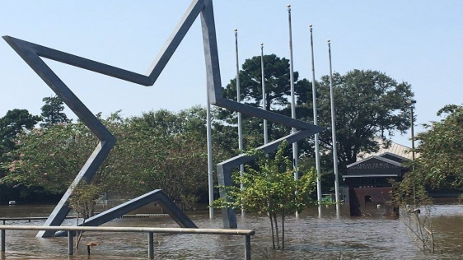
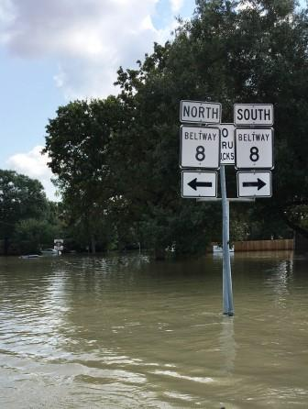
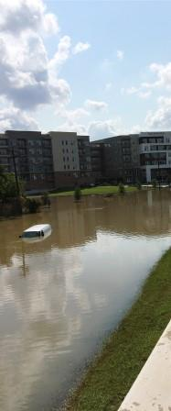
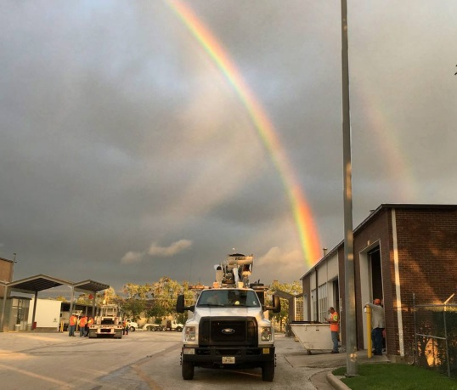
Hurricane Harvey Hits Texas
TxDOT Responds and Rebuilds
September 2017

Slide 22
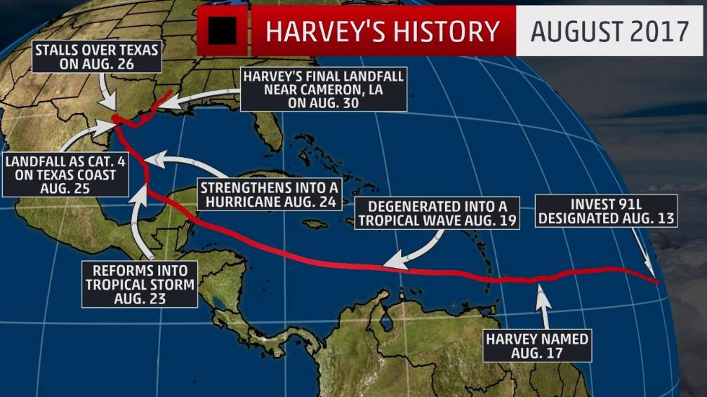
The Formation of Hurricane Harvey

Slide 23
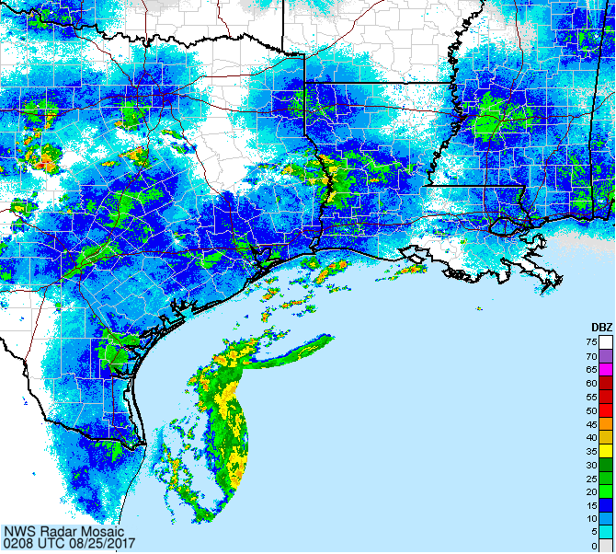
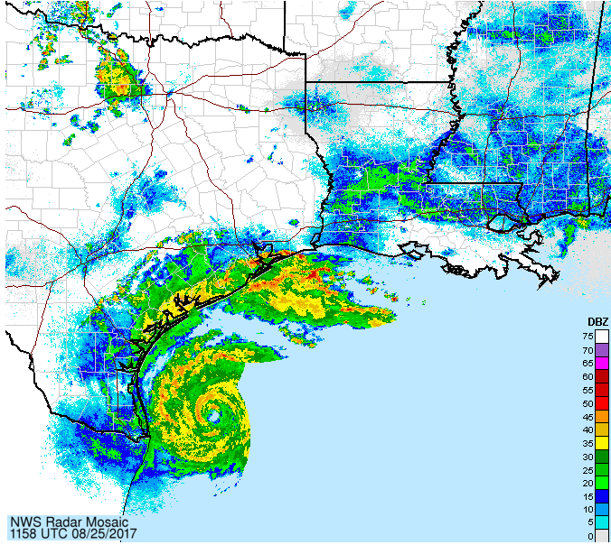
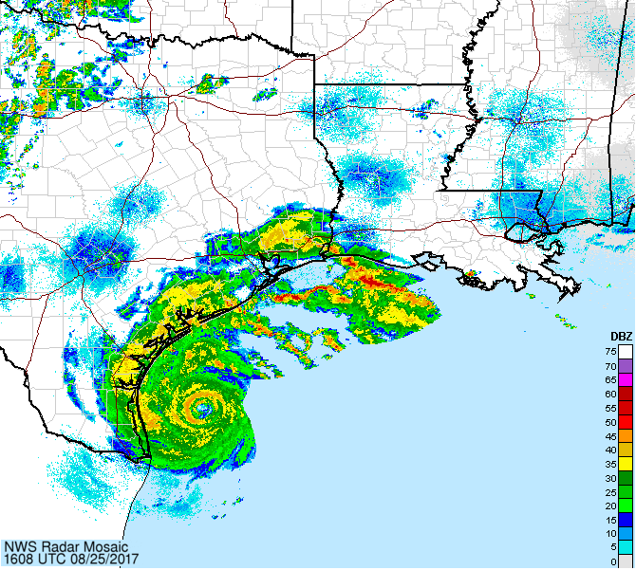
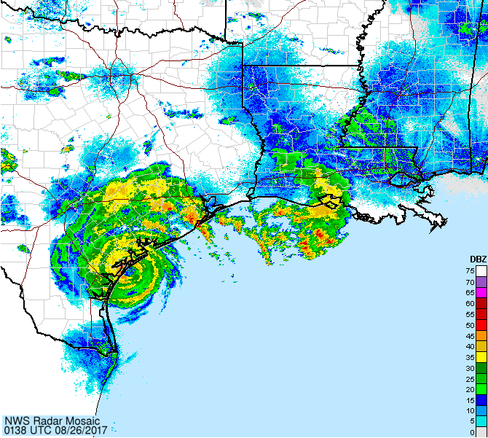
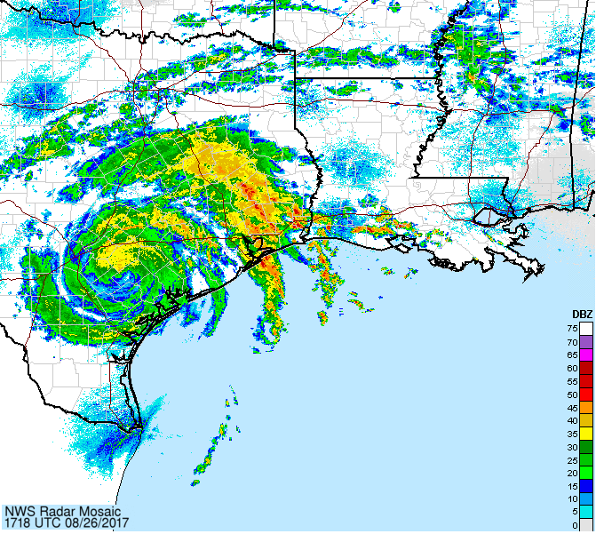
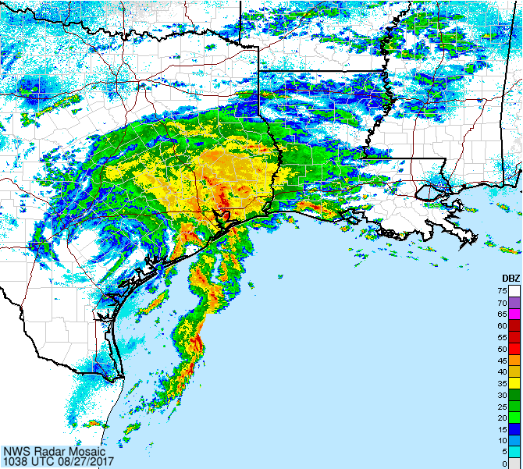
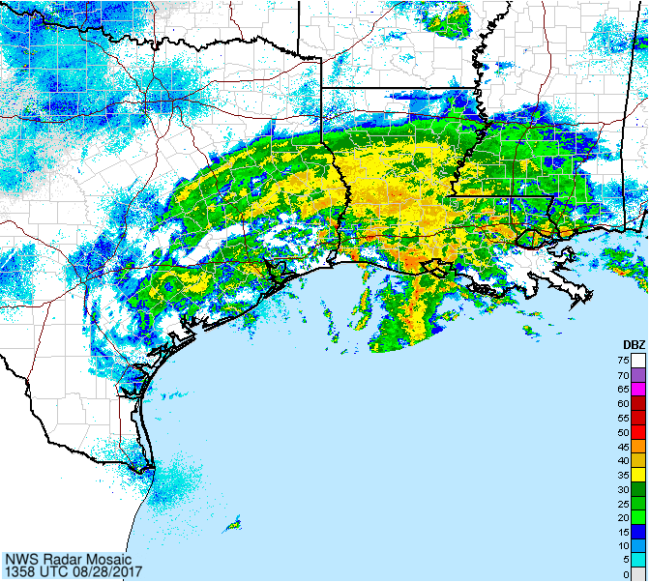
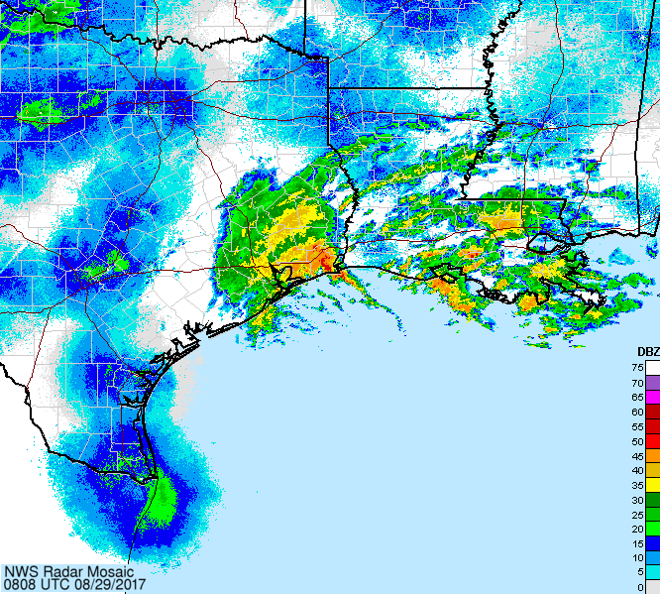
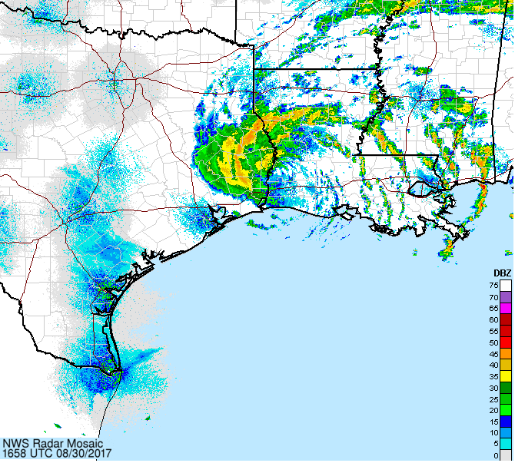
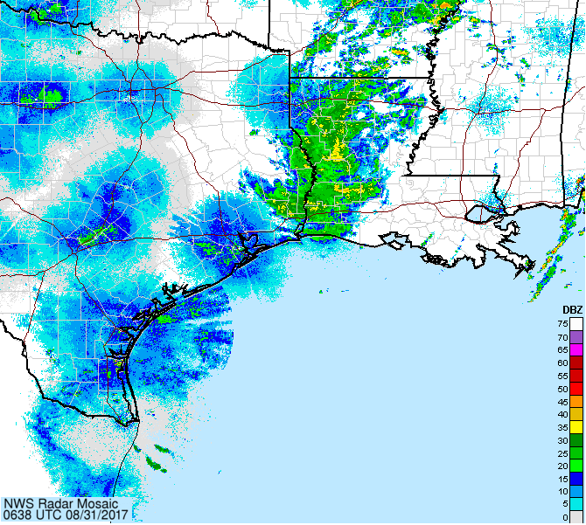
7-Day Radar Loop
8/25/2017 2:08 8/25/2017 11:58 8/25/2017 16:08 8/26/2017 1:38 8/26/2017 17:18
Hurricane Harvey approaching landfall and moving across southeast Texas, August 25 – August 31, 2017
8/27/2017 10:38 8/28/2017 13:58 8/29/2017 8:08 8/30/2017 16:58 8/31/2017 6:38

Slide 24
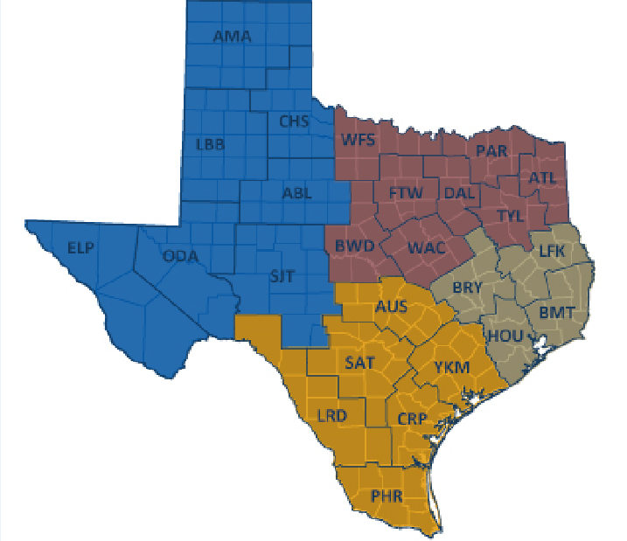
TxDOT Districts

Slide 25
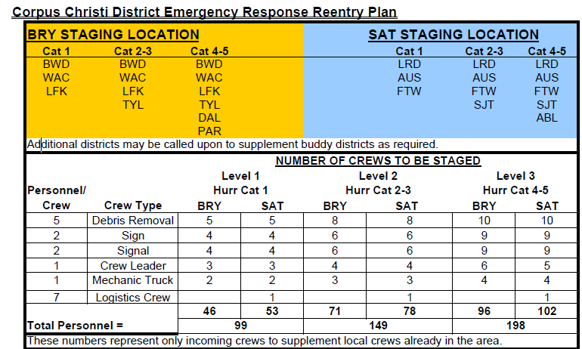
Hurricane Re-entry Plan

Slide 26
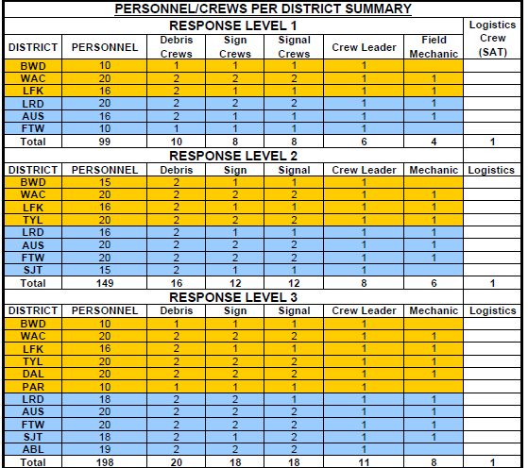
Hurricane Re-entry Plan

Slide 27
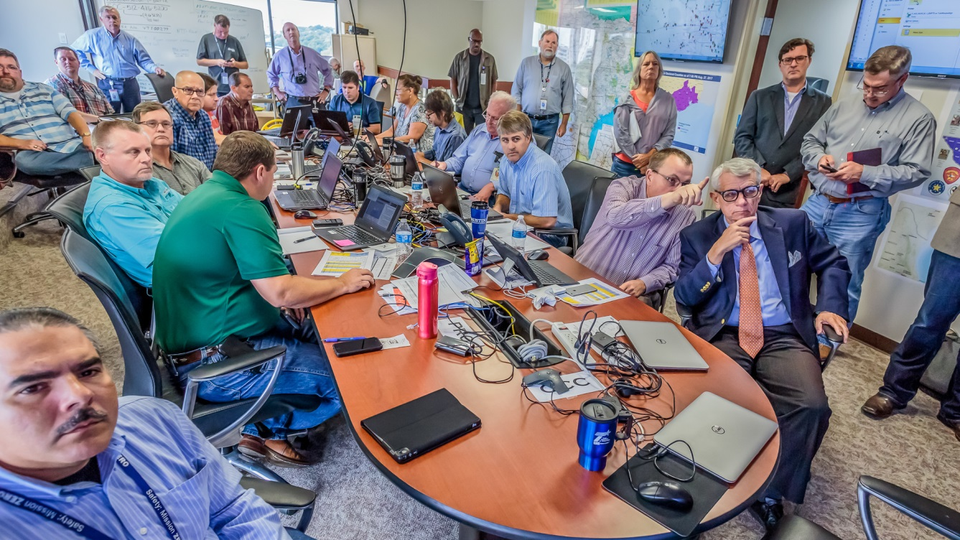
TxDOT’s Maintenance Division Emergency Operations Center

Slide 28
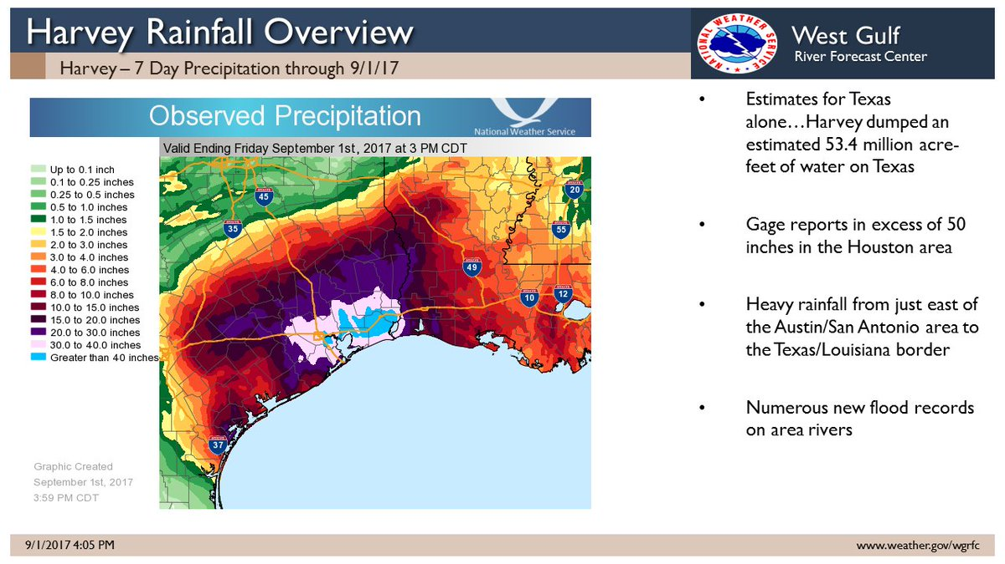
Historic Hurricane Harvey Facts:
The areal coverage of locations picking up at least 20 inches of rain was greater than the state of West Virginia, while the 40-inch-plus zone was larger than Delaware.
The top rainfall total is 60.58 inches in Nederland, Texas from Aug. 24-Sep. 1. Incredibly, a second site, Groves, Texas, also topped the record book by receiving more than 60 inches during that same time period. Both of these topped the previous tropical cyclone rainfall record.
Pending final confirmation, this rainfall total would be the heaviest from any tropical cyclone in the U.S. in records dating to 1950, topping the 48-inch storm total in Medina, Texas, from Tropical Storm Amelia in 1978, according to research by NOAA/WPC meteorologist David Roth.

Slide 29
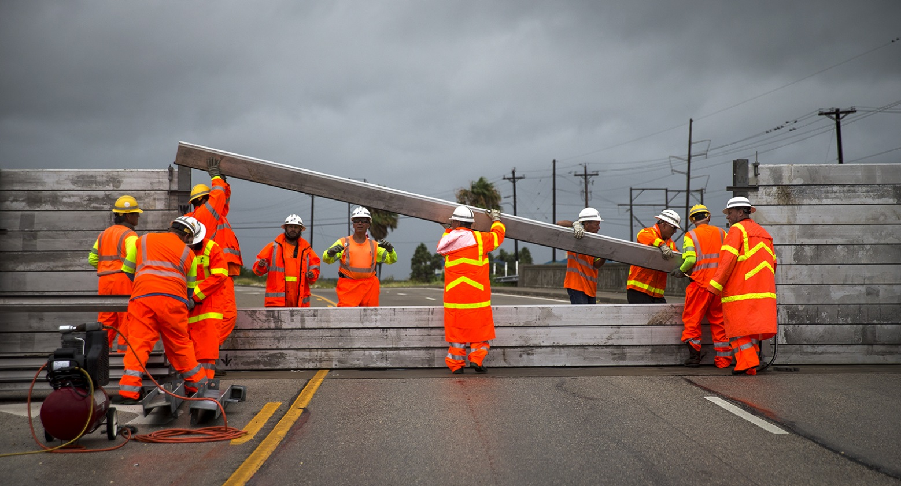
TxDOT responds to Hurricane Harvey
TxDOT crews install a surge wall on SH 361 in Aransas Pass on Aug. 25, hours before Hurricane Harvey devastated the area. (Photo: Nick Wagner, Austin American-Statesman)

Slide 30
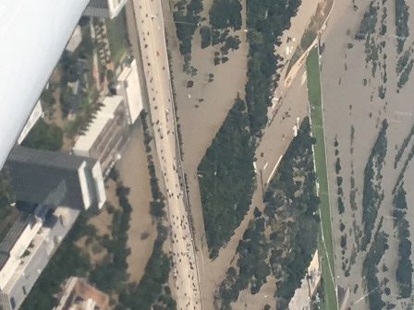



Harvey’s impact on southeast Texas (Houston District)
I-10 W between Eldridge Pkwy and SH 6, Harris County.

Slide 31



Harvey’s impact on southeast Texas (Houston District)
Sam Houston Tollway at Buffalo Bayou, Harris County.
Water level of the Brazos River under I-69 South in Fort Bend County.
Brazos River at Richmond, Fort Bend County.

Slide 32


Harvey’s impact on southeast Texas (Houston District)
Brazos River at Richmond, Fort Bend County
I-10 at San Jacinto River in Harris County.

Slide 33




Harvey’s impact on south Texas (Corpus Christi District)
Drill ship broke free from its moorings near TxDOT’s ferry system in Port Aransas and beached near the jetties.
TxDOT ferry, R.E. Stotzer Jr., pushed onto pile clusters by Harvey. Vessel returned to service after US Coast Guard found it to be undamaged.

Slide 34

TxDOT Responds to the Call

Slide 35


Harvey’s impact on southeast Texas (Beaumont District)
Sept. 1, as water began receding off I-10 at Oak Island Road in Chambers County, the amount of debris was significant including bales of hay on the highway.
I-10 just west of the Beaumont city limits became impassable Aug. 28 forcing all east and westbound lanes to be closed. I-10 between Beaumont and Houston did not reopen until Sept. 2.

Slide 36


Harvey’s impact on south Texas (Yoakum District)
Colorado River near Wharton.
La Grange under water.

Slide 37



TxDOT responds and rebuilds
Sept. 3, I-10 in Orange County. TxDOT assists with clean-up from lowering flood waters from Neches River (BMT).
Aug. 26, Galveston Maintenance Office was unable to reach Bolivar, so Anahuac Maintenance Office responds to remove debris off the road (BMT).
Crews repair bridge at the Lavaca River on SH 111 in Lavaca County (YKM).

Slide 38



TxDOT responds and rebuilds
Sinkhole repairs at FM 762 in Fort Bend County.
Crews work on I-10 in Orange County.
Safety is #1 as out-of-town TxDOT staff conduct safety meetings at Sugar Land Base Camp before deploying to help with recovery efforts in HOU.

Slide 39




TxDOT responds and rebuilds (AquaDam, HOU)
Aug. 29–30, AquaDam installed
I-10 at Eldridge Parkway in west Houston.
Dam dimensions:
36 inches tall
250 feet long
weighs 1,000 pounds (empty)
37,600 gallon capacity
holds back 30 inches of water

Slide 40



Harvey’s impact on southeast Texas (Beaumont District)
I-10 in Orange County (BMT).

Slide 41

Harvey’s impact on SE Texas (US 69 Lumberton, BMT)

Slide 42





TxDOT responds and rebuilds (AquaDam, BMT)
Aug. 31, AquaDam installed on I-10 near SH146 in Mont Belvieu.

Slide 43


TxDOT responds and rebuilds (Yoakum District)
FM 442 at San Bernard River in Wharton County (YKM). TxDOT crews repair large stretch of road, incuding removing asphalt, laying base, prime, and hot mix.
Repairing SH 316 in Calhoun County along the beach near Indianola (YKM).

Slide 44

I-69 at San Jacinto River (Houston District)

Slide 45



Harvey’s impact on south Texas (Corpus Christi District)
SH 35 in Rockport, one of the hardest hit cities along the Texas coast.

Slide 46






TxDOT responds and rebuilds - Crews mobilized statewide

Slide 47





Debris Pick up in Corpus Christi District

Slide 48


TxDOT responds: Debris Pick-Up in Rockport
Debris pick-up continues
(Arial shots taken by Drone in CRP)

Slide 49

TxDOT Responds – Daily Stats
Number of Bridges Inspected | 4,319
Number of Roadways Closed (Damaged) | 1
Number of Roadways Closed (Flood) | 0
Number of Employees Involved (Hurricane Harvey Response) | 4,774
Number of Man Hours Worked (Hurricane Harvey Response) | 740,866
Number of Employees (Off-System Debris) | 1,705
Number of Man Hours Worked (Off-System Debris) | 165,085
Number of Entities Requesting Assistance | 25
Debris Removed (CY) | 504,792
Debris Removed (CF) | 13,629,404

Slide 50

TxDOT Responds - Estimates of Hurricane Harvey Response
Estimated Damages
Estimate of damages to infrastructure (roadway, bridges, signals and signs) | $110,000,000
Estimate of damages to buildings and ferry operations (facilities & travel information center) | $10,000,000
Estimate of damages to Ferries | 215,000
Total Damages | $120,215,000
Equipment Costs
Additional PM | $5,000,000
Rentals | $1,230,000
Total Equipment Costs | $6,230,000
Mobilization Costs
Salaries (Hurricane Harvey Response) | $17,535,000
OT Pay (Hurricane Harvey Response) | $13,360,000
Salaries (Off-System Debris Removal) | $3,500,000
OT Pay (Off-System Debris Removal) | $3,650,000
Base Camps | $7,300,000
IT Changes | $272,000
Radio Preparedness | $550,000
Travel for Staging Employees | $1,800,000
Total Mobilization | $47,967,000
Grand Total | $174,412,000

Slide 51

Questions

