Slide 1
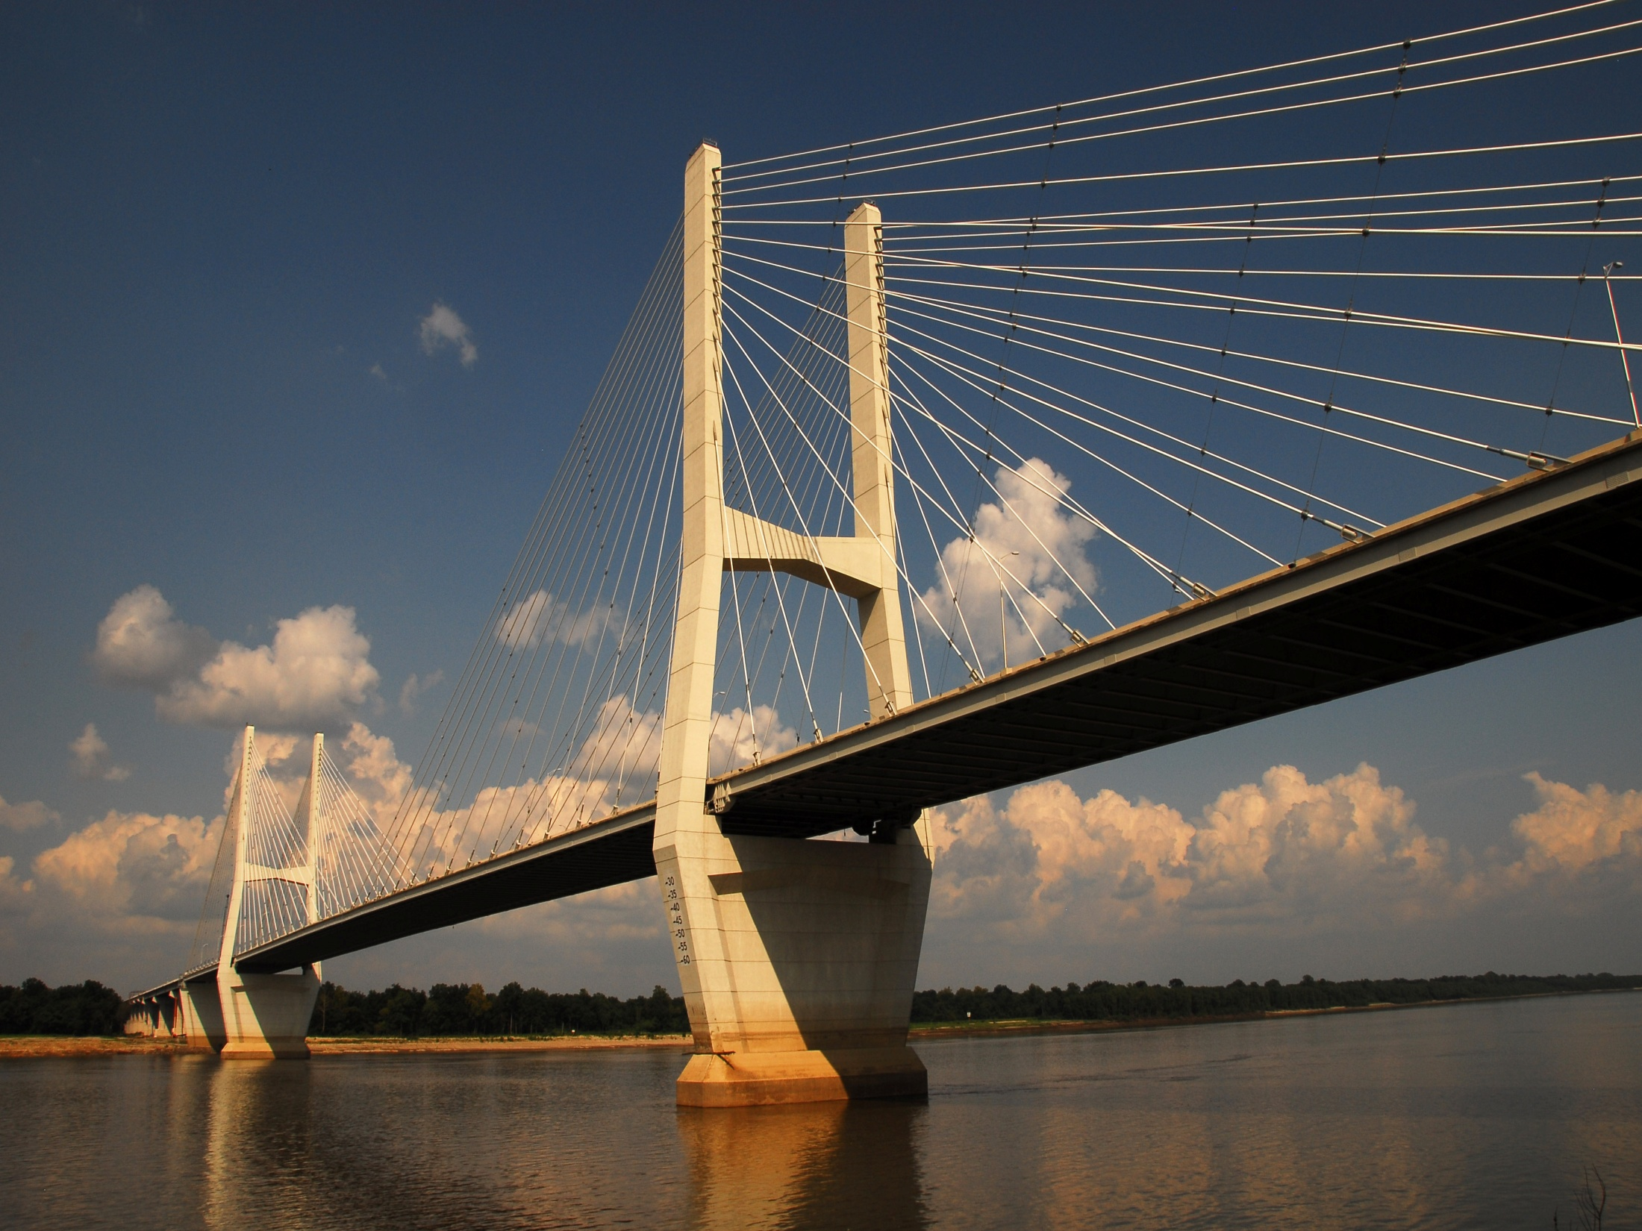
BRIDGE ASSET MANAGEMENT IN ARKANSAS

Slide 2
THE SANDBOXES AROUND OUR BRIDGE INVENTORY
Bridge Modeling & Projections
Programming & Funding
Design
Construction
Inspection
Preservation Rehabilitation Replacement
Maintenance
STATE BRIDGE INVENTORY

Slide 3
THE SANDBOXES AROUND OUR BRIDGE INVENTORY
Bridge Modeling & Projections
Programming & Funding
Design
Construction
Inspection
Preservation Rehabilitation Replacement
Maintenance
STATE BRIDGE INVENTORY

Slide 4
SANDBOXES OUTSIDE OF MAINTENANCE
MAINTENANCE HAS BEEN ASKED TO DEVELOP PROJECTS FOR THE NEXT STIP. THE PROJECTS TO BE RANKED BASED ON THE BENEFIT/COST RATIO DELVELOPED FROM OUR BRIDGE MODELING.
Programming & Funding
MAINTENANCE IS WORKING WITH BRIDGE DESIGN TO DEVELOP NEW DESIGN DETAILS TO INCREASE THE DESIGN LIFE. FOR EXAMPLE – ELIMINATING MORE JOINTS WITH EXPANDED USE OF INTEGRAL ABUTMENTS.
Design
MAINTENANCE IS ENCOURAGING DISTRICTS TO USE THEIR BRIDGE INSPECTION TEAMS TO HELP DEVELOP THE PUNCH LIST FOR THE CONTRACTOR. WILL SHARE LEASONS LEARNED ACROSS DISTRICT LINES.
Construction

Slide 5
THE SANDBOXES AROUND OUR BRIDGE INVENTORY
Bridge Modeling & Projections
Programming & Funding
Design
Construction
Inspection
Preservation Rehabilitation Replacement
Bridge Maintenance
STATE BRIDGE INVENTORY

Slide 6
SANDBOX IN MAINTENANCE
Inspection
INSPECTIONS ARE HANDLED IN-HOUSE ALLOWING GREATER CONTROL OF PROGRAM
IN 2014 WE SWITCH TO INSPECTTECH SOFTWARE FOR:
GIS MAPPING OF ASSETS AND INSPECTION SCHEDULING
CUSTOMIZABLE FORMATS/SCREENS/REPORTS/QUERIES
PHOTOS LINKING TO MAINTENANCE DEFICIENCIES
LARGE COMMENT FIELDS
IPAD MOBILE APPLICATION
BUILT IN DATA VALIDATION
AUTOMATED EMAIL NOTIFICATION FOR CRITICAL FINDINGS & POSTING ISSUES
INTEGRATED BRIDGE MAINTENANCE MODULE

Slide 7
THE SANDBOXES AROUND OUR BRIDGE INVENTORY
Bridge Modeling & Projections
Programming & Funding
Design
Construction
Inspection
Preservation Rehabilitation Replacement
Bridge Maintenance
STATE BRIDGE INVENTORY

Slide 8
SANDBOX IN MAINTENANCE
Bridge Maintenance
HAVING BOTH THE INSPECTON AND MAINTENANCE OF BRIDGES IN-HOUSE UNDER ONE DIVISION ALLOWS FOR RAPID IMPLEMENTATION OF IMPROVEMENTS.
EACH DISTRICT HAS THEIR OWN BRIDGE REPAIR CREWS AND MAINTENANCE HAS STATEWIDE CREWS THAT HANDLE THE BIGGEST BRIDGES AND ASSIST THE DISTRICTS AS NEEDED

Slide 9
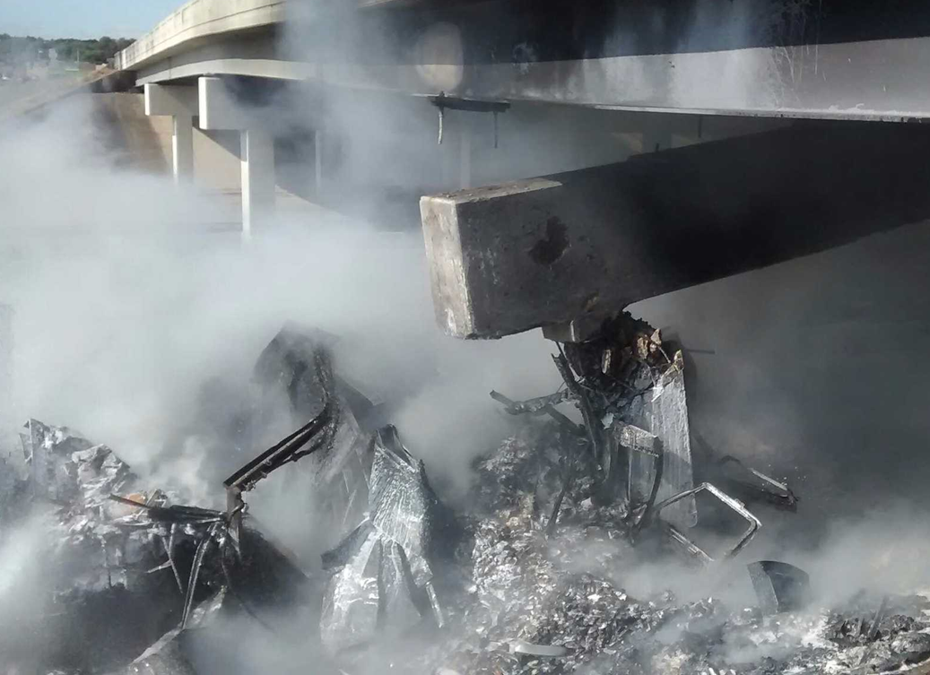
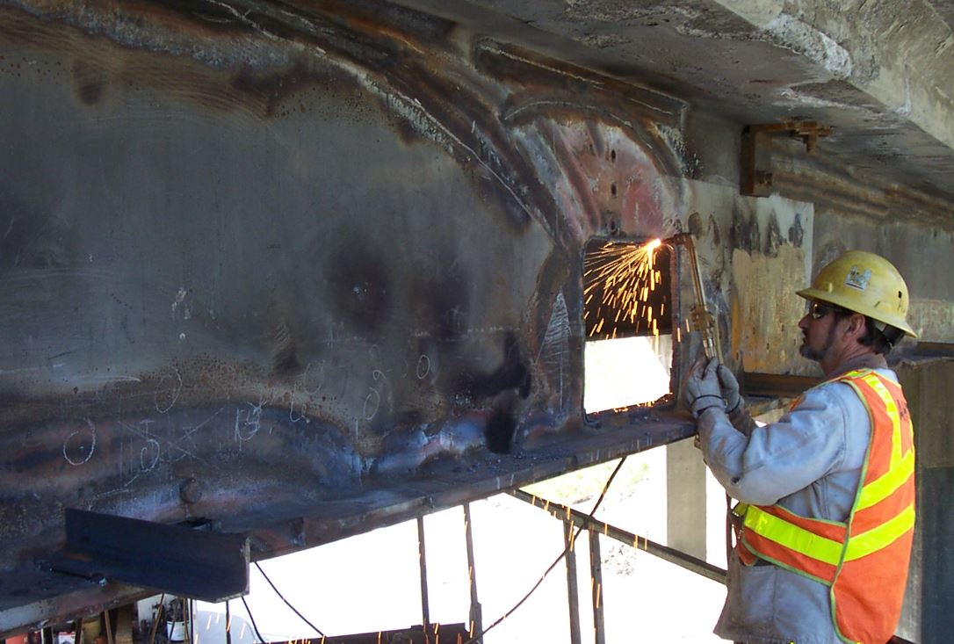
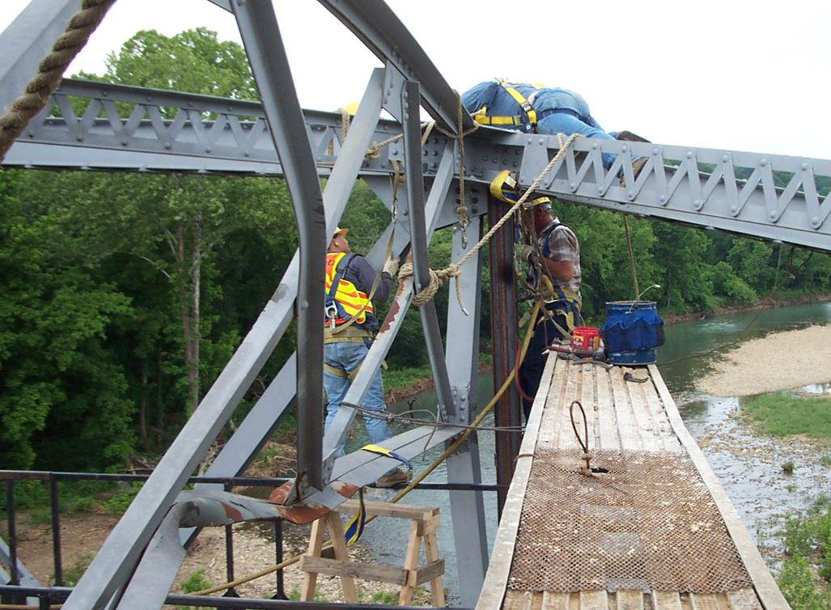
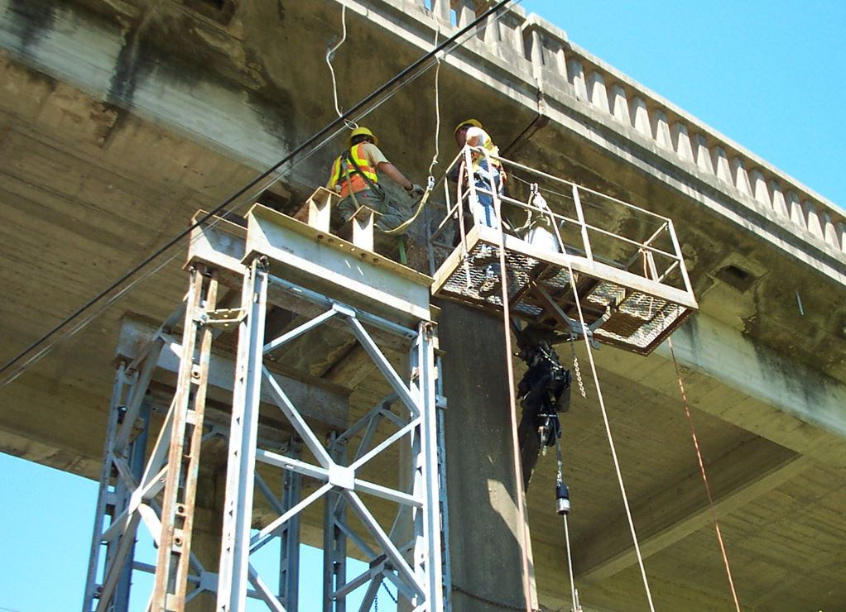
RAPID RESPONSE TO NEEDS
Bent Repair – Less than 2 weeks
Bridge Strike - Heat Straightening etc.
Bridge Strike – Vertical Replacement
Off Loading – Concrete Repairs

Slide 10
THE SANDBOXES AROUND OUR BRIDGE INVENTORY
Bridge Modeling & Projections
Programming & Funding
Design
Construction
Inspection
Preservation Rehabilitation Replacement
Maintenance
STATE BRIDGE INVENTORY

Slide 11
SANDBOX IN MAINTENANCE
Bridge Modeling & Projections
BRIDGE PRESERVATION GUIDELINES HAVE RECENTLY BEEN DEVELOPED TO SET GOALS AND STRATEGIES FOR BRIDGE PRESERVATION.
PREDICTIVE MODELING IN dTIMS SOFTWARE IS USED TO PREDICT HOW DIFFERENT FUNDING SCENARIOS AFFECT THE FUTURE CONDITION OF THE STATE INVENTORY.
THE B/C RATIO FOR REPLACEMENT AND PRESERVATION ACTIONS ARE CALCULATED FOR EACH BRIDGE TO HELP IN PROJECT SELECTION.

Slide 12
Recent guidelines from Maintenance contain criteria that can be used to identify cyclical preservation, maintenance, and rehabilitation work actions for bridges.

Slide 13
dTIMS SOFTWARE ALLOWS PREDICTIVE MODELING

Slide 14
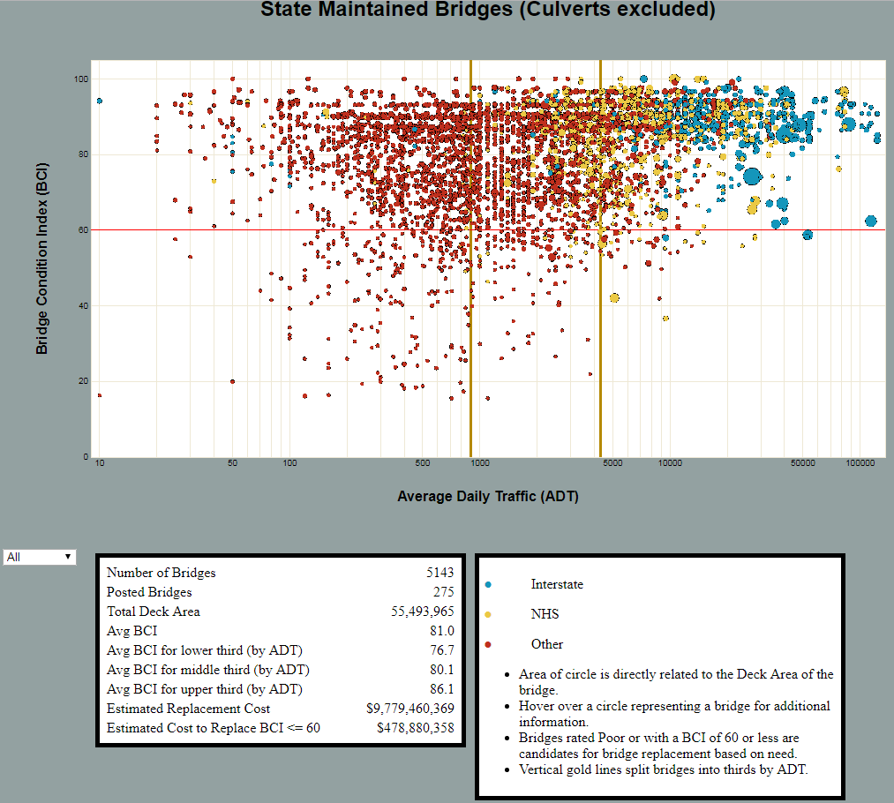
This site does not include bridge length culverts.
This is a tool developed by Maintenance to show bridge needs by District
http://bridges.arkquant.com/index.html?district=0
This site does not work in Explorer

Slide 15
THE SANDBOXES AROUND OUR BRIDGE INVENTORY
Bridge Modeling & Projections
Programming & Funding
Design
Construction
Inspection
Preservation Rehabilitation Replacement
Maintenance
STATE BRIDGE INVENTORY

Slide 16
Preservation
Rehabilitation
Replacement
THIS IS WHERE EVERYTHING COMES TOGETHER. PROJECTS FOR CONTRACT RECOMMENDATIONS ARE MADE FROM THE FOLLOWING:
  RECOMMENDATION FROM SOFTWARE OPTIMIZING B/C RATIO
  RECOMMENDATIONS REVIEWED/REVISED BY MAINTENANCE
  RECOMMENDAITON SENT TO DISTRICT FOR COMMENTS
  SUBMITTAL TO PROGRAM MANAGEMENT FOR FINAL SELECTION
MAINTENANCE HAS DEVELOPED AN AGREEMENT FOR THE USE OF FEDERAL FUNDS FOR PREVENTIVE MAINTENANCE AND PRESERVATION OF BRIDGES. THIS WILL ALLOW THE USE OF FEDERAL FUNDS FOR IN-HOUSE BRIDGE PRESERVATION WORK. PLAN TO HAVE IT SIGNED BY END OF MONTH.

Slide 17
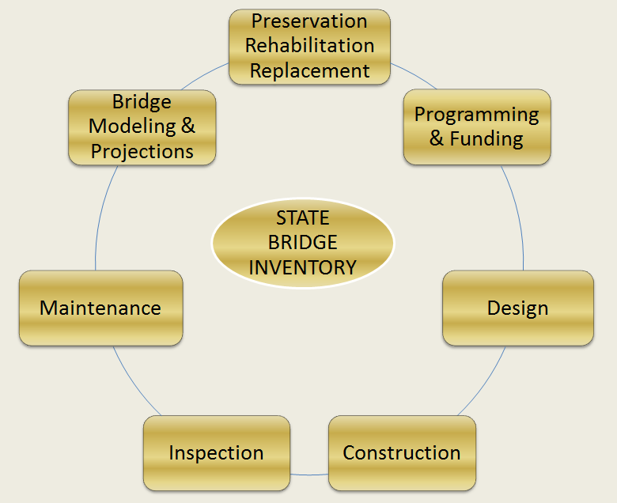
THIS CONCLUDES THE TALK ON THE SANDBOXES OF THE STATE BRIDGE INVENTROY
BUT WAIT – THERE IS MORE
AND FOR NO ADDITIONAL COST

Slide 18
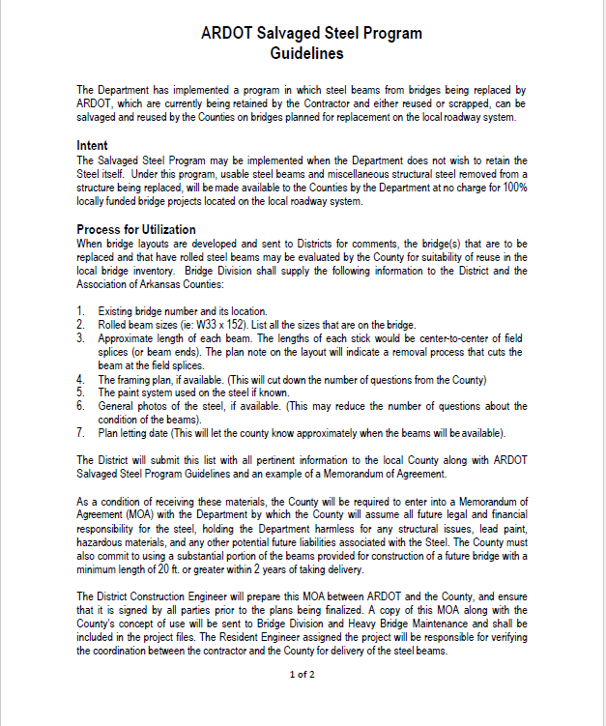
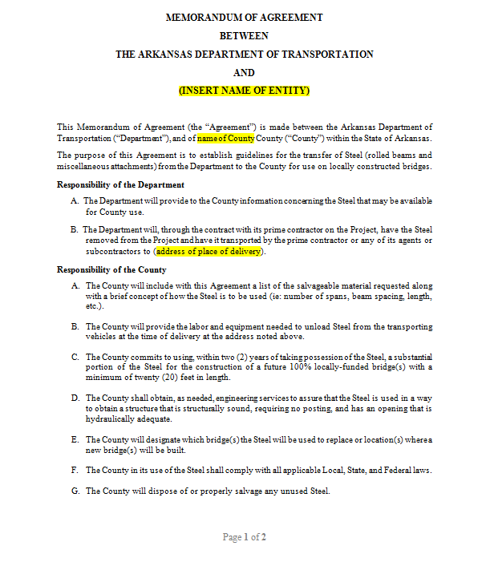
MAINTENANCE IS MEETING WITH THE COUNTY JUDGE ASSOCIATION ON OCT. 25TH TO DISCUSS NEW SALVAGE STEEL PROGRAM
LOCAL BRIDGE INVENTORY

