Slide 1
Maintenance Training Videos and
Electronic Bulletin Boards
Bill Collier
Hampton Roads District Maintenance Manager
October 26th, 2017

Slide 2
VDOT’s Aging Maintenance Workforce
In Hampton Roads District alone, almost 40% of maintenance employees can retire in less than five years
Notes:
Add Bullet from HR

Slide 3
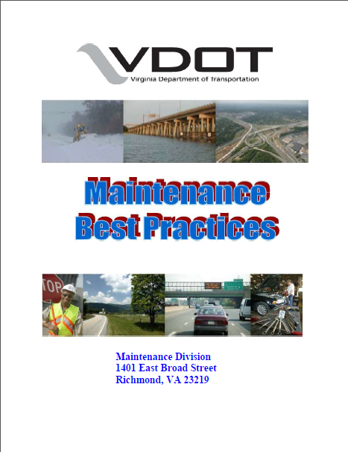
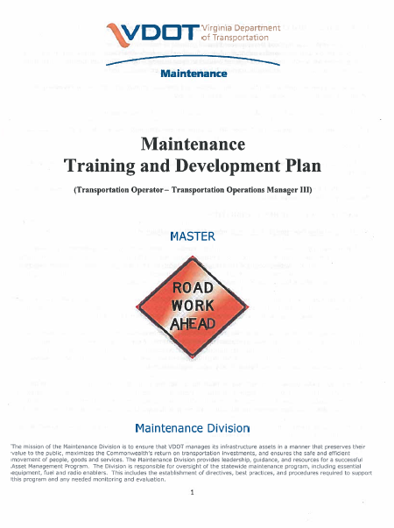
How to Capture and Transfer Experience
Best Practices Manual
Maintenance Training and Development Plan
Succession Planning
Involving Subject Matter Experts / Mentors

Slide 4
How do Millennials Learn?
Collaborative
Micro-learning (Multimedia)
Gamification / Feedback
Mentoring and Coaching
We need to create and support Autonomous Learners
Notes:
Trust group verification over authority. Yelp and trip advisor vs an authority review
A trusted mentor, collaboration
Youtube
Attention span of a Goldfish – not dumber, just find info faster and move on.

Slide 5
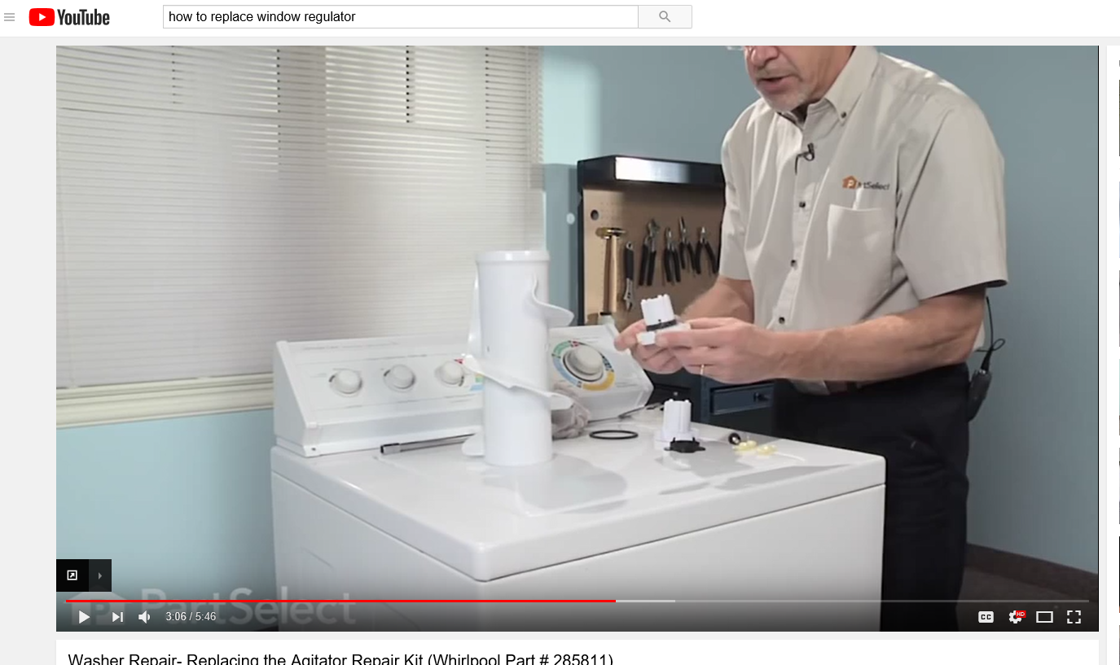
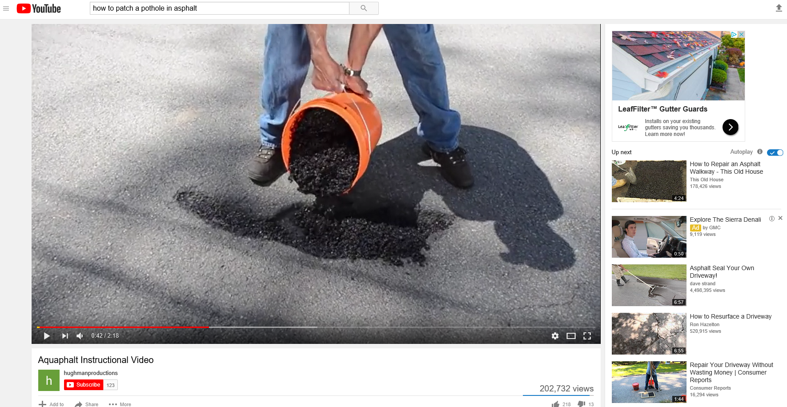
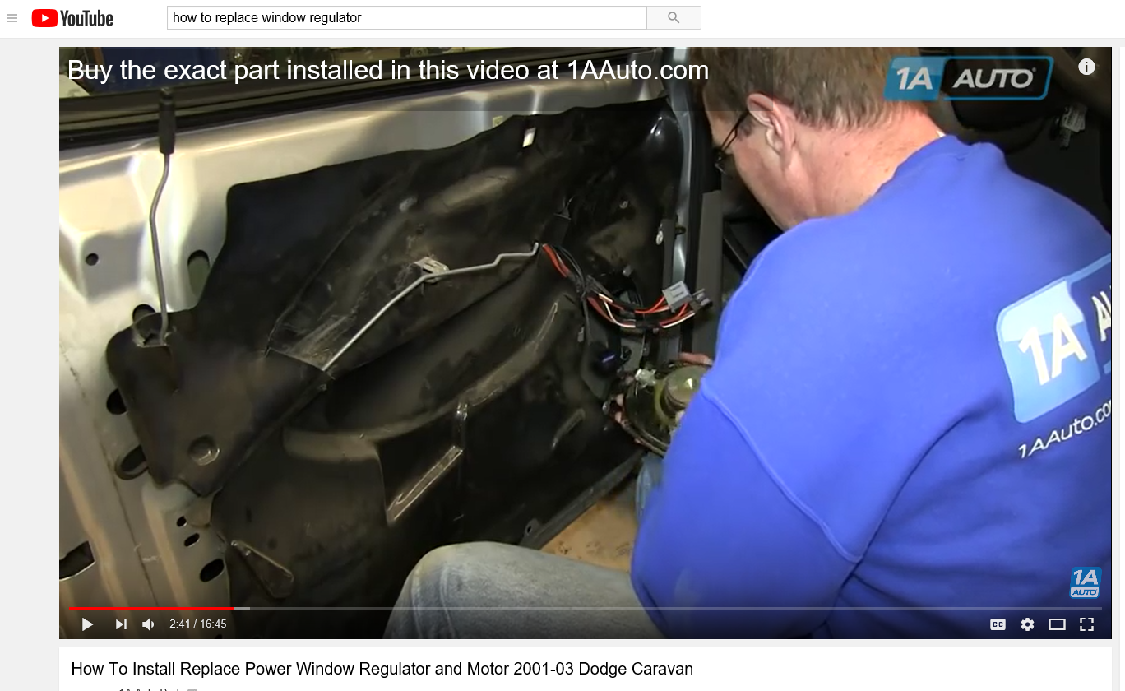
Learning From the Web
Notes:
How many of you have ever used YouTube to teach you how to do something?

Slide 6
“Create Maintenance Training Videos”
Common Topics that support our overall work plans
Involve Employees in production
  Subject Matter Experts (SME’s)
  Workforce pride/Involvement
Short Duration
Available for individual training as well as group training
Easily Accessible at the Area Headquarters
Notes:
Discussion between our Chief Engineer and Commissioner to capture experience and memorialize it in a way that younger generations would use

Slide 7
Initial Topics
Pothole Patching
Equipment Desalting
Tree Trimming / Limb Rack
Chipper Operations
Inspection and use of ABC Fire Extinguisher
Skin Patching
Concrete Patching
Gravel Road Maintenance
Pipe installation and Compaction Techniques
Shoulder Maintenance
Ditching
Notes:
Topics being added regularly, Maintenance, Safety, Environmental etc.

Slide 8
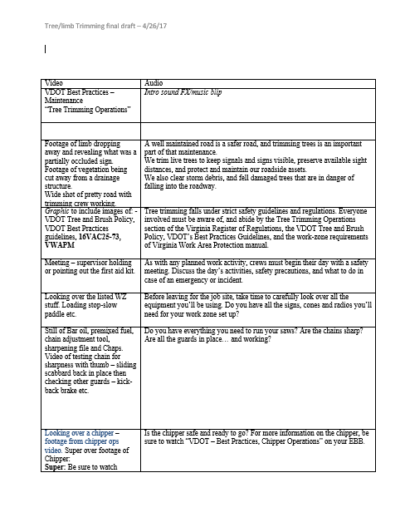
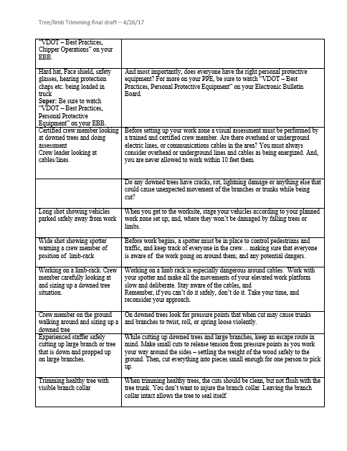
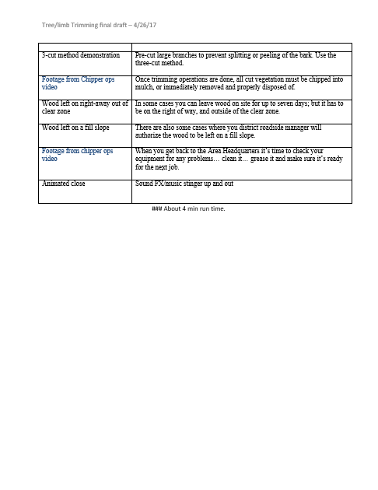
Planning
Maintenance Leadership Group
Local Staff
(Subject Matter Experts)
Communications Division
Script

Slide 9
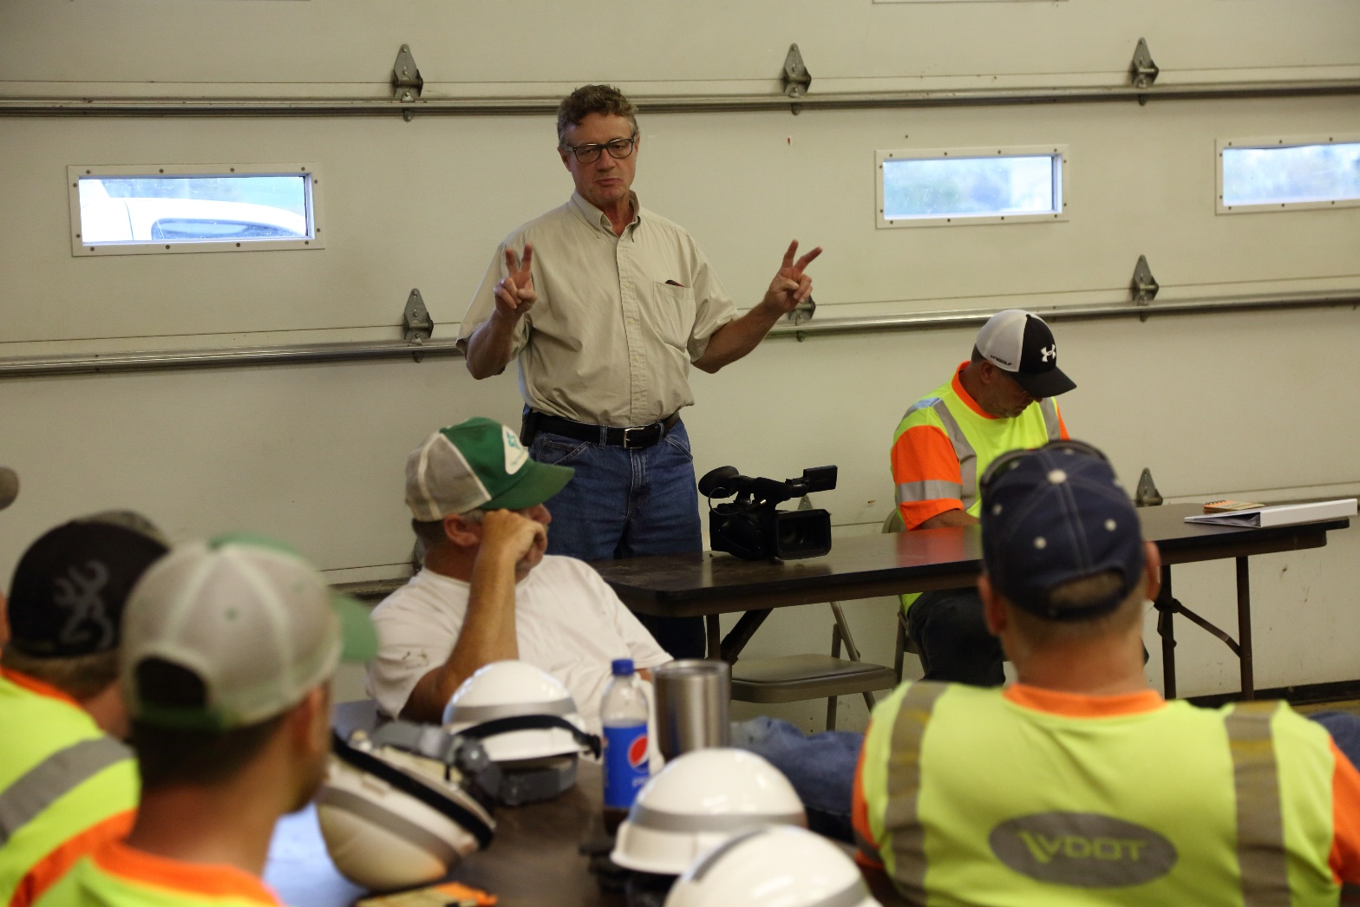
Planning

Slide 10
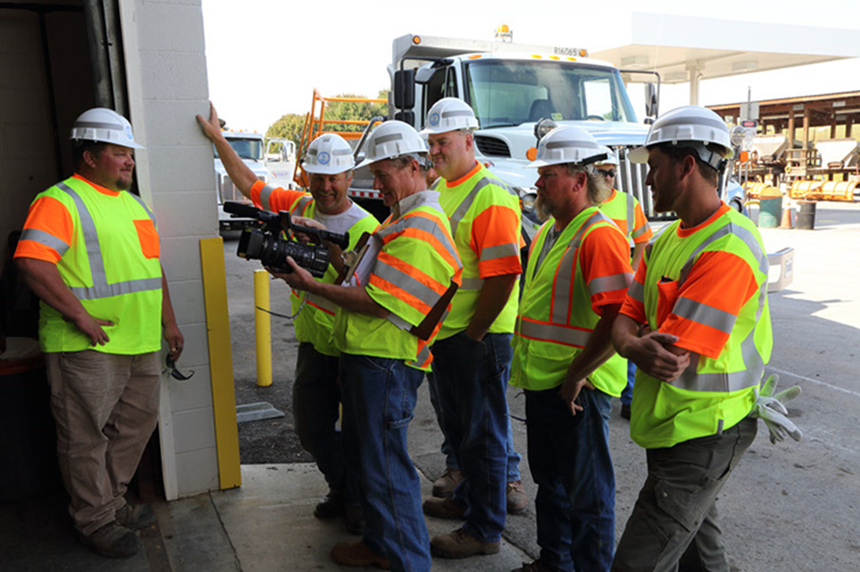
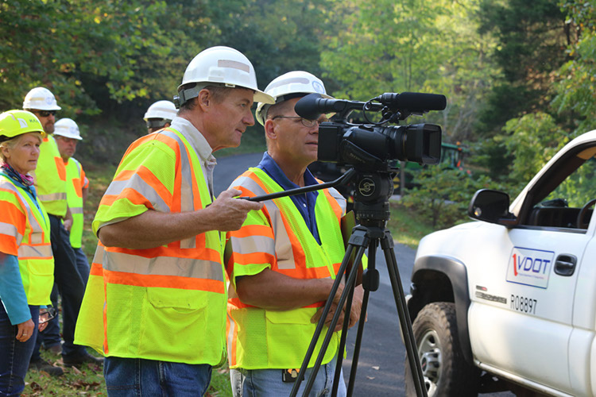
Filming

Slide 11
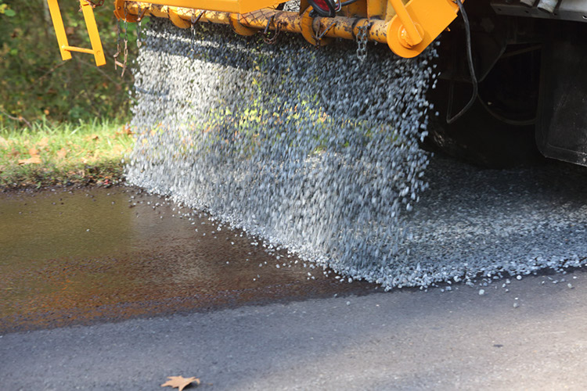
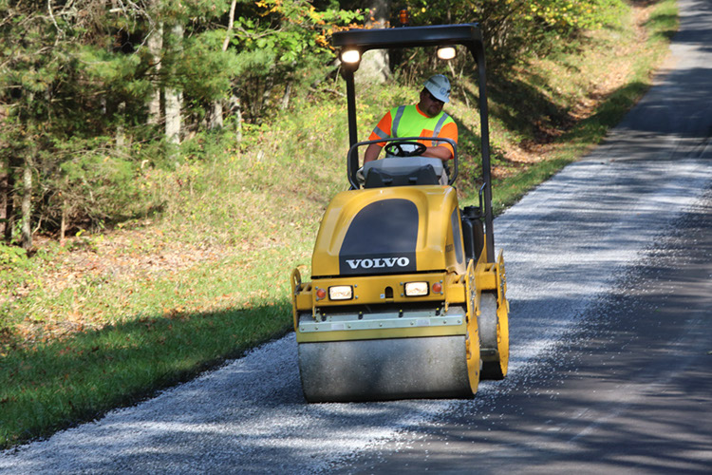
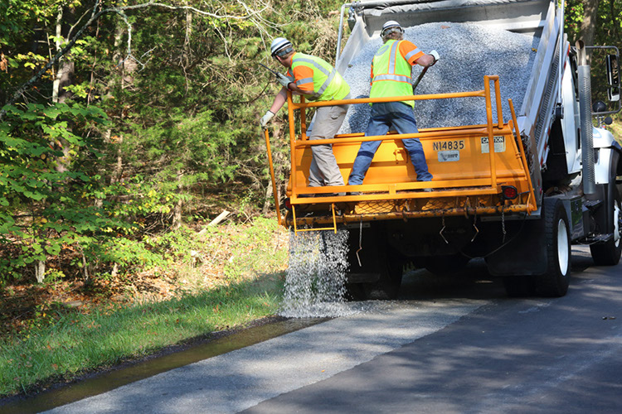
Filming

Slide 12
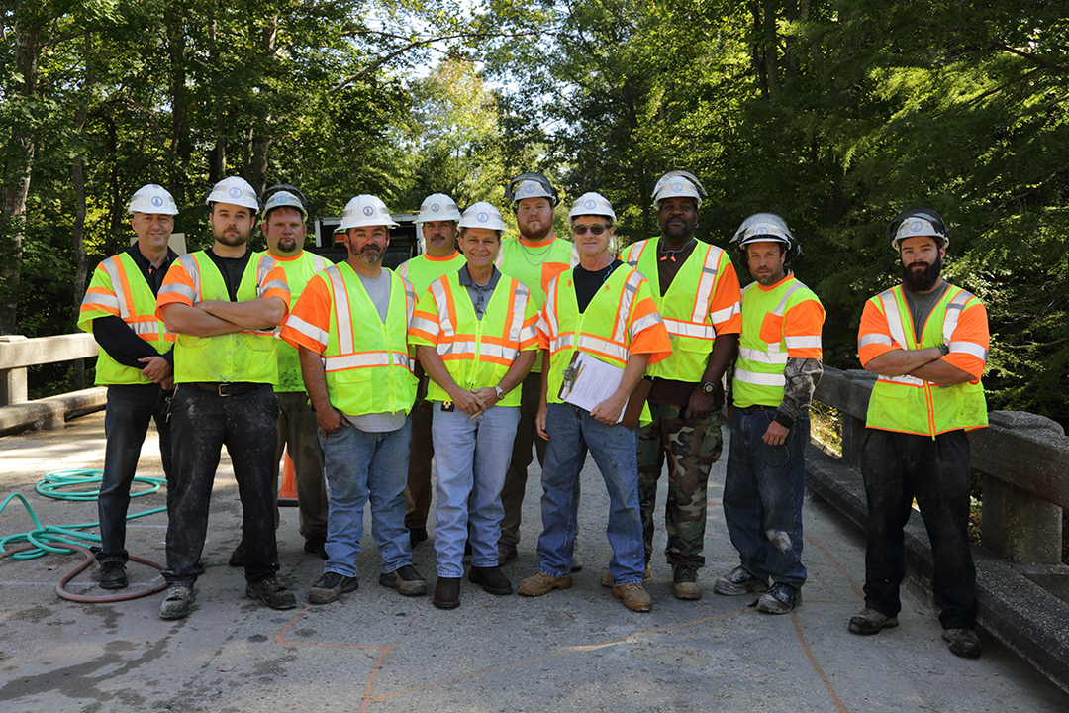
Pride of Employees

Slide 13
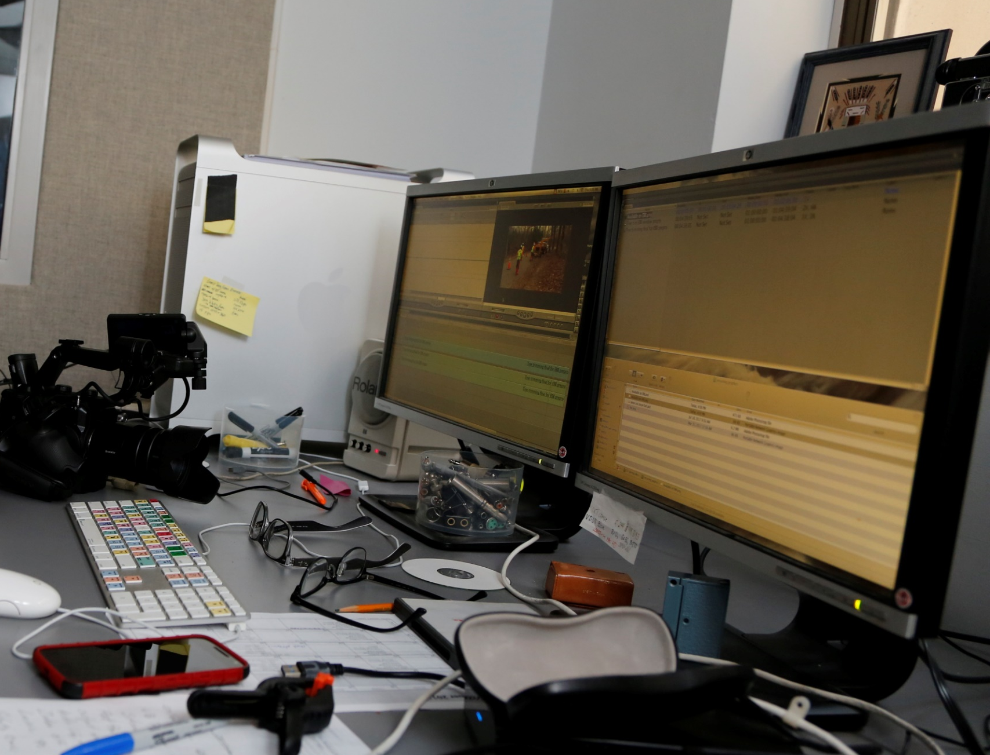
Editing

Slide 14
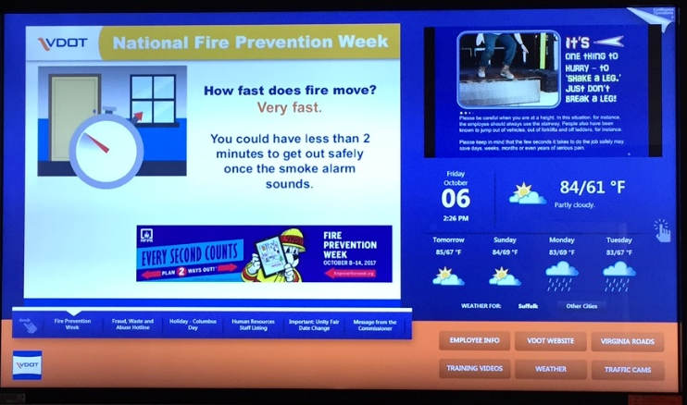
How do we make it easily accessible to the field?

Slide 15
VDOT’s Electronic Bulletin Board
Better “Pushed” communication to employees without email addresses
Limited web access for employees without assigned computers
Presentation and training tool for the field

Slide 16
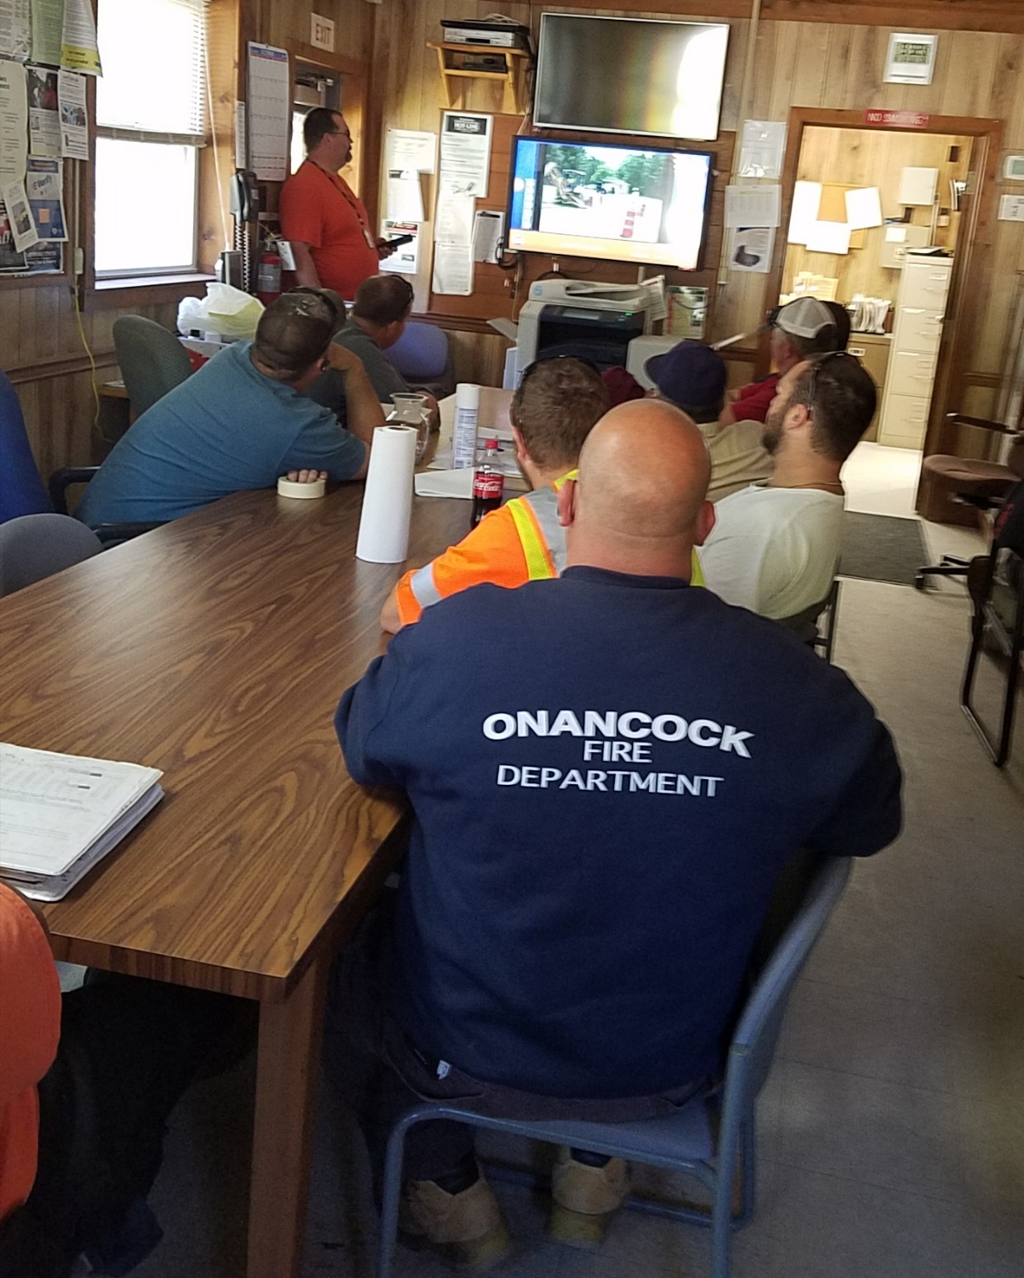
Notes:
Actual AHQ’s using EBB to show training video prior to work.

Slide 17

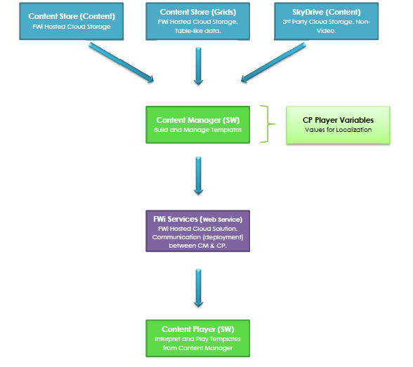
Notes:
Representatives in Central office and Districts can use the Content Manager Software to upload content, and schedule display

Slide 18
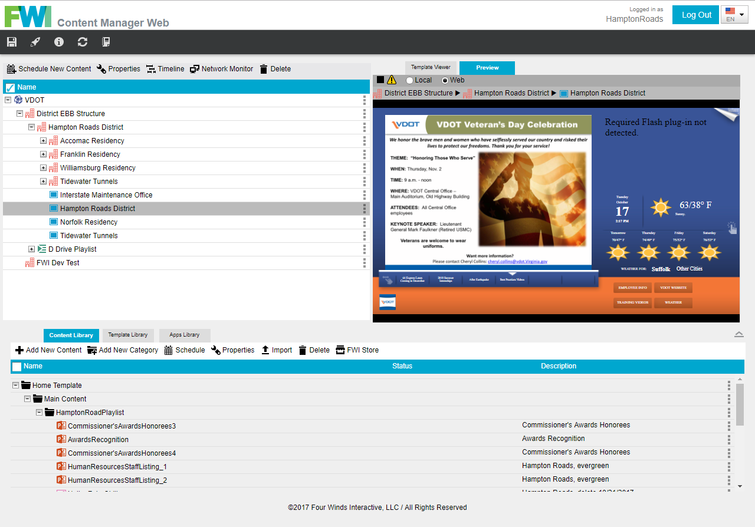
Notes:
Just a quick screen shot of the content manager software.
Direct to specific areas or broadcast

Slide 19
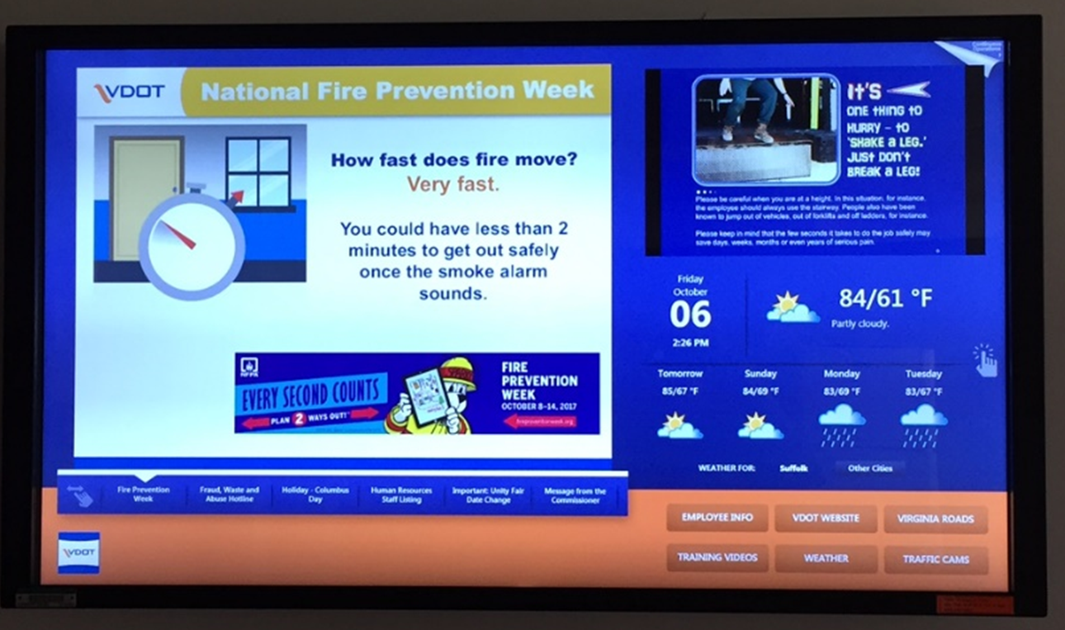
“Pushed” video
content
Continuous
resource
“Pushed” communication content
Continuous web resources

Slide 20

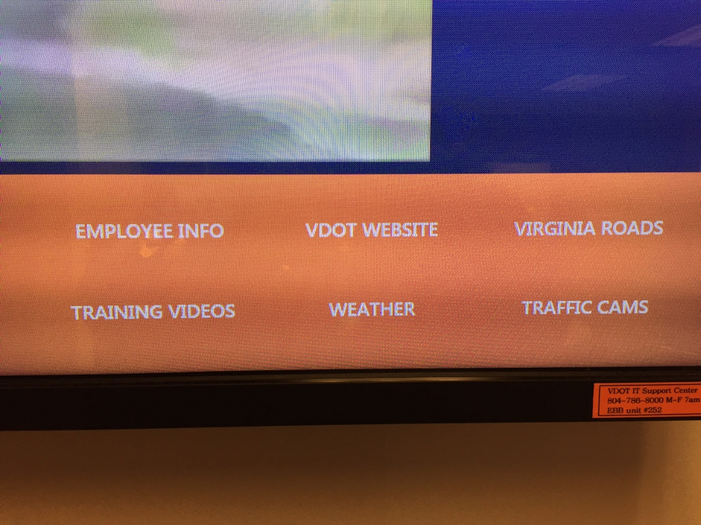
Notes:
In addition to Pushed content, EBB’s provide continuous resource access

Slide 21
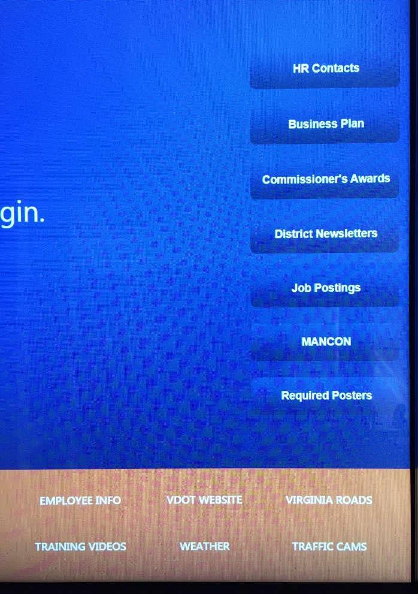
Continuous Web Resources

Slide 22
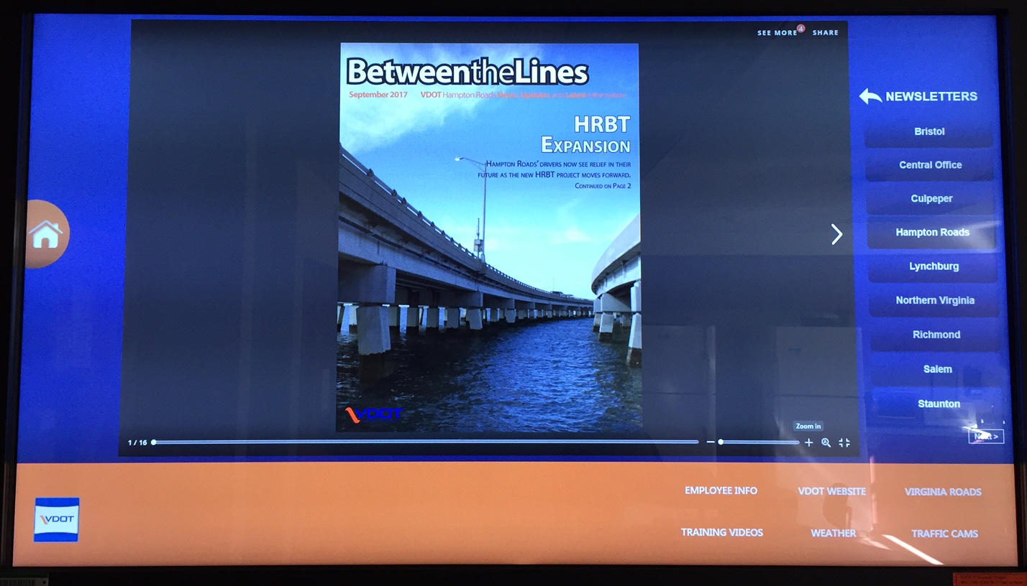
Continuous Web Resources

Slide 23
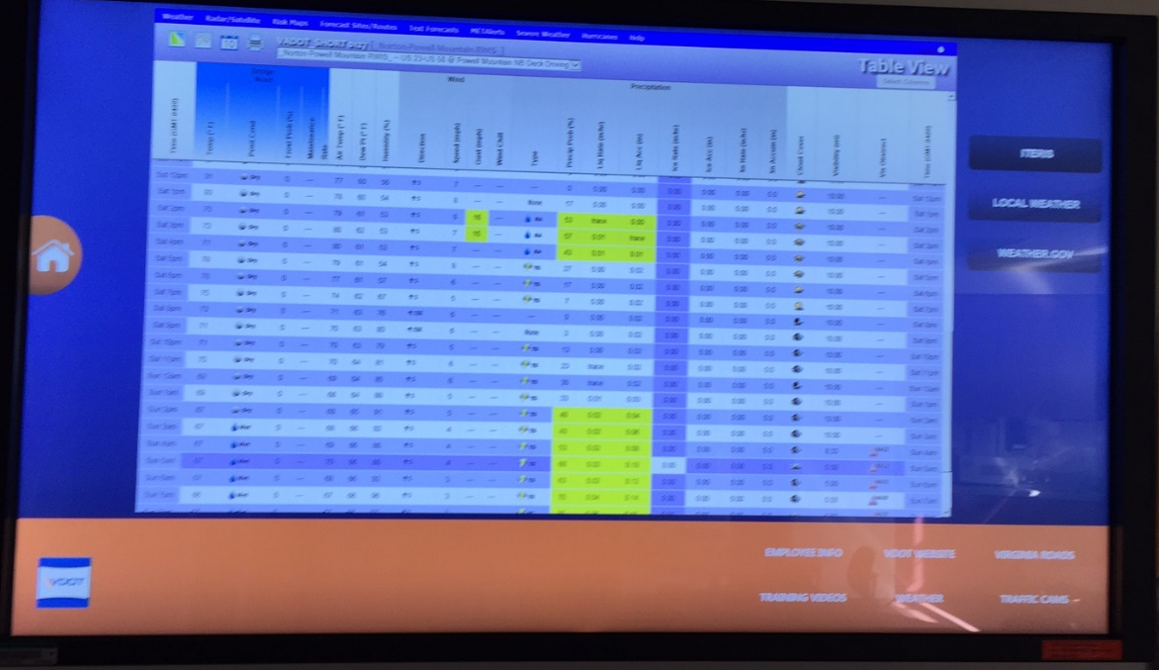
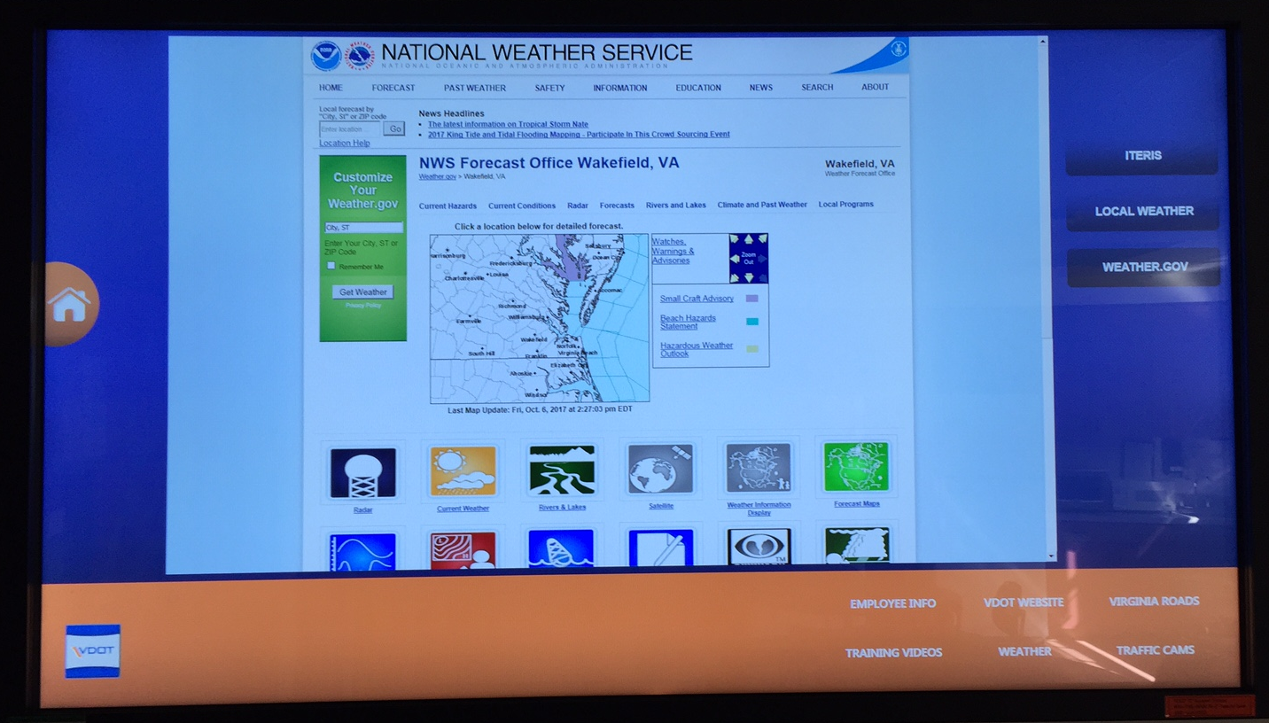
Continuous Web Resources

Slide 24
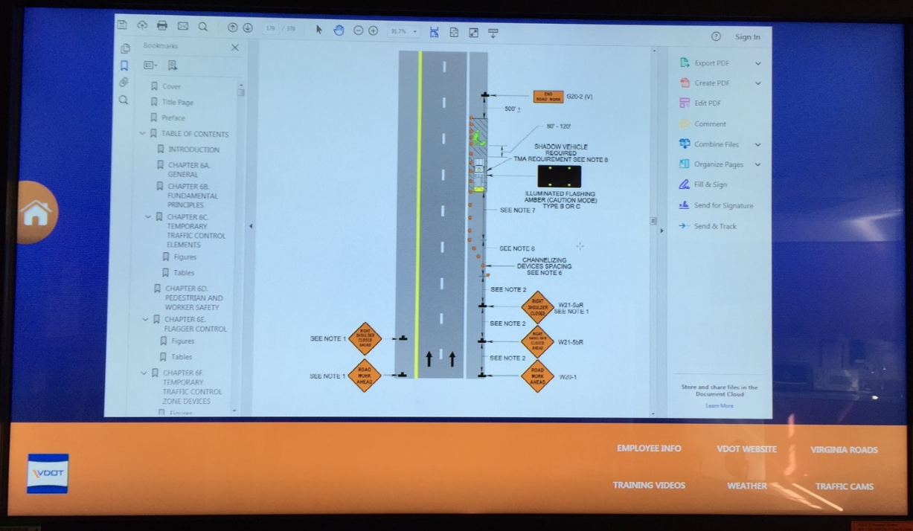
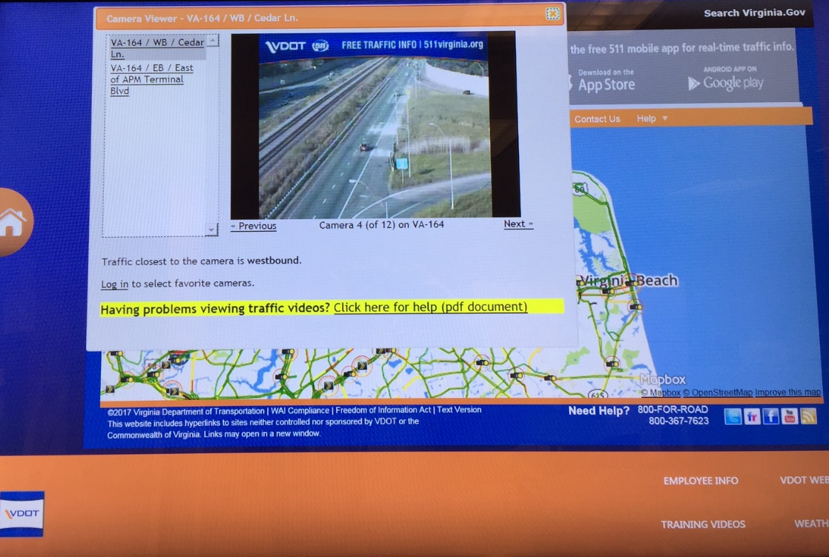
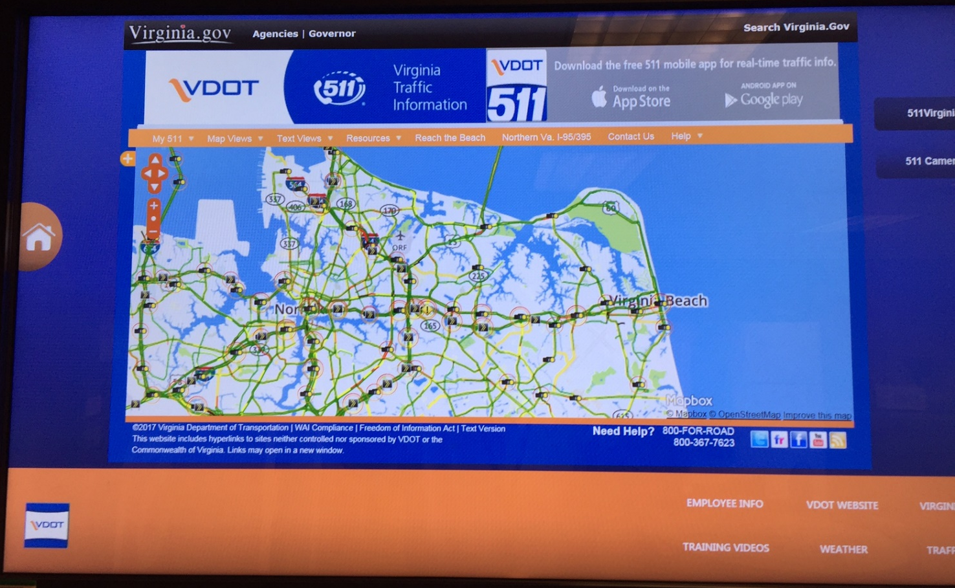
Continuous Web Resources

Slide 25
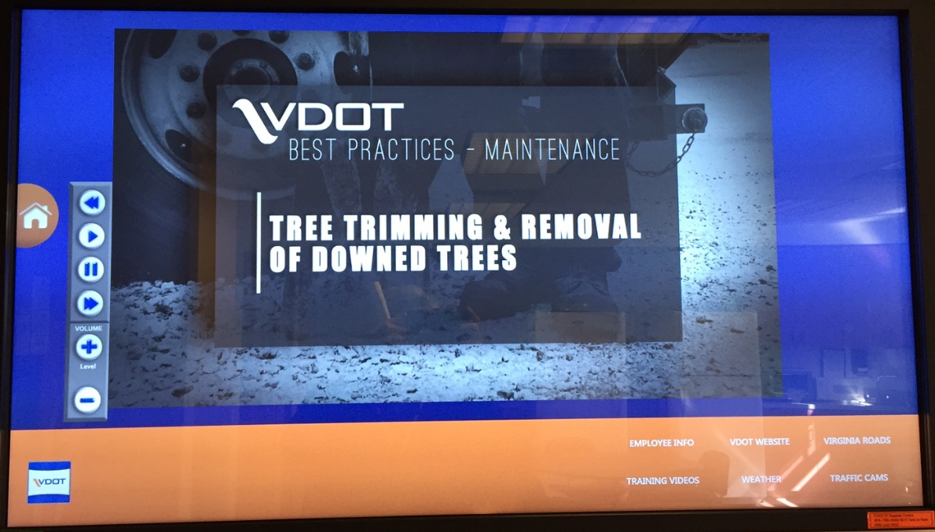
Continuous Web Resources

Slide 26
QUESTIONS?
          Bill Collier
          Hampton Roads
          District Maintenance Manager
          William.Collier@VDOT.Virginia.gov
          757-925-2506

