Slide 1
Hurricane Irma
Rudy Powell

Slide 2
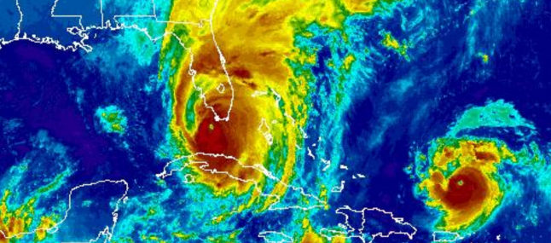
Satellite Aerial Image (September 10, 2017)
Irma
Jose
Hurricane Irma north of the Keys approaching landfall in mainland Florida as a Category 3 storm.
Hurricane Jose following behind Irma as a Category 3 storm.

Slide 3
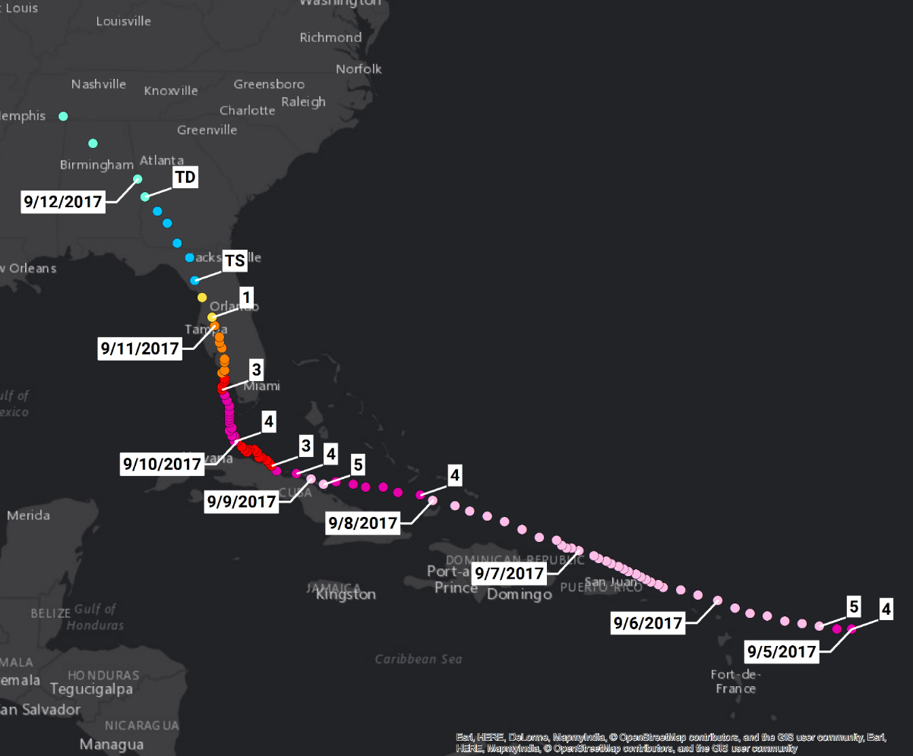
Hurricane Irma Path
Saffir-Simpson Scale
Category | Wind Speeds
Five | ≥157 mph
Four | 130–156 mph
Three | 111–129 mph
Two | 96–110 mph
One | 74–95 mph
Related Classifications
Tropical Storm | 39–73 mph
Tropical Depression | ≤38 mph

Slide 4
Timeline (Advance Preparations- Evacuation, Fuel, Generators)
Tuesday, September 5, 2017
  State Emergency Operations Center (SEOC) activated.
  Prepared emergency generators for deployment and transfer.
  Mobilized Emergency Roadside Assistance Contractor on Alligator Alley and I-75 in District 5 and I-4 in District 5.
Wednesday, September 6, 2017
  SEOC Fuel Discussions- shortage of fuel trucks and drivers impacting deliveries.
  Department Bulk Fuel Sites- anticipating deliveries but all not arriving.
  Emergency Fuel Resources first ordered.
  Emergency Shoulder Use- Heads Up! for all corridors sent.

Slide 5
Hurricane Irma Path
Saffir-Simpson Scale
Category | Wind Speeds
Five | ≥157 mph
Four | 130–156 mph
Three | 111–129 mph
Two | 96–110 mph
One | 74–95 mph
Related Classifications
Tropical Storm | 39–73 mph
Tropical Depression | ≤38 mph

Slide 6
Timeline (Evacuation)
Thursday, September 7, 2017
  Activated I-75 Emergency Shoulder Use at 8PM.
Friday, September 8, 2017
  I-75 Emergency Shoulder Use continues. Limits extended south and north.
  State Office closed.
  Tropical force winds anticipated to start in south Florida tomorrow.
  Tropical force winds anticipated to start in north Florida on Sunday.
Saturday, September 9, 2017
  Deactivated I-75 Emergency Shoulder Use at 11AM.
  Activated I-4 Emergency Shoulder Use at 3PM.
  Deactivated I-4 Emergency Shoulder Use at 8PM.

Slide 7
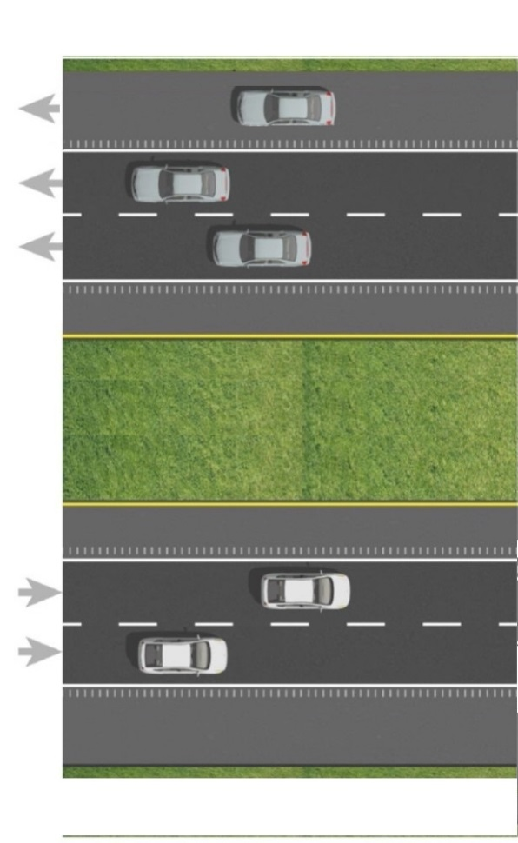
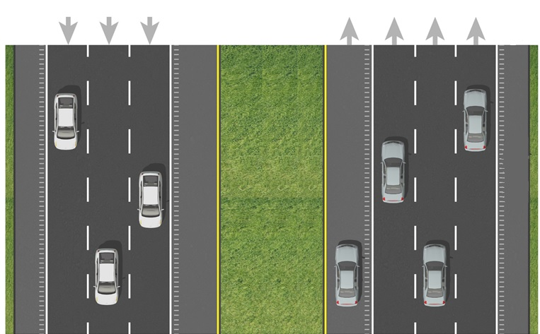
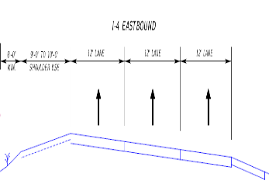
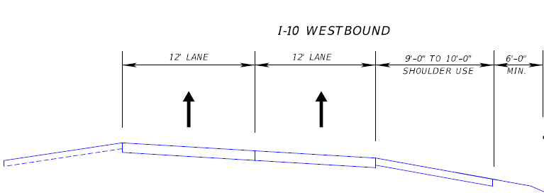
Emergency Shoulder Use
Inside shoulder use
  I-75, Florida’s Turnpike north terminus to Georgia Line (northbound)
  I-4, Tampa to Orlando (eastbound)
Outside shoulder use
  I-75, Alligator Alley (eastbound and westbound depending on the storm track)
  I-10, Jacksonville to I-75 (westbound)

Slide 8
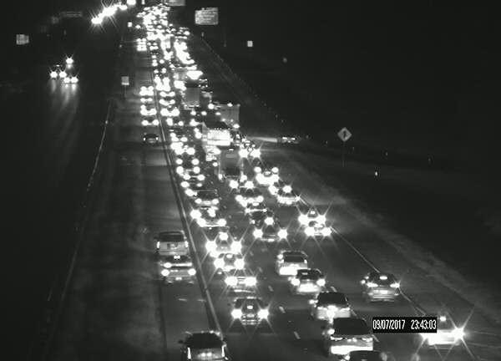
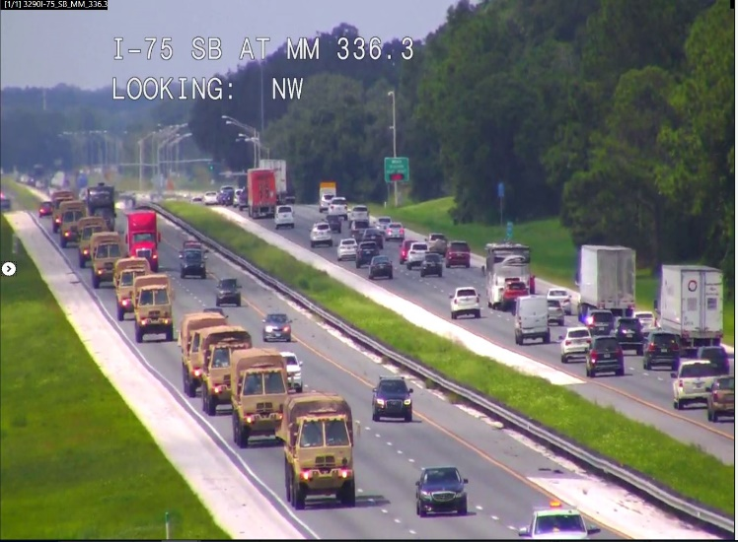
Emergency Shoulder Use
Available continuously, one-way limited to daylight hours
  Same 24-hour capacity as one-way
Reverse direction remained available
  Emergency and incident response
  Fuel delivery to evacuation areas
  Resource staging for quick post storm response
Easier setup/maintenance/take down
  Used one-third vendors as many emergency resources
  Easily adjustable as traffic patterns changed
  All interchanges retained full egress/ingress

Slide 9
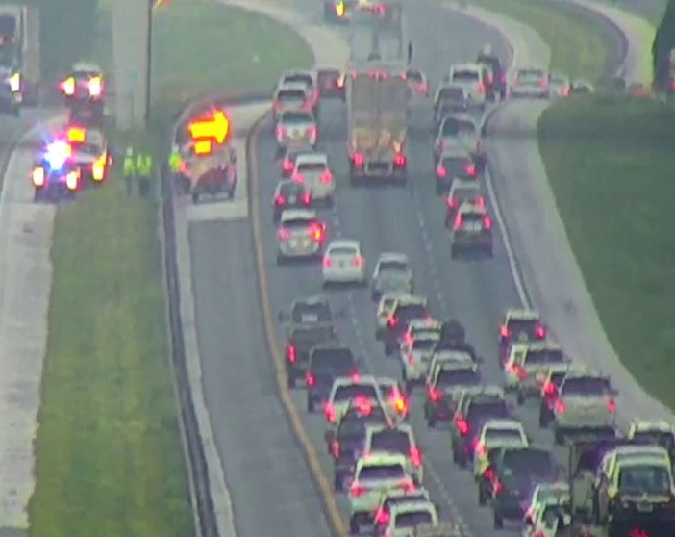
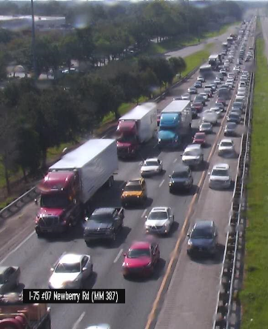
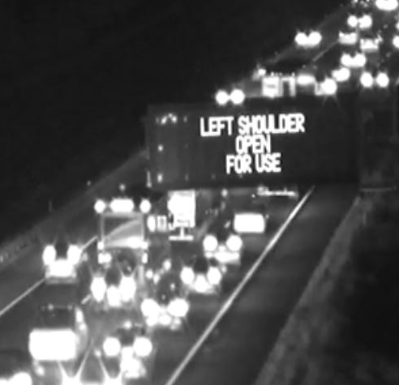
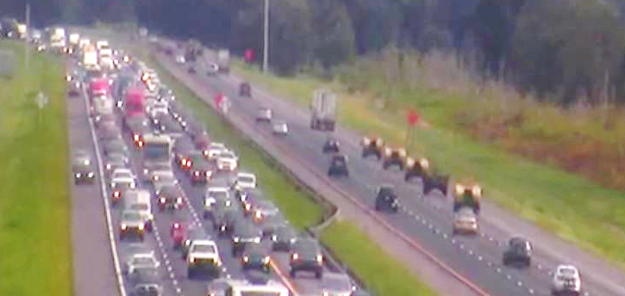
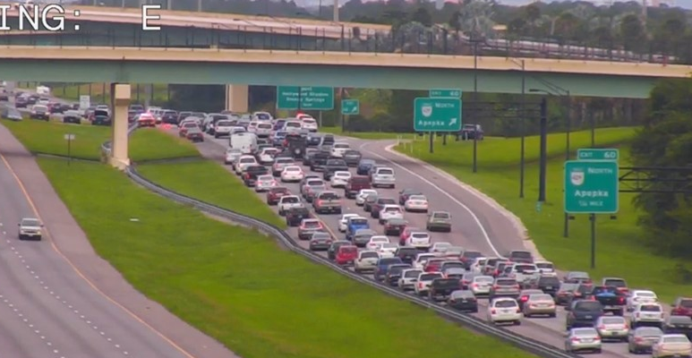
Emergency Shoulder Use

Slide 10
Hurricane Irma Path
Saffir-Simpson Scale
Category | Wind Speeds
Five | ≥157 mph
Four | 130–156 mph
Three | 111–129 mph
Two | 96–110 mph
One | 74–95 mph
Related Classifications
Tropical Storm | 39–73 mph
Tropical Depression | ≤38 mph

Slide 11
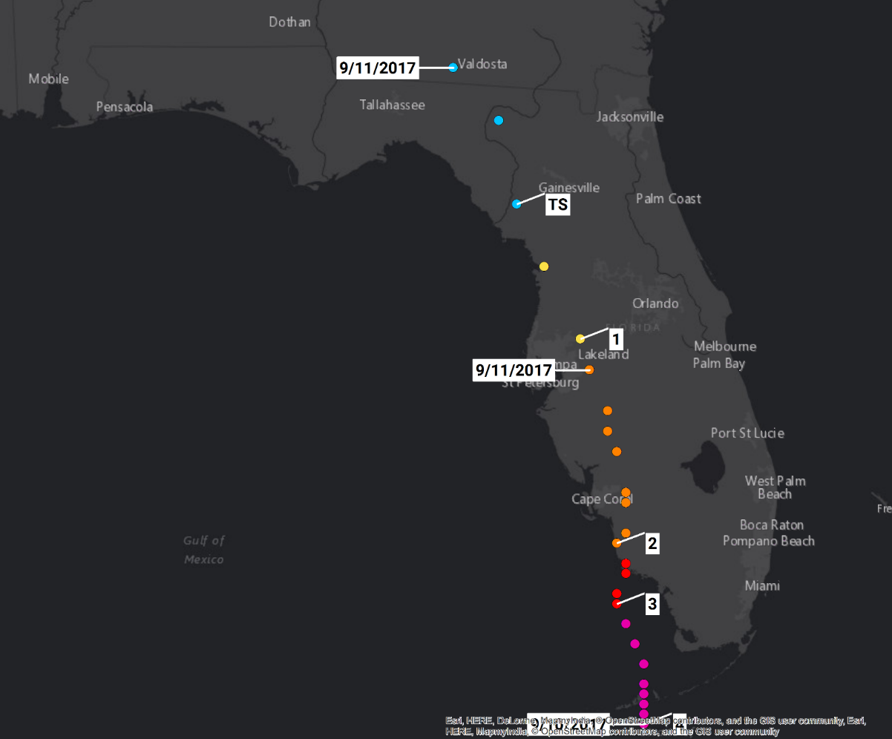
Hurricane Irma Over Florida
Saffir-Simpson Scale
Category | Wind Speeds
Five | ≥157 mph
Four | 130–156 mph
Three | 111–129 mph
Two | 96–110 mph
One | 74–95 mph
Related Classifications
Tropical Storm | 39–73 mph
Tropical Depression | ≤38 mph

Slide 12
Hurricane Irma Over Florida
September 10- 1st Landfall (Cudjoe Key, FL): 130 mph, 929 mb – Category 4
  First Category 4 hurricane to make landfall in Florida since Charley (2004)
  First major hurricane to make landfall in Florida since Wilma (2005)
  929 mb pressure is tied for 7th lowest on record for U.S. landfall with Lake Okeechobee Hurricane of 1928
September 10- 2nd Landfall (Marco Island, FL): 115 mph, 940 mb – Category 3
  Exact same latitude/longitude as well as Category at landfall as Wilma (2005): 25.9°N, 81.7°W

Slide 13
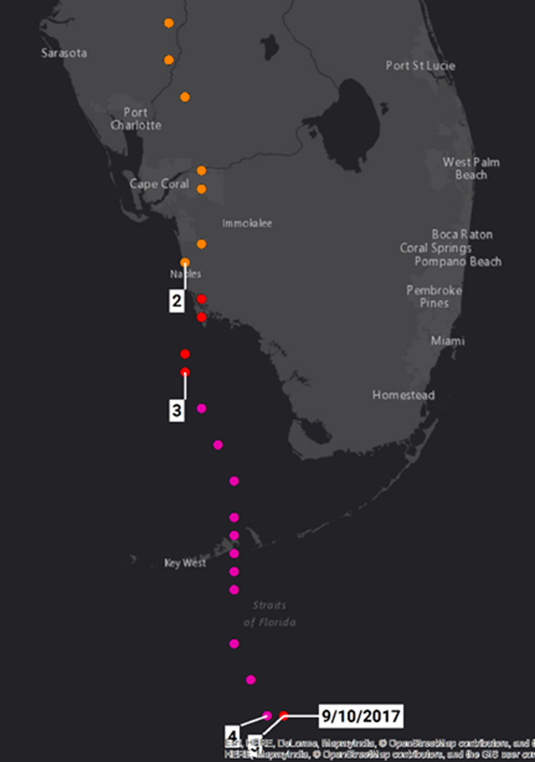
September 10, 2017
Upgrades to a Category 4 as it makes landfall in the Florida Keys.
Downgrades to a Category 3 as it makes landfall in mainland Florida.
Downgrades to a Category 2 as it travels north across Florida.

Slide 14
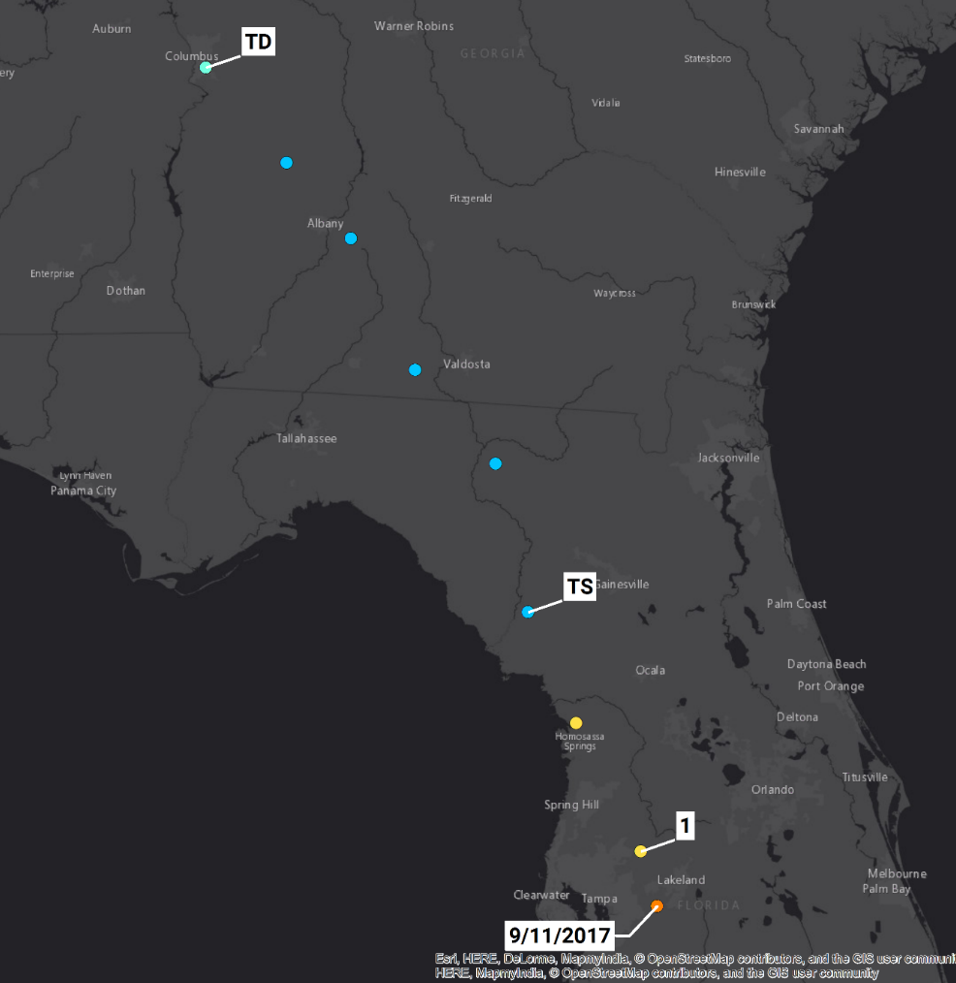
September 11, 2017
Downgrades to a Category 1 Hurricane then Tropical Storm as it continues to travel north.
Downgrades to Tropical Depression over Georgia.

Slide 15
Timeline (Initial Emergency Response)
Sunday, September 10, 2017
  Landfall in south Florida.
  Cut and toss crews and windshield damage assessment to start at first light tomorrow in south Florida.
Monday, September 11, 2017
  Storm tracking up the west side of the state passing Tallahassee around 2PM.
  Cut and toss crews and windshield damage assessment to start at first light tomorrow in north Florida.
  Response starting in south Florida. Critical routes for National Guard, Utilities, and Special Needs Shelters open. Majority of state roads cleared and open except for flooded areas.
  US 1 in the Keys open for legal loads for emergency response to MM 37 (Marathon).
  State Offices closed.
Tuesday, September 12, 2017
  Response starting in north Florida. Critical routes for National Guard, Utilities, and Special Needs Shelters open. Majority of state roads cleared and open except for flooded areas.
  US 1 in the Keys open for legal loads for emergency response to Key West.
  Concerns with re-entry traffic.

Slide 16
Post-Storm Timeline (Emergency Response)
Wednesday, September 13, 2017
  Santa Fe River cresting at I-75, US 41, US 27, and SR 47. Monitored throughout the night.
Friday, September 15, 2017
  First day of returning to “normal” emergency operations.
  Emergency fuel starting to be released.
Saturday, September 16, 2017
  Keys opened to returning residents.
Friday, September 22, 2017
  Concerns and issues with debris contractors.
Continued Ongoing Emergency Response Efforts
  Vegetative debris, C&D debris, leaners and hangers, etc.
  Emergency fuel in Marathon released October 21.

Slide 17
Questions?

