Slide 1

Value Pricing Study
January 22, 2015, MPOAC Meeting
Notes:
Today we are pleased to provide you with a final presentation of the work completed on the Value Pricing Pilot Study, including the work we completed since our last presentation in July and provide a sense of what we believe will be the conclusions of the study and the general design of a potential demonstration project for the Board to consider.
Based on our work so far we believe that a mileage based user fee demonstration project could result in significant new knowledge about how to address traffic congestion and an alternative to funding transportation improvements.
MetroPlan applied for an received funding from a Federal Highway Administration program to conduct this study.
Over the last 12 months a Steering Committee of local experts and a team of consultants have systematically identified and evaluated options for a demonstration project.
During the rest of my presentation I will take you through our process and findings.

Slide 2

Introduction
Review Value Pricing Pilot Study
Pricing Options
Public Involvement
Propose a demonstration

Slide 3
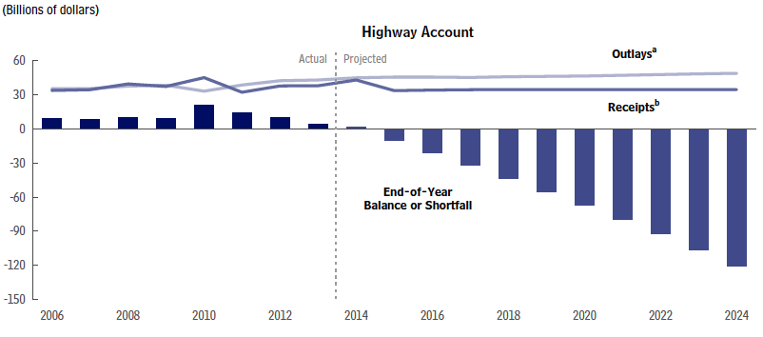

Slide 4
Value Pricing in Transportation
Value pricing (congestion pricing) uses economic incentives to change driving behavior and reduce congestion.
Notes:
Congestion is bad and it’s going to get worse
Supply-side solutions provide diminishing returns, are increasingly expensive and decreasingly effective and revenues to support these solutionsa are diminishing.
Demand-side solutions, includes pricing strategies, or in the language of FHWA value pricing Why?
Fair: people pay for what they use
Efficient: prices ration a scarce resource and in doing so reduce congestion
Generates revenue; substitute for fuel tax
Revenues can build more supply where it makes sense, and the willingness of people to pay travel charges by time and location tells us where they want that revenue spent,
Market principles: user pays for benefits received and “costs imposed.”
Value proposition: safety, speed, convenience and time of travel.

Slide 5



Project Team
Steering Committee Members
Eric Hill, Project Manager MetroPlan Orlando
Gustavo Castro –TTC
Commissioner Robert Olszewski – MAC
Ian Sikonia – BPAC
Corey Quinn - M&O
Bill Randolph – CAC
Gene Ferguson; Lorena Valencia – FDOT

Slide 6
Value Pricing Project
Value Pricing Study: October 2013
Pricing Strategies: June 2014
Status of Project
FHWA Value Pricing
Project Team
Supply-Side
Survey of Public Opinion
31 Pricing Strategies
Criteria; vetting
3 Strategies
Modeling
Mileage Based User Fee
Public Involvement
Draft Final Report
Demonstration
Notes:
Transportation Issues in Central Florida: A Survey of Public Opinion 2013 indicated that 69% respondents support toll revenues and 55% support taxes/fees to fund transportation improvements.
Survey of the Board indicated that 94% support the use of innovative funding strategies for transportation improvements.

Slide 7
Strategies
Strategy | Travel Time | Revenue
Mileage Base User Fee – Fixed | +0.4 % | -0.4 %
Mileage Base User Fee – Variable | -14.2 % | +155.9 %
Parking/Area Pricing | -1.2 % | +16 %
Road Space Management | -4.8 % | +4.9 %

Slide 8
Guidance
Equity
Weight of vehicles
Consistent with FDOT
2015 Legislative Priority

Slide 9
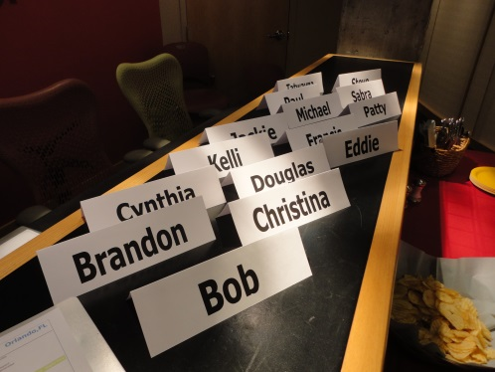
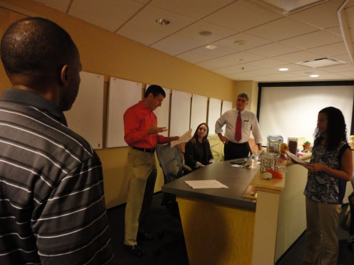
Focus Groups
Agreed traffic congestion is a major problem
More funding was necessary
Concern about how a mileage fee would be implemented and the technology
Intrigued about impact of a mileage fee on traffic, costs and effects on their lives
Notes:
The TDLCB was briefed as a working group. Members were supportive of a mileage fee that could generate additional funding. They had the opinion that additional funding could result in more services for those who are transportation disadvantaged.
Members of the Freight Advisory Council were also briefed as a working group. Members representing railroads felt it was important to charge large trucks a higher fee, due to the wear and tear on the roadways caused by large trucks.
However, those representing the trucking industry were concerned that higher transportation costs would result in higher prices for consumers.

Slide 10
Orlando Chamber of Commerce/Central Florida Partnership
“The concept of a mileage fee that is priced to reduce congestion will help businesses manage their fleets and deliveries more effectively and profitably.”
Jacob Stuart, President, Central Florida Partnership
Notes:
We are not talking about roads—we are expanding avenues of commerce. The purpose of a road is to connect assets to a region. Managing capacity is as old as American business and businesses succeed when they manage capacity well.
The Central Florida Partnership is positioning our community as a center of innovation to encourage global investments. A demonstration project that showcases innovative practices and thinking to help solve the problem of declining fuel tax revenues puts Orlando in the leadership position it deserves

Slide 11
Demonstration
Phase 1: Flat Mileage Fee
Phase 2: Alternate Mileage Fee (Optional)

Slide 12
Objectives
Test replacement of fuel tax
Evaluate technology(s)
User acceptance; value proposition
Examine issues
Notes:
Technical issues of implementation
Driver behavior
Process through which mileage fees are phased in
Institutional issues
Pricing and rate setting policies
Factors that influence user acceptance
Solutions to privacy and evasion challenges

Slide 13
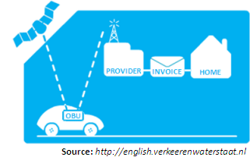
Components
Participatory (volunteers)
Flat fee
Instrumented vehicles (proven technology)
Multiple jurisdictions

Slide 14
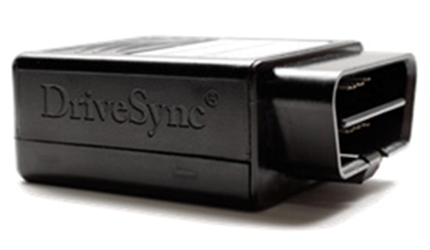
Tasks
Steering Committee
Core Function
Issues
Implementation
Evaluation
Conclusion/Recommendation
Notes:
Evaluation
1. Administration
2. Cost
3. Net revenue generation potential
4. Hardware and software
5. Systemic precision
6. Evasion potential
7. Usefulness for phasing and partial implementation
8. Adaptability to congestion pricing
9. Public acceptance

Slide 15
Budget
Project Task | Cost (000)
Task 1: Steering Committee | $50
Task 2: Core Function | $300
Task 3: Issues | $50
Task 4: Implementation | $400
Task 5: Evaluation | $200
Task 6: Conclusion/Recommendation | $25
Project Total | $1,000
Timeframe: 18 – 24 months

Slide 16
Next Steps
FHWA: FY 2015 Candidate Projects for Value Pricing Pilot Program
Private sector
State and local partnership

Slide 17
Funding
Source | Cost (000)
Federal | $800
FDOT | $150
MetroPlan Orlando | $50
Project Total | $1,000

Slide 18


