Slide 1
Statewide Transportation Planning Update
Metropolitan Planning Organization Advisory Council
Jim Wood, Florida Department of Transportation
January 22, 2015

Slide 2
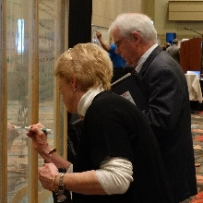
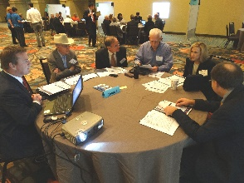
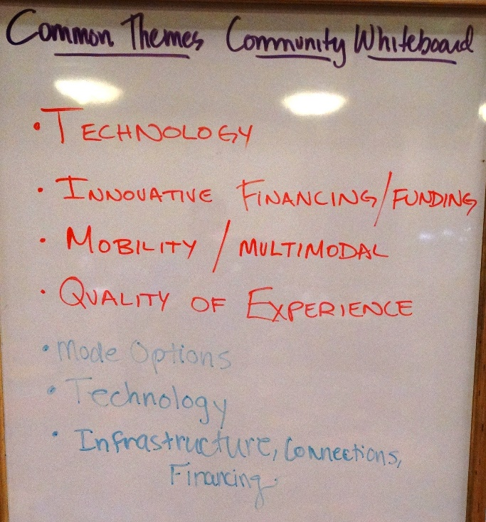
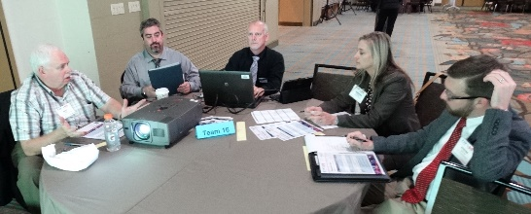
Florida Transportation Visioning Summit
December 17, 2014 in Orlando, 211 participants

Slide 3
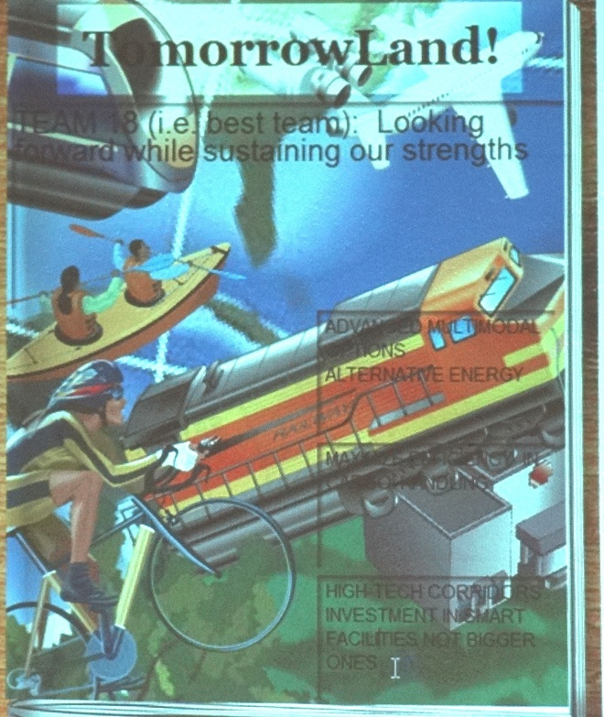
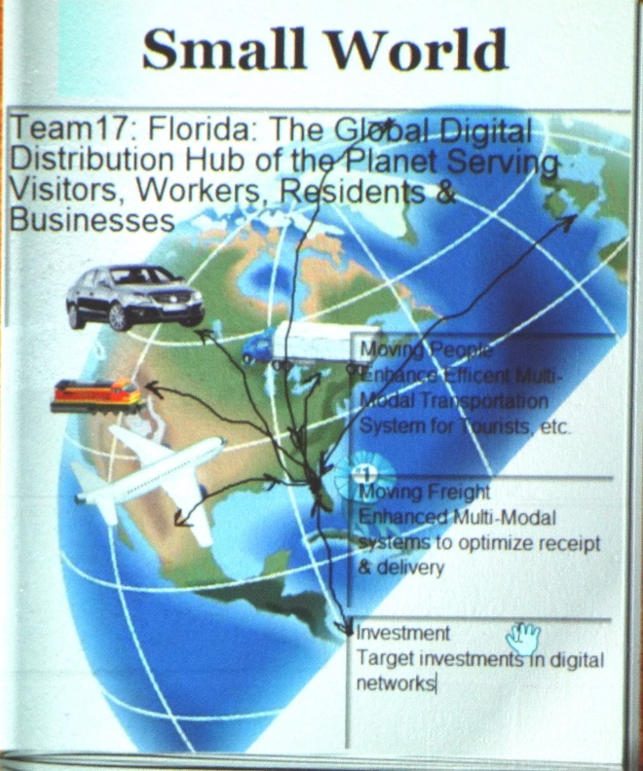
Florida Transportation Visioning Summit Findings
Strong consensus on need for a different future
Strong interest on
future vision around
  Global hub role
  Innovation economy
Discussion of potential
for stronger growth in
inland and rural areas

Slide 4
Florida Transportation Visioning Summit Common Themes
Preparing for changing technologies
Improving efficiency/optimizing use of existing infrastructure
Providing more choices for moving people
Improving connectivity (intrastate, interstate, global) for commerce
Contributing to a high quality of life/experience
Continuing to improve transportation safety
Addressing transportation funding challenges

Slide 5
Regional Forums
February 2 Sebring
February 3 Tampa
February 5 Delray Beach
February 11 Jacksonville
February 12 Fort Walton Beach

Slide 6
Future Activities
FTP/SIS Steering Committee
  6 meetings during 2015, starting January 30
  MPOAC will be represented by Governing Board Chair and Vice-Chair
    Mayor Susan Haynie will serve as Steering Committee Vice Chair
    Councilman Jim Wood will serve as a Steering Committee Member
FTP/SIS Advisory Groups
  ~5 groups to be appointed in March 2015 to advise Steering Committee on key issues
FTP/SIS Workshop with MPOAC (April)
Regional workshops (June/July)
Statewide policy summit (August)
Draft FTP and SIS Plan for public comment (Fall)
FTP and SIS Plan adopted (by December)

Slide 7
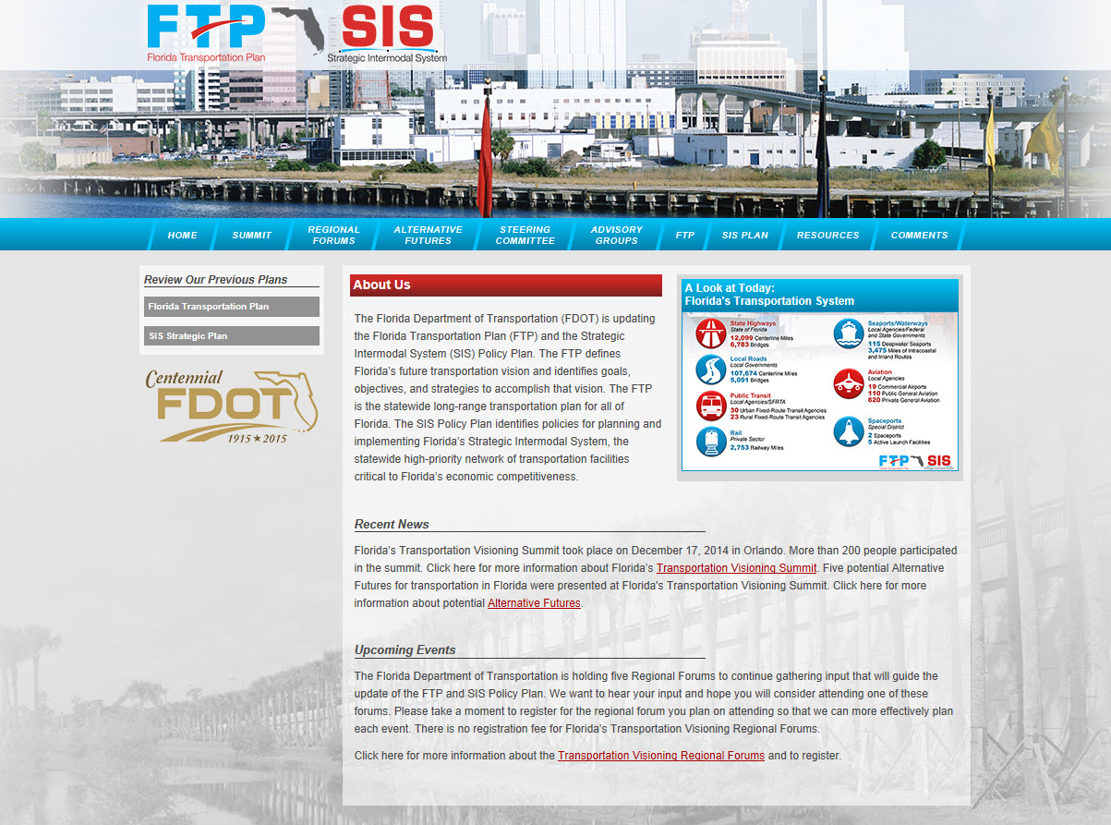
www.floridatransportationplan.org

Slide 8
East Central Florida Corridor Task Force
Created by Executive Order 13-319, November 1, 2013
Purpose: “evaluating and developing consensus recommendations on future transportation corridors serving established and emerging economic activity centers in portions of Brevard, Orange, and Osceola Counties”
Final report was submitted to Governor Scott in December with Proposed Action Plan
Notes:
The Task Force recommends a proposed action plan for further study of existing and new transportation corridors. This action plan includes:
Studies of improvements to the five existing corridors
initiation of Evaluation Studies as part of FDOT’s Future Corridor Planning Process for the four potential new corridor study areas;
amendments to regional and local transportation and land use plans to reflect the corridors and study areas

Slide 9
Proposed Action Plan
Identify future investment needs to maximize the use of and add capacity to existing corridors
Conduct Evaluation Studies of potential new corridors
Develop regional transit system plan
Amend existing local and regional plans to include recommended corridors and be consistent with recommended guiding principles
Develop agreement to strengthen consistency among future transportation, land use, water supply plans
Develop planning tools and legal instruments to reserve and protect rights of way for recommended corridors
Develop framework for partnership and co-location agreements with railroads, utilities, or other infrastructure providers
Notes:
The Task Force recommends a proposed action plan for further study of existing and new transportation corridors. This action plan includes:
Studies of improvements to the five existing corridors
initiation of Evaluation Studies as part of FDOT’s Future Corridor Planning Process for the four potential new corridor study areas;
amendments to regional and local transportation and land use plans to reflect the corridors and study areas

Slide 10
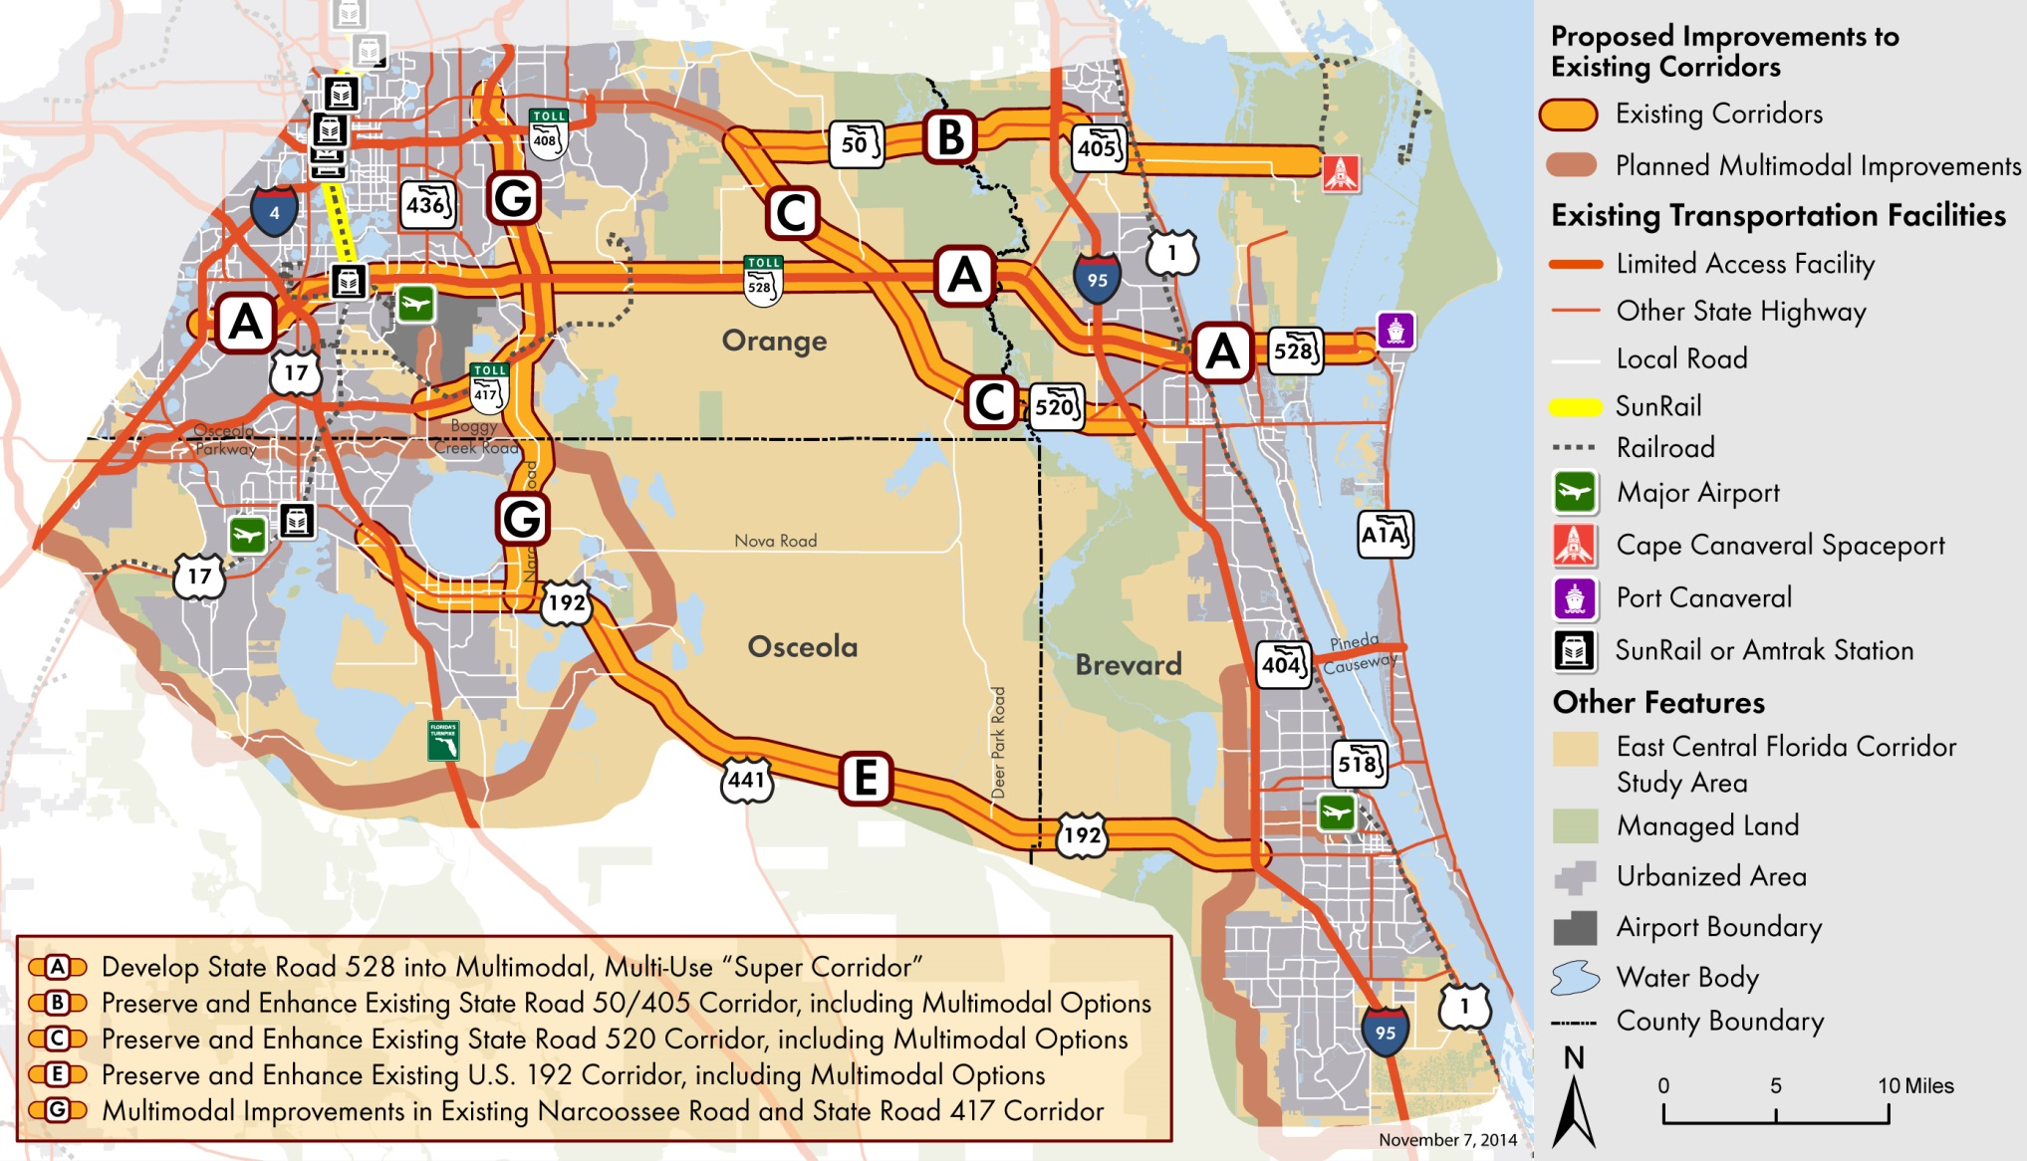
Recommended Improvements to Existing Transportation Corridors
Notes:
Consistent with these principles, the Task Force recommends nine corridor alternatives for further study.
Five of these alternatives primarily involve multimodal improvements to existing corridors, including all four existing crossings of the St. Johns River plus one north-south corridor, as shown on this map
Develop the State Road 528 corridor into a multimodal, multi-use “super corridor” from Interstate 4 in Orlando to State Road A1A in Port Canaveral (Alternative A).
Preserve and enhance the existing State Road 50/State Road 405 corridor from downtown Orlando and the University of Central Florida area to Cape Canaveral, potentially including extensions of planned State Road 50 transit services as well as an extension of the State Road 408/East West Expressway from its current terminus at the Challenger Parkway to the State Road 50/State Road 520 split (Alternative B).
Preserve and enhance the existing State Road 520 corridor from eastern Orange County to Cocoa, building on the planned extensions of State Road 408 and State Road 50 transit service (Alternative C).
Preserve and enhance the existing U.S. 192 corridor from Kissimmee to Melbourne, including multimodal improvements (Alternative E).
Develop multimodal improvements to the existing Narcoossee Road and State Road 417 corridor from U.S. 192 to the University of Central Florida area (Alternative G).

Slide 11
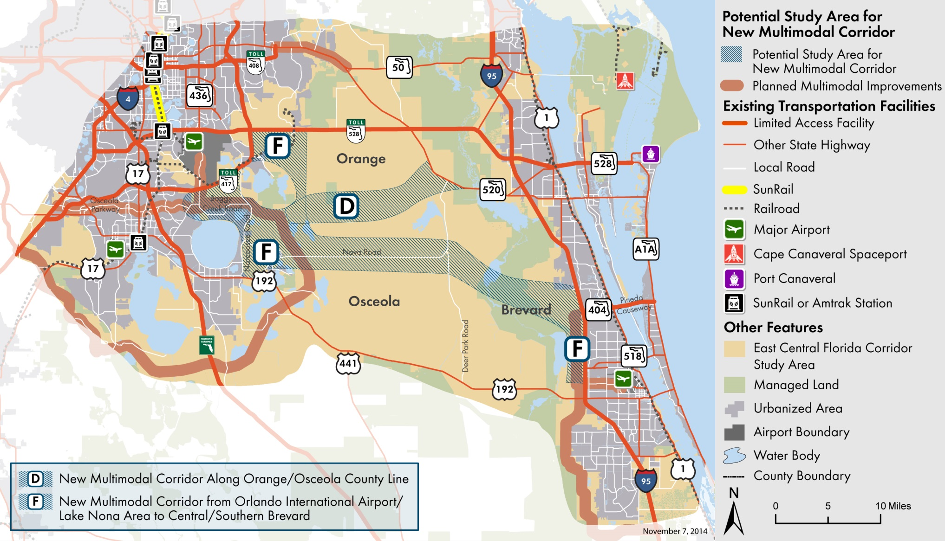
Recommended Study Areas for New East-West Transportation Corridors
Notes:
In addition, the Task Force recommends two potential study areas for new or significantly upgraded east-west corridors:
Develop a new multimodal corridor along the Orange/Osceola County line from the Orlando International Airport/ Lake Nona area to the State Road 520 corridor, serving the Northeast District and portions of the North Ranch (Alternative D).
Develop a new multimodal corridor from the Orlando International Airport/Lake Nona area to central/southern Brevard County to provide a more direct connection between these economic centers, as well as to serve the emerging population centers in the Northeast District and the North Ranch. Planning for this corridor must consider the potential need for an additional crossing of the St. Johns River. The Task Force report notes that this alternative presents environmental and conservation land policy issues that are not evident at this stage of the planning process with regard to other corridor alternatives (Alternative F).

Slide 12
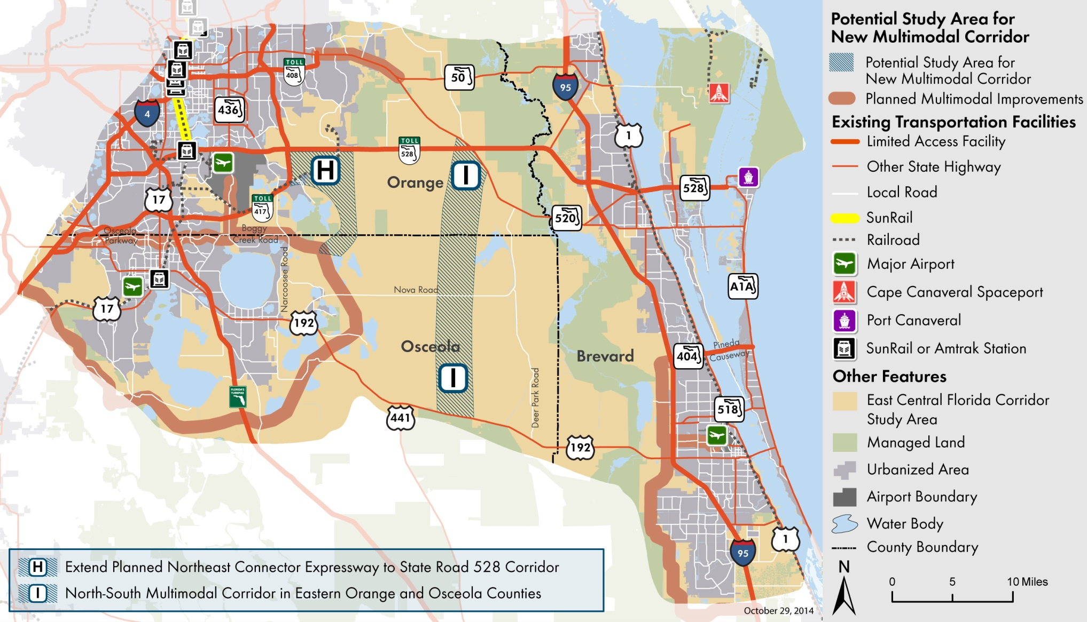
Recommended Study Areas for New North-South Transportation Corridors
Notes:
The Task Force also recommends two potential study areas for new north-south corridors:
Extend the planned Northeast Connector Expressway north from the Osceola Parkway Extension in Osceola County to the State Road 528 corridor in Orange County (Alternative H).
Develop a new north-south multimodal corridor in eastern Orange and Osceola counties to connect the future population centers on the North Ranch to other regional destinations and east-west corridors (Alternative I).
A couple points on these alternatives:
Future studies will evaluate combinations of these corridor alternatives to identify the options that, if implemented together over time, would lead to the regional transportation network most consistent with the guiding principles recommended in this report.
The need for and economic feasibility of each corridor alternative – particularly the potential new corridors—will depend on the magnitude and timing of future population and economic growth including the buildout of existing and planned developments and proposed new centers such as the North Ranch.
In addition, some corridor alternatives may involve impacts on regionally significant lands and waters, productive agricultural lands, and established urban and rural communities. Some alternatives may need to be modified or to maintain consistency with the recommended guiding principles, and planning studies may conclude that some alternatives are not feasible.

Slide 13
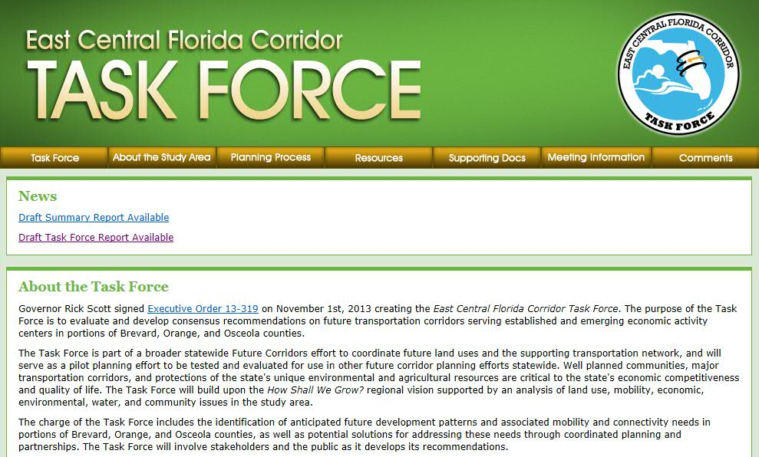
www.ECFCorridorTaskForce.org
Notes:
For more information on the East Central Florida Task Force and to learn about upcoming Task Force meetings and materials please visit the Task Force website at www.ECFCorridorTaskForce.org

Slide 14

Florida Department of
TRANSPORTATION
Jim Wood
Florida Department of Transportation
Jim.M.Wood@dot.state.fl.us
850-414-4814

