Slide 1


Jim Wood
April 2, 2015
Florida Department of
TRANSPORTATION
Briefing
to
MPOAC
Governing Board
and
Staff Directors

Slide 2

Florida Transportation Plan (FTP)
Strategic Intermodal System (SIS) Policy Plan
Schedule Overview
FTP/SIS Steering Committee
  4 more meetings, next on May 29th
FTP/SIS Advisory Groups
  3 Topic Area Advisory Groups (Mar to May)
  SIS Advisory Group (Mar to July)
Regional Workshops (Summer)
Statewide Policy Town Hall (August)
Draft FTP and SIS Plan for public comment (Fall)
FTP and SIS Plan adopted (by December)
Florida Department of Transportation

Slide 3
Advisory Group Structure
Infrastructure
& Growth Leadership
Innovation &
Economic Development
Quality of
Life &
Quality Places
Strategic Intermodal System
Maintenance
Efficiency
Modernization
Connectivity
Choices
Resiliency
Trade & Logistics
Visitors
Innovation
Clusters
Talent Supply
Business Climate
Demographics
Healthy Communities
Environment
Safety
Security
Emergencies
Designation Criteria
Needs Identification
Prioritization Process
Safety
Innovation and Technology
Regional Collaboration
Public/Private and Public/Public Investment Partnerships
Cross-Cutting Topics for all Groups
Florida Department of Transportation

Slide 4
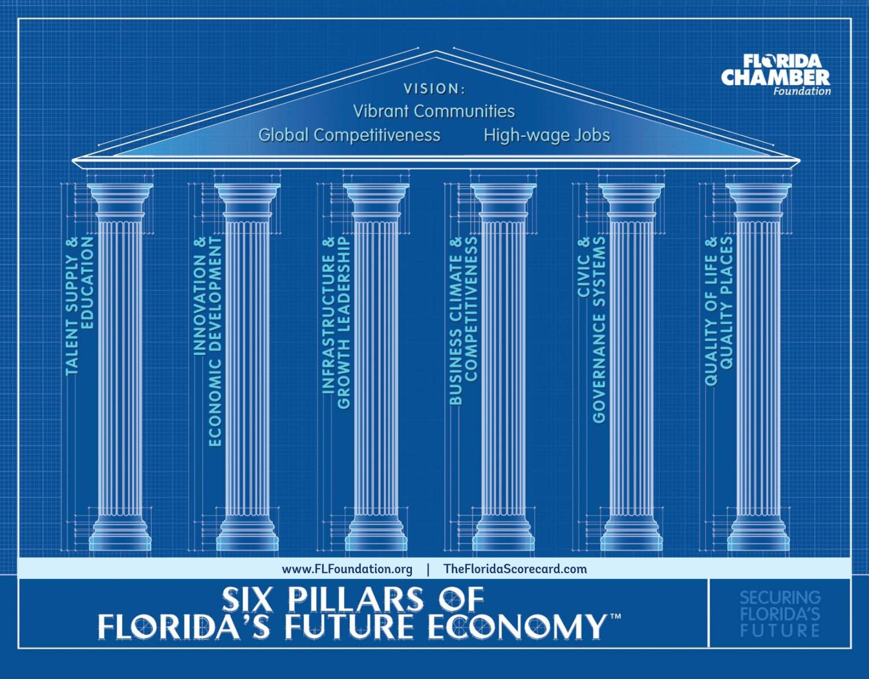
Six Pillars: Framework for the FTP
Florida Department of Transportation

Slide 5
MPO Representatives on FTP/SIS
Steering Committee and Advisory Groups
STEERING COMMITTEE
  The Honorable Susan Haynie (Palm Beach MPO) [Steering Committee Vice-Chair]
  The Honorable Jim Wood (Okaloosa-Walton TPO)
  ADVISORY GROUPS
Infrastructure and Growth Leadership
  The Honorable Susan Haynie (Palm Beach MPO)
  Harry Barley (MetroPlan Orlando)
Innovation and Economic Development
  Carlos Roa (Miami-Dade MPO)
Quality of Life and Quality of Places
  Bob Kamm (Space Coast TPO)
  Marlie Sanderson (Gainesville MTPO)
Strategic Intermodal System
  The Honorable Jim Wood (Okaloosa-Walton TPO)
  Phil Steinmiller (Miami Dade MPO)
  Peter Buchwald (St. Lucie MPO)
Florida Department of Transportation

Slide 6
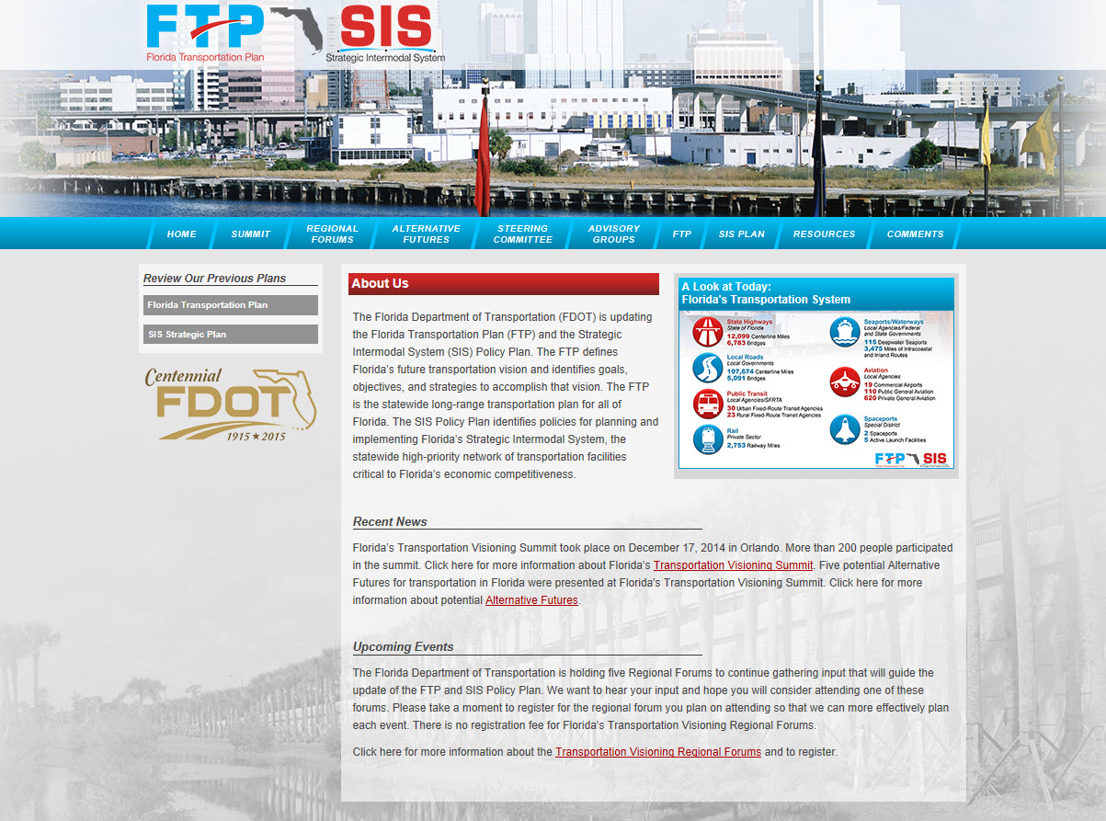
www.FloridaTransportationPlan.com
Florida Department of Transportation

Slide 7
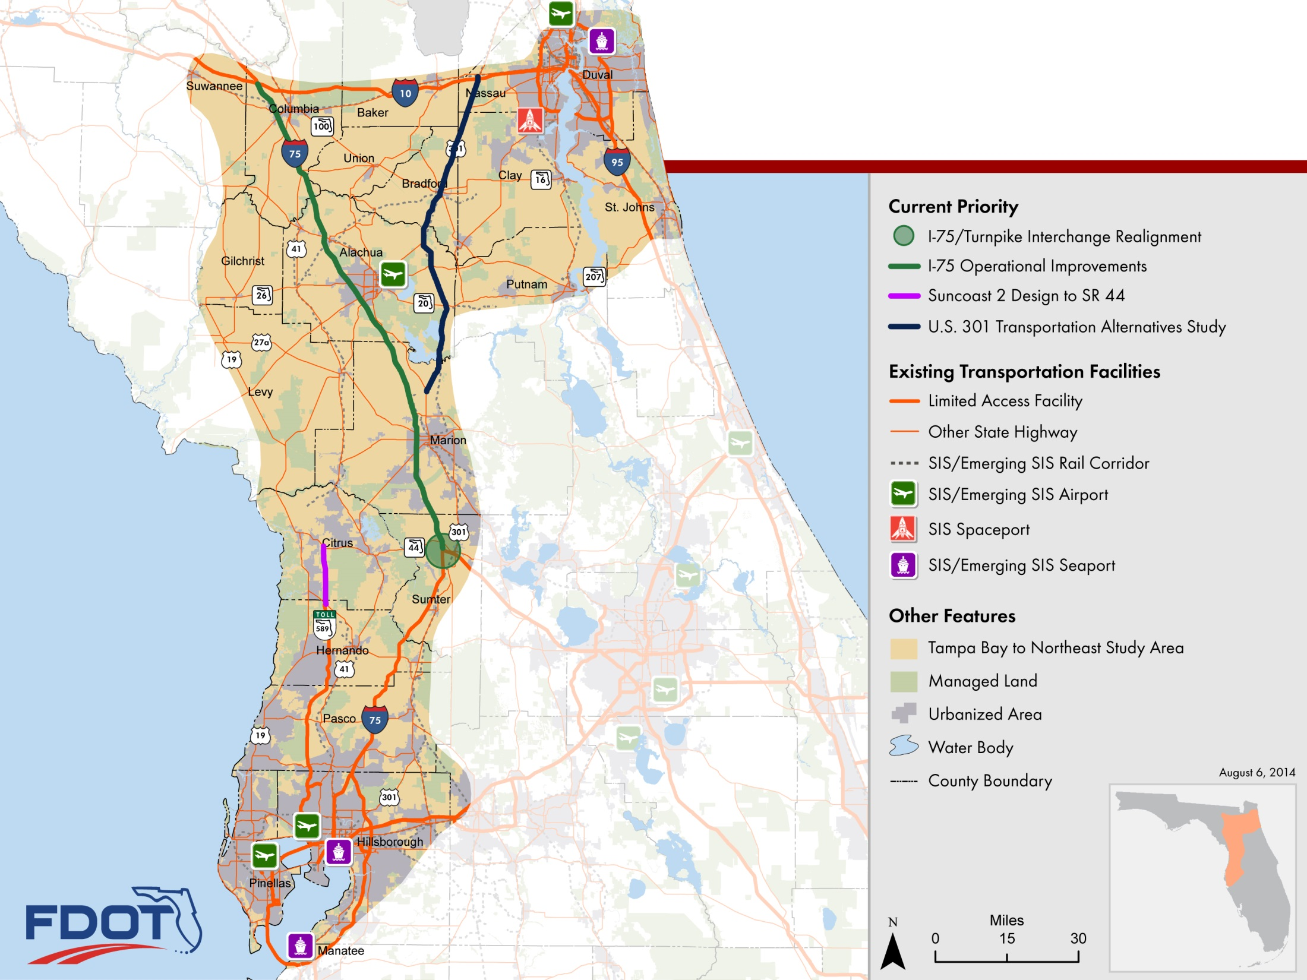
Tampa Bay-NE Florida
Study Area

Slide 8
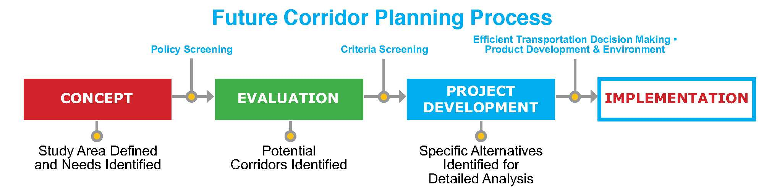
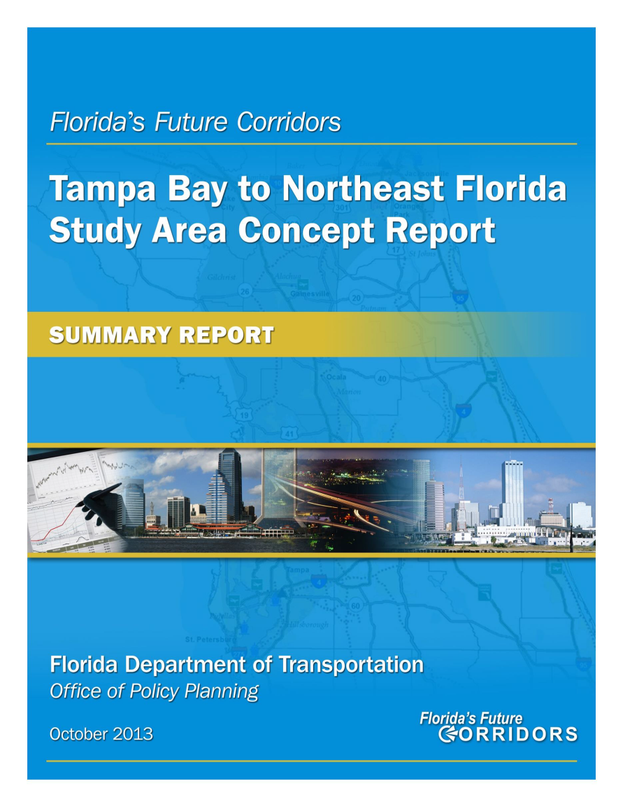
Tampa Bay to Northeast Florida
Florida Department of Transportation

Slide 9
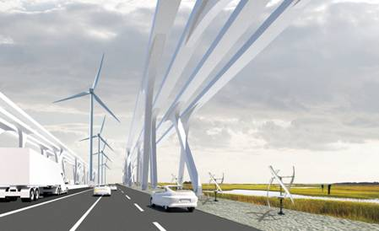
Tampa to NE Florida Future Corridor Study
Identify transportation solutions to connect Tampa Bay to Northeast Florida
  Corridor(s) of the Future
    Multimodal
    Multiuse
    Emerging Technologies
    Utilities
Consultant Selection
  Summer 2015
Launch Formal Evaluation Phase
  Summer/Fall 2015
Florida Department of Transportation

Slide 10
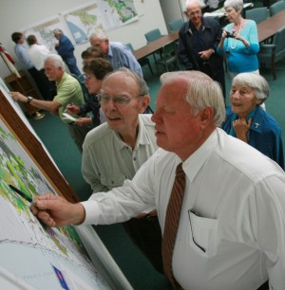
Tampa to NE Florida Evaluation
Public and Stakeholder Involvement
  Launch and support steering group(s)
  Gather stakeholder and public input
  Build consensus
Policy Foundation
  Guiding principles
Alternative Corridor Evaluation (ACE)
  Includes multimodal/multiuse alternatives
Florida Department of Transportation

Slide 11
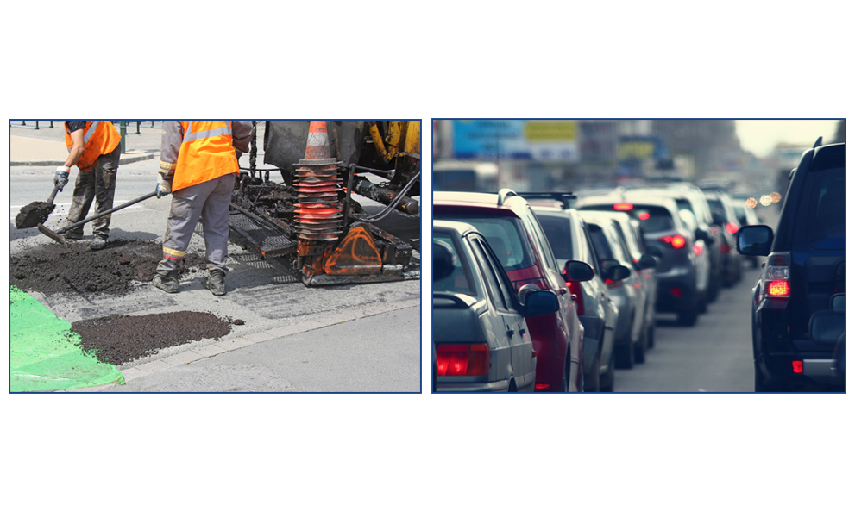
2014 Government Officials Survey
Florida Department of Transportation

Slide 12
Input on Roadway Design
Percent Agree/Strongly Agree
District FDOT officials seek our government unit’s input during design of roadway construction projects.
Florida Department of Transportation
Notes:
Satisfaction varied from year to year. It has increased substantially from the base year though it hasn’t met the target.
NOTE: In 2000, we also surveyed school district transportation coordinators/directors, county sheriffs and city police departments, fire chiefs, and EM heads. That explains the low satisfaction.

Slide 13
Percent Agree/Strongly Agree
Local Govt. Input on Statewide Plans
FDOT officials seek our government’s input when developing statewide plans (e.g., Florida Transportation Plan, Strategic Intermodal System, Freight Mobility and Trade Plan).
Florida Department of Transportation
Notes:
The improvement made previously has sustained. After two cycles of enjoying high satisfaction, we have observed that the results have reached an all-time high at 85%. We can reasonably speculate that high satisfaction may be here to stay.

Slide 14
Input on Priorities in the Work Program
Percent Agree/Strongly Agree
FDOT officials seek our government’s input when establishing priorities for roadway construction projects.
Florida Department of Transportation
Notes:
The improvement made previously has sustained and satisfaction has reached an all-time high.
It was speculated that the increase was due to the extensive local government coordination as part of ARRA**, which might subside. However, during this cycle, we have observed that the results are at its highest, exceeding the performance target even after it’s been raised (80%).
**ARRA: The American Recovery and Reinvestment Act of 2009

Slide 15
Informed How Priorities are Considered
Percent Agree/Strongly Agree
District FDOT officials inform our government unit how our priorities were considered in the development of the Work Program.
Florida Department of Transportation
Notes:
Satisfaction has increased substantially from the base year and met the target.

Slide 16
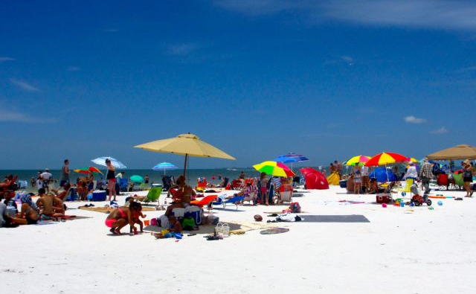
2014 Visitor Survey
Florida Department of Transportation

Slide 17
FL Highways Compared to Home
Florida Department of Transportation
Notes:
Overall, visitor satisfaction with all aspects of the state highway system remained high in 2014. Visitors to Florida view Florida’s roadway features favorably and have had positive travel experience on Florida’s state roads.
Florida highways are also favorably compared to their home state roads by a majority of the respondents. It has reached an all time high.

Slide 18
Rest Area Experience
Florida Department of Transportation
Notes:
Rest areas also received favorable ratings.
Actual statements:
I was satisfied with the cleanliness of rest areas.
I was satisfied with the vending services at the rest areas.
Rest areas were placed frequently enough along the State Highway System
Rest areas were safe.

Slide 19
Airport Experience
Florida Department of Transportation
Notes:
Close to 63% of the respondents used a Florida airport. Respondents were asked to state their satisfaction with access to and from the airport, overall experience at the airport and Florida’s airports vs. those in their home states.
Satisfaction with access to and from the airport has increased from base year and satisfaction with overall experience has reached the highest.
Actual statements:
I was satisfied with access to and from the airport.
I was satisfied with my overall experience at the airport.
Florida’s airports compared favorably to airports in my home state.

Slide 20
Calendar
Statewide FDOT/MPO/FHWA/FTA Meeting
Orlando, April 14 & 15
FTP/SIS Steering Committee
Cocoa Beach, May 29
Statewide Transportation Policy Town Hall
Orlando, August 25
Florida Department of Transportation

Slide 21
Questions?
Florida Department of
TRANSPORTATION

