Slide 1
Presentation to the MPOAC
Transformation of Our State Pre-Construction Process
Text
April 2015

Slide 2
Federal Requirements Impact Analysis
PURPOSE
Objective
To investigate the effect of federal requirements – relative to state requirements – on FDOT’s portfolio of road programs:
  What projects are affected
  What federal requirements have impact
  How much time and money does compliance with federal requirements cost
Goal
To provide analysis to support potential consideration of different approaches to utilizing federal dollars
Scopes
1. Rapid diagnostic that focused on the schedule impact of most significant federal requirements
2. Guidance on how to segment and prioritize federal and state-only projects
3. Design of improvement initiatives improving the efficiency and effectiveness of the state-only process

Slide 3
The study used multiple methods to assess the relative impact of federal requirements
1
2
3
4
Sampling of FDOT projects using Federal-State pairs
FDOT portfolio analysis
External professional interviews
External comparable interviews
Fed v. State Comparison via project sampling
Portfolio analysis for 4 main project types
Interviews with supporting industry
Interviews w/ public and private comps
  59 representative federalized projects compared to 23 non-federalized projects on cost and schedule
  District interviews to understand gaps
  Projects clustered into Widening, New Alignment, Interchange, and Bridge
  Funding source used as a proxy for “federalization”
  Interviews with professional organizations in FL
  Understand how question of federalization affects other industry players
  Interviews with other States that have tackled same issue
  Interviews with private industry in FL that deal with similar environment

Slide 4
Significant findings
  Most if not all projects are being prepared as though they will be federally funded
  Not all projects need to follow the federal process (be federally funded)
  Projects that are implemented following a state only process must remain state funded through construction
  Majority of time/cost savings is in PD&E
  Overlapping the PD&E and Design phases for state funded projects realizes the most time/cost savings
  State funded PD&E process can be further improved to reduce time and costs
  Standardizing state funded PD&E schedules will improve efficiency and improve quality of final products

Slide 5
While only 55% of projects use federal funding, FDOT has an explicit procedural guidance to federalize as many projects as possible
Projects with different levels of federal funding
% of project funded with federal funds
Has some federal funding
100% state funded
  55% of projects are projected to have Federal funding
0%
10%
20%
30%
40%
50%
60%
70%
80%
90%
>90%
It is recommended the District apply the requirements for a federal process any time there is a possibility in which federal funds could be used on any phase of a project or if FHWA, FRA or FTA approval is going to be required.
- FDOT PD&E Manual
(Part 1, Ch 10)
Source: 10-2.1 Determination of Federal Action; FDOT PD&E Manual; 2014-2018 Work Program

Slide 6
The focus of the study is on the share of projects in FDOT’s portfolio where federalization is not mandatory and FDOT therefore has discretion about whether to federalize
2014-2018 Work Program
$B
2
1
2
4
Work Program
Work Program Non-Roadway
Roadway
Interstate¹
Turnpike
Off-System²
Projects over which FDOT has discretion to federalize
Projects with dedicated federal funding sources³
Projects
that likely require little PD&E work⁴
Choice to federalize has impact
Explanation:
Always federalized
Almost always state funded
Almost always has some federal funding
FDOT will continue to make the most of these funds
The choice whether to federalize is likely not impactful
For some share of the $9B, FDOT will still need to go through the federal environmental process because either:
1) The project triggers a federal action under NEPA (e.g. needs a Coast Guard permit)
2) The project touches land over which the federal government has jurisdiction (e.g. interchange with interstate)
1 For interstate, turnpike, and off-system, the value includes all non-preservation and non-ops projects
2 Defined as estimate of county roads
3 Includes preservation
4 Likely includes operations and ITS
Source: Estimates from 2014-2018 work program

Slide 7
Decision tree for when to use state funding only
Federalize project: do NEPA in concert with USDOT/FHWA and spend federal money on ALL phases, including PD&E
No choice but to spend federal money (e.g., off-state highway system)
Do NEPA document for PD&E with only state money¹
Candidate projects for SEIR and only spending state money through full life cycle
Federal action by USDOT requires NEPA, e.g. interstate
To determine what type of money to spend on the project
There is a dedicated and specific federal funding source (e.g., federal bridge program) that can’t be used elsewhere
If federal money remains once we reach this bucket, put federal money first on projects with bigger spend but lower benefit, beginning with lowest Class of Action
Federal action by another agency requires NEPA²
FDOT can choose the funding source
What type of PD&E doc to do?
All other
1 Do NEPA document with state money only, thus later phases of project are not automatically federalized, yet flexibility is maintained for using federal money in subsequent phases
2 Applies in the case of needing a federal permit. The lead agency for issuing the permit should be the lead agency for NEPA approvals. Since no federal dollars are used on PD&E, no USDOT federal action is triggered. Therefore USDOT/FHWA is not required to be involved in NEPA document review or approval.

Slide 8
Federalized projects sampled lasted 1.8x-3.5x longer in pre-construction than State projects
Average length of pre-construction for project samples
Months
108
102
89
1.8x
75
2.0x
PD&E
2.4x
59
52
38
3.5x¹
10
DES
PD&E
DES
0
Turnpike
Federalized
Turnpike
Federalized
Turnpike
Federalized
Turnpike
Federalized
Bridge
Interchange
Widening
New Alignment
1 No PD&E was available for Turnpike projects, so the 3.5x difference is calculated only during the Design phase
Source: Sampled projects provided by all 8 FDOT Districts for purposes of this comparison

Slide 9
Districts selected 44 projects to be programmed as state-funded in the current gaming cycle, resulting in an estimated 97 years of time saved, just by following the state process
Just from putting these projects through the current state process, as demonstrated by the Turnpike, we’d expect to save 97 years of pre-construction timing
By further streamlining the state process, we can expect time savings of up to 247 years²
Projects identified for state-only funding
# of projects across all districts
2-5
SEIRs in Fiscal 2014
Existing state-only eligible projects in gaming cycle ’15
New projects added in gaming cycle ’15
Not programmed as state-only¹
Programmed as state-only (NFE) in gaming cycle ’15
1 Projects removed from state-only eligibility at the discretion of the districts due to: uncertainty of future funding needs, availability of current or future eligible state funds, existing plans to use federal funds
2 Range is based on calculating time savings for the 44 projects through a comparison of average federal pre-construction durations by expected environmental class of action vs. 1) average current state process durations, as shown by Turnpike projects used in project sample and Districts 4 & 6 Value Engineering on the fed process, and 2) streamlined state process with PD&E & Design overlap
Source: Baseline for days saved comparison derived from Federal Impact Analysis, Summer 2014
Notes:
As you’ll remember from the fall, we selected 44 projects to be funded with state dollars, and our expectation is that we can save at least 94 years of work on those projects by putting them through the current state process. With the improvements we are implementing, though, we actually expect those savings to increase significantly – with the possibility of saving almost 250 years of work on just those 44 projects
I’ll now tell you a little about the improved state process we’ve defined and how we will make sure the time savings I’ve shown you here are real

Slide 10
We have defined an improved state process expected to cut pre-construction time by 60-75%
Planning
Procurement
PD&E activity
Design activity
Both PD&E and Design
Existing process: average duration of 94 months across all project types
Const.
letting
LDCA
Planning
PD&E procurement
PD&E
Design procurement
Design
New process : average duration of 28 months across all project types
Federally-funded:
Follow current process
E
District
secretary
signs SEIR
Procurement
PD&E
D
State-funded
Initial data collection and analysis
F
A
Design
Const. letting
SWAT planning
meeting
C
SWAT project kickoff
ROW survey and mapping, acquisition
B
ETDM programming screen
Source: Note: average durations are calculated across different project types, actual expected project duration varies by project.
Notes:
The improved state process consists of six major steps
District SWAT teams meet once per year for the SWAT Planning meeting. At this meeting, the SWAT team, plus ISD/Planning, the work program, and EMO, meet to discuss the projects that are set to be gamed in the upcoming cycle
During this meeting, the group discusses the core elements of the purpose and need for each project, ensures alignment with the MPO on the projects to allow for coordination if necessary, and then decides which projects are good candidates for state funding. The key deliverable of this meeting is a list of projects that work program should try to game with state money.
After the SWAT planning meeting, the ETDM programming screen begins, getting critical information from external partners early in the project development process that will then feed the scope of services and later stages
One year ahead of when PD&E / Design money is programmed, the SWAT team meets for a SWAT project kickoff, to discuss the specific state project that is upcoming. At this meeting, the team defines the scope of services for the project, determines the high-level schedule to be followed and therefore the schedule target for the performance dashboard, and also decides the project management and contracting strategy
Of critical importance is the next step – coming out of the SWAT planning meeting, the team should have an idea of the work that needs to be done. The team then begins as many activities as possible, such as survey, geotech, traffic, long-lead species surveys, etc. This helps ensure consultants are able to hit the ground running once PD&E and Design begin
While initial analysis is starting, procurement begins for BOTH PD&E and Design – contracting them together when possible
Then PD&E and Design begin, with as much overlap as possible given project characteristics

Slide 11
We have been working for the past year to streamline the preconstruction process, and we will continue to do so
Implement transformation across districts
Build foundation for implementation
  Support implementation of improved process across districts
  Build capabilities across districts
  Continue to manage process and monitor performance centrally
Project Diagnostics
  Define lean project planning process and create tools necessary for implementation
  Build management structure to support transformation
Problem Definition
  Assess opportunity
  Design blueprint for change
  Identify whether federal requirements have an impact on project cost and duration
Summer 2014
Fall 2014
Today
Rest of 2015
Notes:
As you know, FDOT is undertaking a large change program that will meaningfully improve the way we work and shorten the timeframe in which we can deliver our projects
We started last year by looking at whether federalized projects took longer than state projects – we found that they did, federalized projects take 2-3 times as long
We then set out to understand what we could do about the difference we saw -- and how we could segment our work program to allow for some projects to be funded with only state dollars
Once we decided to do some projects under a state process, we realized that we had an opportunity to revisit our state process and improve it
Now, we are just finishing work to define an improved state process and are beginning to implement it across the state
This is the start of continued innovation in our processes -- we want to keep getting better in delivering our mission
We see huge value for the public in the improvements we are making
FDOT has a chance to be a real leader among DOTs – we want to seize the moment

Slide 12
We have applied the new process to an initial set of ten projects and have already found 57% time savings, across all project types
District#
Time Savings
% of Federal Benchmark
Time savings from District workshops
Procurement to Production duration
7
69%
Total years for ten projects
Type II CE
EIS
EA
SEIR
T
65%
95
4
59%
-57%
2
58%
3
56%
1
55%
6
52%
Pre-Workshop
Post-Workshop
50%
5
Source: Source
Notes:
Out of the 11 state projects, plus the 1 from the turnpike, we have been able to create new schedules for 10 of them and see 57% reductions on average, comparing the projects to the federal benchmarks.
Assuming that design money can be brought forward for those who need it, we expect to see the 57% savings.

Slide 13





Our transformation focuses on more than just the improved state process
Process Design
Management infrastructure
Define a streamlined process that is easy to use and adaptable
Support change with appropriate systems, teams, and infrastructure
FDOT’s public mission
Culture
Organization and Skills
Build support for a new way of working
Ensure the organization has the required training and support to succeed
Notes:
Transformation of the way we work
We will not just be focused on the state process, we are also making sure we have the right management system, the right skills, and the right culture to succeed in doing things differently and better

Slide 14
Districts have each nominated a State-Wide Acceleration and Transformation (SWAT) Team to lead the effort in improving how we operate
Current SWAT Team Organization Chart – Feb 2015
Text
Text
Bernie Masing
Bill Hartmann
Gwen Pipkin
Steve Walls
Joe Lauk
Henry Pinzon
Patrick Muench
Joseph Chinelly
Ronald Bell
Paul Satchfield
Marlon Bizerra
Turnpike
D1
Text
Text
Nelson Bedenbaugh
Stephen Browning
Kathy Thomas
Will Watts
Jim Knight
Robin Rhinesmith
Karen Demeria
Kirk Bogen
Frank Chupka
Waddah Farah
Richard Moss
Bill
Henderson
D7
D2
CENTRAL TEAM
  Marjorie Kirby (lead)
  District SWAT Leads
  Ken Morefield
  Kendra Sheffield
  Xavier Pagan
  Bob Crim
  Paul Hiers
Teresita Alvarez
Scott Golden
Text
Text
Regina Battles
Joy Swanson
April Williams
Brandon Bruner
Jason Crenshaw
Craig James
Aileen Boucle
Dat Huynh
Alejandro Casals
Linda Glass Johnson
D6
D3
Brian Stanger
Steve Braun
D5
D4
Text
Bill Walsh
Steve Friedel
Jeff Cicerello
Amy Sirmans
Steve Smith
Beata Stys-Palasz
Text
John Olson
Ann Broadwell
Scott Peterson
Richard Young
Leslie Wetherell
  District SWAT Teams: Support the Projects
  Hold SWAT planning and project kick-off meetings to focus the project scope and schedule
  Drive improvement through structured problem solving
  Push District innovations state-wide through Central SWAT
  Communicate process changes to PMs and Consultants
  Central SWAT Team: Support the Districts
  Collect expertise and best practices across Districts
  Identify and deploy tools and programs to encourage continuous improvement
  Monitor progress of implementation
  Work with District SWATs to facilitate state-wide training
Notes:
We have two SWAT teams that support this effort:
District SWAT Teams support state-funded projects at each district
Help us deliver projects within the improved state process by working with project managers to scope projects tightly and to define high-level, streamlined schedules
Are FDOT leadership’s ears within the organization – we want to hear from you about what is working, what is challenging, what else you’d like to be able to
Are critical in disseminating this information from today’s training to PMs, consultants, and the rest of the staff at your district
The Central SWAT Team is made up of each District SWAT Team Lead, plus a group from Central Office – representing many departments and functions
When the Central SWAT team meets, they will discuss how each district is implementing the state process.
We expect each District lead to come with information on what’s working, how the latest state projects are developing, and suggestions for things that FDOT leadership should consider.
These meetings are at the heart of making sure we communicate across districts and that we monitor the progress of implementation

Slide 15
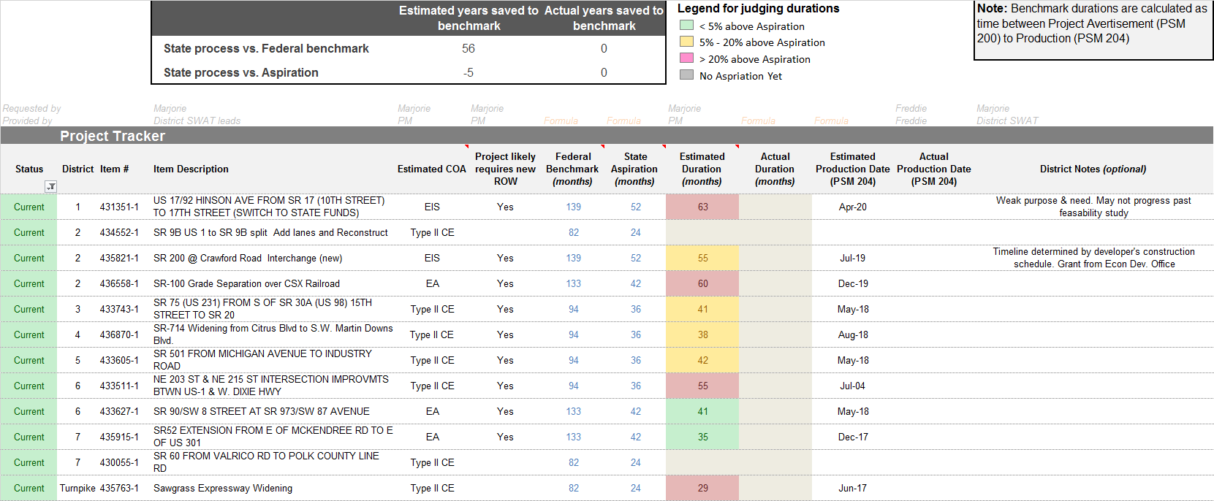
FDOT leadership will track success of the projects in meeting reduced schedule targets
  Performance Management
  The dashboard will be updated and reviewed regularly by leadership
  The dashboard tracks time from Project Advertisement (200) to Production (204)
  We can compare a project to an estimate of what it would have been if it had been federalized
  We will track each project against our aspiration for its duration under the new process
Notes:
Our leadership team will be monitoring each state project to ensure it meets our reduction targets.
The Executive Committee will see a snapshot of each of the state projects during the monthly Executive workshop, where we will get a sense of whether we are on track to hit the schedule reduction targets.
Marjorie will discuss the dashboard and performance management in more detail later this afternoon

Slide 16
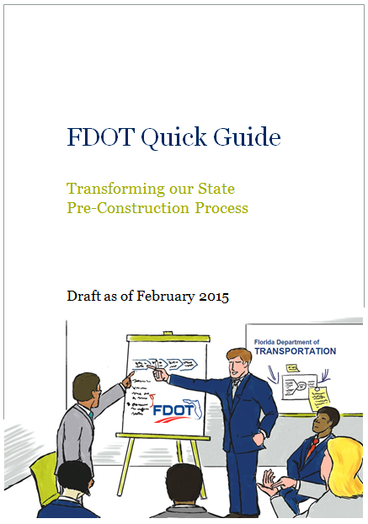
We created a Quick Guide to support staff in implementing the improved state process
The Quick Guide includes information on…
  Each step of the improved state process
  The teams that support the transformation and the performance management system
  Expectations for roles of everyone involved in the process
  Tools to support teams, such as scoping checklists, sample meeting agendas, and example schedules
  Information to support each District to develop a culture of innovation and process improvement
Notes:
We’ve developed a Quick Guide for the new process that supports each District in implementing their projects under the state process. It includes step-by-step guidance, sample meeting agendas, expected deliverables at each stage, and other tools for project management

Slide 17
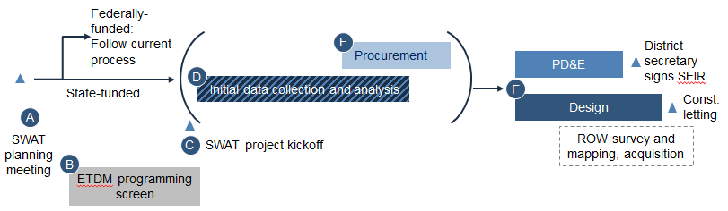
These changes are only the beginning – we have embarked on a long journey of continuous improvement
Continuous improvement of the process
1. Segment Federal vs. State
2. Improve scheduling of high-level blocks
3. Optimize process within blocks
4. Change the way we operate
Implemented and in Work Program Instructions
We are here
Moving the timing of big blocks (e.g. PD&E and Design)
Find waste within each process bucket
Change the detailed process
Long term transformation
E.g. New ways to engage the public
Notes:
The journey to improve the way we work is just beginning. As I’ve discussed today, we have already started and made meaningful improvements. We have done:
Step 1 was segmenting our portfolio to create state-funded projects that could benefit from a state defined process
Step 2 is now, and it is streamlining the process at a high-level to get some quick time savings
We see us digging deeper in the future. That means in the future we could also pursue:
Optimizing our pre-construction process at a more detailed level – e.g. what are we doing within PD&E and Design that we could do differently or more easily? What could we do to improve procurement? What could we do to shorten ROW while still maintaining a good process?
Consider broader changes to the way we operate, which could include things like the way our departments are structured, or the way we engage the public, or the technology we use

Slide 18
Questions?

