Slide 1
Florida Transportation Plan and Strategic Intermodal System Policy Plan Updates
An Overview
Florida Metropolitan Planning Organization Advisory Council
Carmen Monroy, Florida Department of Transportation
Director, Office of Policy Planning
July 23, 2015
Notes:
My name is Carmen Monroy and I serve as the Director of the Office of Policy Planning at the Florida Department of Transportation.
Thank you for the opportunity to present information about the Florida Transportation Plan (FTP) and Strategic Intermodal System (SIS) Policy Plan Updates. The objective today is to highlight parts of the policy framework based on input received so far, and answer any questions or receive comments.

Slide 2
Today’s Agenda
FTP/SIS Update
PL JPA & Invoicing
SB 2514-A Update

Slide 3
FTP/SIS Steering Committee and Advisory Groups: MPO Representation
Steering Committee
  The Honorable Susan Haynie (Palm Beach MPO) [Vice-Chair]
  The Honorable Jim Wood (Okaloosa-Walton TPO)
Advisory Groups
  Infrastructure and Growth Leadership
    The Honorable Susan Haynie (Palm Beach MPO)
    Harry Barley (MetroPlan Orlando)
  Innovation and Economic Development
    Carlos Roa (Miami-Dade MPO)
  Quality of Life and Quality of Places
    Bob Kamm (Space Coast TPO)
    Marlie Sanderson (Gainesville MTPO)
  Strategic Intermodal System
    The Honorable Jim Wood (Okaloosa-Walton TPO)
    Peter Buchwald (St. Lucie MPO)
    Phil Steinmiller (Miami Dade MPO)
Notes:
MPOAC representation on the Steering Committee and Advisory Groups

Slide 4
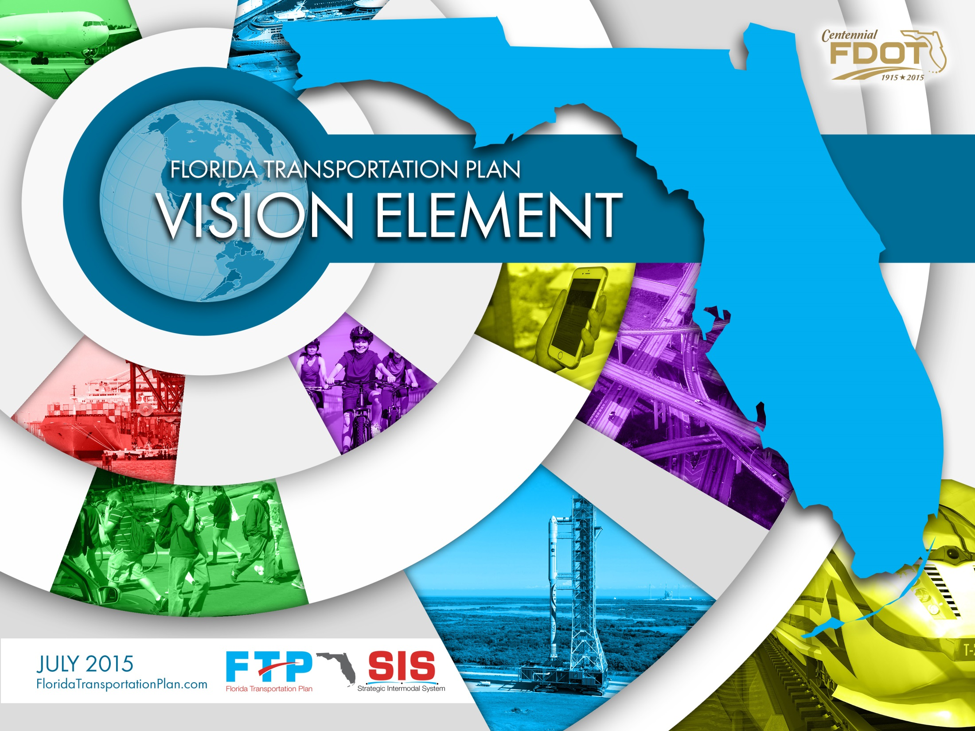
Vision Element
DRAFT
Notes:
FDOT is updating the Florida Transportation Plan this year. The Florida Transportation Plan or FTP is the state's long range transportation plan. The FTP serves as the transportation plan for all of Florida, not just the Florida Department of Transportation and identifies the roles and responsibilities of all partners for implementing this plan.
In addition, FDOT is updating the Strategic Intermodal System Policy Plan to reflect the new policies and direction of the FTP.
========NOTE to PRESENTER==========
In case there are questions about the particular images shown…. This is a DRAFT. They are representative and there will be a variety of photos in the document. The intent is to cover all modes and all regions somewhere within the full document. (For example, a truck could be included on the back cover.)

Slide 5
New Florida Transportation Plan
Anticipated Contents
Vision Element (summer 2015)
  Trends, uncertainties, themes that will shape future of transportation in Florida (50 years)
Policy Element (December 2015)
  Goals and objectives to guide FDOT and partners toward the vision (25 years)
Implementation Element (2016)
  Emphasis areas with key actions (5-25 years)
Notes:
We anticipate that the new FTP will have 3 elements:
Vision element – this element will focus on the major trends, uncertainties, and themes that will shape the future of transportation over a long period (perhaps 50 years). The vision element will be released for comment this summer.
Policy element – goals and objectives that will guide FDOT and our partners in making decisions on long-range plans and investments. This will have a 25 year horizon to match our MPO plans. The policy element will be completed by December.
Implementation element – emphasis areas with specific defined actions during the short and medium term. This will be developed in 2016.

Slide 6
New Florida Transportation Plan
What’s Different?
Greater focus on
  Alignment with economic development, community development, environmental stewardship (including Six Pillars)
  Providing more transportation choices
  Energy, public health
New focus on supporting transportation system through
  Talent/workforce
  “Soft” infrastructure (customer service, information,
  regulatory processes)
  Innovation and technology
Notes:
When it comes to the vision for the future, we are hearing themes similar to those identified in the previous FTP – safety, maintenance of existing infrastructure, mobility, and economic competitiveness, for example. This is appropriate as the key goal areas reflect values for our state. It also helps with tracking progress in implementation.
There also are some existing topic areas receiving more attention this time:
The alignment with the Florida Strategic Plan for Economic Development (led by the Department of Economic Opportunity) is more prevalent, as is alignment with community development and environmental stewardship goals. We are using the Six Pillars of Florida’s Future Economy, developed by the Florida Chamber Foundation and adopted by many agencies statewide, as a framework for the policy discussions.
There is an emphasis on providing more modal choices for people and freight, particularly transit and active transportation – walking and biking.
And, more emphasis on transportation’s relationship with the public’s health and energy use.
There also are some new topic areas being brought into the planning process :
Talent and workforce needs, particularly around global trade and logistics.
Soft infrastructure items, like providing better information to users, improving customer service, and providing more efficient regulatory processes.
And, with advances getting more public attention, addressing innovation and technology and the need to be more nimble regarding planning and implementing transportation solutions
====NOTE to PRESENTER=======
If questioned, this slide focuses on the newer issues being raised with this update. It is not a complete list of all of the issues identified. Other issues from the current FTP, like safety, maintenance, freight, and mobility, continue to remain important.

Slide 7
Where Do We Want to Go?
Over the next 50 years, we want…
Safety
and
Transportation solutions that support Florida’s global
Security
Economic Competitiveness
for residents,
visitors, businesses
Agile, Resilient,
Transportation solutions that support
and
Quality
Quality Places
transportation infrastructure
to live, learn, work, and play
Efficient and Reliable Mobility
Transportation solutions that enhance Florida’s
for people and freight
Environment
and
Conserve Energy
More Transportation Choices
for people and freight
Notes:
The process is being guided by a 35-member Steering Committee representing transportation stakeholder groups. Based on the input received to date, policy goal areas are emerging to answer the question…… What should our transportation system look like in 50 years? These areas are:
Safety and security for residents, visitors and businesses
Broader safety & security and emergency response, beyond the transportation user
Agile, resilient and quality transportation infrastructure
High quality infrastructure, able to react more quickly to technology and societal shifts, and addressing extreme weather and climate trends
Efficient and reliable mobility for people and freight
Reliability, supply chain efficiency, regulatory processes, and quality of service
More transportation choices for people and freight
This area is a new emphasis being added – to provide more modal choices
Transportation solutions that support Florida’s global economic competitiveness
Connectivity among economic centers/clusters; connectivity of data, information; and access to talent
Transportation solutions that support quality places to live, learn, work, and play
Supporting regional and community visions, providing context sensitive solutions, enhancing public health, and responding to demographic shifts
Transportation solutions that enhance Florida’s environment and conserve energy
Preserving and enhancing our natural systems and reducing transportation’s footprint on the environment

Slide 8
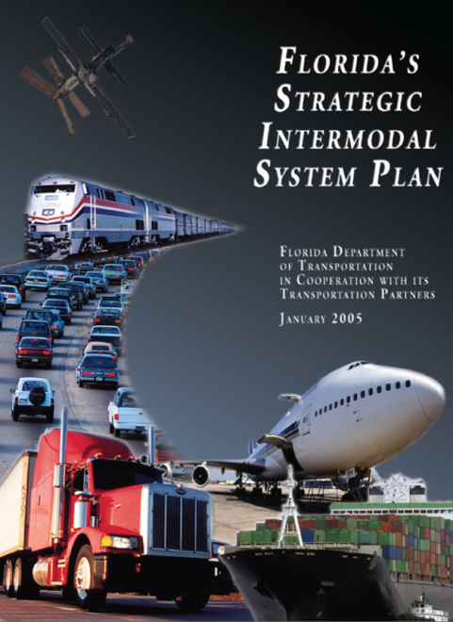
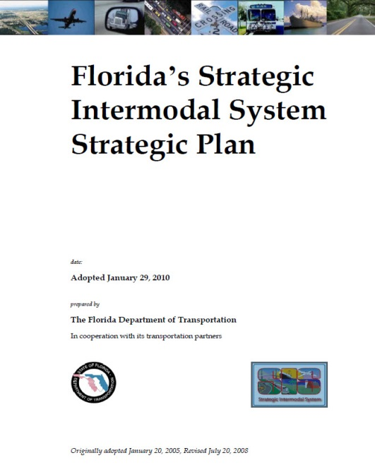
Strategic Intermodal System Policy Plan
Policies and guidance for planning and implementing Florida’s Strategic Intermodal System
Developed by FDOT in consultation with statewide, regional and local partners
8
8
Florida Department of Transportation
Notes:
8
2060 Florida Transportation Plan
8
8
The Strategic Intermodal System (SIS) comprises the state’s largest and most strategic transportation facilities, including major air, space, water, rail, and highway facilities. The SIS facilities are the primary means for moving people and freight between Florida’s diverse regions, as well as between Florida and other states and nations. The SIS is Florida’s highest statewide priority for transportation capacity improvements.
Example SIS facilities in this area are:
Sebring: Major state highways such as US 27, US 17, SR 60, SR 70, SR 80; CSX rail line; Okeechobee Waterway System
Tampa: seaports (Port Tampa Bay, Port Manatee); airports (Tampa International Airport, Sarasota-Bradenton International Airport, St Petersburg-Clearwater International Airport); CSX rail corridor and intermodal terminal in Tampa; I-4, I-75, etc.
Delray: airports (Miami, Fort Lauderdale, Palm Beach); seaports (Miami, Everglades, Palm Beach); CSX and FEC rail lines; Tri-Rail system; I-95, Florida’s Turnpike, etc.
Jacksonville: Jacksonville International Airport; Cecil Spaceport; Jaxport; Port of Fernandina; CSX, FEC and Norfolk Southern rail lines/terminals; I-95, I-10, I-75 etc.
Fort Walton: airports (Tallahassee, NW Florida Beaches, NW Florida, Pensacola), seaports (Panama City, Pensacola, Port St Joe), CSX line, I-10 and n/s corridors such as US 231, SR 77, SR 79
The SIS Policy Plan (formerly known as the SIS Strategic Plan) sets policies to guide decisions about which facilities are designated as part of the SIS, where future SIS investments should occur, and how to set priorities among these investments given limited funding.
Addressing the Strategic Intermodal System (SIS), this comprises the state’s largest and most strategic transportation facilities, including major air, space, water, rail, and highway facilities. The SIS facilities are the primary means for moving people and freight between Florida’s diverse regions, as well as between Florida and other states and nations. The SIS is Florida’s highest statewide priority for transportation capacity improvements.
The SIS Policy Plan (formerly known as the SIS Strategic Plan) sets policies to guide decisions about which facilities are designated as part of the SIS, where future SIS investments should occur, and how to set priorities among these investments given limited funding.

Slide 9
Strategic Intermodal System Policy Plan SIS Objectives
Interregional Connectivity
  Increase the efficiency and reliability of connectivity between Florida’s economic regions and between Florida and other states and nations.
Intermodal Connectivity
  Expand, integrate and connect transportation choices for interregional trips.
Economic Development
  Provide transportation systems to support Florida as a global hub for trade, tourism, talent, innovation, and investment.
Notes:
The current SIS Strategic Plan, updated in 2010, identified seven objectives. Four of these objectives relate to the FTP such as efficiency, choice, energy & air quality, and emergency management. These objectives are covered by the overarching FTP and aren’t specific to SIS. To keep in line with the strategic nature of the SIS, the effort is focusing on the three objectives specifically related to the SIS.
These are interregional connectivity, intermodal connectivity, and economic development. These objectives are integral to how the SIS is intended to operate.
Interregional Connectivity
Increase the efficiency and reliability of connectivity between Florida’s economic regions and between Florida and other states and nations.
Intermodal Connectivity
Expand, integrate and connect transportation choices for interregional trips. (Note to Presenter: this wording would allow for use of local/regional facilities to support interregional trips)
Economic development
Provide transportation systems to support Florida as a global hub for trade, tourism, talent, innovation, and investment.

Slide 10
FTP and SIS Update Process and Schedule
Issues Identification
Potential Policies and Strategies
Recommendations
Adoption
Jan
Feb
Mar
Apr
May
Jun
Jul
Aug
Sep
Oct
Nov
Dec
STEERING COMMITTEE MEETINGS
ADVISORY GROUPS MEET
PARTNER BRIEFINGS AND PUBLIC INPUT
PUBLIC
COMMENT
FINAL
ADOPTION
REGIONAL
FORUMS
REGIONAL
WORKSHOPS
OPEN HOUSE
Notes:
10
2060 Florida Transportation Plan
10
2060 Florida Transportation Plan
We are working this year with our partners to consider the implications of these trends and plan for the future of our transportation system.
Many of you may have attended the statewide summit we convened in December 2014 and he regional forums around the state in February of this year,
In January, we convened a 35 member Steering Committee to guide us as we develop this plan. This committee includes representatives of state agencies, regional and local governments, the transportation modes, business and economic development organizations, and environmental stakeholders.
We are thrilled to have Mayor Haynie, who serves as our Vice-Chair on the Steering Committee and Councilmen Wood who not only represents the MPOAC on the Steering Committee but also serves as the Vice-Chair on the SIS Advisory Committee.
The Steering Committee just met in St. Augustine on July 21-22 and their next meeting is September 17-18 in Fort Myers.
During the spring we launched four advisory groups to provide focused input in specific areas.
*(Harry Barley served on the Infrastructure and Growth Leadership AG, Carlos Roa served on the Innovation and Economic Development AG, Bob Kamm served on the Quality of Life/Quality Places AG)
In June we held 4 regional workshops around the state focusing on the FTP and later on this summer we will have 4 more regional workshops focusing on the SIS as well as a statewide town hall. I will go over those specific dates and locations on the next slide.
We plan on having a draft of the FTP and SIS plan for public comment in the fall and hope to have the plans adopted by December.

Slide 11
FTP and SIS Policy Plan
Regional Workshops
August/September Regional Workshops
  August 11 – Panama City
  August 26 – Vero Beach
  September 1 – Miami
  September 2 – Tampa Bay
August 25 Open House
  Orlando
Notes:
We have a series of in-person FTP and SIS workshops planned for later this summer. The first round was held in June and primarily touched on the FTP policy framework and the SIS efforts to date. The second round of workshops will focus more SIS issues and are being coordinated with the modal office to address freight and rail planning.
FDOT will also be holding an Open House in August that will be a statewide event previewing the FTP and SIS Policy frameworks for public input prior to preparation of the draft documents.
Materials and meeting notices are posted on the website FloridaTransportationPlan.com

Slide 12
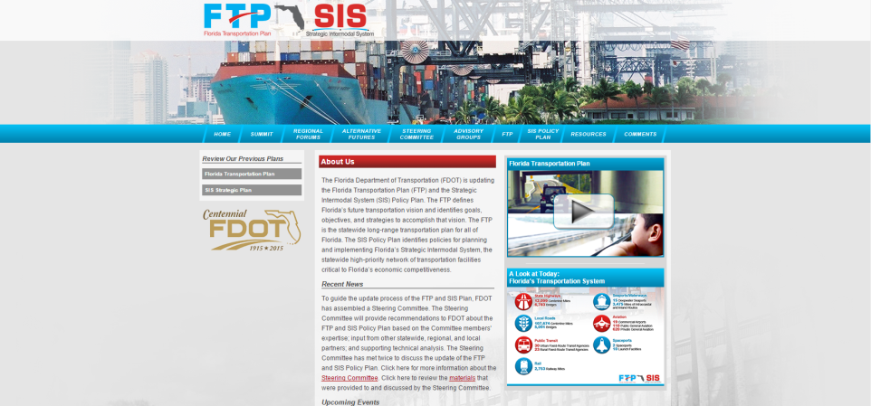
More Information & Comments
FloridaTransportationPlan.com
Notes:
More information is available on the project website.
Latest events or documents are posted. You can register for events here.
The Comments tab allows people to submit comments at any time.

Slide 13

PL JPA & Invoicing
CHALLENGE:
MPO invoicing requirements are exceedingly cumbersome, resulting in extensive time spent in their preparation and review.
OPPORTUNITY:
Streamline invoicing requirements for MPOs and create consistency in PL & UPWP management across the Districts.
The Office of Policy Planning is working jointly with the Office of Comptroller to review and update the existing MPO Joint Participation Agreement (JPA) and corresponding processes with a goal of streamlining invoicing requirements and enhancing guidance on UPWP management.
  Goal: Next UPWP cycle (beginning July 1, 2016)
Florida Department of Transportation

Slide 14
2015 Legislation
Senate Bill 2514-A – Establishes 339.81, Florida Statutes
Creates the Florida Shared-Use Nonmotorized Trail Network
Revises the distribution of revenues from additional motor vehicle registration fees
Provides for the use of these fees by the department
Provides descriptions and components of the network
Provides for the planning, development, operation and maintenance of the network.
Requires funding to be allocated to the Florida Shared-Use Nonmotorized Trail Network in the program and resource plan of the department
Authorizes memoranda of agreement and contracts for maintaining the network
Authorizes the department to adopt rules
14
14
Florida Department of Transportation
Notes:
14
2060 Florida Transportation Plan
14
14

