Slide 1
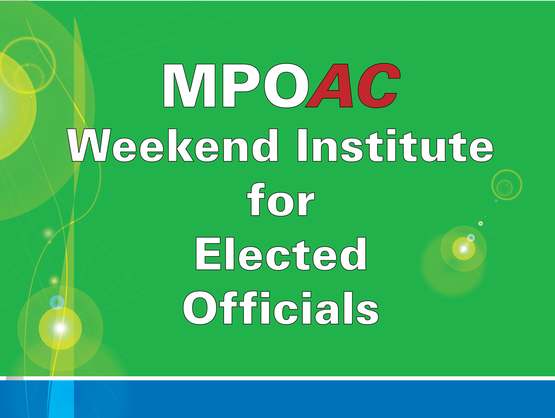

Slide 2
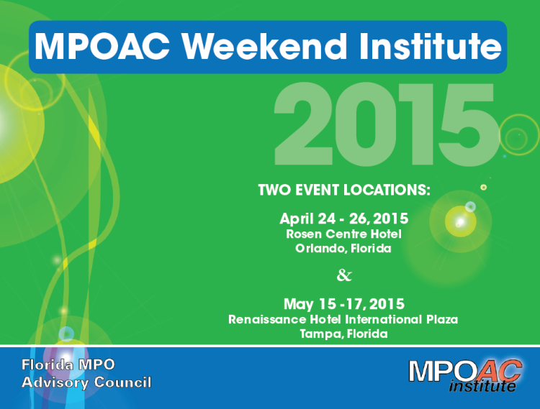
MPOAC Weekend Institute Overview
The Institute provides MPO Board members with an opportunity to enhance their leadership skills and their understanding of transportation decision-making
The Institute topics include:
  Basic Concepts in Transportation Planning
  Sources of Transportation Funding
  Laws and Regulations Affecting MPOs
  MPO Board Responsibilities and Authority
  MPO Products and Processes
  Critical Funding Issues
  Origins of MPOs
  Transportation Jargon & Acronyms

Slide 3
Institute Trainers
Jeff Kramer Senior Research Associate
CUTR at USF
Karen Seggerman
Senior Research Associate
CUTR at USF
Scott Paine
Director Leadership Development and Education
Florida League of Cities
Hal Beardall Transportation Specialist
FCRC Consensus Center at FSU

Slide 4
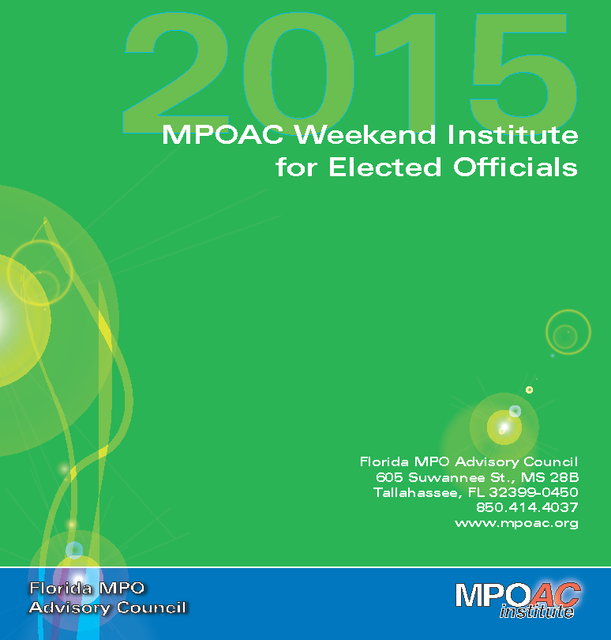
MPOAC Weekend Institute Overview
MPOAC Weekend Institute
16 institutes since 2007
223 attendees for MPOAC Funded Institutes
Held in 6 different locations since 2007
8.5 overall average of attendees sent by each MPO
4.79 overall Average Evaluation score out of 5
57% of attendees still on MPO Board

Slide 5
MPO Board Members Attending MPOAC Institute Training
Total Still On Board
126
57%
Total No Longer on Board
97
43%
Total Attendees
223
100%

Slide 6
Attendance by Jurisdiction:
County
74
33%
Municipality
139
62%
Other
10
4%

Slide 7
Municipality Attendance:
Municipality
Mayor
Vice Mayor
Councilmember/ Commissioner
7.87%
66.29%
25.84%

Slide 8
MPOAC Weekend Institute Evaluation Results from 2007 to 2015
Did the Institute effectively inform you on the following topics?
The origins of MPOs and MPO Board responsibilities and authority
4.91
MPO products and processes
4.74
Critical funding issues and sources of transportation funding
4.80
4.82
Basic concepts and principles in transportation planning
Average:

Slide 9
MPOAC Weekend Institute Evaluation Results from 2007 to 2015
Was the Institute format effective?
Notebooks and materials were helpful
4.85
Q & A and discussion format was effective
4.68
Jeopardy was effective and useful reinforcement
4.66
4.84
Overall, presentations were effective and informative
Average:

Slide 10
MPOAC Institute Attendance based on Location

Slide 11

MPOAC Institute Attendance Record by MPO
Cumulative for 2007-2015

Slide 12

Contact Information
Jeff Kramer
kramer@cutr.usf.edu
813.974.1397
Florida MPO Advisory Council
www.mpoac.org
850.414.4037
Christen Miller
christen@cutr.usf.edu
727.916.2599

