Slide 1
Florida Rural Household
Travel Survey Mobile App
Florida Metropolitan Planning Organization Advisory Council
July 23, 2015

Slide 2
Purpose
Central Office is developing a household travel survey and data collection for Florida’s rural areas.
FDOT has developed a smartphone app for use in the survey.
  iPhone and Android
Need to identify rural areas
  some are within the MPO Boundaries.

Slide 3
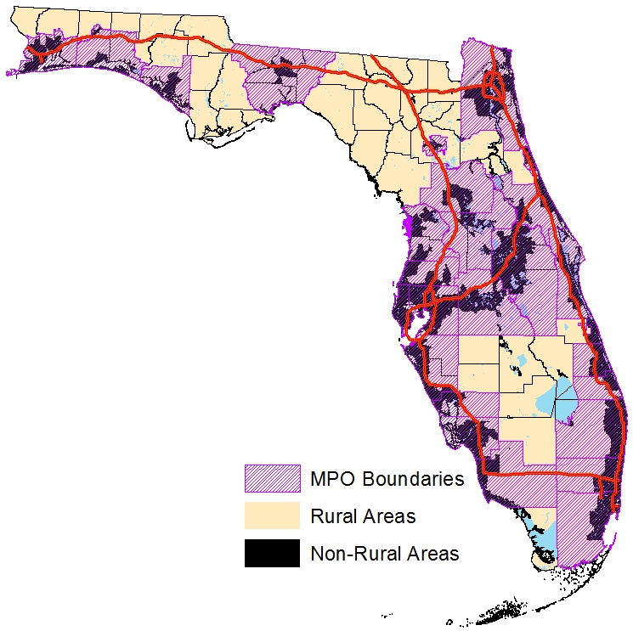
Florida Rural Areas
This map shows the rural areas of Florida based on population density.
All counties have some rural area type except for Pinellas County.

Slide 4
Why Use a Mobile App
Convenient–smartphones are ubiquitous; integral part of our lives
Efficient–no more paper-based trip logs, data entry
More accurate –real times not estimates
Captures more information–GPS data will be collected
Cost savings–less postage, coding, computers, training
Using 21st century technology

Slide 5
Modeling Concerns
Need 10,851 household surveys
This number is based on the rural area type from population density, the number of households in 2010, and the national average sampling rate (0.25%).
It uses the same formula that was discussed at the Model Task Force 2014.

Slide 6
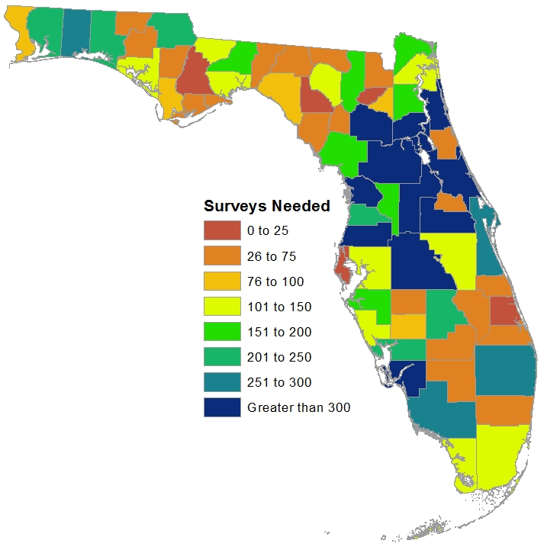
Modeling Concerns
This map shows the range of surveys needed from each county.

Slide 7
Modeling Concerns
Data collected will be used to support the statewide model, a trip-based model.
The data collected may not be sufficient to support activity-based models.
The mobile app code is open source, so MPOs can recode it for their needs especially if they have activity-based models or need more detailed information than the statewide model.

Slide 8

Mobile App
Code must remain open source.
The original code was open source, and the developers stated that the code can be used as long as it remains open source.

Slide 9

Mobile App
The following resources are needed to the support data collection via the mobile app:
Website
Web Service
Database
Web Service
Website
Database

Slide 10

Website
Will function also as a mobile website
A separate page will present the following:
  New user registration
  Terms and conditions
  Frequently asked questions (FAQs)
  Comment box
  App instructions
  User information
    Trip log

Slide 11
Web Service
Created programmatically and resides on the server.
  Transfers data from app to the database.
Listens for app requests.
Accepts app data when the user presses “Save”.
Processes each “Save” request and stores the data in the database on the server.

Slide 12
Database
An SQL Server database has been created on the server and stores data.
Reads data from the web service and writes the tables.
The tables are structured to directly support data analysis.
Database can be exported any time to monitor the progress and statistics of the survey.

Slide 13
Maintenance and Modifications
Once the website, web service, and database are running, they can be changed to suit the data collection requirements with very little cost and effort.
The web service and database have been created for the current mobile app.
Very little maintenance is required – self sufficient

Slide 14
Where to Find
Florida Trip Tracker App is available in Google Play and Apple App stores
Search “florida trip tracker” to install
Send your feedback to FloridaTripTracker@aecom.com

Slide 15
Questions
Thomas Hill
State Modeling Manager
Florida Department of Transportation
Systems Planning Office
(850) 414-4924
thomas.hill@dot.state.fl.us

Slide 16

Questions

