Slide 1

Florida Department of Transportation Report
MPOAC
Governing Board and Staff Directors
Joint Meeting
Florida Department of
TRANSPORTATION
January 28, 2016

Slide 2
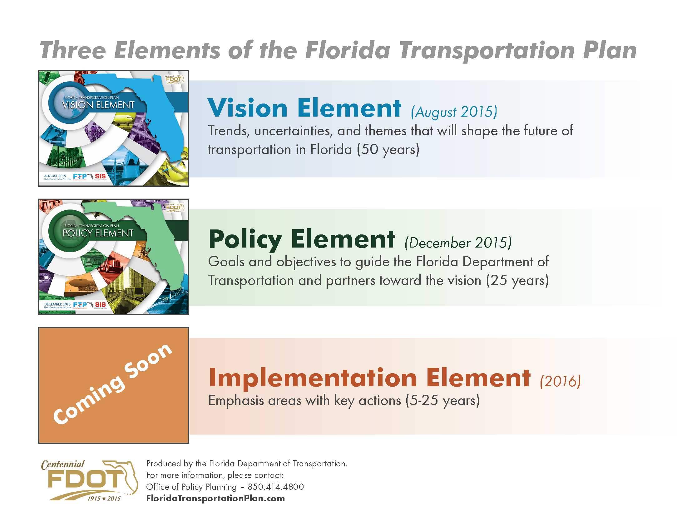
The New Florida Transportation Plan
Available at FloridaTransportationPlan.com

Slide 3

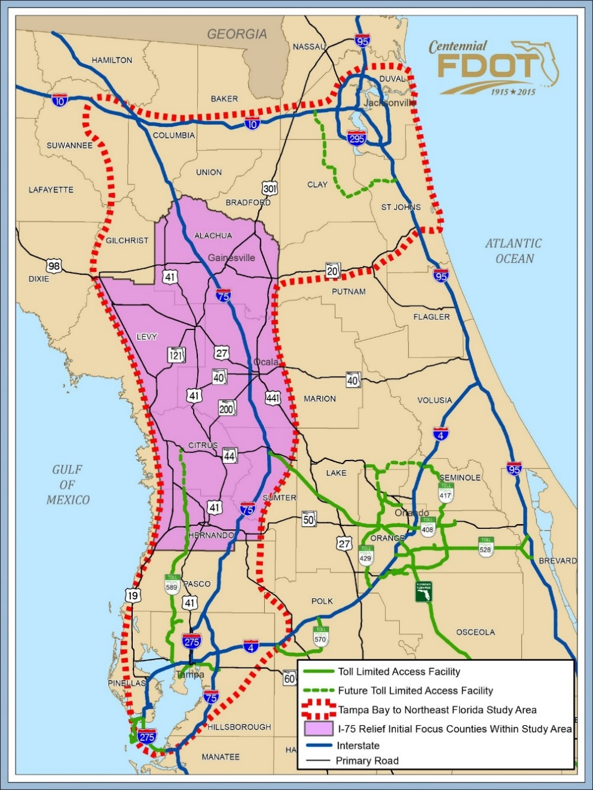

th
TASK FORCE
First Phase of the broader
Tampa Bay to Northeast FL Future Corridor Study
Study Purpose
Improve regional connectivity between
  - Tampa Bay
  - North Central Florida
  - Northeast Florida
Provide relief to
Interstate 75
www.i75relief.org
Full schedule
Meeting materials
TASK FORCE
Notes:
Example for mobility– Future Corridors
The Future Corridor Planning Process is planning for the future of the state’s major transportation corridors over the next 50 years. This is a long-term, large-scale
approach to make decisions about transforming existing corridors and developing new corridors in the context of environmental, economic development, and community goals.
FDOT is collaborating closely with state, regional, and local agencies; environmental stakeholders; business and economic development organizations; private landowners; and the public to develop guiding principles for corridor planning and recommendations on where future corridors should be located.
Two active study areas
Tampa Bay-Central Florida
Tampa Bay-Northeast Florida

Slide 4


Shared-Use Nonmotorized (SUN) Trail Network
Created under 339.81, F.S.
To develop a statewide system of paved non-motorized trails as a component of the Florida Greenways and Trails System (FGTS)
$25 million annually funded from new vehicle tag revenues
Program guidance is in development
4
Florida Department of Transportation
Notes:
4

Slide 5
Framework for Funding Selection
Top Regional Trail System
Coast-to-Coast Connector
Selected at December 2015 meeting
Florida Greenways
and Trails Council
SUN Trail Eligible
(Priority Land Trails Network)
Second Regional Trail System
Will be selected at February 2016 meeting
Individual Trails
5
Florida Department of Transportation
Notes:
5

Slide 6
Tentative Schedule
Through early February 2016 | Developing draft program and process based upon targeted outreach
Late February – March 2016 | Public open houses and comment period
Estimated by April 2016 | Formal SUN Trail Program finalized
Following April 2016 | Begin project solicitation and development of 5-year work program
Program Contact:
Robin Birdsong, FDOT SUN Trail Program Manager
850-414-4922 or Robin.Birdsong@dot.state.fl.us
www.FloridaSunTrail.com
6
Florida Department of Transportation
Notes:
6

Slide 7
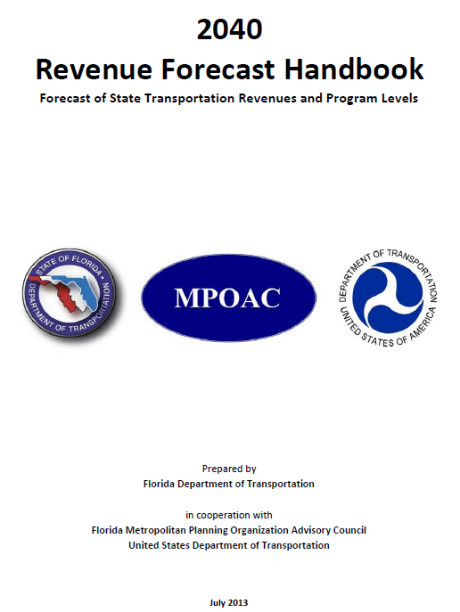
Statewide Revenue Forecast
Purpose
  Promote consistent statewide and metropolitan planning
  Meet federal requirements for cooperative funding estimates
  Supports update to MPO LRTPs and SIS Plan
Revenues
  State and Federal funds that flow through the Work Program
Updates
  Every 5 years with next update due in 2018
  Consensus on methodology with MPOAC
Florida Department of Transportation
Notes:
The Department is launching the Revenue Forecast effort for the next round of LRTP updates beginning in
2019. The forecast assists the MPOs in complying with federal requirements for developing cost feasible transportation plans. The forecast is developed in coordination with the MPO,s, FHWA and FTA. Periodic updates on the development of the forecast will be coordinated with MPO staff directors.

Slide 8
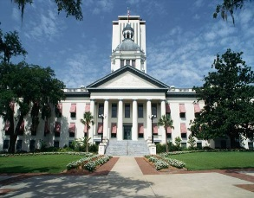

2016 Legislative Session
FDOT Bills
SB 756 and HB 7027
Session ends Friday, March 11th
Florida Department of Transportation

Slide 9
Florida Department of
TRANSPORTATION
Jim Wood
Florida Department of Transportation
jim.m.wood@dot.state.fl.us
850-414-4814

