Slide 1


MPOAC STRATEGIC DIRECTIONS 2020 PROCESS UPDATE
Hal Beardall & Bob Jones,
FCRC Consensus Center FSU
January 28, 2016
Notes:
This template can be used as a starter file for presenting training materials in a group setting.
Sections
Sections can help to organize your slides or facilitate collaboration between multiple authors. On the Home tab under Slides, click Section, and then click Add Section.
Notes
Use the Notes pane for delivery notes or to provide additional details for the audience. You can see these notes in Presenter View during your presentation.
Keep in mind the font size (important for accessibility, visibility, videotaping, and online production)
Coordinated colors
Pay particular attention to the graphs, charts, and text boxes.
Consider that attendees will print in black and white or grayscale. Run a test print to make sure your colors work when printed in pure black and white and grayscale.
Graphics, tables, and graphs
Keep it simple: If possible, use consistent, non-distracting styles and colors.
Label all graphs and tables.

Slide 2
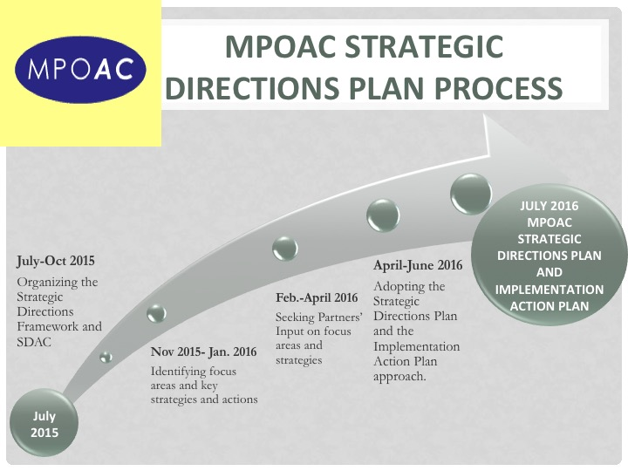
New Employee Orientation
Getting to know your new assignment
Familiarizing yourself with your new environment
Meeting new colleagues
Notes:
Give a brief overview of the presentation. Describe the major focus of the presentation and why it is important.
Introduce each of the major topics.
To provide a road map for the audience, you can repeat this Overview slide throughout the presentation, highlighting the particular topic you will discuss next.

Slide 3

MPOAC Governing Board
Survey Results
October 2015
20 Governing Board Member Responses
on Core Strengths, Key Planning Principles
and MPOAC 2020 Goal areas.
MPOAC Staff director Survey Results
December 2015
18 Staff Directors Responses
on Core Strengths, Guiding Principles, Vision
and MPOAC 2020 draft goals and
objectives/actions
Notes:
This is another option for an overview using transitions to advance through several slides.

Slide 4

MPOAC Vision
The MPOAC improves transportation planning and education by engaging and equipping its members to deliver results through shared innovations, best practices, enhanced coordination and effective communication.

Slide 5

Guiding Principles in Developing the Strategic Plan
Maximize the role of the MPOAC in transportation policy, planning and education.
Serve as a state transportation leader and agent of positive change.
Empower and enable individual members to do their jobs better.
Evaluate organizational
implications (benefits/costs) for
implementing goals/objectives/
actions

Slide 6
draft Goals
Goal A: Communication & Sharing
Best Practices
Goal B: Training and Education
Goal C: Advocacy on Policy &
Planning

Slide 7
draft Goals
Goal A: Communication &
Sharing Best Practices
The MPOAC will effectively coordinate and communicate with members and other transportation organizations and will support the sharing of best practices.

Slide 8
Goal A: Communication & Sharing
Best Practices
Potential Objectives/Actions
The MPOAC will convene workshops to share information on best practices and innovations with members and other interested parties.
Review experiences with other membership organizations and
set up MPOAC Best Practices Committee to develop
recommendations for implementing the workshops.
2. The MPOAC will implement effective
communication and coordination strategies with
members.
E.g. enhance the website, use SharePoint team
collaboration software tools, provide regular updates via
newsletter and e-blast approaches, etc.
3. The MPOAC will improve communication and
coordination with other transportation organizations
E.g. participation in best practice workshops, establish regular briefing opportunities, etc.

Slide 9
draft Goals
Goal B: Training and Education
The MPOAC will expand leadership training and education to engage members and build competence.

Slide 10
Goal B: Training and Education
Potential Objectives/Actions
The MPOAC will increase participation in the MPOAC Institute as the core leadership and educational program.
  Continue to support the delivery of the MPOAC Institute
  Develop recommendations for how to expand participation, strongly encourage MPOAC Board members and Member chairs to attend
  Develop advanced MPOAC Institute modules
2. Develop and share a model new member
orientation process and handbook/manual
3. Develop a MPOAC sponsored staff training
program

Slide 11
draft Goals
Goal C: Advocacy on Policy and
Planning
The MPOAC will advocate and lead collaboratively for effective local, regional and statewide transportation policy and planning.

Slide 12
Goal C: Advocacy on Policy & Planning
Potential Objectives/Actions
The MPOAC will take steps to develop a stronger relationship with the Florida Transportation Commission
Provide regular briefings, seek collaborative studies on regional and local planning, etc.
2. Optimize the MPOAC relationship with the FDOT
Central Office and the Districts to advance shared
goals and member missions and programs
Develop better coordination and communication with the Districts; develop and document the operational flow to become more consistent, predictable and repeatable; collaborate on the updating of the MPO Handbook. etc.
3. Strengthen the MPOAC relationship and coordination
with USDOT to advance member missions and
programs
4. Enhance coordination on advocacy for transportation
policy and planning with partners

Slide 13
Next Steps
Partners Strategic Directions Survey, March 2016
SDAC Meetings, February, March April, May & June 2016
SDAC Governing Board Quarterly Meetings-January, April & July, 2016
Notes:
Use a section header for each of the topics, so there is a clear transition to the audience.

Slide 14
Questions?

