Slide 1
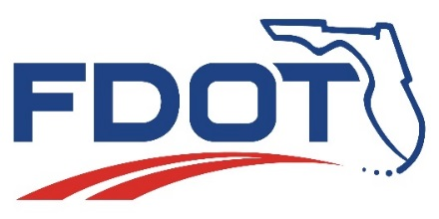
Metropolitan Planning Organization Advisory Council
Florida Department of
TRANSPORTATION
April 28, 2016
Sean Santalla
Office of Policy Planning

Slide 2

Autonomous Vehicle Legislation
2016 Legislature
HB 7027
Recommends MPOs consider advances in vehicle technology when developing
long-range transportation plans
Requires the FDOT to accommodate advances in vehicle technology when updating the Strategic Intermodal System Plan
Florida Department of Transportation
Notes:
HB 7027 was signed by the Governor. It includes provisions for consideration of advances in vehicle technology in plans by both the MPOs LRTPs and the Department in the Strategic Intermodal System plans. In the case of MPOs, consideration is to be given to vehicle technology while the SIS plan is required to accommodate advances in vehicle technology.

Slide 3
Autonomous Vehicle Legislation
339.175 - Long Range Transportation Plan
  Make the most efficient use of existing transportation facilities to relieve vehicular congestions, improve safety, and maximize the mobility of people and goods.
  Such efforts must include, but are not limited to, consideration of infrastructure and technological improvements necessary to accommodate advances in vehicle technology, such as autonomous technology and other developments.
Florida Department of Transportation
Notes:
This language was added to 339.175, Florida Statute, Metropolitan Planning Organization. Emphasis is placed on improving safety and consideration of autonomous vehicle technology and related technology development.

Slide 4
Autonomous Vehicle Legislation
339.64 (3)(c) – Strategic Intermodal System Plan
  The department shall coordinate with federal, regional, and local partners, as well as industry representatives, to consider infrastructure and technological improvements necessary to accommodate advances in vehicle technology, such as autonomous technology and other developments, in Strategic Intermodal System facilities.
Florida Department of Transportation
Notes:
Language was also added to 339.64, Florida Statute, Strategic Intermodal System Plan that requires the Department to coordinate with partners and consider autonomous vehicle technology for Strategic Intermodal facilities.

Slide 5

Next Steps
Legislation signed by the Governor
  April 4, 2016, effective July 1, 2016
State guidance will be developed
Florida Department of Transportation
Notes:
Language was also added to 339.64, Florida Statute, Strategic Intermodal System Plan that requires the Department to coordinate with partners and consider autonomous vehicle technology for Strategic Intermodal facilities.

Slide 6
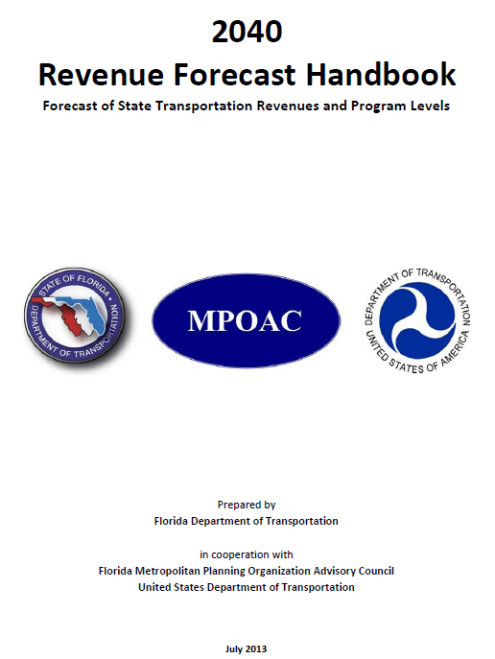
Statewide Revenue Forecast
Purpose
  Promote consistent statewide and metropolitan planning
  Meet federal requirements for cooperative funding estimates
Revenues
  State and Federal funds that flow through the Work Program
Updates
  Every 5 years; next update due in 2018
  Consensus on methodology with MPOAC
Florida Department of Transportation
Notes:
FDOT is kicking off the development of the next Revenue Forecast guidance. The Department will work cooperatively with the MPOAC in this process. The forecast is done every five years and guides the development of the MPO LRTPs and the SIS Cost Feasible Plan.

Slide 7
Tentative Schedule
2016
  End of May: Revenue Forecast Guidebook (documents the 2040 revenue forecast process)
  October 20th: MPOAC Policy & Technical Subcommittee initial discussion
2017
  March 7th- May 5th: Florida Legislative Session
  May-September: work with MPOAC Policy & Technical Subcommittee on Financial Guidelines
  October: MPOAC Board approval of Financial Guidelines
  October: begin development of training materials
2018
  January: begin development of revenue forecast
  End of March: send revenue forecast to districts for review and CFP for delivery to MPOs
  End of April: send finalized revenue forecast to districts
  May: statewide videoconference
  June: meetings with District and MPO staff
Florida Department of Transportation
Notes:
The development is expected over the next three years and this slides shows the tentative schedule through June of 2018.

Slide 8
Repurposing Old Federal Earmarks
Section 125 of the Department of Transportation Appropriations Act of 2016 provides the authority for a state* to repurpose any earmark that was
Designated on or before September 30, 2005
Is less than 10 percent obligated, or
Has been completed and closed with remaining unobligated funds on the earmark
Must be obligated on a new or existing project in the state within 50 miles of the earmark designation
Must be the type of project which would otherwise be eligible under the Surface Transportation Block Grant Program
* States make the final decision as to which earmarks will be repurposed. Florida will consult with MPOs and/or other local gov’ts within the geographic boundary of each earmark before making any decisions to repurpose any available funds on each earmark.
Florida Department of Transportation

Slide 9
Repurposing Old Federal Earmarks
Projects must have Obligation Authority to go with the unobligated funds, else the unobligated funds cannot be obligated and spent.
Florida Department of Transportation
Notes:
Unfortunately when Congress passed the Appropriations Act, the language did not include enough Obligating Authority to fund all of the old earmarks. You cannot obligate or authorize a federal project without both funds and obligating authority.

Slide 10
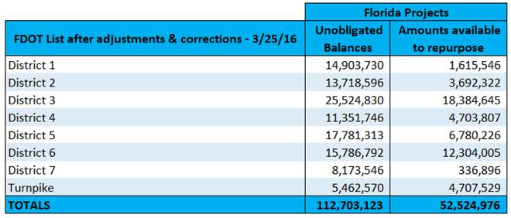
Repurposing Old Federal Earmarks
The list prepared by FDOT totals $112.7 million, with only $52.5 million of obligation authority available to go with the funds. The FDOT list adjusted fund amounts for obligations and/or deobligations since December, and eliminated any projects with less than $1,000 in remaining funds.
Florida Department of Transportation
Notes:
The Florida projects totaled $112.7 million with only $52.5 million of appropriated obligating authority. FDOT chose to not move forward with any projects having a balance in funds of less than $1,000.

Slide 11
Repurposing Old Federal Earmarks
The final corrected FDOT-issued single master list of projects was distributed April 1st to FDOT staff with instructions to share it with MPOs, local governments and other interested parties.
FDOT guidance document, tailored to implementation in Florida, was also issued April 1st (Federal Aid Technical Bulletin 16-02)
Of the 202 projects on this list, only 122 projects have available obligation authority in excess of $1,000.
The 80 projects with less than $1,000 in obligation authority will not be considered for repurposing in Florida.
  Only 14 projects have available obligation authority in excess of $1 million dollars
Florida Department of Transportation

Slide 12

Shared-Use Nonmotorized (SUN) Trail Network
Created under 339.81, F.S.
To develop a statewide system of paved non-motorized trails as a component of the Florida Greenways and Trails System (FGTS)
$25 million annually funded from new vehicle tag revenues
Public Open Houses & Webinar concluded
March 9, 2016
Public comment period concluded March 25, 2016
Florida Department of Transportation
Notes:
Legislation approved in both 2014 and 2015 codifies the Department’s role in the advancement of paved multiuse trails
2015 Legislation: SUN Trail
Excludes: sidewalks; loop trails wholly within a single park or natural area; water trails; the Florida National Scenic Trail;
and On-road facilities except:
Segments less than a ½ mile connecting two or more non-motorized trails; or on-road components of FKOSHT.
2014 Trail Legislation: 335.065(4), FS: set the stage but didn’t include funding
Directed DOT to give funding priority to trail projects identified by the FL Greenways & Trails Council as a priority within the Florida Greenways and Trails System, closes gaps, national/statewide/regional importance, & operated/maintained by an entity other that FDOT.
The FGTS Plan establishes Florida’s vision for a statewide trail network
Not one funding source will implement all trail needs. SUN Trail funding must be strategic.

Slide 13
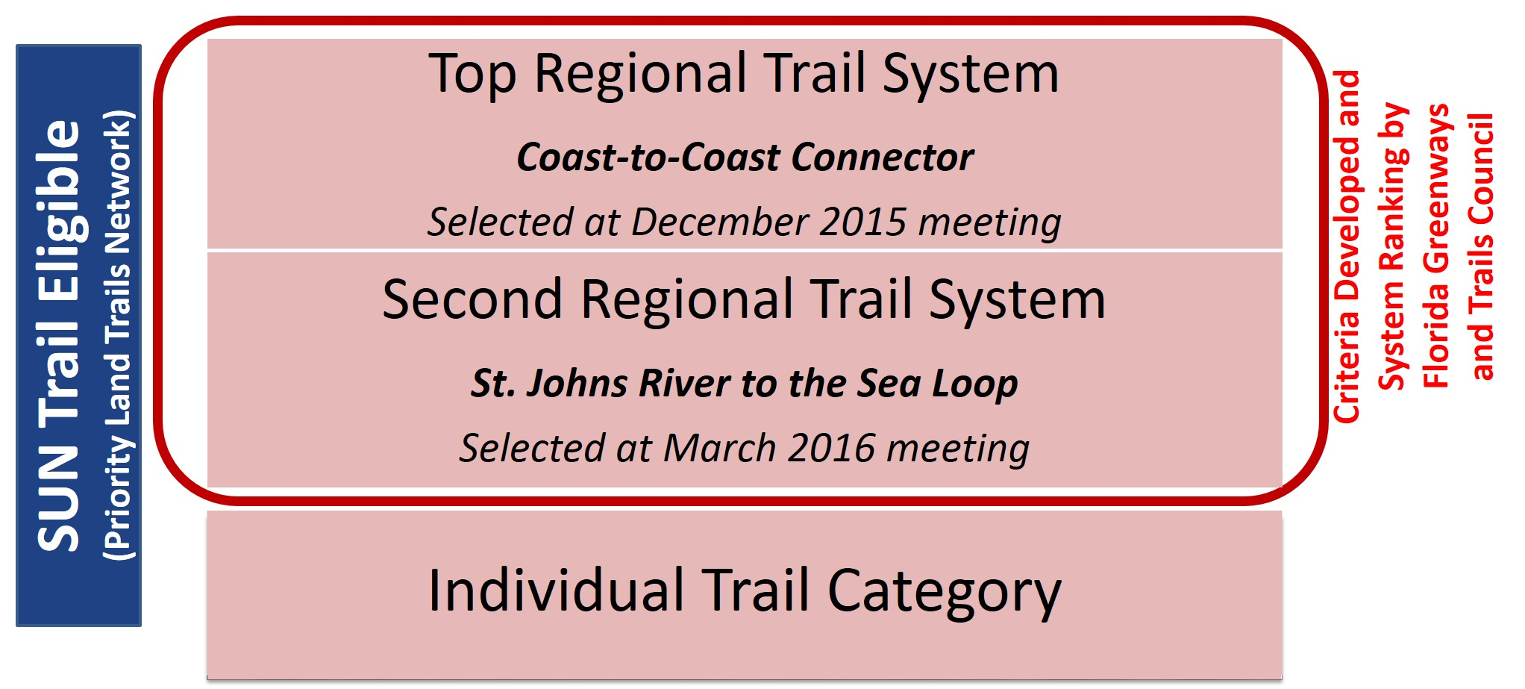
Framework for Funding Selection
Florida Department of Transportation
Notes:
DOT will program allocations from the State Transportation Trust Fund (STTF) for the SUN Trail Network through a Two Tier Structure:
Prioritized Regional Systems paved multi-use trail systems:
Manageable: achievable within a reasonable timeframe
Regional systems selected by the Florida Greenways and Trails Council
Chapter 260, F.S. established the 21 member Florida Greenways and Trails Council (FGTC) to advise FDEP…
FGTC selected Coast-to-Coast as the Top Regional System Dec. 2015
Regional Criteria adopted Jan. 2016 by FGTC.
FGTC met on Feb. 29 selected seven Regional Systems for further analysis
FGTC met on March 31 to evaluate and prioritize the other Regional Systems; ultimately they selected the 2nd system St. Johns River to the Sea Loop
prioritized Individual Trails segments that help close gaps and complete trail systems.
Individual Trail Selection Criteria and Eligibility Criteria outside of those Regional Systems… allocation of statewide equity while implementing statewide/regionally significant projects
Funding: approximately allocated in 1/3 for each category over the period of the 5-year work program.

Slide 14
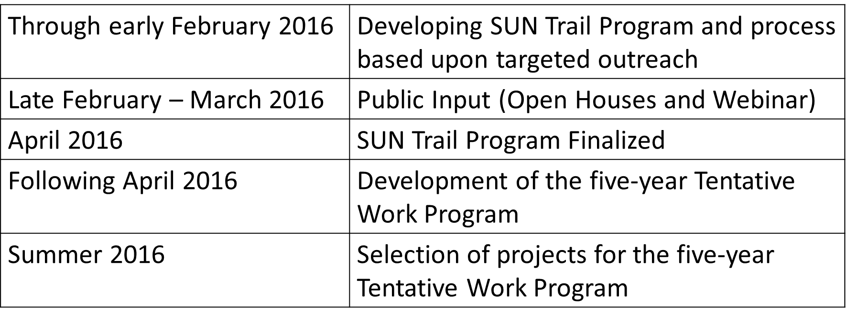
Schedule
Questions? Contact:
Robin Birdsong, SUN Trail Program Manager
850-414-4922
Robin.Birdsong@dot.state.fl.us
www.FloridaSunTrail.com
Florida Department of Transportation

Slide 15
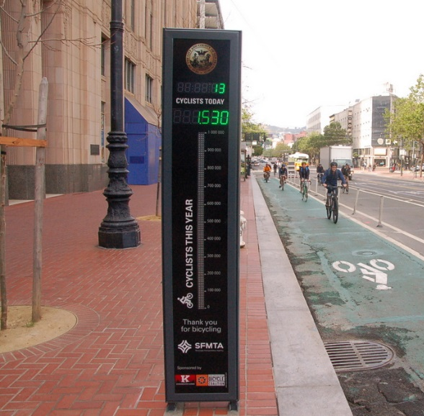
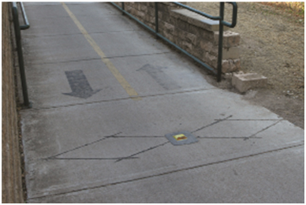
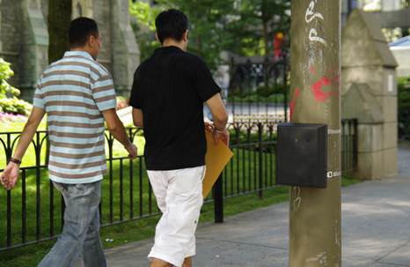
Non-Motorized Transportation Count Data Collection
Who is involved?
The Florida Department of Transportation’s (FDOT) Statistics Office, Safety Office, Systems Planning Office, Office of Policy Planning, District Pedestrian/Bicycle Safety Champions, District Pedestrian/Bicycle Coordinators, CDM Smith, and Marlin Engineering
What is the purpose?
To better understand the performance of the non-motorized transportation system in Florida.
  Develop a statewide standardized methodology for counting non-motorized transportation users.
Who is this for?
Florida Governmental agencies, MPOs, counties, cities and stakeholders who wish to better understand the use of the bicycle and pedestrian network
Florida Department of Transportation
Notes:
The FDOT Statistics Office is leading an effort to collect bicycle and pedestrian count information statewide.
Goal of the effort is to develop a statewide standardized methodology for counting non-motorized transportation users.
This will provide a centralized storage location for all non-motorized count data.
Current bicycle and pedestrian count information is being collected from local agencies, MPOs and other transportation partners.

Slide 16
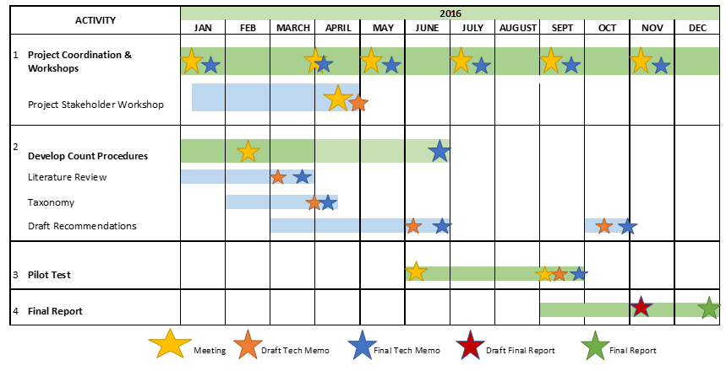
Project Schedule
A review of current non-motorized count procedures will help determine the recommendations for the proposed statewide methodology.
This proposed methodology will be tested, reviewed and revised as needed.
The final report and results of the pilot test will be completed by December 2016.
For any questions, please contact:
Chris Francis (Chris.Francis@dot.state.fl.us)
Martin Guttenplan (guttenplanme@cdmsmith.com)
Florida Department of Transportation
Notes:
The effort was kicked off in January of this year.
Extensive stakeholder input will lead to knowledge of where counting is being done already
The methodology will be piloted tested in a metro area based on infrastructure and programs in place and willingness to work with the project team
The methodology will be refined based on what is learned in the pilot
The effort is scheduled to end in December, 2016, with the production of a final report.
Final report will consider changes to RCI, Traffic Online and crash databases

Slide 17
  Questions?
Florida Department of Transportation
Notes:
Unfortunately when Congress passed the Appropriations Act, the language did not include enough Obligating Authority to fund all of the old earmarks. You cannot obligate or authorize a federal project without both funds and obligating authority.

