Slide 1


MPOAC STRATEGIC DIRECTIONS 2020 PROCESS UPDATE
Hal Beardall & Bob Jones,
FCRC Consensus Center FSU
April 28, 2016
Notes:
This template can be used as a starter file for presenting training materials in a group setting.
Sections
Sections can help to organize your slides or facilitate collaboration between multiple authors. On the Home tab under Slides, click Section, and then click Add Section.
Notes
Use the Notes pane for delivery notes or to provide additional details for the audience. You can see these notes in Presenter View during your presentation.
Keep in mind the font size (important for accessibility, visibility, videotaping, and online production)
Coordinated colors
Pay particular attention to the graphs, charts, and text boxes.
Consider that attendees will print in black and white or grayscale. Run a test print to make sure your colors work when printed in pure black and white and grayscale.
Graphics, tables, and graphs
Keep it simple: If possible, use consistent, non-distracting styles and colors.
Label all graphs and tables.

Slide 2
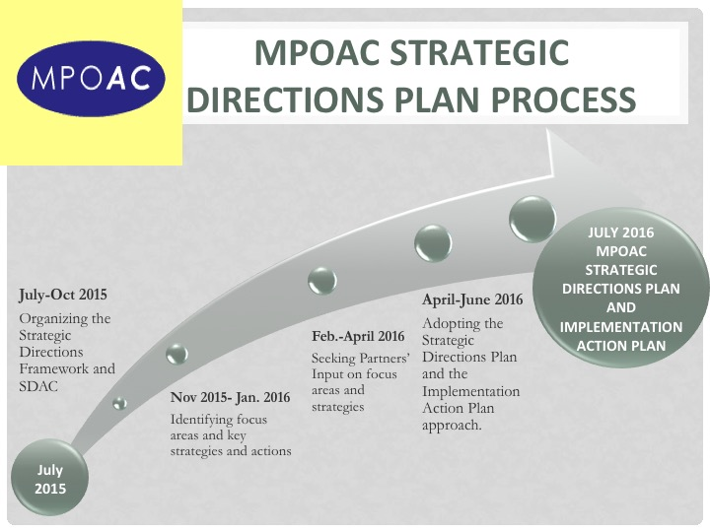
New Employee Orientation
Getting to know your new assignment
Familiarizing yourself with your new environment
Meeting new colleagues
Notes:
Give a brief overview of the presentation. Describe the major focus of the presentation and why it is important.
Introduce each of the major topics.
To provide a road map for the audience, you can repeat this Overview slide throughout the presentation, highlighting the particular topic you will discuss next.

Slide 3

MPOAC Governing Board
Survey Results
October 2015
Governing Board Member Responses
on Core Strengths, Key Planning Principles
and MPOAC 2020 Goal areas.
MPOAC Staff director Survey Results
December 2015
Staff Directors Responses on Core Strengths, Guiding Principles, Vision and MPOAC 2020
MPOAC Partner Survey Results
March 2016
Partner Responses
On Vision and MPOAC 2020 draft goals and objectives/actions
Notes:
This is another option for an overview using transitions to advance through several slides.

Slide 4

MPOAC DRAFT Mission
The MPOAC improves transportation planning and education by engaging and equipping its members to deliver results through shared innovations, best practices, enhanced coordination and communication that meets the needs of Florida’s citizens, businesses and visitors.

Slide 5

Guiding Principles in Developing the Strategic Plan
Maximize the role of the MPOAC in transportation policy, planning and education.
Serve as a state transportation leader and agent of positive change.
Empower and enable individual members to do their jobs better.
Provide opportunities for MPOAC members to participate in committee and workgroup efforts to enhance the organization’s mission and impact.
Evaluate organizational
effectiveness in implementing goals/
objectives/actions.

Slide 6
MPOAC Goals
Goal A: Best Practices & Communication. The
MPOAC will support the sharing of best
& Successful practices, and help
coordinate and communicate with
Members and other organizations.
Goal B: Leadership Training & Education.
The MPOAC will expand leadership
training and education to engage
members and build competence.
Goal C: Advocacy on Policy & Planning. The
MPOAC will advocate and lead
collaboratively for effective local,
regional and statewidE transportation
policy and planning.

Slide 7
Objective 1. The MPOAC will convene a working group to determine
how best to share information on best practices and
successful innovations with members and other
interested parties.
Draft Actions
Establish an MPOAC best practice working group to determine how best to share information on best practices and successful innovations with members and other interested parties.
b. Development of new MPOAC operational and topical best practices
workshops.
Operational e.g. Federal certification reviews, member orientation best practices, budgeting/funding, business and strategic planning, benefit procurement, etc.
Topical: e.g. automated/connected vehicles, technology/data management, public participation, sunshine/ethics, etc.
Communication & Sharing Best
& Successful Practices

Slide 8
Objective 2. The MPOAC will implement effective internal and
external communication and coordination strategies with
members and other organizations.
Draft Actions
Create an MPOAC Communications Workgroup
MPOAC Quarterly Meeting Format
Opportunity for MPOAC Member Participation on Committees & Workgroups
Communication & Sharing Best & Successful Practices

Slide 9
Objective 1. The MPOAC will increase participation in the MPOAC
Institute as the core leadership and educational
program.
Draft Actions
Continue to support the delivery and update of the MPOAC Institute.
Expand Participation in the MPOAC Institute.
Exporting MPOAC Institute Components to Partner Organizations.
B. Leadership Training & Education

Slide 10
Objective 2. Develop an MPOAC sponsored training program
Draft Actions
Establish an MPOAC Training Workgroup
Identify National Training Opportunities
Assess Online Training Strategies
Consider a “Train the Trainers” Approach to Staff Training.
B. Leadership Training & Education

Slide 11
Objective 1. The MPOAC will take steps to develop a stronger
relationship with the Florida Transportation Commission
Draft Actions
MPOAC Representative on the FTC.
b. MPOAC Presentations to the FTC.
c. Strengthen MPOAC & FTC Coordination.
C. Advocacy for Policy and Planning

Slide 12
Objective 2. Optimize the MPOAC relationship with the FDOT
Central Office and the Districts to advance shared goals
and member missions and programs
Draft Actions
Document FDOT/MPOAC Relationship.
Regular Briefings/Update with FDOT.
Update FDOT/MPOAC Procedures.
Enhance the relationship of MPOAC and Districts
C. Advocacy for Policy and Planning

Slide 13
Objective 3. Strengthen the MPOAC relationship and coordination
with USDOT to advance member missions and programs
Draft Action
Enhance the MPOAC & FHWA Relationship
Objective 4. Enhance coordination on advocacy for transportation
policy and planning with partners and other organizations
Draft Actions
Coordinate Advocacy
MPOAC/FAC Partnership on Certification
FLC/FAC Education Opportunities
MPOAC Involvement in AMPO and NARC Committees
C. Advocacy for Policy and Planning

Slide 14
Next Steps
SDAC Meeting #9, June 2016
SDAC Governing Board Quarterly Meeting-July, 2016
Implementation Steps (July 2016- June 2018)
Notes:
Use a section header for each of the topics, so there is a clear transition to the audience.

Slide 15
Questions?

