Slide 1

Florida DOT Report to
MPO Advisory Council
July 18, 2016
Florida Department of
TRANSPORTATION
Notes:
Done

Slide 2
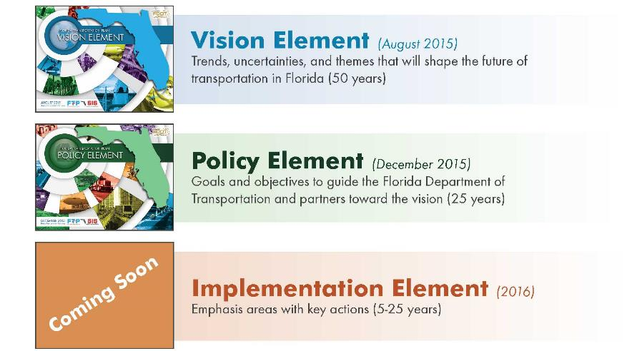

Florida Transportation Plan
Florida Department of Transportation
Notes:
2
Policy plan for all of Florida.
Drives FDOT (including all its modal offices), MPOs and other transportation agencies in planning and policy for the future
The FTP is updated every five years
The FTP has 3 elements:
Vision element – this element focuses on the major trends, uncertainties, and themes that will shape the future of transportation over a long period (perhaps 50 years).
Policy element – goals and objectives that will guide FDOT and our partners in making decisions on long-range plans and investments. This will have a 25 year horizon to match our MPO plans.
Implementation element – emphasis areas with specific defined actions during the short and medium term. This is being developed in 2016 as a web-enabled portion of the FTP that allows for frequent update.
Both the Vision Element and the Policy Element are available on-line at FloridaTransportationPlan.org

Slide 3

Florida Strategic Highway Safety Plan
Florida Department of Transportation
Notes:
3
Began March 2016, following FTP – closely aligned, ties directly to FTP Goal of Safety and Security for Residents, Visitors and Businesses
Outreach through existing coalitions and partnerships
Increased focus on role of MPOs
Target date for publication September 1, 2016
13 Emphasis Areas, including new emphasis on CMV and work zone crashes
Overarching strategies based on the 4 Es – Engineering, Education, Enforcement, and Emergency Response, with additional strategies related to traffic records systems and data that support the 4 Es

Slide 4

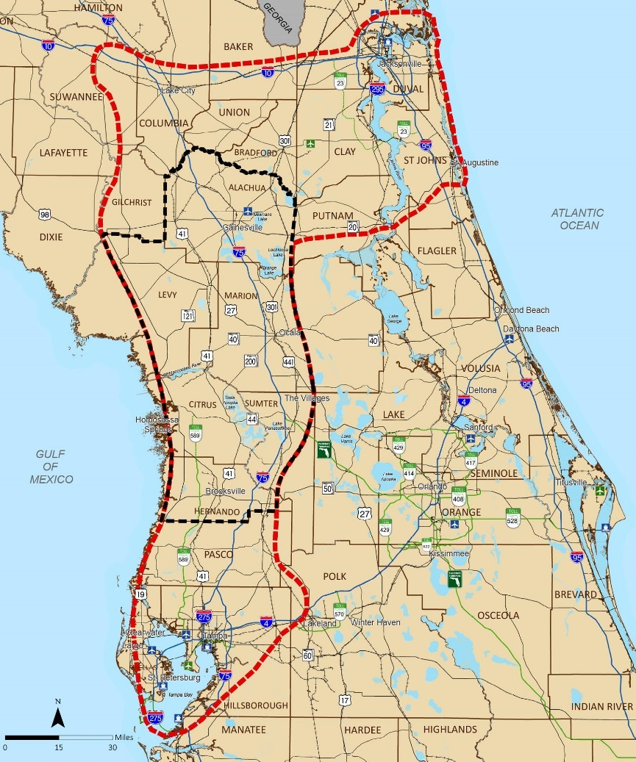
I-75 Relief Task Force
Jacksonville
Task Force is recommending evaluation of options that:
  1. Provide relief to I-75 and improve mobility in the Initial Focus Counties (yellow area)
  2. Enhance regional connectivity between:
  Tampa Bay
  Northeast Florida
Lake City
Gainesville
Ocala
Tampa
NOTE: Information is preliminary and subject to change
Florida Department of Transportation

Slide 5
I-75 Relief Task Force
DRAFT FRAMEWORK
Optimize existing transportation corridors
Evaluate potential enhancements to or transformation of existing transportation corridors
Evaluate potential for new multimodal, multiuse corridors after evaluation of I-75 and other connecting roads, and determination of need
Jacksonville
Lake City
Gainesville
Ocala
Tampa
NOTE: Information is preliminary and subject to change
Florida Department of Transportation

Slide 6

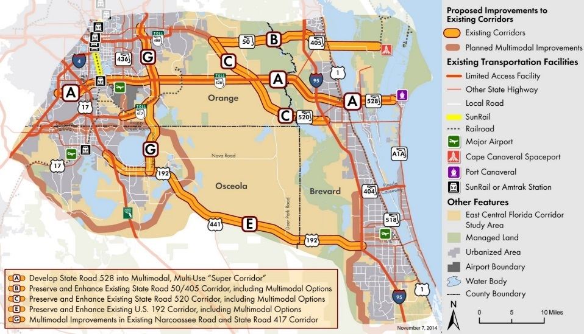
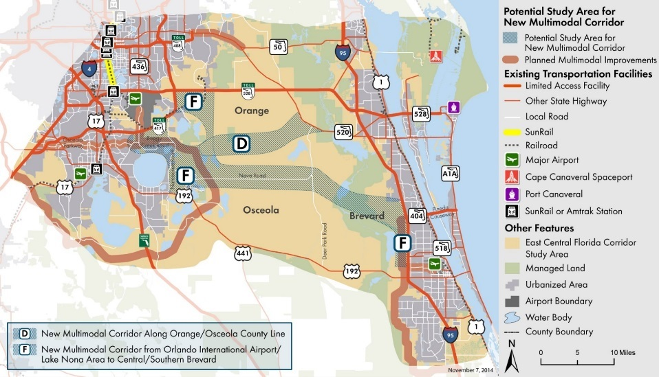
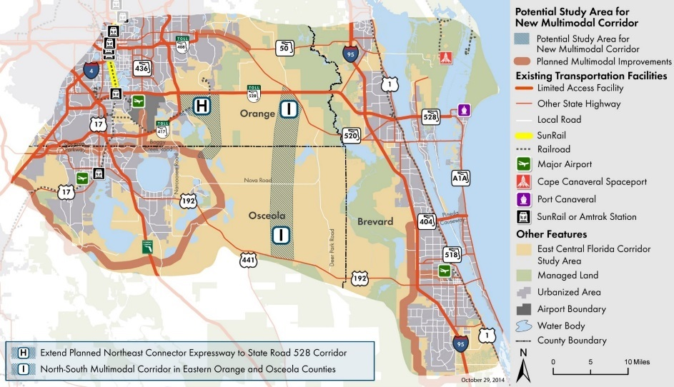
East Central Florida Corridor Task Force
NOTE: Information is preliminary and subject to change
Florida Department of Transportation
Notes:
ECFCTF recommended 9 corridors for further study, using 21 guiding principles and 4 Cs.
Hanson Professional Services selected to work with FDOT D5 and Central Office to develop an innovative approach to evaluating corridors.
An initial meeting of the Project Advisory Group (PAG) for the Evaluation stage was held on June 9 in Orlando. The PAG consists of representatives of Florida’s Turnpike Enterprise, the three study area counties, MetroPlan Orlando, Space Coast TPO, Central Florida Expressway Authority, and East Central Florida Regional Planning Council. Many of the representatives on the PAG were involved in the planning efforts that supported the East Central Florida Corridor Task Force.
The Central Florida MPO Alliance, staffed by MetroPlan Orlando, will lead the development of a Regional Transit Vision to complement and inform the multimodal corridor evaluation effort.
FDOT’s partners have been active in advancing the recommendations of the Task Force.
Counties have begun to integrate the recommendations of the Task Force into their comprehensive plans- e.g., Orange County has incorporated the guiding principles and corridor study areas in its comprehensive plan. Similar steps in the other counties.
Both MetroPlan Orlando and Space Coast TPO also are taking steps to integrate the recommended corridors into their Long Range Transportation Plans.
Central Florida Expressway Authority adopted the new corridors into its recently updated Master Plan

Slide 7

Shared Use Nonmotorized Trail Program
Coast-to-Coast Connector
St. Johns River to the Sea Loop
Individual Trails
August
Final Selection of Projects for FY17
September
Work Program Amendment for FY17 Projects
Up to $50 million to be programmed in FY17
Florida Department of Transportation
Notes:
7

Slide 8
MPO Program Management Handbook
Update to reflect recent changes in federal and state laws and policies
Convert to web-based, user friendly format
Develop new content
  Enhanced certification checklist
  Ethics requirements for Board members
  Public involvement
  Performance management
  Long range planning
  Other planning products/supporting programs
  Glossary
Provide opportunity for MPOAC review
Florida Department of Transportation

Slide 9
Calendar
State Highway Safety Plan Webinar
July 25
SASHTO Conference
West Virginia, August 27-30
Tools of the Trade Conference
(TRB, Transportation Planning in Small and Medium Sized Communities)
Charleston, SC, September 12-14
Florida Metropolitan Planning Partnership Statewide Meeting
Orlando, September 27-28
Florida Automated Vehicles Summit
Tampa, November 28-30
Florida Public Transportation Association and Commission for the Transportation Disadvantaged Annual Conference
Jacksonville, December 11-13

Slide 10



Jim Wood
State Transportation
Planning Administrator
850-414-5251
Jim.M.Wood@dot.state.fl.us
Florida Department of Transportation

