Slide 1
Florida Safe Routes to School Program
Background and What’s New
Sarita Taylor, Florida SRTS Coordinator – FDOT Safety Office
Notes:
The Florida SRTS program has come a long ways since 2005. Many engineering improvements were built and many educational and encouragement programs were implemented around the state.
As the subtitle says, this presentation is going to give you a brief background and where we are today.

Slide 2
What is Safe Routes to School?
Sustained efforts by parents, schools, community leaders and local, state, and federal governments to improve the health and well-being of students by enabling and encouraging them to walk and bicycle to school.
Notes:
The goal of SRTS programs are to get more students walking and bicycling where it is safe and to fix the conditions where it is not safe.
The opportunity to bike and walk to school offers a solution to an array of concerns about traffic safety, traffic congestion, transportation costs, air pollution and lack of physical activity. At the same times, walking and bicycling to school provides an opportunity for students to build independence. Our goals are based on making that solution into a reality.

Slide 3
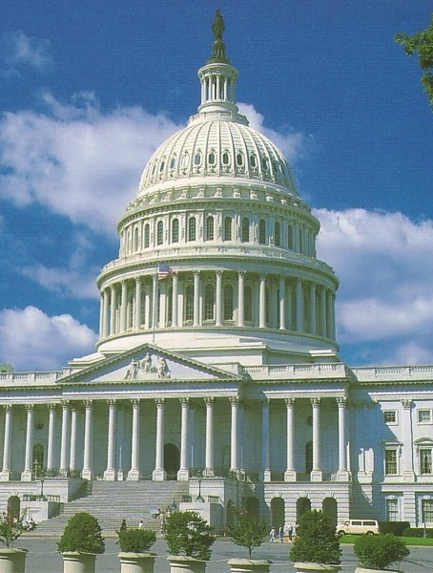
The Federal SRTS Program was established in September, 2005
$1,146,511,860 to States
Infrastructure (70% - 90%) &
Non-Infrastructure (10%-30%)
Funded through September 2012
    More information:
    FHWA http://safety.fhwa.dot.gov/saferoutes
    SRTS Clearinghouse www.saferoutesinfo.org
Notes:
Summary:
Congress established a federal SRTS program that provided over $ 1 billion to states for community SRTS projects.
SAFETEA-LU (Safe, Accountable, Flexible, Efficient Transportation Equity Act: A Legacy for Users):
The funds went to State DOTs, who decided how to spend them.
Eligible activities included infrastructure changes (ie, sidewalks, crosswalks, signs, signals, etc.) and non-infrastructure.
10 to 30 percent of funds had to be used for non-infrastructure activities; 70 to 90 percent was available for infrastructure projects.
Each State distributed funds using different criteria and formulas, based on their priorities (eg., population, student enrollment)
Matching funds were not required (in fact, the law specifically stated that projects will be funded at 100 percent).
Each state appointed an SRTS coordinator.
A National SRTS Information Clearinghouse was established.

Slide 4
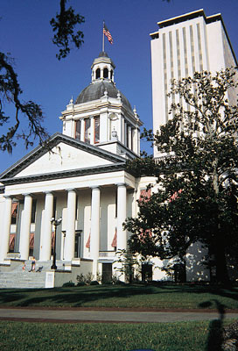
How did Florida do under SAFETEA-LU?
$58 million thru September 30, 2012
Most funds distributed to 7 Districts
Program managed by District under state guidelines and SRTS Coordinator
269 SRTS projects and programs
Reached over 1000 schools
Notes:
Florida received over $58 million under SAFETEA-LU for Safe Routes to School. Funds were distributed to the districts based on student population. Each district managed the SRTS program using the state guidelines. We programmed over 269 projects and educational programs throughout Florida. Safe Routes programs and projects reached well over 1000 schools statewide.

Slide 5
What we have learned
Lots of interest in program – more applications than can be funded
SRTS takes a lot of work, but it is definitely worth it
We started with a good process and have made modification as we learn more
It takes all of the 5 E’s to have a successful SRTS program
Notes:
The first couple of years were slow as far as applications coming in. However, once other agencies and schools saw what was happening in other areas, they wanted in.
There is a lot of information and leg work that is required to complete the SRTS application; however, it is worth it when a project is built and students are using it to get to school.
Through the years, the application process has evolved. And, it will continue to evolve as we continue to make new strides in safety.

Slide 6
FLORIDA’S SRTS APPLICATION
Call for Applications November14 – March 31
Eligible Applicants are Kindergarten through 12th grade schools or any school that has several of those grades.
Eligible Maintaining Agencies are:
  FDOT
  Counties
  Cities
Applicants are encouraged to engage other partnerships

Slide 7
WWW.SRTSFL.ORG
Basic Program Information
Application Guidelines
Form
SRTS Updates
Website Resources List
Helpful Links
Notes:
Message:
First, review the guidelines and application before you begin your project.
You can find the guidelines and application on the Florida SRTS website, www.srtsfl.org
You can also check back time to time to see updates and changes there.
www.srtsfl.org will take you to this Change of Address Page. Once there, click on Safe Routes to School Program . You will be redirected to http://www.dot.state.fl.us/safety/2A-Programs/Safe-Routes.shtm
This is a temporary change of address page that will take you to the SRTS site on the FDOT Safety page. In the future, www.srtsfl.org will be the address again with more information and aids for all things SRTS.

Slide 8
SUBMIT APPLICATIONS TO
Dist | Contact | Phone | Email
1 | David Wheeler | 863-519-2378 | David.Wheeler@dot.state.fl.us
2 | Jeff Scott | 904-360-5644 | Jeffrey.Scott@dot.state.fl.us
3 | Michael Lewis | 850-330-1266 | Mike.Lewis@dot.state.fl.us
 | Barbara Lee | 850-330-1428 | Barbara.Lee@dot.state.fl.us
4 | Tracey Xie | 954-777-4355 | Yujing.Xie@dot.state.fl.us
5 | Tony Nosse | 386-943-5334 | Anthony.Nosse@dot.state.fl.us
 | Chad Lingenfelter | 386-943-5336 | Chad.Lingenfelter@dot.state.fl.us
6 | Misleidys Leon | 305-470-5345 | Misleidys.Leon@dot.state.fl.us
7 | Matt Weaver | 813-975-6254 | Matthew.Weaver@dot.state.fl.us

Slide 9
What’s New!
Most important change is:
This is Florida’s Safe Routes to School Program.
High Schools are eligible.
Notes:
This is Florida’s Safe Routes to School Program.

Slide 10
Funding
This is another area that was tweaked.
SAFETEA-LU is gone
MAP-21 is gone
Welcome FAST Act and SR2T
Notes:
The stand alone funding for the National SRTS program ended along with SAFETEA-LU. Safe Routes projects were still eligible under MAP-21 - Transportation Alternative funding. However, State DOTs, MPOs and non profits were not eligible recipients. FAST Act helped by allowing these recipients eligible.
Beginning December 1st, 2015, Florida recognized the need for additional support to municipalities in providing safe walk and bike ways for students to use to and from school. With this is mind, $7 million a year, beginning in 2017, was set aside for our Safe Routes to School Program. We were actually able to bring $2 million in 2016, which left $5 million in 2017 to fund a number of old SRTS projects.
You must be wondering where the SR2T funds are coming from.
You already know that MAP-21 eliminated the SRTS Program and rolled it into the Transportation Alternatives Program (TAP).
MAP-21 added TAP activities to the eligible activities for the Surface Transportation Program (STP).
Therefore, SRTS projects (infrastructure and/or non-infrastructure) now qualify for the STP program.
MAP-21 also eliminated the prohibition against using STP funds on local roads or rural minor collectors. Now, they can be used for SRTS activities on any public road, even if they are off the federal aid system.
STP Program funds in the work program were fully programmed but federal safety funds (HSP) were not. So we arranged to have available excess some of the HSP funds transferred to the STP program (on the federal books) and assigned a unique fund code (SR2T) in the work program for this dedicated funding.

Slide 11
Hazardous walking conditions and schools in rural communities.
Applications that eliminate a documented a Hazardous Walking Condition area will be given higher priority.
For language on Hazardous Walking Conditions, go to FS 1006.23
Rural community assistance is through a contract with UF.
Currently being piloted in Gadsden County. School travel plans are being developed.
Notes:
There is a higher emphasis on schools that have Hazardous Working Conditions and also schools in rural communities.
This bill revises the criteria used to determine hazardous walking conditions for public school students and the procedures for identification and inspection of the perceived hazardous location. It requires that school districts work with the state and/or local government that has jurisdiction over the roadway to develop a plan to correct the identified hazard within the jurisdiction’s five-year transportation work plan or provide a statement to the school superintendent indicating that the hazard will not be corrected. The bill protects the school district in civil actions that may be brought against it because of hazards and allows the school district to enter into interlocal agreements with other governmental entities to identify and correct hazards.
Hazardous walking conditions, to:
• Revise the criteria that identify a hazardous walking condition for public school students who walk parallel to the roadway, as follows: o Retains the requirement for an area to be at least four feet wide adjacent to the road for students to walk to and from school, but excludes drainage ditches, sluiceways, swales or channels from inclusion in the required four-foot walkway;
o Reduces the posted speed limit from 55 miles per hour to 50 miles per hour or greater, and requires uncurbed roads to have at least a three-foot buffer from the edge of the road to the required four-foot area on which students walk to and from school;
o Removes the exception for residential roads with little or no transient traffic.
• The bill creates additional criteria to be used to identify hazardous walking conditions for students who may be “crossing over the road” (currently known as walking perpendicular to the roadway). The bill also states that any road with an uncontrolled crossing site will be considered a hazardous walking condition if the road has:o A posted speed limit of 50 miles per hour or greater; or
o Six lanes or more, not including turn lanes, regardless of the speed limit.
According to the National Center for Safe Routes to School, active transportation in rural areas can pose a unique set of challenges including “long distances between home and school, few sidewalks or bicycle lanes, low lighting, and drivers traveling at high speeds on low traffic roads through sparsely populated areas.”
The University of Florida has been contracted to provide technical assistance to help ensure small cities, rural areas and under-represented communities receive their share of the available funds for SRTS type projects. This research and implementation project will take the well-established metrics and methodologies that have been developed over the last two decades and identify the best SRTS program implementation approaches for Florida’s rural communities. After identifying the best approach, we provide technical assistance to ensure that small cities, rural areas and under-represented communities receive their share of the available funds. This assistance will include a report that can be used as documentation for other funding sources.

Slide 12
Non Infrastructure Applications
  For the next 3 years, we will be developing with FDOE, a new curricula for bike/ped education for use in the classroom. We have allocated $2 million a year of the $7 million for this effort. This is to cover all counties in Florida in the 3-year period.
We are not accepting any Non Infrastructure Applications under the SR2T funding.
Eligible applicants can apply through Transportation Alternatives.
Notes:
We are not accepting Non-Infrastructure applications under SR2T.
For the next 3 years, we will be developing with FDOE, a new curricula for bike/ped education for use in the classroom. We have allocated $2 million a year of the $7 million for this effort. This is to cover all counties in Florida with no additional funds in the 3-year period.
Curriculum includes Elementary, Middle, High schools and ESE.
Providing trainings for all schools throughout Florida.

Slide 13
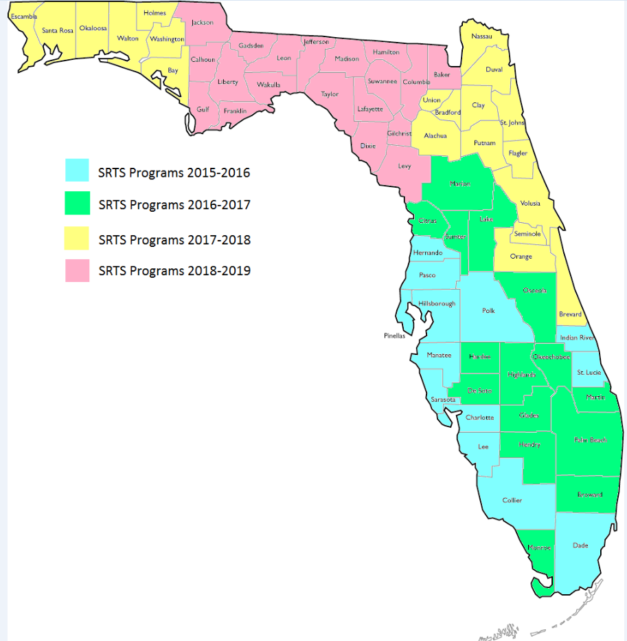
Education throughout Florida
Notes:
As the image shows, we were in 13 counties in FY 2016. This was not with the new curriculum or efforts and under the same guidance that we had been using since the beginning of Safe Routes.
Beginning with the 2016-17 school year, we have a new format and direction. We will cover the previous 13 counties by training the teachers, showing them the new curriculum and assisting with a training. Then we move on to the new 15 counties. We accepted proposals/grant applications earlier this year. Applicants were chosen by who could meet our need to reach all counties in a 3-year period. We cut a number of programs and selected new applicants to fill the void.
Once we have covered all of Florida, the bicycle pedestrian training will be given to the Department of Education. FDOT will not be funding non-infrastructure programs after this time.

Slide 14
What was programmed this first cycle under SR2T
39 applications received
28 applications programmed
Sidewalks
Elementary & Middle Schools
(D6 is still reviewing applications for this cycle.)
Notes:
The most recent call for applications closed on March 31st. From bits and pieces of information that I heard, I knew that come districts were going to have more than others.
We received applications from 15 counties.
We were able to approve 28 of them.
Most of the applications received were for sidewalks. There were some for signal equipment, pedestrian bridge (we weren’t able to approve due to cost - $5 million) and of course sidewalks.
While most of the applications came from Elementary and Middle schools, there were several submittals from high schools. Unfortunately, the high schools did not complete the necessary information.
For all of the applications that were not programmed due to lack of information, we will be working with the applicants to get the necessary information to be able to resubmit the updated application for the next cycle beginning the end of November. Some applications might be asked to be split into phases or asked to apply for other funding.

Slide 15
WRAP UP & QUESTIONS
Safe Routes projects take a lot of work and effort, but are definitely worth it.
It takes all of the 5 E’s to have a successful SRTS program.
Help is available with the application process.
QUESTIONS???
Notes:
In wrapping up, we have come full circle back to what we have learned. Safe Routes projects do take a bit of work. However, providing a safer place for our students to bike and walk is definitely worth it.
We know why it is important to give all 5 E’s involved with the program. This is a community project, not just one entity.
If you are feeling overwhelmed with all of the prep work and application, just reach out to your local District SRTS Coordinator. They can help you navigate your way through the process. Please note, they will not complete the application for you.

