Slide 1
FL LRTP Reviews
Jeff Kramer, AICP
MPOAC Policy and Technical Subcommittee l December 20, 2016

Slide 2
Background/Purpose
Prior Reviews in 1997, 2002, 2008 and 2013
Purpose:
  Observations: identify current practices and compare to previous practices
  Suggestions: prompt change in practice ahead of next update cycle
  Estimate statewide shortfall in metropolitan areas

Slide 3
Example Changes in Practice
Statewide financial guidelines
  Uniform LRTP horizon years; “Needs” plan guidance; Include TIP years
Shortfall estimate used to champion increased transportation spending
  Basis for MPOAC Revenue Study and Policy Positions
Coordination between:
  LRTPs, FTP and other state plans; input to FTP
  Neighboring MPOs; regional coordination studies

Slide 4
Example Changes in Practice
Improved “user friendliness”
  no model output; executive summaries; brochures
More descriptive LRTPs; fewer “sanitized” plans
Clearer linkages between LRTP projects and goals

Slide 5
2013 Sample Suggestions
Appropriate “needs” plan projects
Determine transit “needs” beyond the 10-year window of the TDP
Be clear about tradeoffs
More focus on freight movement
Scenario planning
Describe how public input informed decisions
Mitigation and adaptation strategies

Slide 6
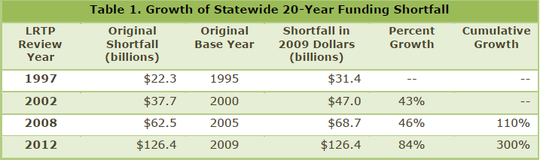
Estimated Statewide Shortfall

Slide 7
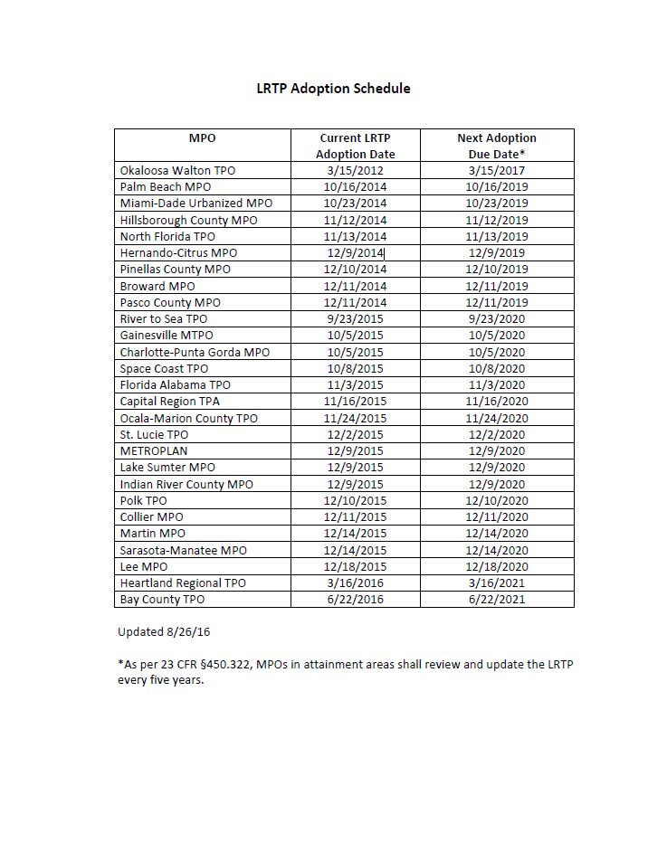
Timing to Review of 2040 LRTPs?
Last adopted 2040 LRTP
  3/2017
First adopted 2045 LRTP
  10/2019

Slide 8
What Would It Take?
Review all 27 MPO plans and supporting documentation
  Follow-up with MPOs as needed
Develop generalized statewide observations and document unique practices
Develop shortfall model (Needs plan costs v. estimated revenues)
  Estimate individual MPO shortfall
  Estimate statewide shortfall

Slide 9
What Would It Take? – Part II
Approximate schedule
  18 months
Approximate cost
  $175k
Potential source of funding – PL reserve
  Spread across 2 to 3 fiscal years

Slide 10
Questions?
Jeff Kramer
Center for Urban Transportation Research
University of South Florida
kramer@cutr.usf.edu
813-974-1397

