Slide 1
MPOAC Freight Committee Meeting
January 26, 2017 | Sunrise, FL
Rickey Fitzgerald, FDOT Freight & Multimodal Operations Office Manager
Notes:
I am excited to be here with you today at MPOAC to talk about how FDOT has continued our leadership in freight, with an overview of our current initiatives and priorities.
Today’s Florida DOT
Recognizing the economic importance of transportation … FDOT is seeking to find the right balance between moving people AND goods.
Today – at the Florida DOT – we are doing just that with a new focus on Freight and Logistics.
Merger of Rail, Motor Carrier, and Freight in the new Freight & Multimodal Operations Office
The Office of Freight & Multimodal Operations of FDOT will serve as a principle freight, trade and logistics partner contributing to the growth of Florida’s economy as a global, export-oriented hub.

Slide 2
Agenda
New Strategic Focus
FASTLANE
FAST Act Guidance
NHFN
  CUFC/CRFC
State Freight Advisory Committee

Slide 3
Current Priorities
Rail & Motor Carrier
  Rail System Plan
  Hazards Program
  Open & Closure Program
  Motor Carrier System Plan
  Restricted Roads
  Connectivity, Reliability, Safety
Freight Coordinators
  Outreach
  Freight Roadway Design
  Heavy Trucks
  Agribusiness
  Truck Parking
  Connectivity, Reliability, Safety
Notes:
The Rail and Motor Carrier Operations Office rail functions include development of FDOT’s rail policy, as well as technical support to FDOT’s executive leadership and districts, and management of Florida’s Strategic Intermodal System (SIS) rail program.
The Office is responsible for developing and implementing the Florida Freight Rail System Plan and the Florida Passenger Rail System Plan, rail safety, rail project development/management, and rail research.
The Office also leads FDOT’s preparation for and response to major rail incidents and emergencies and on rail freight/rail passenger interoperability issues with freight railroads and intercity/commuter rail entities. The Office also and has a co-leadership role with the districts in development of commuter rail systems.
The Office serves as FDOT’s liaison with the private rail industry, the Federal Railroad Administration (FRA), Amtrak, and represents the Department on the American Association of State Highway and Transportation Officials’ (AASHTO) Standing Committee on Rail Transportation (SCORT).
On the motor carrier side, the Office has taken a leadership role in developing the Freight Mobility and Trade Plan in coordination with all modal offices, as well as assisting FDOT freight coordinators in implementation.
While many Department Offices impact truck movements, the Rail and Motor Carrier Operations Office has also taken on the role of setting policy guidance regarding asset management, safety, and truck mobility.

Slide 4
FDOT Freight Strategy Profile – After FMO
Implementation of the Freight and Multimodal Operations Office means:
Peers, Partners & Stakeholders have an identified freight champion and structure
FL freight initiatives are pushed to FMO
FL has a champion to align, promote, & enhance all FDOT freight initiatives
Policy Planning Heavy Truck Corridor Study
Maintenance Office Size and Weight Regs
Traffic OPS
TSM&O Freight Management
Freight
Strategy
Safety Office CMV Emphasis Area
Traffic OPS
Truck Parking
Design Office Complete Streets
TRANSTAT
Freight Performance Measures

Slide 5
Moving Forward
Efficient & Strategic Operations
Institutional
Infrastructure
Funding
Notes:
How are we going to do all of this?
The FMO office is focused on creating efficient and strategic operations for FDOT.
Institutional
We have unique challenges to ensure that we are not creating or causing our own institutional bottlenecks.
Applying public policy to multiple stakeholders
Building relationships (internal and external) that may be fragile in nature
Balancing adhering to technical requirements while responding to political demand
Infrastructure & Funding
As we think about transportation investments, a basic principle to consider is that Florida will compete with other states and nations if we continue to invest wisely in transportation. We must continue to reduce our infrastructure bottlenecks:
Freight Imbalances
Last Mile Connectivity
As a department we will shift our focuses:
From planning to move vehicles to planning to move people and freight
From looking at individual modes and facilities to consideration of complete end-to-end trips
From emphasis on individual jurisdictions to emphasis on economic regions and trade corridors
From assessing needs and setting priorities based on measures such as capacity, throughput and travel time costs to setting priorities based on reliability, business logistics and economic competitiveness
From reacting to economic growth and community and environmental impacts to proactive planning for economic, community and environmental goals
Part of shifting the way we think is proactively planning for the infrastructure needs of the future, and taking advantage of the technology that is available, rather than simply accommodating it.

Slide 6
FASTLANE Project Details
Project Name | Truck Parking Availability System (TPAS)
Applicant | Florida Department of Transportation
Project Size | Small
Project Description | The project will install an Intelligent Transportation System (ITS) to detect available truck parking at approximately 74 public facilities across the entire Interstate System in Florida. In addition, the project will collect information on some private locations.
Awarded | $10,778,237
Notes:
Florida applied for three freight projects
Awarded one:
$10.7 Million aid in TPAS deployment
TPAS – Truck Parking Availability System
Fiber-Optic cables have been set in Welcome Centers, Weigh Stations and Rest Areas (ITS network)
Along I-4, I-10, I-75, and I-95
Using these cables, sensors will be applied to these areas for counting the types and numbers using the facilities
Can be used with Signage system for more efficient use of parking and other benefits

Slide 7
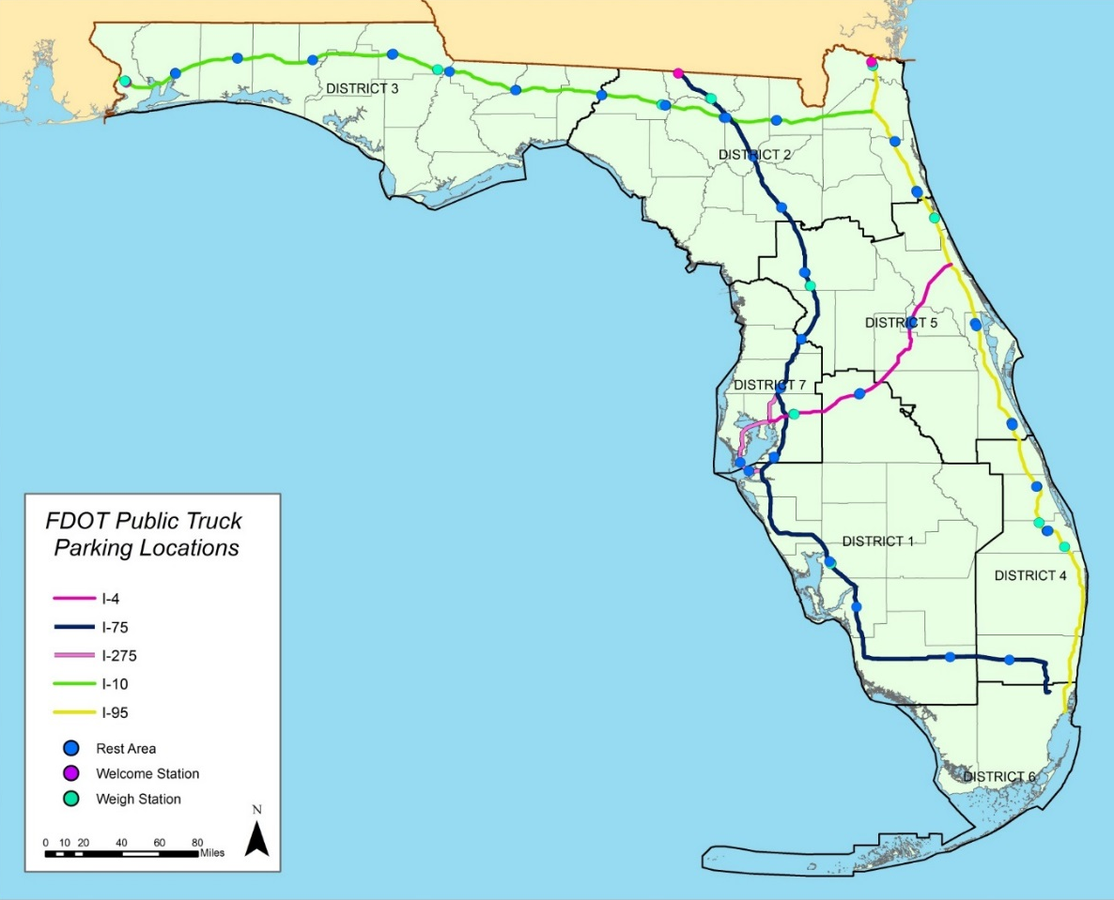
FASTLANE Project System Overview
Four major corridors:
  I-95
  I-4
  I-75/I-275
  I-10
74 Public Facilities:
  3 Welcome Centers
  20 Weigh Stations
  51 Rest Areas
Notes:
FDOT Applied for the FHWA AID Grant in 2015
Grant awarded July 2015
Grant based on 25 sites covering entire I-95 and I-4 corridors
Funds obligated January 2016
$1,000,000 FHWA AID Grant
$500,000 FDOT Match

Slide 8
FAST Act Guidance
SEC 1116 National Freight Program
  Formula program funding of $6.2 billion over five years (FL $301M)
  States must develop freight investment plan before obligating any funds
  States are encouraged to establish freight advisory committee
  USDOT and states will designate national freight network, and will be updated every five years: Initial designation of Primary Highway Freight System 41,518 mile network plus critical rural and urban freight corridors, and non-PHFS interstate.
  Funds will be directed under national and state strategic plans to project that improve highway freight transportation
  May obligate up to 10% of funds for improvements to freight rail or ports

Slide 9
National Highway Freight Network (NHFN)
Critical Rural Freight Corridors (CRFC)
  320.14 miles
  Rural routes are under DOT approval
  Must provide access to Ag & Industry
Critical Urban Freight Corridors (CUFC)
  160.07 miles
  Urban areas over 500,000 require MPO approval
  Must provide access to freight facilities

Slide 10
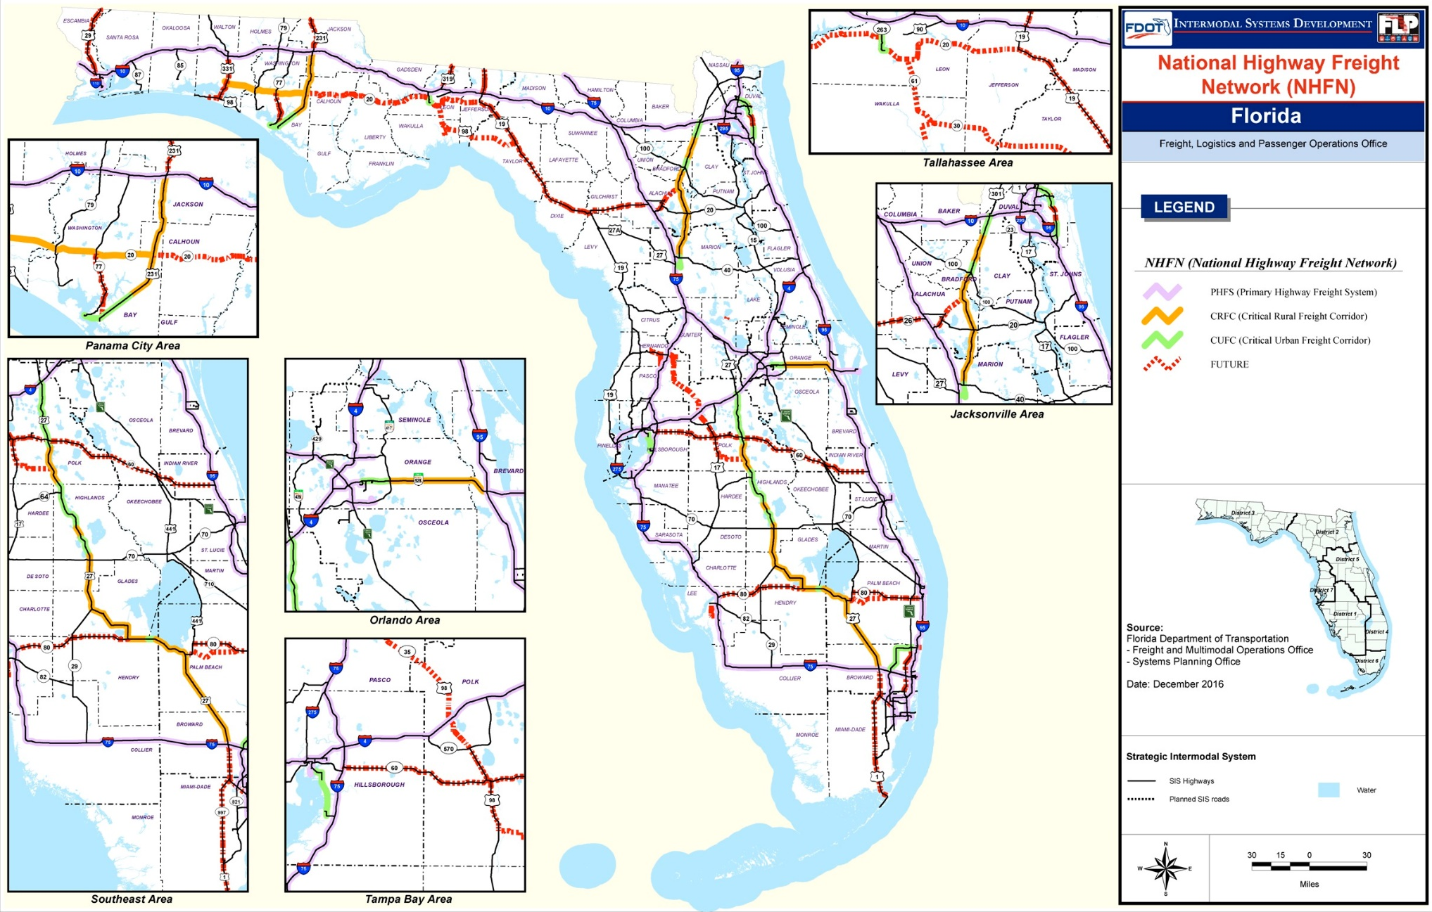
NHFN CRFC/CUFC

Slide 11
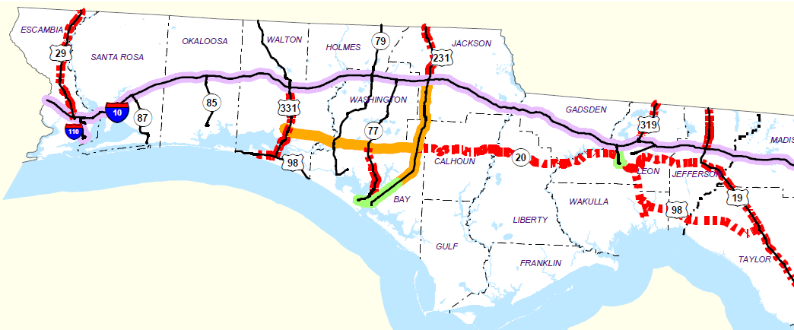
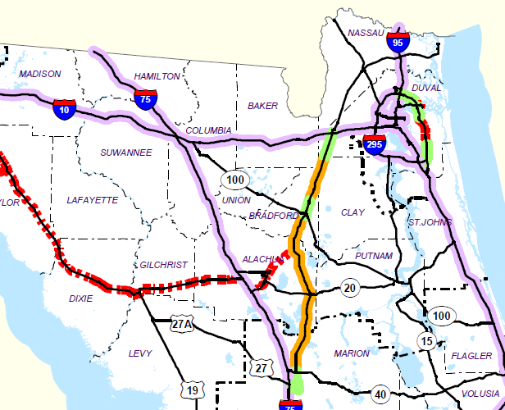
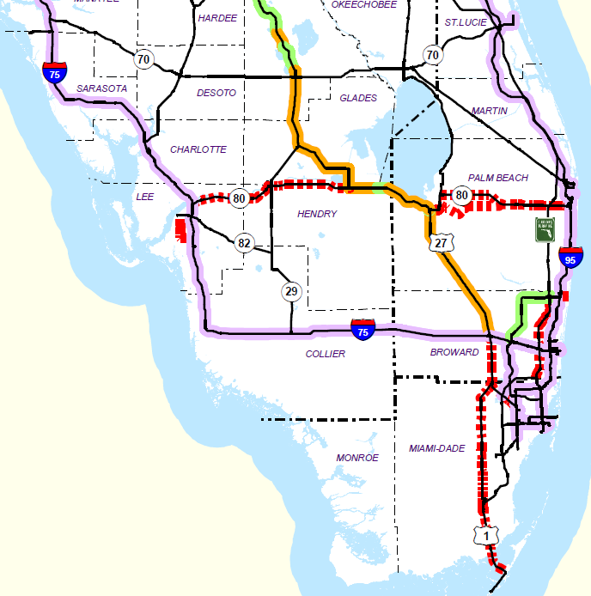
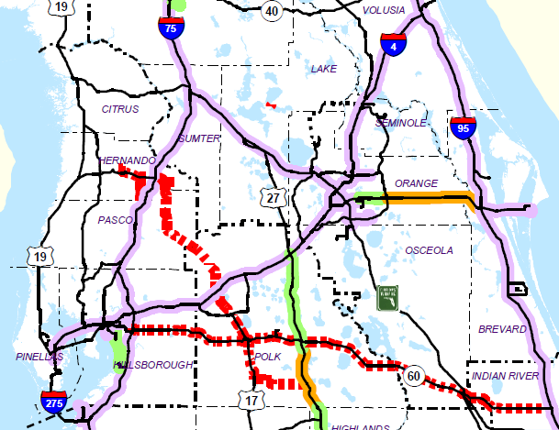
NHFN CRFC/CUFC
Northeast
Northwest
Central
South

Slide 12
State Freight Advisory Committee - Structure
Would like to draw thirteen committee members from multiple State freight stakeholders:
  5 Industry
  7 MPO
  3 County Representatives
  1 Rural
  1 DOT Member
Notes:
Would like to draw Committee members from multiple State freight stakeholders
Look to FMTP stakeholders as a jumping off point for consideration
4 Industry
Likely one from each mode (Rail, Sea, Air, and Truck)
5 MPO
Spread by region
3 County Representatives
One from North Florida, Central Florida, and South Florida
Candidates: EDC, Chamber, Planning and Zoning, or similar stakeholders
1 DOT Member
Undecided on who
Nominate members from CO
Each position will need a secondary Rep

Slide 13
State Freight Advisory Committee - Legal
Still open to Sunshine Law, even if they are not a decision making body
  This creates a few extra steps
    All meetings must be open door & A/V Recorded
    Public meeting notices must be posted 2 weeks prior
    Venue must be free and accessible to all
There can be no communication between members outside of meetings
  Would be beneficial to include legal team to intro meetings
  The communication can never be related to anything that may come in business of meetings.
  Always remember not to allow reply all in e-mail by members
Any business interactions between members should be reported to FDOT FAC partners for the sake of public record simplicity
Notes:
Still open to Sunshine Law, even if they are not a decision making body
This creates a few extra steps
All meetings must be open door & A/V Recorded
Meetings must be recorded (A/V recording)
Meetings minutes must be taken and published
Public meeting notices must be posted 2 weeks prior
Complete the FAR process through Sabrina
Posting requires a nominal fee
Can be paid through FLP cost center
Venue must be free and accessible to all
There can be no communication between members outside of meetings
Would be beneficial to include legal in intro meetings
The communication can never be related to anything that may come in business of meetings.
Always remember not to allow reply all in e-mail by members
Any business interactions between members should be reported to FDOT FAC partners for the sake of public record simplicity

Slide 14
State Freight Advisory Committee – Timeline
(Tentative) FDOT Freight Advisory Committee development:
  Oct 10 - 17, 2016: FDOT develops and submits a draft FAC framework
  Jan – Feb 2017: request for nominees/applicants
  March 2017: Committee is designated
  April 2017: Committee policy is developed and published
Notes:
FDOT Applied for the FHWA AID Grant in 2015
Grant awarded July 2015
Grant based on 25 sites covering entire I-95 and I-4 corridors
Funds obligated January 2016
$1,000,000 FHWA AID Grant
$500,000 FDOT Match

Slide 15

State Freight Advisory Committee – Application Online
Enhancing & expanding intermodal connectivity within the Department
Cross-sectional representation of public and private sector freight stakeholders advising FDOT
Apply before February 17th at: http://freightmovesflorida.com/contact-us/flfac/

Slide 16
Questions?
January 26, 2017 | Tallahassee, FL
Rickey Fitzgerald, FDOT Freight & Multimodal Operations Office Manager

