Slide 1
Year in Review
Thomas Hill

Slide 2
Ready for Launch
(anybody see my keys … ?)

Slide 3



Next Generation of TDM & Forecasting
Refreshed for next generation of travel demand modeling and forecasting
Reorganized around core principles
  Relevancy & Timeliness
  Accessibility & Communication
  Consistency & Efficiency
Renamed to TFF to foster a collaborative, incremental, and iterative process
3

Slide 4




Mission Overview
Guidance & Training
Transportation Forecasting Forum
Tools
Technical Support
Notes:
Click again for planets to rotate to Guidance and Training
------------------------------------------------------------------
New Data Committee
Was tasked with developing a comparative analysis of different transportation data products
This work resulted in a broad table of vendors and compared individual attributes
By evaluating a wide range of products across key attributes—such as
data type, resolution, accessibility, and quality assurance
the committee has provided insights into how each data source
can be leveraged for specific transportation needs.
This work helps us:
Identify the best data sources for different applications,
Ie, short-term predictive analysis, traffic operations, or safety forecasting.
Improve decision-making
by providing clear guidance on data accessibility,
Facilitate data integration
by highlighting how these sources can complement each other,
Drive improvements in forecasting accuracy,
with data quality checks and
more reliable predictive models.
For DOTs, MPOs, and consultants,
This work is important overall because it helps create a
clear, comprehensive understanding of the diverse data sources.
By evaluating and comparing these sources across critical attributes—
such as data accuracy, accessibility, and resolution
it provides a roadmap for selecting the right tools for specific transportation challenges.
Short-term Predictive Analytics Committee
Purpose and Scope
The committee was tasked with creating guidance for short-term predictive analyses to support TDM
Looked at merging these concepts together
Pretty tough task
Started with a national, statewide, and local scan of best practices and a
literature review
What is out there where we can start with a foundation.
Deliverables and Outcomes
Literature Review
Summarized 35+ tools and use cases,
including resiliency, safety, operations, freight, and corridor studies.
Explored emerging methodologies,
such as machine learning, digital twins, and
and exploratory modeling.
Included a tool matrix linking predictive tools to specific transportation challenges.
Flyer (Accessible via the HUB!):
Condensed into a visual overview.
Highlighted multiple use cases
(5 Florida-based),
with a focus on safety, operations, special events, and corridor studies.
Tailored Points for Audience Interests
For DOT Representatives
Showcase how predictive analyses align with FDOT goals, such as
improving safety, managing special events, and optimizing traffic operations.
Emphasize coordination with the FDOT Safety Office
and focus on practical tools that can support near-term planning and operational decisions.
For MPOs
We sought to
Highlight tools and case studies that assist with
corridor studies and capital improvement planning,
tying results to regional goals and stakeholder priorities.
And, encouraging adoption of digestible and visual materials like the flyer for broader stakeholder communication.
For Consultants
Stress emerging technologies such as machine learning and digital twins,
Underscore the potential for innovative approaches in traffic impact studies and special-event forecasting.
Summary (STPA)
We’ve made a solid start in exploring how short-term predictive analytics can work alongside traditional travel demand modeling,
but there’s still more to figure out.
We need to keep digging into how these tools can really fit together and add value.
The work isn’t done yet, but it’s a step in the right direction to handle the ever-changing challenges in transportation.
FTFF Annual Meeting

Slide 5
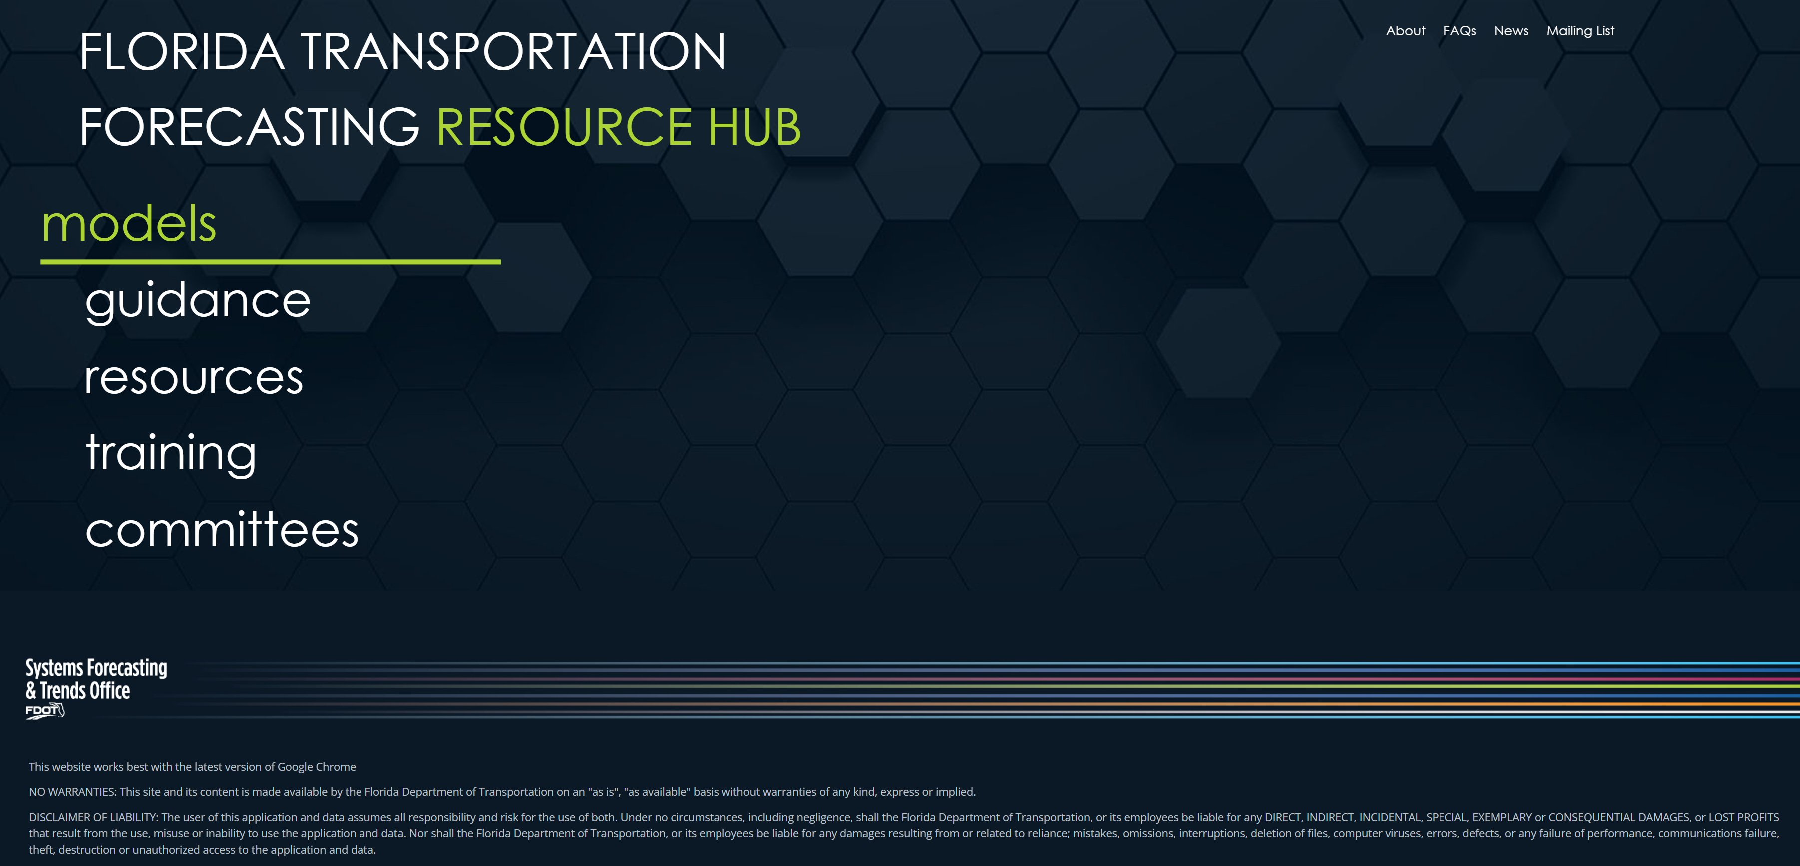
fdot.gov/forecasting
5
Notes:
Website Overview:
One of the first improvements we made was the complete overhaul of our website.
It’s now designed to be a one-stop hub for all things related to transportation forecasting in Florida.
Centralized Access to Resources:
The site centralizes access to all of our models across the state,
provides downloads and metadata to each one for easy access.
We also provide essential resources, for modeling information and guidance generated outside of florida.
Training and Development:
We’ve made training resources readily available to help users at every level enhance their forecasting skills.
You can access some individualized training for the district models via this link
We will also post our upcoming training and workshops here.
Supporting Committees:
Then we have our committee work linked here as well.
This is an essential part of fostering collaboration and ensuring consistency in the work we do.
Comprehensive & Easy-to-Use:
The layout is designed to be intuitive,
with easy navigation so you can quickly locate information,
whether you’re looking for guidance on models or seeking a specific resource."
Link to the Webpage:
For more detailed information and to explore the resources we’ve made available,
visit the Florida Department of Transportation’s forecasting page at the link on the bottom.

Slide 6
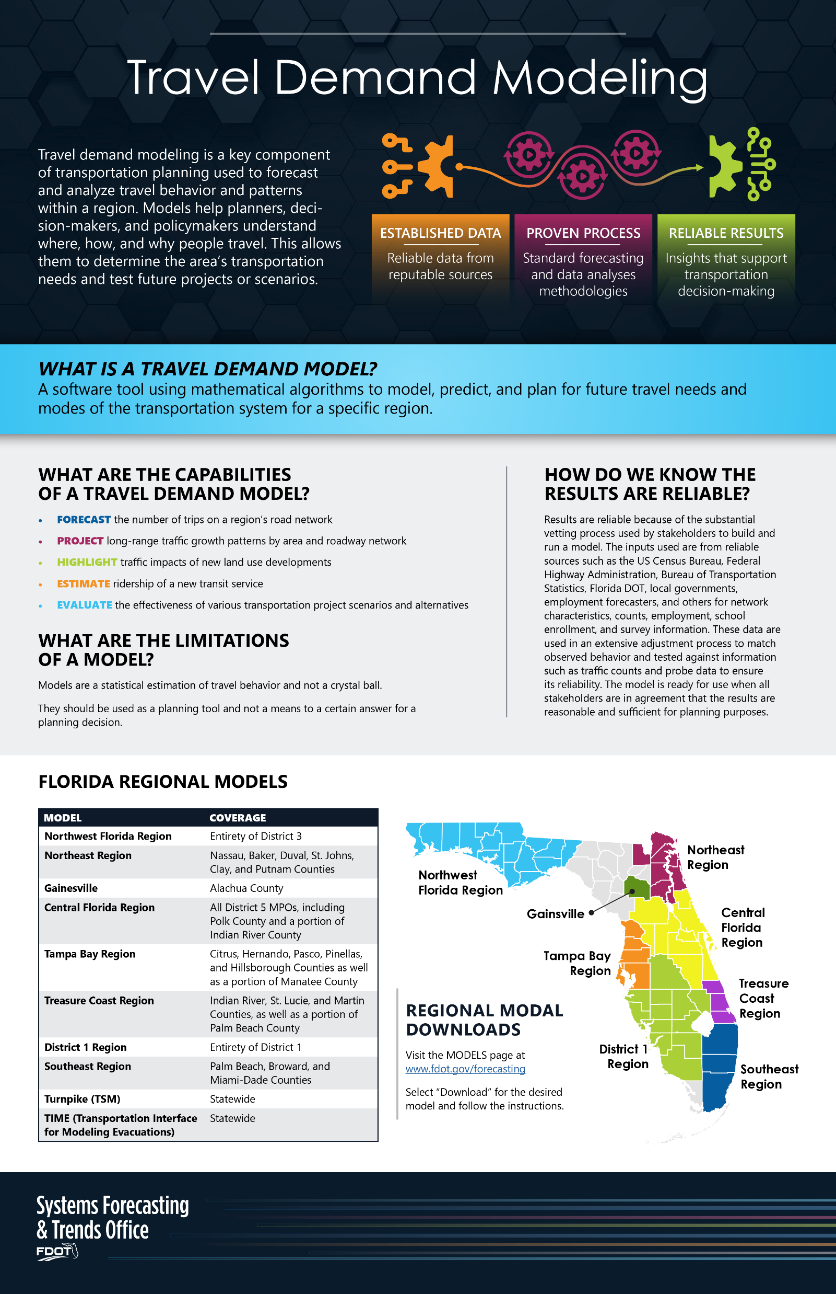
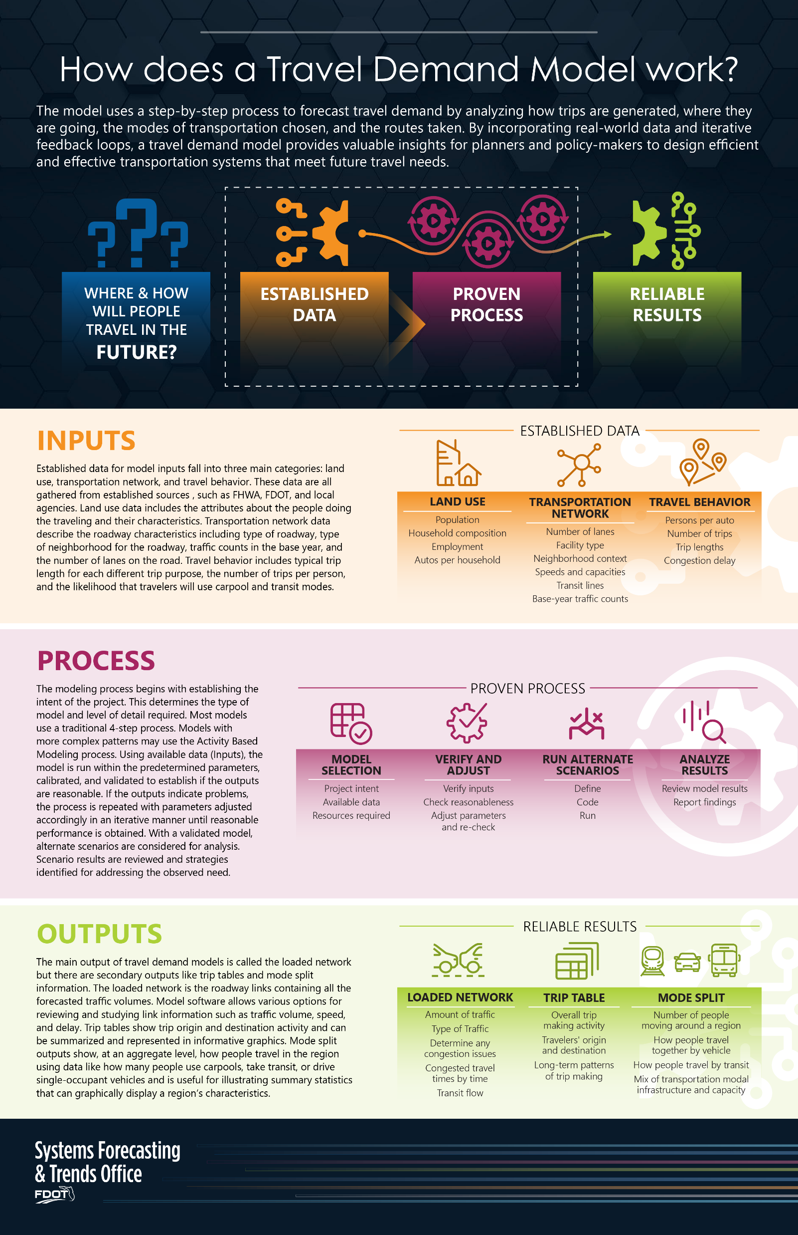
Communicating The Value of Modeling
Notes:
One of the first challenges that originated from the TFF Ver.2023
Was to develop a series of infographics that
Communicated, in simple terms, the value of travel demand modeling
The intent was to provide a easily digestible information flyer that
Can be used at public meetings
Or handed out to elected officials for a broad overview
In two pages, this flyer communicates:
What is a Travel Demand Model?
Capabilities and Limitations of the Model
What can they do and not do
Establishes concepts of reliability
The results of a model are only as good as the data and methods it uses.
Establishes the foundation of what is a very rigorous development process
Drives home the message that model results are both reliable and actionable.
Regional Models in Florida
The infographic provides a list of these models, along with links for easy access to download data and resources.
We did this in two pages!
Cant tell you how difficult that was.
We took (for example)
consider this statement in defining a TDM – I know everyone of you have made something similar …
Models are the application of multi-modal, dynamic, spatiotemporal demand-supply equilibrium frameworks in conjunction with stochastic traffic assignment algorithms facilitates the optimization of network flows, accounting for both endogenous and exogenous variables that influence the aggregate mobility patterns within urban regions under varying policy interventions and infrastructural modifications.
And turned that into:
Modeling helps us predict traffic patterns based on policies and infrastructure changes.
You know what I said, but nobody else outside this room does.
<page>

Slide 7
Value Principles
Travel Demand Modeling
ESTABLISHED Data
Reliable data from reputable sources
Proven Process
Standard forecasting and data analyses methodologies
RELIABLE RESULTS
Insights that support transportation decision-making
Notes:
This work facilitated the development of a couple slides
They are intended for use in public presentations
Simple language
AND, we wrote a narrative to go along with slides
This is the simplified version
And if what you need is a little bit more substance then …
<page>
Travel demand models are valuable because they use trusted data sources such as the US Census Bureau, Federal Highway Administration, Bureau of Transportation Statistics, Florida DOT, and local governments.
The models rely on processes developed, tested, and improved over the last 60 years to provide reasonably reliable insights into future traffic volumes that supports transportation decision-making.
Planners often forecast short-term traffic using recent trends, but this method becomes unreliable beyond five years. Traffic growth slows as it approaches the roadway’s capacity, making long-term projections less accurate. Travel demand models, on the other hand, account for the complex traffic diversion caused by congestion, or the spillover effect of traffic diverting to other facilities in the transportation network.
Models account for land use changes expected over the next 20-30 years. These changes in development may significantly alter travel patterns.

Slide 8
How Does a Model Work?
Question
Inputs
Process
Outputs
Where & How will people travel in the future?
ESTABLISHED
DATA
Land use
Transportation network
Travel behavior
PROVEN
PROCESS
Model selection
Verify and adjust
Run alternate scenarios
Analyze results
RELIABLE RESULTS
Future estimated travel behavior
Notes:
We also provide some slides with a little more information
That add more insight and discussion around
Models and modeling
And, we wrote a longer written document of
Talking points
Support narrative to help with a public presentation
Gives more information of the modeling process
While maintaining the simplified approach
Again, we spent a lot of time
Condensing subject into digestible terms
This was in response to the DMC suggestions
Think it is going to be very helpful
As a resource
It is available on the Hub
Encourage you to use it.
The model uses a step-by-step process to forecast travel demand by working with established data and using a proven process to estimate future travel behavior. In most cases, a 4-step approach is used to analyze how trips are generated, where they are going, the modes of transportation chosen, and the routes taken.
Models with more complex patterns may use the Activity Based Modeling process. By incorporating real-world data and iterative feedback loops, a travel demand model provides valuable insights for planners and policy-makers to design efficient and effective transportation systems that meet future travel needs.
It all starts with the question, where and how will people travel in the future?
INPUTS
Established data for model inputs fall into three main categories: land use, transportation network, and travel behavior. These data are all gathered from established sources, such as FHWA, FDOT, and local agencies.
Land use data includes the attributes about the people doing the traveling and their characteristics.
Transportation network data describe the roadway characteristics including type of roadway, type of neighborhood for the roadway, traffic counts in the base year, and the number of lanes on the road.
Travel behavior includes typical trip length for each different trip purpose, the number of trips per person, and the likelihood that travelers will use carpool and transit modes.
PROCESS
The modeling process begins with establishing the intent of the project.
This determines the type of model and level of detail required. Using available data (Inputs), the model is run within the predetermined parameters, then calibrated, and validated to establish if the outputs are reasonable.
If the outputs indicate problems, the process is repeated after adjusting the parameters accordingly in an iterative manner until reasonable performance is obtained.
With a validated model, alternate scenarios are considered for analysis. Scenario results are reviewed, and strategies identified for addressing the observed need.
OUTPUTS
The main output of travel demand models is called the loaded network but there are secondary outputs like trip tables and mode split information.
The loaded network is the roadway links containing all the forecasted traffic volumes. Model software allows various options for reviewing and studying link information such as traffic volume, speed, and delay.
Trip tables show trip origin and destination activity and can be summarized and represented in informative graphics.
Mode split outputs show, at an aggregate level, how people travel in the region using data like how many people use carpools, take transit, or drive single-occupant vehicles and is useful for illustrating summary statistics that can graphically display a region’s characteristics.

Slide 9
Mission Overview
Guidance & Training
Transportation Forecasting Forum
Tools
Technical Support
Notes:
Click again for planets to rotate to Guidance and Training
------------------------------------------------------------------
New Data Committee
Was tasked with developing a comparative analysis of different transportation data products
This work resulted in a broad table of vendors and compared individual attributes
By evaluating a wide range of products across key attributes—such as
data type, resolution, accessibility, and quality assurance
the committee has provided insights into how each data source
can be leveraged for specific transportation needs.
This work helps us:
Identify the best data sources for different applications,
Ie, short-term predictive analysis, traffic operations, or safety forecasting.
Improve decision-making
by providing clear guidance on data accessibility,
Facilitate data integration
by highlighting how these sources can complement each other,
Drive improvements in forecasting accuracy,
with data quality checks and
more reliable predictive models.
For DOTs, MPOs, and consultants,
This work is important overall because it helps create a
clear, comprehensive understanding of the diverse data sources.
By evaluating and comparing these sources across critical attributes—
such as data accuracy, accessibility, and resolution
it provides a roadmap for selecting the right tools for specific transportation challenges.
Short-term Predictive Analytics Committee
Purpose and Scope
The committee was tasked with creating guidance for short-term predictive analyses to support TDM
Looked at merging these concepts together
Pretty tough task
Started with a national, statewide, and local scan of best practices and a
literature review
What is out there where we can start with a foundation.
Deliverables and Outcomes
Literature Review
Summarized 35+ tools and use cases,
including resiliency, safety, operations, freight, and corridor studies.
Explored emerging methodologies,
such as machine learning, digital twins, and
and exploratory modeling.
Included a tool matrix linking predictive tools to specific transportation challenges.
Flyer (Accessible via the HUB!):
Condensed into a visual overview.
Highlighted multiple use cases
(5 Florida-based),
with a focus on safety, operations, special events, and corridor studies.
Tailored Points for Audience Interests
For DOT Representatives
Showcase how predictive analyses align with FDOT goals, such as
improving safety, managing special events, and optimizing traffic operations.
Emphasize coordination with the FDOT Safety Office
and focus on practical tools that can support near-term planning and operational decisions.
For MPOs
We sought to
Highlight tools and case studies that assist with
corridor studies and capital improvement planning,
tying results to regional goals and stakeholder priorities.
And, encouraging adoption of digestible and visual materials like the flyer for broader stakeholder communication.
For Consultants
Stress emerging technologies such as machine learning and digital twins,
Underscore the potential for innovative approaches in traffic impact studies and special-event forecasting.
Summary (STPA)
We’ve made a solid start in exploring how short-term predictive analytics can work alongside traditional travel demand modeling,
but there’s still more to figure out.
We need to keep digging into how these tools can really fit together and add value.
The work isn’t done yet, but it’s a step in the right direction to handle the ever-changing challenges in transportation.
FTFF Annual Meeting

Slide 10
Mission Overview
Technical Support
Transportation Forecasting Forum
Guidance & Training
Tools
Notes:
Travel Demand Model Manual
Context Classification in Modeling
Resilience & Travel Demand Modeling
Visitors & Travel Demand Modeling
Training Plan
Webinars
Microsimulation Training

Slide 11

TDM Manual
Overview of Travel Demand Models
Technical
Specifications
Development
Application
Notes:
The manual is made up of three main components:
Developing a model,
Data
Overview of model components
Validation/calibration
Using a model, and
Targeting special applications
Understanding
How you should interpret outputs
What you shouldn’t do
Travel demand modeling for the unethical TDM (!)
Technical Specifications of a model
Base requirements that will
Build trust in your model
We are not recreating guidelines
Pointing to existing resources if they exist
Recognize that the previous guidance was
Disjointed
Outdated
Needed to be tailored to a new set of requirements
To be fair
That guidance was
Intended for a different modeling environment
When we started it was targeting
Software development
We don’t need to do that anymore
But we still need to provide that guidance
That’s why this work is so important.
The component related to Developing a Model are farthest along in drafting,
with significant content also already drafted for the sections related to Using a Model.
We intend to kick off the section regarding
Technical Specifications of a model
with today’s discussion which we hope will be robust and productive.

Slide 12
Mission Overview
Technical Support
Transportation Forecasting Forum
Guidance & Training
Tools
Notes:
Click again for planets to rotate to Technical Support​
<-------------------------------------------------------->​
​
Context Classification in Modeling ​
​
Resilience & Travel Demand Modeling ​
​
Visitors & Travel Demand Modeling ​
​
Training Plan ​
​
Webinars​
​
Microsimulation Training ​
​

Slide 13
Mission Overview
Guidance & Training
Tools
Technical Support
Transportation Forecasting Forum
Notes:
Ongoing work
Model Migrations
District Modelers User Groups (In-person & virtual)
Discussion of this topic later in our agenda
Important to coordinate across our regions
Software licensing
Continuing to provide support and products
For FDOT, MPO, and local agencies
ensures consistent access to the same high-quality tools across all levels of transportation planning.
This fosters collaboration, allows for uniform data analysis, and
It also reduces cost barriers for smaller agencies, ensuring that everyone has the necessary resources to perform accurate forecasting and modeling,
which improves efficiency and alignment in transportation planning efforts.
CTPP/ACTS data sponsorship
This data helps agencies understand travel patterns, commuter behavior, and population trends,
Only reliable source for journey to work information
Core component of your model’s development stucture.
Employment Data
We continue to provide this refined statewide employment dataset
It is crucial for regional model development
because it offers accurate, detailed data on employment by location,
which is a key factor in forecasting travel demand.
FAF Disaggregation
Is freight analysis important?
Is FAF an essential component of your model development?
Should we continue to disaggregate this information resources?
We will be exploring this dataset in our discussions
As a critical component to what we want our models to do
What is the relevant information they should provide.

Slide 14
Mission Overview
Technical Support
Tools
Transportation Forecasting Forum
Guidance & Training
Notes:
What we are powering up in our databanks:​
​
Land Use Model​
TIME Model update​
Data Field Guide?​
Resource Hub (mentioned earlier)​
Explainer videos​

Slide 15
Mission Overview
Guidance & Training
Transportation Forecasting Forum
Tools
Technical Support
Notes:
As I wrap up this overview, ​
it’s clear that the work we’ve discussed today sets the stage for the more detailed conversations to come. ​
From refining our models to understanding the key data resources that drive decision-making, ​
We are laying foundation for the next generation of modelers​
For DOT representatives, ​
this conference provides actionable insights on how ​
statewide datasets and advanced modeling techniques ​
can inform long-term planning, policy development, and project prioritization. ​
How your model ​
Should be developed​
Standards it should meet​
How to promote it’s use​
MPOs will gain a deeper understanding of ​
how to leverage these resources to enhance regional forecasting ​
and better align local needs with state goals. ​
And how to ensure trust and value in model results​
For our consultants, there are plenty of opportunities to ​
explore innovative tools and methodologies ​
to improve client projects, ​
And develop strategies for collaborating ​
with DOTs and MPOs ​
Most importantly, ​
For everyone​
Network​
Meet new people​
Explore new ideas​
Collaborate.​
I hope through this conference we can ​
continue to innovate and improve the way we ​
forecast, plan, and build the transportation systems of tomorrow.​
And I look forward to our discussions.​
To quote Communications Officer Uhura​
Communications Out​
Thank you​

