Slide 2


Context Class Capacity Integration into Travel Demand Models
Govardhan Muthyalagari, PE, PTOE

Slide 3

Overview
Findings
Objective
Need for travel demand model updates
Next Steps
Methodology
Complete Streets 360°
(FDOT Context Classification Framework)
3

Slide 4


Value in Updating Travel Demand Modeling
Accurate Future Projections:
Improved Environmental Impact Assessments:
Changing Demographics
Economic Shifts
Technological Advancements
Emissions Reduction
Land Use Planning
Informed
Decision-Making:
Adapting to
Changing Conditions:
Investment Prioritization
Policy Development
Emergency Planning
Real-time Updates
Scenario Analysis
4
Notes:
Travel demand models are valuable because they use trusted data sources such as the US Census Bureau, Federal Highway Administration, Bureau of Transportation Statistics, Florida DOT, and local governments.
The models rely on processes developed, tested, and improved over the last 60 years to provide reasonably reliable insights into future traffic volumes that supports transportation decision-making.
Planners often forecast short-term traffic using recent trends, but this method becomes unreliable beyond five years. Traffic growth slows as it approaches the roadway’s capacity, making long-term projections less accurate.Travel demand models, on the other hand, account for the complex traffic diversion caused by congestion, or the spillover effect of traffic diverting to other facilities in the transportation network.
Models account for land use changes expected over the next 20-30 years. These changes in development may significantly alter travel patterns.

Slide 5

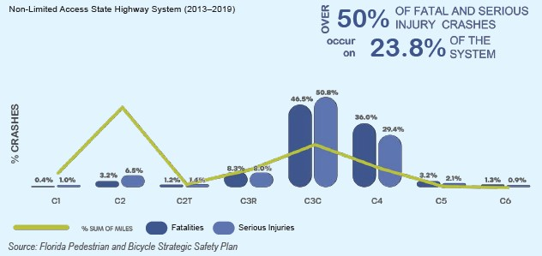
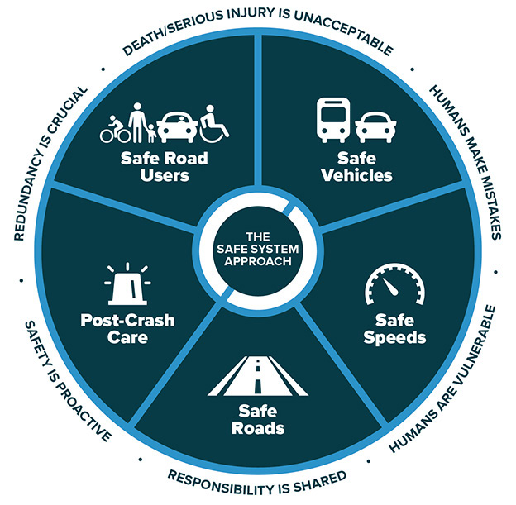
COMPLETE STREETS 360⁰: FDOT CONTEXT CLASSIFICATION FRAMEWORK)
  APPROACH
Safe System Approach
    “Putting the right street in the right place”
    Target Zero
    Safe Systems Approach
5

Slide 6
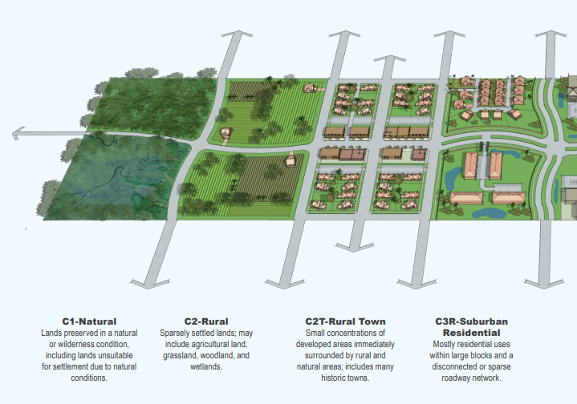
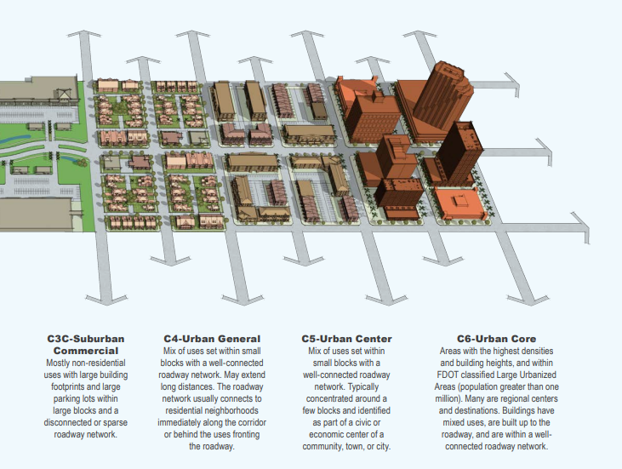
FDOT Context Classification Framework
  Roadway characteristics,
  Traffic Patterns, and
  Development Densities within Spatial Context
6

Slide 7

Objective
Establish a framework for incorporating FDOT's latest Context Class capacity guidelines into travel demand models to improve the accuracy and reliability of future transportation planning and decision-making.
7

Slide 8

Current Practice
  Area Type (Core Urbanized, Urbanized, Transitioning, Rural)
  Facility Type (Limited Access, Arterial)
  UROAD factor (accounting for roadway geometry)
  CONFAC factor (similar to K factor, accounting for development density)
  Bureau of Public Roads (BPR) Coefficient and Exponent (used in speed-flow relationships)
8

Slide 9

Next Steps
Methodology
  Key Findings
  Implement the Context Class
  Based Capacities
  Comparison with Key Metrics
  National Scan
  Model Selection Criteria
9

Slide 10
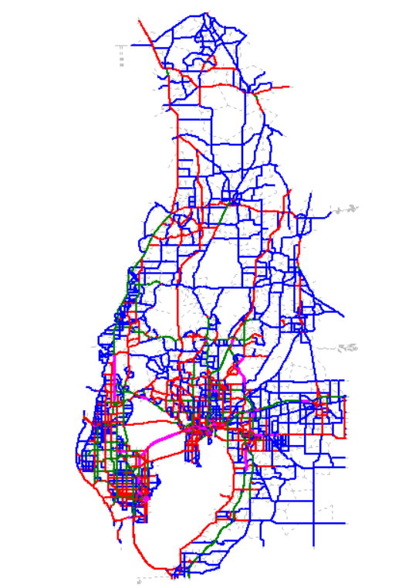
Model Selection Criteria
  Tampa Bay Regional Planning Model (TBRPM) was selected
  Accommodates Time-of-day (TOD) and daily volume within the model.
  Coverage of all context classes within the model area's roadway network.
  Requires minimal data and effort for integration of context-based capacities.
  Offers balance between model size and computational efficiency.
10

Slide 11
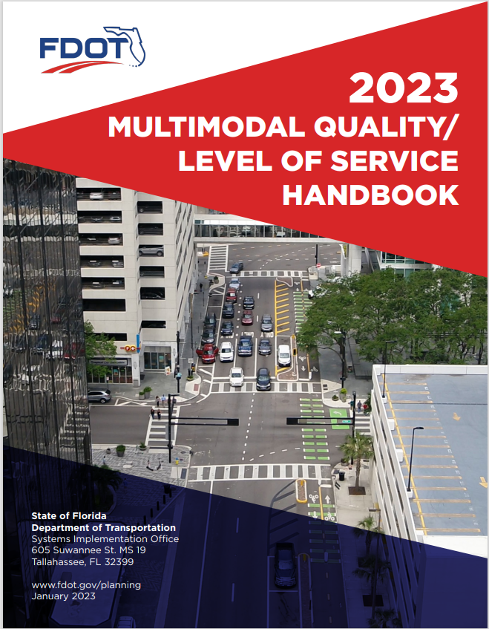
Implementation of Context Class Capacities
  Utilize 2023 FDOT Multimodal Quality/LOS Handbook
  No capacity changes to the limited access facilities
  Updated capacities for State Roadways (C1, C2, C3R, C3C, C4, C5, and C6)
  No capacity changes to the local roadway
11

Slide 12
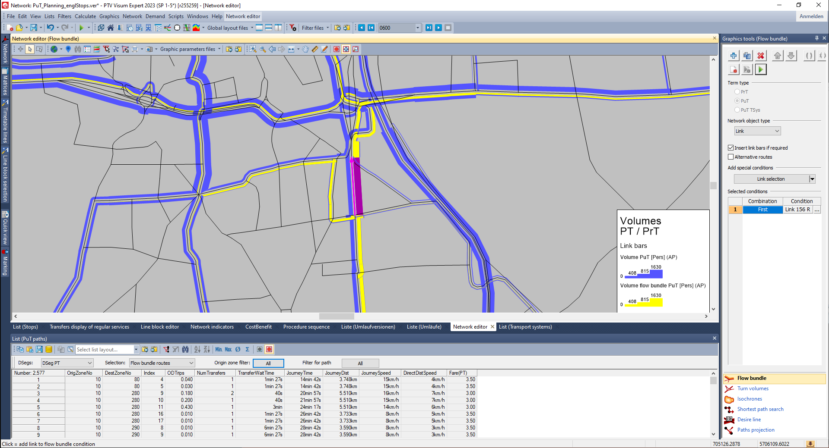
Implementation of Context Class Capacities
  Updated speed and capacities based
  on Context Class - Procedure 15 within Visum model (Python Script File: 2_update_speed_capacity.py)
  5,004 (20%) out of 24,780 links were updated for the 2015 Base Year TBRPM
  Quality check performed for speed and capacity using context classification
12

Slide 13
Findings
TRIP PURPOSE | PEAK - Total Trip Length (Miles) | OFF-PEAK - Total Trip Length (Miles)
HBW | -1.24% | -4.77%
HBSH | -1.54% | -3.38%
HBSR | -1.81% | -2.75%
HBSC | -1.26% | -4.76%
HBO | -1.39% | -2.47%
NHBW | -1.59% | -8.01%
NHBO | -1.61% | -8.28%
LTRK | -1.68% | -6.95%
HTRK | -0.59% | -0.90%
TAXI | -1.95% | -7.15%
EI | 0.64% | 3.54%
AIRP | -0.14% | 0.52%
COL | -0.94% | -4.46%
Overall | -1.28% | -3.67%
Person | -1.39% | -4.32%
Vehicle | -0.05% | 0.99%
Compared to 2013 FDOT Q/LOS handbook, the 2023
FDOT Q/LOS handbook shows:
  Reduction in capacities for most of the state roadway context classes
  Increase in capacities for limited access facilities for Urban Core, Urban, Transitioning and Rural Area Types
Trip lengths during peak period all Trip purposes are increased by approx. 1.3%
Higher changes approx. 3.7% increase is observed for the off-peak period for all Trip purposes
13

Slide 14
Findings
Highway Validation by Facility Type
Facility Type | Count | Volume | Volume/Count
Freeway | 0.00% | 4.18% | 3.96%
Divided Arterial | 0.00% | -6.82% | -7.00%
Undivided Arterial | 0.00% | -20.00% | -19.59%
Collector | 0.00% | 1.99% | 1.20%
One Way Facility | 0.00% | -13.04% | -13.28%
Ramps | 0.00% | 5.32% | 5.71%
Toll Facilities | 0.00% | 4.38% | 4.65%
Overall | 0.00% | -3.76% | -4.08%
Overall deviation of around 4%
based on the Volume/Count ratio
Traffic volumes have decreased along:
  Freeway/limited access facilities,
  Toll facilities, and
  Collectors
Traffic volumes have increased along:
  Undivided arterials,
  Divided arterials, and
  One Way facilities
14

Slide 15

Next Steps
Need to convert LA facilities ( FT 10-19, 70-99) into Urban Core, Urban, Transitioning and Rural Area Types to match the 2023 FDOT Q/LOS handbook.
Explore eliminating or adjusting UROAD/CONFAC in VFACTORS to refine capacities in the Context Class Speed Capacity file.
Need standard guidance to be used by local agencies to reclassify the local roadways with the appropriate context classes.
Compare results within a subarea to understand effects at granular level.
Evaluate the model outputs showing shift in traffic to arterials.
15

Slide 16
High-Resolution Statewide
Socio-demographic, Land Use and Economic Development Framework for Transportation Planning
Naveen Eluru
Professor in Civil, Environmental and Construction Engineering
University of Central Florida
BOLDLY GOING: TRIPS IN CONTEXT, TFF 2024

Slide 17
Presentation Outline
Project Vision and Approach
Takeaways
Project Findings
Data products and Use cases

Slide 18
Background
The project focuses on developing a standardized high resolution state-wide sociodemographic, land use and economic development model
The project will generate a universal template of variables that will be useful for the statewide framework
For the universal template built, the research team will generate socio-economic, land use and economic development variables

Slide 19
Objectives
To establish a universal template of socio-demographic, land use and economic indicators
To develop and validate an algorithm to generate socio-demographic, land use and economic indicators
To employ the validated algorithm developed to generate future socio-demographic, land use and economic indicators in 5-year increments from 2025 through 2050
To generate the variables for a spatial resolution that can be directly employed for local jurisdictions and statewide models

Slide 20
Research Overview
Review and stakeholder survey
Data compilation and processing
Conceptualization of the framework
Validation and consistency checks
Software development
Model estimation

Slide 21
Data
Resources
Spatial
Resolutions
Florida Department of Revenue
U.S. Census Bureau
FDOT Roadway Characteristics Inventory and Florida Geographic Data Library
Parcels
Block Group
American Community Survey
UF Population Data
Census Tract
County

Slide 22
Conceptual Framework for Land Use Evolution

Slide 23











Model Framework
Demographics
BG Level Land Use
Existing Land Use of Parcels
Parcel Data with Updated Land Use
Proposed LU Model Framework
Economic Variables

Slide 24
Land Use Model Structure

Slide 25
Socio-Demographic
Variables
Economic Development Variables
Population
Ethnicity Distribution
Number of HHs
Vehicle Ownership
Number of Jobs
Median Income
Jobs by industry
Number of Businesses

Slide 26
Simulation Validation and Results

Slide 27
Simulation Engine
Land Use Modeling
  LU Change (Binary Logit)
  Parcel Split (Binary Logit)
  Split Fraction (Fractional Split)
  New Land Use (MNL)
Inputs
  2020 Data
  Models
Economic & Demographic Modeling
  Population (Linear Regression)
  Race (MNL Fractional Split)
  Vehicle Ownership (MNL Fractional Split)
  Jobs (Linear Regression)
  Income (Linear Regression)
  Jobs by Industry (MNL Fractional Split)
Output
  Updated parcel land use and area
  Updated independent variables

Slide 28
Simulation Engine Validation

Slide 29
Land Use at the State Level

Slide 30
Data Products

Slide 31
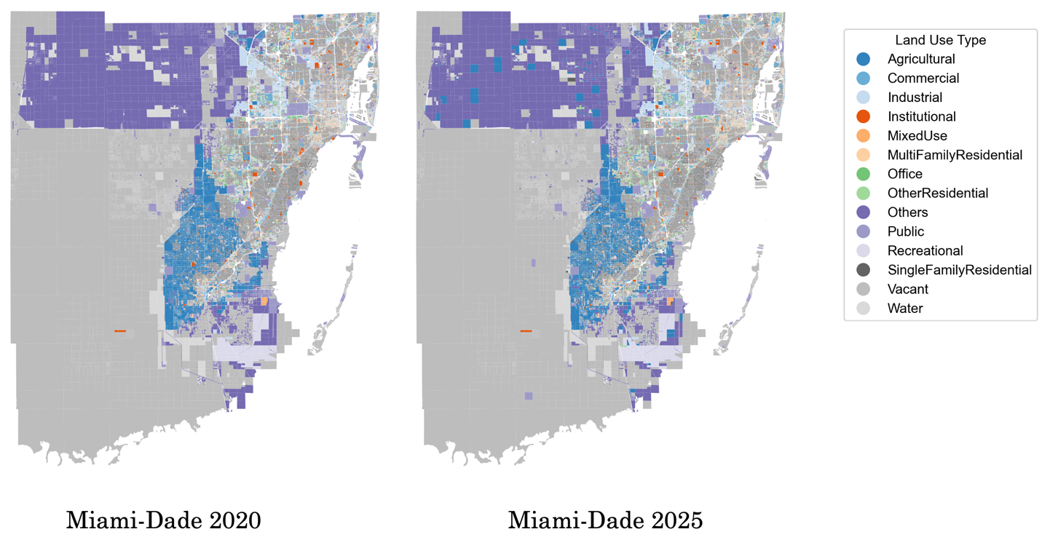
Parcel Data Sample
Parcel Level Land Use Forecast for 2025

Slide 32
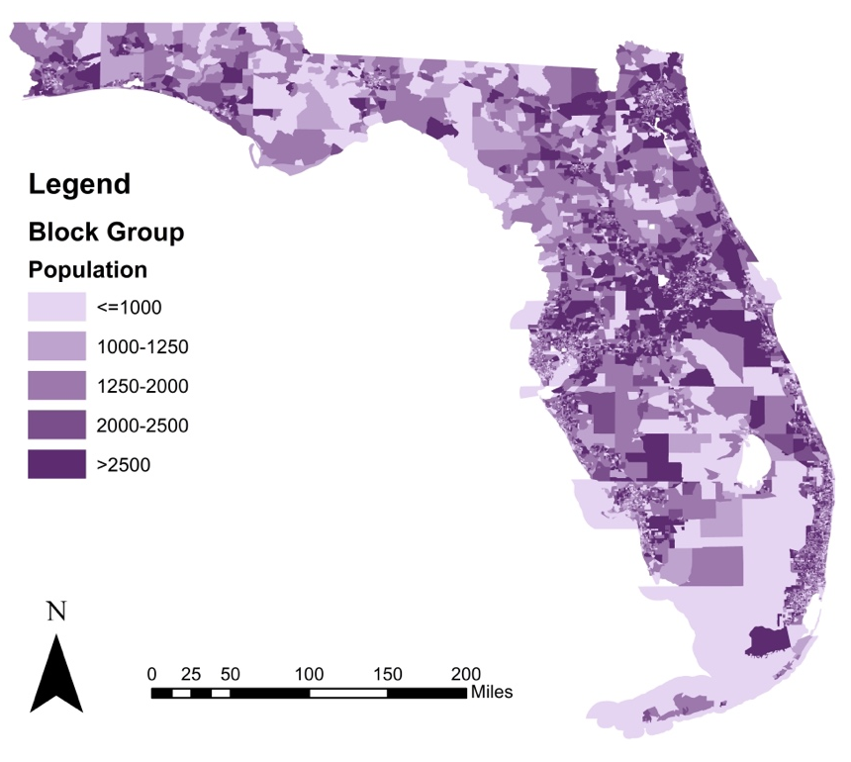
Block Group Data Sample
Block Group Population Forecast for 2025

Slide 33
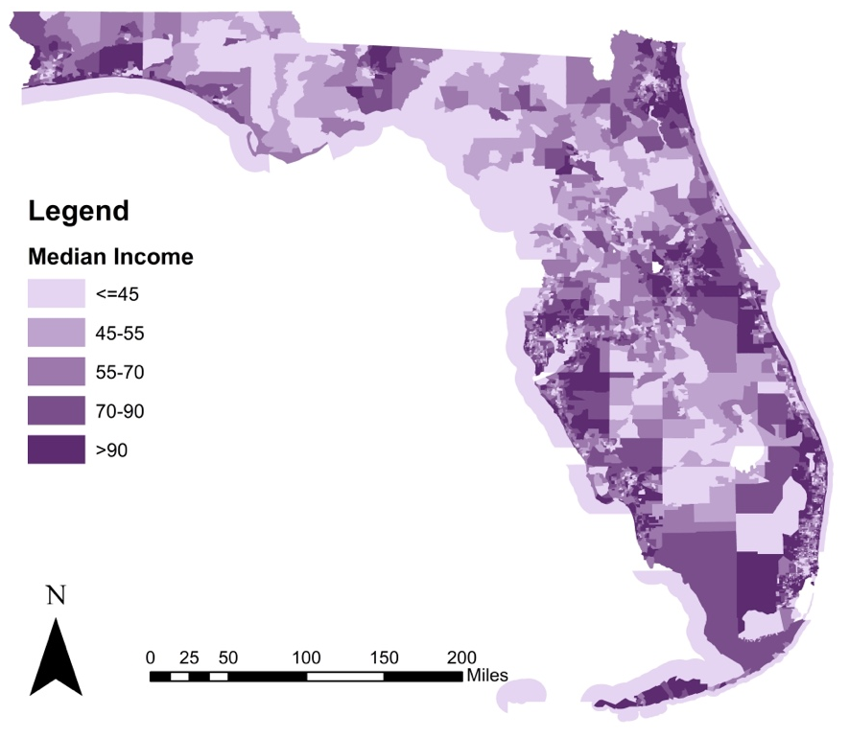
Census Tract Data Sample
Census Tract Median Income Forecast for 2025

Slide 34
How Can the Data Products
Be Used?

Slide 35
Use Case 1
Direct consideration in travel demand models as land use variables at different spatial resolutions (BG, CT and county)
Every urban/rural jurisdiction in Florida can readily use the data developed for
  Running travel demand models with a universal template of variables
  Jurisdictions can examine future growth generators and types of land use changes
  Explore opportunities to influence patterns to grow their revenue (from tax and business)

Slide 36
Use Case 2
Use the data products to study how land use patterns are likely to evolve and identify transportation needs
  Increasing residential (such as single-family parcels) will require different infrastructure relative to commercial establishments
Explore how current transportation infrastructure is performing in locations with similar patterns right now and plan proactively for the future
Identify locations where land use patterns are changing significantly and evaluate future transportation infrastructure needs

Slide 37
Use Case 3
Pro-active safety planning will be possible with the data products
We can use the data products to identify future locations that have a land use pattern that corresponds to high crashes currently
  Proactively plan and apply these corrective measures for these locations that can allow us to avoid re-design or retrofitting
Explore what patterns contribute to safety and pro-actively apply these for different locations based on their evolutionary paths
Proactively examine how land use needs impact safety – study current locations with similar land use and their safety needs and plan for future developments.

Slide 38
Takeaways
We are building a standard sociodemographic, land use and economic indicator framework for Florida
Land use changes at the parcel level in open-source software that can be aggregated at any resolution including BG, CT and county for ready adoption in Florida
Several potential Use cases are identified for future adoption of these data products
The data presented should be available for all of you to use in 2-3 months

Slide 39
Acknowledgements
Team Members
  Sudipta Tirtha
  Lauren Hoover
  Md Istiak Jahan
  Dewan Parvez
  Susmita Sarker
Others
  Sheldon Harrison
  Krishnan Viswanathan
FDOT personnel
  Thomas Hill (program manager and main advocate)
  Vladimir Majano
  Terry Corkery

Slide 40

Questions?
For more details - https://people.cecs.ucf.edu/neluru/
Email: naveen.eluru@ucf.edu

Slide 41
Freight Discussion
Jeanette Berk

Slide 42


MentiMeter Instructions (Live Poll)
Welcome to the Live Poll!
Scan the QR Code with your phone to access the questions. Your answers will show up on the screen.
We look forward to hearing your thoughts!

Slide 43
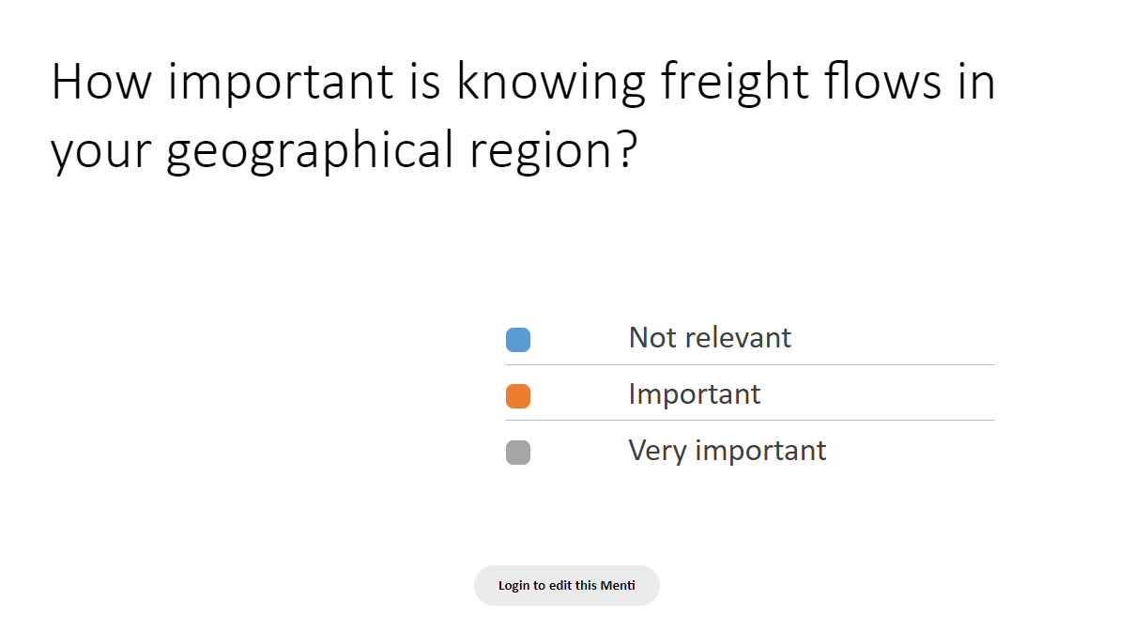

Slide 44
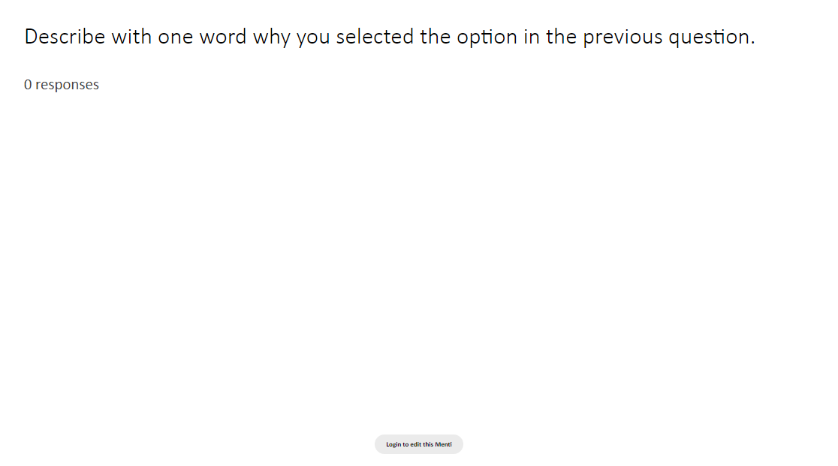

Slide 45
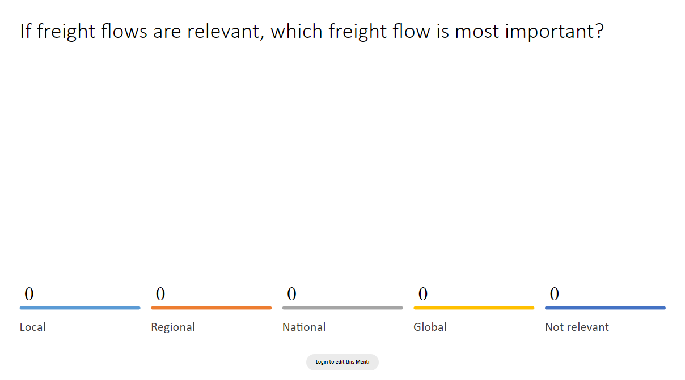

Slide 46
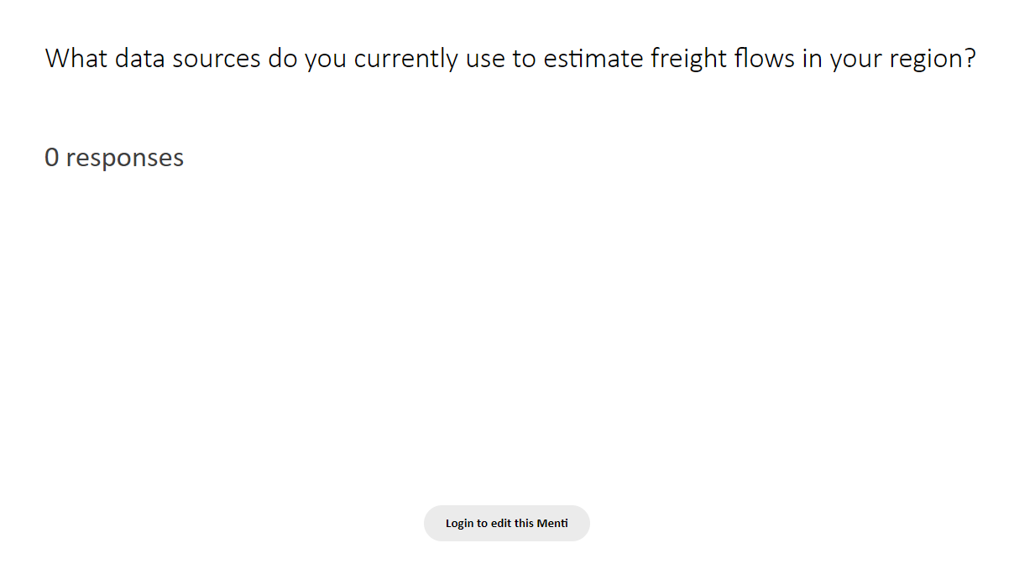

Slide 47
Thank you for attending!

