Slide 1
The Prime Directive
When and How to Modernize Modeling
Standards

Slide 2
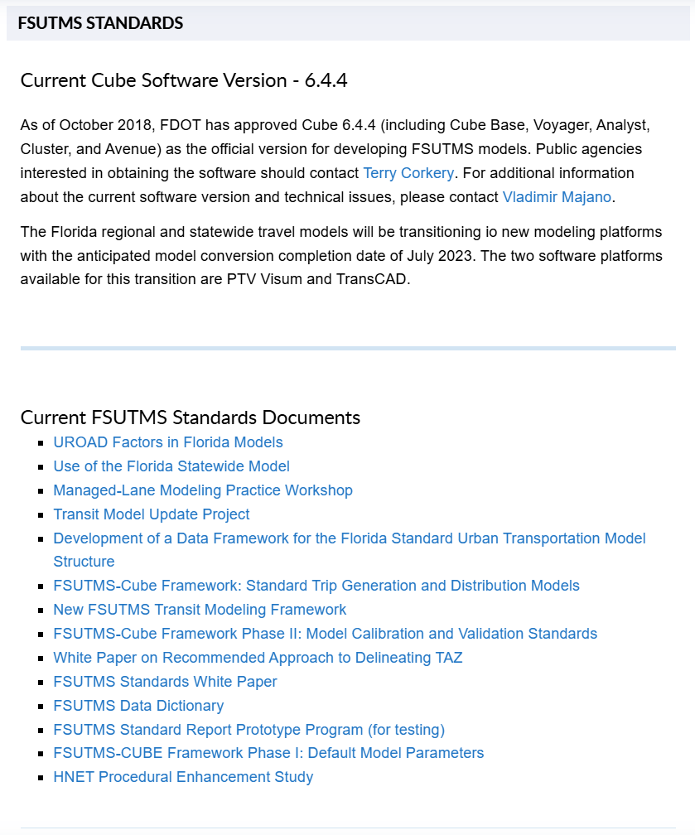
The Recent Past: FSUTMS
Notes:
The Florida Standard Urban Transportation Model Structure has served as the guiding principle for Florida’s modeling community for the last 30 years.
Many of these standards are still applicable, and we always take into consideration the new technological advancements, changes in labor force, and national practice.
Hardware and software has evolved at a fast pace in past 20 years. However, one key component missing is a standard review and update process for all of Florida’s models.

Slide 3
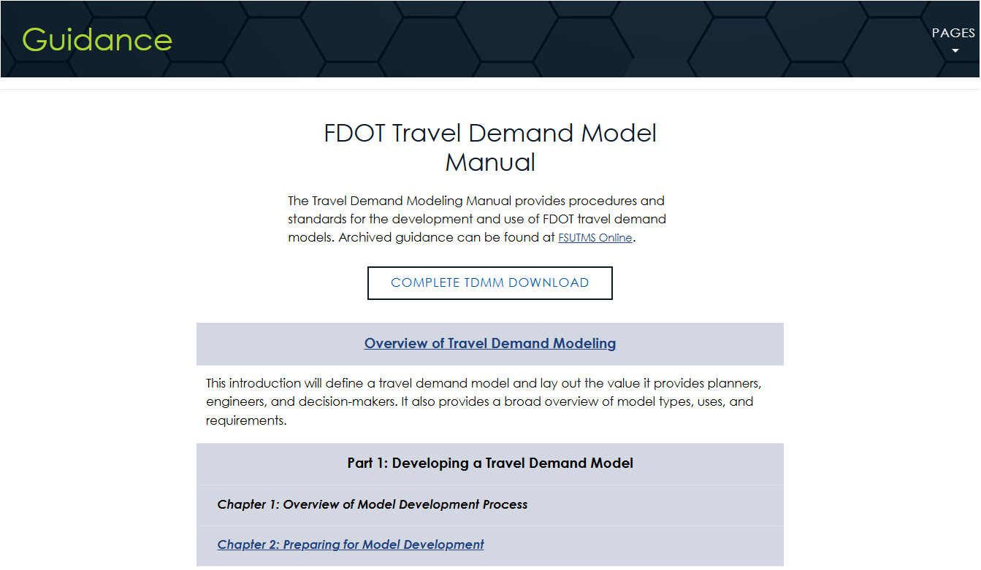

The Present: Travel Demand Modeling Manual (TDMM)
Notes:
To build on the work done over the years and modernize the content to better serve today’s modeling practice, SFT decided to develop the Travel Demand Modeling Manual. It aligns with other FDOT documents such as the Traffic Analysis , Project Traffic Forecasting , and Multimodal Quality/Level of Service Handbooks, as well as, and the Managed Lanes Guidebook.
The effort started with the intent of updating the old FSUTMS standards documents, but it quickly became clear that it wasn’t going to meet the needs of today.
Drafts of the "Overview of Travel Demand Modeling, along with Chapters 2 through 4" are currently published for review on the Transportation Forecasting Resource Hub and we would appreciate your feedback. You can submit your feedback by following the survey link on the resource hub. The QR code on the screen will direct you to the manual, and then scrolling down you will see the survey link to provide the feedback.

Slide 4

TDMM Structure
Overview of Travel Demand Models
Technical
Specifications
Development
Application
Notes:
The manual is made up of three main components: Building a model, Using a model, and the Technical Specifications.
Part 1 / Development is almost finished, and Part 2 / Application has significant content already drafted. We intend to kick off the section regarding Part 3 / Technical Specifications within today’s discussion.

Slide 5

TDMM Part 1 – Developing a Model
Chapter 1
  Overview of Model Development Process
Chapter 2
  Preparing for Model Development
Chapter 3
  Preparing Model Data
Chapter 4
  Developing and Refining the Base Year Model
Chapter 5
  Developing the Future Year
Chapter 6
  Resources
Notes:
Developing a model is Part 1 of the manual and is made up of six chapters:
Chapter 1 provides a brief introduction and overview of the overall model development process - within the context of the Transportation Planning process.
Chapter 2 discusses the early stages of the development process, including: identifying stakeholders, establishing a collaboration plan, and drafting the scope document.
Chapter 3 focuses on determining data needs, identifying reliable data sources, and data collection practices.
Chapter 4 is on preparing the base year scenario. It introduces the concepts of calibration, validation, and reasonableness checks.
Chapter 5 focuses on the steps needed to be taken to develop the future year scenario, including socioeconomic data, the future year network and reasonableness testing.
Chapter 6 is the final chapter of Part 1 of our manual, providing a repository of modeling resources referenced throughout this part of the manual.

Slide 6

TDMM Part 2 – Using a Model
Chapter 1
  Defining the Ask
Chapter 2
  Accuracy and Precision
Chapter 3
  Running a Baseline
Chapter 4
  Modeling Scenarios
Chapter 5
  Scenario Outputs
Chapter 6
  Communicating Results
Notes:
Using a model is Part 2 of the manual and is made up of six chapters:
Chapter 1 establish the need for travel demand modeling and forecasting, understanding the consumer, and selecting the appropriate modeling tool.
Chapter 2 provides detail on how to assess accuracy and precision within the chosen modeling tool.
Chapter 3 discusses how to prepare the baseline framework and the considerations when running and documenting the scenario.
Chapter 4 covers how to build and test alternate scenarios.
Chapter 5 familiarizes users with the most common model outputs.
Chapter 6 wraps up Part 2 by guiding users through methods of communicating the model results to the appropriate audiences.

Slide 7
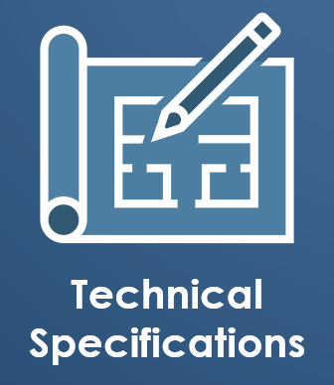
TDMM - Future Technical Specifications
  User Interface
  Auto Calibration/Validation Using AI
  Minimum Requirements for Input Data
  Trip Generation Rate Modification
  Seasonal Population
  Visitor Data
  Freight Data
Notes:
As the manual is being finished, we recognize the need to update or create new technical specifications for modeling in Florida.
The discussion today will largely focus on the needs for model technical specifications, including User Expectations, Auto Calibration / Validation using AI, Data Governance, Expanding Trip Purposes, Seasonal Population, Visitor Data, and Freight Data.
Vlad hands it off to Regina to facilitate

Slide 8
Future Technical Specification:
User Interface
Specification | Description
User Interface | dashboards, reports, export functionality
Notes:
In today’s landscape, the need for model results that are easy to interpret and share is more prevalent than ever. Today’s models need to be more intuitive and accessible for their users. Demystifying the black box and making models more transparent through enhanced reporting and visualizations is just one way to address this.

Slide 9

TDMM – Future Technical Specifications
www.menti.com
Mentimeter Code:
9646 3389
Notes:
We will be using Mentimeter for the next slide to help gather your comments.
You can access our menti poll by visiting menti.com and enter the code seen on the screen or by scanning the QR Code on your handheld devices

Slide 10
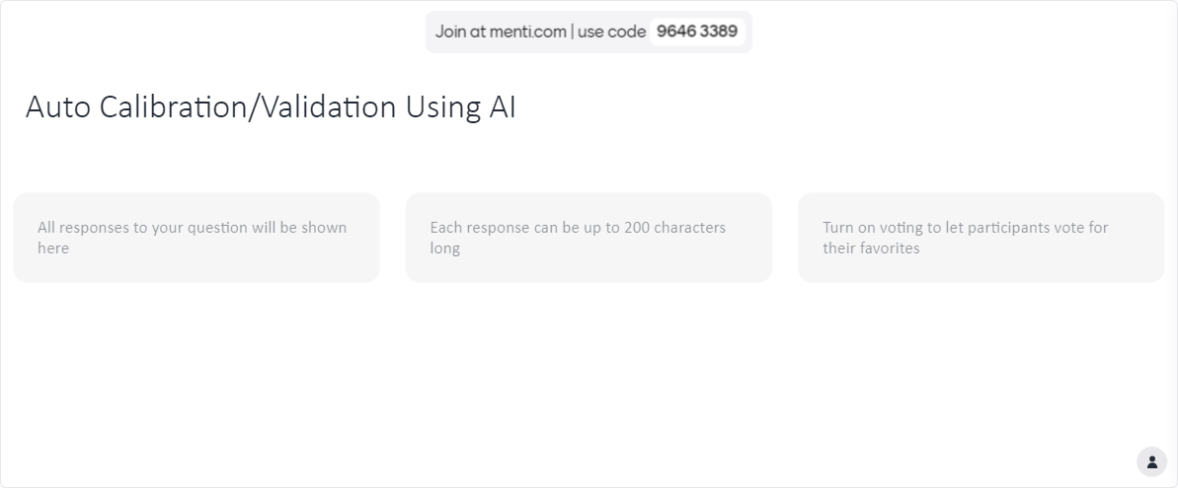
Future Technical Specification:
Auto Calibration/Validation Using AI
Specification | Description
Auto Calibration/Validation Using AI | Using AI for calibration and real-time adjustments
Notes:
The use of AI is a hot topic in every profession. One of the most notable ways AI could support the TDM process is utilizing it to auto calibrate and validate our models. While a human will never be removed from the process, AI could help to streamline calibration and validation, reducing the overall time it would take to do it manually. It could also serve to make our models more agile, increasing their capability of quick application.
What other areas can we use AI?

Slide 11
Future Technical Specification:
Minimum Requirements for Input Data
Specification | Description
Minimum Requirements for Input Data | Minimum expectations for model input data
Notes:
Data governance is crucial for ensuring reasonable model outputs. The saying “garbage in, garbage out” continues to ring true, as we need consistent, quality data as inputs to our models to ensure quality model outputs. This helps reduce uncertainty and ambiguity around whether or not our models are reliable.
Do we need to have minimum requirements for input data?
What type of data do we need to have minimum requirements?
What issues are you seeing now?

Slide 12
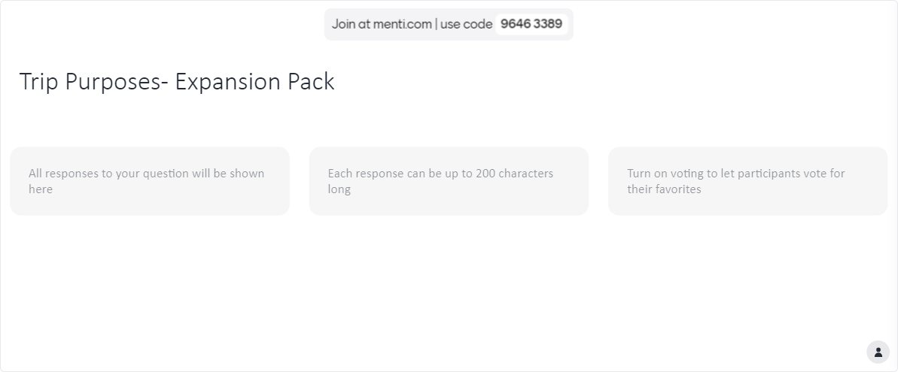
Future Technical Specification:
Trip Generation Rate Modification
Specification | Description
Trip Generation Rate Modification | Work from home, e-commerce, gig economy, short-term rentals
Notes:
The pandemic fundamentally changed the way work is conducted across the US. As we heard from our presenters this week, there has been an approximate 20% increase in population working from home. E-commerce and the gig economy is changing the nature of trips and what constitutes a trip-end. In light of this, the way trip purposes are classified may need to be updated to accurately reflect these changes.
Are we missing anything?
What are the areas that you see things changing?
What type of guidance do you need?

Slide 13
Future Technical Specification:
Seasonal Population
Specification | Description
Seasonal Population | Temporary population estimates, Census supplemental data
Notes:
Florida has long been considered to be America’s winter playground, making the seasonal population of the state relatively unique. Seasonal residents have different travel patterns when compared to those of permanent residents. Taking these into account in our models can support an improvement in resource allocation during these seasonal surges.
Has anyone incorporated seasonal population into their model? If so, how have you done this?

Slide 14
Future Technical Specification:
Visitor Data
Specification | Description
Visitor Data | Short-term populations, housing rentals
Notes:
Between Florida’s beaches, theme parks, and other attractions, the state is a big destination for vacationers and other visitors. Like the seasonal population, visitors tend to have different trip patterns than residents.
How can we apply this in the model?

Slide 15
Future Technical Specification:
Freight Data
Specification | Description
Freight Data | FAF disaggregation, long-distance truck flows
Notes:
The movement of good into and out of Florida is key to our economy. Defining technical specifications for freight data will help models better align with state transport goals, support infrastructure planning, and better understand the interaction between freight and passenger vehicles.

Slide 16
TDMM – Future Technical Specifications
www.menti.com
Mentimeter Code:
9646 3389
Notes:
We will be using Mentimeter for the next slide to help gather your comments.
You can access our menti poll by visiting menti.com and enter the code seen on the screen or by scanning the QR Code on your handheld devices

Slide 17
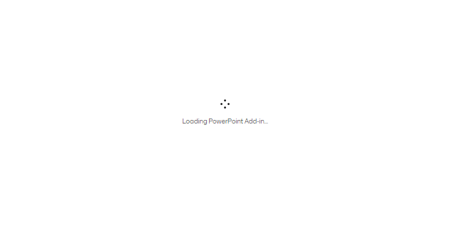
Future Technical Specifications: What did we miss?

Slide 18
Thank You
Notes:
Thank you for the great discussion and comments on the technical specifications needed for Florida models. We will review the menti poll and include them within the development of Part 3 of the Travel Demand Modeling Manual.

