Slide 2
Starfleet Academy
Terry Corkery, FDOT

Slide 3
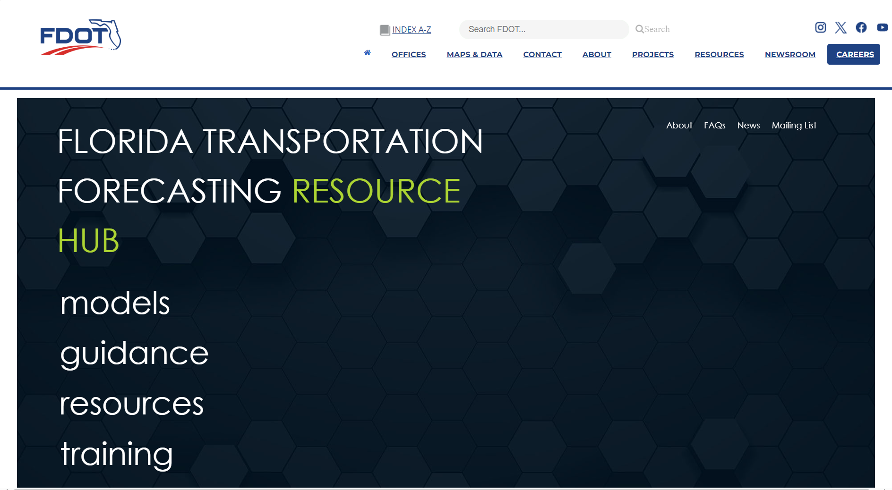
Florida Transportation Forecasting Resource Hub
Notes:
Introduce the FL transportation resource hub.
Access past trainings and upcoming trainings by visiting the training page.

Slide 4
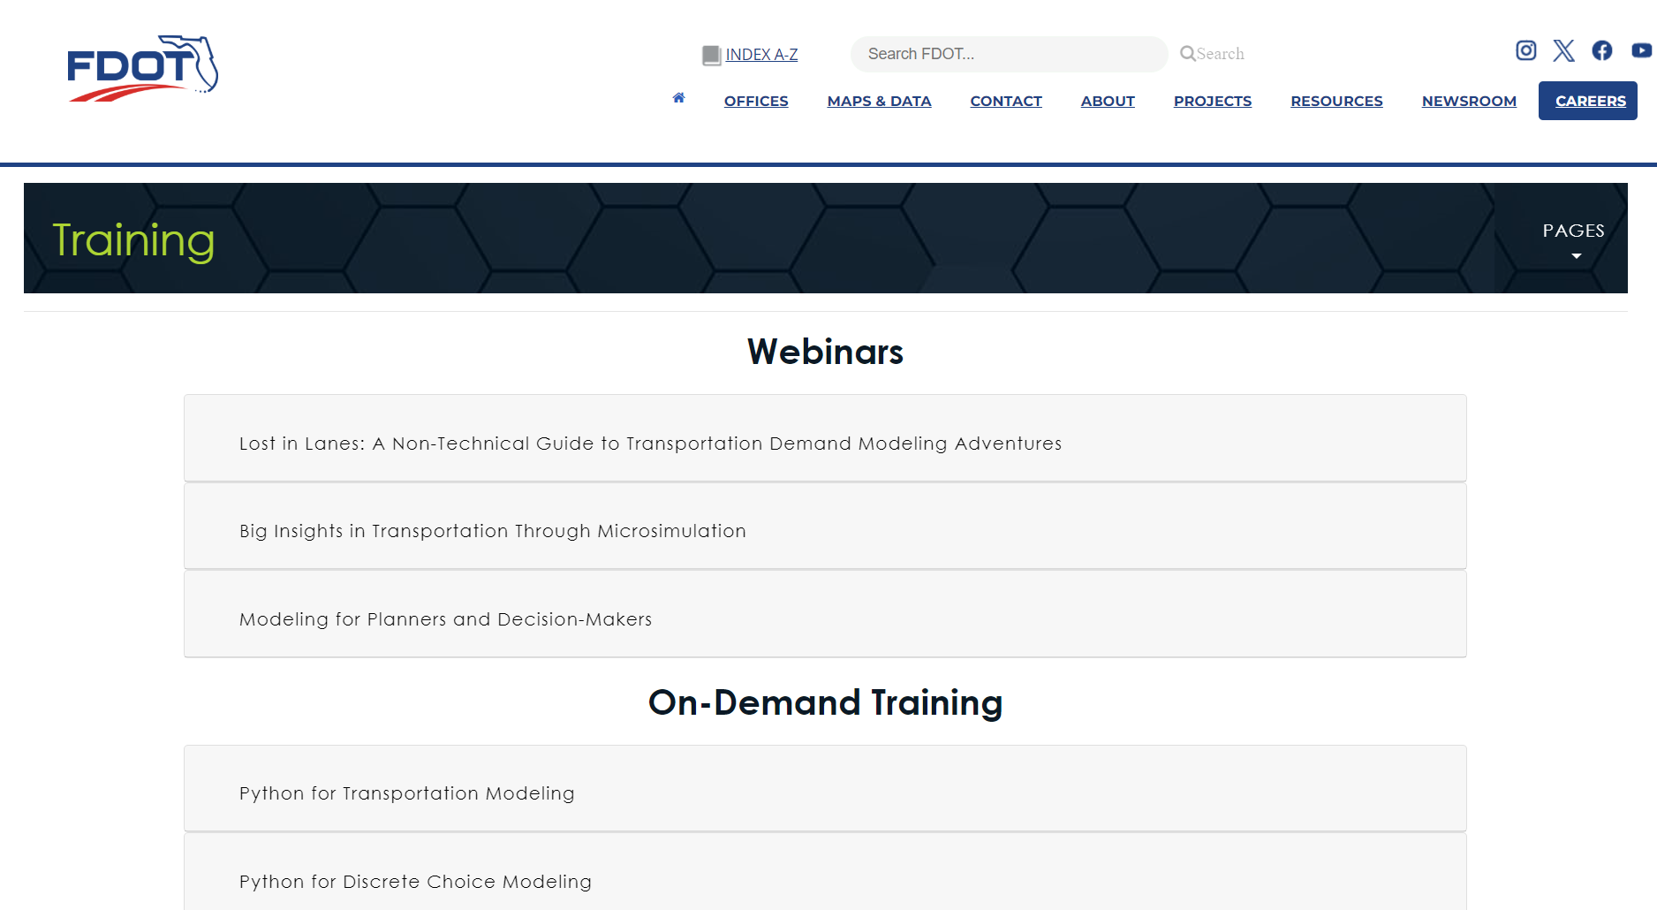
Training Page
Notes:
Multiple different training opportunities are found on the trainings page.
Webinars (both virtual and in-person training)
On-demand training
And Third party software training
Explore this page to see what trainings may interest you
This page gets updated periodically to add new opportunities.

Slide 5
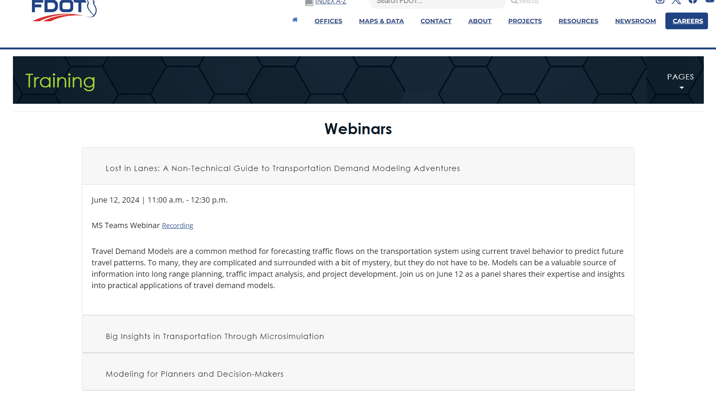

Webinars
Notes:
Available recorded webinars:
-Lost in Lanes: A Non-Technical Guide to Transportation Demand Modeling Adventures
-Big Insights in Transportation Through Microsimulation
-Modeling for Planners and Decision-Makers
Click on the training of your choice to see additional details of when the webinar was held, where the recording can be found, and a description of the training.

Slide 6
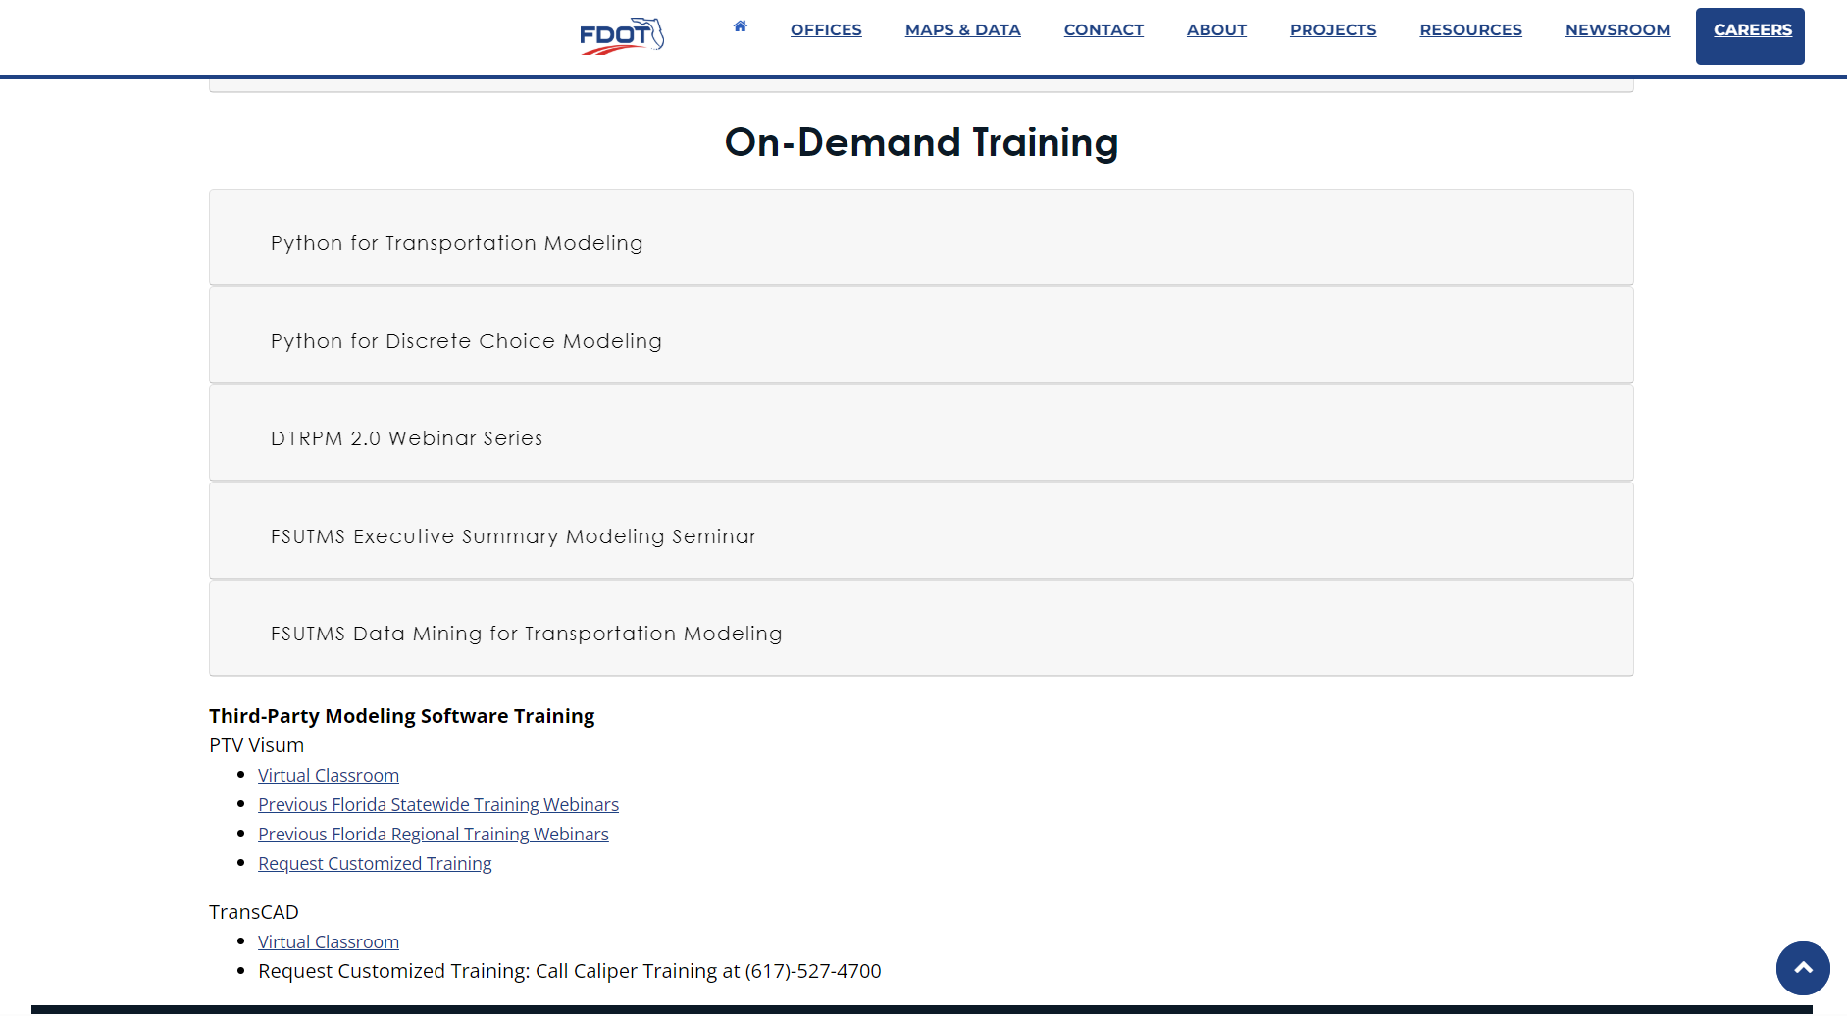
On-Demand Training
Notes:
On-demand training
-Python for Transportation Modeling
-Python for Discrete Choice Modeling
-D1RPM 2.0 Webinar Series
-FSUTMS Executive Summary Modeling Seminar
-FSUTM Data Mining for Transportation Modeling
Third party modeling software trainings
-PTV Visum (Video recordings)
-TransCAD (Virtual classroom)

Slide 7
Future Trainings
Executive Level 1-day Course (Basics of Modeling)
Microsimulation
Python Scripting
Sourcebook Training
Explainer Videos
Notes:
Click to next side to play the explainer video. Once on the slide, click the space bar to play video.

Slide 8

Notes:
Click enter to start video.

Slide 9
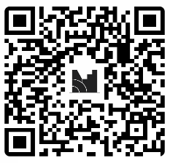
Training Survey
Mentimeter Code:
9321 7704
Notes:
We’d like to collect insight from the audience.
Please scan the QR code with your mobile device or insert code to submit your responses.

Slide 10
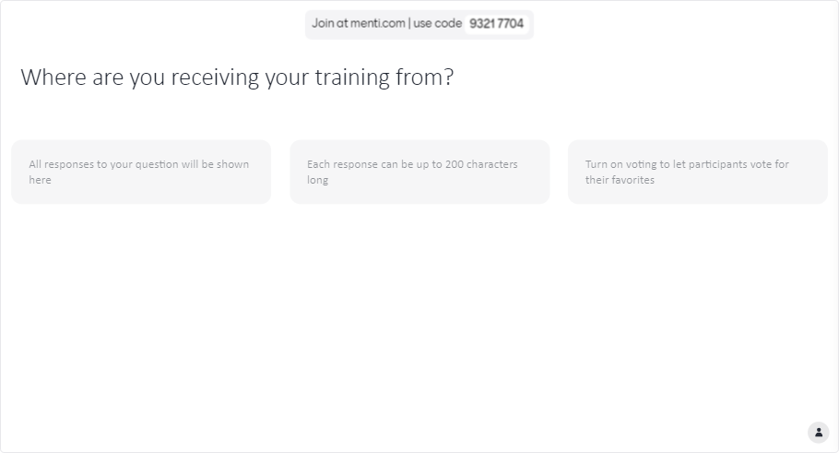
Training Survey
ADD QR CODE TO ACCESS MENTIMETER
Notes:
Q1. Where are you receiving your training from?

Slide 11
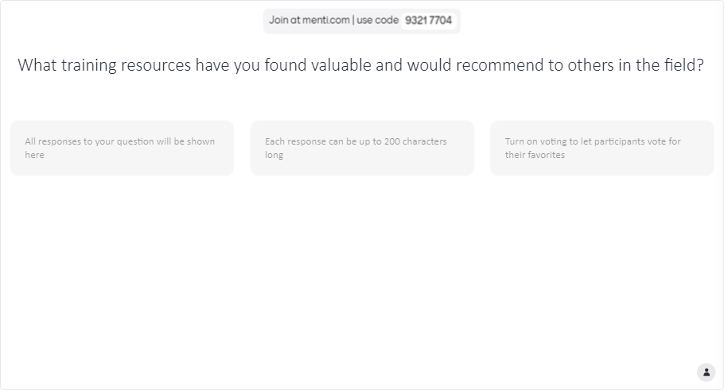
Training Survey
Notes:
Q2. What training resources have you found valuable and would recommend to others in the field?

Slide 12
Questions?
Thank you

Slide 13
Notes:
Huiwei provides final closing remarks for Live Long and Model!
- Remind participants to turn in their credit form at the registration desk on the way out.

