Slide 1
Modeling promotional materials

Slide 2
Suggestions for use
Slide 3 – high-level summary on the value of modeling, can be used solo or in combination with others in this deck
Slide 4 - if only time for high level description of how a model works – use this one.
Slides 5-10 – use these slides together if time allows to explain how a model works

Slide 3
Value Principles
Travel Demand Modeling
ESTABLISHED Data
Reliable data from reputable sources
Proven Process
Standard forecasting and data analyses methodologies
RELIABLE RESULTS
Insights that support transportation decision-making
Notes:
Travel demand models are valuable because they use trusted data sources such as the US Census Bureau, Federal Highway Administration, Bureau of Transportation Statistics, Florida DOT, and local governments.
The models rely on processes developed, tested, and improved over the last 60 years to provide reasonably reliable insights into future traffic volumes that supports transportation decision-making.
Planners often forecast short-term traffic using recent trends, but this method becomes unreliable beyond five years. Traffic growth slows as it approaches the roadway’s capacity, making long-term projections less accurate.Travel demand models, on the other hand, account for the complex traffic diversion caused by congestion, or the spillover effect of traffic diverting to other facilities in the transportation network.
Models account for land use changes expected over the next 20-30 years. These changes in development may significantly alter travel patterns.

Slide 4
How Does a Model Work?
Question
Inputs
Process
Outputs
Where & How will people travel in the future?
ESTABLISHED
DATA
Land use
Transportation network
Travel behavior
PROVEN
PROCESS
Model selection
Verify and adjust
Run alternate scenarios
Analyze results
RELIABLE RESULTS
Future estimated travel behavior
Notes:
IF ONLY TIME FOR HIGH LEVEL DESCRIPTION OF HOW A MODEL WORKS – USE THIS ONE.
The model uses a step-by-step process to forecast travel demand by working with established data and using a proven process to estimate future travel behavior. In most cases, a 4-step approach is used to analyze how trips are generated, where they are going, the modes of transportation chosen, and the routes taken.
Models with more complex patterns may use the Activity Based Modeling process. By incorporating real-world data and iterative feedback loops, a travel demand model provides valuable insights for planners and policy-makers to design efficient and effective transportation systems that meet future travel needs.
It all starts with the question, where and how will people travel in the future?
INPUTS
Established data for model inputs fall into three main categories: land use, transportation network, and travel behavior. These data are all gathered from established sources, such as FHWA, FDOT, and local agencies.
Land use data includes the attributes about the people doing the traveling and their characteristics.
Transportation network data describe the roadway characteristics including type of roadway, type of neighborhood for the roadway, traffic counts in the base year, and the number of lanes on the road.
Travel behavior includes typical trip length for each different trip purpose, the number of trips per person, and the likelihood that travelers will use carpool and transit modes.
PROCESS
The modeling process begins with establishing the intent of the project.
This determines the type of model and level of detail required. Using available data (Inputs), the model is run within the predetermined parameters, then calibrated, and validated to establish if the outputs are reasonable.
If the outputs indicate problems, the process is repeated after adjusting the parameters accordingly in an iterative manner until reasonable performance is obtained.
With a validated model, alternate scenarios are considered for analysis. Scenario results are reviewed, and strategies identified for addressing the observed need.
OUTPUTS
The main output of travel demand models is called the loaded network but there are secondary outputs like trip tables and mode split information.
The loaded network is the roadway links containing all the forecasted traffic volumes. Model software allows various options for reviewing and studying link information such as traffic volume, speed, and delay.
Trip tables show trip origin and destination activity and can be summarized and represented in informative graphics.
Mode split outputs show, at an aggregate level, how people travel in the region using data like how many people use carpools, take transit, or drive single-occupant vehicles and is useful for illustrating summary statistics that can graphically display a region’s characteristics.

Slide 5
How Does a Model Work?
Question
Inputs
Process
Outputs
Where & How will people travel in the future?
ESTABLISHED
DATA
PROVEN
PROCESS
RELIABLE RESULTS
Notes:
IF THERE IS MORE TIME TO EXPLAIN HOW A MODEL WORKS – USE SLIDES 5-10 IN THIS DECK
The model uses a step-by-step process to forecast travel demand by working with established data and using a proven process to estimate future travel behavior.
In most cases, a 4-step approach is used to analyze how trips are generated, where they are going, the modes of transportation chosen, and the routes taken.
Other model approaches can be used in certain circumstances. By incorporating real-world data and iterative feedback loops, a travel demand model provides valuable insights for planners and policy-makers to design efficient and effective transportation systems that meet future travel needs.

Slide 6
Question
Where & How will people travel
in the future?
Notes:
It all starts with the question, where and how will people travel in the future?

Slide 7










Four-Step Approach
Who is
traveling and
how many trips?
Where are
they going?
How are
they getting
there?
What route did they take and how long did travel take?
Notes:
The most common approach in travel demand modeling is called the four-step model, and most models in Florida are four-step models. These four steps combine to produce a map showing traffic volumes on all the roadway and transit links in the transportation network. The four steps help us answer:
Generation - Who is traveling and how many trips are they making
Distribution - Where in the region are they going
Mode Choice - How are they getting there?—bus, driving alone, traveling with a friend, walking
Assignment - What route and how long did the travel take?

Slide 8



Inputs
ESTABLISHED DATA
Land Use
Population
Household composition
Employment
Autos per household
Transportation Network
Number of Lanes
Facility Type
Neighborhood Context
Speeds and Capacities
Transit Lines
Base-year traffic counts
Travel Behavior
Persons per Auto
Number of Trips
Trip Lengths
Congestion delay
Notes:
Established data for model inputs fall into three main categories: land use, transportation network, and travel behavior. These data are all gathered from established sources, such as FHWA, FDOT, and local agencies.
Land use data includes the attributes about the people doing the traveling and their characteristics.
Transportation network data describe the roadway characteristics including type of roadway, type of neighborhood for the roadway, traffic counts in the base year, and the number of lanes on the road.
Travel behavior includes typical trip length for each different trip purpose, the number of trips per person, and the likelihood that travelers will use carpool and transit modes.

Slide 9

Process
PROVEN PROCESS
Model Selection
Project intent
Available data
Resources required
Verify and Adjust
Verify Inputs
Check reasonableness
Adjust parameters and re-check
Alternate Scenarios
Define
Code
Run
Analyze Results
Review model results
Report findings
Notes:
The modeling process begins with establishing the intent of the project.
This determines the type of model and level of detail required. Using available data (Inputs), the model is run within the predetermined parameters, then calibrated, and validated to establish if the outputs are reasonable.
If the outputs indicate problems, the process is repeated after adjusting the parameters accordingly in an iterative manner until reasonable performance is obtained.
With a validated model, alternate scenarios are considered for analysis. Scenario results are reviewed, and strategies identified for addressing the observed need.

Slide 10





Outputs
RELIABLE RESULTS
Loaded Network
Amount of traffic
Type of Traffic
Determine any
congestion issues
Congested travel times
by time
Transit flow
Trip Table
Overall trip making activity
Travelers' origin and destination
Long-term patterns
of trip making
Mode Split
Number of people moving
around a region
How people travel
together by vehicle
How people travel by transit
Mix of transportation modal infrastructure and capacity
Notes:
The main output of travel demand models is called the loaded network but there are secondary outputs like trip tables and mode split information.
The loaded network is the roadway links containing all the forecasted traffic volumes. Model software allows various options for reviewing and studying link information such as traffic volume, speed, and delay.
Trip tables show trip origin and destination activity and can be summarized and represented in informative graphics.
Mode split outputs show, at an aggregate level, how people travel in the region using data like how many people use carpools, take transit, or drive single-occupant vehicles and is useful for illustrating summary statistics that can graphically display a region’s characteristics.

Slide 11
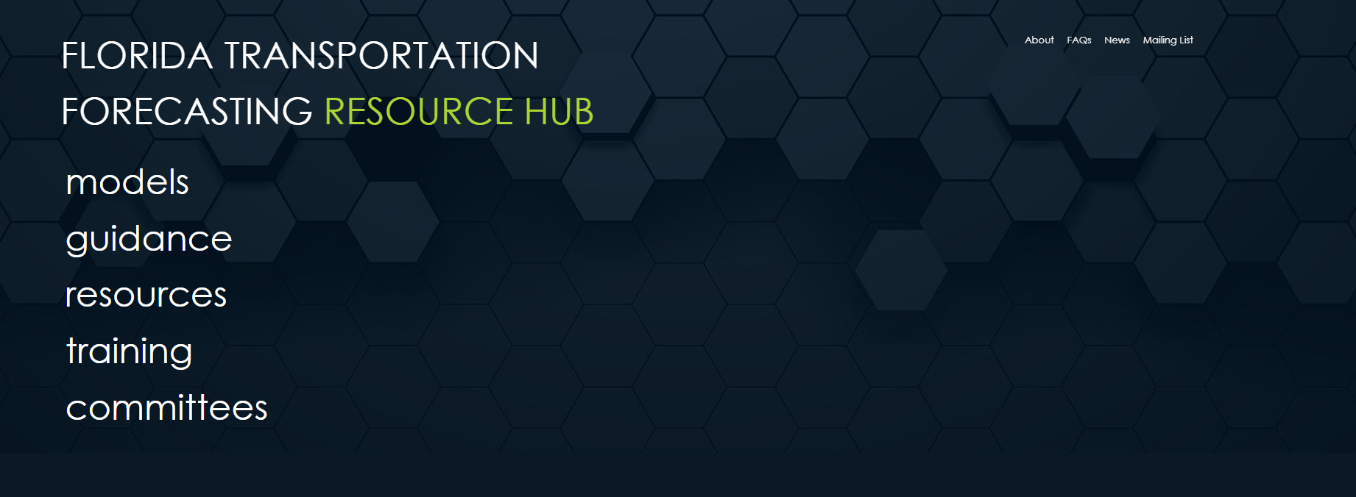
fdot.gov/forecasting
Notes:
The Florida Transportation Forecasting Resource Hub is now the official modeling website in Florida, replacing FSUTMSOnline.
The hub, located at fdot.gov/forecasting, provides links to download Florida’s model data sets; you can view documentation and guidance that we’ve developed over the years; you can see links to outside resources, find training opportunities, and read about the work of the Florida Transportation Forecasting Forum.
In the upper-right corner of the home page there’s a link to join the modeling mailing list.
When you click on the MODELS link, it will take you to a download page.

Slide 12
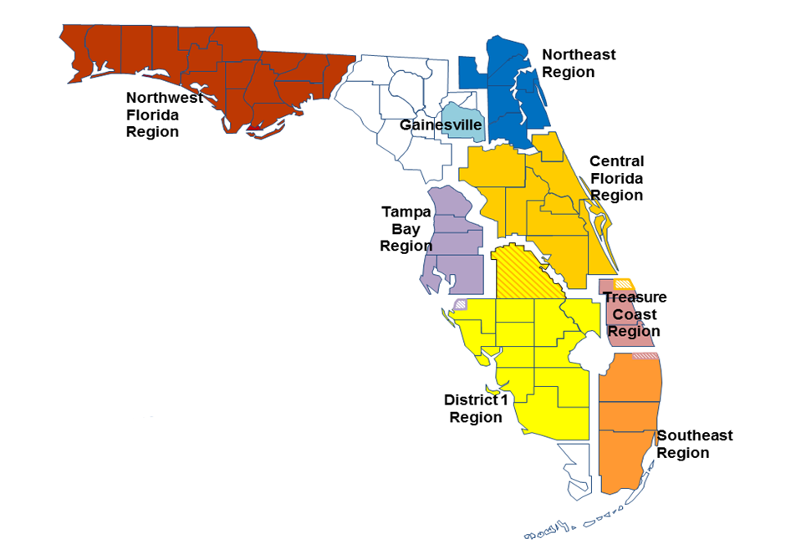
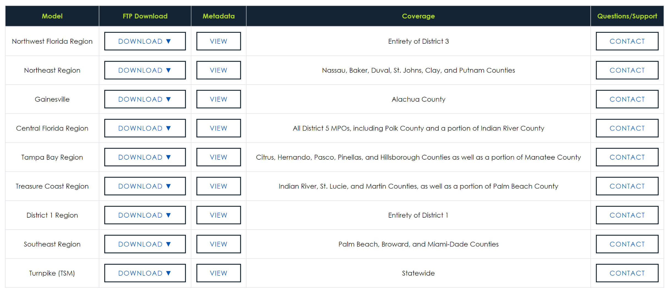
Model
Downloads
Notes:
This is the most frequently visited page on our website.
All of Florida’s regional and statewide models are available for download from FDOT’s FTP site, but you can also see metadata about the models such as total number of zones and average time it takes to run the model.
Contact information for the District Modeling Coordinator in charge of each model is available to the right of each model coverage description.

