Slide 1


Joint
Systems Implementation &
Office of Environmental Management
Interchange Process Training
February 14, 2018

Slide 2

Agenda
Introductions
Interchange Access Requests
Federal Highway Administration Interstate System Access Policy
Interchange Access Request Approval Process
Approval Authorities
  Non-programmatic Agreement
  Programmatic Agreement
  Tolling Authorities
Safety Analysis
Interchange Access Request Review
IAR Re-evaluation
PD&E Process
What is Upcoming?
  Interchange Repository System
  Training
Professional Credits Available
1.5 PDH Credits
1.5 AICP CM Credits

Slide 3






FDOT Central Office Team
Maria Overton, PE
  Systems Management Manger, FDOT Systems Implementation Office, Maria.Overton@dot.state.fl.us, 850-414-4909
Victor Muchuruza, PhD, PE, PTOE
  State Environmental Development Engineer, FDOT Office of Environmental Management, Victor.Muchuruza@dot.state.fl.us,
  850-414-5269
Andrew Young
  Statewide Interchange Review Coordinator, FDOT Systems Implementation Office, Andrew.Young@dot.state.fl.us, 850-414-4582
Martha Hodgson
  Project Development Engineering Specialist, FDOT Office of Environmental Management, Martha.Hodgson@dot.fl.us, 850-414-4804
Bikram Wadhawan, PE, PTOE
  Hanson, Consultant FDOT Systems Implementation Office, bwadhawan@hanson-inc.com, 904-423-5369

Slide 4

Interchange Access Requests

Slide 5
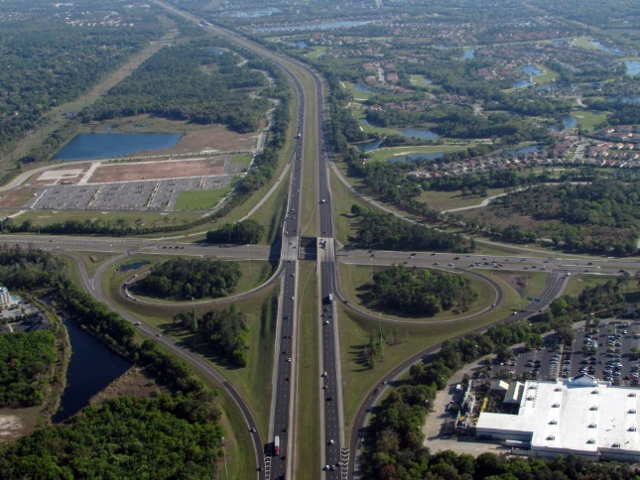
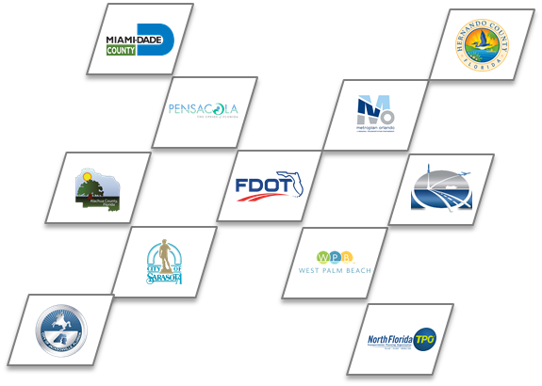
Interchange Access Requests
Requests for new or modified access to
  Interstate Highway System
  Non-interstate limited access facilities on the State Highway System (SHS)
An Interchange Access Request (IAR) shows that a proposed interchange proposal is Safety, Operational and Engineering (SO&E) viable
The Requestor of an IAR can be
  FDOT
  Local government
  Metropolitan Planning Organization (MPO) or Transportation Planning Organization (TPO)

Slide 6
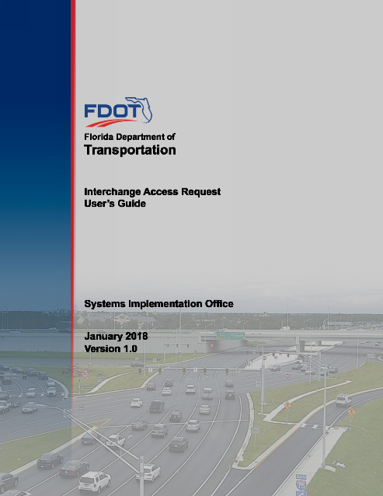
Interchange Access Request User’s Guide
First released in December 2002
  Updated March 2015
Current version released January 2018 includes updated
  FHWA Policy
  Safety analysis methodology
  Re-evaluation of IARs
  Approval Authorities Tables
Provides guidance related to process, policies, technical requirements, documentation to satisfy State and Federal requirements
  Used by local agencies, consultants, FHWA, FDOT and staff from other agencies
Available online at
  http://www.fdot.gov/planning/systems/programs/sm/intjus/

Slide 7

Interchange Access Requests - Documentation
Common IAR documents
  Methodology Letter of Understanding (MLOU) - required for all IJRs and IMRs
    For IOAR projects, the DIRC will determine the need for MLOU
  Interchange Justification Report (IJR)
    Proposed new full or partial interchange
    Requires highly detailed analysis and documentation to justify the need for and operational impact of proposed new access
  Interchange Modification Report (IMR)
    Significant modification to existing interchange
    For example: conversion of a diamond interchange to a DDI, completion of basic movements at an existing partial interchange
  Interchange Operational Analysis Report (IOAR)
    Minor modification to existing interchange
    For example: signalization of an existing stop-controlled ramp terminal intersection

Slide 8

Methodology Meetings
Requestor and IRC start drafting MLOU once project need is determined.
The MLOU is used to reach a consensus among all stakeholders.
Meeting should be conducted to discuss the access proposal and MLOU for the access request.
Any fatal flaws to IAR acceptance should be identified and resolved.
The MLOU does not serve as a scope of work.
Any work done prior to approval is at risk.
Meeting minutes should be documented
MLOU template

Slide 9


Review and Acceptance of MLOU
Stakeholders shall accept and sign the MLOU after they concur with the MLOU requirements and need
Work performed by the requestor prior to the acceptance is at “at risk”
Requestor shall prepare amendments, should they be asked for, and submit them for approval.
All parties must approve the amendment.

Slide 10
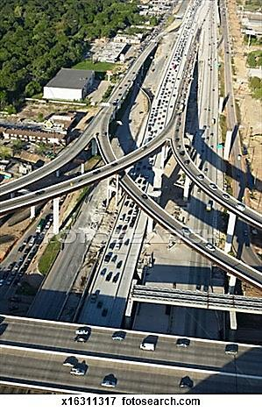
Interchange Access Report
Developed as a stand-alone document consistent with the MLOU.
If other reports available, relevant information should be summarized.
Understandable to the unfamiliar reader
Determines the safety, operational and engineering (SO&E) acceptability of the IAR.
The report must address the FHWA’s two policy points

Slide 11


Documentation Requirements
Executive summary (FHWA’s two policy points)
Purpose and need
Methodology
Existing conditions
Safety Analysis
Future conditions
Alternatives analysis
Funding plan and schedule
Recommendation
These will be determined by the IRC during the MLOU development phase.

Slide 12
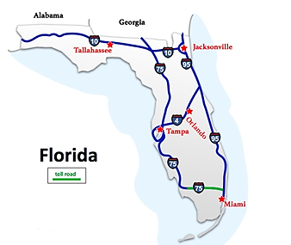


Interchange Access Requests
IAR shall be consistent with adopted statewide and local transportation plans
IAR shall consider all fatal flaws and environmental issues that might influence the NEPA compliance phase of the project
Funding plan to be in place prior to approval of IAR proposal

Slide 13
Federal Highway Administration Interstate System Access Policy Update

Slide 14
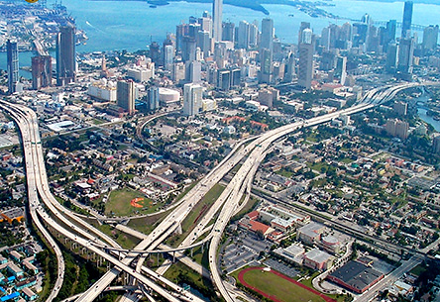
FHWA’s Interstate System Access Policy
Policy statement entitled “Access to the Interstate System”
  Published in Federal Register on October 22, 1990
  Last modified May 22, 2017
  Replaces the old August 2009 Policy
The new Policy focuses on technical feasibility of
proposed changes in terms of
  SO&E Acceptability
All ongoing and new Interchange Access Requests
will follow the new Policy
  The old eight (8) Policy Points will be
  replaced with the new two (2) Policy Points

Slide 15
FHWA Policy Points
Old FHWA Policy – August 27, 2009
New Policy – May 22, 2017
Policy Point 1
Existing roadway network cannot be improved to handle the current and/or future traffic demand. Note: This policy does not apply for Categorical Exclusion Type I projects
Not Applicable.
Evaluated in the Purpose and Need
during PD&E
Policy Point 2
The request cannot be adequately satisfied by reasonable transportation system management alternatives
Not Applicable. Addressed and evaluated the alternatives analysis during PD&E
Policy Point 3
The request does not have a significant adverse impact on the operation and safety of the freeway system
New Policy Point 1
Policy Point 4
The proposed access connects to a public road only and will provide for all traffic movements
New Policy Point 2
Policy Point 5
The proposal considers and is consistent with local and regional land use and transportation plans
Not Applicable. Addressed during PD&E Through planning consistency (required in NEPA) and land use evaluation as part of socio-cultural effect evaluation During NEPA.
Policy Point 6
The proposed modification lies within the context of a long-range system or network Plan
Not Applicable.
Addressed during NEPA during
alternative development and planning consistency.
Policy Point 7
Appropriate coordination has occurred
between the development and any
proposed transportation system improvements
Not Applicable.
Addressed during NEPA through public
involvement process
Policy Point 8
The proposal does not have any fatal
environmental flaws
Not Applicable.
Addressed during NEPA through
environmental analysis

Slide 16
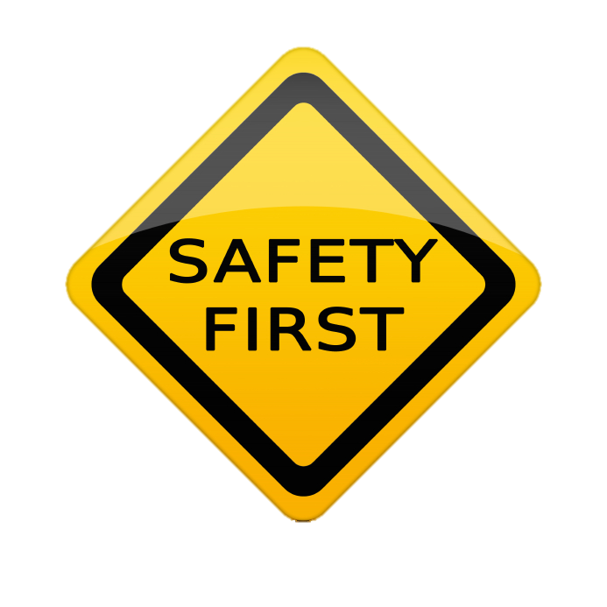
FHWA Policy Point 1
An operational and safety analysis has concluded that the proposed change in access does not have a significant adverse impact on the safety and operation of the Interstate facility (which includes mainline lanes, existing, new, or modified ramps, ramp intersections with crossroad) or on the local street network based on both the current and the planned future traffic projections. The analysis should, particularly in urbanized areas, include at least the first adjacent existing or proposed interchange on either side of the proposed change in access (23 CFR 625.2(a), 655.603(d) and 771.111(f)). The crossroads and the local street network, to at least the first major intersection on either side of the proposed change in access, should be included in this analysis to the extent necessary to fully evaluate the safety and operational impacts that the proposed change in access and other transportation improvements may have on the local street network (23 CFR 625.2(a) and 655.603(d)). Requests for a proposed change in access should include a description and assessment of the impacts and ability of the proposed changes to safely and efficiently collect, distribute, and accommodate traffic on the Interstate facility, ramps, intersection of ramps with crossroad, and local street network (23 CFR 625.2(a) and 655.603(d)). Each request should also include a conceptual plan of the type and location of the signs proposed to support each design alternative (23 U.S.C. 109(d) and 23 CFR 655.603(d)).
  “The IAR does not have a significant adverse impact on the operation and safety of the freeway system”

Slide 17
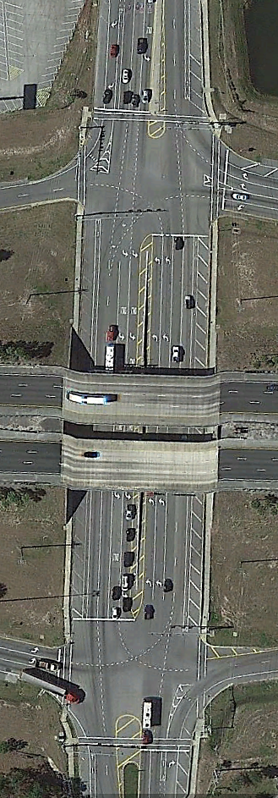
FHWA Policy Point 2
The proposed access connects to a public road only and will provide for all traffic movements. Less than “full interchanges” may be considered on a case-by-case basis for applications requiring special access, such as managed lanes (e.g., transit, HOVs, HOT lanes) or park and ride lots. The proposed access will be designed to meet or exceed current standards (23 CFR 625.2(a), 625.4(a)(2), and 655.603(d)). In rare instances where all basic movements are not provided by the proposed design, the report should include a full-interchange option with a comparison of the operational and safety analyses to the partial-interchange option. The report should also include the mitigation proposed to compensate for the missing movements, including wayfinding signage, impacts on local intersections, mitigation of driver expectation leading to wrong-way movements on ramps, etc. The report should describe whether future provision of a full interchange is precluded by the proposed design.
“The proposed access connects to a public road only and will provide for all traffic movements”

Slide 18
Interchange Access Request Approval Process

Slide 19
Interchange Access Request Approval Process
Approval process consists of two parts:
  Safety, Operational and Engineering (SO&E) acceptability
  NEPA document (PD&E study) approval
SO&E process
  Compliance with FHWA’s two policy points and FDOT’s Procedure 525-030-160
  Indicates access proposal is a viable alternative to include in the environmental analysis stage
PD&E process
  Can be performed concurrently or following SO&E acceptance
  However, approval can only occur following SO&E acceptance
  NEPA documents are prepared per guidelines and requirements outlined in the PD&E Manual
This two-part process offers flexibility to obtain the SO&E acceptability prior to completing the environmental review and approval process.

Slide 20
Interchange Access Request (IAR)
Safety, Operational & Engineering (SO&E) Process
Notes
¹ Refer to Section 1.7 of the IARUG
² This flow chart covers the check for Time Lapse based Re-evaluation only. Refer to Chapter 4 of the IARUG for other types of Re-evaluation
³ According to FDOT PD&E Manual
⁴ SO&E acceptability must be complete before NEPA approval
Request for Access
(Safety Operational and Engineering (SO&E) )
Follow IARUG
Identify Re-evaluation Requirements
(Refer IARUG)
Coordination Meetings with Program Offices
(Requestor, District, CO, FHWA)
IAR Re-evaluation
Needed
NEPA
NEPA can be prepared concurrent or following the IAR
Methodology Letter of Understanding
Whenever Next Phase is initiated…(Design, Design-Build, Etc.)
Yes
Draft SO&E Report Submittal QA/QC
By District & CO
Check
Has IAR Concept or other Project Condition Changed significantly since IAR Approval? (such as Land Use, Traffic new Travel Demand Model, Ect.)
Does SO&E Comply with
FHWA Policy Points & FDOT Procedure?
No
NEPA Approval³
Yes
Determination of Safety Operational and Engineering Acceptability⁴
(Processed based on PA or non PA type)¹
No
IAR Re-evaluation Not Needed
District IRC documents no change
District IRC coordinates with FHWA and CO and informs of no change
District IRC Submits Letter to FHWA
Notifying IAR SO&E & NEPA Approval
IAR Approval/Affirmative Determination
FHWA Confirms Concept is same in SO&E and NEPA and Signs the Letter
Time Lapse²
If Project has not Progressed to Construction within 3 Years of the Letter
Proceed with Project

Slide 21
Project Development Process
Right of Way
Planning (Master Plan, Corridor Study)
PD&E Study
Final Design
Construction
Interchange Access Request

Slide 22
Approval Authorities

Slide 23

Stakeholders
  Requestor
  Reach an agreement with the IRC and other applicable acceptance authorities on the type of IAR
  Develop, sign and submit to the IRC a Methodology Letter of Understanding (MLOU) documenting the agreed-upon study methodology
  Perform appropriate quality control
  Develop and submit to the IRC a draft Interchange Access Report containing the results documenting the analysis of safety and operation of the access proposal
  Respond to or resolve all comments and requests for additional information from reviewers and revise the IAR documents accordingly
  Sign and submit a final IAR document to the IRC for an acceptance decision.
  Interchange Review Coordinator (IRC)
  Point of contact for all requestors
  Responsible for quality control
  Establishes the basis for acceptance, criteria, level of
  coordination and scope of the analysis and documentation

Slide 24

Stakeholders
  State Interchange Review Coordinator (SIRC)
  Provide guidance for rules, policies and procedures related to IAR, reviews, ensure consistency and coordinate with the FHWA and districts’ IRCs and the FTE IRC.
  Systems Management Administrator (SMA)
  Responsible for the approval of IARs after they have been reviewed by the SIRC
  Coordinates with FHWA on matters related to interchange projects and FDOT processes
  Federal Highway Administration (FHWA)
  Responsible for protecting the structural and operational integrity of the interstate
  The district transportation engineer (DTE) is the FHWA Florida Division point of contact.

Slide 25

Programmatic Agreement
Formally known as:
“Programmatic Agreement between the Federal Highway
Administration Florida Division and the Florida Department
of Transportation regarding the review and approval of
Specific types of changes in Interstate-system Access”
In place April 2, 2015

Slide 26

Programmatic Agreement
  Key points
  FDOT has more control on the IAR process
  Streamline and expedite the review and approval of IARs
  FHWA provides final approval (affirmative determination) after completion of PD&E
  IARs eligible for Programmatic Agreement
  Not all IARs are included under PA process
  FHWA Division Office and FDOT establish Programmatic Agreement status during initiation stage
  Following IARs are included under the PA Process
    New and major modifications to service interchanges outside TMAs
    Modifications to service interchanges inside TMAs
    Completion of partial interchanges
  Refer to IARUG for more information
  IARUG

Slide 27
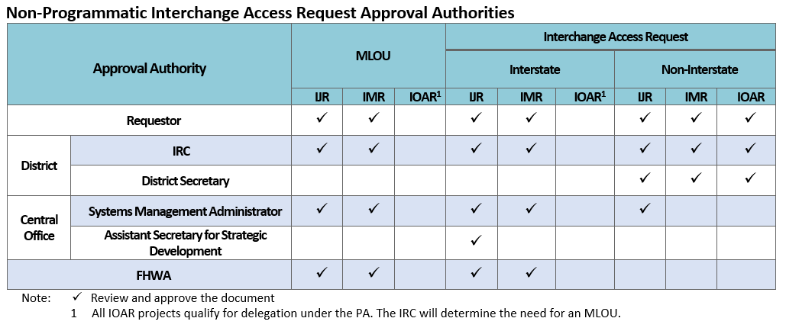
Approval Authorities – Non PA
Non-Programmatic IAR Approval:

Slide 28
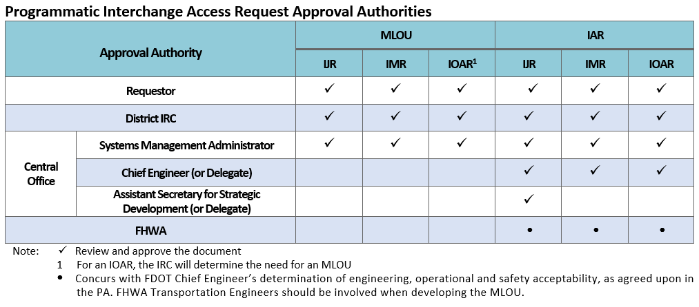
Approval Authorities – PA
Programmatic IAR Approval:

Slide 29
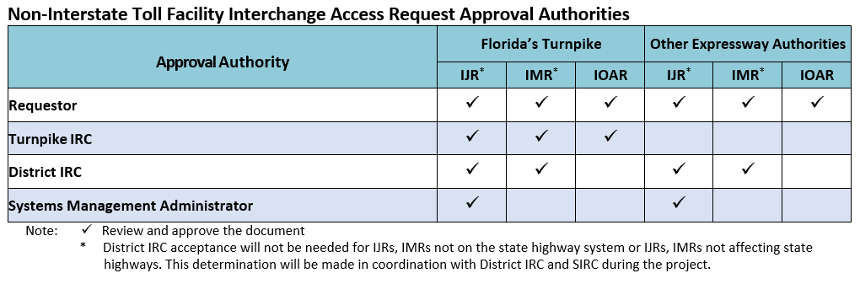
Approval Authorities – Tolling
Proposed acceptance table for tolling authorities:

Slide 30

District Coordination
IAR should take an interdisciplinary approach
Interchange coordination meetings must be held for each IAR proposal
Staff should include other division offices such as
  Environmental Management
  Design
  Traffic Operations
  Structures
  Safety
  ROW
  Maintenance and Program Management
FHWA and State Interchange Review Coordinator must be invited

Slide 31
Safety Analysis

Slide 32
Safety Analysis
IARs require an updated safety analysis methodology
IJR
Calculation of Crash Rates
Crash Diagrams
Description of Existing Crash Trends
Safety Performance Functions
Crash Reduction Estimation (CMF’s)
Benefit Cost Analysis (Optional)
Documentation
IMR
Calculation of Crash Rates
Crash Diagrams
Description of Existing Crash Trends
Safety Performance Functions
Empirical Bayes Method
Crash Reduction Estimation (CMF’s)
Benefit Cost Analysis
Documentation
IOAR
Calculation of Crash Rates
Crash Diagrams
Description of Existing Crash Trends
Crash Reduction Estimation (CMF’s)
Documentation
Existing Conditions
Calculation of Crash Rates
Crash Diagrams
Description of Existing Crash Trends
Documentation
Safety analysis based on the procedures in the Highway Safety Manual (HSM)
See Section 3.3 of the IARUG for further detail regarding safety analysis

Slide 33
Interchange Access Request Review

Slide 34
IAR Review Process
  IAR Review Process
Originator performs QC and submits IAR
Review by QC checker (IRC)
Concurrence by originator
Incorporation by originator
No
No
SIRC
Satisfied
with IAR submittal
IRC submits IAR to SIRC for QA
Yes
Comments addressed satisfactorily
Verification by QC Checker (IRC)
IAR submitted to FHWA (as applicable)

Slide 35
IAR Re-evaluation

Slide 36



IAR Re-evaluation
  Re-evaluations are required for one or more of the following conditions:
  Change in an approved IAR design concept
  Significant change in conditions (traffic characteristics, land use type, environment)
  Failure of an IAR to progress to the construction phase within three years of approval (time lapse). The approval of the IAR occurs after SO&E affirmative determination and NEPA parts are complete.
  MLOU shall be prepared for all IAR re-evaluations
  Bulletin being developed for future inclusion in FDOT Design Manual

Slide 37

IAR Re-evaluation
  Change in approved access design concept
  Design changes due to environmental impacts
  Design changes during design phase
  Design changes due to Design-Build or P3 alternative concept
  Change in conditions
  Change in projected traffic demand
  Change in land use
  Change in roadway configuration or design
  Change in environmental commitments

Slide 38

IAR Re-evaluation
  Time lapse before construction
  The need for re-evaluation will be determined if construction does not begin within three years of IAR approval/affirmative determination
  District IRC will determine need for re-evaluation in coordination with Central Office and FHWA (for non-programmatic projects)
  Re-evaluation shall demonstrate need for project is still viable
  Depending on amount of lapsed time and change in project area conditions, a new IAR could be required instead of a re-evaluation

Slide 39
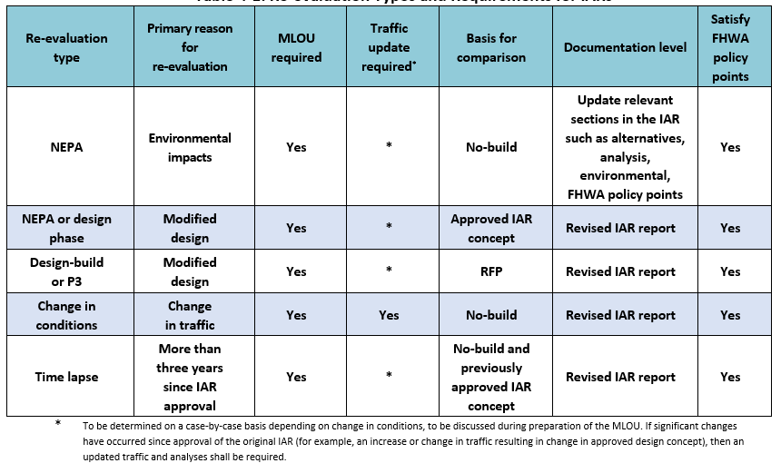
IAR Re-evaluation
  IAR re-evaluation types and requirements summarized in the following table.

Slide 40
PD&E Process

Slide 41
What is upcoming?

Slide 42
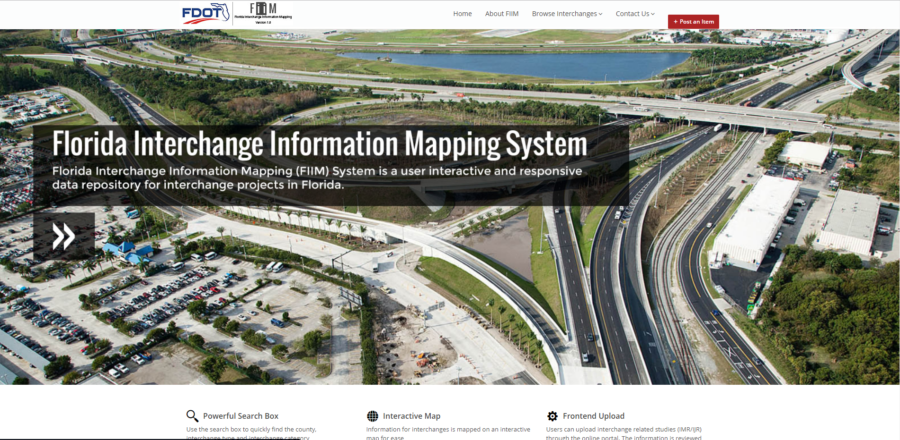
Interchange Repository System
  Florida Interchange Repository System
  Provides a central storage location for all interchange information used in IARs:
    Location
    Interchange type
    Safety statistics
    Existing traffic operations
    Previous studies performed on interchange
    Traffic forecasts
    Design plans
    Interchange photos
  This will allow for consistent data provided when FDOT and consultants are working to develop IARs

Slide 43
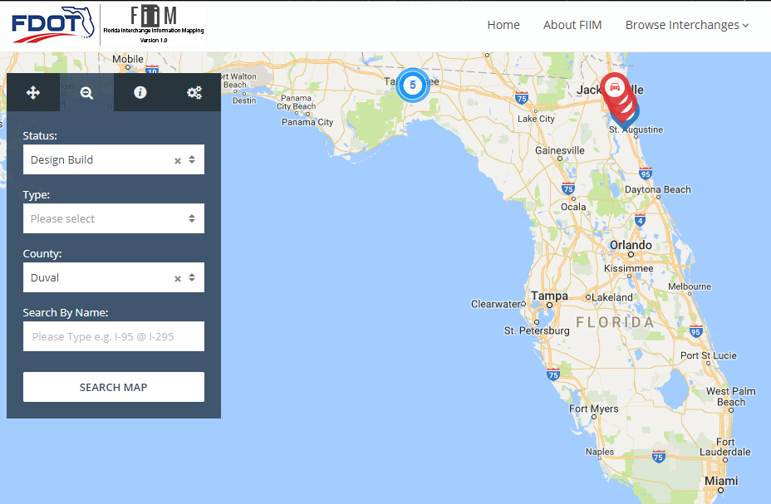
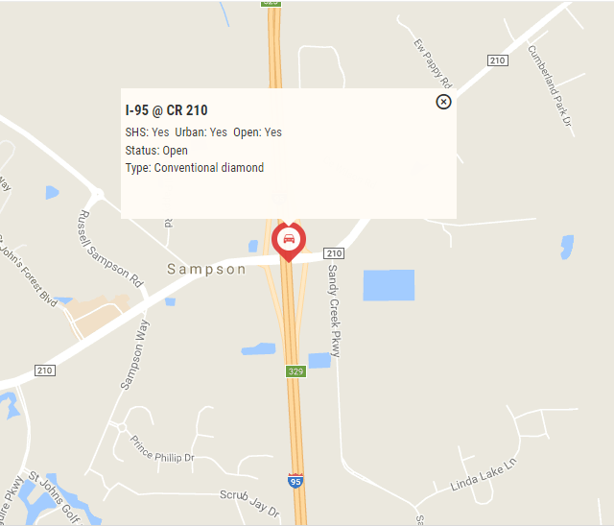
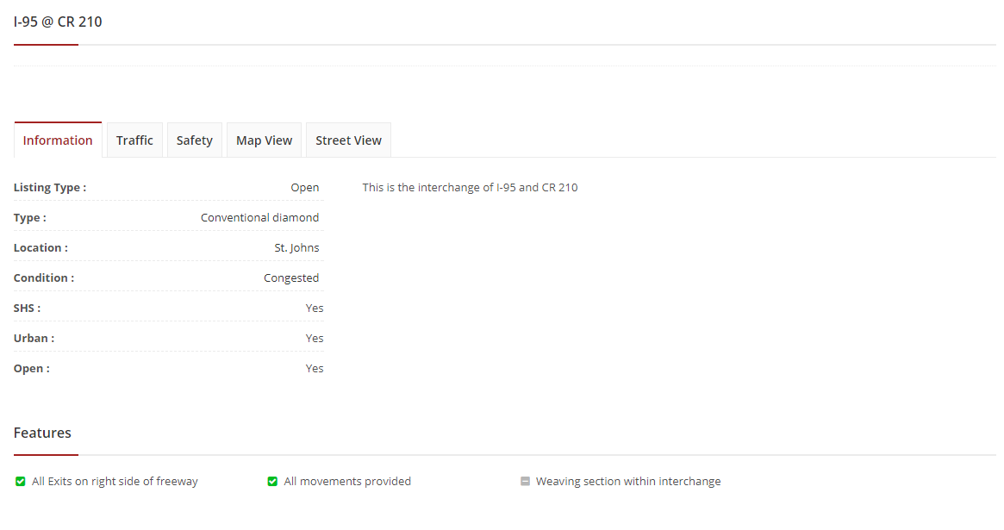
Interchange Repository System
  Florida Interchange Repository System

Slide 44
Upcoming Training
  March 8th – IAR Safety Methodology Webinar Training (1:30 – 3:30)
    To register: https://attendee.gotowebinar.com/register/2215815385017946625
  Spring / Summer – Statewide IAR Training

Slide 45
FDOT Central Office Team
Maria Overton, PE
  Systems Management Manger, FDOT Systems Implementation Office, Maria.Overton@dot.state.fl.us, 850-414-4909
Victor Muchuruza, PhD, PE, PTOE
  State Environmental Development Engineer, FDOT Office of Environmental Management, Victor.Muchuruza@dot.state.fl.us,
  850-414-5269
Andrew Young
  Statewide Interchange Review Coordinator, FDOT Systems Implementation Office, Andrew.Young@dot.state.fl.us, 850-414-4582
Martha Hodgson
  Engineering Specialist, FDOT Office of Environmental Management, Martha.Hodgson@dot.fl.us, 850-414-4804

Slide 46
Thank You!

