Slide 1
Invoice Training for Project Managers
Presented by Jackson Delikat and Dewayne Baxley

Slide 2
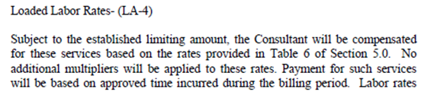
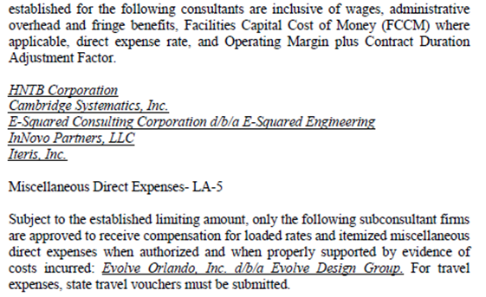
Standard Professional Services Agreement
    Project Managers are advised to look at Exhibit B, Method of Compensation, Section 2.2.

Slide 3
Miscellaneous Direct Expenses
Authorized rates established in Table 6 of the contract.
Firms that can be reimbursed for miscellaneous direct expenses through the contract are listed in the Method of Compensation Section 2.2 Details of Compensation Miscellaneous Direct Expenses LA-5.
  Miscellaneous direct expenses must be authorized and properly supported by evidence of costs incurred.
The Prime Consultant may be compensated for the separate miscellaneous direct expense purchase of the Tangible Personal Property if such expenses are identified under Section 2.1 of the contract, properly supported by evidence of costs incurred.
  Approval must be obtained from Central Office Audit Rate Manager for tangible assets.

Slide 4
Field Office Direct Expenses
Miscellaneous Direct Expenses for Field Office Rent and Utilities - LA-5
Subject to the established limiting amount, only the following firm(s) is/are approved to receive compensation for itemized direct expenses associated with field office rent, utilities (excluding phone services), field office set-up/mobilization and de-mobilization costs only, when authorized and when properly supported by evidence of costs incurred: list firms here . Utility costs to be reimbursed as a direct project cost are: electricity, water, natural gas, sewer, internet service, trash pick-up, and hook-up fees associated with the aforementioned utilities. Field office set-up/mobilization and de-mobilization charges involved with transporting the trailer to and from the job site may also be reimbursed. Utility costs associated with phone services will not be reimbursed as a direct project charge. Charges for furniture, supplies, insurance, cleaning, and equipment (including fax, copier, computer, and phone equipment), and all phone services are included in the direct expense percentage and are not compensated as an itemized expense directly on the contract.

Slide 5
Field Office Direct Expenses
Must be included on the contract and explicitly listed on the contract that the firms are eligible to receive field office direct expenses.
What may be reimbursed?
Direct expenses associated with field office rent, utilities, field office set-up/mobilization and de-mobilization costs; only when authorized and when properly supported by evidence of costs.
  Utility costs may include electricity, water, natural gas, sewer, internet connection (e.g., non-mobile DSL or cable lines), trash pick-up, and hook-up fees associated with the aforementioned utilities.
  Field office set-up/mobilization and de-mobilization charges involved with transporting the trailer to and from the job site may also be reimbursed.
  Charges for furniture, supplies, and equipment (including fax, copier, computer, phone, and monthly phone charges) are included in the direct expense percentage and are not compensated as an itemized expense directly on the contract.

Slide 6
Field Office Direct Expenses FAQ
Utilities: Does this include monthly electric bill, water bill, phone or cable installation, garbage disposal, building maintenance fee, etc.. what are the parameters?
  Per April 13, 2007 Memo (http://www.fdot.gov/procurement/pdf/Changes%20to%20Overhead%20Audit.pdf), Utilities are limited to “electricity, gas, water, sewer and trash pick-up.” However, the “Method of Compensation” language includes “internet connection (e.g., non-mobile DSL or cable lines)” … “and hook-up fees associated with the aforementioned utilities.”
Would paying for a “Moving Company” to move furniture and equipment to the field office be acceptable?
  No, however, the costs should be reimbursed through the direct expense rate.
Are deposits allowed to be reimbursed?
  Deposits cannot be reimbursed. These costs are “pre-paid” costs and generally returned at a specified date.
Are security services/costs considered “utility” costs for actual reimbursement?
  No, however, the costs for security should be included in the direct expense rate, just not reimbursed on the contract.

Slide 7
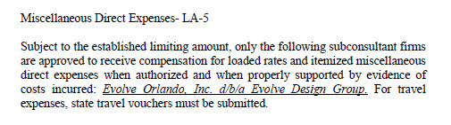
How to audit travel expenses?
If the firm has a direct expense rate they cannot bill for travel expenses separately. (In other words, if a firm appears in LA-4, they are not to be reimbursed for Miscellaneous Direct Expenses on the contract-i.e. Travel Schedule E-3)

Slide 8
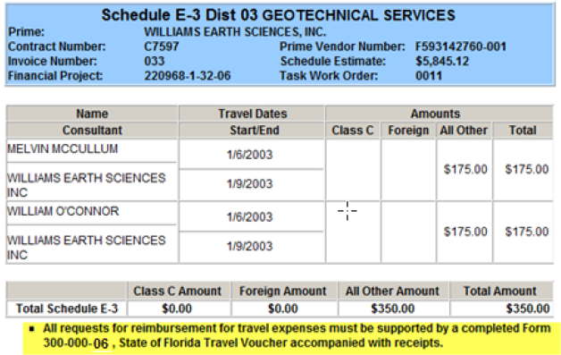
How to audit travel expenses?

Slide 9
How to audit travel expenses?
If the firm does not have a direct expense rate they can bill for travel expenses that have been approved by the Project Manager and that meet the following criteria.
  Unit rates used to compute travel costs may not exceed those authorized for State employee travel in accordance with Section 112.061, F.S. Air fare must be based on coach rates with reasonable advance purchase and costs for rental cars must be based on the use of compact cars, unless otherwise justified and approved by the Department. Mileage for private vehicles must be at the state rate. The Disbursement Operations Handbook, is available on the Department’s Office of Comptroller (OOC) Intranet website.
  http://cbt.dot.state.fl.us/ois/TravelTrainingBasics/TravelTrainingBasics.htm
        *Training is geared towards FDOT Employees but rates and allowability rules still apply
  https://fldot.sharepoint.com/sites/FDOT-OOC/DOO/HB/Shared%20Documents/Disbursement%20Handbook%20for%20Employees%20and%20Managers.pdf
  http://www.leg.state.fl.us/statutes/index.cfm?App_mode=Display_Statute&URL=0100-0199/0112/Sections/0112.061.html
  For travel expenses, state travel forms must be submitted.
    Contractor Travel Form, 300-000-06
      https://fms.fdot.gov/Anonymous/SendDocumentToClient?documentId=1194

Slide 10
How to audit travel expenses?
  If firm does not have direct expense rate -
Example of allowable: Commercial Coach Flights, Hotel Rooms up to $175/night (not including taxes), Meals/Per Diem
Examples of disallowed: Food for Conference, First Class Flights, rental car upgrades without business justification.

Slide 11
Required documentation
Documents to substantiate payments and keep in your file
  Receipts for utility costs such as electricity, water, natural gas, sewer, internet connection (e.g., non-mobile DSL or cable lines), trash pick-up, and hook-up fees associated with the aforementioned utilities.
  Receipts for field office set-up/mobilization and de-mobilization charges involved with transporting the trailer to and from the job site.
  Receipts for the field office trailer or field office building lease.
  Receipts for any “extraordinary” expenses, “extraordinary” expenses in the contract must first be approved by Central Office Audit Administrator; Jeffrey Owens, CPA.
  Travel forms for reimbursable preapproved travel (when no direct expense rate).
  If quotes are received in advance during negotiation to support the costs, such as monthly utility fees, and field office monthly lease, these costs can be added in Table 6 as monthly unit rates, and won’t require submittal of backup documentation to support the charges for the expenses with the invoices each month.

Slide 12
Invoice timing required for payment of invoice per contract
Based on contract language found in the method of compensation section 3.0 Invoice Procedure : “The Department will render a decision on the acceptability of services within ____ working days of receipt of either the services, invoice, or progress report, whichever is later.”
  The number of working days will be specified in the contract. Typically 5 or 10 days.
  The invoice must be approved or rejected by the Project Manager.
If approved it goes to Financial Services where it has an additional 5 days to be approved.
Once Financial Services approval is met the invoice is submitted electronically and is processed through Electronic Estimates Disbursement (EED).
Lastly it is approved by Department of Financial Services (10 days to approve) and funds are disbursed to the consultant.

Slide 13
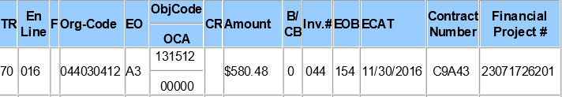
Federal Participating Indicator
In CITS, a B/CB (Current Billing) indicator of “0” indicates federal participating, and “1” non-participating.

Slide 14
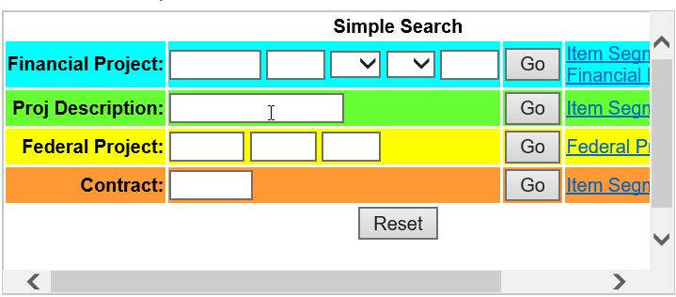
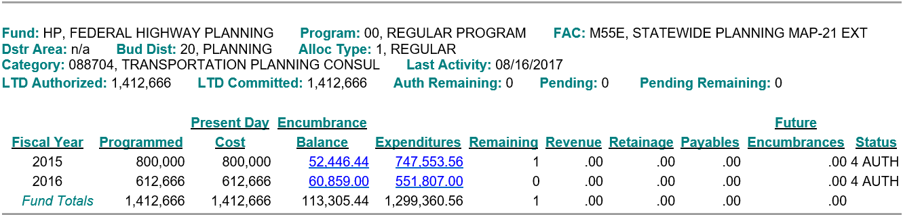
Federal participating vs non-participating on invoices
To check for financial project correlation to federal participating – the work program SharePoint site for project search.

Slide 15
Appropriate dates in invoices
The Consultant will be eligible for progress payments under this agreement at monthly intervals or when individual tasks or mileposts defined in this agreement are completed or reached.
Date invoice and/or any required documentation received should reflect the last date all required documents are received.

Slide 16
Thank you for participating
If you have any questions, please contact us by phone or e-mail.
  Procurement Office
    Jackson Delikat
      Jackson.Delikat@dot.state.fl.us
      (850) 414-4476
  Office of Comptroller
    Dewayne Baxley
      Dewayne.Baxley@dot.state.fl.us
      (850) 414-4678
    For questions regarding travel expenses and allowable charges contact Dooqas@dot.state.fl.us

