Slide 1
FHWA’s Functional Classification and Adjusted Urban Area Boundary Guidelines
Joseph Hausman and Supin Yoder
FHWA Office of Planning
Systems Planning & Analysis Team

Slide 2
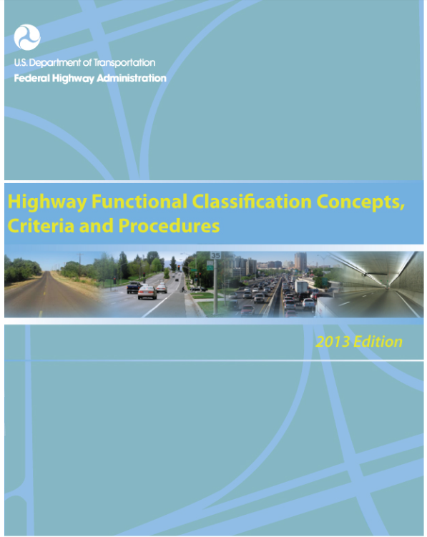
https://www.fhwa.dot.gov/planning/processes/statewide/related/highway_functional_classifications/

Slide 3
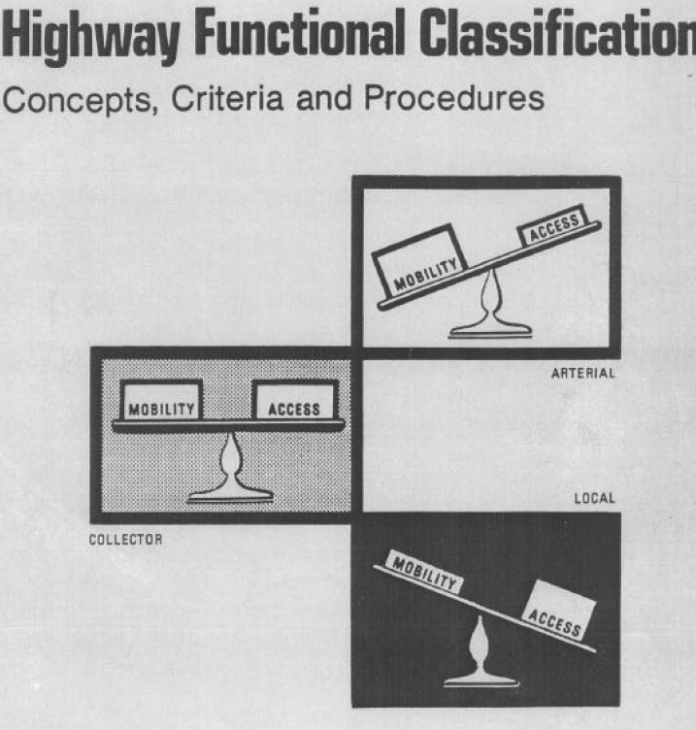
Overview
2013 Guidelines are a refresh, not a departure
Acknowledges advances in mapping technologies and analysis capabilities
Introduces relationship of design and functional classification
Geared towards everyday practitioners and interested professionals

Slide 4
Document Overview
Builds on 1989 document and 2008 interim guidance
Provides tangible “how to” – process and technical tasks
  Clarifies what is mandatory and what is not
Describes concepts and ideas behind functional classification
  Describes influence of functional class and factors that have an influence on functional class

Slide 5
Contents
 | Rural | Urban
1 | Principal Arterial – Interstate | Principal Arterial - Interstate
2 | Principal Arterial - Other Freeways & Expressways | Principal Arterial - Other Freeways & Expressways
3 | Principal Arterial – Other | Principal Arterial – Other
4 | Minor Arterial | Minor Arterial
5 | Major Collector | Major Collector
6 | Minor Collector | Minor Collector
7 | Local | Local
How and where functional classification is used
Definition of functional classifications
  Retained original terms
  Minimized urban and rural distinctions
  Introduced OFE/minor and major collectors for all areas
Description of mobility and access
Updated mileage and VMT distribution ranges

Slide 6
What’s Changed?
Federal Aid system is mature
For States, level of coordination for decision-making is high and increasing
Geospatial technologies and data acquisition capabilities have grown considerably
Roadway design options have increased, to accommodate non-auto modes

Slide 7
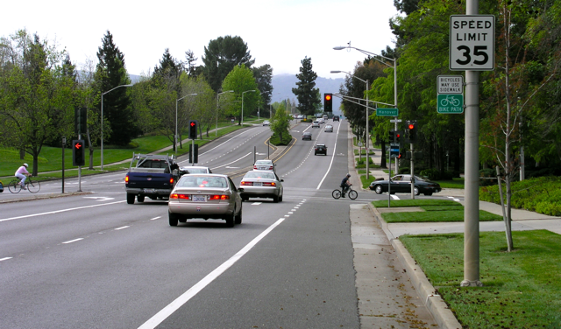
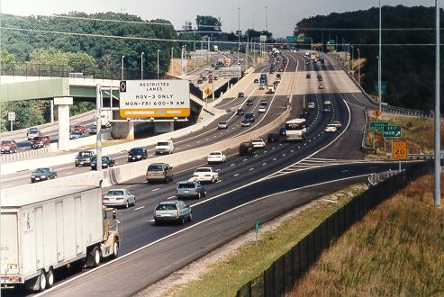
Guidance Highlights
Urban and rural demarcation defined by function not urban area boundary
All functional classification exist in urban and rural categories
  New Urban Minor Collector
“Rule of Thumb” recommendations on VMT and mileage distributions
Future roads – include only if in STIP
Assign same FC to ramps as highest FC of connecting roadways
Other Principal Arterial in California
HOV lane on Interstate 95 in Woodbridge, VA

Slide 8
Functional Classification (FC) Decision Tree
All Roads
Arterial
Principal
Minor
(Full Access)
Non-Arterial
Collector
Local
Limited Access
Full Access
Major
Minor
Interstate
Other Freeways & Expressways
Other Principal Arterial

Slide 9
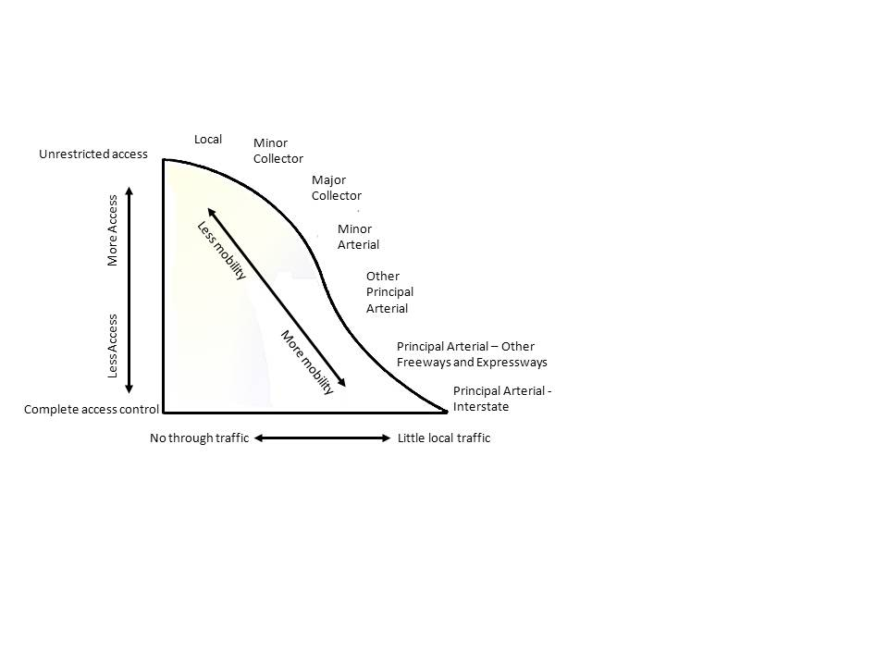
Mobility vs. Accessibility
Notes:
Mobility: Few opportunities for entry and exit and low travel friction
Accessibility function: Provides many opportunities for entry and exit; higher travel friction

Slide 10
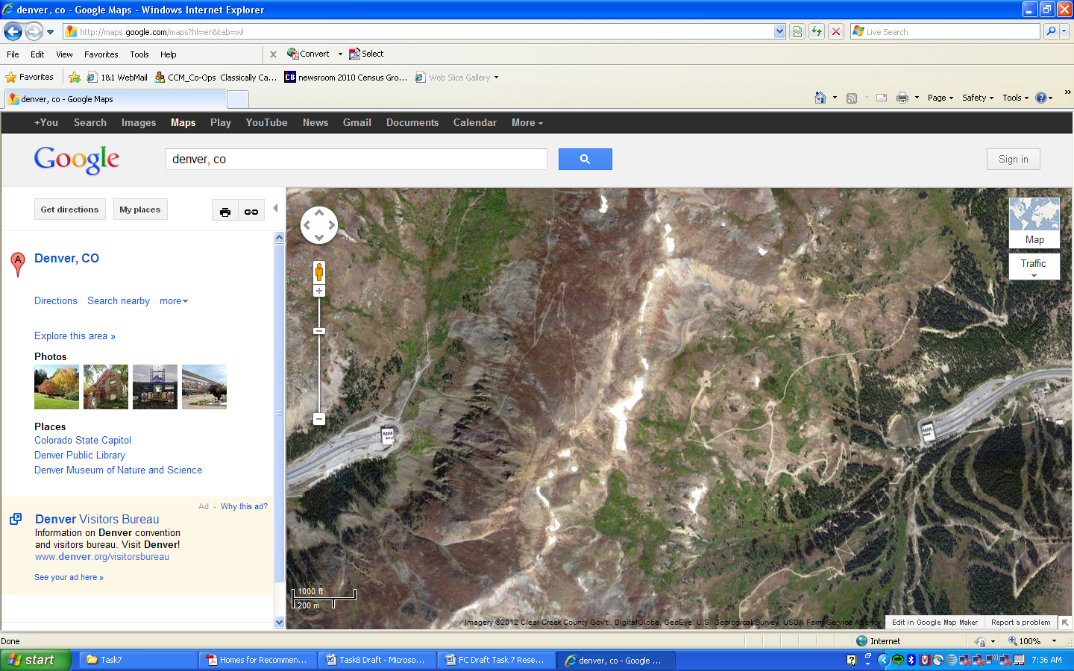
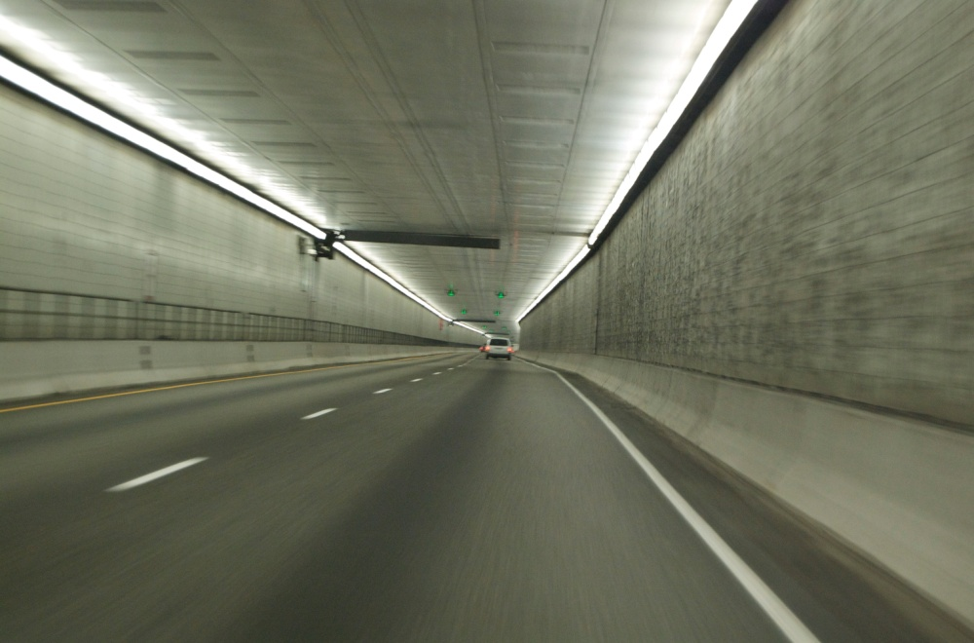
FC Concepts - Mobility
Inside the Eisenhower Tunnel
Eisenhower (and Johnson) Tunnels along I-70, west of Denver, CO

Slide 11
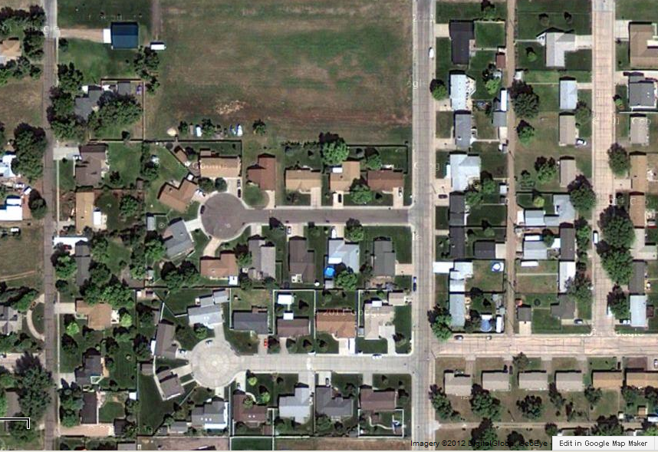
FC Concepts - Access
Eisenhower Court
Mobility: Few opportunities for entry and exit and low travel friction
Accessibility function: Provides many opportunities for entry and exit; higher travel friction

Slide 12
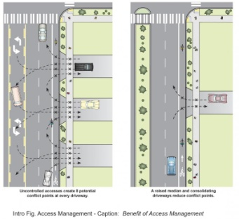
FC Influencers
Trip length: Longer trips – More Principal Arterial use. Shorter trips – more Local/Collector use.
Access points: In theory, Surface Arterials provide the least access for-grade roads – Access Management tries to preserve function.
Speed limit
Route spacing
Usage / traffic volume
Number of lanes
Connections to activity
centers

Slide 13
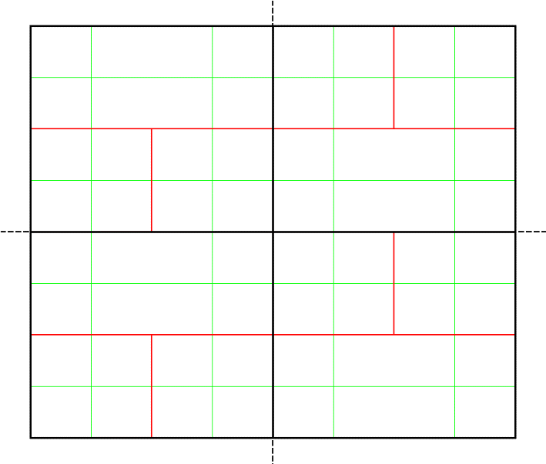
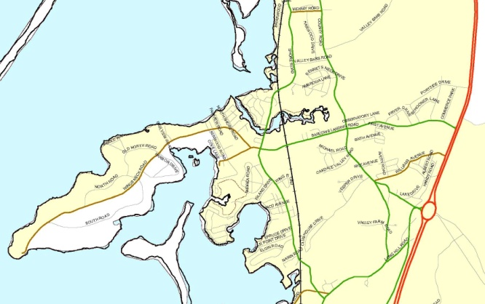
FC Concepts: Continuity
Arterials
Collectors
Locals
A roadway of a higher classification should not terminate at a single roadway of a lower classification.
Of course there are exceptions…
Wings Neck Road, Bourne, MA

Slide 14
Principal Arterials Characteristics
Urban | Rural
Serve major activity centers, highest traffic volume corridors and longest trip demands Carry high proportion of total urban travel on minimum of mileage Interconnect and provide continuity for major rural corridors to accommodate trips entering and leaving urban area and movements through the urban area Serve demand for intra-area travel between the central business district and outlying residential areas | Serve corridor movements having trip length and travel density characteristics indicative of substantial statewide or interstate travel Connect all or nearly all Urbanized Areas and a large majority of Urban Clusters with 25,000 and over population Provide an integrated network of continuous routes without stub connections (dead ends)

Slide 15
Minor Arterials- Characteristics
Urban | Rural
Interconnect and augment the higher-level Arterials Serve trips of moderate length at a somewhat lower level of travel mobility than Principal Arterials Distribute traffic to smaller geographic areas than those served by higher-level Arterials Provide more land access than Principal Arterials without penetrating identifiable neighborhoods Provide urban connections for Rural Collectors | Link cities and larger towns (and other major destinations such as resorts capable of attracting travel over long distances) and form an integrated network providing interstate and inter-county service Be spaced at intervals, consistent with population density, so that all developed areas within the State are within a reasonable distance of an Arterial roadway Provide service to corridors with trip lengths and travel density greater than those served by Rural Collectors and Local Roads and with relatively high travel speeds and minimum interference to through movement

Slide 16
Major Collectors- Characteristics
Urban | Rural
Serve both land access and traffic circulation in higher density residential, and commercial/industrial areas Penetrate residential neighborhoods, often for significant distances Distribute and channel trips between Local Roads and Arterials, usually over a distance of greater than three-quarters of a mile Operating characteristics include higher speeds and more signalized intersections | Provide service to any county seat not on an Arterial route, to the larger towns not directly served by the higher systems and to other traffic generators of equivalent intra-county importance such as consolidated schools, shipping points, county parks and important mining and agricultural areas Link these places with nearby larger towns and cities or with Arterial routes Serve the most important intra-county travel corridors

Slide 17
Minor Collectors- Characteristics
Urban | Rural
Provide direct access to adjacent land Provide access to higher systems Carry no through traffic movement Constitute the mileage not classified as part of the Arterial and Collector systems | Primarily, provide access to adjacent land Provide service to travel over short distances as compared to higher classification categories Constitute the mileage not classified as part of the Arterial and Collector systems

Slide 18
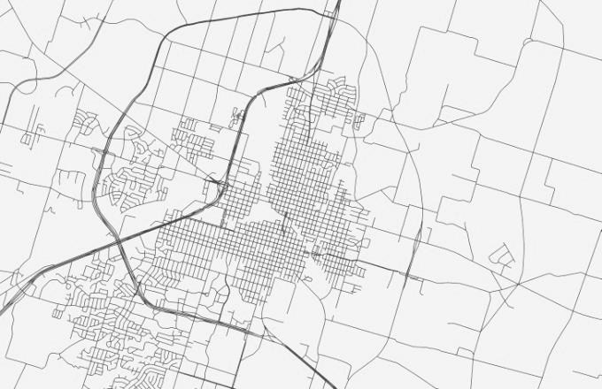
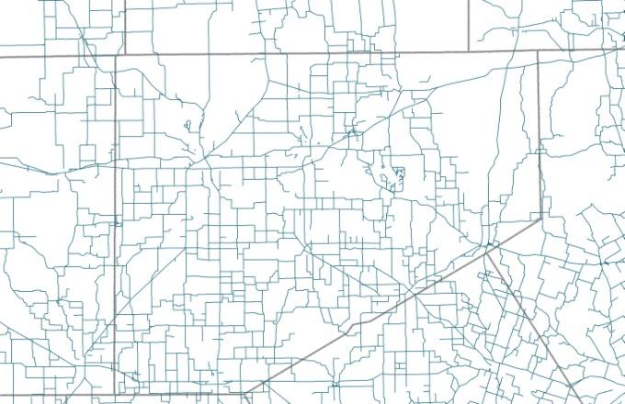
FC – Typical Rural and Urban Distinctions
Urban area networks more diverse
  Greater variety in density, land use
  Generally, stronger land use controls
Rural area networks less diverse
  Less variety in density, land use, less zoning control

Slide 19
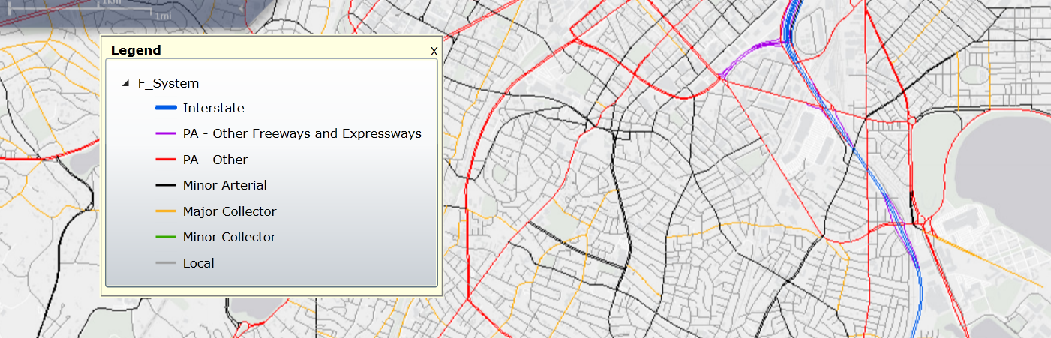
Boston, MA
Notes:
he city of Worcester is served by two interstate routes, Interstate 190 and Interstate 290 (shown in black). These interstates provide high mobility service to residential communities to the north, northeast and south sides of the city.
A handful of Other Freeways & Expressways and Other Principal Arterials (shown in red and blue) radiate out from the central core of the city and provide direct service into, out of and through the city, offering connections to the surrounding areas not served by the Interstates.
An even larger number of Minor Arterials (shown in green) provide connectivity between the Interstate, Other Freeways & Expressways and Other Principal Arterials and are rather evenly spaced. Note that only a few of these Minor Arterial routes actually extend outside of the city border, as most of them terminate at Arterials within the city limits.
The Collector roadway system (shown in brown) consists of relatively shorter routes that mainly connect to Minor Arterials.
All other roadways (shown in gray) are Local Roads and comprise the vast majority of the mileage of the city’s roadway network.

Slide 20
FC – Flexibility and Overlap
Common sense should be guide
Look at over all distribution and spacing when in doubt
Be consistent with community standards

Slide 21
FC – Typical Characteristics
Typical Characteristics | Interstate | Other Freeways and Expressways | Other Principal Arterials | Minor Arterials
Lane Width | 12 feet | 11 - 12 feet | 11 - 12 feet | 10 feet - 12 feet
Inside Shoulder Width | 4 feet - 12 feet | 0 feet - 6 feet | 0 feet | 0 feet
Outside Shoulder Width | 10 feet - 12 feet | 8 feet - 12 feet | 8 feet - 12 feet | 4 feet - 8 feet
AADT (Rural) | 12,000 - 34,000 | 4,000 - 18,500 | 2,000 - 8,500 | 1,500 - 6,000
AADT (Urban) | 35,000 - 129,000 | 13,000 - 55,000 | 7,000 – 27,000 | 3,000 - 14,000
Divided/Undivided | Divided | Undivided/ Divided | Undivided/ Divided | Undivided
Access | Fully Controlled | Partially/Fully Controlled | Partially/Fully Controlled | Uncontrolled

Slide 22
FC – Mileage/VMT Guidelines (Rural System)
Typical Characteristics | Interstate | Other Freeways and Expressways | Other Principal Arterials | Minor Arterials
Mileage Extent for Rural States | 1% - 3% | 0% - 2% | 2% - 6% | 2% - 6%
Mileage Extent for Urban States | 1% - 2% | 0% - 2% | 2% - 6% | 3% - 7%
Mileage Extent for All States | 1% - 2% | 0% - 2% | 17% - 36% | 3% - 7%
VMT Extent for Rural States | 18% - 38% | 0% - 7% | 15% - 31% | 9% - 20%
VMT Extent for Urban States | 18% - 34% | 0% - 8% | 12% - 29% | 12% - 19%
VMT Extent for All States | 20% - 38% | 0% - 8% | 14% - 30% | 11% - 20%

Slide 23
FC – Mileage/VMT Guidelines (Urban System)
Typical Characteristics | Interstate | Other Freeways and Expressways | Other Principal Arterials | Minor Arterials
Mileage Extent for Rural States | 1% - 3% | 0% - 2% | 4% - 9% | 7% - 14%
Mileage Extent for Urban States | 1% - 2% | 0% - 2% | 4% - 5% | 7% - 12%
Mileage Extent for All States | 1% - 3% | 0% - 2% | 4% - 5% | 7% - 14%
VMT Extent for Rural States | 17% - 31% | 0% - 12% | 16% - 33% | 14% - 27%
VMT Extent for Urban States | 17% - 30% | 3% - 18% | 17% - 29% | 15% - 22%
VMT Extent for All States | 17% - 31% | 0% - 17% | 16% - 31% | 14% - 25%

Slide 24
FC – Mileage/VMT Guidelines
Typical Characteristics | Major Collector |  | Minor Collector | Local
Lane Width | 10 feet - 12 feet |  | 10 - 11 feet | 8 - 10 feet
Inside Shoulder Width | 0 feet |  | 0 feet | 0 feet
Outside Shoulder Width | 1 feet - 6 feet |  | 1 feet - 4 feet | 0 feet - 2 feet
AADT (Rural) | 300 - 2,600 |  | 150 - 1,110 | 15 - 400
AADT (Urban) | 1,100 - 6,300² |  |  | 80 - 700
Divided/Undivided | Undivided | Undivided |  | Undivided
Access | Uncontrolled | Uncontrolled |  | Uncontrolled

Slide 25
FC – Mileage/VMT Guidelines
Mileage/VMT Extent (Percentage Ranges) | Major Collector | Minor Collector | Local
Rural System
Mileage Extent for Rural States | 8% - 19% | 3% - 15% | 62% - 74%
Mileage Extent for Urban States | 10% - 17% | 5% - 13% | 66% - 74%
Mileage Extent for All States | 9% - 19% | 4% - 15% | 64% - 75%
VMT Extent for Rural States | 10% - 23% | 1% - 8% | 8% - 23%
VMT Extent for Urban States | 12% - 24% | 3% - 10% | 7% - 20%
VMT Extent for All States | 12% - 23% | 2% - 9% | 8% - 23%
Urban System
Mileage Extent for Rural States | 3% - 16% |  | 62% - 74%
Mileage Extent for Urban States | 7% - 13% |  | 67% - 76%
Mileage Extent for All States | 7% - 15% |  | 63% - 75%
VMT Extent for Rural States | 2% - 13% | 2% - 12% | 9% - 25%
VMT Extent for Urban States | 7% - 13% |  | 6% - 24%
VMT Extent for All States | 5% - 13% |  | 6% - 25%

Slide 26
FC Update Triggers
New significant roadways that may warrant Arterial or Collector status
Any Principal Arterial roadway reconstructed as a divided facility
Construction of major development that has caused traffic patterns to change
Significant growth that causes new access or mobility needs
Arterial or Collector roadways been extended or to attract more through trip movements?
Significant growth in daily traffic volumes?

Slide 27
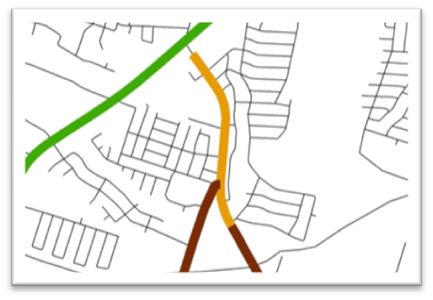
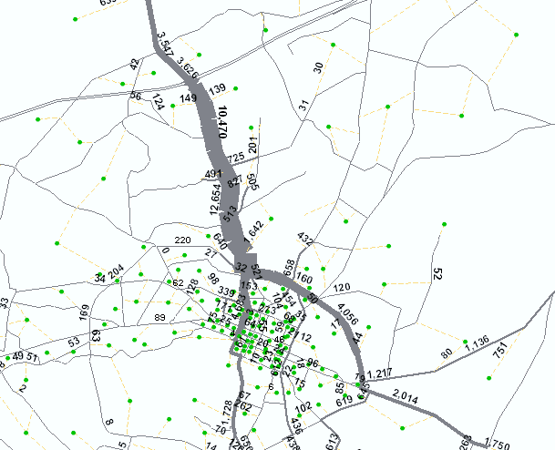
FC – Validation/Review
Use of GIS
  Identify traffic generators/activity centers
  Rank / estimate traffic generated
  Connect with roadway system/validate FC
  Travel demand models (Select Link Analysis) can estimate the origin and destination of trips on a facility
  Results of GIS-based mapping and editing should synch up with enterprise data systems
Selected Link Analysis

Slide 28
FC Good Practice - Steps/Schedule
Event | Month Following FHWA Adjusted Urban Area Boundary Approval
State DOT launches the formal Functional Classification update process after FHWA approves the State’s adjusted urban area boundaries | Month 1
State DOT works with planning partners to review and propose changes to the functional classification of its roadways | Months 2-17
State DOT gathers and processes all proposed function classification changes and submit draft final data and/or maps to FHWA division office for review | Months 18-20
DOT incorporates updates into planning process and related databases, to ensure submittal of updated functional classification in upcoming June 15th HPMS submittal | Months 22-24
Create a multi-agency review team- stay in touch
Build/share understanding of game plan
Generate maps and share electronically – use GIS if at all possible
Encourage/work towards timely delivery of FC revisions

Slide 29
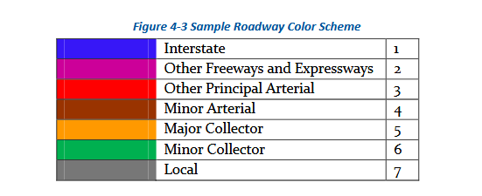
Map Colors

Slide 30
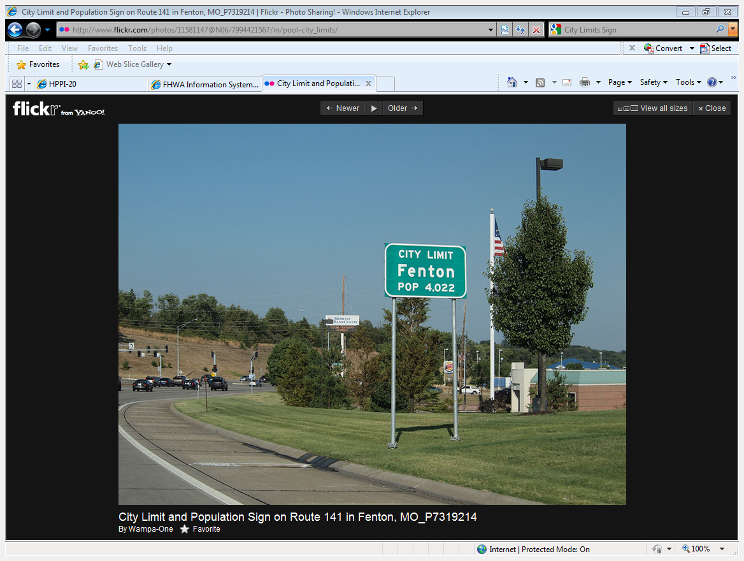
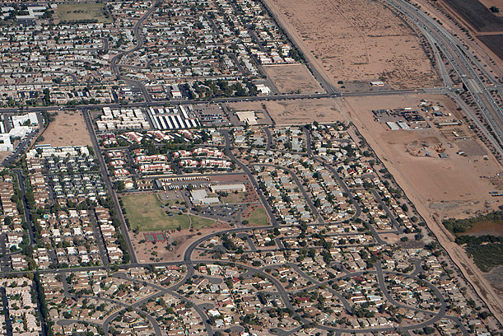
Urban Area - Urban/Rural Definition
Notes:
Rural anything outside of urban areas

Slide 31
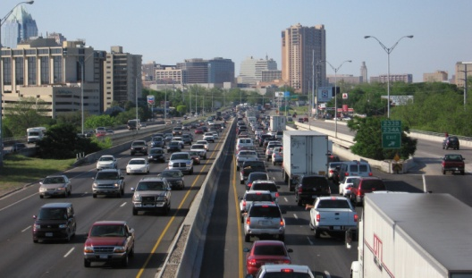
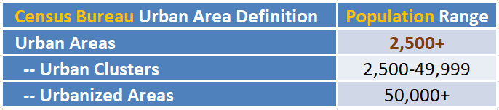
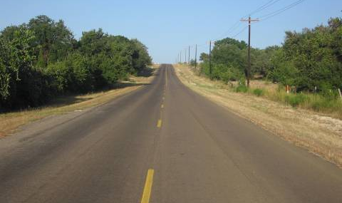
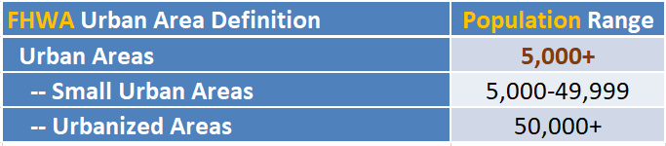
2010 Urban Area Population Thresholds
Notes:
Rural anything outside of urban areas

Slide 32
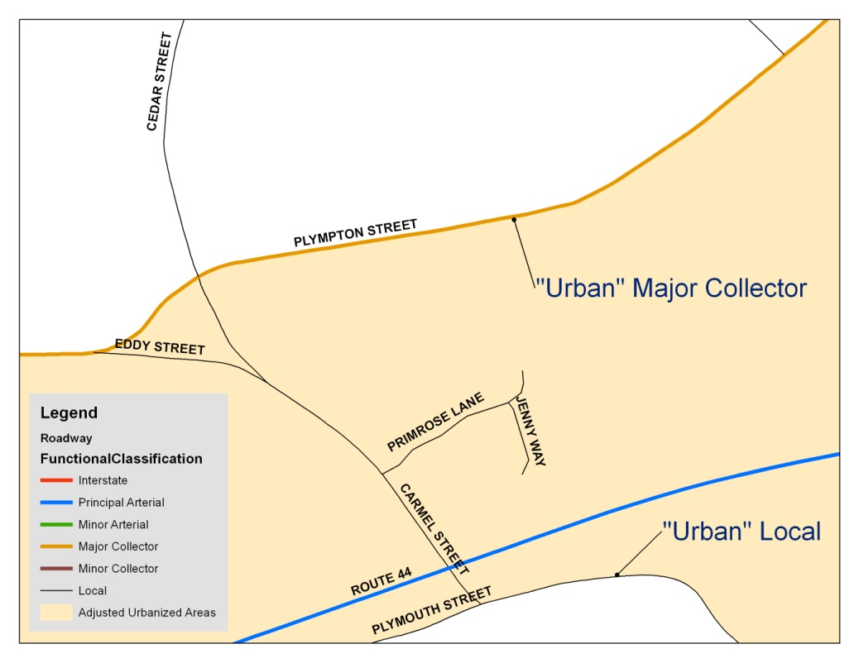
Census Urban Area Boundaries – Reasons to Expand
Example of Roadway Coinciding with Adjusted Urban Area
Urban and rural demarcation defined by function not urban area boundary
Roads that define a boundary should be consistently urban or rural
Area must encompass Census Bureau urban area, at a minimum

Slide 33
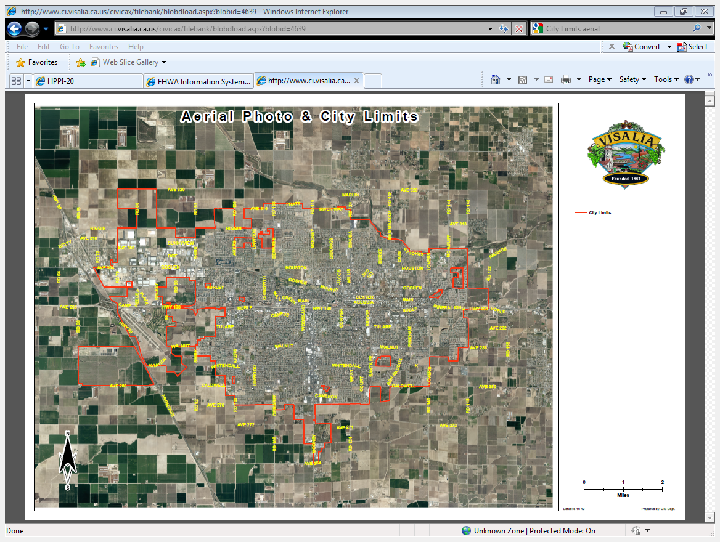
Census Urban Area Boundaries –
Adjustment Considerations
Include entire municipality
Include areas with urban characteristics
Include large/significant generators, e.g., airports, industrial areas, transportation terminals, transit routes

Slide 34
Census Urban Area Boundaries –
Adjustment Considerations
Boundary should follow municipal limits or physical features
Boundary should be easy to discern
Boundaries should be simple, without irregularities
Boundaries should not split roadways or ramps
Boundaries should be one contiguous area
Example Boundary Adjusted to Align with Major East-West Roadway to the South

Slide 35
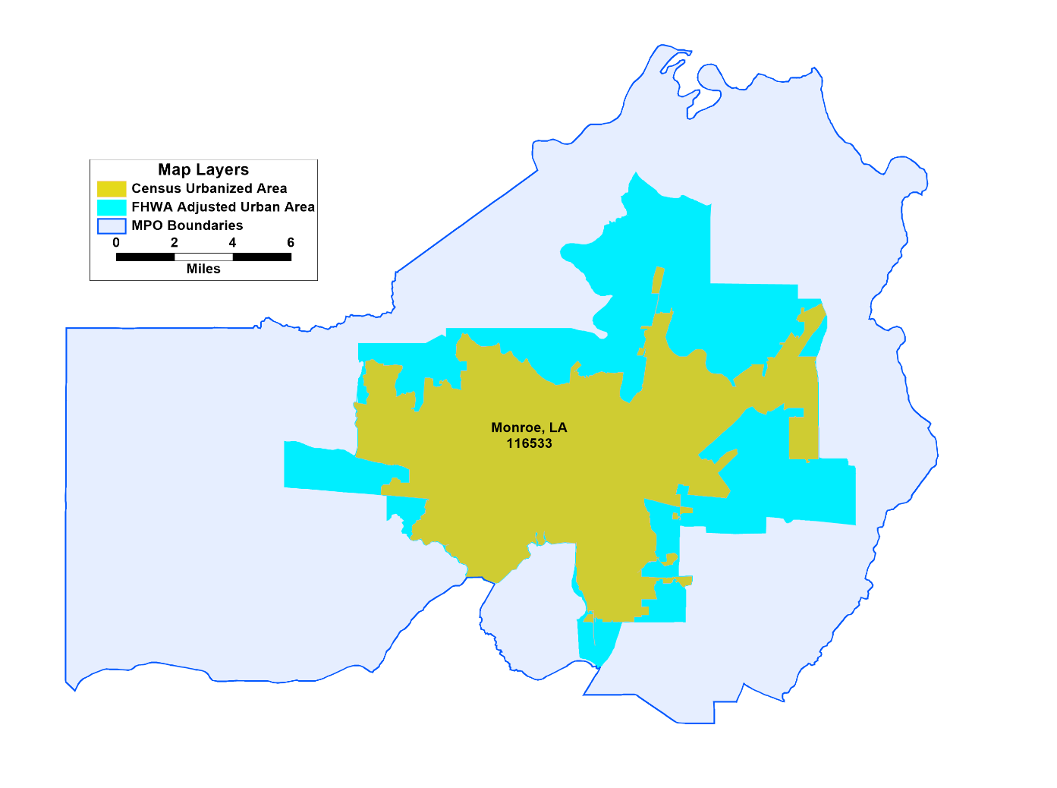
Boundary Development Sequency
Census Urban Area → Adjusted Urban Area → MPO Boundaries
MPO boundaries can include multiple urbanized areas
A MPO can also cover portions of urbanized areas inasmuch as the remaining portions of the UZA are covered by other MPOs
Requirement: an Urbanized Area must be covered entirely by one or more MPO boundaries

Slide 36
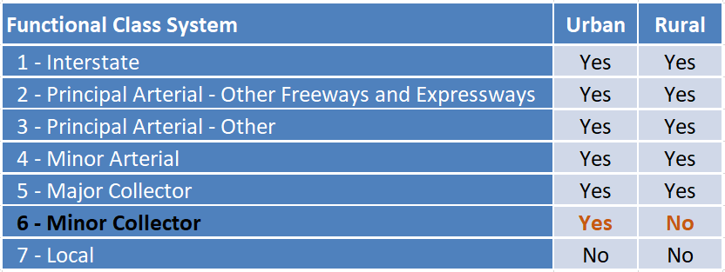
Relationship between Functional Class
& Adjusted Urban Area Boundaries
Federal-Aid Highway System Impact

Slide 37
Urban Area Boundary Adjustment
Good Practice Steps/Schedule
Event | Months Following Release of 2020 Census Urban Area boundaries
FHWA issues transmittal letter | Month 1
Begin adjusted urban area boundary update process | Month 1
DOT works with planning partners to define adjusted urban area boundaries | Month 3-9
Provide draft final data and/or maps to FHWA Division Office for review | Month 10
DOT incorporates Review Comments | Month 11
DOT submits adjusted urban area boundaries to FHWA Office of Planning | Month 12
Recommended 12 month schedule following Census release of Urban Area Boundaries.
At a minimum – confirm Census boundaries are adequate, also…
  Build/share understanding of game plan
  Generate maps and share electronically – use GIS if at all possible
  Encourage/work towards timely delivery of UAB revisions

Slide 38
Summary of Common Errors in Adjusting 2010 Census Urban Boundaries
Boundaries do not encompass an entire Census Bureau urban area
One adjusted urban area is not associated with one census urban area
States do not coordinate in adjusting multi-state urban areas
Adjustment of those Census urban areas that are not defined as FHWA urban areas (may not be applicable to the 2020 urban areas)

Slide 39
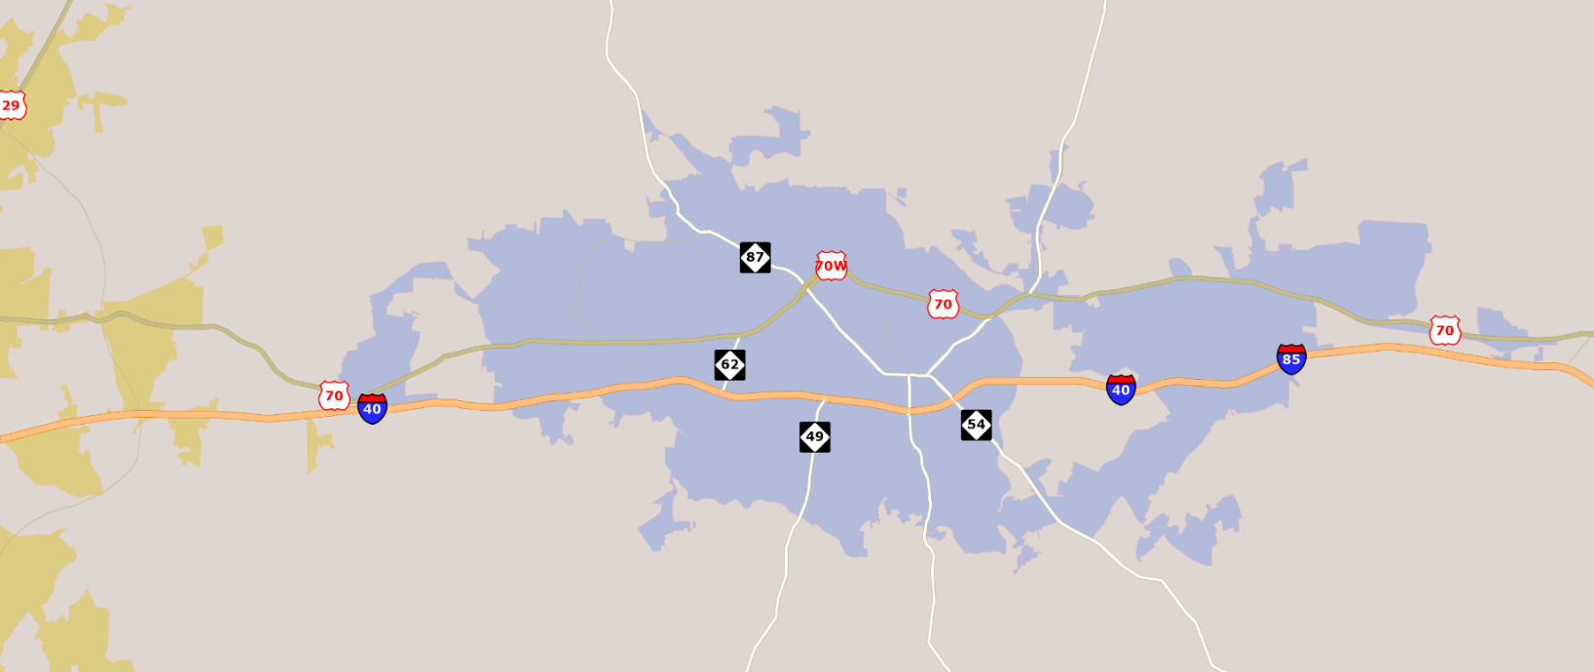
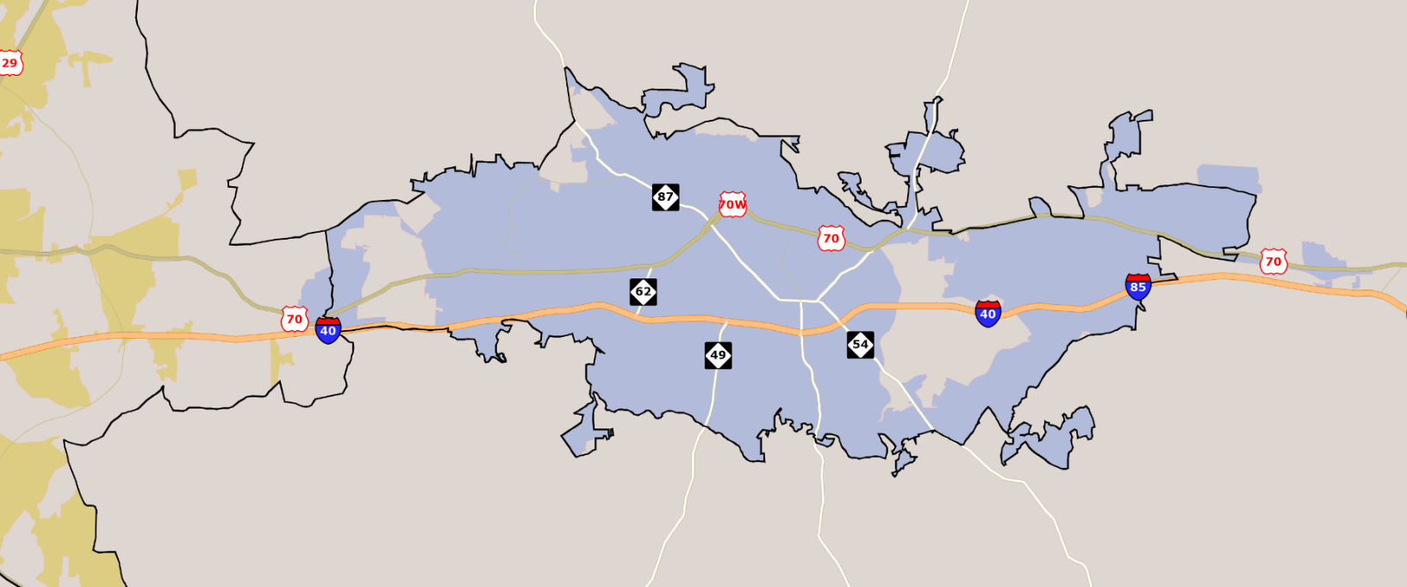
Common Errors Found in Adjusting 2010
Census Urban Areas
Error:
Missing portions of Census Urban areas

Slide 40
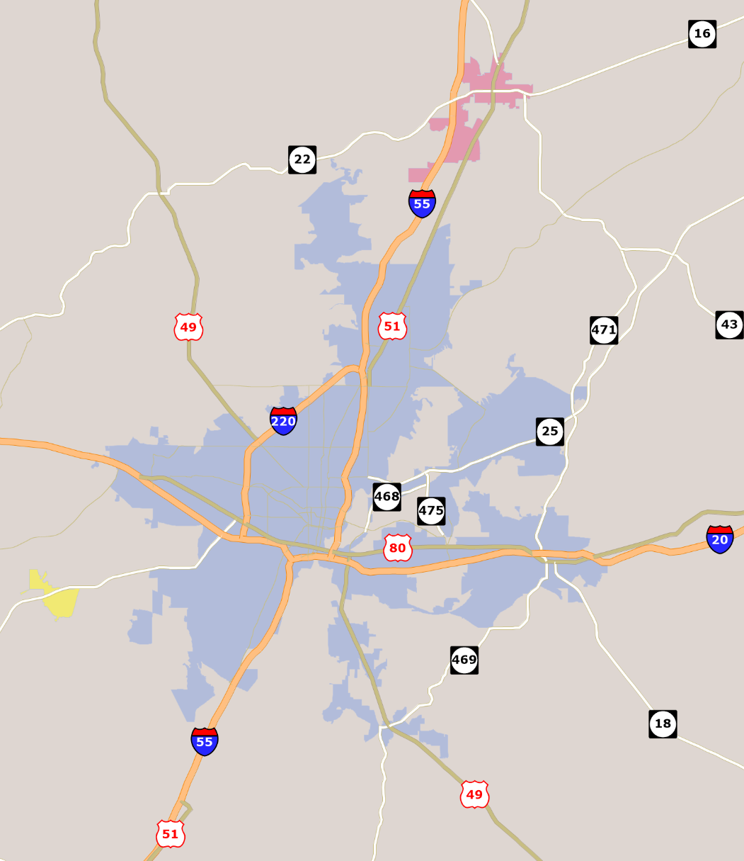
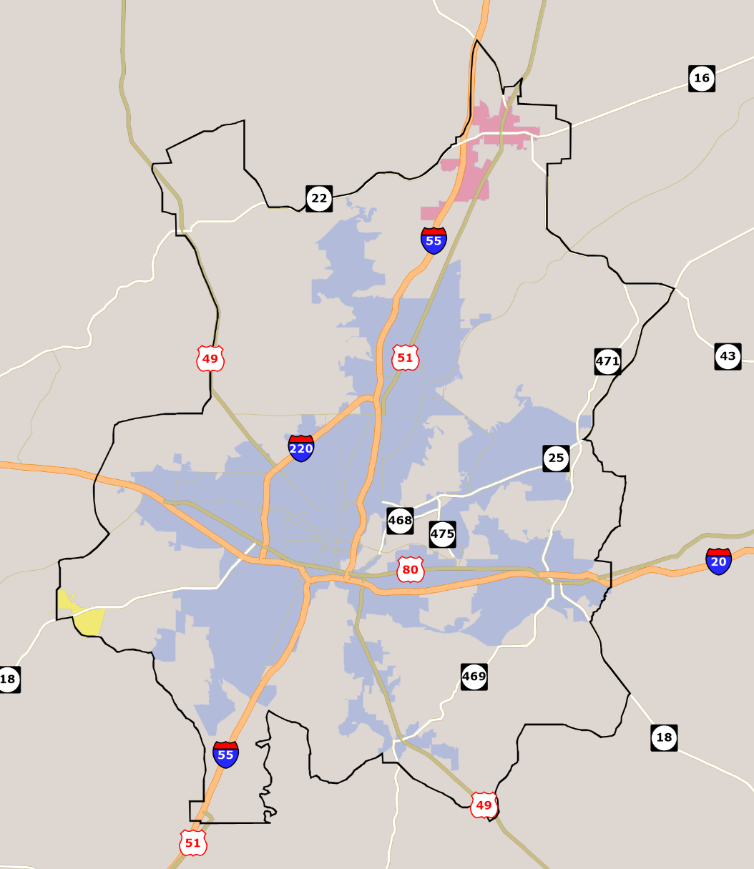
Common Errors Found
Errors:
One-to-One relationship: multiple Census Urban Areas in one Adjusted Urban Area, should be 3 Adjusted Urban Areas

Slide 41
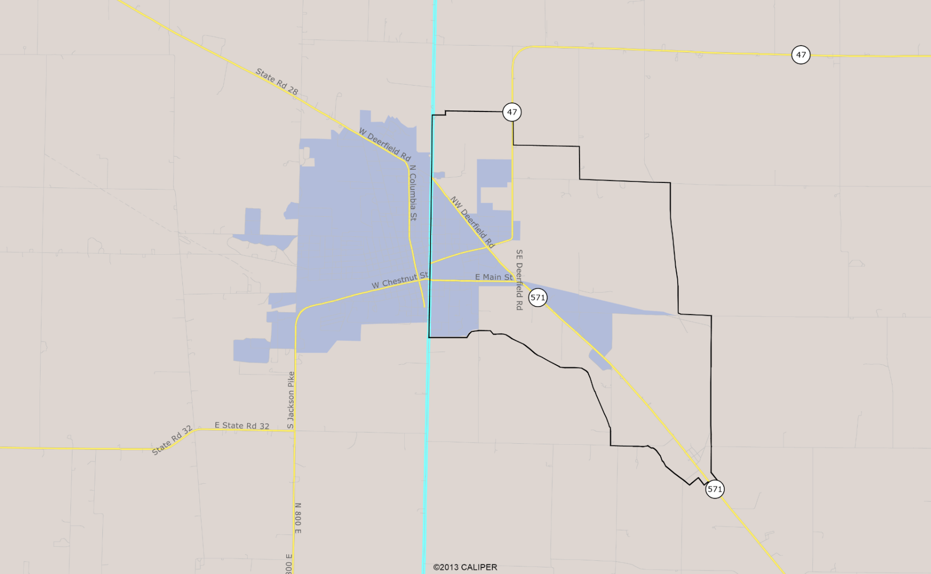
Common Errors Found
Multi-State Urban Areas: Each state adjusts only their own state portion without working with other states
State
Line

Slide 42
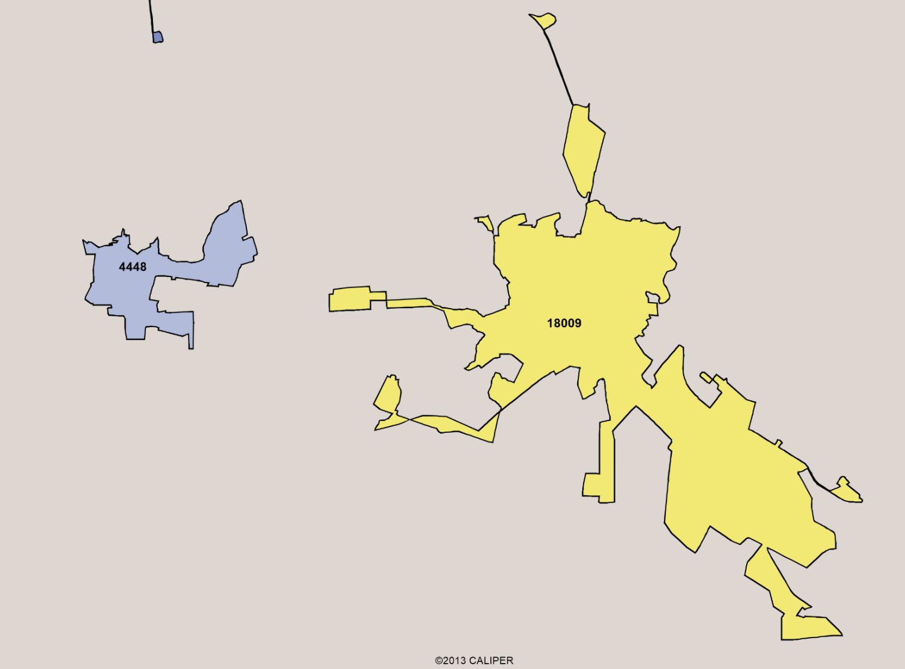
Common Errors Found
FHWA Urban Area Definition:
Decennial Census Population of 5000 or more, the one in blue should not be included as an FHWA urban area (population =4448)

Slide 43
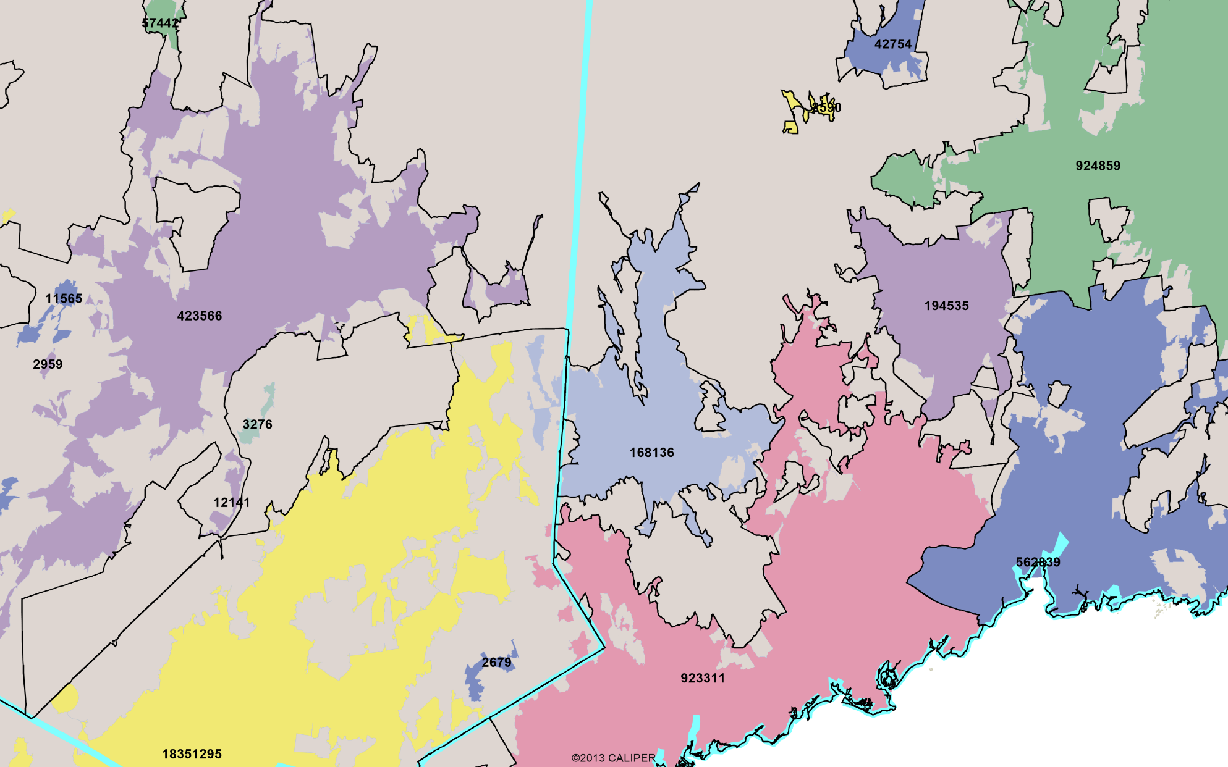
Common Errors Found
State
Line
Summary
(figures shown are 2010 Census Population):
How many errors can you find?

Slide 44
Common Errors Found
State
Line
Summary
(figures shown are 2010 Census Population):
How many errors can you find?

Slide 45
Adjusted Urban Area Boundaries
Guideline Summaries
Boundaries should encompass the entire Census Bureau urban area
Boundaries should be one contiguous area
Boundaries should be simple, without irregularities
Boundaries should follow municipal boundaries or other physical features
Boundaries should include areas with urban characteristics, such as airports, industrial areas, transportation terminals, major activity centers, etc.
Reference: https://www.fhwa.dot.gov/planning/processes/statewide/related/highway_functional_classifications/fcauab.pdf,
Note: States and MPOs may choose not to adjust the Census urban boundaries

Slide 46
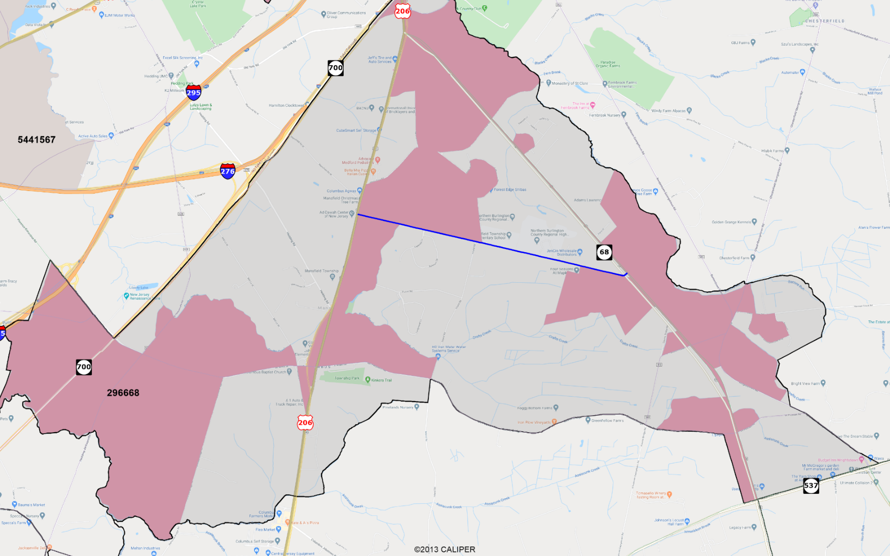
Example of Benefit in Adjusting Census Urban Areas
Benefits of Adjusted Urban Area Example: With the adjusted urban area boundaries, the Minor Connector shown in Blue connecting two arterials can be uniformly designated as an Urban Minor Collector. Without adjusting the urban boundaries, the connector would be divided into three roadway segments: urban, rural and then again urban minor connectors, making the roadway planning, programming and maintenance difficult

Slide 47
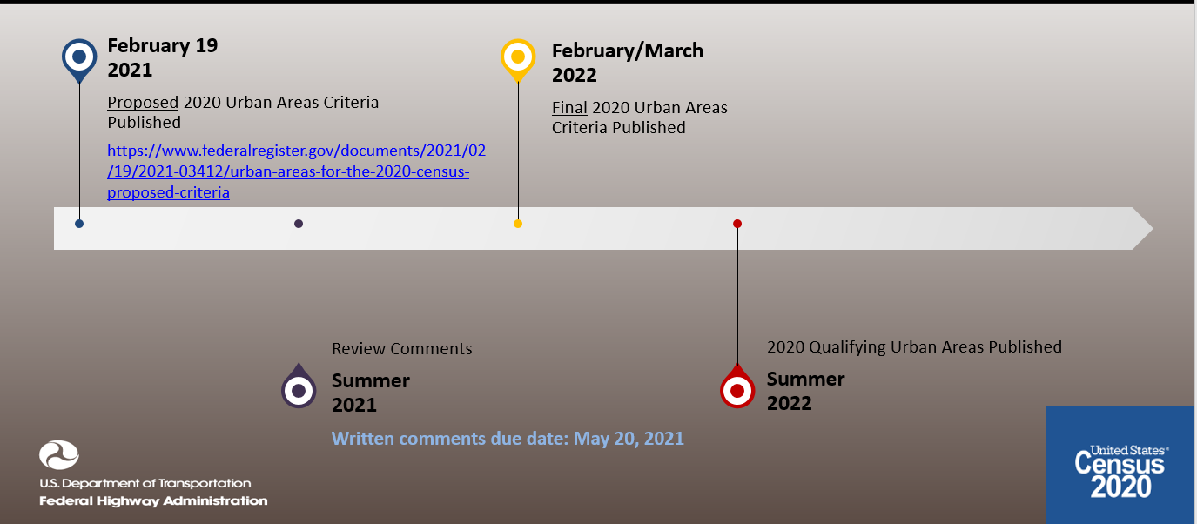
2020 Census Urban Area Boundary Release Schedule

Slide 48
Questions?
Joseph Hausman
Senior Community Planner
FHWA Office of Planning
Joseph.Hausman@dot.gov, Phone: 312-257-6356
FHWA - Office of Planning
Ms. Supin L. Yoder
Travel Demand Forecasting & GIS Specialist
FHWA Office of Planning
Supin.Yoder@dot.gov, Phone: 312-257-6356
FHWA HEPGIS Maps

