Slide 1


Change Management Board Meeting
Thursday, January 19, 2017
Video Conference: CO-Burns Video Bridge 2
Audio Only: 850-414-3101
Do NOT Put On Hold Call is Being Recorded
GoToMeeting:
https://global.gotomeeting.com/join/681786189

Slide 2
Welcome and Call for Quorum
Bryan Homayouni, P.E., CMB Chairman

Slide 3
Agenda
Time | Item | Lead
1:30 – 1:40 | Welcome and Call for Quorum | Bryan Homayouni
1:40 – 1:50 | Previous Meeting Recap & Action Item Review | Derek Vollmer
1:50 – 2:00 | ITS WAN Update | Randy Pierce & Frank Deasy
2:00 – 2:15 | SunGuide Software Update | Derek Vollmer
2:15 – 2:25 | Accurate Latitude / Longitude | Daniel Smith
2:25 – 2:35 | SunGuide Executive Enhancement (vote) | Pete Vega
2:35 – 2:45 | SunGuide Arterial Enhancements | Pete Vega
2:45 – 2:50 | Color / Graphic DMS Committee | Pete Vega

Slide 4
Agenda
Time | Item | Lead
2:50 – 3:05 | Graphic DMS Travel Time Messaging (vote) | Mark Laird
3:05 – 3:20 | WWD Enhancements (vote) | Bryan Homayouni
3:20 – 3:35 | End of Life for Devices | Derek Vollmer
3:35 – 3:45 | District 5 Architecture Updates | Jeremy Dilmore
3:45 – 4:00 | Open Discussion | Bryan Homayouni
4:00 – 4:10 | Review Action Items | Bryan Homayouni
CMB Agenda, slides, and attachments posted here:
http://www.dot.state.fl.us/trafficoperations/ITS/Projects_Deploy/CMB.shtm

Slide 5
Previous Meetings Recap and Action Items Review
Derek Vollmer, P.E., Formal CMB Chairman

Slide 6
Previous Meeting Action Items
Owner | Action Item
Derek Vollmer | Get with D6 on Waze roadway selection around the Golden Glades. Add “dismiss with no action” option to alerts.
Districts | Send Derek request to get the IV&V early deployment for testing software.
Derek Vollmer | Discuss Waze alerts with Russell for 511
Derek Vollmer | Send concept slides/ConOps to Craig/Lee for standalone video application.
Russell Allen | Reported delays tab on new 511 system- excluding color-coding from map if districts find inaccurate data.
Russell Allen | Ask Inrix data questions, verify 511 survey for questions asking what user information is helpful.
Derek Vollmer | Send out Bryan’s contact information to Robbie.

Slide 7
ITS Communications Update
Randy Pierce & Frank Deasy, P.E.

Slide 8
ITS WAN Update
Florida Keys Microwave Project
  ITS Central Office has designed an upgrade of the unlicensed microwave system along Overseas Highway for ITS (cameras, DMS, and traffic counters).
  Project awarded to CenturyLink/Nokia
  Replacement system will use licensed RF spectrum
  New system will be resistant to interference
  Bandwidth for transporting video and other data traffic will be increased
  System will leverage AT&T MetroEthernet services to provide redundancy during periods of microwave fading
  Will utilize FTE Fiber from District 6 to the bottom of the HEFT.

Slide 9
ITS WAN Update
Florida Keys Wind Sensors
  25 sites in the Florida Keys along Overseas Highway received ultrasonic wind-speed sensors
  Monitors wind speed near bridges to aid in determining when to close roadway for safety
  Wind speed data can be accessed via web page from any PC on District ITS network by pointing browser to http://192.168.167.227, or http://192.168.167.251 (must be allowed through any firewalls).
  Click the red “6” on the map, and then click on an arrow to see the station’s data.
  System installed and live as of January 1, 2017.

Slide 10
ITS WAN Update
Tallahassee Fiber Ring
  Network is operational
  Logical configuration of hardware is complete
  Provides traffic camera video to State Emergency Operations Center
    Used during Hurricane Matthew in Oct. 2016
  Enhances connectivity to ITS WAN for TERL and District 3
  Near completion for District 3 and COT testing of multicast.

Slide 11
ITS WAN Update
ITS WAN – District IP Re-allocation Effort
  All Districts have been notified of their assigned CIDR blocks for the Next Generation Statewide Network.
  District 5 is actively migrating to assigned CIDR blocks and this step must be completed prior to statewide adoption.
  District 6 and MDX are using their assigned CIDR blocks for new deployments
Multicast (Re)Addressing
  D3, D4 & D6 completed their multicast addressing
    Continued testing with D3.
  Remaining Districts should (re)address their multicast devices now to resolve any overlapping addresses
  D1, D5, D7 & MDX are in process
  D2 and FTE not implemented at Layer 3 at this time
  Multicast video can then be shared statewide
  Goal is to have statewide video available at the State Emergency Operations Center

Slide 12
ITS WAN Update
Upgrade Statewide Microwave System (SMS) Project
  Many ITS WAN project put on hold and will be worked into the SMS Upgrade Project
  Previous project are now folded into D5 RTMC relocation project
    D5/Turkey Lake Redundancy Project -TBD
    Tolls Middleware Application – TBD
    D5/Deland to I-95 - TBD
    D5 to D2 via I-95 - TBD
    D5 to D7 Link Upgrade project – TBD
    Southeast Florida Fiber Re-route Project at Commercial Blvd (D4/D6/Andytown/FTE Pompano/McArthur Sunrise) – TBD.
    District 4 and 6 IP Management Address overlap – Managed Lanes Project - TBD

Slide 13
QUESTIONS?
Randy Pierce & Frank Deasy, P.E.
Randy.Pierce@dot.state.fl.us
Frank.Deasy@dot.state.fl.us

Slide 14
SunGuide Software Update
Derek Vollmer, P.E., FDOT

Slide 15
Status of Upgrades
City of Tallahassee (CoT) upgraded to 6.2
D7 upgrade to 6.2
D6 upgraded to 6.2
CFX upgraded to 6.2
D4 upgraded to 6.2
D2 upgraded to 6.2 last week
MDX remote upgrade this week
D5 reached out for 6.2 upgrade
D1 reached out for 6.2 upgrade
D3 reached out for 6.2 upgrade
FTE reached out for 6.2 upgrade

Slide 16
Upcoming Activities
Release 7.0 FAT tentative for week of February 27th, 2017.
Release 7.0 IV&V tentative for week of March 20th, 2017
  Will release installer to Districts with test systems prior to this week.
Release 7.1 design review needs to be scheduled
Release 7.1 FAT tentative early May
Prepping to have short weekly SSUG meetings

Slide 17
Hotfixes
Executive notification hotfix released for 6.1 and 6.2, but put on hold after issues discovered.
  Issues reported have been fixed
  Additional minor changes include:
    Removed status from e-mail subject
    Added Road Closed Duration field
    Combined narrative and response actions
    Removed text at top of e-mail

Slide 18
Detector Data Loss
With Wavetronix SS126
Discovered by District 6
SS126 protocol had some new messages causing issues
Fixed for District 6, hotfix to follow

Slide 19
QUESTIONS?
Derek Vollmer, P.E., FDOT
Derek.Vollmer@dot.state.fl.us

Slide 20
Accurate Latitude / Longitude
Daniel Smith, FDOT

Slide 21
SunGuide Executive Enhancement
(VOTE)
Pete Vega, P.E., FDOT

Slide 22
SunGuide Executive Enhancement
Trigger actions based on the original Executive Notification criteria
  Send email to EM List
  Color-code Executive Notification Event – similar to R6.2 coloring by ownership
  Color-code the Event List
  IDS pop up

Slide 23
QUESTIONS?
(VOTE)
Pete Vega, P.E., FDOT
Peter.Vega@dot.state.fl.us

Slide 24
SunGuide Arterial Enhancements
Pete Vega, P.E., FDOT

Slide 25
SunGuide Arterial Enhancements
Add TRAFFIC SIGNAL MALFUNCTION to Event Types with coordination with 511
Footprint #3848: Change how roadways are handled/presented in SunGuide
  Changes in roadway designation on arterial roads causes issues with 511
  Performance Measures and treats them as different roads. For Example: Philips Highway, US-1, US-1/ New Kings
Footprint #3849: Add roadway type flags to roadway definitions
  Arterial vs. Interstate Performance Measures

Slide 26
SunGuide Arterial Enhancements
Address roundabouts
Relationship to Exit for INTERSECTION OF
RPGs and Device Linking: Loops and short distances
Device/ SunGuide designation of Interstate vs Arterials for map display, RPG, etc.

Slide 27
SunGuide Arterial Enhancements
Next steps
  Will discuss each arterial enhancement in detail in committee and work with FDOT CO to acquire a cost estimate

Slide 28
QUESTIONS?
Pete Vega, P.E., FDOT
Peter.Vega@dot.state.fl.us

Slide 29
Color / Graphic DMS Committee
Pete Vega, P.E., FDOT

Slide 30
Color / Graphic DMS Committee
Re-start committee
  Central Office participation to standardize processes statewide

Slide 31
QUESTIONS?
Pete Vega, P.E., FDOT
Peter.Vega@dot.state.fl.us

Slide 32
Graphic DMS Travel Time Messaging
Footprints #3855
(VOTE)
Mark Laird, FDOT

Slide 33


Graphic Messages in DMS Messages Report
When using graphics in travel time messages, the destination text is not included in the message template
DMS Messages Report:
105 | 12/22/2016 04:37:10 | 12/22/2016 06:01:51 | {img41}4 MILES 6-9 MIN |  |  | tvtMain
Adding a column to the report would be a problem (width)
Maybe insert destination into message with indication that it represents graphic, e.g.:
105 | 12/22/2016 04:37:10 | 12/22/2016 06:01:51 | [to I-195] MILES 6-9 MIN |  |  | tvtMain
Or, use graphic name:
105 | 12/22/2016 04:37:10 | 12/22/2016 06:01:51 | [I-195] MILES 6-9 MIN |  |  | tvtMain

Slide 34
Graphic Messages in DMS Messages Report
PSA
  Text is better than graphic is many cases (sorting, searching)
  Maybe show name of graphic instead of {img39}?
DMS_ NAME | DATE_CREATED | DATE_ENDED | MESSAGE_TEXT_PG1 | MESSAGE_TEXT_PG2 | MESSAGE_TEXT_PG3 | OWNER | EVENT_ID
76 | 12/12/2016 12:00:06 | 12/12/2016 12:02:00 | {img39}BUCKLE UP SAVE LIVES |  |  | lairdm
76 | 12/12/2016 12:00:06 | 12/12/2016 12:02:00 | [PSA] BUCKLE UP SAVE LIVES |  |  | lairdm

Slide 35

Graphic Messages in DMS Messages Report
Event Messaging
  D6 currently includes roadway name (and direction, if off-route), in addition to graphic.
  But that may change, resulting in:
105 | 12/22/2016 05:44:10 | 12/22/2016 06:01:51 | {img22}LFT LN BLOCKED AT N MIAMI AVE |  |  | operat
  Using name of graphic would work well for these
105 | 12/22/2016 05:44:10 | 12/22/2016 06:01:51 | [I-195] LFT LN BLOCKED AT N MIAMI AVE |  |  | operat

Slide 36
QUESTIONS?
(VOTE)
Mark Laird, FDOT
mark.laird@sunguide.info

Slide 37
Wrong Way Driving Enhancements
(VOTE)
Bryan Homayouni, P.E., CFX

Slide 38
WWD Detection
Current Implementation
Existing WWD Detection Driver added to IDS
Wavetronix Click 512 Interface driver
EM Supports WWD Event Type and Response Plan parameters
Added flag for each agency contact to automatically receive WWD email notifications

Slide 39

WWD Detection
Proposed Changes, 1
Addition of TAPCO Interface driver
  Interface directly with WWD camera equipment
  Supports deployments with one or multiple cameras
CFX Two-Camera Deployment
Incoming radar (Zone 1) detection
SunGuide to receive WWD Alert as soon as all zones are activated
Incoming radar (Zone 2) detection
WWD Direction
Outgoing radar (Zone 3) detection
Outgoing camera (Zone 4) detection
Direction of Travel

Slide 40

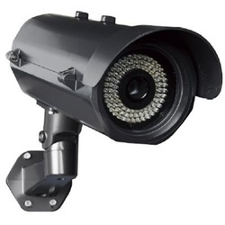
WWD Detection
Proposed Changes, 2
Detectors
Beacons
Activate Beacons
WWD Event
Camera
Email Notification
SunGuide
Cellular Radio
Or
Fiber
IDS
TMC Operator Alert
Activation Notice
TAPCO Driver
Camera Snapshot Download

Slide 41
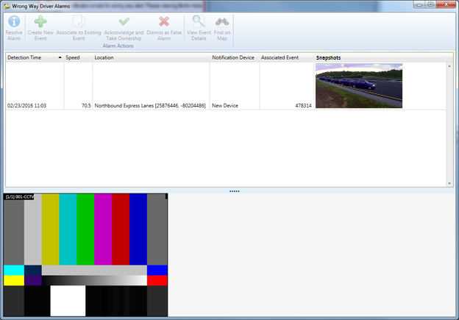
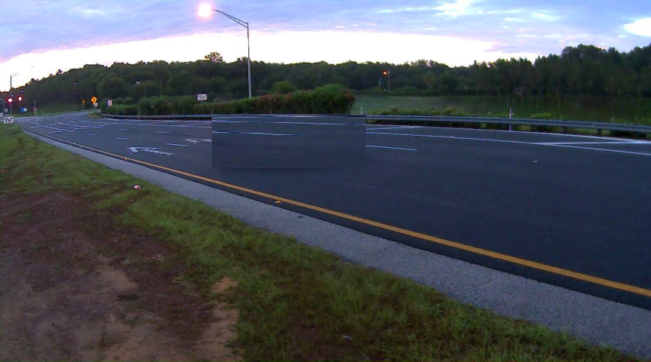

WWD Detection
Proposed Changes, 3
Video snapshot(s) and video added to WWD Alert window
Note: Alert may reach the operator before the snapshot. If so, SunGuide will display a “LOADING IMAGE” default image.
Speed hidden for TAPCO since TAPCO system does not report it
Event ID may be blank if event has not yet been associated
Continually loop through images
Streaming video of nearby CCTV(s)

Slide 42
WWD Detection
Proposed Changes
Estimated cost: $20k

Slide 43
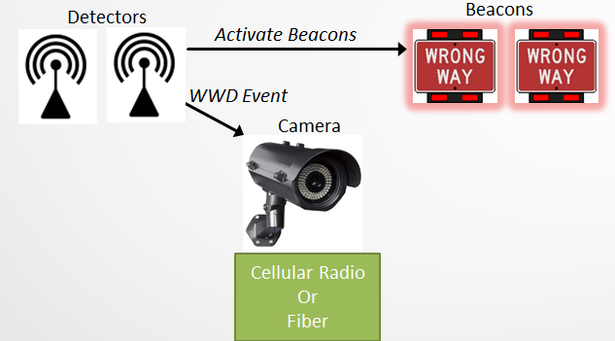
WWD Detection
Possible Future Enhancement
SunGuide
BlinkLink Software
BlinkLink Interface is not yet available
TAPCO estimates interface will be ready late 2017

Slide 44
QUESTIONS?
(VOTE)
Bryan Homayouni, P.E., CFX
Bryan.Homayouni@cfxway.com
Derek Vollmer, P.E., FDOT
Derek.Vollmer@dot.state.fl.us

Slide 45
End of Life for Devices
Derek Vollmer, P.E., FDOT

Slide 46
Possible District Issues Related to EOL
Devices purchased for a project are End of Life (EOL) or near EOL and no longer sold by the manufacturer
Manufacturer no longer supports the device or will stop supporting the device soon
Issues typically occur with Cameras and Microwave Vehicle Detectors
Discussion – Who has experience this and what was your experience?

Slide 47
Short Term Solution
Add language to standard spec section 603-6 “Documentation for Electronic Equipment” to require vendors provide an EOL schedule for devices and show how long they will support a device after it is no longer manufactured.
Add the End of Life information to the APL with language about not purchasing or using products on projects after the EOL date.
Currently looking to do this for Bosch 800 series and 7000 series cameras, Axis Q6045-E MKII, and Wavetronix SS 125.

Slide 48
Longer Term Solution
Consider adding EOL schedule requirement to the warranty section for each device
Makes the requirement more visible
Vendors to notify TERL of any EOL changes
Feedback/input from Districts

Slide 49
QUESTIONS?
Derek Vollmer, P.E., FDOT
Derek.Vollmer@dot.state.fl.us

Slide 50
District 5 Architecture Updates
Jeremy Dilmore, P.E., FDOT

Slide 51
Architecture Update
Context
Planning Organizations are updating ITS Master Plans
  Space Coast TPO - Complete
  MetroPlan Orlando – In Progress
  Lake Sumter – In Progress
  River to Sea – In Progress
MetroPlan Orlando update led to a need to up architecture
  More Stakeholders
  Additional Service Packages

Slide 52
Architecture Update
Ask
Asking for approval for approval of the updated District 5 Architecture
Details in the PDF
Does not reach beyond District boundary

Slide 53
Architecture Update
More Stakeholders
Added stakeholders
  City of Apopka
  City of Kissimmee
  City of Ocoee
  City of Winter Garden
  Reedy Creek Improvement District

Slide 54
Architecture Update
Additional/Modified Service Packages
APTS01 – Transit Vehicle Tracking
ATMS01 – FDOT District 5 is currently updating its CCTV camera system to grant local law enforcement access to their video feeds
AVSS12 – Cooperative Vehicle Service Package updating for ride sharing

Slide 55
QUESTIONS?
Jeremy Dilmore, P.E., FDOT
Jeremy.Dilmore@dot.state.fl.us

Slide 56
Open Discussion
Bryan Homayouni, P.E., CMB Chairman

Slide 57
Review Action Items
Bryan Homayouni, P.E., CMB Chairman

