Slide 1


Welcome and Call for Quorum
Jay Williams, P.E., FDOT
CMB Chairman

Slide 2
Agenda
Time | Item | Lead
1:00 – 1:05 | Welcome and Call for Quorum | Jay Williams
1:05 – 1:10 | Previous Meeting Recap & Action Item Review | Jay Williams
1:10 – 1:30 | SunGuide Software Update | Christine Shafik
1:30 – 1:40 | SG-5300: Access to district SunGuide data from the Central Office | Mark Dunthorn
1:40 – 1:50 | Enhancement #1 SG-4815: Response plans should use Congestion Tail if available (VOTE) | Tucker Brown
1:50 – 2:00 | Enhancement #2 SG-4527: Operators requesting to have data sort feature added (VOTE) | Tucker Brown
2:00 – 2:10 | Enhancement #3 SG-4562: Nearest camera for SPARR created events (VOTE) | Tucker Brown

Slide 3
Agenda
Time | Item | Lead
2:10 – 2:20 | Enhancement #4 SG-2510: Indicate removed items in Current Response Plan list prior to plan activation (VOTE) | Tucker Brown
2:20 – 2:30 | Enhancement #5 SG-564: Remove List Options without Deleting (VOTE) | Tucker Brown
2:30 – 2:40 | Enhancement #6 SG-4084: On Ramp Backup Event Type (VOTE) | Tucker Brown
2:40 – 2:50 | Enhancement #7 SG-3499: Reporting "Ramp Closed" for Different Lane Mappings (VOTE) | Tucker Brown
2:50 – 3:00 | Enhancement #8 SG-3335: Alert the operator when a travel time is double (or some other ratio) the free flow travel time (VOTE) | Tucker Brown
3:00 – 3:10 | Enhancement #9 SG-2364: Log username of user that changes device status (VOTE) | Tucker Brown

Slide 4
Agenda
Time | Item | Lead
3:10 – 3:20 | Enhancement #10 SG-4559: Add Ability to Filter IDS Alerts on Per User Group Basis (VOTE) | Tucker Brown
3:20 – 3:30 | Enhancement #11 SG-3800: Reporting of more accurate locations (VOTE) | Tucker Brown
3:30 – 3:40 | Enhancement #12 SG-4967: SunGuide VDS data drift (VOTE) | Tucker Brown
3:40 – 3:55 | Open Discussion | Jay Williams
3:55 – 4:00 | Review Action Items | Jay Williams

Slide 5
Previous Meetings Recap and Action Items Review
Jay Williams, P.E., FDOT
CMB Chairman

Slide 6
Previous Meeting Action Items
Owner | Action Item
Dan Smith | Dan Smith to give us an update based on the hotfix being applied to the WWD.
Christine Shafik | Central Office to resend out the RISC and RCA ConOps.
Christine Shafik | Central Office is going to coordinate a survey to the Districts in terms of priorities from the voting items from this meeting to include in future releases or possibly 8.0.
Christine Shafik | Central Office to discuss the RCA enhancement at the next ITS Working Group which would be coordination in advance of hurricane season and giving Districts access to each other’s systems.

Slide 7
QUESTIONS?
Jay Williams, P.E., FDOT
Jay.Williams@dot.state.fl.us

Slide 8
SunGuide Software Update
Christine Shafik, P.E., FDOT

Slide 9
Release 7.2
Released 10/5/19
Currently deployed in D1,D5, D6, D7,CFX, MDX & FTE
Hotfix 1 (fixes for 9 issues) testing completed and released on 2/26/20

Slide 10
Release 8.0
  33 issues have been approved and authorized – development in process

Slide 11
Release 8.0
District RISC and RCA ConOps – development in process
IV&V build from SwRI planned for October 2020

Slide 12
QUESTIONS?
Christine Shafik, P.E., FDOT
Christine.shafik@dot.state.fl.us

Slide 13
SG-5300 - Access to district SunGuide data from the Central Office
Mark Dunthorn, HNTB

Slide 14
Current Situation
CO gets data from districts via:
Ad-Hoc report and data requests
Annual request for full database backup
C2C
Notes:
* Ad-Hoc Report Requests: examples include the traffic reports we asked for daily in March, or the secondary crash query in May; also, annual PM and QAR reports
* Annual database backup: our most complete data source but it gets stale very quickly; besides reporting we also use these during IV&V (our test systems are based on district databases)
* C2C is where we get data for the latest set of dashboards; it’s real-time but the data is very limited (not the full set – e.g. we don’t see event chronology); also there’s no way to recover lost data

Slide 15
RITIS
SunGuide DAR module:
Data Archive for RITIS
Subscribes to Event and Traffic Data
Packages and uploads to RITIS every minute
A second DAR module running in each district can be configured to send data to the CO

Slide 16
Benefits
Central Office – convenient access to current data
Districts – reduced number of requests from CO

Slide 17
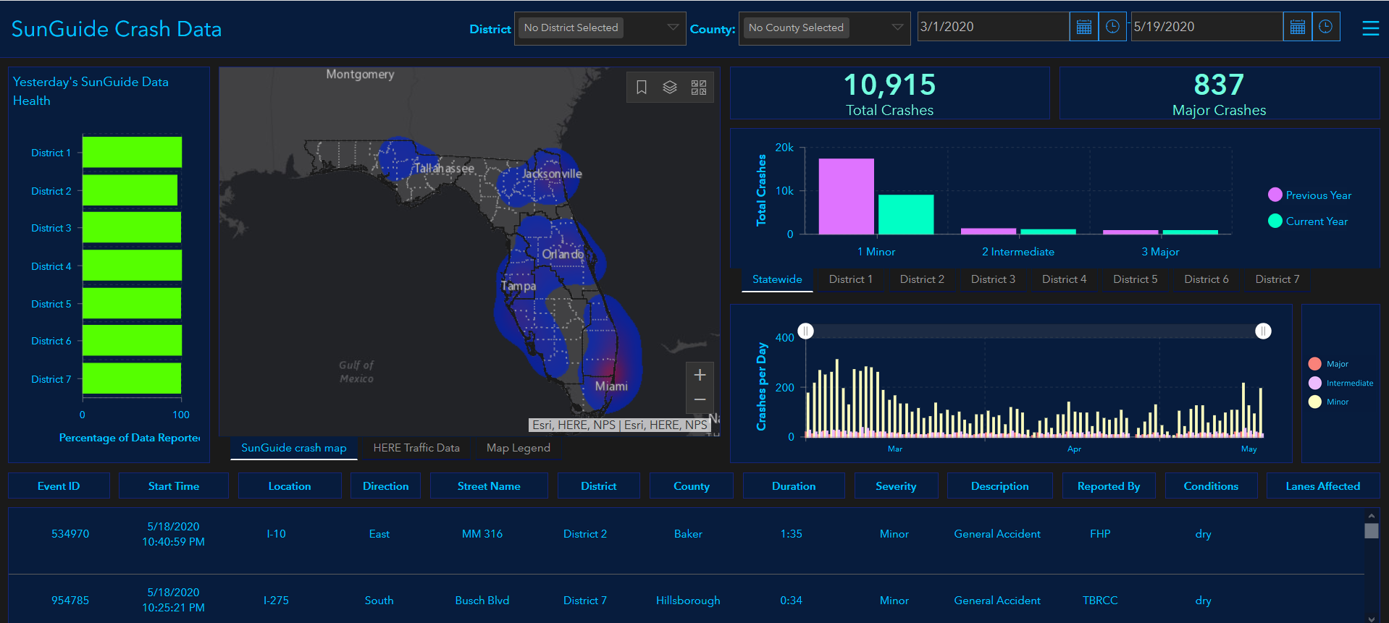
Dashboards
Notes:
Statewide Crash and Traffic Volumes presented by Christine at a recent ITSWG meeting (as well as FHWA).
First use of this data will be to implement a more robust backend for the dashboards.

Slide 18
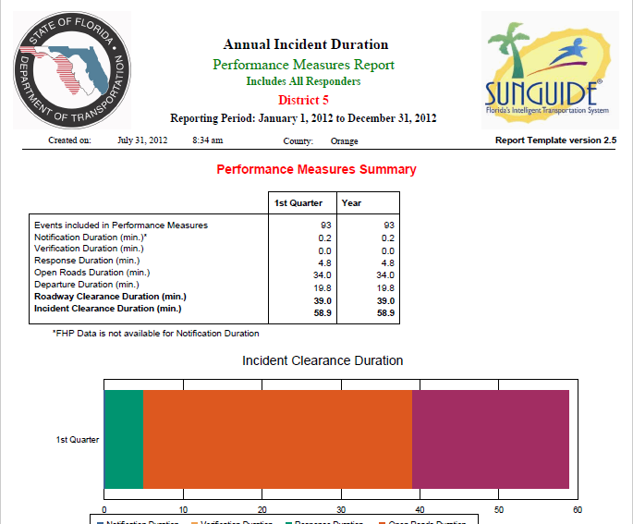
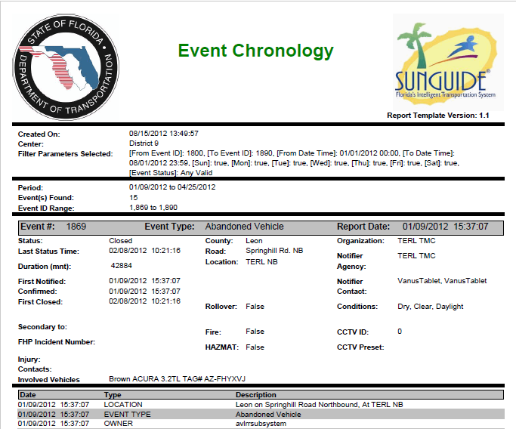
Centralized SunGuide Reports
Notes:
We plan to store event data in the same tables used by SunGuide, so the same Crystal Reports templates should work.
QAR report depends on DMS data that isn’t part of the RITIS feed – it’s something that RITIS has also requested

Slide 19
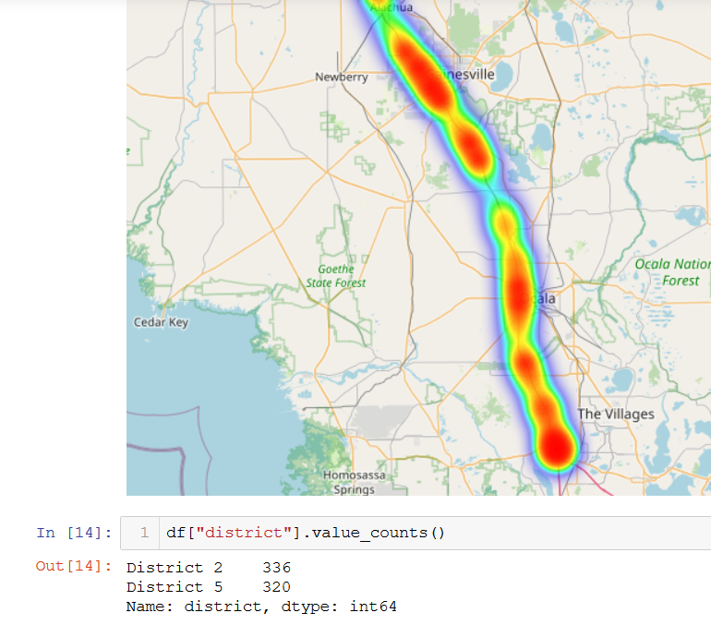
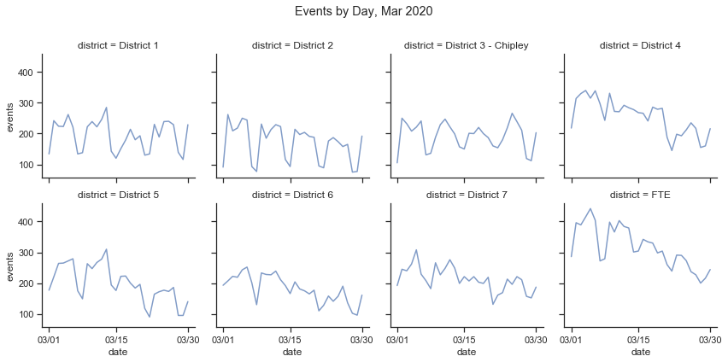






Analytics
Open-source tools
Notes:
* Comparison between districts
* Look at roadways that span districts

Slide 20
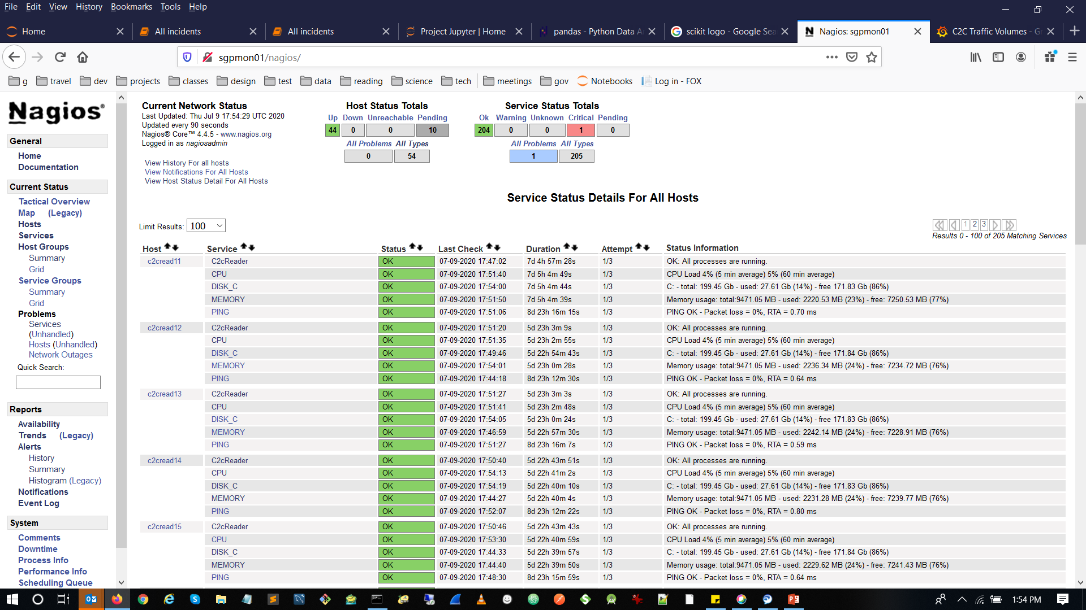
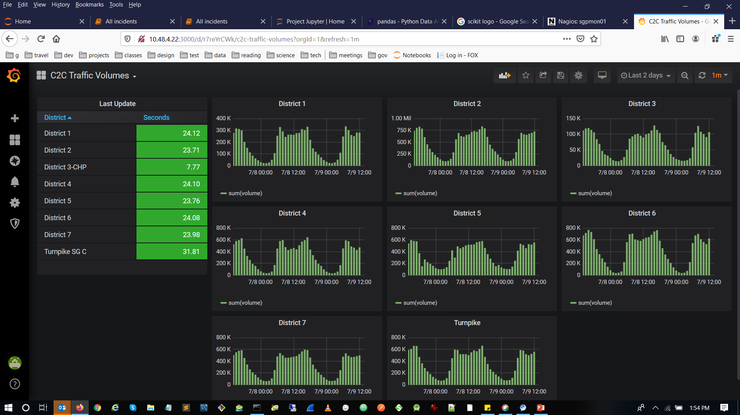
Monitoring
Notes:
Existing monitoring already helps the CO become aware of outages that impact SunGuide. We’re also interested in subsystem and driver level uptime (we’ll be getting that in R8.0) and anything else that can help us make SunGuide better or more useful to the districts.

Slide 21
Next Steps
CO to prep environment and follow up with email to districts
Districts to install second instance of Data Archive for RITIS (DAR) process
  Shouldn’t take more than an hour – no downtime or impact on operations
  Open Jira issue to coordinate with SwRI

Slide 22
Coordination?
Dashboards
Storage
Analytics
Notes:
Maybe a monthly meeting where districts can present what they’re doing with SunGuide data, discuss problems and solutions related to managing SunGuide data, etc.

Slide 23
QUESTIONS?
Christine Shafik, P.E., FDOT
Christine.shafik@dot.state.fl.us

Slide 24
Enhancement #1: SG-4815 - Response plans should use Congestion Tail if available
Tucker Brown, SwRI

Slide 25
Current Situation
Issue: EM templates always use the Event Location to populate DMS messaging, even if the event has defined congestion.
Proposed Enhancement
  When choosing the location to use as the basis for DMS signage, the Tail Location should be used, if set.
  This would be configurable at an installation level
  Note: The usefulness of this may depend on your template and messaging
    “Congestions X miles ahead” would work when using the tail location.
    “Crash ahead at Test Blvd” would probably want to use the primary location.

Slide 26
Estimate: $3k
Potential Release: Post 8.0

Slide 27
QUESTIONS?

Slide 28
VOTE NOW
Select the link for:
Enhancement #1: SG-4815: Response plans should use Congestion Tail if available

Slide 29
Enhancement #2: SG-4527 – Operators requesting to have data sort feature added
Tucker Brown

Slide 30
Issue and Proposed Enhancement
Issue:
  When multiple organizations are running operations from a single installation (Chipley and Pensacola), there is a need to split reporting to isolate the individual centers.
  This is done by setting the Organization parameter of the event so it can filter in the reports, but this is a manual process and could be lead to errors.
Proposed Enhancement
  Add a way to associate a user and organization, and default the event to the Organization assigned to user.
  Changes to reports

Slide 31
Estimate: $8k
Potential Release: Post 8.0

Slide 32
QUESTIONS?

Slide 33
VOTE NOW
Select the link for:
Enhancement #2: SG-4527: Operators requesting to have data sort feature added

Slide 34
Enhancement #3: SG-4562 – Nearest camera for SPARR created events
Tucker Brown

Slide 35
Issue and Proposed Enhancement
Issue: When creating an event from the Operator Map, the nearest camera is set. When creating an event from AVL, the nearest camera is NOT set. This action is currently being performed by the map itself.
Proposed Enhancement
  Modify EM to get the list of cameras and set the nearest camera for both Map created events, AVL created events, or 3rd party created events.

Slide 36
Estimate: $8k
Potential Release: Post 8.0

Slide 37
QUESTIONS?

Slide 38
VOTE NOW
Select the link for:
Enhancement #3: SG-4562: Nearest camera for SPARR created events

Slide 39
Enhancement #4: SG-2510 – Indicate removed items in Current Response Plan list prior to plan activation
Tucker Brown

Slide 40
Issue and Proposed Enhancement
Issue: When a response plan item is removed from a previously activated Current Plan, the Current Plan no longer reflects roadway conditions
Proposed Enhancement
  Indicate that the response plan item is set to be removed, but don’t remove it from the Current Plan until the plan is reactivated

Slide 41
Estimate: $13k
Potential Release: Post 8.0

Slide 42
QUESTIONS?

Slide 43
VOTE NOW
Select the link for:
Enhancement #4: SG-2510: Indicate removed items in Current Response Plan list prior to plan activation

Slide 44
Enhancement #5: SG-564 –
Remove List Options without Deleting
Tucker Brown

Slide 45
Issue
Most devices do not have the ability to “Cease Use” the device (Delete the device without deleting the reference in the system)
Some configurations are stored in DA but not all
EM does “Cease Use” most things but not all
Once a device/location is “deleted”, seeing the old configurations or running reports against those devices is no longer possible

Slide 46
Proposed Solution
Make all objects in the system persistent and only “Cease Use” them as opposed to delete.
This is a large change, so it would be done in stages
  Phase 1: AVL and the rest of EM
  Phase 2: Core Devices (CCTV, DMS, TSS)
  Phase 2: Modify reporting to allow reporting on cease use devices and EM objects
  Phase 3: All other devices types

Slide 47
Estimate for ONLY phase 1: $85k
Potential Release: Post 8.0

Slide 48
QUESTIONS?

Slide 49
VOTE NOW
Select the link for:
Enhancement #5: SG-564: Remove List Options without Deleting

Slide 50
Enhancement #6: SG-4084 –
On Ramp Backup Event Type
Tucker Brown

Slide 51
Issue and Proposed Enhancement
Issue: There is currently an event type for “Off Ramp Backup” but nothing for “On Ramp Backup”
Proposed Enhancement
  Add “On Ramp Backup” as a statewide event type
    Should this be included in performance measures?

Slide 52
Estimate: $7k
Potential Release: Post 8.0

Slide 53
QUESTIONS?

Slide 54
VOTE NOW
Select the link for:
Enhancement #6: SG-4084: On Ramp Backup Event Type

Slide 55
Enhancement #7: SG-3499 - Reporting "Ramp Closed" for Different Lane Mappings
Tucker Brown

Slide 56
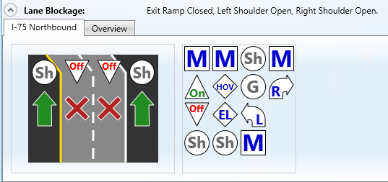
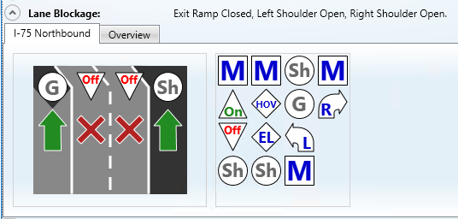
Issue and Current Behavior
Issue: Initial issue reports different lane mappings result in different Lane Blockage description for “Closed” situations however that appears to be resolved.
Current Behavior
  Lanes still reports a Exit Ramp Closed but Shoulders Open. Should this be “Exit Ramp Closed”?

Slide 57
Proposed Solution
Districts were split on desired behavior
Configuration Option between “Exit Ramp Closed” and “Exit Ramp Closed, Left Shoulder Open, Right Shoulder Open”

Slide 58
Estimate: $9k
Potential Release: Post 8.0

Slide 59
QUESTIONS?

Slide 60
VOTE NOW
Select the link for:
Enhancement #7: SG-3499: Reporting "Ramp Closed" for Different Lane Mappings

Slide 61
Enhancement #8: SG-3335 - Alert the operator when a travel time is double (or some other ratio) the free flow travel time
Tucker Brown

Slide 62
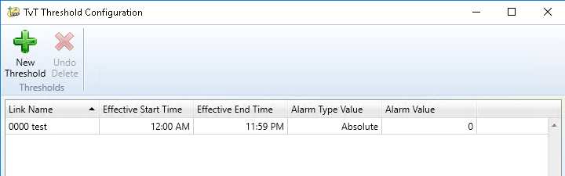
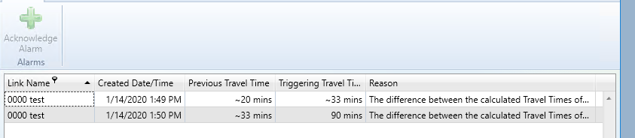
Issue and Current Behavior
Issue: There is no mechanism to alert when a travel time is very slow. Up to the operator to notice when travel times are high.
Current Behavior
  There is a concept of travel time alerts. Users configure the travel time and either a relative or percentage change from the last time the travel time was calculated.

Slide 63
Proposed Enhancement
Incorporate historical TSS times from Tennessee for TSS links to calculate a travel time for comparison
Incorporate IDS alarms that trigger based on the threshold with a recovery

Slide 64
Estimate: $25k
Potential Release: Post 8.0

Slide 65
QUESTIONS?

Slide 66
VOTE NOW
Select the link for:
Enhancement #8: SG-3335: Alert the operator when a travel time is double (or some other ratio) the free flow travel time

Slide 67
Enhancement #9: SG-2364 – Log username of user that changes device status
Tucker Brown

Slide 68
Issue and Proposed Enhancement
Issue: Device Changes are logged in the database but the user (or system) that made the change is not logged to the database.
Proposed Enhancement
  Add a username column to the database and log the user or the subsystem that makes a status change.

Slide 69
Estimate: $16k
Potential Release: Post 8.0

Slide 70
QUESTIONS?

Slide 71
VOTE NOW
Select the link for:
Enhancement #9: SG-2364: Log username of user that changes device status

Slide 72
Enhancement #10: SG-4559 – Add Ability to Filter IDS Alerts on Per User Group Basis
Tucker Brown

Slide 73
Issue and Proposed Enhancement
Current Situation
  With Release 8.0, the system will be able to define regions
Proposed Enhancement
  Incorporate the ability to set up IDS filters for user groups
    Chooses a region and, optionally, a roadway

Slide 74
Estimate: $26k
Potential Release: Post 8.0

Slide 75
QUESTIONS?

Slide 76
VOTE NOW
Select the link for:
Enhancement #10: SG-4559: Add Ability to Filter IDS Alerts on Per User Group Basis

Slide 77
Enhancement #11: SG-3800 – Reporting of more accurate locations
Tucker Brown

Slide 78
Issue and Proposed Enhancement
Issue: EM Location isn’t always an accurate location for an event
Proposed Enhancement: Associate an additional (and optional) “accurate” location with each event

Slide 79
Capturing Accurate Locations
Operator “Place on Map”
FHP CAD
  Multiple locations sent
  Last location is not always the best
SPARR

Slide 80
Estimate: $8k
Potential Release: Post 8.0

Slide 81
QUESTIONS?

Slide 82
VOTE NOW
Select the link for:
Enhancement #11: SG-3800: Reporting of more accurate locations

Slide 83
Enhancement #12: SG-4967 – SunGuide VDS data drift
Tucker Brown

Slide 84
Issue and Proposed Enhancement
Issue: Fractional parts of time are lost each poll cycle due to the process of reading the data, sending out updates, and then resetting the poll cycle timer.
Proposed Enhancement:
  Set the timer to constantly reoccur at the exact interval
    Potential for backlog
      Should be a low risk now due to reliable, fast networks

Slide 85
Estimate: $7k
Potential Release: Post 8.0

Slide 86
QUESTIONS?

Slide 87
VOTE NOW
Select the link for:
Enhancement #12: SG-4967: SunGuide VDS data drift

Slide 88
Open Discussion
Jay Williams, P.E., FDOT
CMB Chairman

Slide 89
Review Action Items
Jay Williams, P.E., FDOT
CMB Chairman

