Slide 1


Welcome and Call for Quorum
Jay Williams, P.E., FDOT
CMB Chairman

Slide 2
Agenda
Time | Item | Lead
1:00 – 1:05 | Welcome and Call for Quorum | Jay Williams
1:05 – 1:10 | Previous Meeting Recap & Action Item Review | Jay Williams
1:10 – 1:30 | SunGuide User Management Audit | Christine Shafik
1:30 – 1:50 | SunGuide Software Update | Christine Shafik
1:50 – 2:10 | Device Integrations | Mark Dunthorn
2:10 – 2:20 | Blank Out Signs Integration | Jeremy Dilmore
2:20 – 2:40 | Enhancement #1 SG-564: Remove List Options without Deleting (VOTE) | Tucker Brown

Slide 3
Agenda
Time | Item | Lead
2:40 – 2:50 | Enhancement #2 SG-3499: Reporting "Ramp Closed“ (Blocked) for Different Lane Mappings (VOTE) | Tucker Brown
2:50 – 3:00 | Enhancement #3 SG-3488: DMS priority in Response Plan changes all DMS sign messages (VOTE) | Tucker Brown
3:00 – 3:10 | Enhancement #4 SG-2570: Allow comments to be added to closed events without reopening (VOTE) | Tucker Brown
3:10 – 3:20 | Enhancement #5 SG-5376: Center-to-Center (C2C) Add Nearest Camera Information (VOTE) | Tucker Brown
3:20 – 3:30 | Enhancement #6 SG-4876: Agency Contact Config (VOTE) | Tucker Brown
3:30 – 3:40 | Enhancement #7 SG-5251: Wrong Way Device – Incorrect images displayed in SunGuide with Alert (VOTE) | Tucker Brown

Slide 4
Agenda
Time | Item | Lead
3:40 – 3:50 | Enhancement #8 SG-3429: Reliable DAR to RITIS Interface Using a Message Queueing Product (VOTE) | Mark Dunthorn
3:50 – 3:55 | Open Discussion | Jay Williams
3:55 – 4:00 | Review Action Items | Jay Williams

Slide 5
Previous Meetings Recap and Action Items Review
Jay Williams, P.E., FDOT
CMB Chairman

Slide 6
Previous Meeting Action Items
Owner | Action Item
Central Office | Three enhancements were tabled for future ITS Working Group meeting. Enhancements 5, 6 & 7.
Central Office | Any topic to be added to the next CMB meeting agenda should be sent to Jay Williams and he will work with Christine Shafik to get a new topic added.
Central Office | Mark Dunthorn to work with Christine Shafik to send out an email asking that all Districts submit their databases.
District 5 | Jeremy Dilmore brought up the possibility of having the Dashboard meeting. Christine agreed that it will be on the Agenda for the next ITS Working Group meeting on August 12.
Central Office | Mark Dunthorn to run two instances of separate nodes for RITIS and measure load.

Slide 7
QUESTIONS?
Jay Williams, P.E., FDOT
Jay.Williams@dot.state.fl.us

Slide 8
SunGuide User Management Audit
Christine Shafik, P.E., FDOT

Slide 9
Issue
State Auditor General has requested detailed information on SunGuide “User Access Privilege Controls”
AG Report 2017-121, finding #14 recommends that the department “ensure that periodic reviews of SunGuide user access privileges are performed” and that we “develop a methodology to retain historical user access privilege records”

Slide 10
AG Questions
AG submitted a set of 8 questions 3/23/2020
Central Office forwarded these questions to the districts 3/25/2020
Central Office collated district responses and forwarded to the AG 4/3/2020

Slide 11
AG Response
User access and permissions history are not consistently available

Slide 12
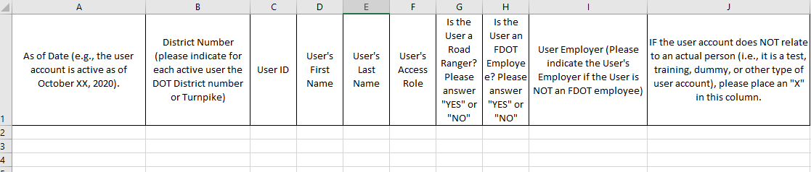
Next Steps
Contact Person per District.
AG is requesting all the districts to fill out two templates for their Audit:
1- Current Active SunGuide User List Template
Notes:
CO will work with AG and Districts to develop a process for ensuring compliance while minimizing required district effort

Slide 13
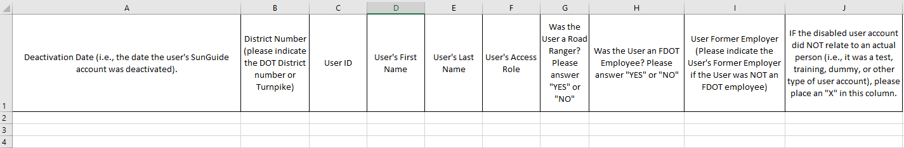
Next Steps
2- Deactivated SunGuide User Accounts Template
Notes:
CO will work with AG and Districts to develop a process for ensuring compliance while minimizing required district effort

Slide 14
QUESTIONS?
Christine Shafik, P.E., FDOT
Christine.Shafik@dot.state.fl.us

Slide 15
SunGuide Software Update
Christine Shafik, P.E., FDOT

Slide 16
Release 7.2
Released 10/5/19
Currently deployed in all districts
  Release 7.1.2 no longer supported
Hotfix 2 testing completed and released on 5/28/20
5114, 5115, 5119, 5120, 5123, 5125 ,5130, 5134, 5135, 5145, 5147, 5153, 5200 ,5201 ,5218 ,5220, 5223
Hotfix 3 testing completed and released on 8/18/20
5016, 5141, 5315, 5317, 5321, 5328, 5330, 5331, 5337, 5344, 5353, 5369, 5380

Slide 17
Release 8.0
33 issues – testing in process
RISC and RCA – testing in process

Slide 18
Post 8.0 Release
CMB January 2021 – Cutoff for Post 8.0 Release enhancements

Slide 19
QUESTIONS?
Christine Shafik, P.E., FDOT
Christine.Shafik@dot.state.fl.us

Slide 20
Device Integrations
Mark Dunthorn

Slide 21
New Device Integrations (WWD)
  SG-5327: TrafficVision
    Camera AI based Incident detection, Alert with Images
  SG-5313: K&K WWD
    Field device, REST API, Alert with Images
  SG-5469: ISS WWD Device
    Field device, Web API, Alert with Images
  SG-5303: M.H. Corbin WWD Device
    Field device, Multiple sensors, Alert with Images
  SG-5470: Carmanah
    Field device, SOAP API, Alert with Images
10/27/2020

Slide 22
QUESTIONS?
10/27/2020

Slide 23
BOS
Blank Out Signs Integration
Jeremy Dilmore

Slide 24
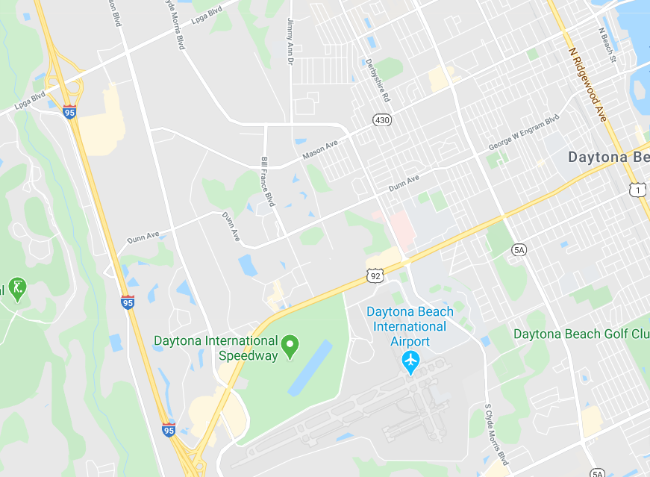

BOS
General purpose of BOS are to redirect traffic during planned or unplanned traffic events
X

Slide 25
BOS
Uses of BOS
  Arterial route alternative routing
    Coordinated activation of multiple BOS using SunGuide’s response plan functionality
  Warnings to over-height vehicles approaching bridges
    Automated activation to warn traveling public of potentially dangerous situations
    Permit Application System (PAS) and FOX system can provide over-height vehicle information
  Parking availability
    Automatically/manually activate signs to direct incoming traffic to parking facilities

Slide 26
BOS
Changes in SunGuide
  Communication with BOS devices
  Configuration of BOS plans, which may also use beacons
  Integration of PAS/FOX systems for over-height vehicle data
  Integration into EM’s Response Generation
  Additional Conceptual information available in
  BOS Integration Document

Slide 27
QUESTIONS?
Jeremy Dilmore
Jeremy.Dilmore@dot.state.fl.us

Slide 28
Enhancement #1: SG-564 – Remove List Options without Deleting
Tucker Brown

Slide 29
Issue
Most devices do not have the ability to “Ceased Use” the device (Delete the device without deleting the reference in the system)
Some configurations are stored in DA but not all
EM does “Ceased Use” most things but not all
Once a device/location is “deleted”, seeing the old configurations or running reports against those devices is no longer possible

Slide 30
Proposed Solution
Make all objects in the system persistent and only “Cease Use” them as opposed to delete.
This is a large change, to be done in stages
  Phase 1: Core Devices (CCTV, DMS, TSS) with SAA for users
  Phase 1: Modify reporting to allow reporting on “Ceased Use” devices and EM objects
  Phase 2: AVL and the rest of EM
  Phase 3: All other devices types

Slide 31
LOE
Estimate for phase 1: $146k
  CCTV, DMS, TSS
  SAA
  Reporting on Ceased Use devices
Estimate for phase 2: $85k
  AVL and EM
Estimate for phase 3: $207k
  HAR, RMS, RWIS, SB, Beacon, TPS, MLS, GPIO, IDS, VS, CVS, TVT
  Phase 3 could be broken into multiple phases if needed.
Release: Post 8.0

Slide 32
QUESTIONS?

Slide 33
VOTE NOW
Select the link for: https://www.questionpro.com/t/ABslzZjVjY
Enhancement #1 Phase(1): SG-564 – Remove List Options
without Deleting
CCTV, DMS, TSS
Reporting on Ceased Use devices

Slide 34
VOTE NOW
Select the link for: https://www.questionpro.com/t/ABslzZjVkT
Enhancement #1 Phase (2): SG-564 – Remove List Options
without Deleting
AVL, EM, and SAA

Slide 35
VOTE NOW
Select the link for: https://www.questionpro.com/t/ABslzZjVkU
Enhancement #1 Phase (3): SG-564 – Remove List Options
without Deleting
HAR, RMS, RWIS, SB, Beacon, TPS, MLS, GPIO, IDS, VS, CVS, TVT

Slide 36
Enhancement #2: SG-3499 - Reporting "Ramp Closed“ (Blocked) for Different Lane Mappings
Tucker Brown

Slide 37
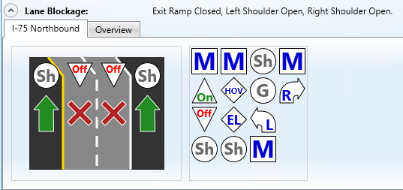
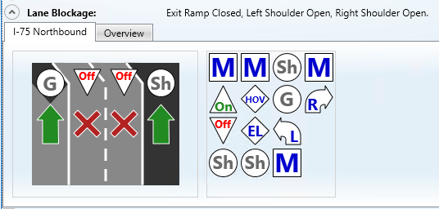
Issue and Current Behavior
Issue: Initial issue reports different lane mappings result in different Lane Blockage description for “Closed” situations however that appears to be resolved.
Current Behavior
  Lanes still reports a Exit Ramp Closed but Shoulders Open.

Slide 38
Proposed Solution
Discussed at the ITS Working Group
There was a collective consensus that ‘All Lanes Blocked’ and ‘All Ramps Blocked’ would be used, even if the shoulders would still be open.

Slide 39
LOE
Estimate: $4.5k
Release: Post 8.0

Slide 40
QUESTIONS?

Slide 41
VOTE NOW
Select the link for: https://www.questionpro.com/t/ABslzZjVkf
Enhancement #2: SG-3499 - Reporting "Ramp Closed“ (Blocked) for Different Lane Mappings

Slide 42
Enhancement #3: SG-3488: DMS priority in Response Plan changes all DMS sign messages
Tucker Brown

Slide 43
Proposed Enhancement
  When a user multi-selects DMS to edit, there are multiple actions they can take.
    Clicking on the button to modify the message will sync all messages and priorities of the DMS signs (Current Behavior)
    There will be a context menu icon (right click) which will allow the user to set the priority of the message without affecting other aspects of the message, like the message itself.
    There will be a context menu icon (right click) which will allow the user to set the message of the message without affecting other aspects of the message, like the priority.

Slide 44
LOE
Estimate: $5k
Release: Post 8.0

Slide 45
QUESTIONS?

Slide 46
VOTE NOW
Select the link for: https://www.questionpro.com/t/ABslzZjVkl
Enhancement #3: SG-3488: DMS priority in Response Plan changes all DMS sign messages

Slide 47
Enhancement #4: SG-2570: Allow comments to be added to closed events without reopening
Tucker Brown

Slide 48
Current Situation and Proposed Enhancement
While comments can be added via audit, there is sometimes a need to add a comment to a newly closed issue that is still in the event list, without reopening the event.
Proposed Enhancement
  Allow comments to be added to Closed events while they are still on the event list (1 hour after closure).
10/27/2020

Slide 49
LOE
Estimate: $2k
Release: Post 8.0

Slide 50
QUESTIONS?
10/27/2020

Slide 51
VOTE NOW
Select the link for: https://www.questionpro.com/t/ABslzZjVk2
Enhancement #4: SG-2570: Allow comments to be added to closed events without reopening

Slide 52
Enhancement #5: SG-5376: Center-to-Center (C2C)
Add Nearest Camera Information
Tucker Brown

Slide 53
Current Situation
SunGuide already has functionality to auto-select the nearest CCTV
  Operators can modify
Event information and camera/stream information is reported via C2C
  No connection between the two
10/27/2020

Slide 54
Enhancement
Add closest camera to C2C Command Channel (cmdEventCmdReq) and C2C Status Channel (eventData)
Allows 511 to associate the nearest camera to the event for the public
10/27/2020

Slide 55
LOE
Estimate: $3k
Release: Post 8.0

Slide 56
QUESTIONS?
10/27/2020

Slide 57
VOTE NOW
Select the link for: https://www.questionpro.com/t/ABslzZjVlB
Enhancement #5: SG-5376: Center-to-Center (C2C)
Add Nearest Camera Information

Slide 58
Enhancement #6: SG-4876: Agency Contact Config
Tucker Brown

Slide 59
Issue and Proposed Enhancement
Issue: When a new device (or one that has never produced an alert) sends an alert, EM needs to make a contact based on the device for the event. This fails if the user handling the alert doesn’t have permission to create contacts.
Proposed Enhancement
  Allow the system to add the contact as an Administrator so that this will succeed and the user can continue to manage the event, even though they do not have permission to create contacts.
10/27/2020

Slide 60
LOE
Estimate: $2k
Release: Post 8.0

Slide 61
QUESTIONS?
10/27/2020

Slide 62
VOTE NOW
Select the link for: https://www.questionpro.com/t/ABslzZjVlF
Enhancement #6: SG-4876: Agency Contact Config

Slide 63
Enhancement #7: SG-5251 Wrong Way Device – Incorrect images displayed in SunGuide with Alert
Tucker Brown

Slide 64
Proposed Enhancement
Issue: Only one alert can exist on a WWD device at any time. If another alert comes in, the images are overwritten with the newer ones, but no new alert is generated.
Proposed Solutions
  Allow multiple alerts from the same device
    Would need to make the images unique filenames and store them
    Will overwrite files once the alert is resolved so no long-term storage
10/27/2020

Slide 65
LOE
Estimate: $10k
Release: Post 8.0

Slide 66
QUESTIONS?
10/27/2020

Slide 67
VOTE NOW
Select the link for: https://www.questionpro.com/t/ABslzZjVlX
Enhancement #7: SG-5251 Wrong Way Device – Incorrect images displayed in SunGuide with Alert

Slide 68
Enhancement #8: SG 3429 - Reliable DAR to RITIS Interface Using a Message Queueing Product
Mark Dunthorn

Slide 69
Objectives
Replace FTP as data exchange mechanism to eliminate data transfer issues.
Implement a new interface that is reliable, persistent, and scalable, and that allows for easier/quicker forensic analysis.
A REST API is a better fit to their development environment.
Sending updates in real-time rather than batched every minute will allow RITIS to develop tools that depend on real-time data.
10/27/2020

Slide 70
RITIS Changes
RITIS will implement REST API service to ingest data from FDOT.
This service will provide two or more endpoints per district.
  Detector data endpoint that will consist of two endpoints
    One for detector inventory
    One for detector data
  Event data endpoint
  Additional endpoints for other data as needed -- DMS
This service will accept XML data in current SunGuide XML schema format.
Data will be queued by the service to be processed by RITIS loaders that will read from the service queues.
10/27/2020

Slide 71
SunGuide Changes
Raw data reads would be forwarded on to RITIS as XML
  No zip files
For backlogs (RITIS or network downtime)
  Raw files would be written to disk
  After some amount of downtime, files would be zipped
  Zip files could potentially be uploaded to FTP site or pushed to RITIS in another way if defined in the new interface.
  Email for not being able to upload is available now and would still be available.
10/27/2020

Slide 72
LOE
Estimate: $17k
Release: Post 8.0

Slide 73
QUESTIONS?
10/27/2020

Slide 74
VOTE NOW
Select the link for: https://www.questionpro.com/t/ABslzZjVle
Enhancement #8: SG 3429 - Reliable DAR to RITIS Interface Using a Message Queueing Product

Slide 75
Open Discussion
Jay Williams, P.E., FDOT
CMB Chairman

Slide 76
Review Action Items
Jay Williams, P.E., FDOT
CMB Chairman

