Slide 1


Welcome and Call for Quorum
Jay Williams, P.E., FDOT
CMB Chairman

Slide 2
Agenda
Time | Item | Lead
1:00 – 1:05 | Welcome and Call for Quorum | Jay Williams
1:05 – 1:10 | Previous Meeting Recap & Action Item Review | Jay Williams
1:10 – 1:30 | SunGuide Software Update | Christine Shafik
1:30 – 1:40 | Enhancement #1 SG-3338 – Allow floodgates to be scheduled through SAS (VOTE) | Tucker Brown
1:40 – 1:50 | Enhancement #2 SG-5278 – Blank Out Signs Integration (VOTE) | Tucker Brown
1:50 – 2:00 | Enhancement #3 SG-5359 – Wrong Way Driver Alert (VOTE) | Tucker Brown
2:00 – 2:10 | Enhancement #4 SG-5156 – Timestamp Logic Pop-Up Warnings (VOTE) | Tucker Brown

Slide 3
Agenda
Time | Item | Lead
2:10 – 2:20 | Enhancement #5 SG-3336 – Automatically select associated event in alert handling dialog (VOTE) | Tucker Brown
2:20 – 2:30 | Enhancement #6 SG-3925 – Add assigned Beat to Road Ranger information in Event Reports (VOTE) | Tucker Brown
2:30 – 2:40 | Enhancement #7 SG-5410 – Question about new Executive Notification (VOTE) | Tucker Brown
2:40 – 2:50 | Enhancement #8 SG-4758 – RWIS Alerts need the alert type and value added (VOTE) | Tucker Brown
2:50 – 3:00 | Enhancement #9 SG-5170 – Ability to filter roadway in Waze Alert (VOTE) | Tucker Brown
3:00 – 3:10 | Enhancement #10 SG-3143 – Status Logger Filters (VOTE) | Tucker Brown

Slide 4
Agenda
Time | Item | Lead
3:10 – 3:20 | Enhancement #11 SG-4209 – Use polyline instead of a single point for road closures (VOTE) | Tucker Brown
3:20 – 3:30 | Enhancement #12 SG-3429 – Reliable DAR to RITIS Interface Using a Message Queueing Product (VOTE) | Tucker Brown
3:30 – 3:40 | SG-5300 - Access to district SunGuide data from the Central Office | Mark Dunthorn
3:40 – 3:55 | Open Discussion | Jay Williams
3:55 – 4:00 | Review Action Items | Jay Williams

Slide 5
Previous Meetings Recap and Action Items Review
Jay Williams, P.E., FDOT
CMB Chairman

Slide 6
Previous Meeting Action Items
Owner | Action Item
Central Office | Records retention – CO to determine legal requirements to comply with the Florida statutes
Central Office | Questions regarding RITIS interface enhancement: Does RITIS support compression? Determine bandwidth requirements. What does recovery look like? How will administrators enable/disable sending updates/recovery?

Slide 7
QUESTIONS?
Jay Williams, P.E., FDOT
Jay.Williams@dot.state.fl.us

Slide 8
SunGuide Software Update
Christine Shafik, P.E., FDOT

Slide 9
Release 7.2
Currently deployed in all districts
Hotfix 4 testing completed and released on 1/11/21
  Many fixes included
  Review Read-Me file
  Event Management / Operator Map fixes

Slide 10
Release 8.0
Released to Districts - 12/17/2020
District planned install dates needed

Slide 11
Release 8.0 Hotfix 1
Hotfix 1 Released – 1/22/21
  Included 7.2 issues
  Release 8.0 issues:
    SG-5368 Silver Alert Input Screen
    SG-3010 Error Messages with Object Ref.
    SG-5256 GPIO DMS Message Actions
    SG-5264 Location information not populating
    SG-5555 Spanish Floodgate Spellcheck
    SG-5556 Workzone status change in Chronology

Slide 12
QUESTIONS?
Christine Shafik, P.E., FDOT
Christine.shafik@dot.state.fl.us

Slide 13
Enhancement #1: SG-3338 – Allow floodgates to be scheduled through SAS
Tucker Brown

Slide 14
Issue and Proposed Enhancement
Issue: All floodgates are manually entered at the time they are needed.
Proposed Enhancement
  Allow users to schedule floodgates to post to 511
  Start time would post the floodgate and the end time would pull the floodgate down from 511.

Slide 15
LOE
Estimate: $13k

Slide 16
QUESTIONS?

Slide 17
VOTE NOW
Select the link for: https://www.questionpro.com/t/ABslzZko0O
Enhancement #1: SG-3338 – Allow floodgates to be scheduled
through SAS

Slide 18
Enhancement #2: SG-5278 – Blank Out Signs Integration
Tucker Brown

Slide 19
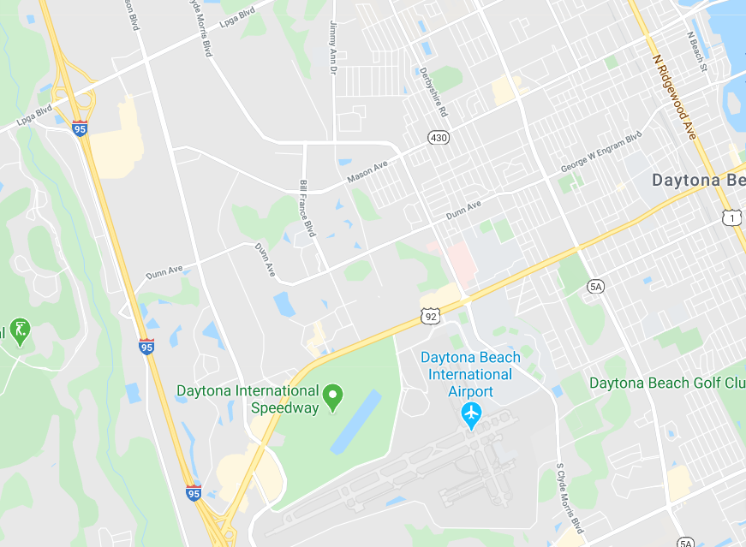

BOS
General purpose of BOS are to redirect traffic during planned or unplanned traffic events
X

Slide 20
BOS
Uses of BOS
  Arterial route alternative routing
    Coordinated activation of multiple BOS using SunGuide’s response plan functionality
  Warnings to over-height vehicles approaching bridges
    Automated activation to warn traveling public of potentially dangerous situations
    Future permit Application System (PAS) and FOX system can provide over-height vehicle information
  Parking availability
    Automatically/manually activate signs to direct incoming traffic to parking facilities

Slide 21
BOS
Changes in SunGuide
  Communication with BOS and OHVD devices
  Configuration of BOS plans, which may also use beacons
  Integration into EM’s Response Generation
  Changes in Beacon Management

Slide 22
LOE
Estimate: $113k

Slide 23
QUESTIONS?

Slide 24
VOTE NOW
Select the link for: https://www.questionpro.com/t/ABslzZko1l
Enhancement #2: SG-5278 – Blank Out Signs Integration

Slide 25
Enhancement #3: SG-5359 – Wrong Way Driver Alert
Tucker Brown

Slide 26
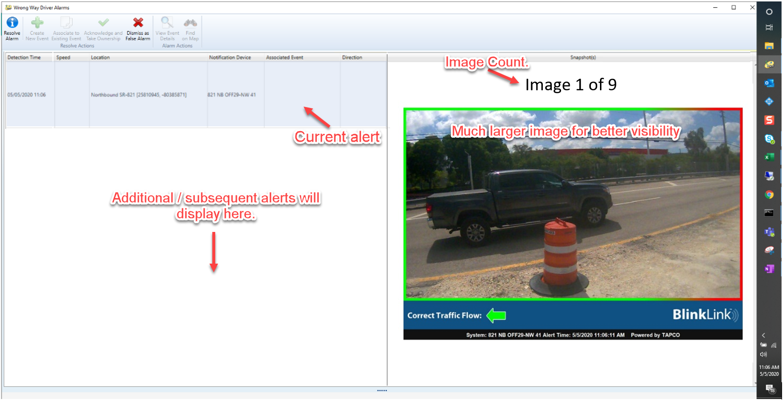
Proposed Change
Images will be displayed when the row is selected allowing for a larger view
Thumbnails of images will be available below the image

Slide 27
LOE
Estimate: $8k

Slide 28
QUESTIONS?

Slide 29
VOTE NOW
Select the link for: https://www.questionpro.com/t/ABslzZko1r
Enhancement #3: SG-5359 – Wrong Way Driver Alert

Slide 30
Enhancement #4: SG-5156 – Timestamp Logic
Pop-Up Warnings
Tucker Brown

Slide 31
Issue and Proposed Enhancement
Issue: In responder dialog, there are cases where operators are allowed to manually enter non-logical timestamps for responders
Proposed Enhancement
  Notify users of timestamps that may not make sense. Users can still save if appropriate
    Examples
      Arrive > Depart
      Depart with no Arrival
      Dates in the future
  Optional - can be disabled if not needed.

Slide 32
LOE
Estimate: $6k

Slide 33
QUESTIONS?

Slide 34
VOTE NOW
Select the link for: https://www.questionpro.com/t/ABslzZko10
Enhancement #4: SG-5156 – Timestamp Logic
Pop-Up Warnings

Slide 35
Enhancement #5: SG-3336 – Automatically select associated event in alert handling dialog
Tucker Brown

Slide 36
Current Situation and Proposed Enhancement
When handling an FHP update alert, the user is still required to pick the associated event, even if previously associated.
Proposed Enhancement
  Since the Event Id is already known, auto-select the event to allow a fast selection and association to the event.

Slide 37
LOE
Estimate: $2k

Slide 38
QUESTIONS?

Slide 39
VOTE NOW
Select the link for: https://www.questionpro.com/t/ABslzZko19
Enhancement #5: SG-3336 – Automatically select associated event in alert handling dialog

Slide 40
Enhancement #6: SG-3925 – Add assigned Beat to Road Ranger information in Event Reports
Tucker Brown

Slide 41
Current Situation
  Currently, vehicle is reported, but not the beat the Road Ranger was assigned to when the event occurred.
  Can currently choose the responding agency but can't filter that by Beat or specific vehicle.

Slide 42
Proposed Enhancement
  Add beat information to Event reports (Chronology, etc.)
  Add Road Ranger/Beat information to EM sort filters.

Slide 43
LOE
Estimate: $12k

Slide 44
QUESTIONS?

Slide 45
VOTE NOW
Select the link for: https://www.questionpro.com/t/ABslzZko2H
Enhancement #6: SG-3925 – Add assigned Beat to Road Ranger information in Event Reports

Slide 46
Enhancement #7: SG-5410 – Question about new Executive Notification
Tucker Brown

Slide 47
Executive Notification (current)
Operator who owns the event is the only one to be notified when an Executive Notification needs to be handled.
UI enforces consistency in format of the email and allows attachments
If users don’t have permission to send the email, authorization from a user with permission can be granted.

Slide 48
Concerns
Alert only visible to event owner (operators)
  Operators do not send EN so management through SunGuide may require unnecessary event ownership changes

Slide 49
Proposed Changes
Broadcast executive notifications to all users with permissions to edit.
  Widens the distribution
Configurable Option to EXCLUDE the event owner for distribution.

Slide 50
Concerns and Proposed Solution
Missing or ignoring the prompt may result in no EN being sent
  Example scenario: Operator enters a crash with right lane blocked. Enters an EN comment in error and dismisses. As the event progresses it is updated to an event meeting executive notification criteria – no EN pop-up
Proposed Solution
  Introduce an option to “Dismiss as false alarm” that will reset all timers so the next EN criteria that is met will be just like the 1st.

Slide 51
LOE
Estimate: $8k

Slide 52
QUESTIONS?

Slide 53
VOTE NOW
Select the link for: https://www.questionpro.com/t/ABslzZko2P
Enhancement #7: SG-5410 – Question about new Executive Notification

Slide 54
Enhancement #8: SG-4758 – RWIS Alerts need the alert type and value added
Tucker Brown

Slide 55
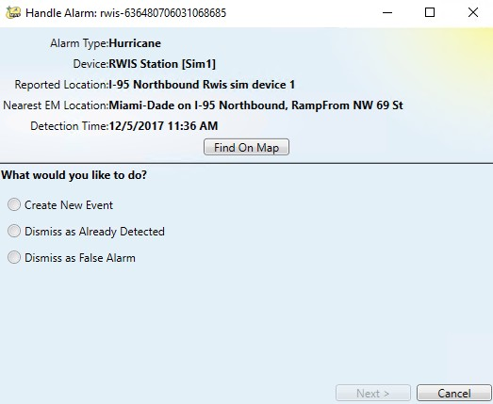
Issue
RWIS alerts can be configured on Wind, Temperature, Rain, etc.
Alerts does not currently tell you what criteria caused the alert.
Reported as “Weather”

Slide 56
Proposed Solution
Add both the field the alert was based on and the current value at the time of the alert.

Slide 57
LOE
Estimate: $2k

Slide 58
QUESTIONS?

Slide 59
VOTE NOW
Select the link for: https://www.questionpro.com/t/ABslzZko3j
Enhancement #8: SG-4758 – RWIS Alerts need the alert type and
value added

Slide 60
Enhancement #9: SG-5170 –
Ability to filter roadway in Waze Alert
Tucker Brown

Slide 61
Current Situation and Proposed Solution
The Waze process running at the TERL allows districts to whitelist the roadways where they would like to see alerts generated.
The system does not allow districts to pick which roadways where they DO NOT want to see alerts generated.
Proposed Enhancement
  Allow a blacklist of roadways so certain roadways can be filtered out.
  Districts would get to choose between a whitelist or a blacklist, but not both.

Slide 62
LOE
Estimate: $7k

Slide 63
QUESTIONS?

Slide 64
VOTE NOW
Select the link for: https://www.questionpro.com/t/ABslzZko62
Enhancement #9: SG-5170 – Ability to filter roadway in Waze Alert

Slide 65
Enhancement #10: SG-3143 –
Status Logger Filters
Tucker Brown

Slide 66
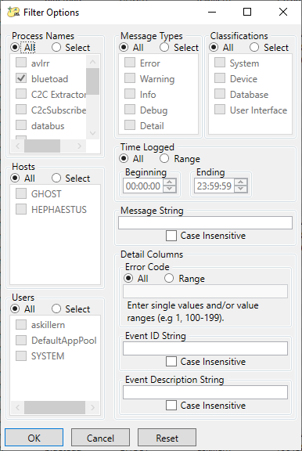
Issue and Proposed Enhancement
Issue: The filter window in Status Log Viewer items too small/hard to read, lacking “None” and additional options.
Proposed Enhancement
  Resize the selection box for the process names
  Add an additional filter option for “None”
  Add the ability to handle AND or OR queries

Slide 67
LOE
Estimate: $13k

Slide 68
QUESTIONS?

Slide 69
VOTE NOW
Select the link for: https://www.questionpro.com/t/ABslzZko7D
Enhancement #10: SG-3143 – Status Logger Filters

Slide 70
Enhancement #11: SG-4209 –
Use polyline instead of a single point for road closures
Tucker Brown

Slide 71
Polylines
Polyline ConOps was sent for review
Trying to achieve multiple goals as part of this effort
  Give operations the ability to put in events that contain multiple EM locations and track as part of one event
  Get events to show in the Waze feed.
    Waze requires a start and end point for all events
  Get events to show in the Waze closure feed
    Waze requires a start and end point for all events

Slide 72
Proposed Changes
Operator creates an event
  Have the option to turn the event into a polyline event if it is a full road closure
  Operator would set the start and end of the closure
  Software would pick up and automatically select all locations between the start and the end point
    Operator would be allowed to view the list of midpoints and deselect locations they might not need to publish
  Operator publishes message to 511 with full list of affected locations

Slide 73
Polylines for Waze
If an event is a single point (not a closure over the roadway), we have already asked the 511 team to create a second point within 50m in the direction of the event.
If an event is multiple EM locations, we will ask the 511 team to provide a list of points between the start point and end point.
This may move to SunGuide generating the points based on those discussions but this would all be automated with no operator input

Slide 74
LOE
Estimate: $40k

Slide 75
QUESTIONS?

Slide 76
VOTE NOW
Select the link for: https://www.questionpro.com/t/ABslzZko7O
Enhancement #11: SG-4209 – Use polyline instead of a single point for road closures

Slide 77
Enhancement #12: SG-3429 –
Reliable DAR to RITIS Interface Using a Message Queueing Product
Tucker Brown

Slide 78
Objectives
Replace FTP as data exchange mechanism to mitigate issues of unreliable data transfer.
Implement a new interface that is reliable, persistent, and scalable, and that allows for easier/quicker forensic analysis.
A REST API is a better fit to their development environment.
Sending updates in real-time rather than batched every minute will allow RITIS to develop tools that depend on real-time data.

Slide 79
RITIS Changes
RITIS will implement REST API service to ingest data from FDOT.
This service will provide two or more endpoints per district.
  Detector data endpoint that will consist of two endpoints
    One for detector inventory
    One for detector data
  Event data endpoint
  Additional endpoints for other data as needed (e.g. DMS)
This service will accept XML data in current SunGuide XML schema format.
Data will be queued by the service to be processed by RITIS loaders that will read from the service queues.

Slide 80
SunGuide Changes
Raw data reads would be forwarded on to RITIS as XML
  No zip files
For backlogs (RITIS or network downtime)
  Raw files would be written to disk
  After some amount of downtime, files would be zipped
  Zip files could potentially be uploaded to FTP site or pushed to RITIS in another way if defined in the new interface.
  Email for not being able to upload is available now and would still be available.

Slide 81
SunGuide Changes
Compression would be implemented for updated files
Options for the district to pause sending to RITIS and archive to the local disk.
  District can then resume and upload the backlog.

Slide 82
LOE
Estimate: $28k

Slide 83
QUESTIONS?

Slide 84
VOTE NOW
Select the link for: https://www.questionpro.com/t/ABslzZko7V
Enhancement #12: SG-3429 – Reliable DAR to RITIS Interface Using a Message Queueing Product

Slide 85
SG-5300 - Access to district SunGuide data from the Central Office
Mark Dunthorn, HNTB

Slide 86
CO Products
Dashboards
  Traffic Data, Crash, and ESU
  TIM and AVL/RR
Reporting
  Auditor General
  ITS infrastructure usage
  Ad-hoc for other offices

Slide 87
Current Situation
Channel | Problem | User Need
Ad-hoc data requests | Requires manual work from Districts and CO | Automation
Annual database backup | Database backup gets out of date very quickly | Timeliness
C2C | C2C data does not contain most event data; link speeds are capped | Completeness

Slide 88
Options
Option | District | SunGuide | Impacts | CO
DAR | Run separate instance of DAR | No change | Additional load (probably small) | Distributed data consumers Message handling infrastructure Databases Monitoring Enhance dashboards and reporting to use new data sources
RCA | Configure Read-Only SunGuide account for CO Exchange security certificates with CO Allow network access to CO | No change | Comparable to a remote operator with limited access
C2C | Allow network access from TERL (already done) | Update C2C Schema with more detail Update C2C Provider | More data to be handled in FL511

Slide 89
Timeline
Option | District | SunGuide | CO
DAR | Available now | Available Now | Early second quarter (may need to be updated depending on SG-3429)
RCA | First or second quarter (requires update to SunGuide R8.0) | No change | Early second quarter
C2C | Will need to deploy hotfix once released by CO | Second quarter? | Early second quarter

Slide 90
QUESTIONS?
Christine Shafik, P.E., FDOT
Christine.shafik@dot.state.fl.us

Slide 91
Open Discussion
Jay Williams, P.E., FDOT
CMB Chairman

Slide 92
Review Action Items
Jay Williams, P.E., FDOT
CMB Chairman

