Slide 1


Welcome and Call for Quorum
Jay Williams, P.E., FDOT
CMB Chairman

Slide 2
Agenda
Time | Item | Lead
1:00 – 1:05 | Welcome and Call for Quorum | Jay Williams
1:05 – 1:15 | SunGuide Software Update | Christine Shafik
1:15 – 1:30 | SG-5300 - Access to District SunGuide data from the Central Office | Mark Dunthorn
1:30 – 1:40 | New CMB Chairman (VOTE) | Jay Williams
1:40 – 1:50 | Enhancement #1 SG-5557 - Ability to Set WWD Sites to Maintenance Mode via SG (VOTE) | Tucker Brown
1:50 – 2:00 | Enhancement #2 SG-5468 - DMS removal request (VOTE) | Tucker Brown
2:00 – 2:10 | Enhancement #3 SG-5403 - Add GPS coordinate checkbox to Event Management reports (VOTE) | Tucker Brown

Slide 3
Agenda
Time | Item | Lead
2:10 – 2:20 | Enhancement #4 SG-5349 - FL-511 not publishing correct lane blockage if an event has both the turn lane and travel lane blocked (VOTE) | Tucker Brown
2:20 – 2:30 | Enhancement #5 SG-5293 - Add a CCTV Field In the Executive Notification Email (VOTE) | Tucker Brown
2:30 – 2:40 | Enhancement #6 SG-5195 - Confirmation dialog before taking ownership of an event (VOTE) | Tucker Brown
2:40 – 2:50 | Enhancement #7 SG-4485 - Link Roadway Selection (VOTE) | Tucker Brown
2:50 – 3:00 | Enhancement #8 SG-4385 - Apply On a per day basis filter to device report (VOTE) | Tucker Brown
3:00 – 3:10 | Enhancement #9 SG-3926 - Assign CCTV to DMS and provide shortcut in DMS dialog (VOTE) | Tucker Brown

Slide 4
Agenda
Time | Item | Lead
3:10 – 3:20 | Enhancement #10 SG-3232 - Associating FHP and TSS Alerts to Already Created Events (VOTE) | Tucker Brown
3:20 – 3:55 | Open Discussion | Jay Williams
3:55 – 4:00 | Review Action Items | Jay Williams

Slide 5
SunGuide Software Update
Christine Shafik, P.E., FDOT

Slide 6
Release 7.2
Hotfix 5 released to Districts - 3/9/2021
  Many fixes included
  Review Read-Me file
Still being supported, however Districts are encouraged to upgrade to Release 8.0 as soon as possible.

Slide 7
Release 8.0
Released to Districts - 12/17/2020
District 5, District 6, and CFX have deployed.
Remaining Districts’ planned deployment dates needed.

Slide 8
Release 8.0 Hotfix 2
Hotfix 2 Released to Districts – 3/3/2021
  Included 7.2 issues
  Many fixes included
  Review Read-Me file

Slide 9
Release 8.0 Hotfix 3
Hotfix 3 Released to Districts – 4/9/2021
  Included:
    SG-3800 - Reporting of more accurate locations
    SG-4815 - Response plans should use Congestion Tail if available
    SG-5313 - K&K Wrong Way Driving application support
  Many fixes included
  Review Read-Me file

Slide 10
Release 8.0 Hotfix 4
Hotfix 4 Currently Being Tested
  Includes:
    SG-5359 - Wrong Way Driver Alert
    SG-5565 - Add support for Govcomm WWVDS
    SG-4965 - Add support for mileage tracking in SPARR interface
  Review Read-Me file

Slide 11
Release 8.1
Design Review Meeting scheduled for 4/29/2021.
On schedule for release later this year.

Slide 12
SG-5300 - Access to District SunGuide data from the Central Office
Update
Mark Dunthorn, HNTB

Slide 13
Goals Recap
Automation
  Minimize requests to Districts
Timeliness
  Target real-time
Completeness
  All event details
  Lane-level traffic data

Slide 14
TERL Data Infrastructure

Slide 15
Next Steps
Task | Target Date
Prep and test infrastructure | April/May 2021
Support Districts in deploying 2nd DAR instance | June/July 2021
Enhance ingesters | June/August 2021
Cutover dashboard pipelines | September 2021

Slide 16
Future Considerations
New use cases
  Self-service data share
Prioritize access from SEOC
Statewide distribution
On-prem vs. cloud
Extending lessons-learned to SunGuide

Slide 17
QUESTIONS?
Christine Shafik, P.E., FDOT
Christine.shafik@dot.state.fl.us

Slide 18
New CMB Chairman
Voting Item
Jay Williams

Slide 19
New CMB Chairman
CMB Process Document states the following:
  “The Chairperson will change every two years with the new Chairperson determined by the CMB as a normal Board action.”

Slide 20
Verbal VOTE
New CMB Chairman

Slide 21
Enhancement #1:
SG-5557 - Ability to Set WWD
Sites to Maintenance Mode via SG
Tucker Brown

Slide 22
Enhancement Request
TAPCO BlinkLink supports a “Maintenance Mode” that allows communication with the WWD device but does not produce alerts.
  There are a number of WWD device types being integrated soon and it has been requested to make this part of SG functionality so it can be used on other WWD devices.
  A configurable reminder will be added to alert users that WWD devices are still in maintenance mode.
  Icon state will reflect the “Maintenance Mode” status.

Slide 23
LOE
Estimate: $13k

Slide 24
QUESTIONS?

Slide 25
VOTE NOW
Select the link for: https://www.questionpro.com/t/ABslzZmJXH
Enhancement #1: SG-5557 – Ability to Set WWD Sites to Maintenance Mode via SG

Slide 26
Enhancement #2:
SG-5468 - DMS removal request
Tucker Brown

Slide 27
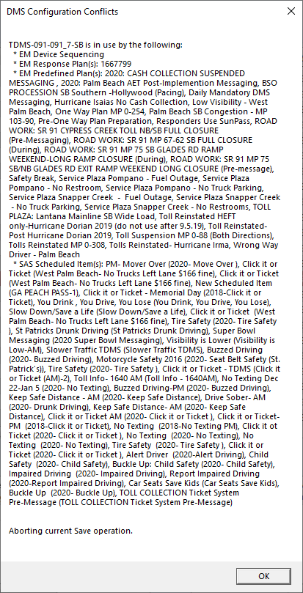
Enhancement Request
When attempting to delete a DMS, the user is required to manually remove references to a DMS before deleting.
A list is provided but the list can be extensive.
Proposed Change
  Add a mechanism to automatically remove references to a DMS.
    Still allow manual changes.
    User will be required to fix device linking manually.

Slide 28
LOE
Estimate: $9k

Slide 29
QUESTIONS?

Slide 30
VOTE NOW
Select the link for: https://www.questionpro.com/t/ABslzZmJYO
Enhancement #2: SG-5468 – DMS removal request

Slide 31
Enhancement #3:
SG-5403 - Add GPS coordinate checkbox to Event Management reports
Tucker Brown

Slide 32
Enhancement Request
Add a selectable parameter within SunGuide event management reports that allows the user to append coordinates to the report.
  Initially starting with Event List Report.
Latitude and Longitude values would need to populate in separate columns and apart from the reference location.
Allows for data integration into GIS applications.

Slide 33
LOE
Estimate: $5k

Slide 34
QUESTIONS?

Slide 35
VOTE NOW
Select the link for: https://www.questionpro.com/t/ABslzZmJYi
Enhancement #3: SG-5403 - Add GPS coordinate checkbox to Event Management reports

Slide 36
Enhancement #4:
SG-5349 - FL-511 not publishing correct lane blockage if an event has both the turn lane and travel lane blocked.
Tucker Brown

Slide 37
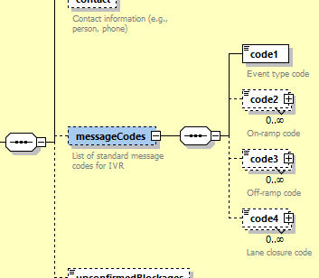
FLATIS Lane Blockage (current)
SunGuide uses Society of Automotive Engineers (SAE) codes to relay lane and blockage information to FLATIS.
Due to a lack of options to relay information, SunGuide can't send things like “Left travel lane and turn lane blocked”.
  Would show as “Left lane blocked”.
We could expand the SAE codes but still may not get a full solution.

Slide 38
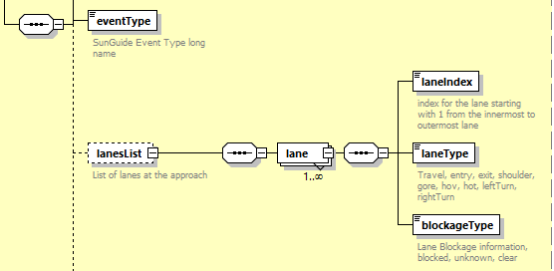
Enhancement Request
Change blockage to report actual lanes and blockage.
FLATIS can then generate any blockage convention based on the actual data.
FLATIS is currently the only user of the “publishEventData”.
3rd parties may be affected by the “eventData” C2C type.

Slide 39
LOE
Estimate: $5k

Slide 40
QUESTIONS?

Slide 41
VOTE NOW
Select the link for: https://www.questionpro.com/t/ABslzZmJYm
Enhancement #4: SG-5349 - FL-511 not publishing correct lane blockage if an event has both the turn lane and travel lane blocked

Slide 42
Enhancement #5:
SG-5293 - Add a CCTV Field
In the Executive Notification
Email
Tucker Brown

Slide 43
Enhancement Request
Original request was to add a link to CCTV feeds in DIVAS during major events requiring Executive Notifications.
Operations does not have access to DIVAS so addition of the CCTV name used to manage event was proposed.
  Currently, supervisors are adding the number manually.
  Request is to add a field and automatically add the CCTV number of the nearest CCTV based on information entered in the SunGuide event.

Slide 44
LOE
Estimate: $5k

Slide 45
QUESTIONS?

Slide 46
VOTE NOW
Select the link for: https://www.questionpro.com/t/ABslzZmJYv
Enhancement #5: SG-5293 - Add a CCTV Field In the Executive Notification Email

Slide 47
Enhancement #6:
SG-5195 - Confirmation dialog before taking ownership of an event.
Tucker Brown

Slide 48
Enhancement Request
Current Behavior
  When obtaining ownership of an event, the previous event owner instantly loses the ability to make changes to the event.
Proposed Change
  When obtaining ownership of an event, the previous owner will get a pop up notifying them a user is attempting to take ownership and they can confirm or deny the request.
    After a configured amount of time, if no response is received, the requesting user would get ownership.
    This would be an optional feature.

Slide 49
LOE
Estimate: $6k

Slide 50
QUESTIONS?

Slide 51
VOTE NOW
Select the link for: https://www.questionpro.com/t/ABslzZmJY6
Enhancement #6: SG-5195 - Confirmation dialog before taking ownership of an event

Slide 52
Enhancement #7:
SG-4485 - Link Roadway
Selection
Tucker Brown

Slide 53
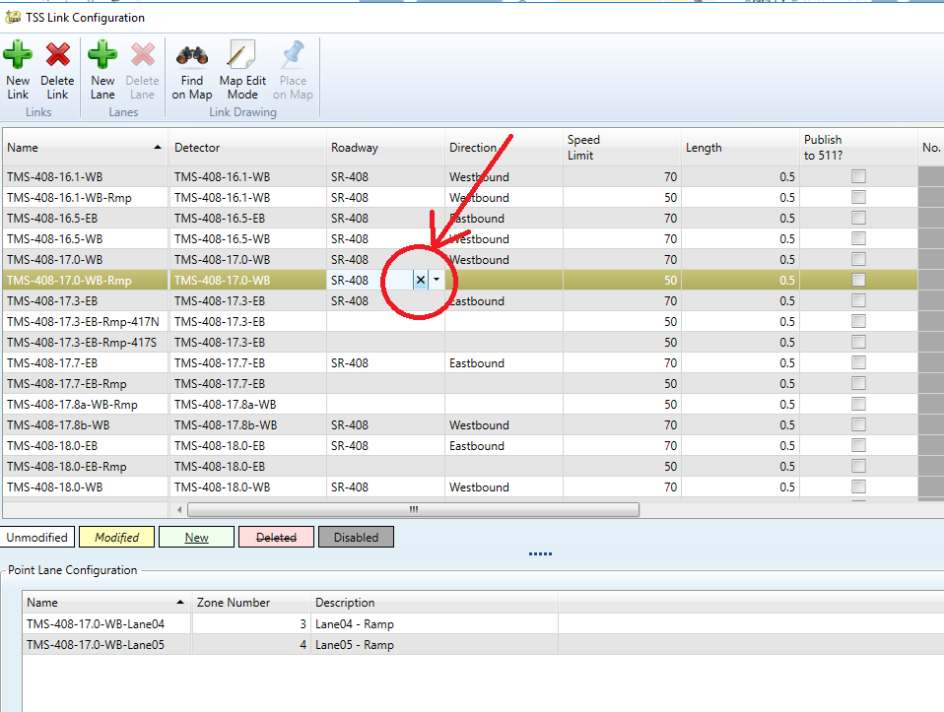
Enhancement Request
Current State:
  Deselection “X” on the configuration GUIs can accidentally be pressed when selecting the roadway or direction column.
  This removes the item from the configuration and causes issues on FLATIS.
Requested Change:
  Remove the “X” and force the user to blank the column, if needed.
  Make Roadway and Direction required fields.

Slide 54
LOE
Estimate: $4k

Slide 55
QUESTIONS?

Slide 56
VOTE NOW
Select the link for: https://www.questionpro.com/t/ABslzZmJaD
Enhancement #7: SG-4485 - Link Roadway Selection

Slide 57
Enhancement #8:
SG-4385 - Apply On a per day basis filter to device report
Tucker Brown

Slide 58
Enhancement Request
Current State (Example)
  If running any report for 5 months and the times of 7AM to 10AM are used, it will give the whole 5 months starting at 7AM on day one and ending at 10PM on the last day.
  It is not currently possible to apply the time per day.
Proposed Enhancement
  Allow a checkbox that dictates that the time range should be used on each day, as opposed to the start and end date only.
  This would be applied to almost all of the 90+ reports.

Slide 59
LOE
Estimate: $17.5k

Slide 60
QUESTIONS?

Slide 61
VOTE NOW
Select the link for: https://www.questionpro.com/t/ABslzZmJaQ
Enhancement #8: SG-4385 - Apply On a per day basis filter to device report

Slide 62
Enhancement #9:
SG-3926 - Assign CCTV to DMS and provide shortcut in DMS dialog
Tucker Brown

Slide 63
Enhancement Request
Add the ability to configure an optional camera and an optional preset to a DMS, RMS, and MLS Gates.
Add a shortcut to the DMS/RMS/MLS status dialog for an "associated" camera that can be used to quickly access the video stream for that camera.
  If a preset is configured, the request to change to the preset would be sent to CCTV.
Add a shortcut to the Response Plan dialog as a verification shortcut.

Slide 64
LOE
Estimate: $19k

Slide 65
QUESTIONS?

Slide 66
VOTE NOW
Select the link for: https://www.questionpro.com/t/ABslzZmJaa
Enhancement #9: SG-3926 - Assign CCTV to DMS and provide shortcut in DMS dialog

Slide 67
Enhancement #10:
SG-3232 - Associating
FHP and TSS Alerts to
Already Created Events
Tucker Brown

Slide 68
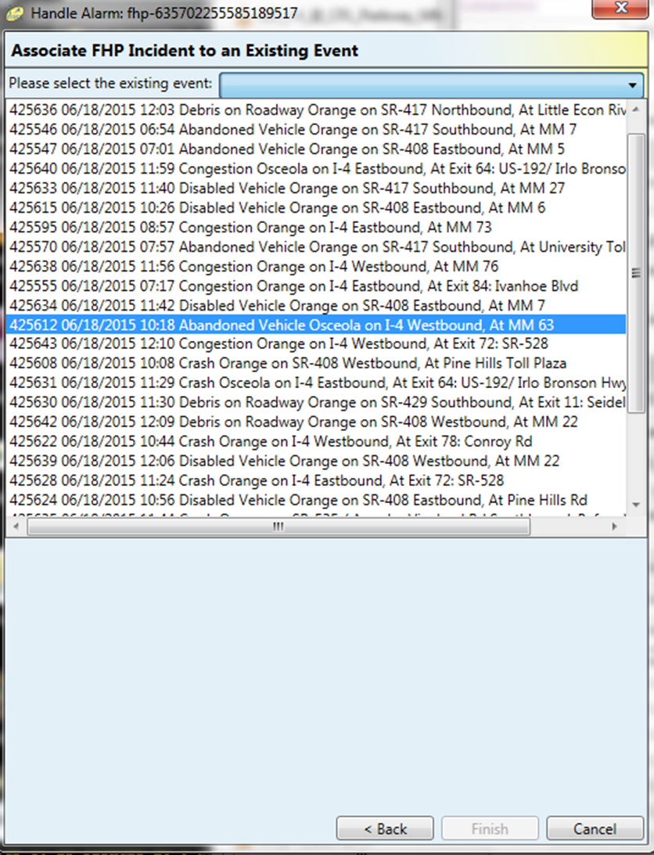
Current State
When picking an event to associate an alarm, the event list presented is difficult to find the correct event.
Current:
  Option to show “Nearby Events”
    “Nearby” is in the System Settings.
  Option to show all events
    Include closed and non-lane blocking.
  No sort filter applied.

Slide 69
Enhancement Request
Nearby and Show All Event options would still be supported.
Change to a grid format.
  Filtering and sorting supported.
Add a column for Distance from event.
  Default sort will sort by this column (least to greatest).

Slide 70
LOE
Estimate: $7k

Slide 71
QUESTIONS?

Slide 72
VOTE NOW
Select the link for: https://www.questionpro.com/t/ABslzZmJai
Enhancement #10: SG-3232 - Associating FHP and TSS Alerts to Already Created Events

Slide 73
Open Discussion
Jay Williams, P.E., FDOT
CMB Chairman

Slide 74
Review Action Items
Jay Williams, P.E., FDOT
CMB Chairman

