Slide 1


Welcome and Call for Quorum
Jay Williams, P.E., FDOT
CMB Chairman

Slide 2
Agenda
Time | Item | Lead
8:30 – 8:35 | Welcome and Call for Quorum | Jay Williams
8:35 – 8:50 | Previous Meeting Recap & Action Item Review | Jay Williams
8:50 – 9:20 | CMB Process Update | Jay Williams
9:20 – 9:30 | SITSA/RITSA Updated Schedule | Christine Shafik
9:30 – 9:45 | SunGuide Software Update | Christine Shafik
9:45 – 9:55 | SG-4771 – Report diagnostics from TPS devices | Tucker Brown
9:55 – 10:05 | SG-3228 – NWS Weather Feed | Tucker Brown
10:05-10:15 | SG-4656/SG-3875 – Notify Manager Enhancements | Tucker Brown

Slide 3
Agenda
Time | Item | Lead
10:15 – 10:20 | SG-1584 – Event Attributes | Tucker Brown
10:20 – 10:25 | SG-4727 – Update Camera Blocking Functionality | Tucker Brown
10:25 – 10:30 | SG-1698 – TSS Alarm Configuration | Tucker Brown
10:30 – 10:35 | SG-4679 – Modify Comments through Audit | Tucker Brown
10:35 – 10:40 | SG-4677 – Remove County Reporting Boundaries | Tucker Brown
10:40 – 10:50 | Open Discussion | Jay Williams
10:50 – 11:00 | Review Action Items | Jay Williams
CMB Agenda, slides, and attachments posted here:
http://www.dot.state.fl.us/trafficoperations/ITS/Projects_Deploy/CMB.shtm

Slide 4
Previous Meetings Recap and Action Items Review
Jay Williams, P.E., FDOT
CMB Chairman

Slide 5
Previous Meeting Action Items
Owner | Action Item
Christine Shafik | Central Office will follow up on who should attend from the districts and send out a calendar invite.
Christine Shafik | As part of item number 4678 we will need to survey the Districts to find out which reports should include the weather filtering functionality.
Jay Williams | Jay is going to circle back with Jeremy on the information received from District Six.
Dan Smith | Dan Smith to give us an update based on the hotfix being applied to the WWD.
Mark Laird | Enhancement 3029 possible additional enhancements to the predefined enhancement. The comments should be handled separately from 3029. Mark Laird should generate a ticket for his comments.

Slide 6
Previous Meeting Action Items
Owner | Action Item
Tucker Brown | Enhancement 3900 – Tucker to check on the suggested spellings of a word would be presented to a user if it was flagged. Also, to look into an approved list or library to see how it would function.
All Districts | Christine wants the Districts who have the resources to volunteer to help with regression testing. If the Districts are interested they should send an email to Christine.

Slide 7
CMB Process Updates
Jay Williams, P.E., FDOT

Slide 8
CMB Process Updates
The purpose of the Change Management Board is to ensure that changes to ITS are implemented through a controlled process that takes into consideration how the proposed change will affect statewide systems, including the following areas: ITS architecture, ITS standards and specifications, and ITS software.

Slide 9
CMB Process Document
Document Outlines the CMB process, including purpose, roles and responsibilities, and the tie-in to the software development process.
Attachment A includes list of delegates and alternates from each voting member group.
  Provide request for changes to Attachment A in writing to the CMB chairman.

Slide 10
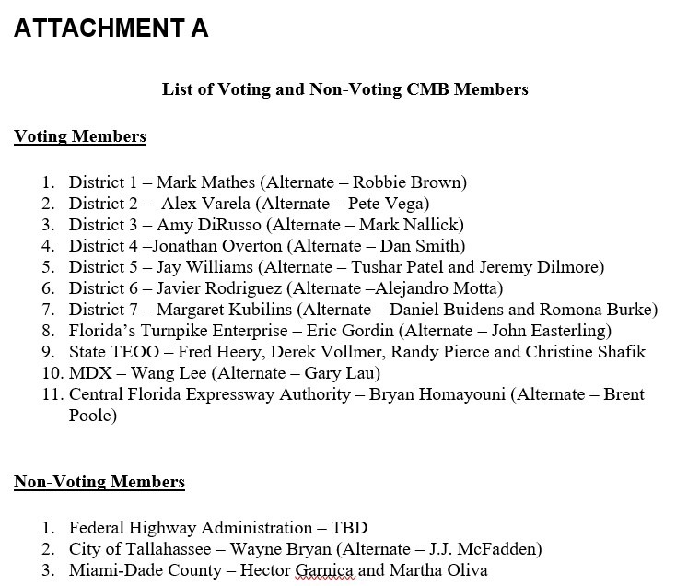
CMB Process Document

Slide 11
CMB Process Document
Recent Changes to Process:
Modified voting process to conduct vote via web-based polling system instead of verbal roll call.
Updated Attachment A to reflect recent staff changes

Slide 12
CMB Process Updates
Questions?

Slide 13
SITSA/RITSA Updated Schedule
Christine Shafik, P.E., FDOT

Slide 14
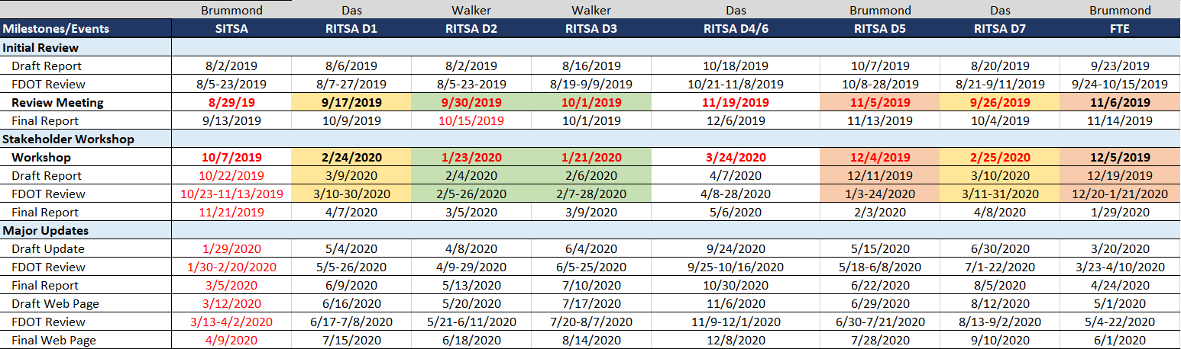
RITSA/SITSA Schedule

Slide 15
QUESTIONS?
Christine Shafik, P.E., FDOT
Christine.shafik@dot.state.fl.us

Slide 16
SunGuide Software Update
Christine Shafik, P.E., FDOT

Slide 17
Release 7.2
IV&V started 9/9/2019, currently in-progress
Three issues still need to be addressed
Target release date - early October

Slide 18
Release 7.3
  10 items previously voted on and approved
  SG-3974 - Permission issue with some Subsystem
  SG-3029 - Predefined Plans do not Populate Dynamic Vehicle Information
  SG-3900 - Enable spellcheck for text fields
  SG-4082 - Allow audit of secondary event status
  SG-4366 - Depreciate Old SAS Scheduled Items
  SG-4678 - Weather Conditions Filter for Reporting
  SG-4705 - Adding Cameras from Three Counties to SunGuide
  SG-4705 - Adding Cameras from Three Counties to SunGuide
  SG-4706 - Add County to Device Configuration
  SG-4789 - A “Snooze” or “Reset” Button for RR Stopped Vehicle Alert

Slide 19
Release 7.3
8 voting items today
Two pending ConOps (RISC and RCA) to be distributed, reviewed, and voted on
Release planned for 2020

Slide 20
QUESTIONS?
Christine Shafik, P.E., FDOT
Christine.shafik@dot.state.fl.us

Slide 21
4771 – Report diagnostics from TPS devices
Tucker Brown
SunGuide CMB | 9/19/19

Slide 22
TPS Report Diagnostics
Issue: No current status information for device level status is currently gathered from SunGuide for TPS devices (other than the feed being active)
Proposed Enhancement
  Gather additional status from the feed and allow users to see this information in the Operator Map
    Device status (failed or ok)
    Specific location (parking space) of device
    Ability to resync the sensor (if supported)
    Ability to set a device (“puck”) Out of Service until it can be repaired so same issue isn’t constantly reported to the user.
  Given the different feed and different types, this may end up being custom settings per protocol
SunGuide CMB | 9/19/19

Slide 23
Cost:
  $20k - grid based status
  $30k – lat/lon based status
    Map granularity is an issue because the devices are so close to each other. New dialog and map-like dialog would need to be developed.
Schedule: ??
SunGuide CMB | 9/19/19

Slide 24
QUESTIONS?
VOTE
Tucker Brown, SwRI
tucker.brown@swri.org

Slide 25
CMB Process Document

Slide 26
3228 – National Weather Service
Weather Feed
Tucker Brown
SunGuide CMB | 9/19/19

Slide 27
Weather Feed
Issue: Weather Feed (DTN) was discontinued so there are no current weather alerts being produced.
Proposed Enhancement
  Use the NWS feed as a replacement for the DTN feed
  Filter by County
  Type *might* be available and, if so, would be filterable
  Weather alert handling would be the same as previous weather alerts
SunGuide CMB | 9/19/19

Slide 28
Cost: $12k
Schedule: ??
SunGuide CMB | 9/19/19

Slide 29
QUESTIONS?
VOTE
Tucker Brown, SwRI
tucker.brown@swri.org

Slide 30
CMB Voting

Slide 31
SG-4656/3875 – Notify Manager Enhancements
Mark Dunthorn, HNTB
SunGuide CMB | 9/19/19

Slide 32
Thresholds
Current:
    Monitors processes and compares CPU and Memory to hard-coded thresholds
Proposed:
    Update thresholds for 64-bit environment
    Set thresholds per application (e.g. higher memory threshold for AVLRR)
    Thresholds should be configurable
SunGuide CMB | 9/19/19

Slide 33
Process State
Current:
    Sends notification when process exits abnormally
Proposed:
    Send notification when process starts or exits
SunGuide CMB | 9/19/19

Slide 34
Level of Detail
Current:
    Notifications include no detail of actual memory usage
Proposed:
    Include detail from Status Logger:
PID: 10676, CPU: 0.91%, Working Set: 1,000MB (Last: 993MB, Difference: 6MB), Private Memory: 1,030MB (Last: 1,024MB, Difference: 6MB)
SunGuide CMB | 9/19/19

Slide 35
Restarts
Current:
    [SG-4656] Notify Manager requires restart when new operator or email address added
Proposed:
    Notify Manager will subscribe to appropriate messages, not require restart.
SunGuide CMB | 9/19/19

Slide 36
Data Archive
Current:
    [SG-3428] Need to avoid archived data loss
Proposed:
    Query database to verify that raw data and rollups are being written
SunGuide CMB | 9/19/19

Slide 37
Telemetry
Current:
    No way for Central Office to track SunGuide in the field
Proposed:
    Periodic telemetry message
      SunGuide version
      Status of each subsystem
      Machine-readable format (probably json or xml)
SunGuide CMB | 9/19/19

Slide 38
Cost: $13k
Schedule: ??
SunGuide CMB | 9/19/19

Slide 39
QUESTIONS?
VOTE
Tucker Brown, SwRI
tucker.brown@swri.org

Slide 40
CMB Voting

Slide 41
1584 – Event Attributes
Tucker Brown
SunGuide CMB | 9/19/19

Slide 42
Issue
Issue: In the Event Details dialog, one of the options is a checkbox to indicate this event is a Rollover/Fire/HAZMAT event
There are other options that districts have requested
  WWD
  Damage
There are others that will be requested in the future as well
SunGuide CMB | 9/19/19

Slide 43
Proposed Enhancement
There is a need for a more dynamic way to track event attributes that allow for performance metrics as well as district specific criteria.
This enhancements would give each district a predefined list of attributes to go along with current attributes
  Pre-defined attributes can’t be deleted from the system
Attributes will have the following:
  Sort Order
  Visibility (ability to hide ones you don’t need)
SunGuide CMB | 9/19/19

Slide 44
Proposed Enhancement
Custom Attributes can be added by the district
  Will have sort order as well.
Existing attributes would be migrated to the new structure
Audit functionality for all attributes would be added
Updated reports to be filterable on new attributes
SunGuide CMB | 9/19/19

Slide 45
Issue and Proposed Enhancement
Users can select multiple attribute for the event
This would be a combo box with the following options added to the current list:
  Bridge Hit
  Canal
  Work Zone
  Crossover
  Ditch
  FDOT Employee
  Head On
  Hit And Run
  Infrastructure Damage
  ITS Equipment Damage
  Jack-Knife
  Jack-Knife Tractor-Trailer
  Limited Visibility
  Off Road
  Pavement Damage
  Road Ranger Vehicle Incident
  Rollover
  Spin Out
  Vehicle vs. Motorcycle
  Vehicle vs. Pedestrian
  Vehicle vs. Guardrail
  Vehicle vs. Object
  Vehicle vs. Vehicle
  Vehicle vs. Wall
  Vehicle vs. Attenuator
  Vehicle vs. Bridge
  Vehicle vs. Cable Barrier
  Vehicle vs. First Responder
  Vehicle vs. Road Ranger
SunGuide CMB | 9/19/19

Slide 46
Cost: $24k
Schedule: ??
SunGuide CMB | 9/19/19

Slide 47
QUESTIONS?
VOTE
Tucker Brown, SwRI
tucker.brown@swri.org

Slide 48
CMB Voting

Slide 49
SG-4727
Update Camera Blocking Functionality to
Not Require VS Subsystem
Tucker Brown, SwRI
SunGuide CMB | 9/19/19

Slide 50
Issue
Without setting up a “source” for every camera, you cannot use the camera blocking functionality
  Currently accomplished with a “dummy” source, just to use the camera blocking functionality.
Districts are using less external encoders/decoders.
SunGuide CMB | 9/19/19

Slide 51
Proposed Solution
Allow the camera blocking to apply to the camera, not just a “source”.
Maintain a single Camera Blocking dialog that has both the sources and the cameras with the ability to block cameras.
SunGuide CMB | 9/19/19

Slide 52
Cost: $12k
Schedule: ??
SunGuide CMB | 9/19/19

Slide 53
QUESTIONS?
VOTE
Tucker Brown, SwRI
tucker.brown@swri.org

Slide 54
CMB Voting

Slide 55
TSS Alarm Configuration
1698
Tucker Brown, SwRI
SunGuide CMB | 9/19/19

Slide 56
Issue and Proposed Solution
Problem
  TSS alarms are set by link which means the configuration is huge for districts with a large number of links.
  This is compounded when trying to set them by time-of-day and multiple thresholds per day are needed.
Suggested Solution
  TSS Threshold Group
    Add links to a group
    Apply thresholds to the group
  Would need to limit a link to one group due to a possible time-of-day conflict
SunGuide CMB | 9/19/19

Slide 57
Cost: $20k
Schedule: ??
SunGuide CMB | 9/19/19

Slide 58
QUESTIONS?
VOTE
Tucker Brown, SwRI
tucker.brown@swri.org

Slide 59
CMB Voting

Slide 60
Modify Comments through Audit (4679)
Tucker Brown
SunGuide CMB | 9/19/19

Slide 61
Modifying Comments
Auditing allows adding new comments but not editing existing comments
Change would allow existing comments to be editable or deleted
  Would still have a Audit entry added in the Event Chronology
  Comments from all users would be editable
SunGuide CMB | 9/19/19

Slide 62
Cost: $6k
Schedule: ??
SunGuide CMB | 9/19/19

Slide 63
QUESTIONS?
VOTE
Tucker Brown, SwRI
tucker.brown@swri.org

Slide 64
CMB Voting

Slide 65
Remove County Boundaries from Reporting (4677)
Tucker Brown
SunGuide CMB | 9/19/19

Slide 66
Current Functionality
When running a report between 2 points, the user is required to select the County, Roadway, and Direction before selecting the 2 points.
  This prevents a user from selecting points in different counties
Also note, there is no current path for traversing EM locations along a roadway. This is currently done by giving all the locations defined for the county, roadway, and directions between the sort orders of the selected endpoints.
SunGuide CMB | 9/19/19

Slide 67
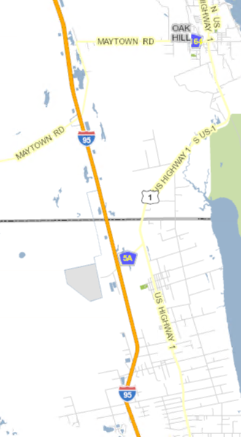
Proposed Solution
Using a combination of sort orders and shape files, have the system figure out the order of the points on the roadway.
  Updated for each configuration change
Less configuration, less user interaction
Possibility of errors in the generation
SunGuide CMB | 9/19/19

Slide 68
Cost: $25k
Schedule: ??
SunGuide CMB | 9/19/19

Slide 69
QUESTIONS?
VOTE
Tucker Brown, SwRI
tucker.brown@swri.org

Slide 70
CMB Voting

Slide 71
Open Discussion
Jay Williams, P.E., FDOT
CMB Chairman

Slide 72
Review Action Items
Jay Williams, P.E., FDOT
CMB Chairman

