Slide 1


SunGuide 8.0 Hotfix 3
Design Review
SunGuide Software Users Group | 3/4/21

Slide 2
SG-3488 - DMS priority in Response Plan changes all DMS messages
Tucker Brown
SunGuide Software Users Group | 3/4/21

Slide 3
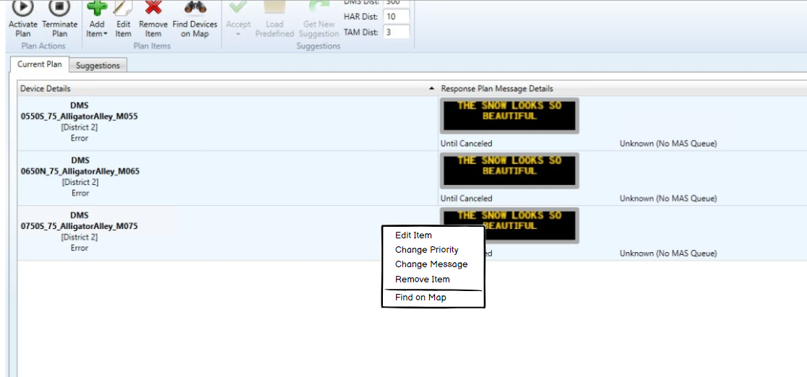
  Context menu will have options to change the priority of the message.
SunGuide Software Users Group | 3/4/21

Slide 4
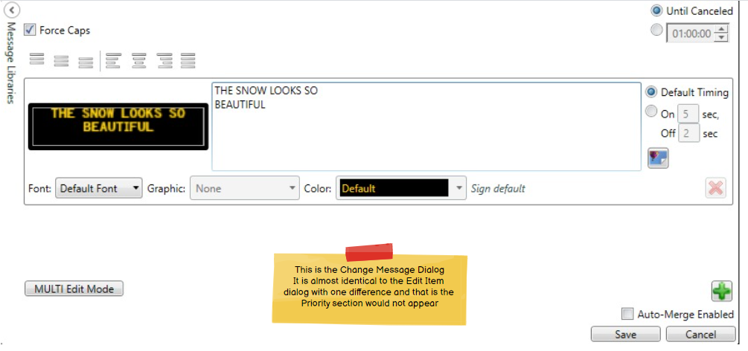
Change Message
SunGuide Software Users Group | 3/4/21

Slide 5
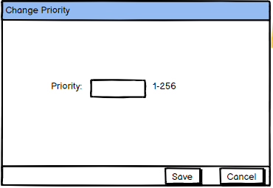
Change Priority
  Priority will be the only field the user would be able to set.
SunGuide Software Users Group | 3/4/21

Slide 6
QUESTIONS?
SunGuide Software Users Group | 3/4/21

Slide 7
SG-4815 - Response plans should use Congestion Tail if available
Tucker Brown
SunGuide Software Users Group | 3/4/21

Slide 8
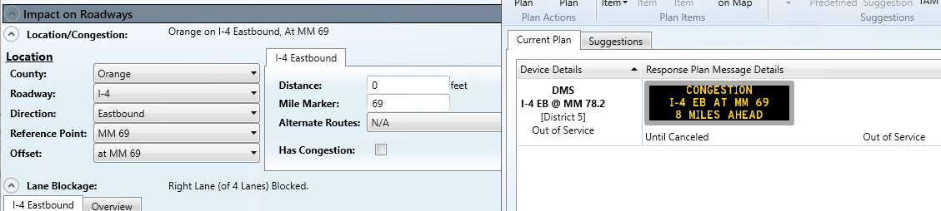
Using Primary Location
No changes to existing templates. When using the Event Location tags in the message template, the Congestion Tail Location information would be used.
Using the Primary Location (current behavior)
SunGuide Software Users Group | 3/4/21

Slide 9
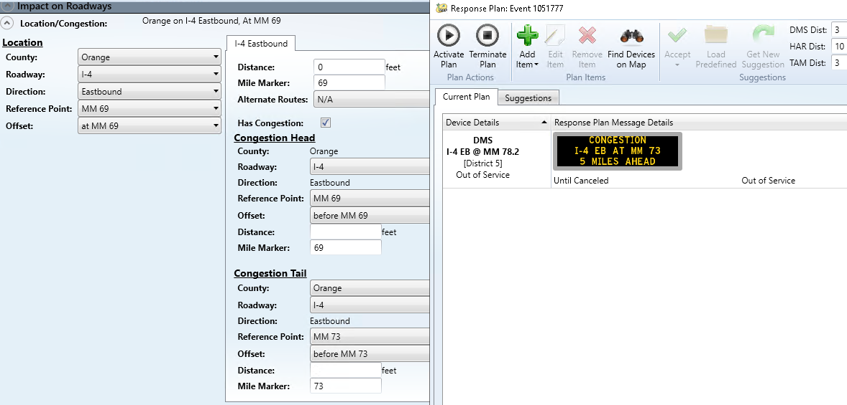
Using Congestion Tail
Congestion Tail location information would be used to generate the selected message.
SunGuide Software Users Group | 3/4/21

Slide 10
QUESTIONS?
SunGuide Software Users Group | 3/4/21

Slide 11
SG-3800 - Reporting of more accurate locations
Tucker Brown
SunGuide Software Users Group | 3/4/21

Slide 12
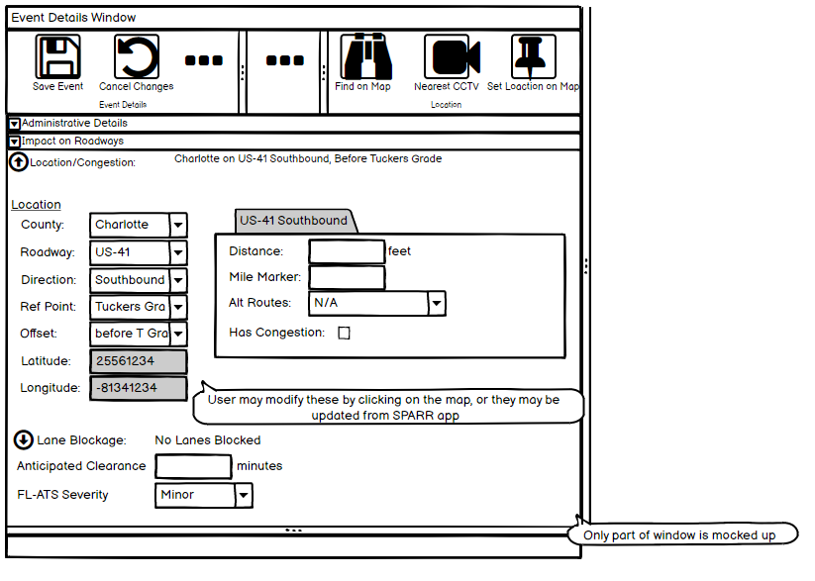
New values would be read-only.
Will get the lat/lon of the event location at first.
Operators can set through the ribbon button.
RRs can set the value from the SPARR app.
  Will be supported through the SPARR interface if other vendors decide to use the functionality.
SunGuide Software Users Group | 3/4/21

Slide 13
QUESTIONS?
SunGuide Software Users Group | 3/4/21

Slide 14
SG-5156 - Timestamp logic pop-up warnings
Tucker Brown
SunGuide Software Users Group | 3/4/21

Slide 15
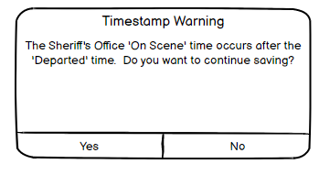
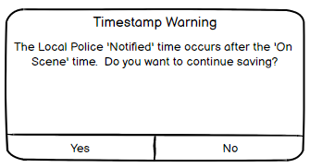
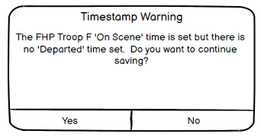
Criteria:
  For a responder, the arrival time is after the departure time.
  For a responder, the arrival time is set but there is no departure time.
  For a responder, the departure time is set but no arrival time is set.
  For a responder, the notification time is after the arrival time.
  For a responder, the notification, arrival, or departure time is before the event’s creation time.
Should these be applied on Closure or on each Save?
  Criteria may be altered if done per Save operation.
SunGuide Software Users Group | 3/4/21

Slide 16
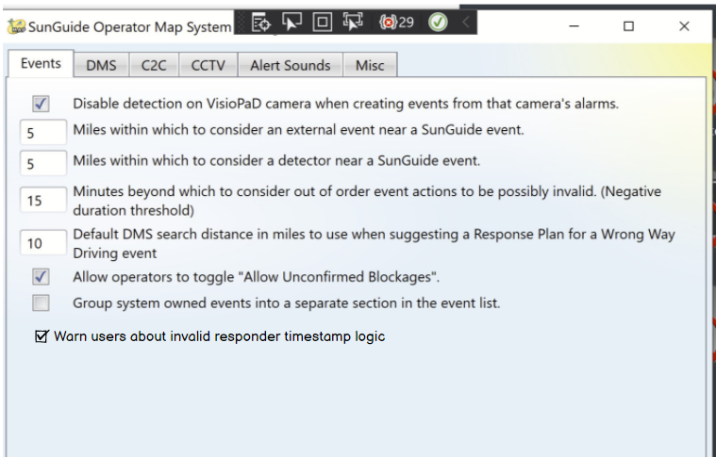
  This could be an option for all criteria or we could give check boxes for each criteria so district can pick and choose what to monitor.
SunGuide Software Users Group | 3/4/21

Slide 17
QUESTIONS?
SunGuide Software Users Group | 3/4/21

Slide 18
Other Enhancements
Tucker Brown
SunGuide Software Users Group | 3/4/21

Slide 19
Other Enhancements
  SG-3336 - Automatically select associated event in alert handling dialog
    Event would be selected from a drop down of open events. This will function in the same way as it does now, but will have automatically selected the event from the drop down if the alert was previously associated to an event.
  SG-5170 - Ability to filter roadway in Waze Alert
    This will be a configuration item in the Waze Reader running at the TERL. No operational changes to the districts are needed for this issue.
  SG-5376 - Add Nearest Camera Information to C2C eventData
    For the nearest camera, both the camera name and ID will be added to schema for the “eventData” type as well as the “publishEventReq” sent to 511 when publishing an event.
SunGuide Software Users Group | 3/4/21

Slide 20
QUESTIONS?
SunGuide Software Users Group | 3/4/21

